Slide 1

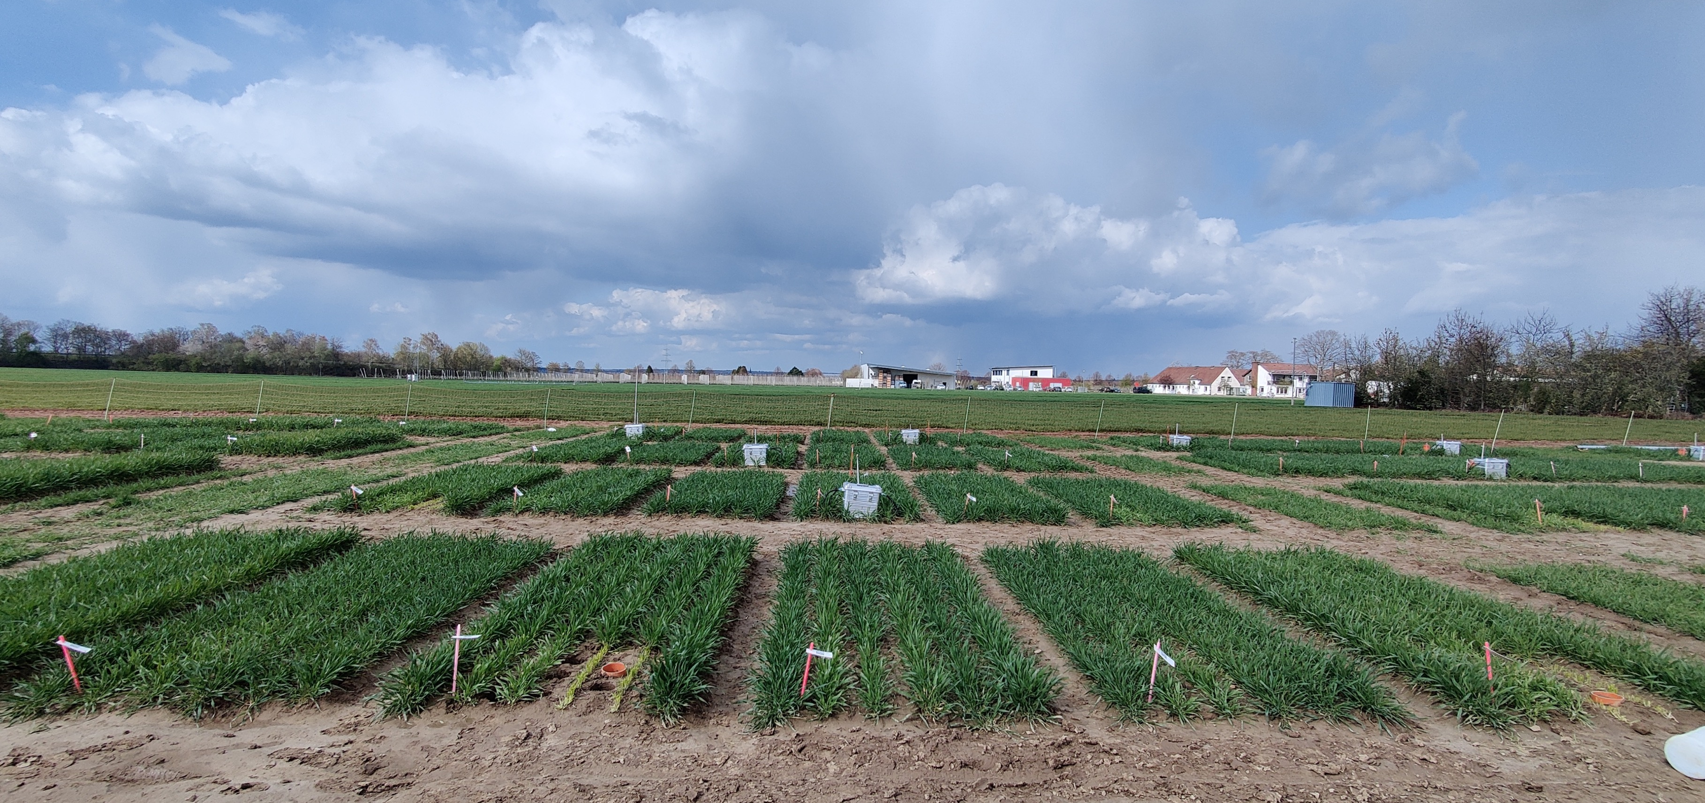
AgroC model for carbon and nitrogen cycling in soils and plant organs across different fertilization levels
Rajina Bajracharya (PhD)
Prof. Harry Vereecken, Dr. Michael Herbst and Dr. Lutz Weihermüller

Slide 2
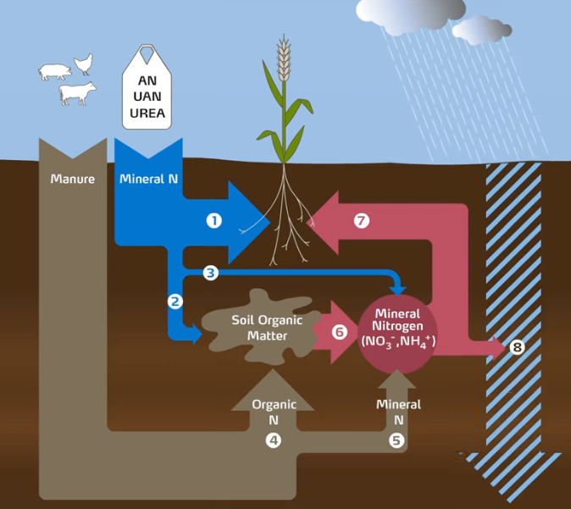
NItrogen cycle and Leaching
N availability determined by mineralization of the soil N pool and synthetic N application
N leaching when residual and newly mineralized nitrate is washed out of root zone by rain
Notes:
C processes are driven by the environmental variables of temperature, solar radiation, soil moisture, and atmospheric CO2 concentration.

Slide 3
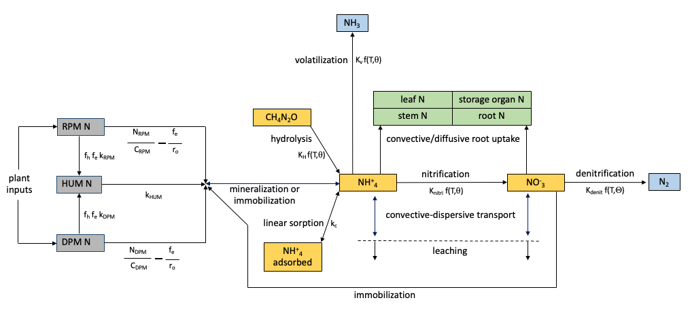
AgroC nitrogen cycle
Combination of RothC (Coleman & Jenkinson, 2014) and SWATNIT (Vereecken et al., 1991)
organic N
Notes:
Incorporated organic carbon is assumed to consist of two components, labile-C and resistant-C. The reaction rate of decomposition depends on the soil parameters of temperature, moisture, texture, and pH.

Slide 4
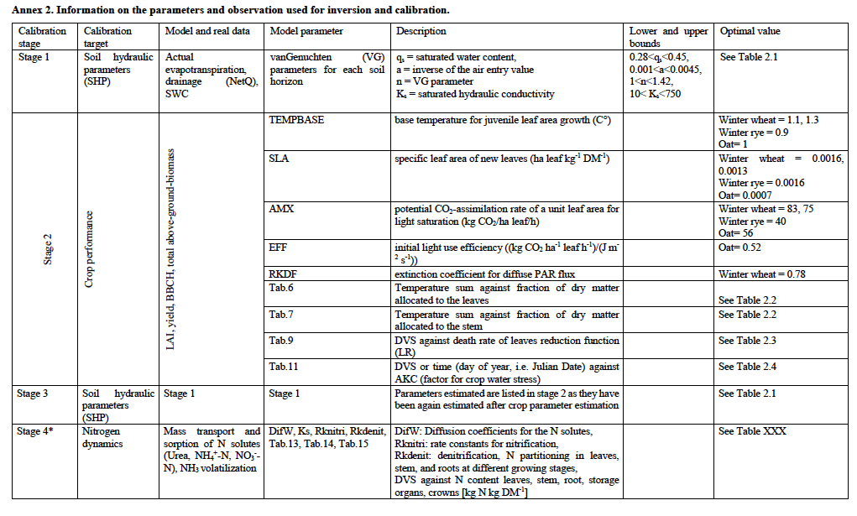
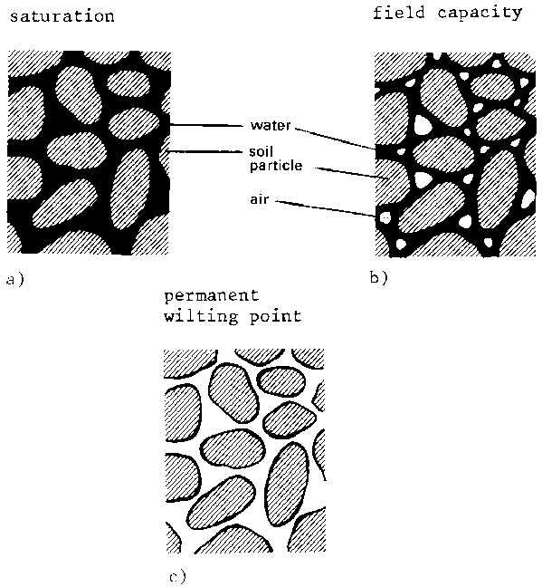
Parameterization: Inverse estimation
Inverse estimation based on measured soil water content (SWC), drainage and evapotranspiration
Notes:
The soil C pools, clay content, soil temperature are predefined

Slide 5
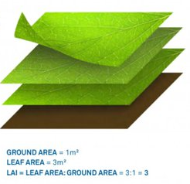
Stage 2: Plant parameterization
Hand-tuning based on plant outputs like LAI, yield, biomass

Slide 6
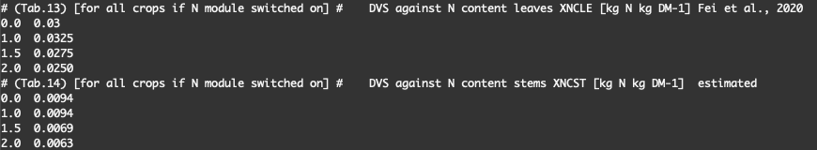
Stage 4: Nitrogen parameterization
Hand-tuning based on nitrogen flux outputs like leaching

Slide 7
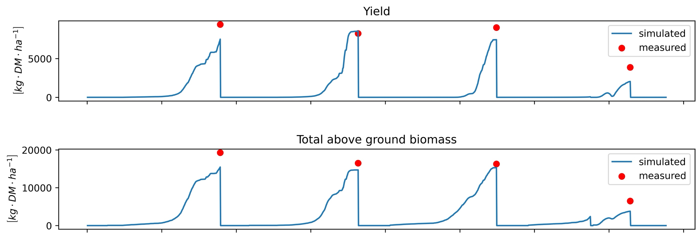
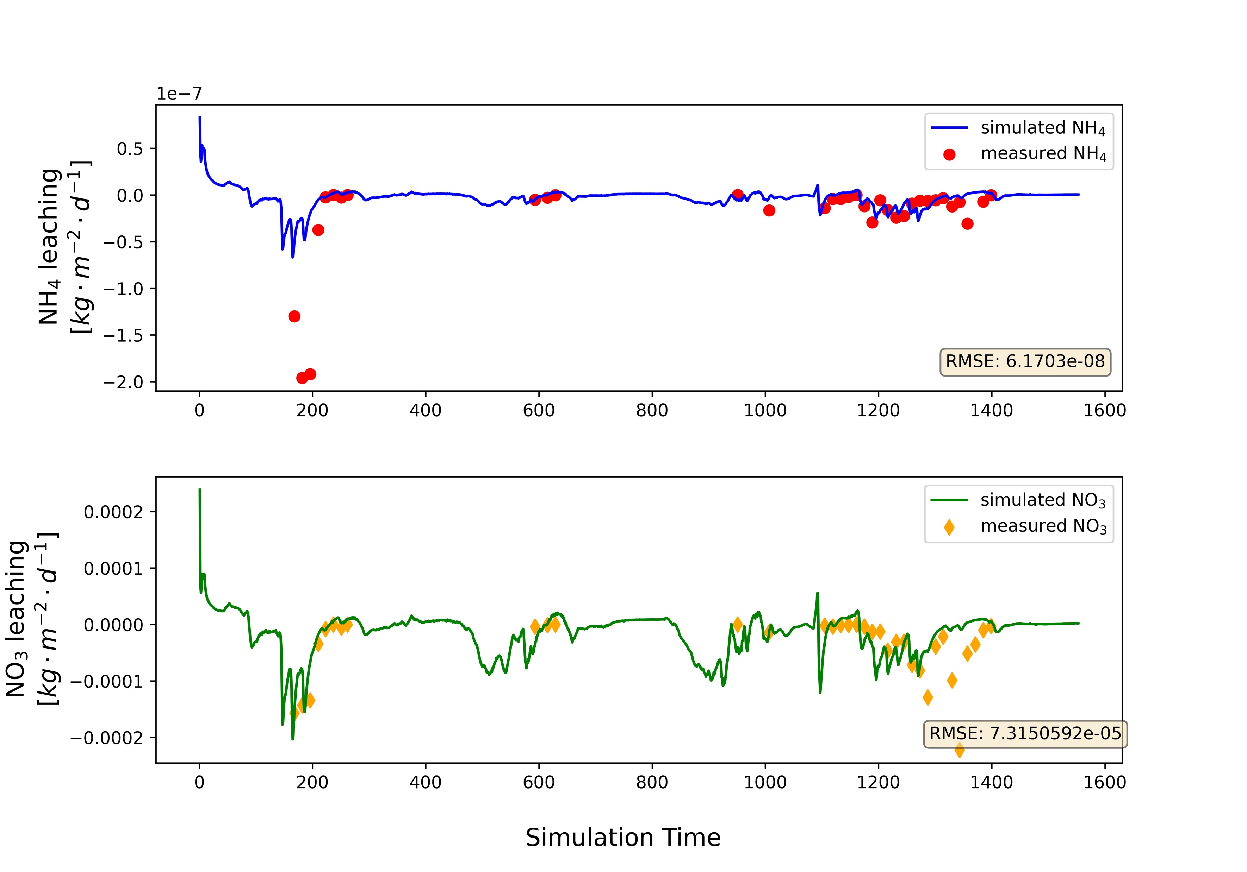
N POOL Initialization: 20 YEARS SPINUP

Slide 8
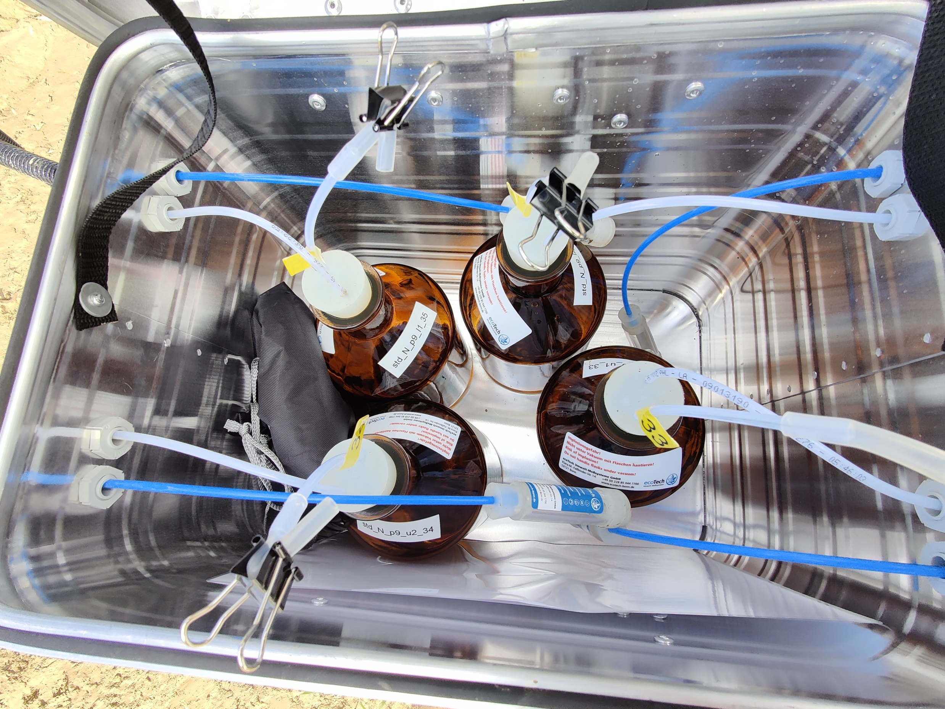
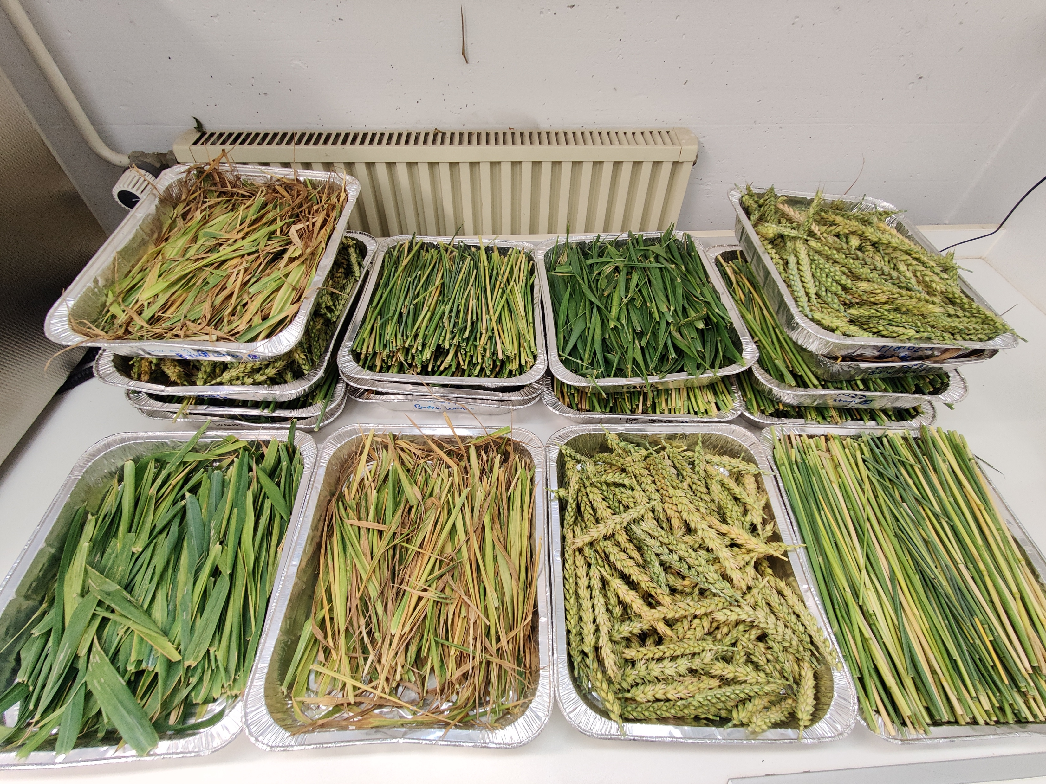
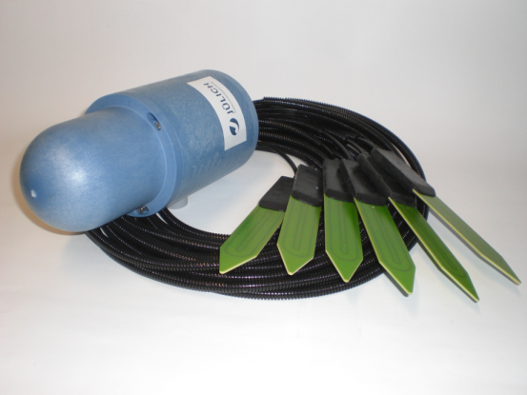
Field measurements
Soil Solution
Plant Organs
SoilNet Sensors
Weekly soil solution sampling from suction cups evaluated for total N, NH₄⁺, NO₃⁻ at 30 and 90 cm.
Bi-weekly harvest for Biomass (stem, ear, green and brown leaves), C and N content of each organ, LAI, plant height.
Real-time data on soil temperature, matric potential and soil water content at 10, 20 and 50 cm from SoilNet sensors.

Slide 9
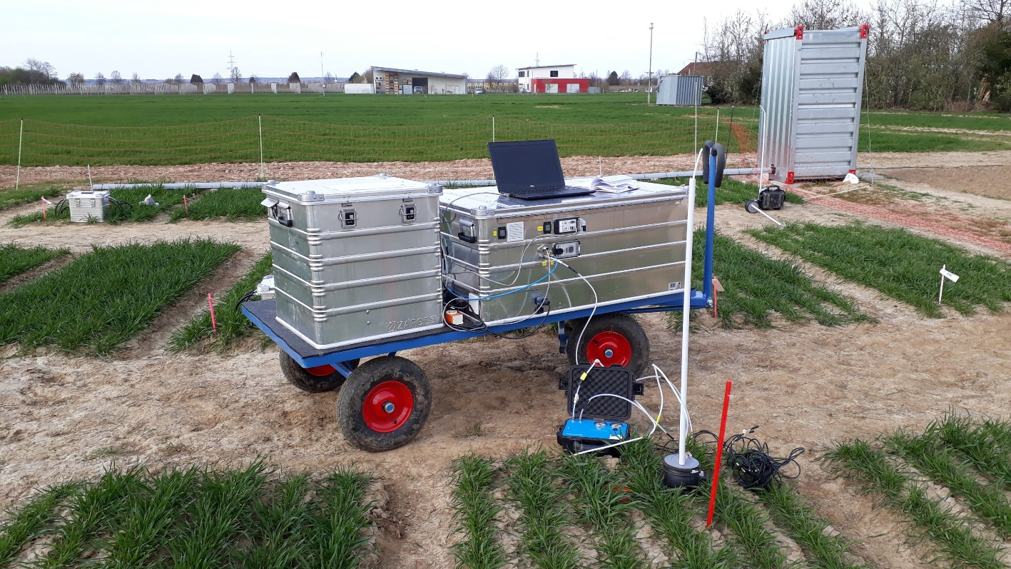
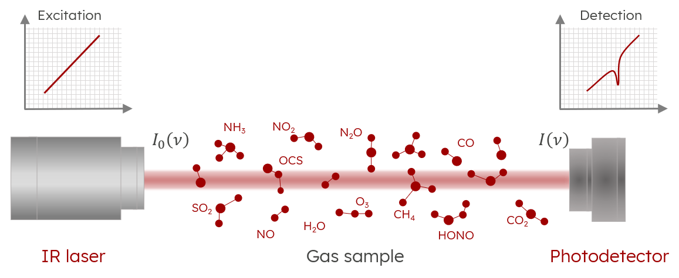
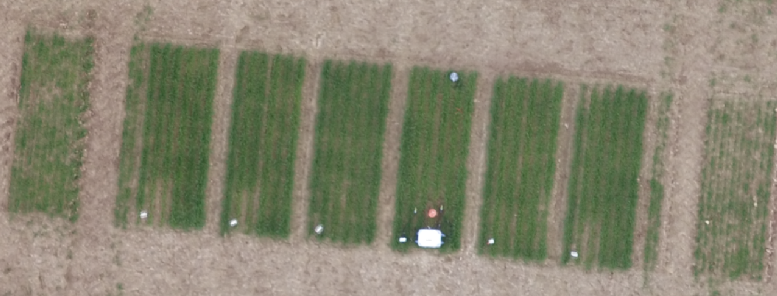
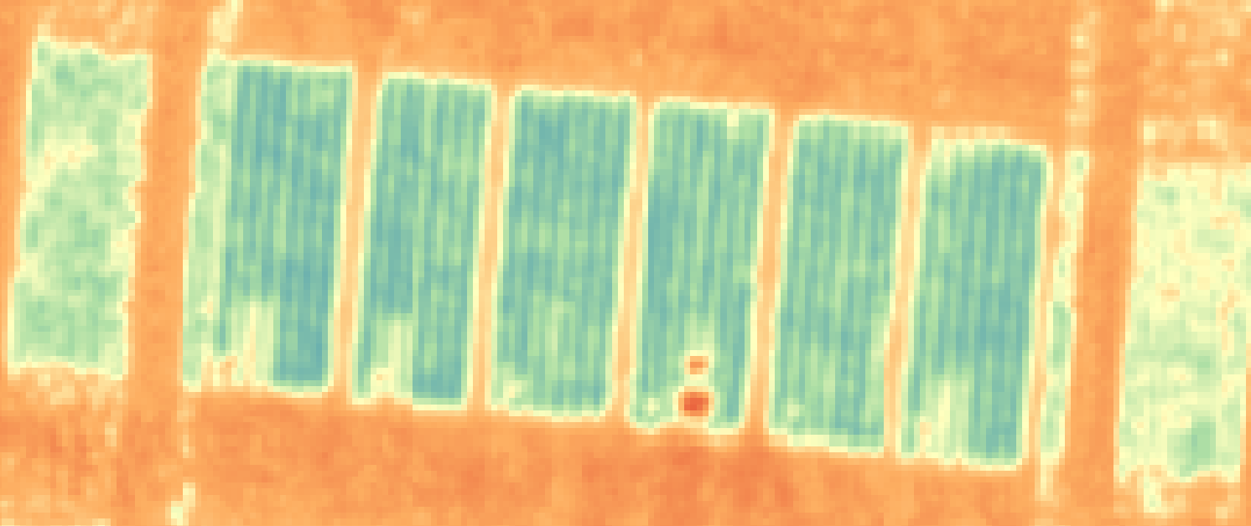
Conclusion and outlook
Gas measurements
NH₃, NO, NO₂, HONO, N₂O, CO₂
UAV LiDAR
LAI, crop height
@Matthias Class
Real-time autonomous system to measure the current N status in soil and model to predict N emissions or leaching
@Jordan Bates
Notes:
Investigating the use of LiDAR for Biomass estimations using Gap Fraction (GF), height, and intensity.

Slide 10

Thank you
Contact: Rajina Bajracharya (r.bajracharya@fz-juelich.de)

Slide 11
References
Coleman, K., Jenkinson, D.S., 2008. RothC-26.3. A model for the turnover of carbon in soil. Model description and windows users guide. IACR-Rothamsted, Harpenden. 47 pp.
Herbst, M., Hellebrand, H.J., Bauer, J., Huisman, J.A., Šimůnek, J., Weihermüller, L., Graf, A., Vanderborght, J., Vereecken, H., 2008. Multiyear heterotrophic soil respiration: Evaluation of a coupled CO2 transport and carbon turnover model. Ecol Model 214 (2-4), 271-283. DOI 10.1016/j.ecolmodel.2008.02.007.
Klosterhalfen, A., Herbst, M., Weihermüller, L., Graf, A., Schmidt, M., and Stadler, A. et al. 2017. Multi‐site calibration and validation of a net ecosystem carbon exchange model for croplands. Ecol. Modell. 363: 137– 156. https://doi.org/10.1016/j.ecolmodel.2017.07.028.
Simunek, Jiri, Jirka & Suarez, Donald. (1993). Modeling of Carbon Dioxide Transport and Production in Soil 1. Model Development. Water Resources Research - WATER RESOUR RES. 29. 487-497. 10.1029/92WR02225.
Spitters, C.J.T., van Keulen, H., van Kraalingen., D.W.G., 1989. A simple and universal crop growth simulator, SUCROS87, in: Rabbinge, R., Ward, S.A., van Laar, H.H., (Eds.), Simulation and systems management in crop protection. Simulation Monographs 32, PUDOC, Wageningen, pp. 147-181.
Vanclooster M, Viaene P, Diels J and Christiaens K 1994 WAVE: a mathematical model for simulating water and agrochemicals in the vadose environment. Reference and user’s manual, release 1.0, Institute for Land and Water Management, Katholieke Universiteit Leuven, Leuven, Belgium. 147 p.
Vereecken H, Vanclooster M and Swerts M 1990 A model for the estimation of nitrogen leaching with regional applicability. In Fertilizer and the Environment. Eds. R Merckx, H Vereecken and K Vlassak. pp 250–263. Leuven Academic Press, Leuven. Belgium.

Slide 12
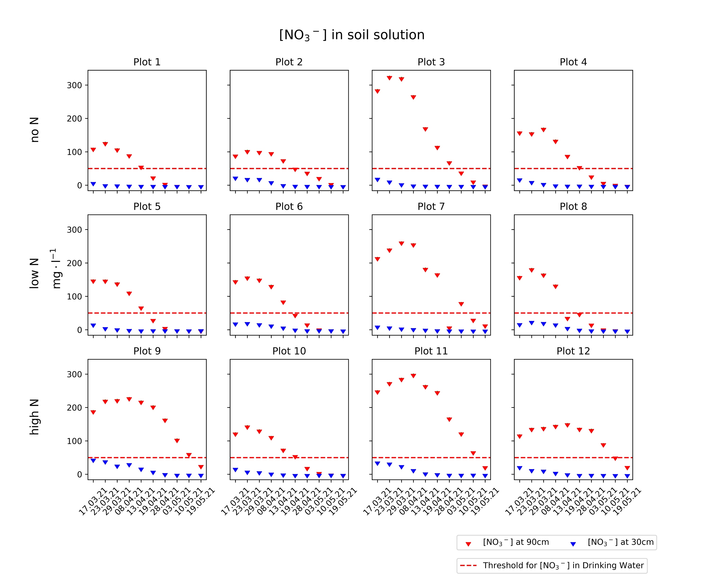
CKA2021: N solutes
Continuous Flow Analysis (CFA); Metrohm IC 930
Notes:
favourable weather conditions enhance N release from fertilizers as well as from old organic matter (humus), which might overrule the lower N fertilization rates.

Slide 13
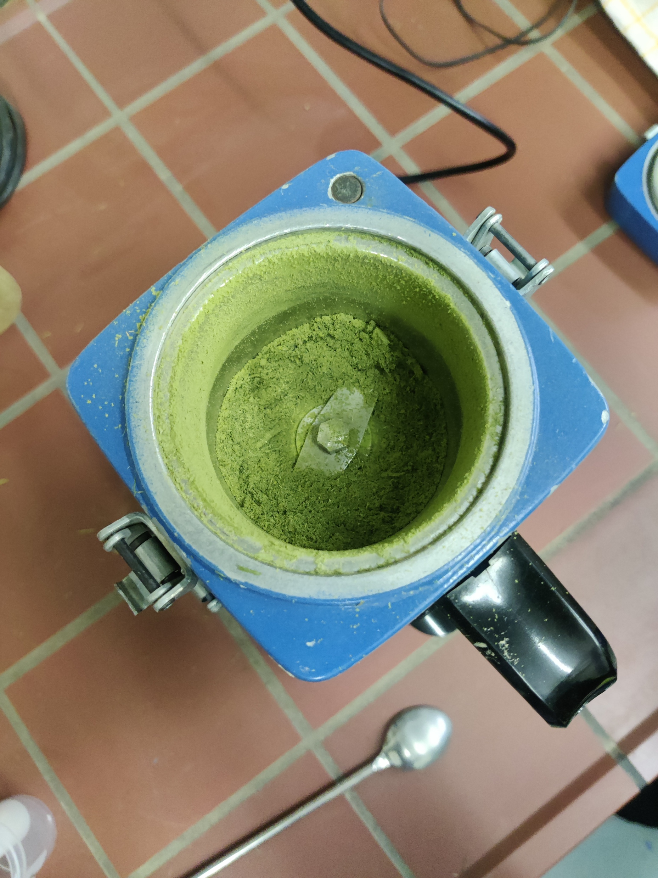
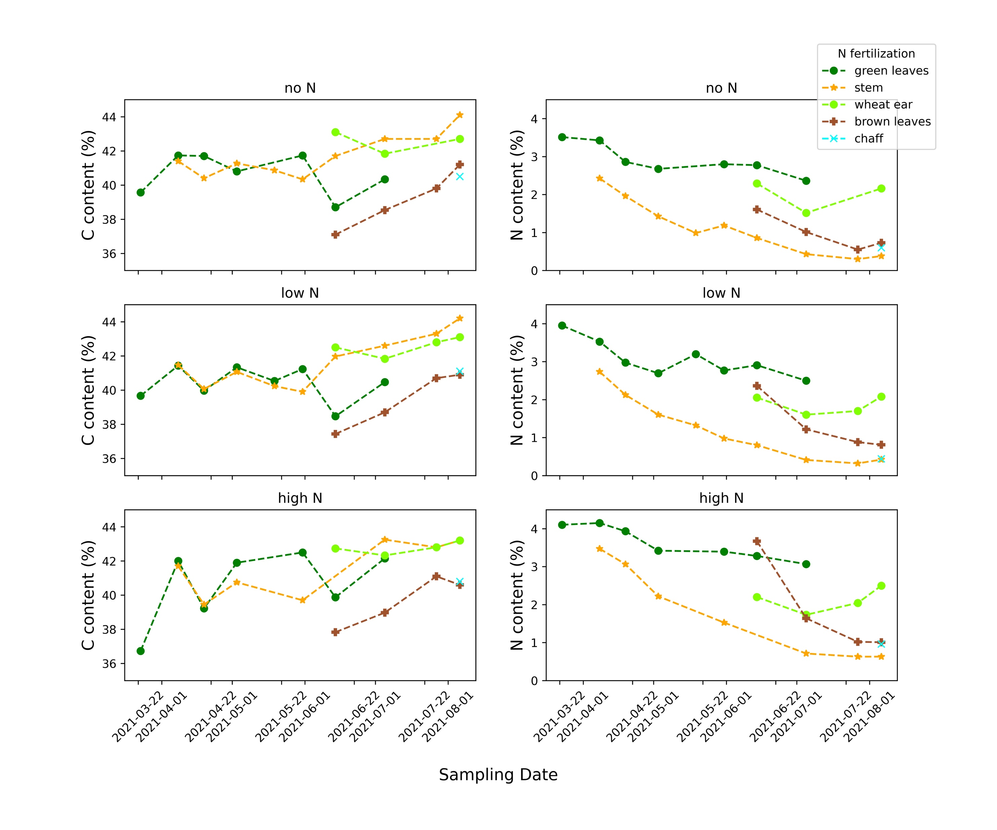
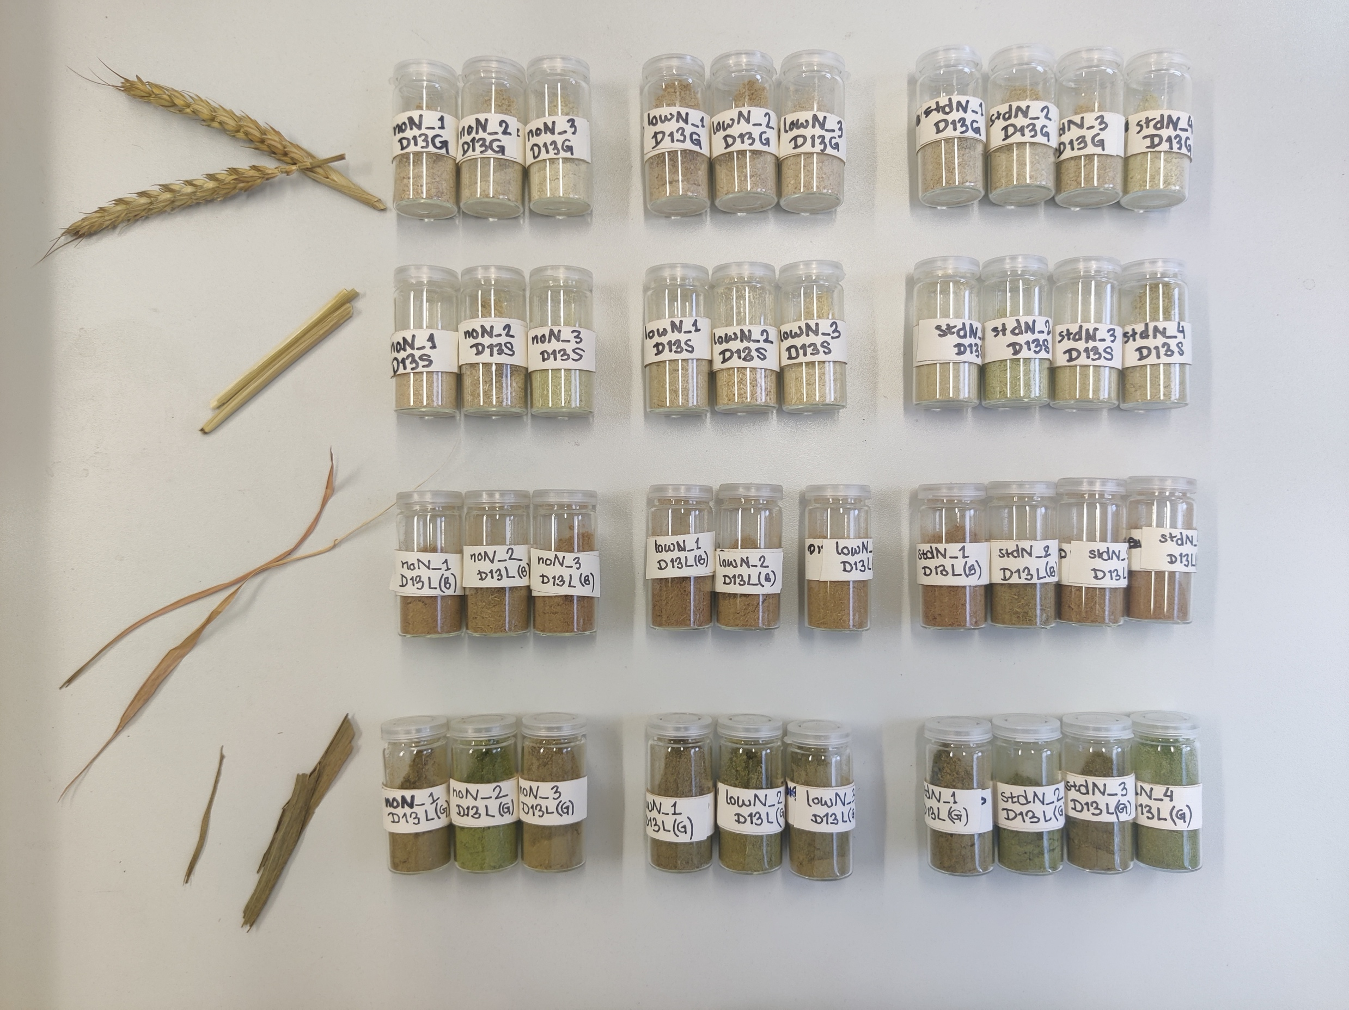
CKA2021: C&N in Plant organs
Gas preconcentration technology

