Slide 1

Early Career Scientists (ECS) attendance and participation at the annual EGU General Assembly: are online meetings more accessible than in person?
Anouk Beniest, Claudia Alves de Jesus-Rydin, Johanna Stadtmark
a.beniest@vu.nl
EOS 3.1 | Promoting and supporting equality, diversity and inclusion in the geosciences
Meetings | Publications | Outreach | www.egu.eu

Slide 2
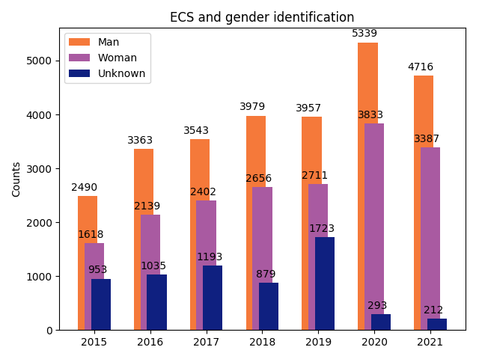
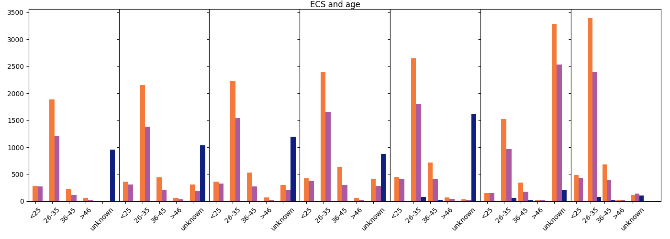
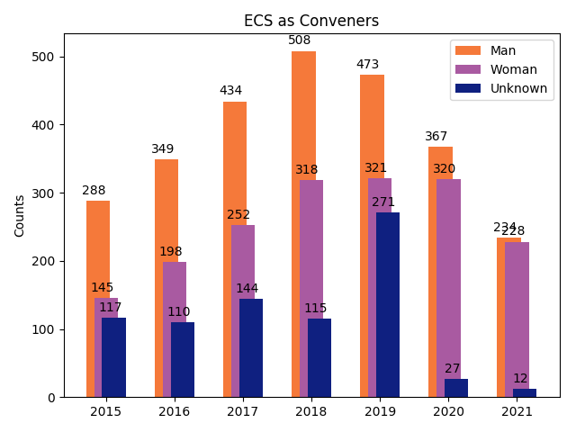
…about 40% identify as woman,
57% as man, 3% prefers not to say
…about 55% is between 26-35 years old, 10% is younger than 25 years and 10-14% is older than 35 years.
Counts
Click on the boxes for more details!
2015
2016
2017
2018
2019
2020*
2021*
2015
2016
2017
2018
2019
2020*
2021*
Age distribution ECS per year
From all the ECS attending the General Assembly….
…6-7% are active as conveners
…100% present their scientific work as a first author
What is an ECS?
Database
Physical
vs
Digital
Things to consider…
…geographical origin became more varied during the virtual GA.
2015
2016
2017
2018
2019
2020*
2021*
* Conference was a virtual

Slide 3
Home
What is an ECS?
ECS stands for ‘Early Career Scientist’,
and is defined by the EGU, someone who is:
‘…a student, a PhD candidate, or a practicing scientist who received their highest certificate (e.g. BSc, MSc or PhD) within the past seven years. The seven-year period can be extended to allow for periods when the scientist was not working in science because of, but not limited to, caring and/or parental responsibilities, disability, personal illness, community obligations or national service.’

Slide 4
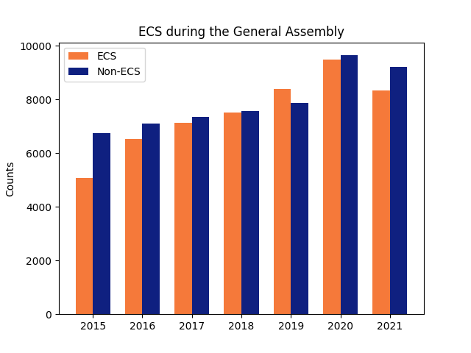
Home
Data base
ECS member distribution
Gender | 2015 | 2016 | 2017 | 2018 | 2019 | 2020 virtual | 2021 virtual | Average
Men | 2490 (49.2%) | 3363 (51.4%) | 3543 (49.6%) | 3979 (52.8%) | 3957 (47.2%) | 5339 (56.4%) | 4761 (57.1%) | 52.4%
Women | 1618 (32.0%) | 2139 (32.7%) | 2402 (33.7%) | 2656 (35.2%) | 2711 (32.3%) | 3833 (40.5%) | 3387 (40.6%) | 35.7%
Prefer not to say | 953 (18.8%) | 1035 (15.9%) | 1193 (16.7%) | 879 (11.7%) | 1723 (20.5%) | 300 (3.2%) | 212 (2.5%) | 12%
Total | 5061 | 6537 | 7138 | 7541 | 8391 | 9472 | 8338 | 52,451
The data base:
6 General Assemblies (2015-2021)
5 physical GA’s, 2 virtual GA’s
107,920 datapoints
Metrics on:
gender; age-group; career stage; country of residence; convener activity; presenter activity
*% from total ECS members per year
Non-ECS member distribution
Gender | 2015 | 2016 | 2017 | 2018 | 2019 | 2020 virtual | 2021 virtual | Average
Men | 3287 (48.7%) | 3713 (52.4%) | 3958 (53.8%) | 4266 (56.5%) | 3393 (43.1%) | 6337 (65.7%) | 5762 (61.8%) | 55.4%
Women | 1172 (17.4%) | 1340 (18.9%) | 1357 (18.4%) | 1550 (20.5%) | 1337 (17.0%) | 2670 (27.7%) | 2932 (31.4%) | 22.3%
Prefer not to say | 2292 (34.0%) | 2036 (28.7%) | 2042 (27.8%) | 1739 (23.0%) | 3139 (39.9%) | 635 (6.6%) | 630 (6.8%) | 22.6%
Total | 6751 | 7089 | 7357 | 7555 | 7869 | 9642 | 9324 | 54,469
year

Slide 5
Currently, about 40% of ECS identify as woman, 57% as man and 3% does not identify as man or woman or prefers not to share their gender.
Home
Gender | 2015 | 2016 | 2017 | 2018 | 2019 | 2020 virtual | 2021 virtual
Men | 2490 (49.2%) | 3363 (51.4%) | 3543 (49.6%) | 3979 (52.8%) | 3957 (47.2%) | 5339 (56.4%) | 4716 (57.1%)
Women | 1618 (32.0%) | 2139 (32.7%) | 2402 (33.7%) | 2656 (35.2%) | 2711 (32.3%) | 3833 (40.5%) | 3387 (40.6%)
Prefer not to say | 953 (18.8%) | 1035 (15.9%) | 1193 (16.7%) | 879 (11.7%) | 1723 (20.5%) | 300 (3.2%) | 212 (2.5%)
Total | 5061 | 6537 | 7138 | 7541 | 8391 | 9472 | 8338
*% from total ECS members per year
The percentage of people that identified as man or woman increased with 8-10% since the 2020 virtual GA.
Database

Slide 6


Home
The majority of the ECS participants is between 26-35 years old.
2015
2016
2017
2019
2020 virtual
2021 virtual
2018
These percentages have been very constant through the years, apart from the age-group ’36-45 years, which has seen a slight increase from 10 to 14% over the past years.
During the online GA, about 60% of the ECS members refrained from sharing their age group.
Database

Slide 7
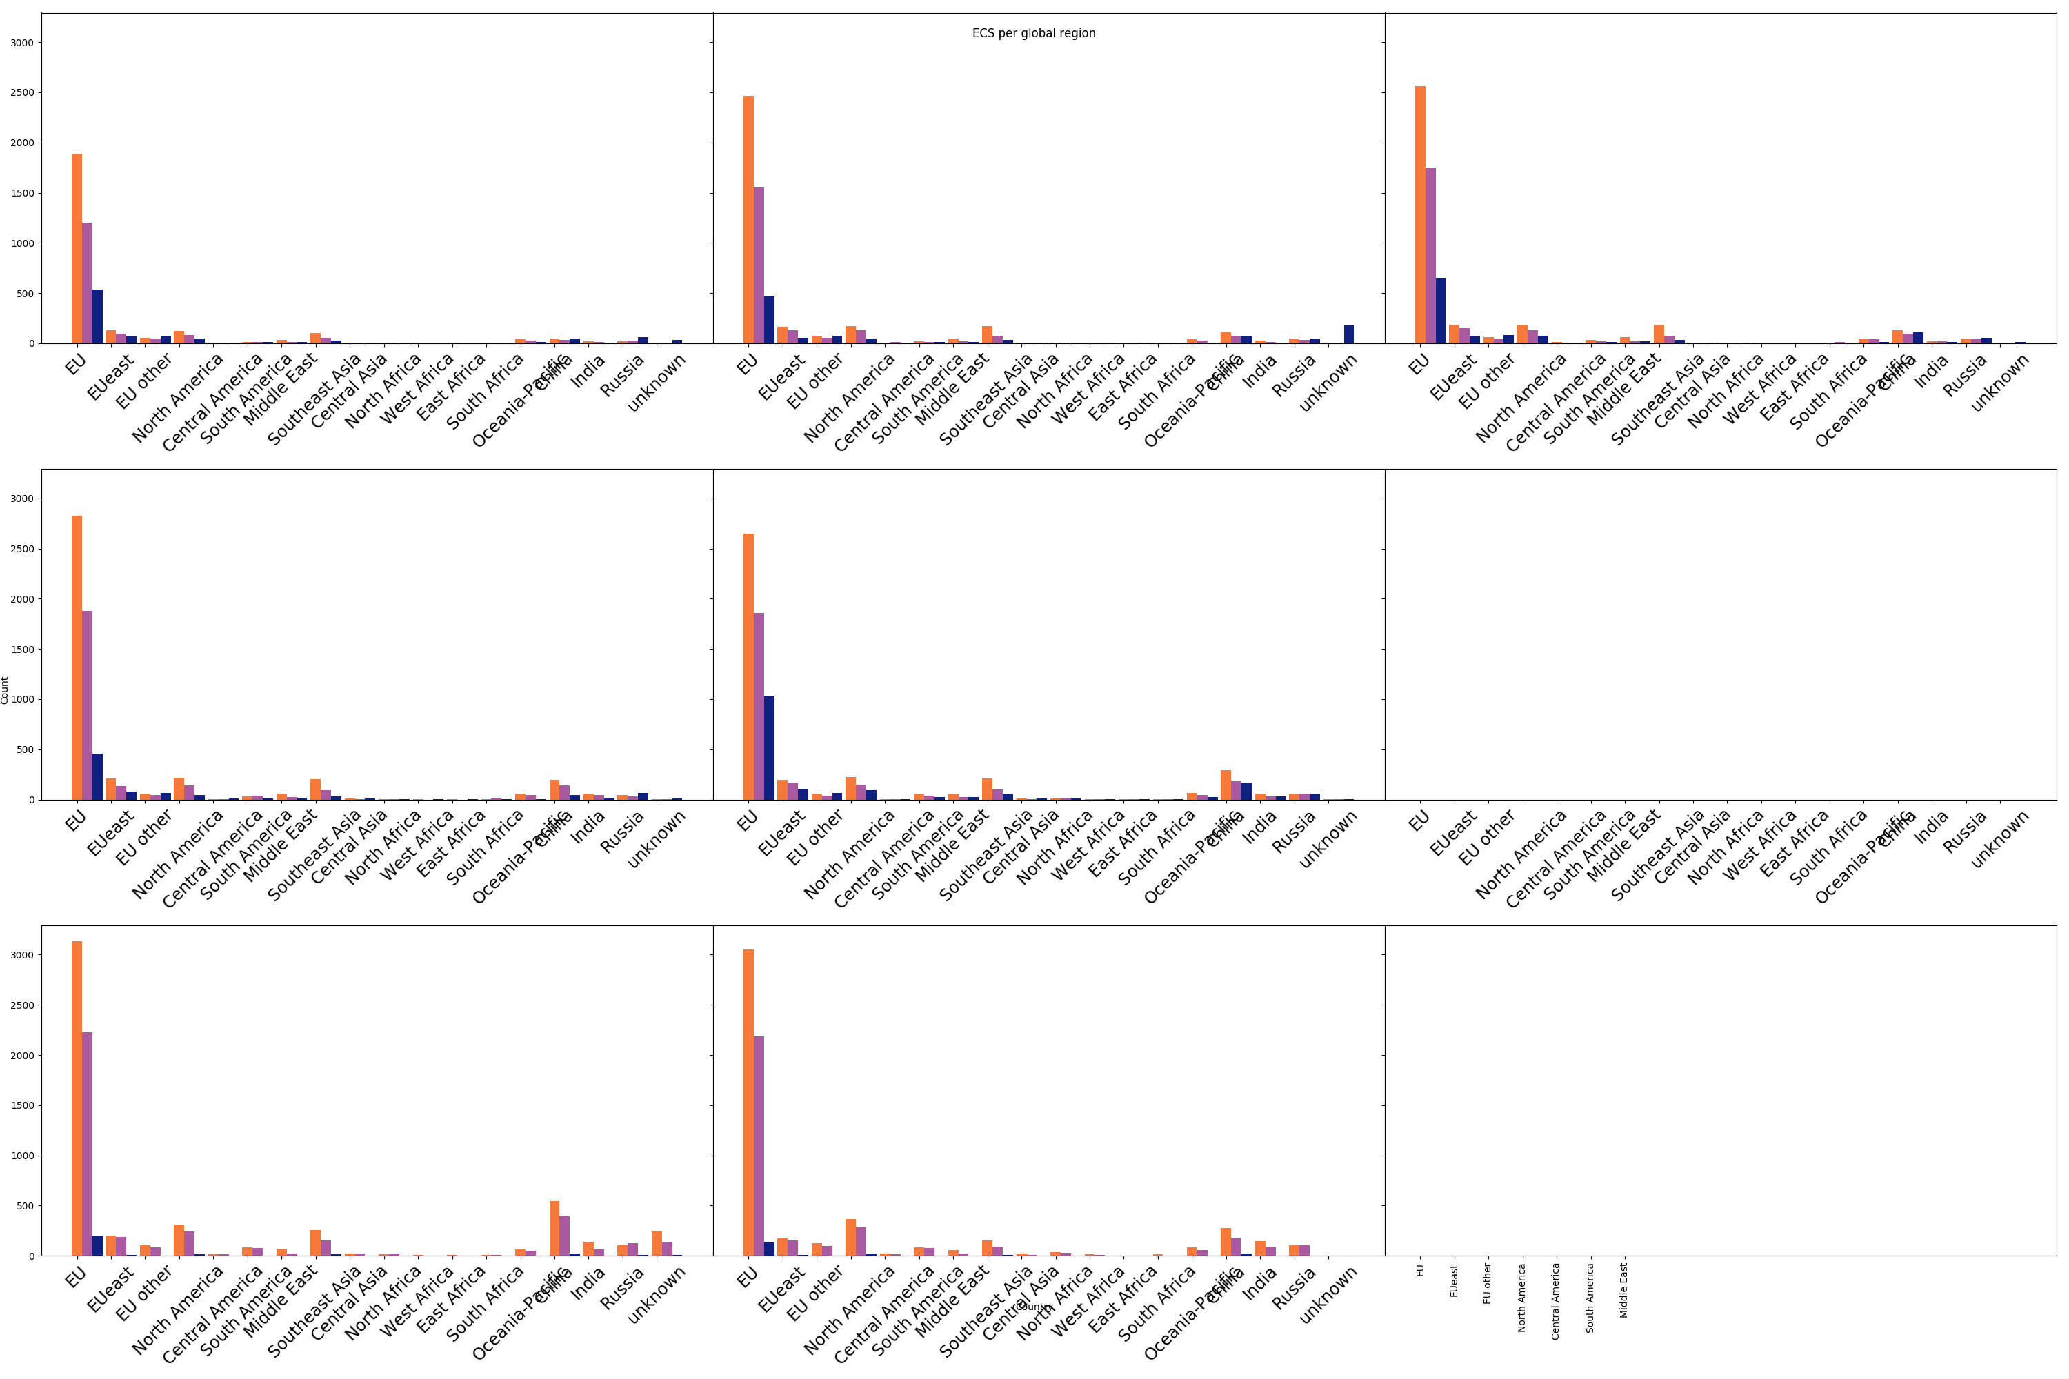
Home
The geographical origin of people identifying as ECS became more varied during the virtual GA.
3000
2015
2016
2017
2000
1000
0
3000
2018
2019
The large majority of ECS participating in the EGU GA are from Europe (including the UK and Norway).
During the free virtual GA in 2020, Central Asia, India and Central America saw the largest increase in participants.
During the paid virtual GA in 2021, ECS participating from Europe (including the UK and Norway) and Africa increased the most. ECS participation from India, Oceania and Pacific and North America and eastern European countries specifically, also saw an increase.
2000
1000
0
3000
2020 virtual
2021 virtual
2000
1000
0
Database

Slide 8
Home
6-7% of the ECS are active as a convener during a virtual General Assembly (GA).
Gender | 2015 | 2016 | 2017 | 2018 | 2019 | 2020 virtual | 2021 virtual
Men | 288/2490 (5.5%) | 349/3363 (5.3%) | 434/3543 (6.6%) | 508/3979 (6.7%) | 473/3957 (5.6%) | 367/5339 (3.9%) | 234/4716 (5.0%)
Women | 145/1618 (2.8%) | 198/2139 (3.0%) | 252/2402 (3.5%) | 318/2656 (4.2%) | 321/2711 (3.7%) | 320/3833 (3.4%) | 228/3387 (6.7%)
Prefer not to say | 117/953 (2.3%) | 110/1035 (1.7%) | 144/1193 (2.0%) | 115/879 (1.5%) | 271/1723 (3.2%) | 29/300 (10%) | 12/212 (5.7%)
Total | 550/5061 (10.8%) | 657/6537 (10.1%) | 830/7138 (11.6) | 941/7541 (12.5%) | 1065/8391 (12.7%) | 716/9472 (7.6%) | 474/8338 (5.7%)
Total Senior | 1261/6751 (18.7%) | 2118/7089 (29.9%) | 1447/7357 (19.7%) | 2334/7555 (30.9%) | 1398/7869 (17.8%) | 1579/9642 (16.4%) | 1776/9206 (19.3%)
*% from total ECS members per year
Since 2015 the number of ECS that were active as conveners gradually increased during the physical GA’s. There is a decreasing trend of ECS convening during a virtual GA, which not observed for senior scientists.
Database

Slide 9
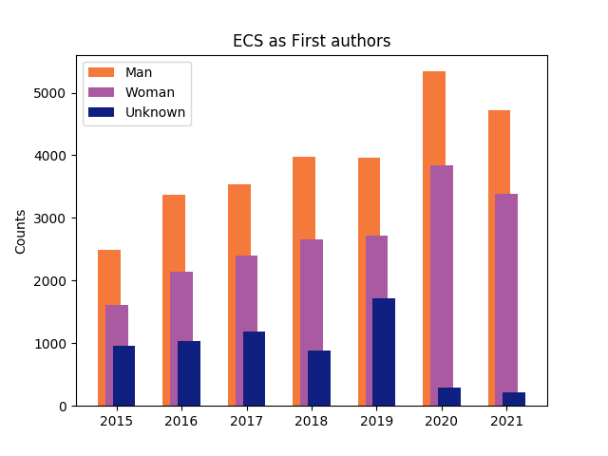
Home
All people identifying as ECS are first authors during the GA
Gender | 2015 | 2016 | 2017 | 2018 | 2019 | 2020 virtual | 2021 virtual
Men | 2490/2490 (100%) | 3363/3363 (100%) | 3543/3543 (100%) | 3979/3979 (100%) | 3957/3957 (100%) | 5339/5339 (100%) | 4761/4761 (100%)
Women | 1618/1618 (100%) | 2139/2139 (100%) | 24022402 (100%) | 2656/2656 (100%) | 2711/2711 (100%) | 3833/3833 (100%) | 3387/3387 (100%)
Prefer not to say | 953/953 (100%) | 1035/1035 (100%) | 1193/1193 (100%) | 879/879 (100%) | 1723/1723 (100%) | 300/300 (100%) | 212/212 (100%)
Total | 5061 | 6537 | 7138 | 7541 | 8391 | 9472 | 8338
Initiatives such as the Roland Schlich Travel Award, the Outstanding Student and PhD candidate Presentation Award, visibility of the active Early Career Scientist members, may contribute to awareness of the ECS label amongst ECS presenters.
Database

Slide 10
Home
Physical versus virtual General Assemblies
The free #Share Geosciences Online (SGO) in 2020 attracted about 17.5% more people than the year before, but the general attendance numbers in the paid virtual GA in 2021 were similar to 2019. ECS participation specifically follows this trend. Online and free conferences appear much more accessible.
The virtual GA appeared more accessible for people living outside of Europe, both in 2020 and 2021.
The number of ECS participating as conveners is in decline since 2019, during the virtual setting of the GA.
Willingness to share personal data was highest during the virtual 2021. Making this type of data acquisition mandatory seems to be the only way to get this data.

Slide 11
Home
Things to consider…
In these statistics, a person is considered an ECS through a self-identified label. People actively have to tick this box during subscription to the conference. This may lead to:
People who qualify as ECS may miss this box
People who qualify as ECS may not wish to be seen as an ECS and do not tick the box
People who do not qualify might tick the box
The General Assembly of 2020 was a free virtual conference, lowering the boundary for people to attend. The General Assembly of 2021 was a paid virtual conference.
Studies like this one allow organizations like EGU to track the success and developments of initiatives that support ECS career and conference experiences, and redefine strategies and actions that are in line with their established goals and mission.

