Slide 1
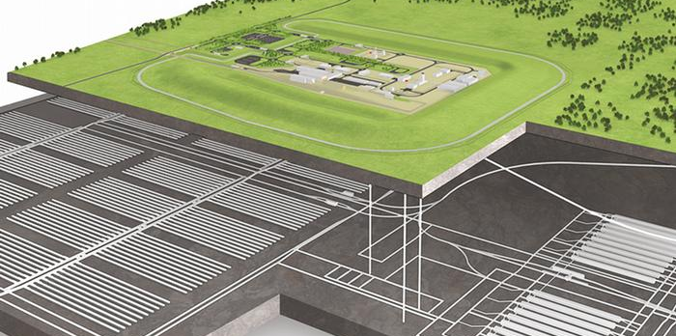


Natural Analogues – A proposed strategy for implementation within the Nuclear Waste Services (UK) programme of geological disposal
Heini Reijonen (heini.reijonen(at)gtk.fi), Russell Alexander, Simon Norris

Slide 2
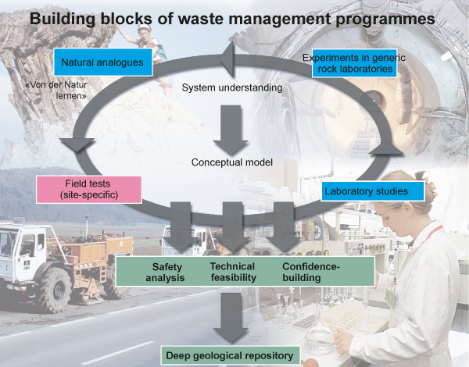
Introduction & background
Example of the role of NAs within geological disposal projects:
Nuclear Waste Services (NWS) in UK
is continuing to move forward with siting programme for a geological disposal facility (GDF)
focus of the programme is shifting from generic stage to a more site-specific stage
Natural Analogues (NA) have been considered in the generic safety case, but at general level
Objective
to realize a full potential of NA for system understanding
Image: Alexander et al. 1998
Notes:
Nas are one of he building blocks of the system understanding along side with the Experiments in URLs , field tests and laboratory studies.

Slide 3
Review of NA strategies
STRATEGY
CANADA
Several general overviews published over the years
Few programme-specific strategies regarding the use and development of NAs have been reported
Inherently included in many programmes, even if not mentioned at strategic level
JAPAN
IAEA
NEA
FINLAND
UK
GERMANY
PROGRAMME
SPECIFIC
GENERAL
GUIDANCE
NA NET
EU NAWG
COMPILATION / NETWORKING
Notes:
This slide is to provide an overview of the strategy work done to date. No time to explain this in detail, but the image may be accessed later by the audience.
Second bullet, mention: and these general strategies are of questionable value

Slide 4

Examples of the use of NA data in safety case to assess long-term safety
Spent fuel (UO₂) corrosion rates
Radioactive waste
Maximum rate for pitting of copper
Waste packaging
(copper / steel)
Development of secondary phases due to hyperalkaline leachates
Concrete
Bentonite longevity < 100℃
Natural clays
Matrix diffusion depths
Host rock
1980
1990
2000
2010
2020
Before 1980
SWEDEN: KBS-3 (SKB 1983)
SWITZERLAND: Pojeckt Gewähr (Nagra 1985)
SWEDEN: SKB-91 (SKB 1992); SFR-1, Project Safe (Andersson et al. 1998); SR-97 (SKB 1999)
FINLAND: TVO-92 (Vieno et al. 1992); TILA-99 (Vieno & Nordman 1999)
SWITZERLAND:Kristallin-1 (Nagra 1994)
CANADA: AECL EIS (AECL 1994)
JAPAN: H-12 (JNC 2000); JAEA (2007)
SWITZERLAND: Opalinus Clay (Nagra 2002)
FINLAND: TURVA-2012 e.g. Posiva (2012)
SWEDEN: SR-Site (SKB 2011); Forsmark (2014) Sidborn et al. 2014
FINLAND: Posiva (2021) Operational license application SC
Nas included in the overall concept for geolocal disposal
USE OF NATURAL MATERIALS
RWM (2016) – generic safety case
Examples of safety cases utilizing NAs
Notes:
Natural analogues have been used in various safety cases for conceptual model development, model testing and as direct data input. This slide is just to point out the time line and a few examples of direct input to safety cases over the years. Again, this slide can’t have much time to it in the 5 min presentation.

Slide 5
Lessons learned
Research
What is defined as a NA study is occasionally confusing and literature reviews should ideally cover all relevant publications on the topic
Critical reviews are called for in SC application
In many programmes, NA screening has been done via FEP analyses, but the results may not always produce a state-of-the-art product (see safety culture right)
Screening of existing material for both relevance and significance to current sites and designs is required
NA studies are most effective when integrated in a combined programme of laboratory, modelling and underground rock laboratory studies (cf. Alexander et al. 1998)
Safety case ‘culture’
There is a lack of critical screening and strategic planning in most programmes
Inherited/predefined complementary/alternative status of NA information → risk of detaching relevant information from other evidence (lab work etc.)
Programme level use
In addition to more traditional uses (siting, safety case and communication), NAs have significant potential for use in development of GDF design (e.g. EBS materials)
There are differences in degree of success of using analogues depending if they have been directed to communication, siting, design, or safety case etc
Communication
There are good examples of using NAs in local audience communication
Less has been achieved in communicating between scientific disciplines
Communication aspects utilising NAs have potential to be developed further
Notes:
These points are considered specifically important for the NWS strategy development. Bold ones are the ones to mention in the presentation.
Safety culture: When NAs are used only as “alternative” line of evidence, there is a risk that the information is detached from the other evidence (experimental lab and URL). This creates a risk of over or underestimating processes if extrapolated
(traceability from examples used in stakeholder communications to safety case details)

Slide 6
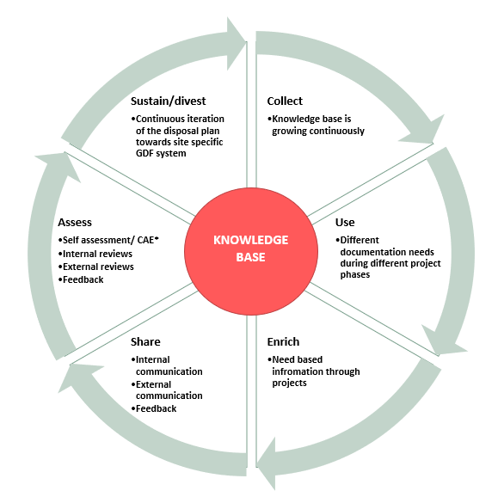
Proposed strategy
NA catalogue has been updated for NWS (Alexander & Reijonen 2022)
Which forms a part of NWS’ knowledge base
Systematic approach to develop the NA catalogue as the GDF programme evolves as a part of NWS’ knowledge base

Slide 7
Conclusions
Mission: deliver a Geological Disposal Facility and provide radioactive waste management solutions
Vision: to provide a safer future by managing radioactive waste efectively, to protect people and the environment
Forecast: UK GDF process
Goals (SC to meet requirements)
Objectives (utilise NA data effectively in the safety case)
Activities (R&D, design, safety cases, projects)
Outcomes (results, knowledge base updates)
To realize a full potential of NA for system understanding:
A strategy for full integration of NAs in the SC has been developed (Reijonen & Alexander 2022)
Strategy report is supported by an update of the NA catalogue (Alexander & Reijonen 2022)
Notes:
NAs to date have been reported as geological studies in the main and that has not helped get them into the SC? Then state we have tried to get around this in both the strategy report and the NA catalogue by demystifying the lingo to make the results more widely understood.

Slide 8
References
AECL 1994. Environmental Impact Statement on the concept for disposal of Canada’s nuclear fuel waste. AECL-10711, COG-93-1. Chalk River, Canada: Atomic Energy of Canada Ltd (AECL) 496 p.
Alexander, W.R. & Reijonen, H. (Eds) 2022. A Catalogue of Analogues for Radioactive Waste Management – an update. In prep.
Alexander, W.R., Gautschi, A. & Zuidema, P. 1998. Thorough testing of performance assessment models: the necessary integration of in situ experiments, natural analogues and laboratory work. Extended abstract in Sci. Basis Nucl. Waste Manag. XXI, 1013-1014.
Andersson, J., Riggare, P. & Skagius, K. 1998. Project Safe. Update of the SFR-1 safety assessment – Phase 1. SKB R-98-43. Stockholm, Sweden. 65p.
JAEA 2007. Second Progress Report on Research and Development for TRU Waste Disposal in Japan − Repository Design, Safety Assessment and Means of Implementation in the Generic Phase. JAEA/FEPCO joint report, JAEA-Review 2007-010, JAEA, Tokai, Japan.
JNC 2000. H12: Project to Establish Technical Basis for HLW Disposal in Japan, Project Overview Report and three Supporting Reports, JNC TN1410 2000-001-004. JAEA, Tokai, Japan.
Nagra 1985. Project Gewahr 1985 - Nuclear waste management in Switzerland -Feasibility studies and safety analyses. Nagra Project Gewahr Report series, NGB 85-09, Nagra, Wettingen, Switzerland.
Nagra 1994. Kristallin-1. Safety assessment report. Nagra Technical Report Series NTB 93-22, Nagra, Wettingen, Switzerland.
Nagra 2002. Project Opalinus Clay Safety Report. Demonstration of disposal feasibility for spent fuel, vitrified high-level waste and long-lived intermediate-level waste (Entsorgungsnachweis). Nagra Technical Report NTB 02-05, Nagra, Wettingen, Switzerland.
Posiva 2012. Safety case for the disposal of spent nuclear fuel at Olkiluoto – Complementary Considerations 2012. POSIVA 2012-11, Eurajoki, Finland: Posiva Oy 262 p.
Posiva 2021. Safety case for operational license application (in press).
Reijonen, H. & Alexander, W.R. 2022. Natural Analogues – A proposed strategy for implementation within the Nuclear Waste Services (NWS), UK, programme of geological disposal. In prep.
RWM 2016. Geological Disposal: Generic Environmental Safety Case – Main Report. NDS Report no. DSSC/203/01. Harwell, Didcot, UK. 185 p.
Sidborn, M., Marsic, Crawford, N.J., Joyce, S., Hartley L., Idiart, A., de Vries, L.M., Maia, F., Molinero, J., Svensson, U., Vidstrand, P. & Alexander, W.R. 2014. Potential alkaline conditions for deposition holes of a repository in Forsmark as a consequence of OPC grouting. SKB Report SKB R-12- 17, SKB, Stockholm, Sweden.
SKB 1983. Final storage of spent nuclear fuel - KBS-3. Stockholm, Sweden: Svensk Kaernbraenslefoersoerjning AB / Swedish Nuclear Fuel Supply Co/Div KBS.
SKB 1992. Final disposal of spent nuclear fuel, Importance of the bedrock for safety. SKB Technical report 92-20. Stockholm, Sweden. 230p.
SKB 1999. Deep reository for spent nuclear fuel. SR 97 – Post-closure safety. Main Report –Volume I, Volume II and Summary. Technical Report TR-99-06, Stockholm, Sweden: Swedish Nuclear Fuel and Waste Management Co. (SKB) 217+265+1p.
SKB 2011. Long-term safety for the final repository for spent nuclear fuel at Forsmark - Main report of the SR-Site project. Technical Report TR-11-01, Stockholm, Sweden: Swedish Nuclear Fuel and Waste Management Co. (SKB) 893 p.
Vieno, T., Hautojärvi, A., Koskinen, L. & Nordman, H. 1992. TVO-92 safety analysis of spent fuel disposal. YJT-92-33E, Helsinki, Finland: Nuclear Waste Commission of Finnish Power Companies (YJT) 254 p.
Vieno, T. & Nordman, H. 1999. Safety assessment of spent fuel disposal in Hästholmen, Kivetty, Olkiluoto and Romuvaara - TILA-99. POSIVA 99-07, Helsinki, Finland: Posiva Oy 253 p.

