Slide 1



Experimental investigation of Particle Laden Gravity Currents using the light attenuation technique (PILAT)
Jean SCHNEIDER, Yvan DOSSMANN, Sébastien KIESGEN DE RICHTER,
Yoann CHENY, Mickaël DELCEY
LEMTA, Université de Lorraine – CNRS

Slide 2
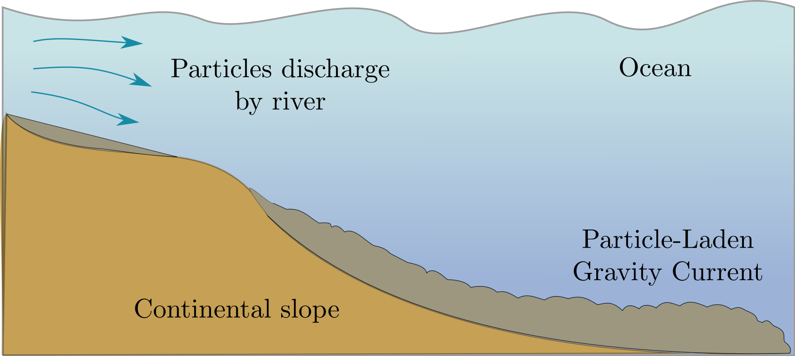





Slide 3

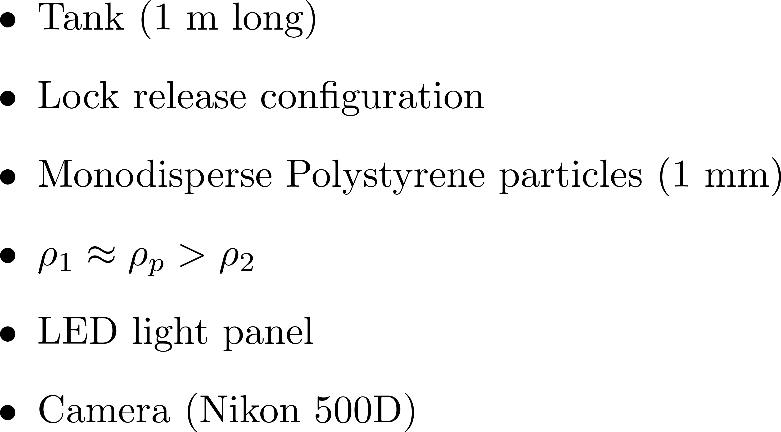
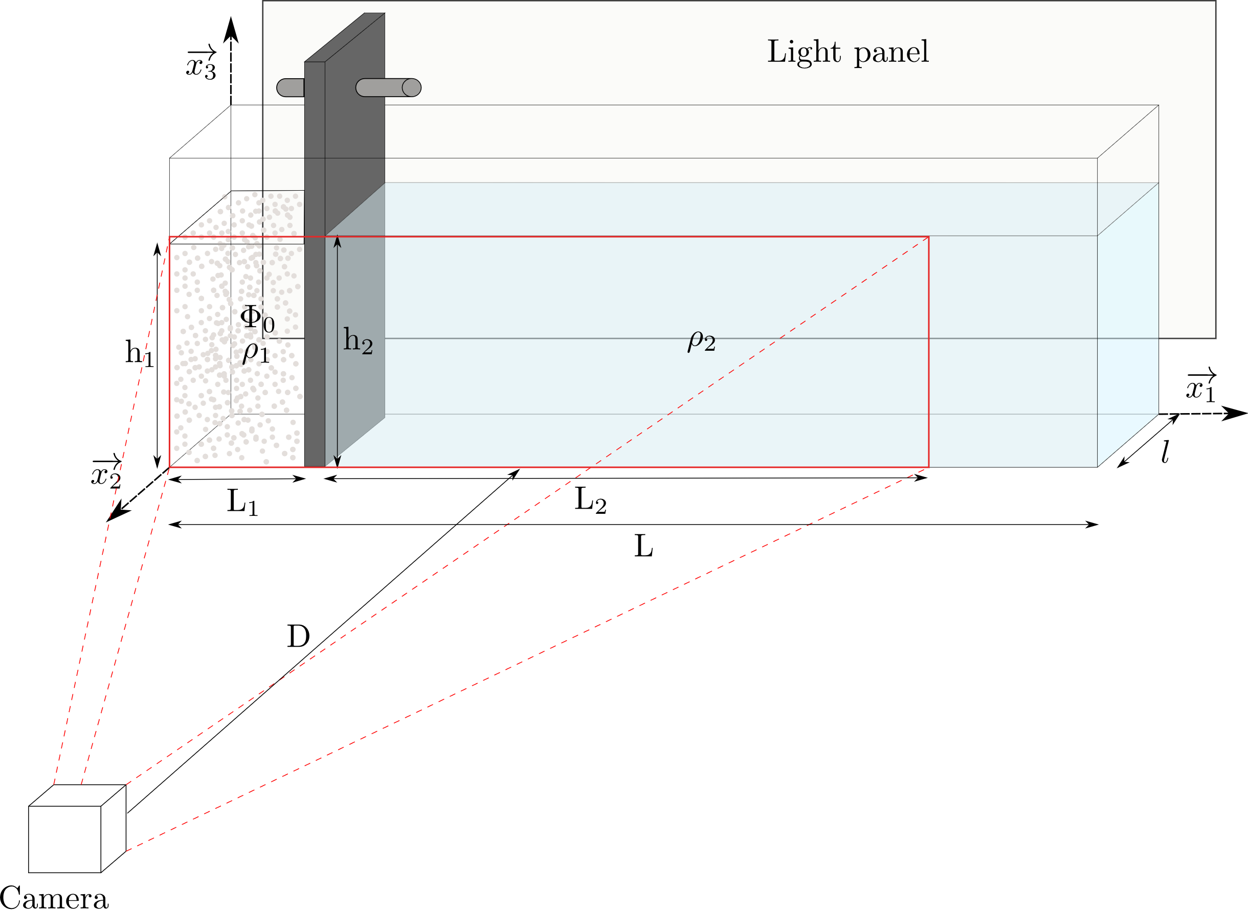
Experimental set-up of PILAT method

Slide 4
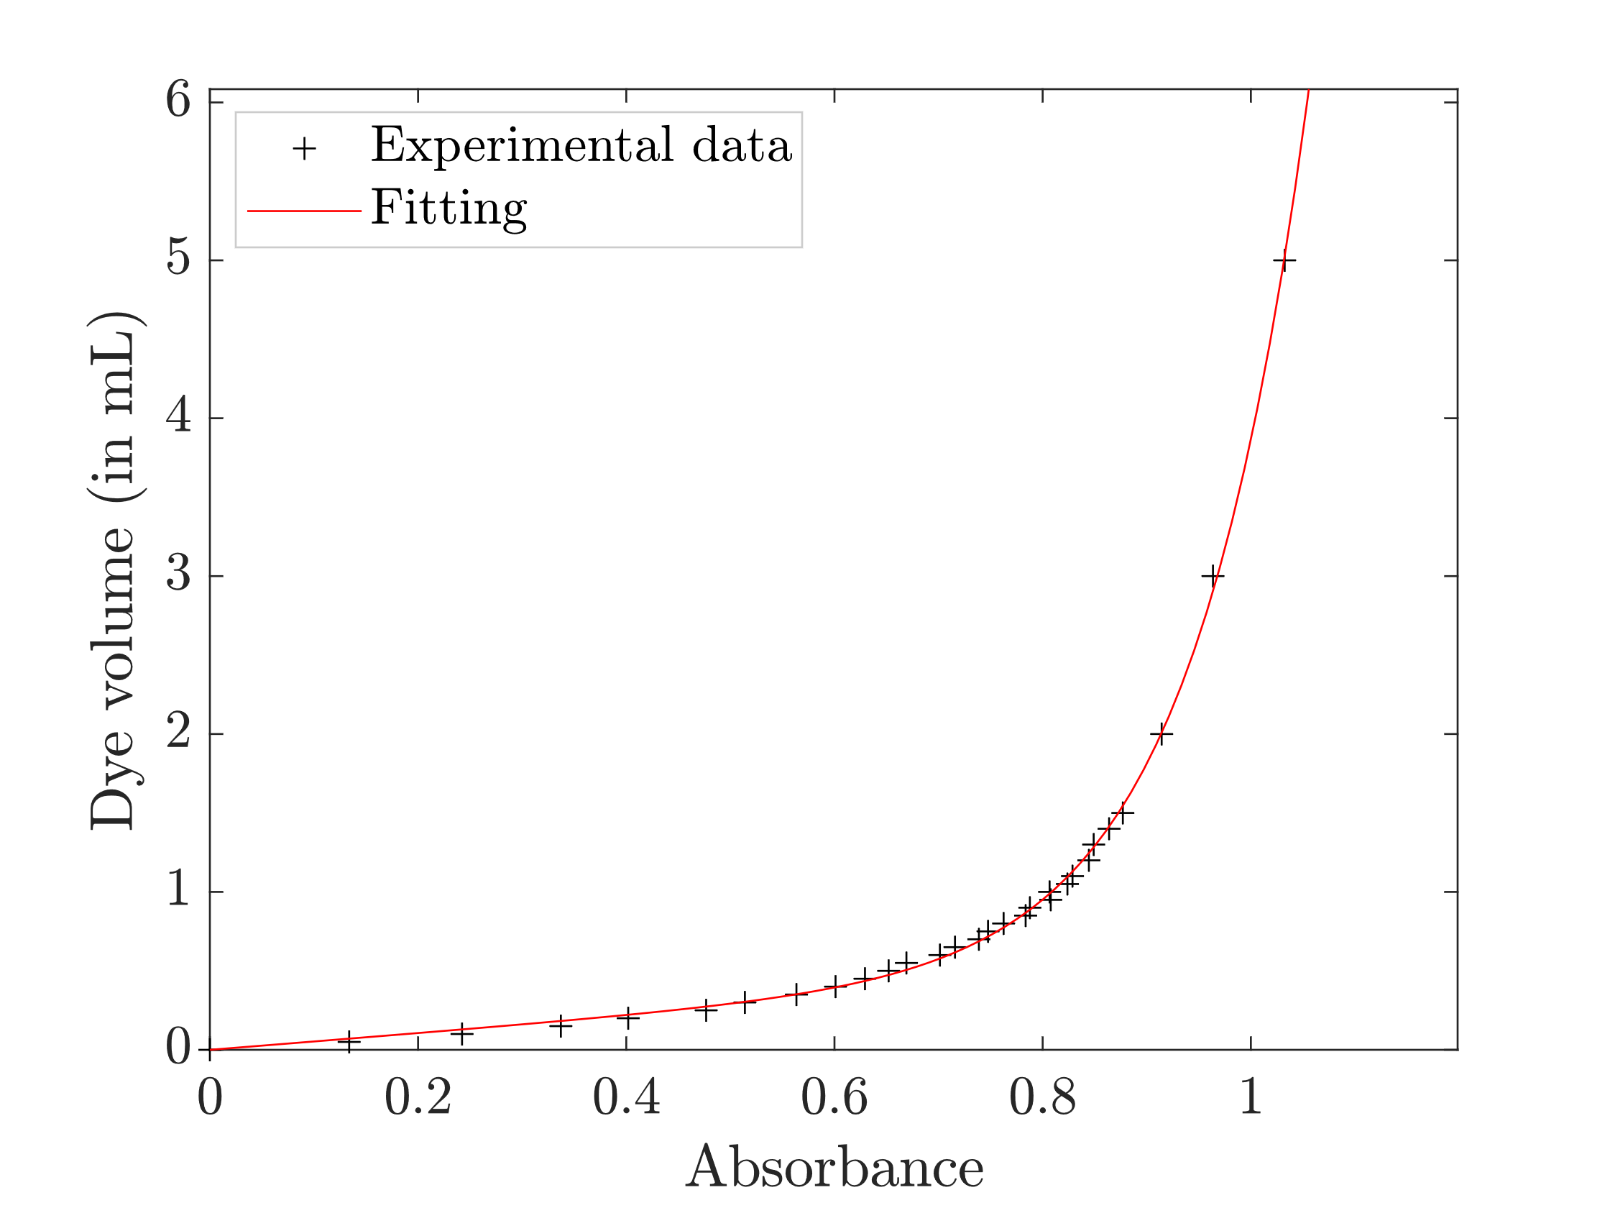

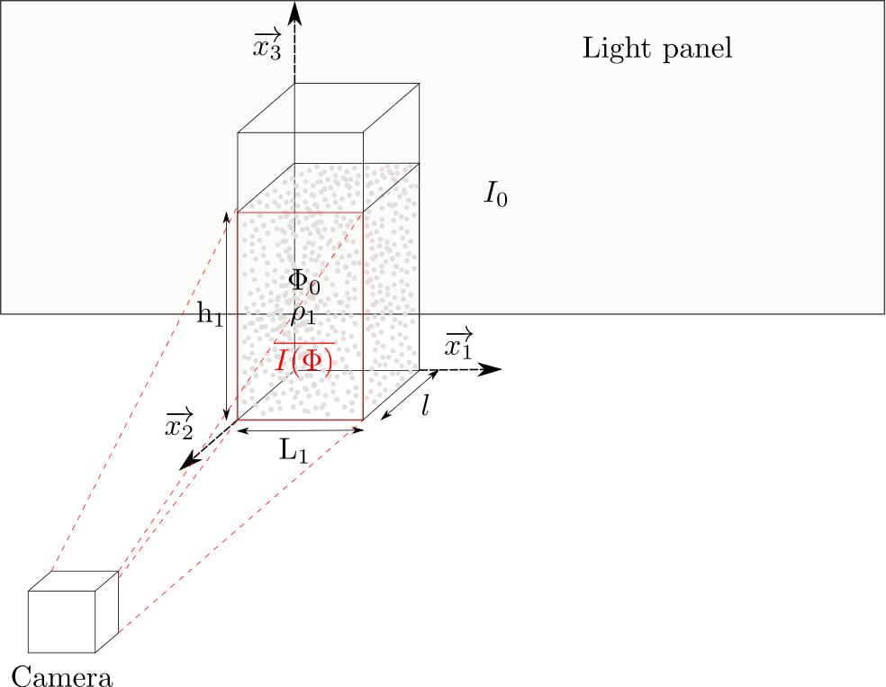
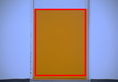
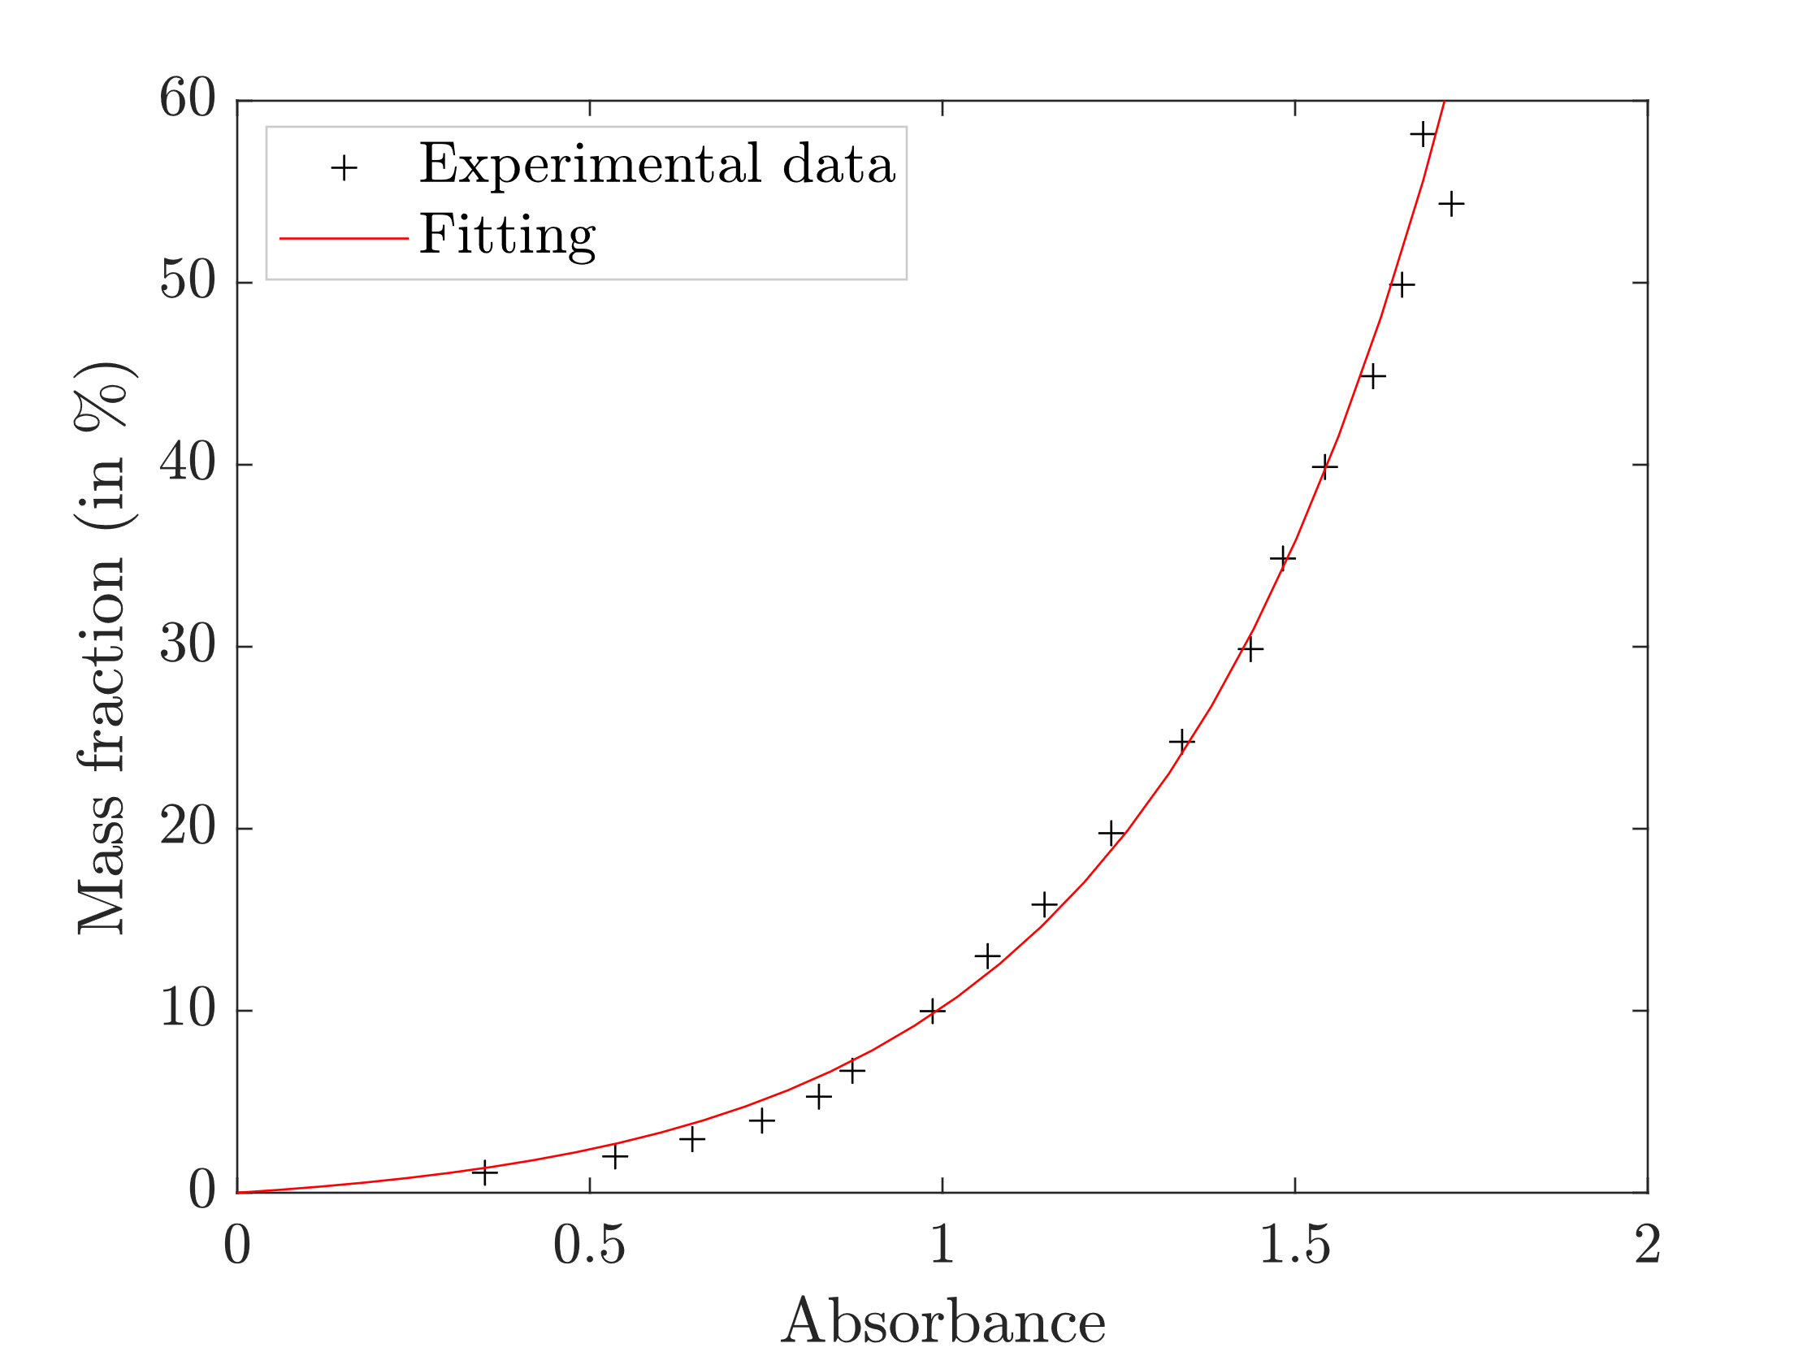
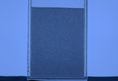

Calibration of Average light absorbance of red dye using LAT method (Dossmann et al., 2017)
Calibration of Average light absorbance of the suspension using PILAT method
Calibration set-up of PILAT method

Slide 5


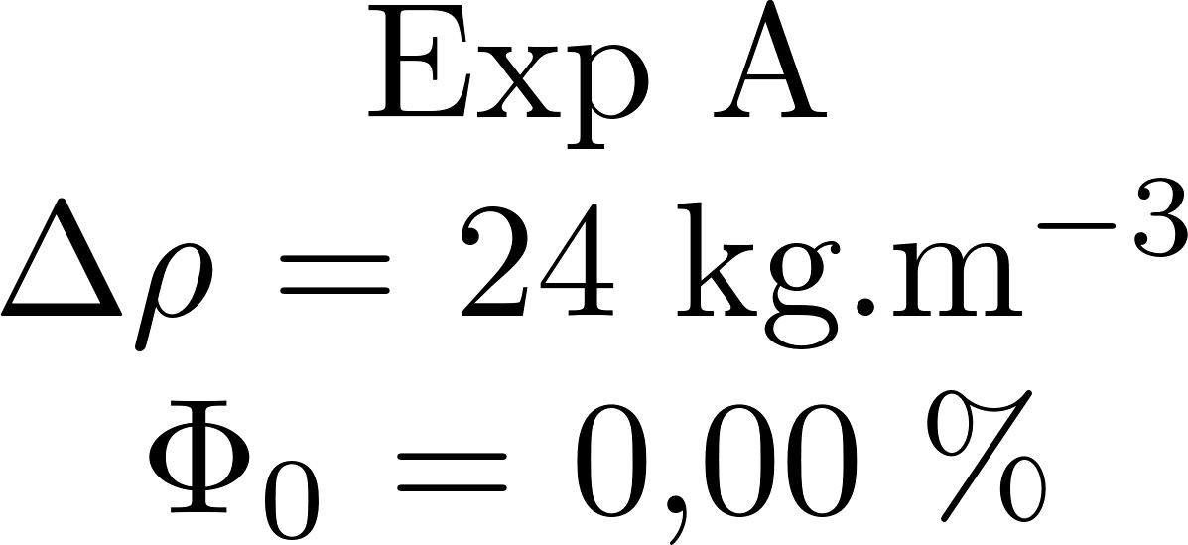
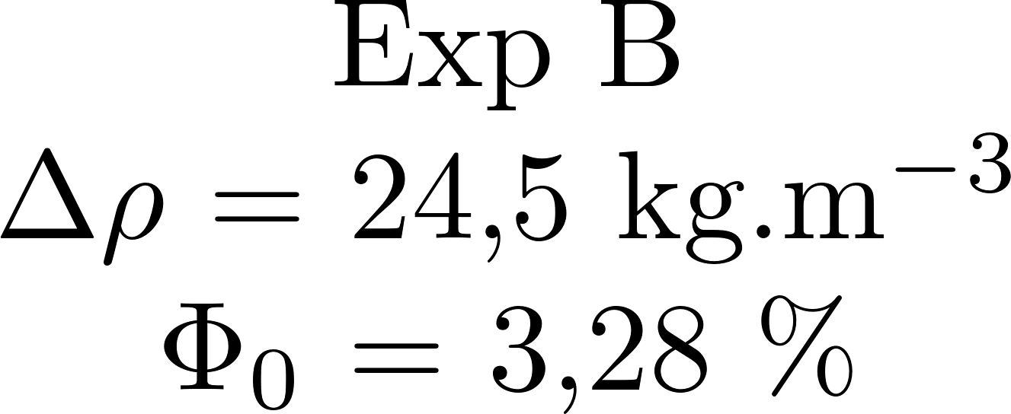
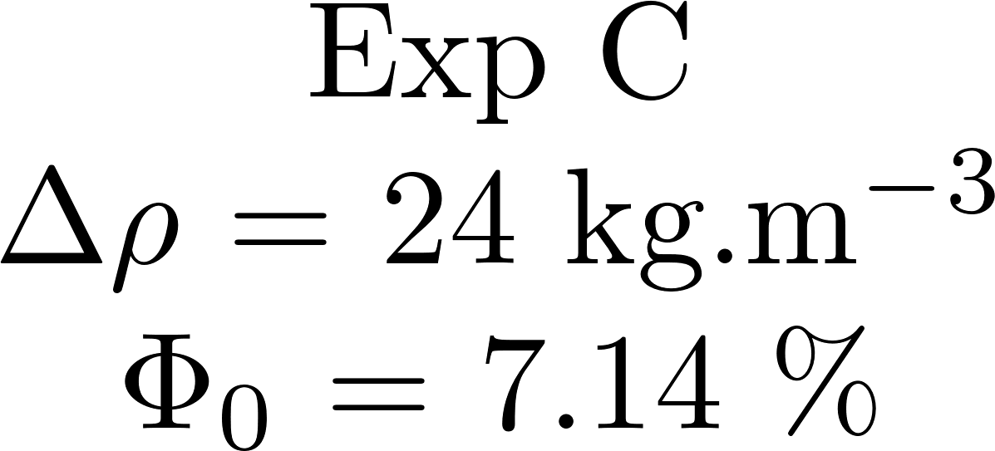
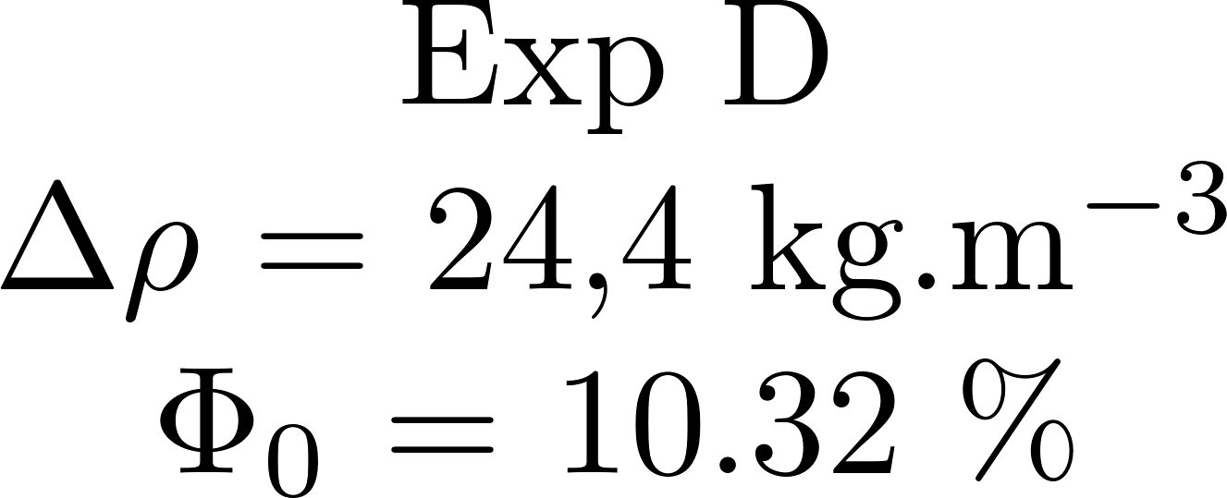
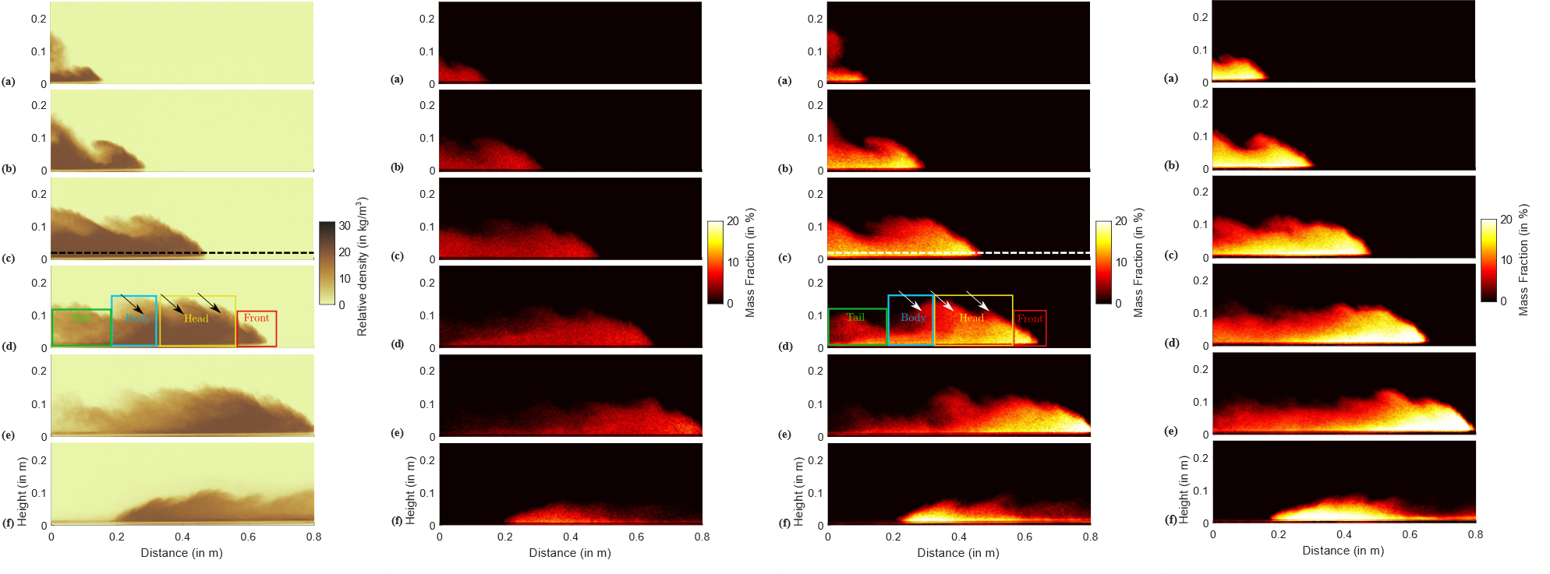


Slide 6
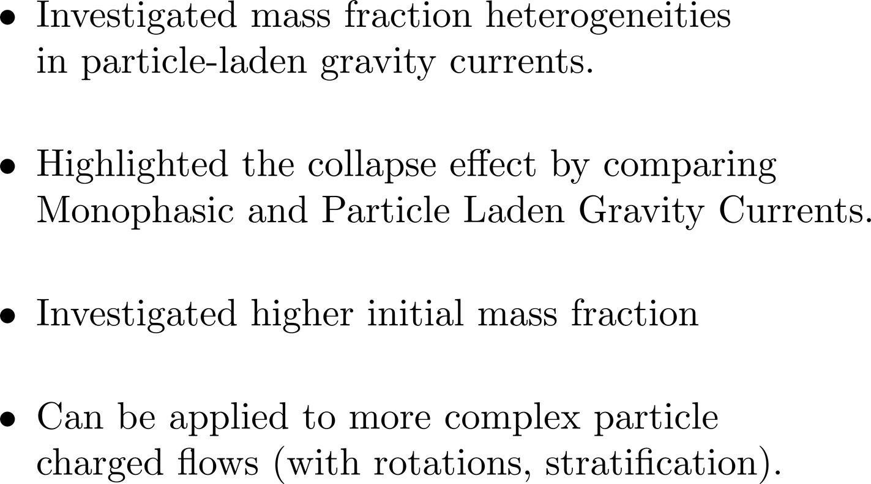

Slide 7

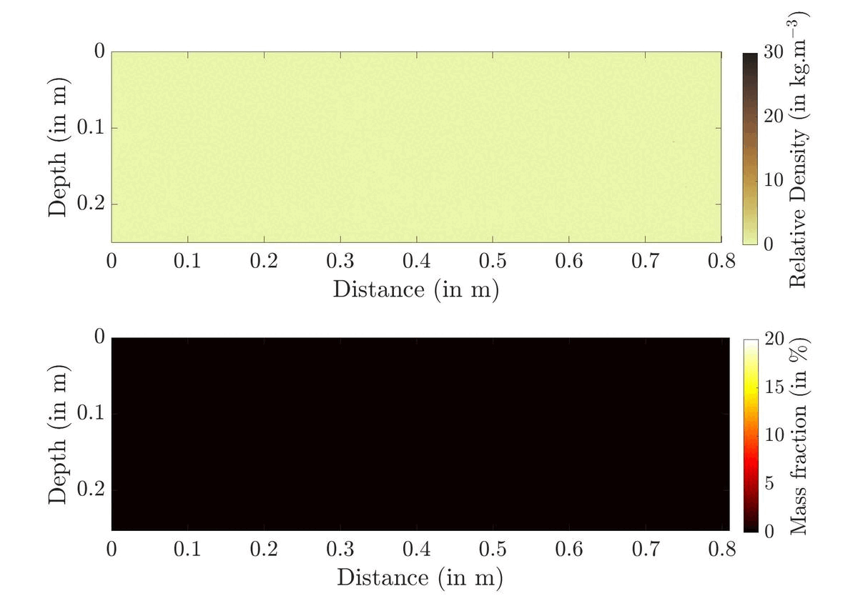
Jean Schneider
PhD student 2020-2023

