Slide 1




Louvain centre for Toxicology
and Applied Pharmacology
Short vs. long amosite fibers: implication of pulmonary clearance for asbestos-associated lung inflammation and fibrosis
Riccardo Leinardi
Catholic University of Louvain, Belgium
riccardo.leinardi@uclouvain.be
May 25th

Slide 2

Background
Paradigm for asbestos pulmonary toxicity
(experimental observations)
Short fibers
(L < 5 μm)
Long fibers
(L ≥ 5 μm, AR > 3)
Poorly
pathogenic
Highly
pathogenic
Lung inflammation/fibrosis/cancer
Asbestosis
Mesothelioma
Pulmonary clearance: key role?
Boulanger et al., Env Health, 2014
Barlow et al., Inhal Toxicol, 2017

Slide 3
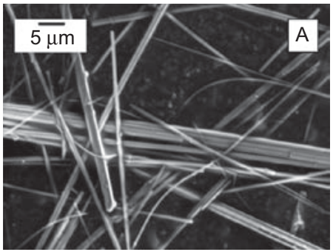
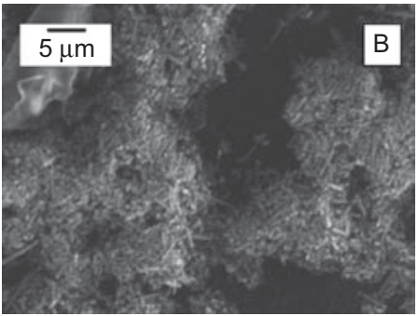
Challenging the established paradigm comparing long vs. short amosite in-vivo and in-vitro
Controlled fracturing
Long amosite fibers
(LAF)
Short amosite fibers
(SAF)
L: 2-100 μm (30% > 5 μm); Ø 0,2-1,5 μm
L: 1-10 μm (1% > 5 μm); Ø 0,2-1,5 μm
Davis et al., Br J Exp Pathol., 1986
Tomatis et al., Inhal Toxicol., 2010

Slide 4

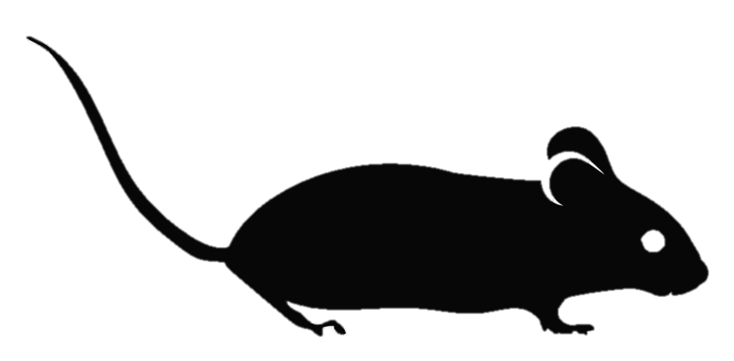

In-vivo: long amosite triggers short-term lung inflammation
LUNGS (fibrosis)
BAL (acute lung inflammation)
C57BL/6 (n=5)
3
120
Days
PBS or fibers instillation
(0,1 mg/500 μl)
Sacrifice
Sacrifice
Neutrophils
CXCL1
Ctrl- (PBS)
Ctrl+ (Crocidolite UICC, CRC)
Short amosite (SAF)
Long amosite(LAF)
Acute neutrophilic inflammation

Slide 5
In-vivo: long amosite triggers long-term lung fibrosis
LUNGS (fibrosis)
BAL (acute lung inflammation)
C57BL/6 (n=5)
3
120
Days
PBS or fibers instillation
(0,1 mg/500 μl)
Sacrifice
Sacrifice
OH-Proline
TIMP-1
CCL2
Ctrl- (PBS)
Ctrl+ (Crocidolite UICC, CRC)
Short amosite (SAF)
Long amosite(LAF)
Collagen deposition
Fibrosis-related
chemokine

Slide 6
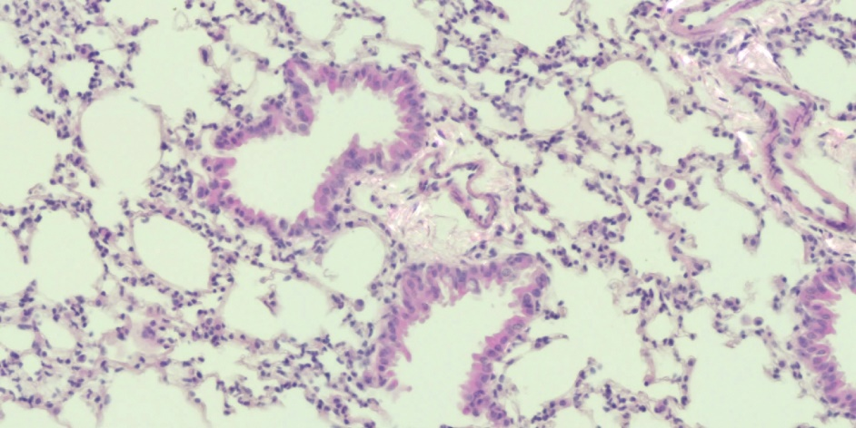
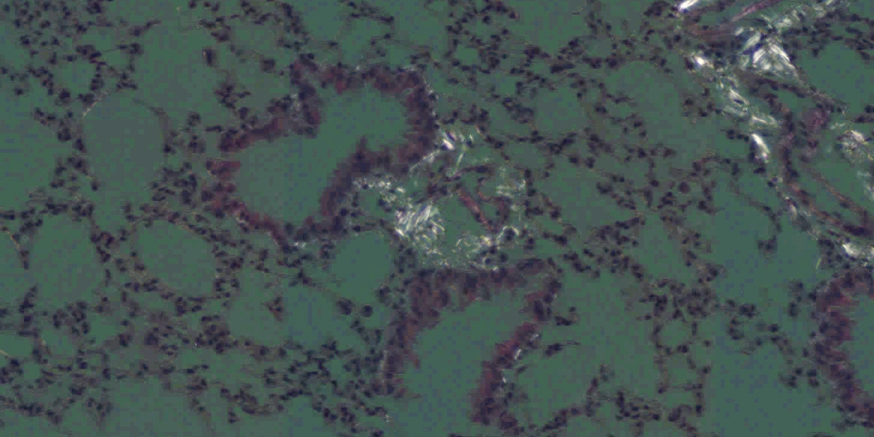
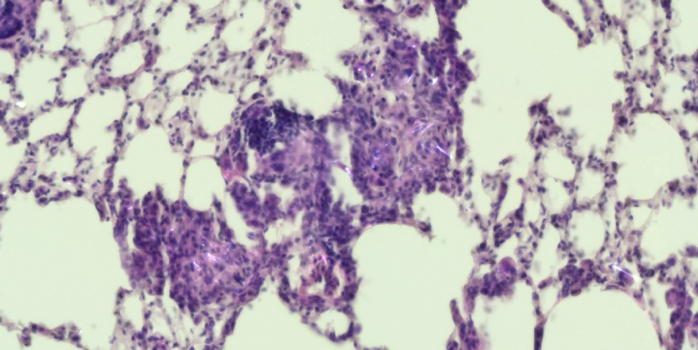
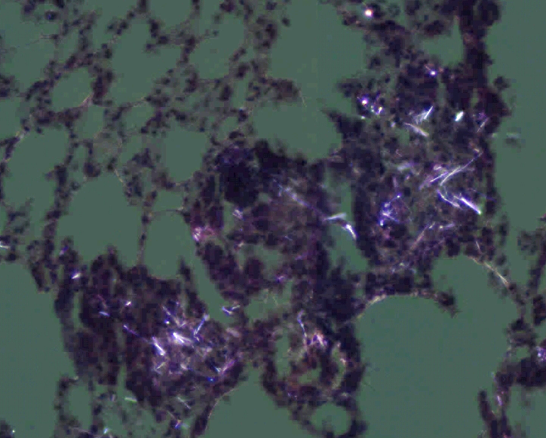
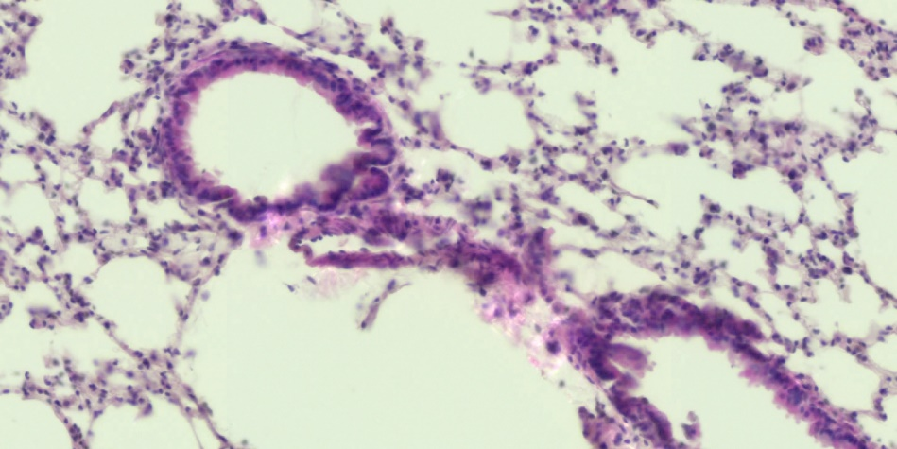
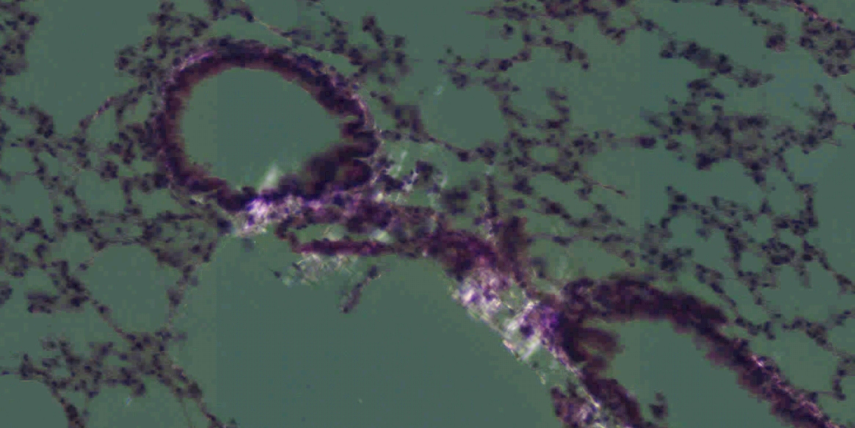
In-vivo: long amosite is retained in the lungs
bright light
polarized light
PBS
LAF
SAF

Slide 7
In-vivo: long amosite is retained in the lungs
bright light
polarized light
PBS
Lung amosite content
(estimated by Mn levels)
LAF
SAF

Slide 8
In-vitro: short amosite is more cytotoxic and proinflammatory
J774 mouse Mφ,
24 h, 37 °C
Extracellular LDH activity
IL-1α release
μg/cm²
μg/cm²
Cytotoxicity
Proinfammatory activity

Slide 9
Conclusions
1. In-vivo amosite lung pathogenic activity is size dependent
Long fibers retained in the lungs
Onset of lung inflammation and fibrosis
Short fibers cleared/removed from the lungs
No/low lung inflammation and fibrosis
2. Predictivity of in-vitro assays supported by in-vivo investigations
Overloading of short fibers by cultured macrophages
In-vitro results poorly representative

Slide 10







Acknowledgements
François Huaux
Amandine Pochet
Yousof Yakoub
Francesco Turci
Jasmine R. Petriglieri
Valérie Lecureur-Rolland
Alain Lescoat

