Slide 1





Characterization of cereals in a semi-arid context based on remote sensing indicators from high spatial resolution images from the Sentinel 1 and Sentinel 2 satellite in central Tunisia
Aicha Chahbi^{1,2}, Mehrez Zribi ³, Echraf Shil ², Zohra Lili-Chabaane ²
¹ Institut Supérieur des Etdues Technologique de Nabeul
² LR17AGR01 (GREEN-TEAM-TEAM), Institut National Agronomique de Tunis Université de Carthage
³ CESBIO (CNRS/IRD/UPS/CNES)
Date: May 23, 2022

Slide 2
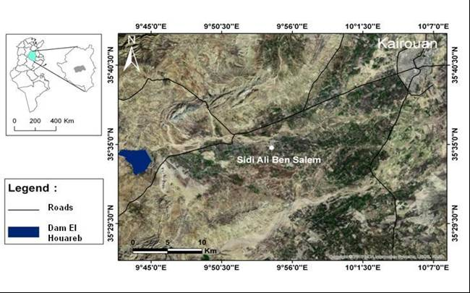
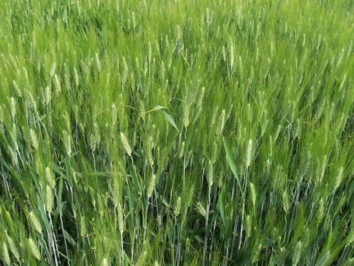
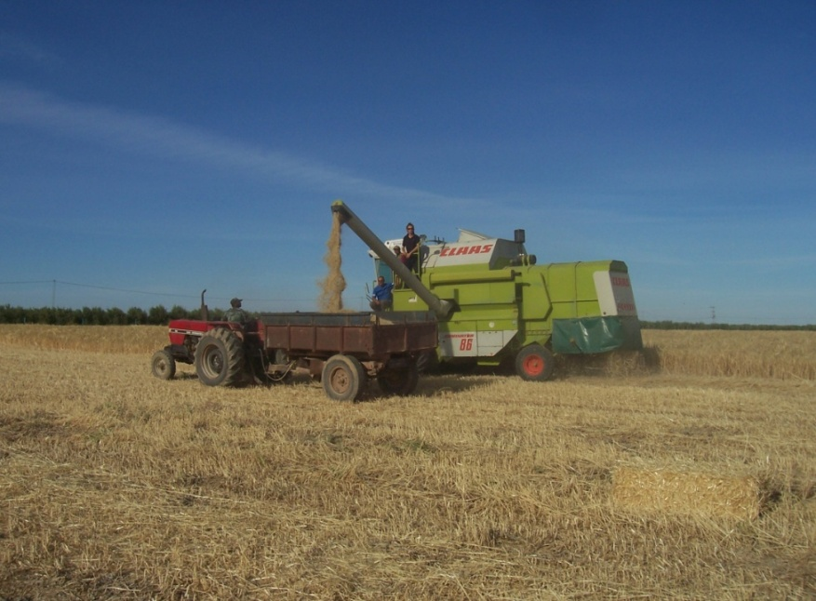
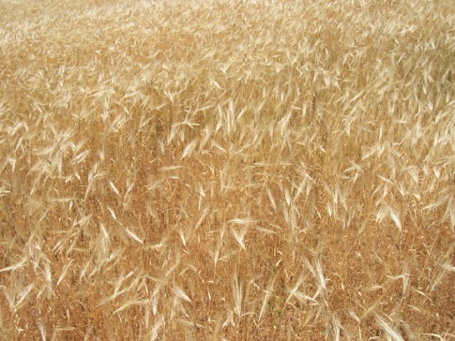
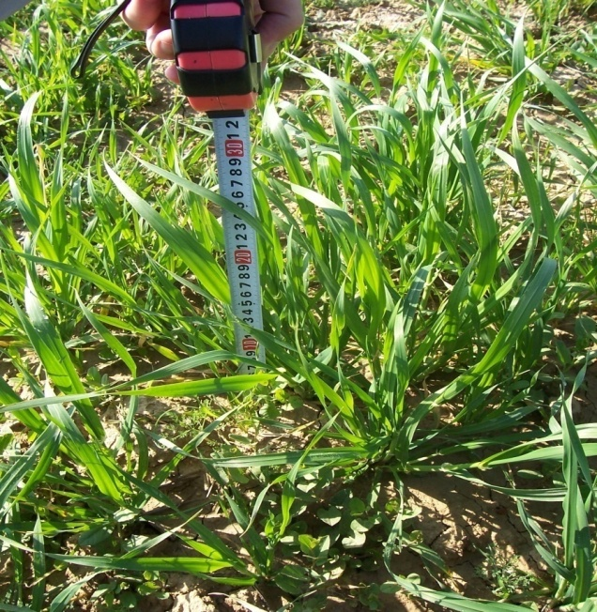
Problematic and context
For Tunisia, net cereal imports between 2005 - 2021 amounted on average to 72% of annual consumption.
Net imports
An operational early grain yield prediction system has been needed to assist policy makers in making initial assessments and planning for annual grain imports.
Source: Office des Céréales https://www.oc.com.tn/

Slide 3
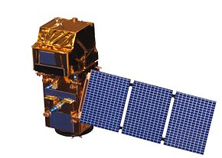

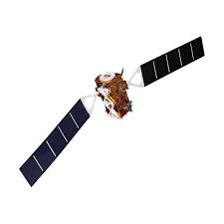

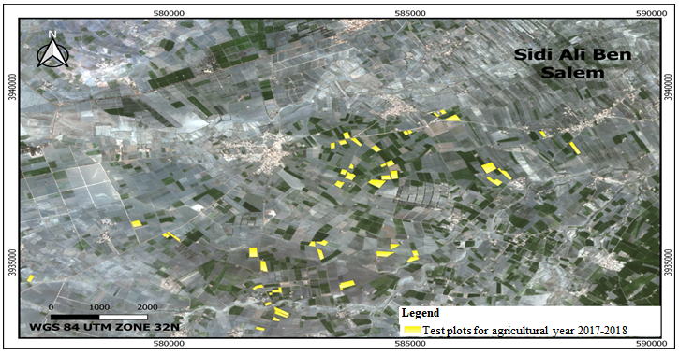
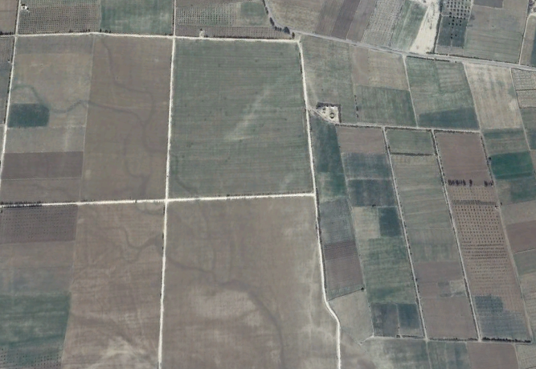
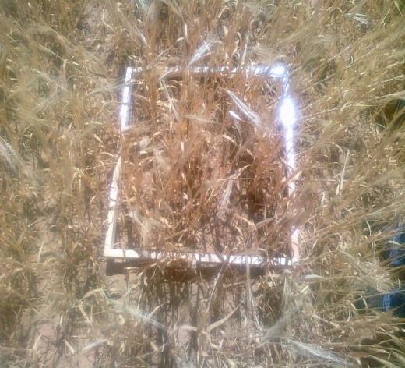
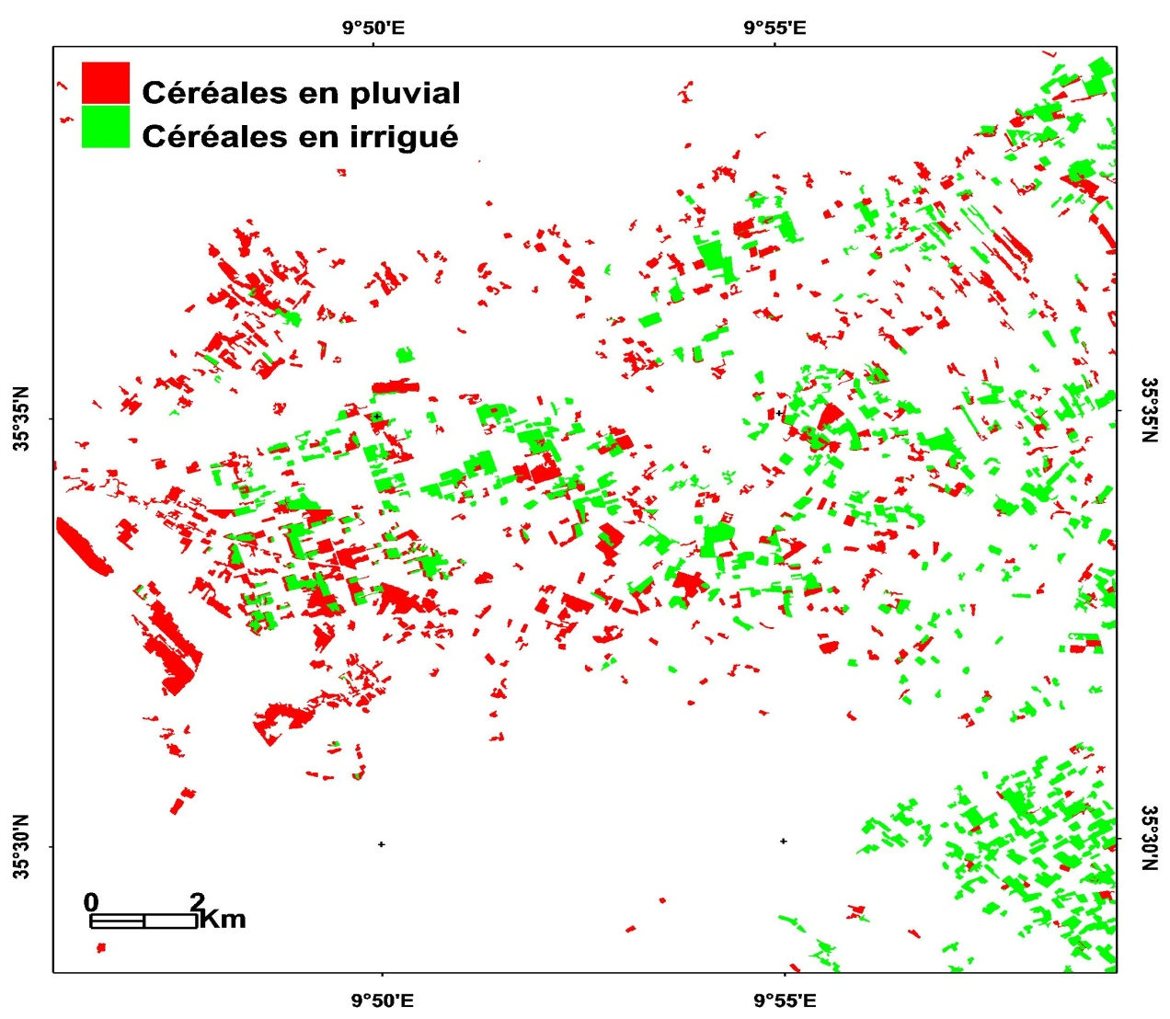
Data base
01/09
18/09
21/09
08/10
18/10
07/11
16/01
26/01
05/02
28/02
10/03
06/04
09/04
16/04
29/04
26/05
29/05
05/06
08/06
28/06
05/07
Sentinel 2
07/09
19/09
08/10
14/10
07/11
17/01
24/01
05/02
28/02
12/03
06/04
11/04
17/04
29/04
24/05
05/06
08/06
28/06
05/07
18/12
30/03
20/09
26/09
01/10
25/10
13/11
18/11
30/11
12/12
30/12
05/01
11/01
29/01
10/02
22/02
06/03
18/03
25/03
23/04
05/05
11/05
17/05
29/05
22/06
11/06
24/12
11/07
17/07
22/07
28/07
03/08
09/08
15/08
21/08
27/08
Sentinel 1
Number and type of test plots for the 2017-2018 agricultural year
Samples
Species | Irrigated | Rainfed
Wheat | 39 | 2
Barley | 9 | 3
Cereals mask

Slide 4
The first approach : Empirical regression model using optical data
Distribution of datasets between :
  The empirical relationships : 26 plots
  The validation: 27 plots
 |  |  | NDVI | EVI2 | EVI
Grain yield | 10/03/2018 | Correlation | 0.69 | 0.66 | 0.58
 |  | RMSE quintals / ha | 1.79 | 1.98 | 2.17
 | 01/04/2018 | Corrrlation | 0.78 | 0.76 | 0.68
 |  | RMSE quintals / ha | 3.76 | 1.84 | 4.60
Straw yield | 10/03/2018 | Corrrlation | 0.72 | 0.70 | 0.62
 |  | RMSE quintals / ha | 1.22 | 1.28 | 1.35
 | 01/04/2018 | Correlation | 0.78 | 0.79 | 0.73
 |  | RMSE quintals / ha | 2.54 | 1.27 | 3.34

Slide 5
The first approach : Empirical regression model using optical data
Cereal grain yield map produced by NDVI for the 2017-2018 agricultural year (quintals/ha)
Cereal straw yield map produced by NDVI for the 2017-2018 agricultural year (quintals/ha)

Slide 6
The first approach : Empirical regression model using Radar data (VH/VV)
The VH/VV ratio is sensitive to the growth cycle of the culture and depends on the phenology stade of the plant
The possibility of early estimation of cereal yields using Radar images
Evolution of the NDVI and the VH/VV ratio during the 2017-2018 agricultural year for a plot of barley

Slide 7

The second approach : The optical radar combined index
The combined optical radar index I_{rc} is a mixed index which involves the radar index I_{r} and an optical index I_{o} :
$$Irc=\sqrt{Ir²+Io²}$$
Cereal grain yield map produced by Irc for the 2017-2018 agricultural year (quintals/ha)

Slide 8
Conclusion
- Strong correlation between measured and estimated yield by NDVI from mid-March (R²_{grain} = 69.22% ; R²_{straw} = 72.38% ).
- Radar time series allow to capture short phenological stages thanks to the high sensitivity of polarization ratio to plant phenology (R²_{grain} = 53.8% ; R²_{straw} = 56% ).
-The possibility of an early estimation of yields from Radar images in combination with optical data.
-The combined Radar-NDVI index is robust for an early estimate of cereal yield from mid-March (R²_{grain/straw} = 64. % ; RMSE_{grain} =1.97qx/ha and RMSE _{straw} =1.31qx/ha).

Slide 9
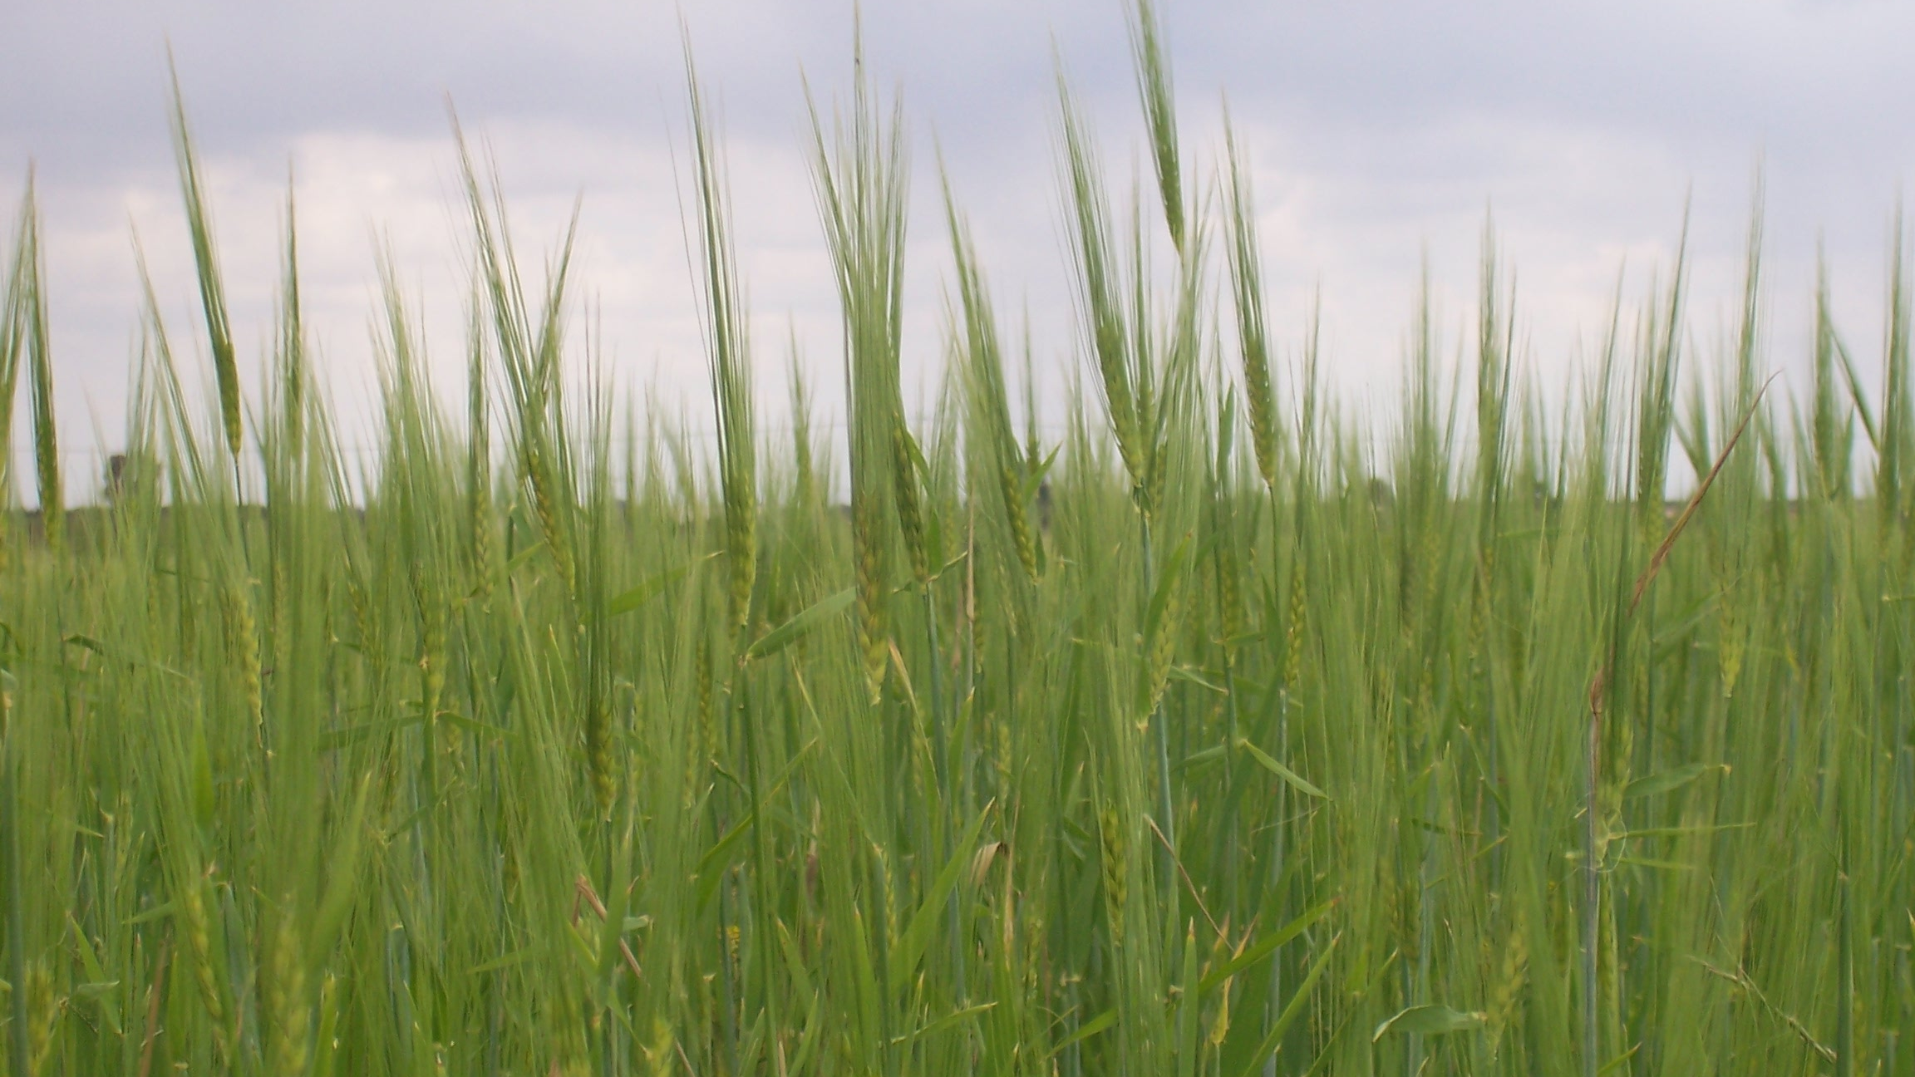
Thank you for your attention !

