Slide 1
GRAIN-SIZE DISTRIBUTION OF SEDIMENTS IN LAKE MUNOZERO (BALTIC SEA DRAINAGE BASIN)
N. A. Myasnikova
Northern Water Problems Institute of the Karelian Research Centre, Russian Academy of Sciences (KarRC RAS)

Slide 2
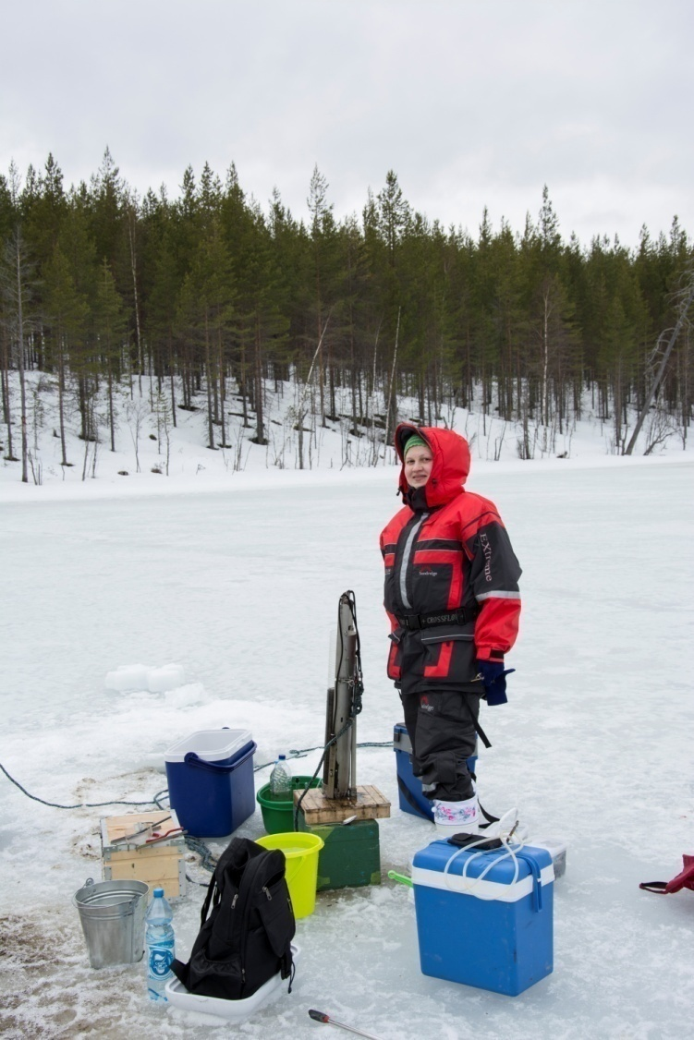
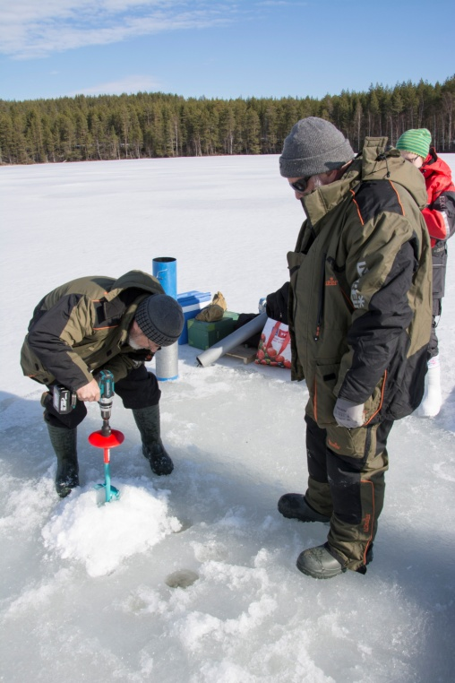
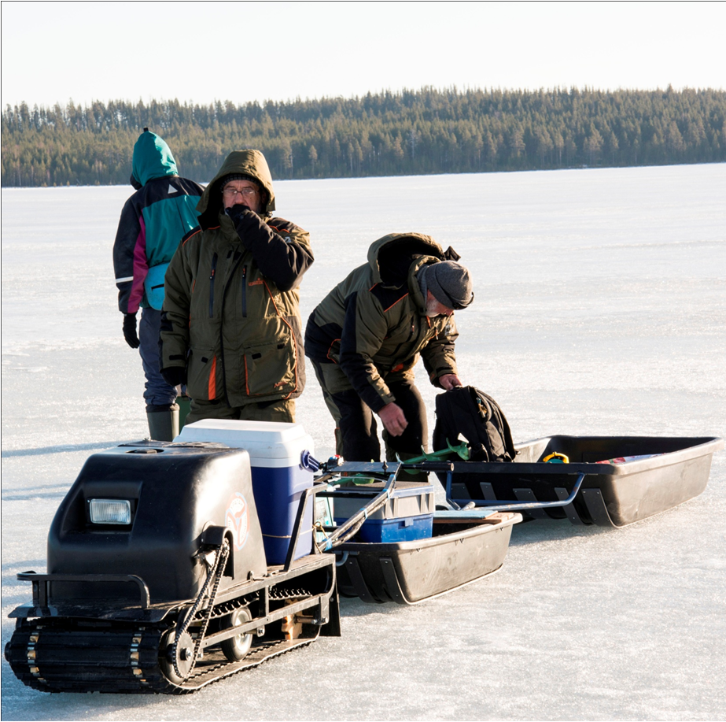
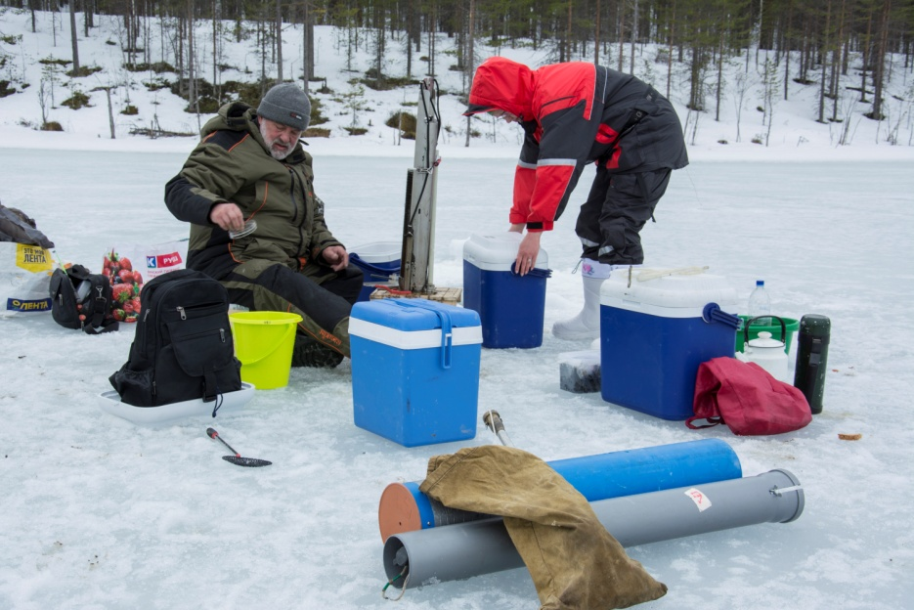
Objective:
Seeking to learn more about the deglaciation process in the Onega ice lake basin, we studied bottom sediments from Lake Munozero

Slide 3
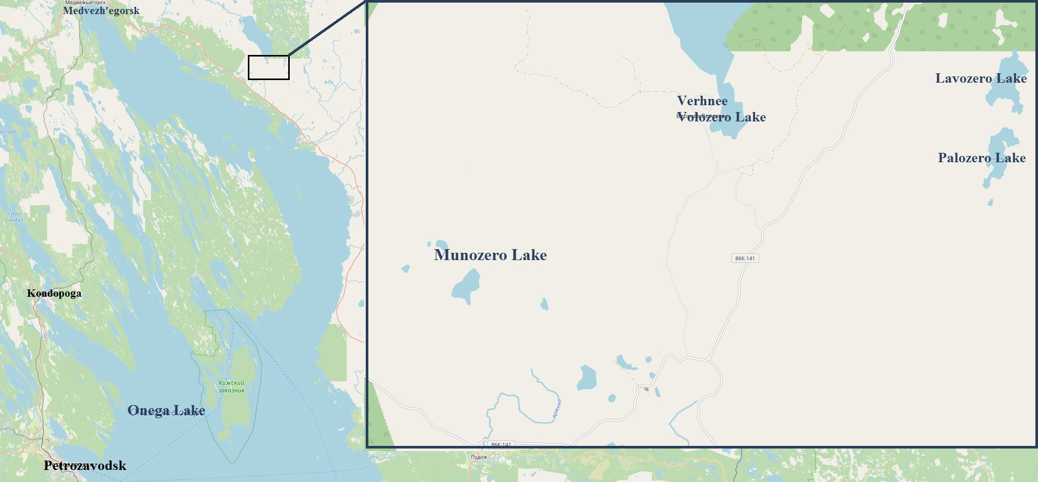
Lake Munozero
(geographic center coordinates: 62°44'42''; 35°20‘24'') situated in North-west Russia (Republic of Karelia). Its water surface area is 0.144 km² and elevation above sea level is 79 m a.s.l.

Slide 4
Research methods:
The grain size composition of the lake sediments was determined using the multifunctional LS 13 320 Laser Particle Size Analyzer (Beckman Coulter, USA) at the Karelian Research Centre RAS Core Facility with subsequent statistical data processing

Slide 5
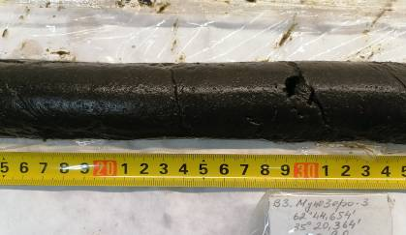
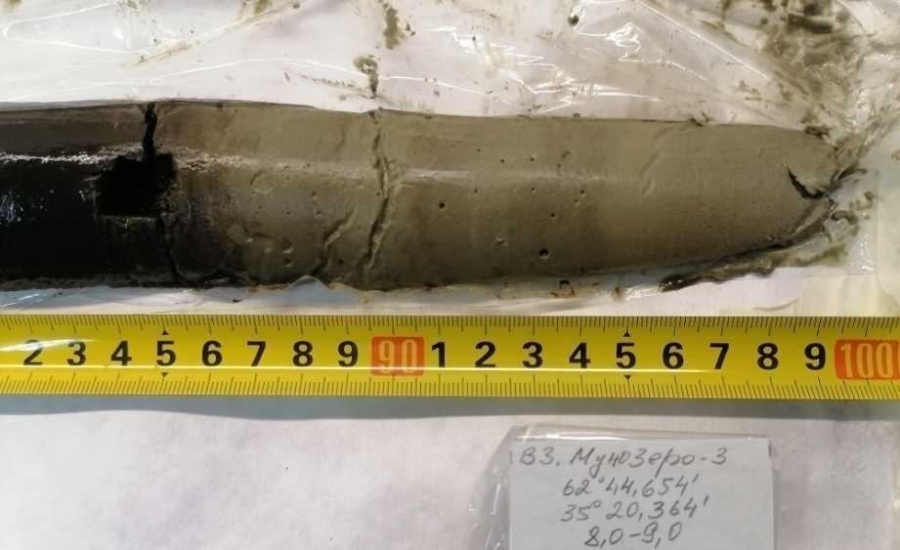
Sediments in Munozero Lake
Three sediment cores up to 4.80 m thick were exposed and their lithostratigraphy was described. The core of sediments from a depth of 8.00 - 9.00 m was studied in more detail.
Greenish-brown gyttja of Lake Munozero in layer 8.05 - 8.35 m
Greenish-gray clayey silt of Lake Munozero in the layer 8.86-9.00 m

Slide 6
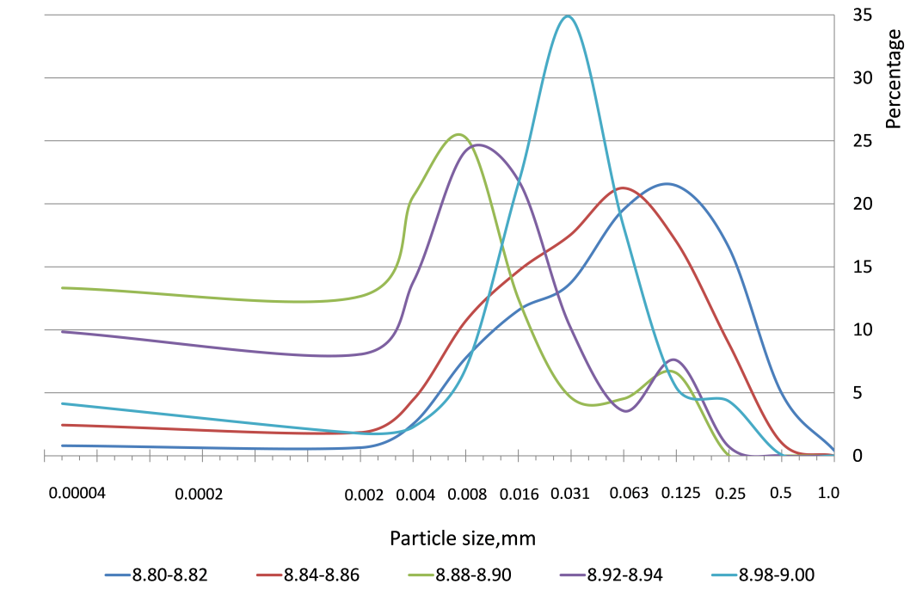
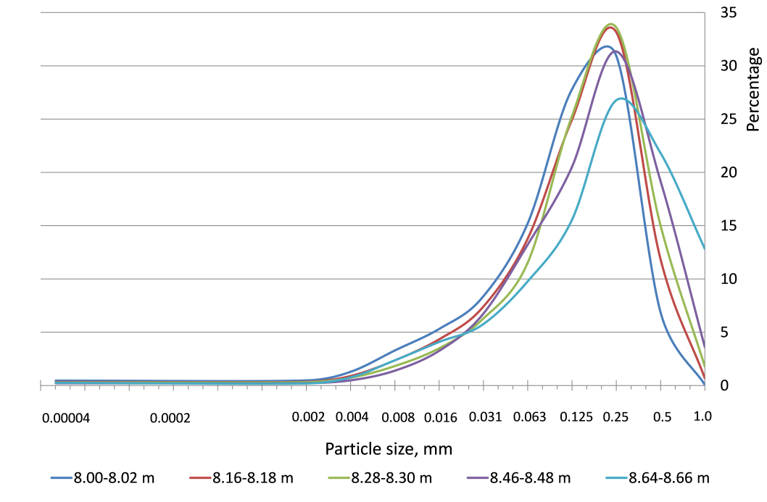
The grain size composition of sediments in samples from Munozero Lake is illustrated by the diagrams of size fraction distribution curves

Slide 7
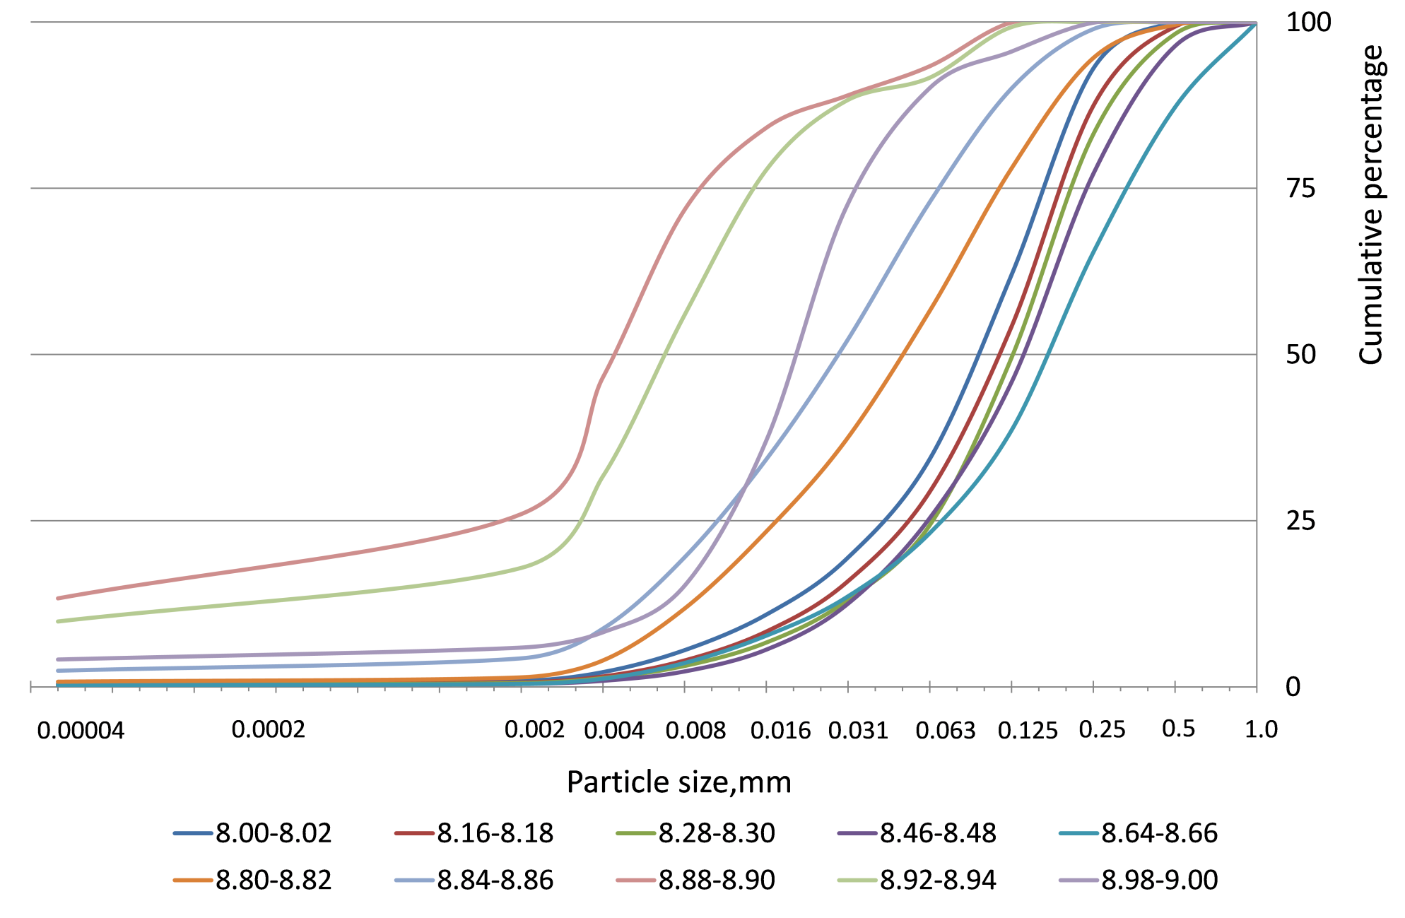
Diagram of cumulative curves of bottom sediment samples

Slide 8
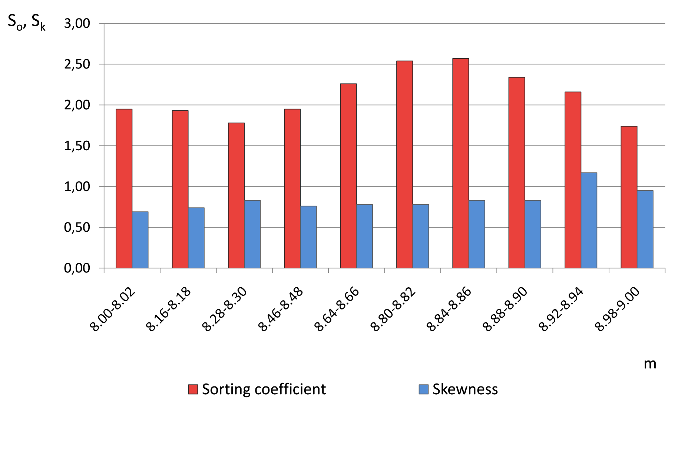
Variation of the sorting coefficient and skewness of Lake Munozero sediments

Slide 9
Conclusions:
Analysis of the grain-size distribution in sediments in the 8.00-9.00 m interval revealed the paleohydrodynamic environment for sedimentation in Lake Munozero during deglaciation.
Studies have demonstrated that the water dynamic regimes changed at least twice during the transition from a nival to a humid climate.
In the 8.00-8.30 m depth interval the sand fraction prevails with 81% to 87%, while the silt fraction contributes 13% to 19%;
at the 8.46-8.66 m depth the sand fraction constitutes 87% and 88%, and the silt fraction 12% and 13%;
in the 8.80-9.00 m layer the sand fraction declines from 63% to 11%, while the silt fraction grows from 36% to 78%.
The share of the clay fraction at 8.00-9.00 m depth is minor, 3% on average. The highest clay content is found in the 8.88-8.90 m interval (13%).

Slide 10
Acknowledgements:
The research was funded from the federal budget under state assignment to KarRC RAS (Northern Water Problems Institute KarRC RAS) and partially funded by RSF grant #18-17-00176.

Slide 11
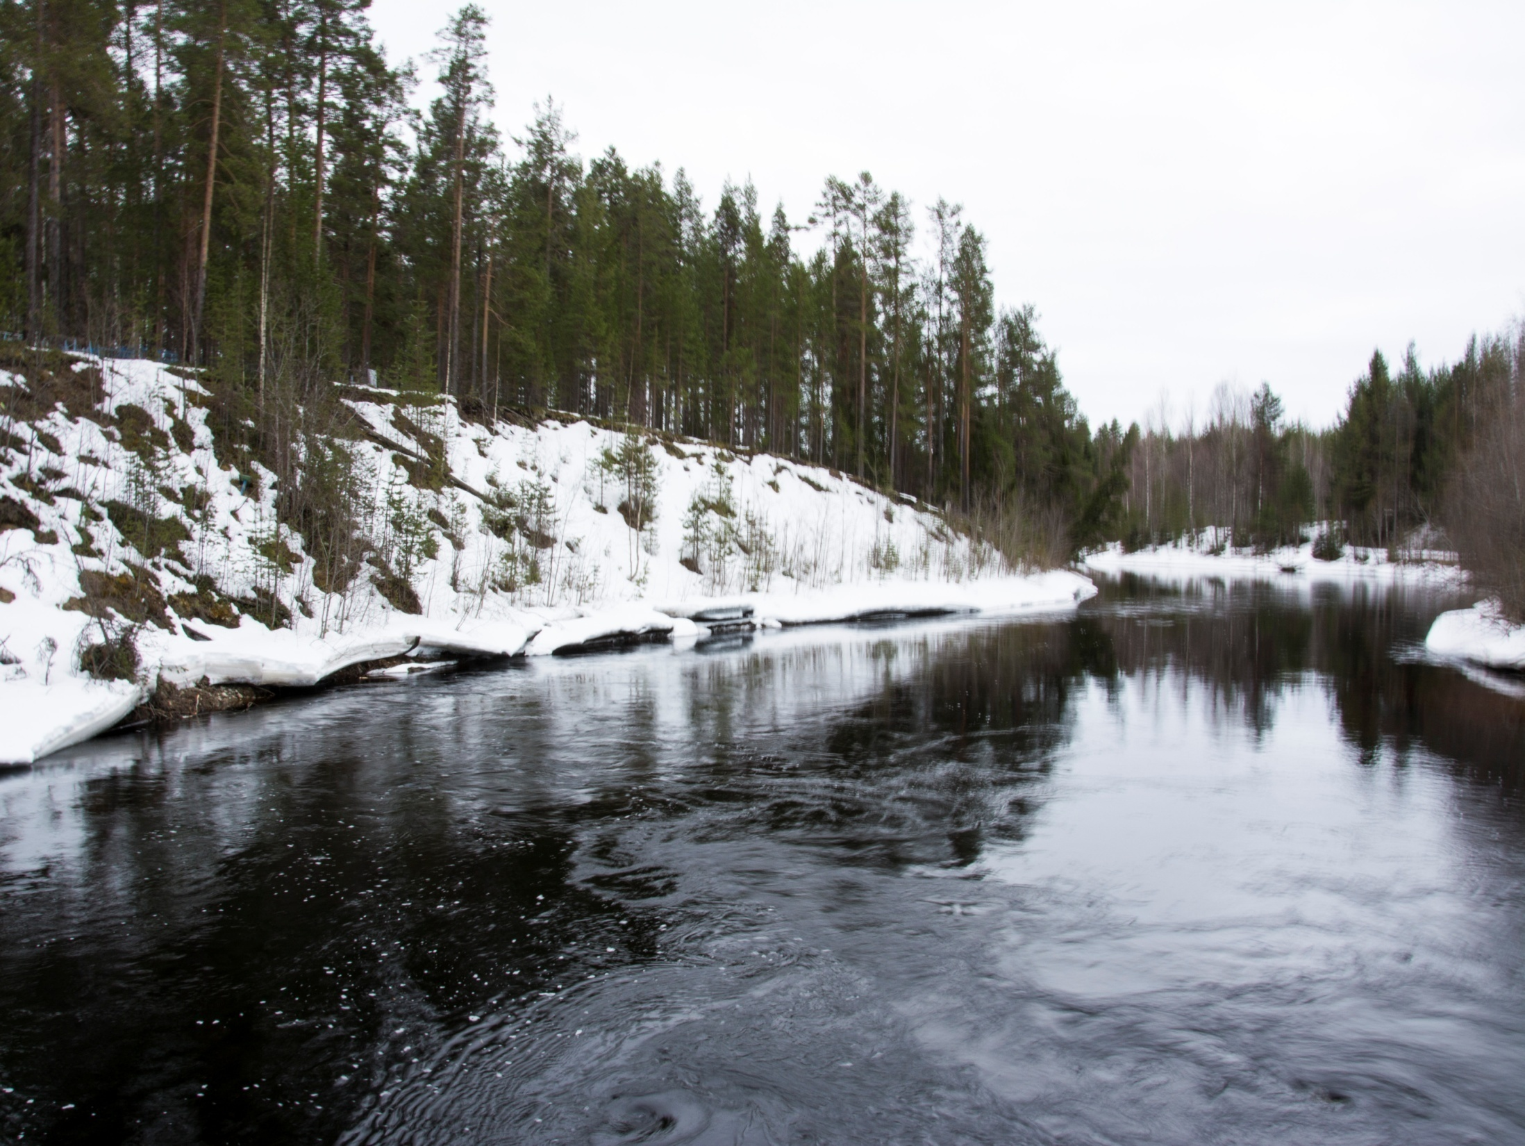
Thank you for attention!

