Slide 1





WOAST : an xarray package applying Wavelet Scattering Transform to geophysical data
Edouard Gauvrit
edouard.gauvrit@ifremer.fr
Marie-Noëlle Bouin (LOPS) | Jean-Marc Delouis (LOPS) | François Boulanger (LPENS)

Slide 2
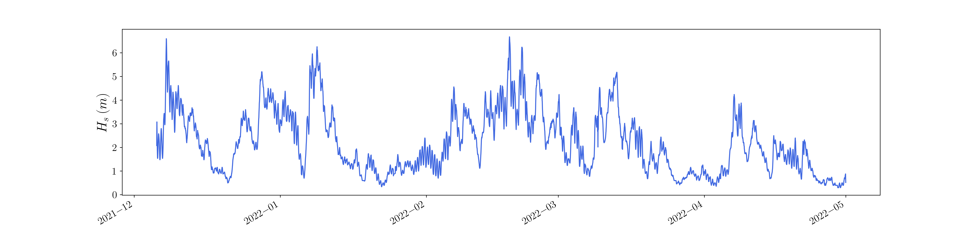
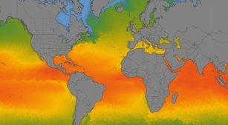

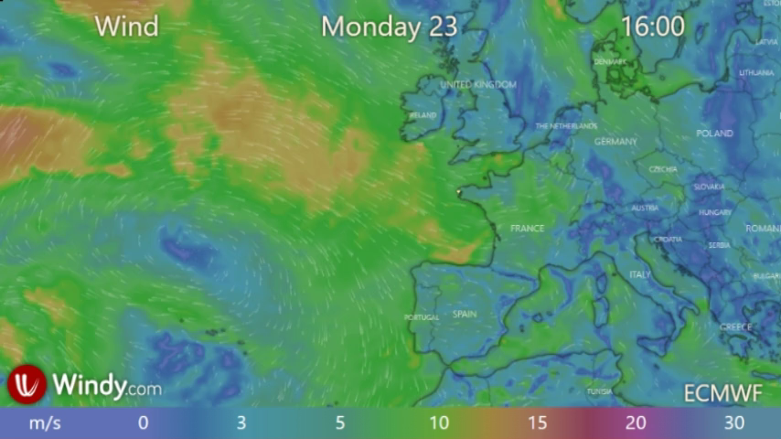
Geoscience Data
1D
Large datasets
2D
3D
Or 4D and + …

Slide 3
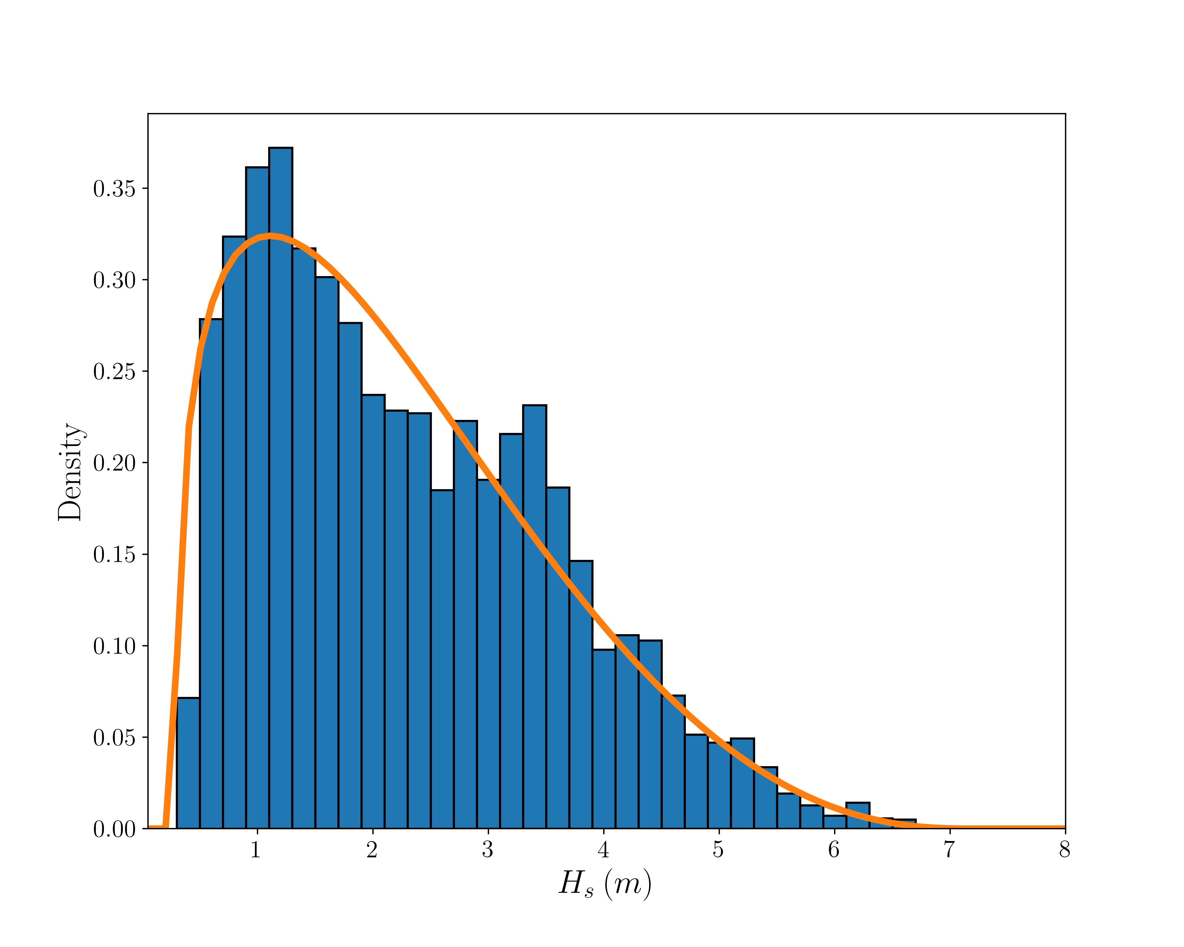
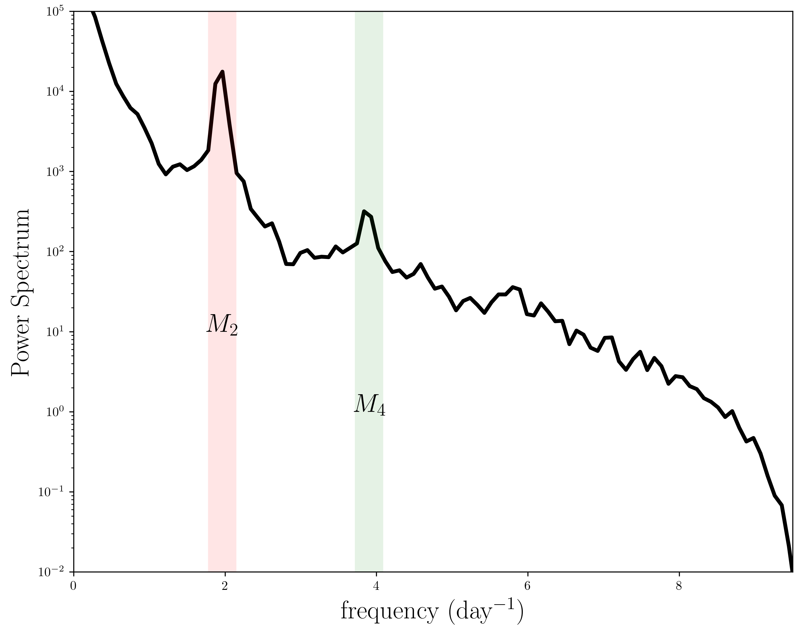
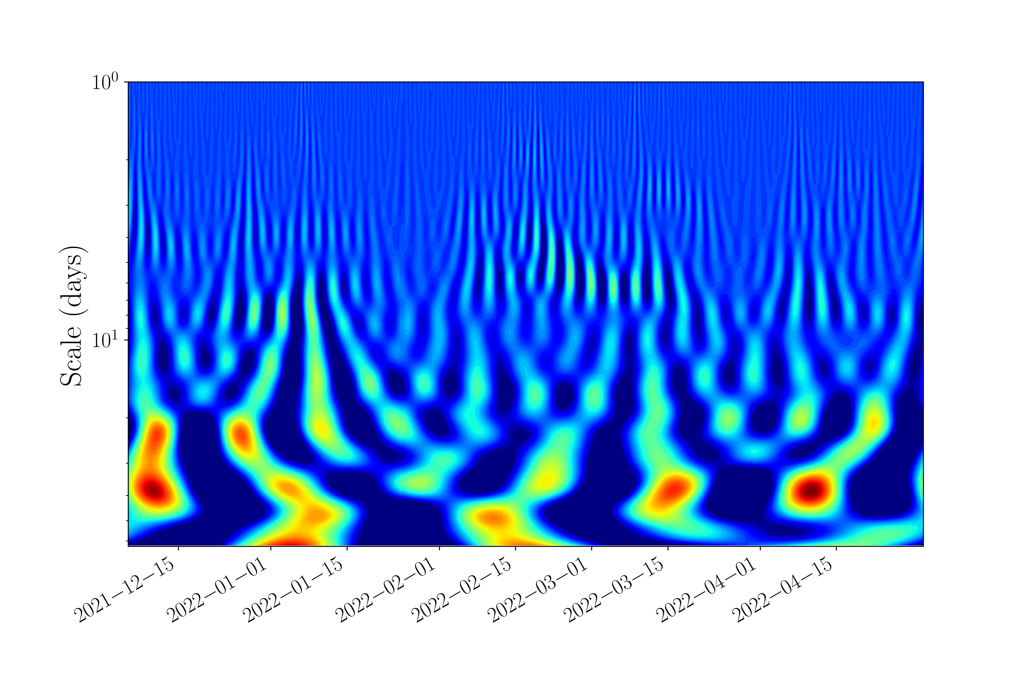
What do we do to statistically characterize a signal ?
PDF
Mean
Variance
Higher Moments
Power Spectrum
Energy distribution
Wavelet decomposition
local spectral + temporal info
But what about detecting structures (i.e. scales couplings) ?

Slide 4
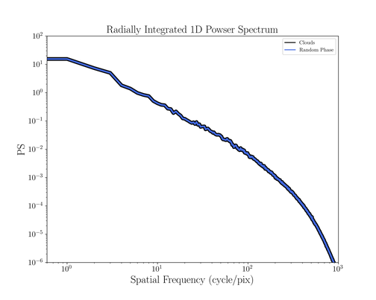
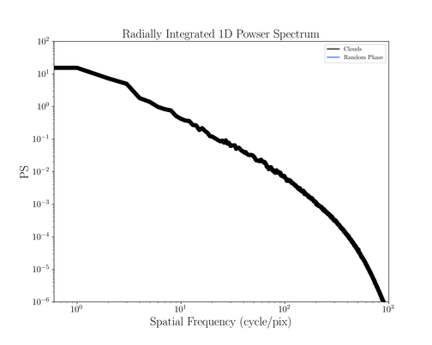
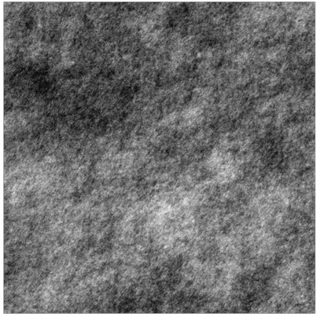
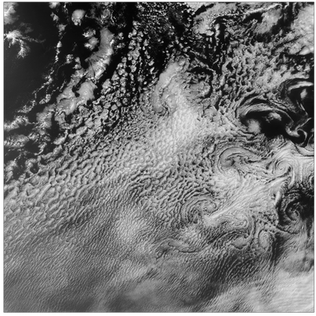
Power Spectrum Limitation
Same Power Spectrum !
PS → Blind to scale couplings (structures)

Slide 5
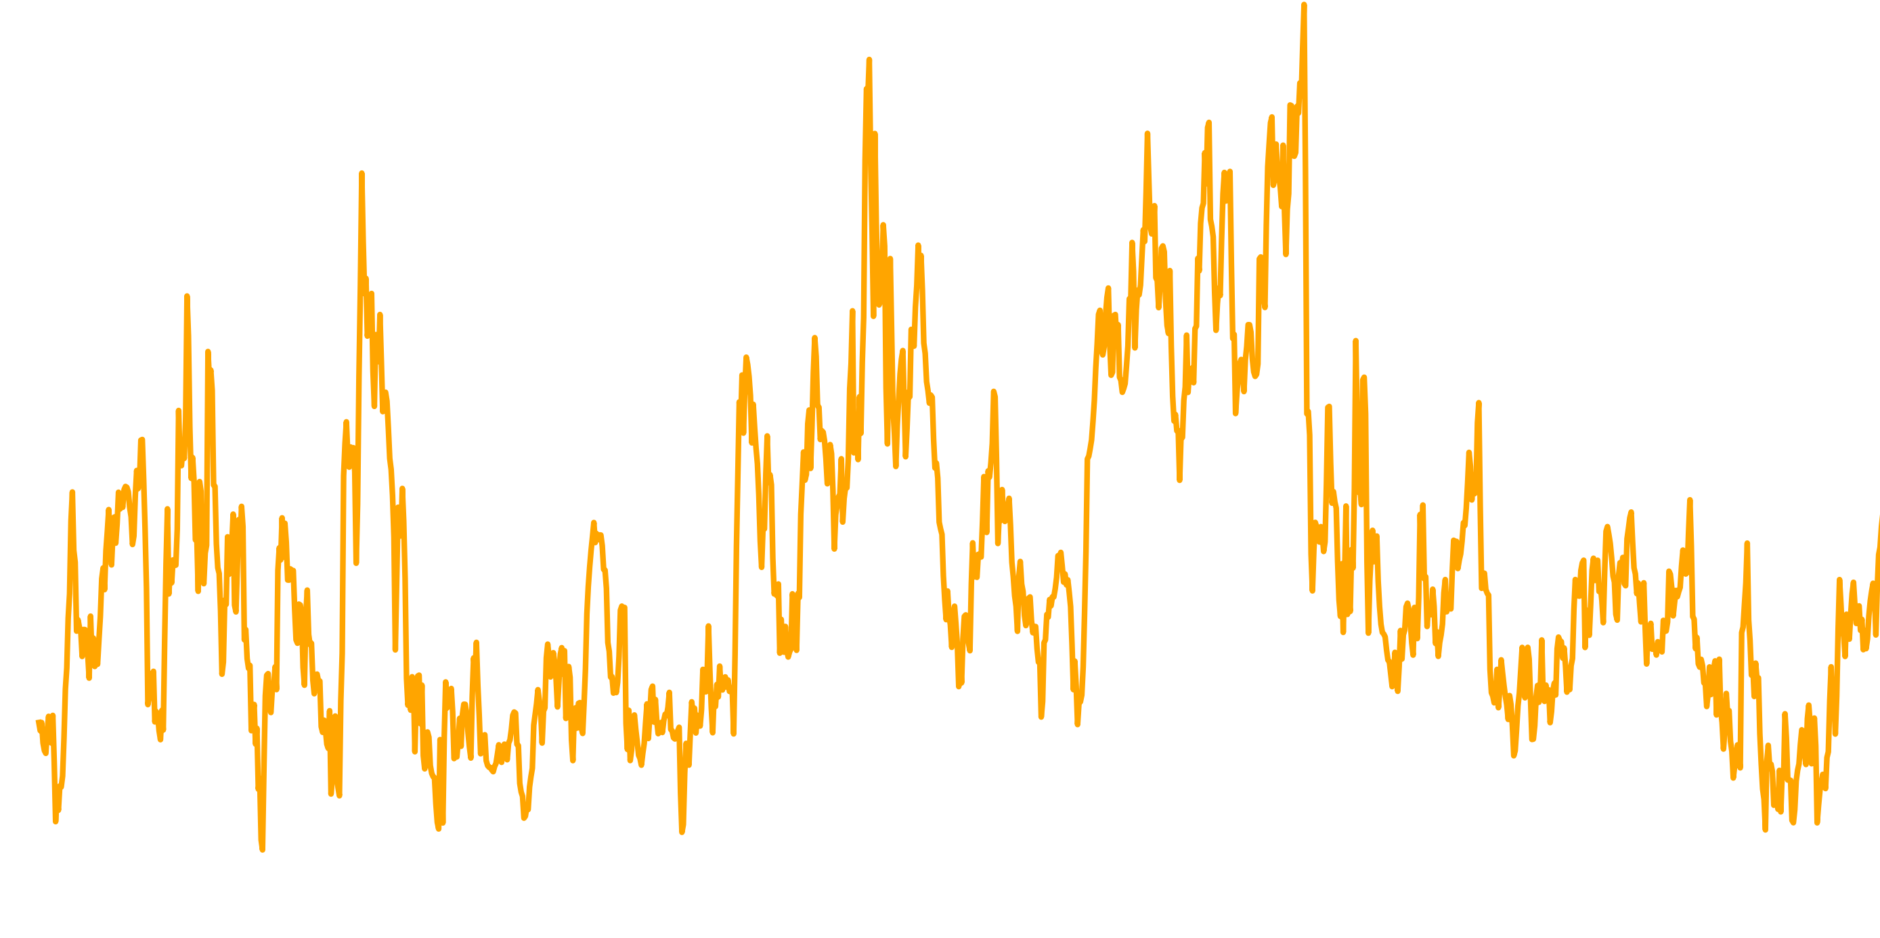
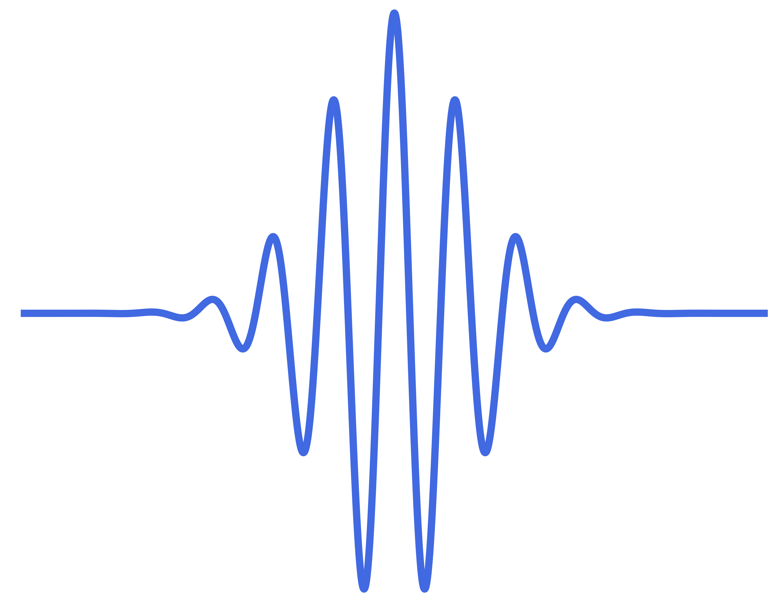








Wavelet Scattering Transform
Main properties :
Dedicated to scale coupling characterization
Dimension Reduction
Concept :
Wavelet Transform
Network Structure
$$I_{0}$$
$$∗$$
$$ψ_{j}$$
$$= I_{j}$$
Used in many scientific fields :
Signal processing (Bruna & Mallat 2013)
Quantum chemistry (Hirn et al. 2017)
Plasma physics (Glinsky et al. 2020)
Astrophysics (Allys et al. 2019)
Cosmology (Cheng & Ménard 2021)
$$I_{0}$$
Typical Use :
Classification
Regression or parameter inference
Exploratory data analysis
IA
$$I_{1}$$
$$…$$
$$I_{2}$$
Notes:
Dedicated to scale coupling characterization

Slide 6

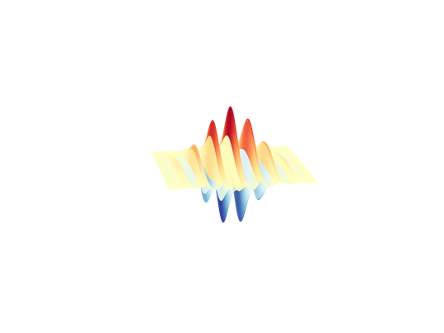
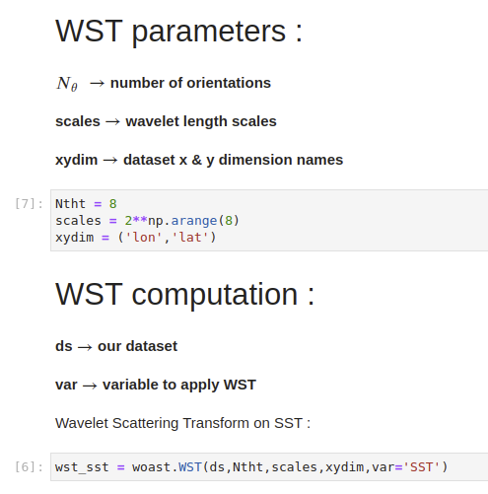
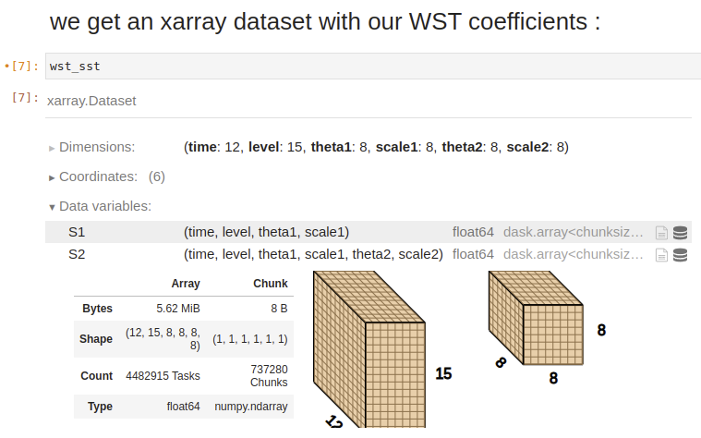
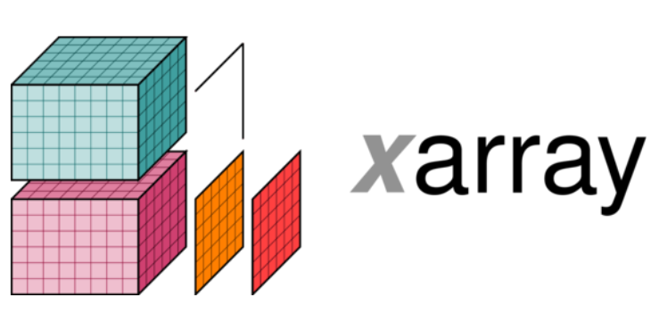

WOAST
Wavelet for Ocean Atmosphere Scattering Transform
What is this?
A Python package
WOAST

Slide 7
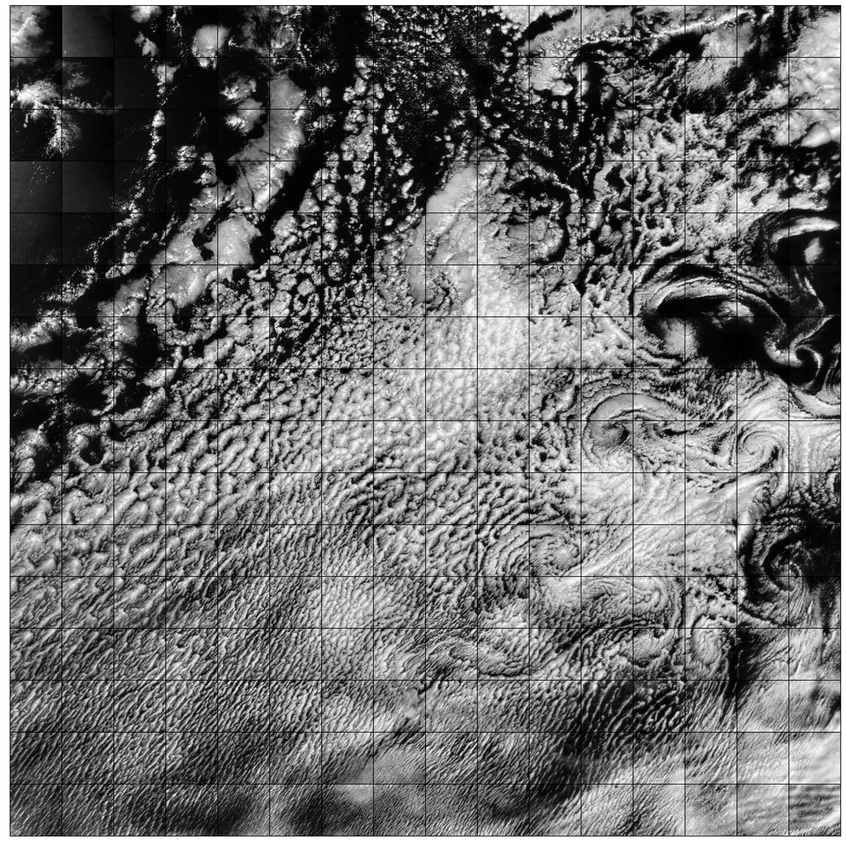
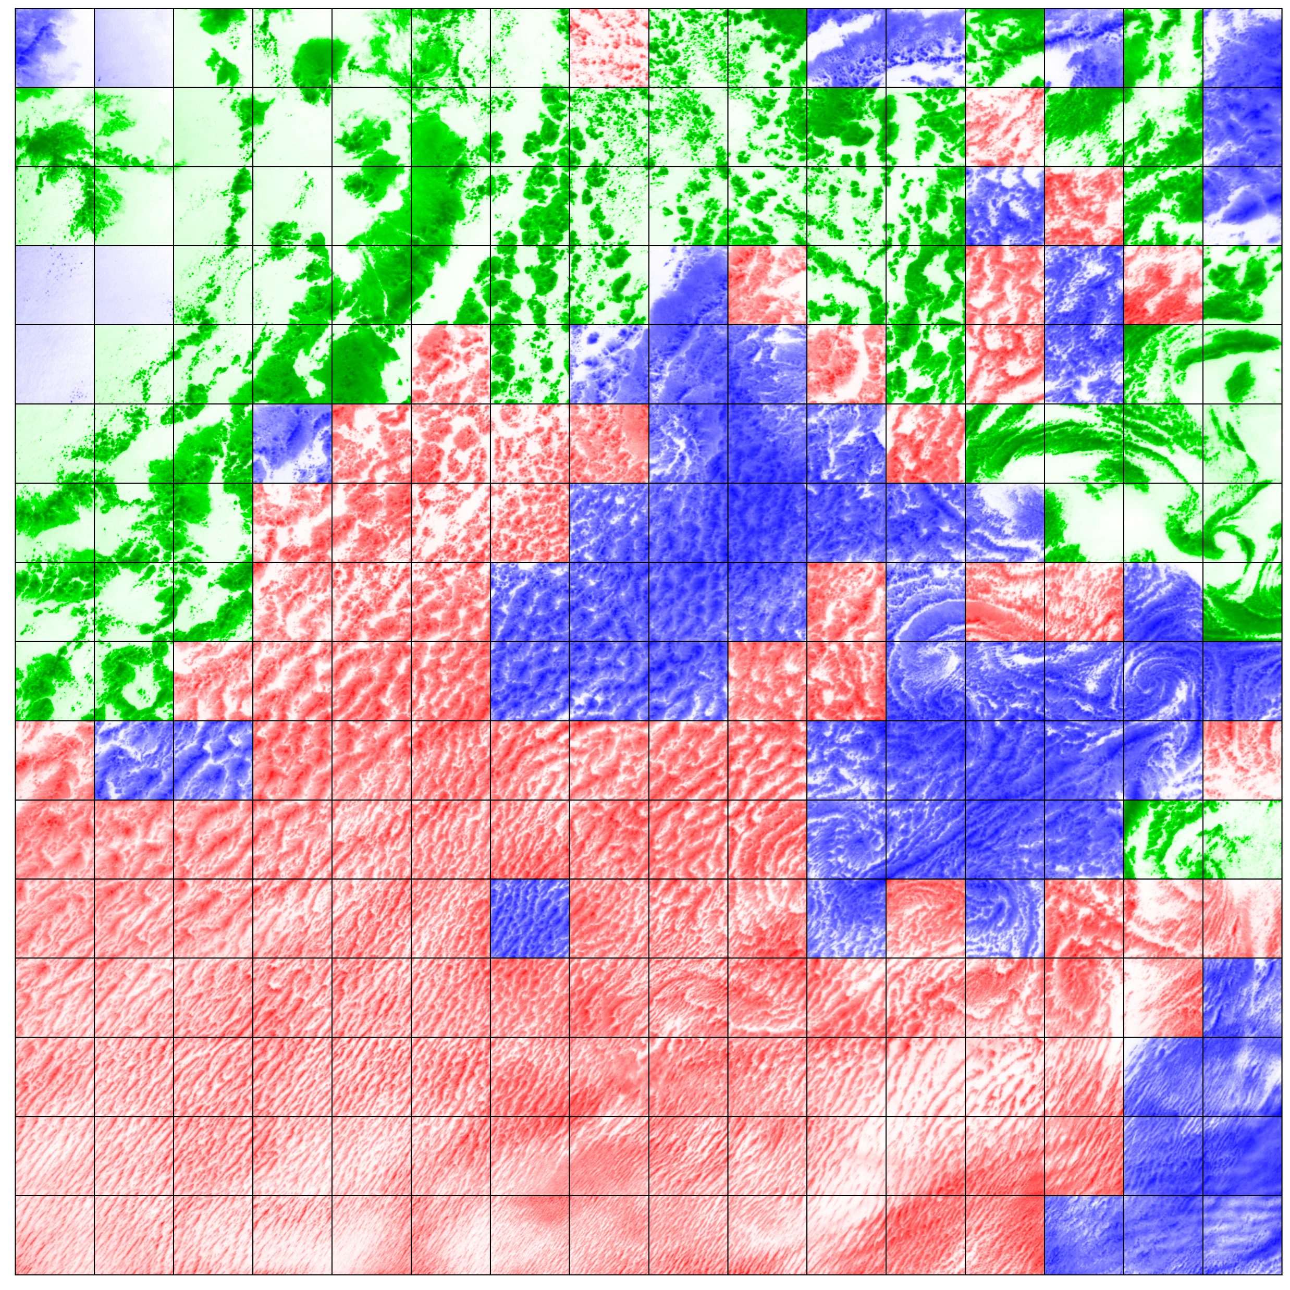
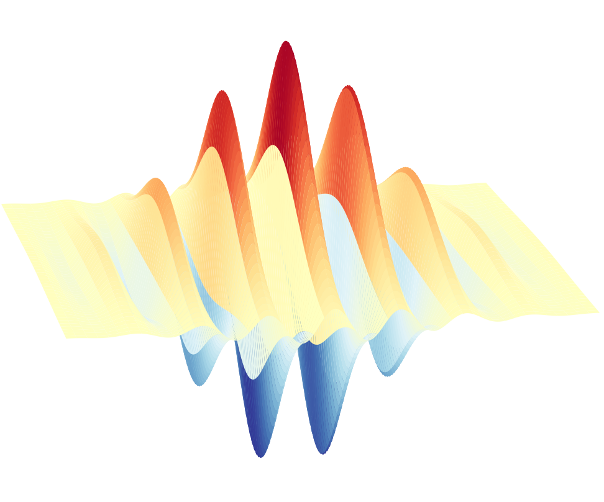

WOAST
Wavelet for Ocean Atmosphere Scattering Transform
What is this?
A Python package
What does it do ?
Computes WST statistics
Clouds Classification example
256 sub-pictures of 512 x 512 pixels
144 WST coefs./picture
Clustering based on WST coefs.
Compression factor $\sim 2000$

Slide 8



WOAST
Wavelet for Ocean Atmosphere Scattering Transform
What is this?
A Python package
What does it do ?
Computes WST statistics
Why use it ?
Made for Big Data geoscience

Slide 9
Thanks for listening

Slide 10








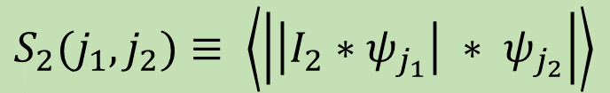





WST Formalism
Scattering operations form multi-layer network
Mean
$$I_{0}$$
$$S_{0}≡ \left\langle I_{0}\right\rangle$$
$${|I_{0}∗ψ}_{j_{1}}|$$
Spectrum (L¹-norm)
$$S_{1}(j_{1})≡ \left\langle \left|I_{1}∗ψ_{j_{1}}\right|\right\rangle$$
$$j_{1}≔$$
$$0$$
$$1$$
$$2$$
$$…$$
Modulation at j₂ of structures seen at j₁
$${||I∗ψ}_{j_{1}}|{∗ψ}_{j_{2}}|$$
$$S_{2}(j_{1},j_{2})≡ \left\langle \left|\left|I_{2}∗ψ_{j_{1}}\right| ∗ ψ_{j_{2}}\right|\right\rangle$$
$$j_{2}≔$$
$$0$$
$$1$$
$$2$$
$$1$$
$$2$$
$$3$$
$$2$$
$$3$$
$$4$$
Notes:
Pas expliquer ! Dire que formalisme maths existe

