Slide 1


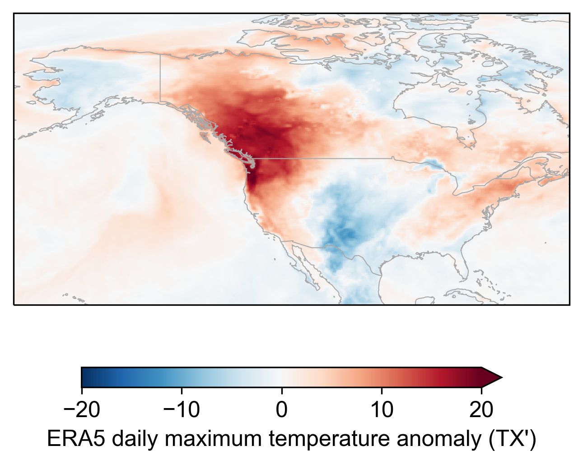
Drivers and Mechanisms of the
2021 Pacific Northwest heatwave
June 28, 2021
climatology: 1982–2008
Dominik L. Schumacher, Mathias Hauser, Sonia I. Seneviratne

Slide 2
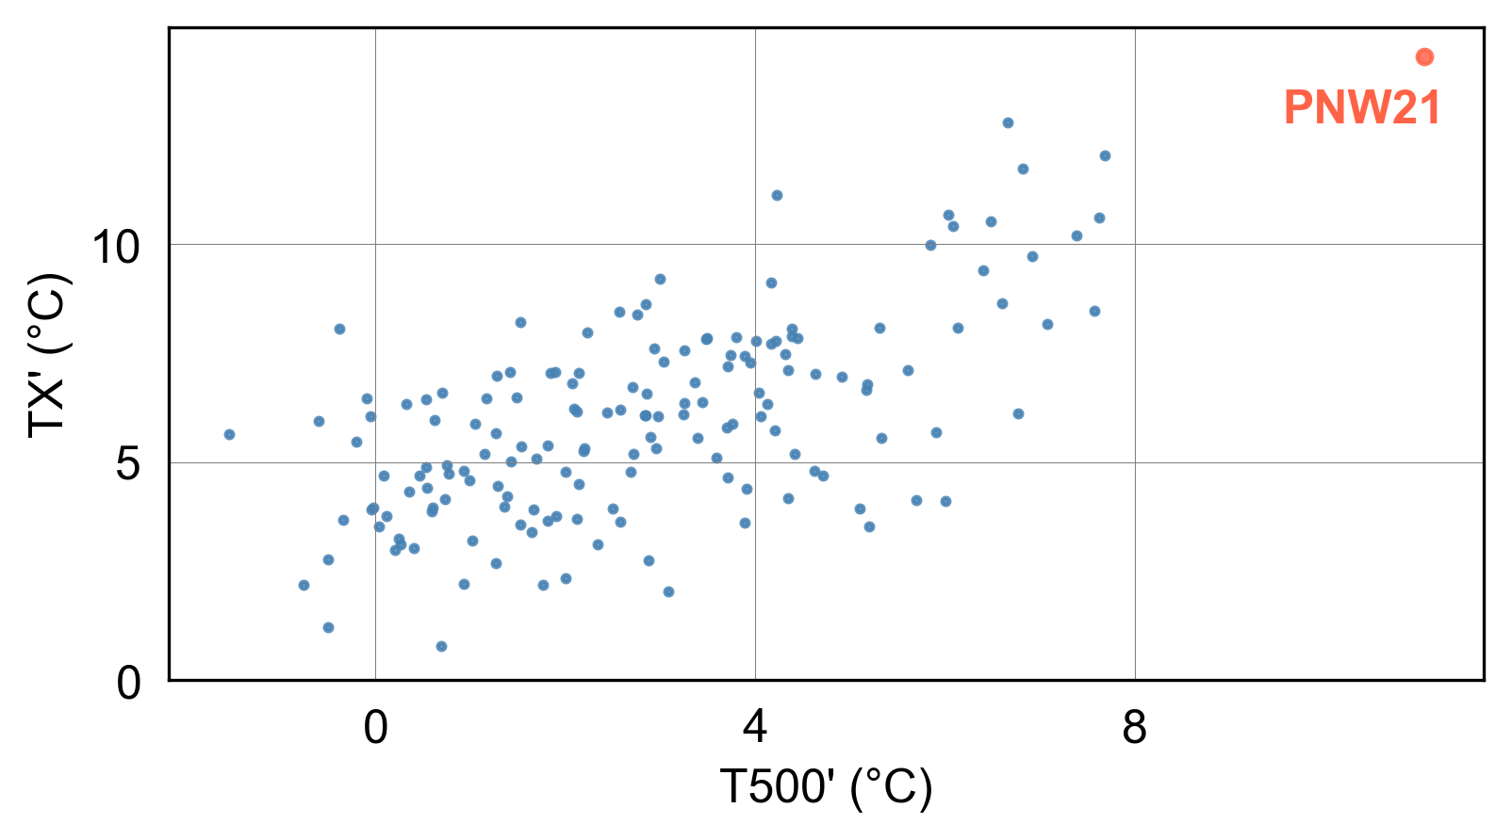
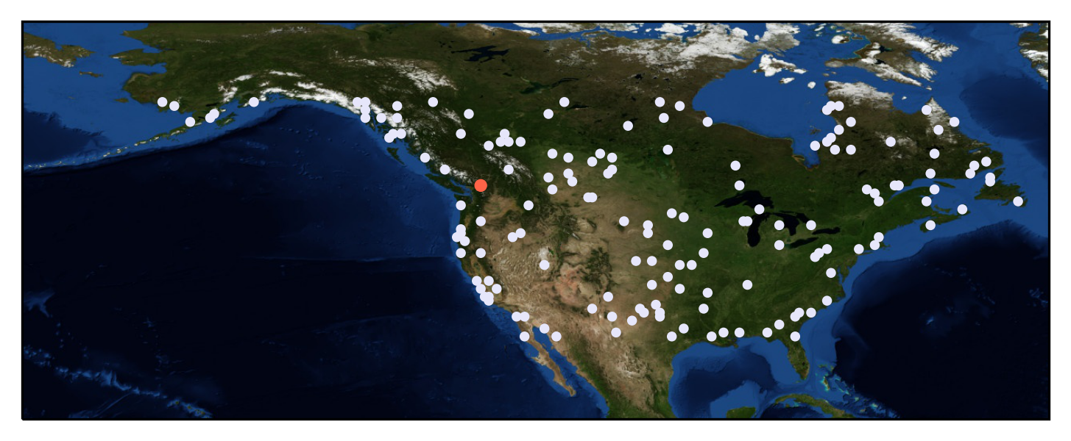
Comparing the 2021 PNW heatwave to other hot events
160 hot events: 4 per summer (JJA), 1982–2021
based on a 3° x 3° domain centered on each hot event,
averaged over the 5 days prior to (and including) ‘peak heat’
Showing only event centers;
based on ERA5 daily maximum temperature anomalies (TX')
Mean temperature at 500 hPa
(~ troposphere temperature)
Schumacher et al., in prep.

Slide 3
Comparing the 2021 PNW heatwave to other hot events
160 hot events: 4 per summer (JJA), 1982–2021
Showing only event centers;
based on ERA5 daily maximum temperature anomalies (TX')
extremely hot troposphere
Schumacher et al., in prep.

Slide 4
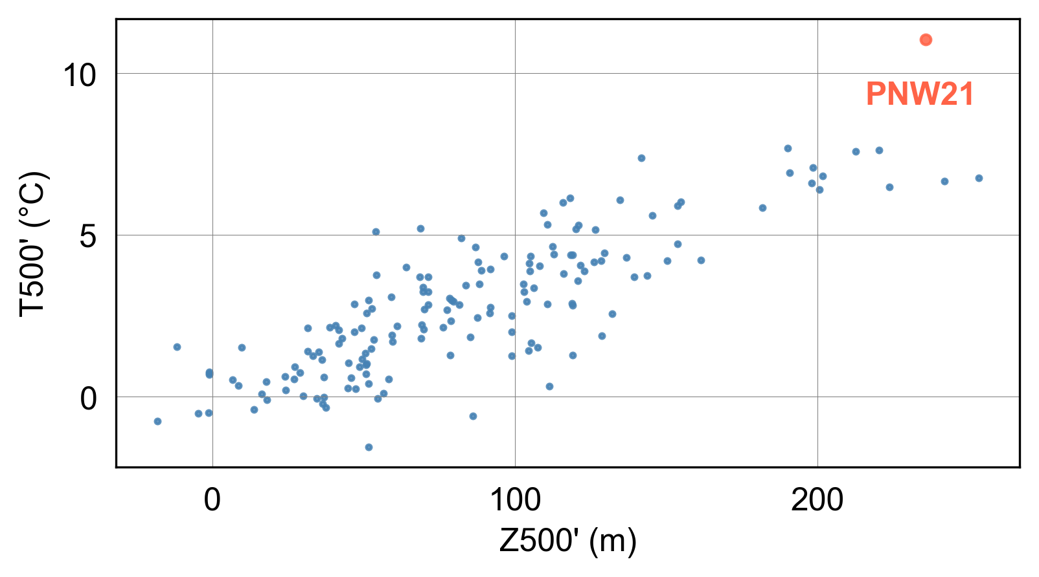
Anticyclonic circulation implies subsidence, and hence tropospheric heating
based on a 3° x 3° domain centered on each hot event,
averaged over the 5 days prior to (and including) ‘peak heat’
anticyclone intensity
Schumacher et al., in prep.

Slide 5
PNW21 — strong anticyclonic circulation, exceptional temperatures
The local circulation pattern only partly ‘explains’ the extreme tropospheric heat…
Schumacher et al., in prep.

Slide 6

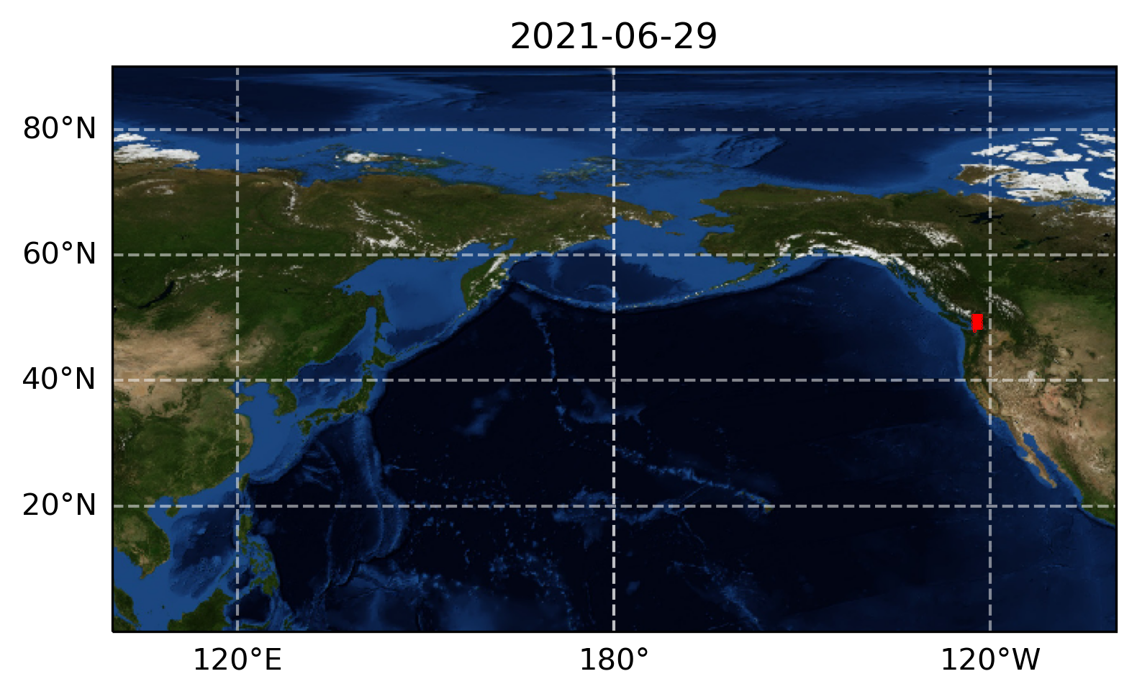
Tracking air over the heatwave region back in time
TRACMASS
powered by
ECMWF Reanalysis v5 (ERA5)
Schumacher et al., in prep.

Slide 7
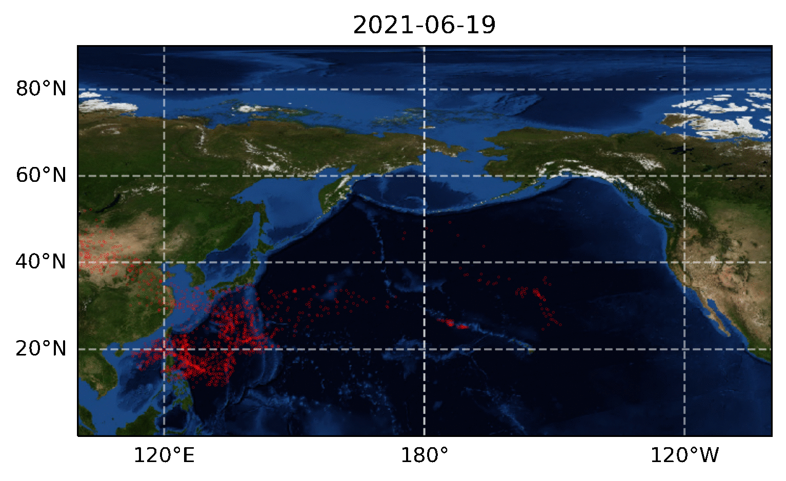
Tracking air over the heatwave region back in time
Schumacher et al., in prep.

Slide 8
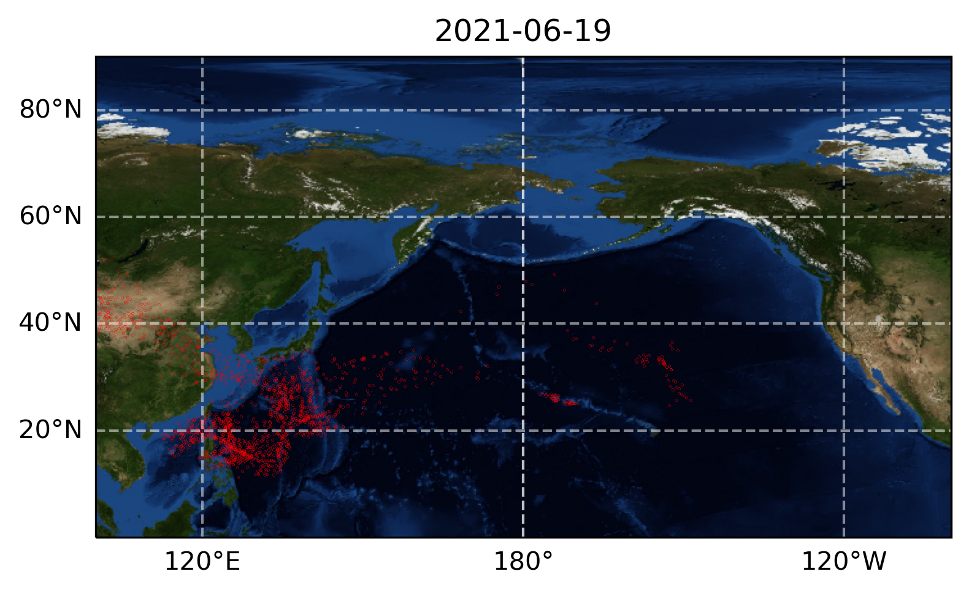
Conceptualizing 10-day diabatic heating budgets of hot events
Net diabatic temperature change
Δ𝜃_{net}
Final potential temperature, 𝜃_{fin}
Initial potential temperature, 𝜃_{ini}
‘en route’
Schumacher et al., in prep.
Notes:
Tropical West Pacific: T not *that* high… but humid!

Slide 9
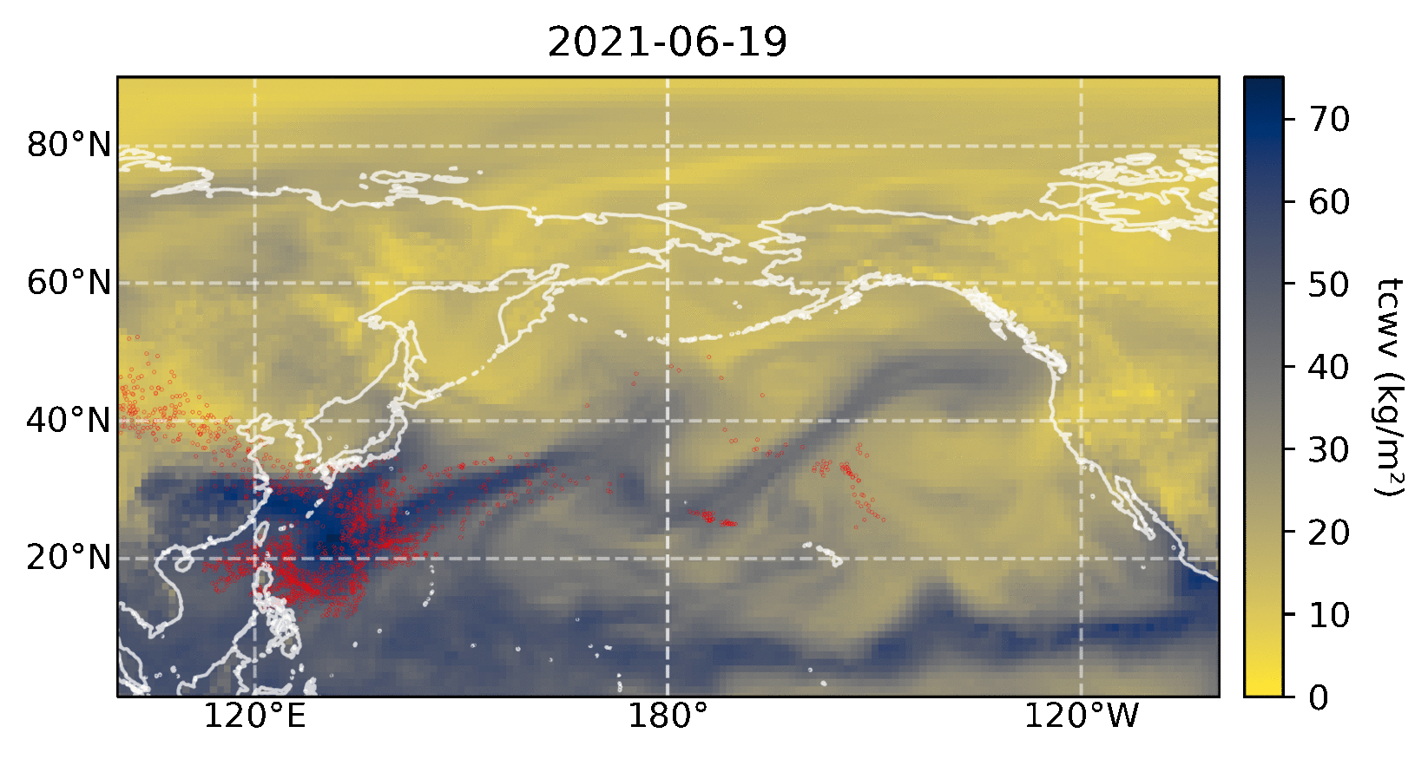
Large amounts of air over the PNW21 heatwave region were previously part of
a pronounced moisture filament
ERA5
Schumacher et al., in prep.
Notes:
Map shows total column water vapor (from ERA5)
Dark, blue colors indicate high moisture content; note air parcel positions

Slide 10
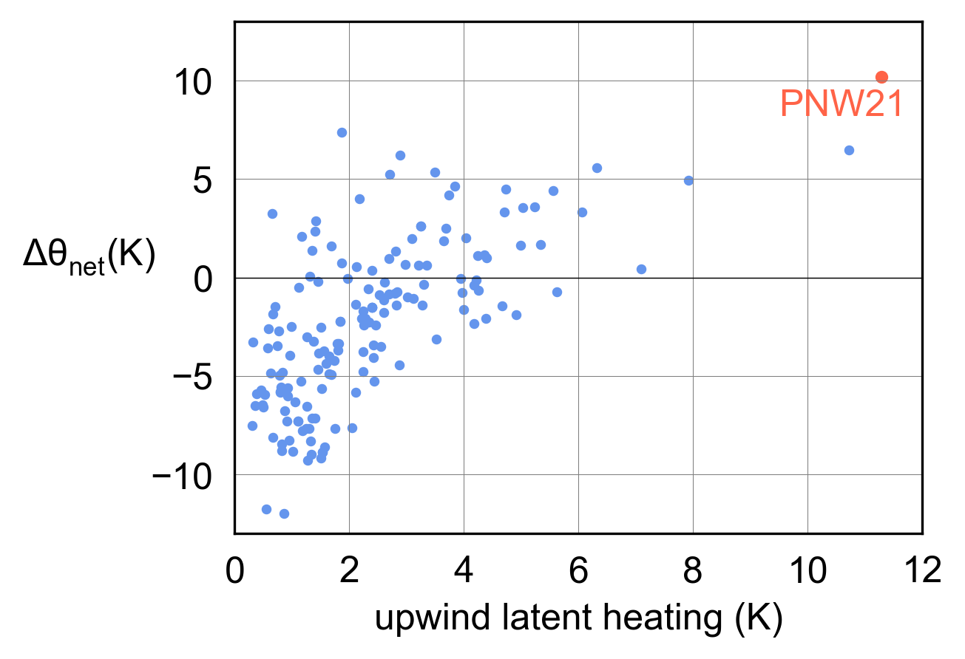
Exceptional upwind latent heating contributed to the
hot troposphere over the PNW21 heatwave region
To diagnose latent heating based on 6-hourly air parcel property changes, we require
a high relative humidity,
a decrease in specific humidity,
increasing potential temperature

Slide 11
Summary & conclusion
Over the Pacific Ocean, air that would later become part of the anticyclone was heated by condensation — more intensely than for any other recent hot extreme in North America since 1982
The strong atmospheric blocking over the Pacific Northwest enabled adiabatic heating, resulting in ‘downwelling heat’
Surface heating was facilitated by dry soils, and resulted in deep atmospheric boundary layers; essentially tapping far into the ‘tropospheric heat’ reservoir
⇒ more analyses & details in the publication (in prep.)!
For the future, we expect a growing potential for upwind latent heating to exacerbate downwind heatwave temperatures,
as a warmer atmosphere absorbs more moisture (Clausius–Clapeyron),
hence ascending air streams — which tend to rain out virtually all of their initial moisture — will experience stronger latent heating…
Schumacher et al., in prep.
Notes:
Inverse order for future (expectation last)

Slide 12
References
Döös, K., B. Jönsson, and J. Kjellsson (2017). Evaluation of oceanic and atmospheric trajectory schemes in the TRACMASS trajectory model v6.0, Geosci. Model Dev. 10, 1733–1749, doi:10.5194/gmd-10-1733-2017.
Hersbach, H. et al. (2020). The ERA5 global reanalysis. Q. J. R. Meteorol. Soc. 146, 1999–2049, doi:10.1002/qj.3803
Jönsson, B., K. Döös, and J. Kjellsson (2015). TRACMASS: Lagrangian trajectory code, doi:10.5281/zenodo.34157

