Slide 1

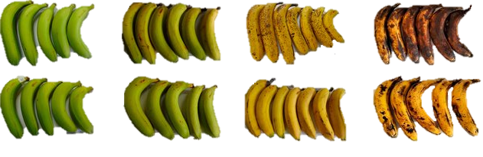


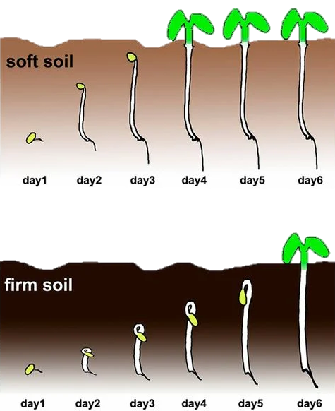
What influences
the occurrence of
the phytohormone…
..in forest soils?
source: Peninah et al. 2021
Spotting C₂H₄ in forest soils
₁Verena Lang | Veronika Schneider | ₁Alexander Schengel |
₂Jürgen Schäffer | ₃Helmer Schack-Kirchner | ₁Martin Maier
₁Forest Research Institute Baden-Württemberg (FVA), Wonnhalde 4, 79100 Freiburg, Germany
₂ Chair of Soil Science and Site Ecology, University of Applied Forest Sciences Rottenburg, 72108 Rottenburg, Germany
₃ Institute of Soil Science and Forest Nutrition, University of Freiburg, 79085 Freiburg, Germany
source: Zhong et al. 2014

Slide 2
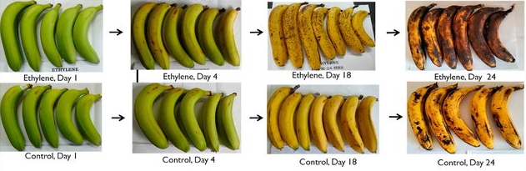

Short Introduction: What is ethylene (C₂H₄)
gaseous and reactive
known as a phytohormone: controls the process of fruit ripening & senescence
source: Peninah et al. 2021
plants produce C₂H₄, microorganisms and fungi are also capable to degrade it
indicator for soil biological processes → „stress hormone“
occurrence & concentrations depend on various soil physical and chemical properties
Little knowledge about occurrence of C₂H₄ in soils
Most studies conducted in the laboratory
source: Zhong et al. 2014
EGU 2022 - SSS8.3 – Soil gases / Verena Lang / Forest Research Institute
Notes:
Ethylene is probably best known as a plant hormone that controls fruit maturity and senescence. Plants produce ethylene in the soil, and microorganisms and fungi can additionally degrade it. Soil ecology studies on ethylene focus primarily on plant development. The occurrence and concentration are determined by various soil physical and soil chemical factors. Ethylene is also considered a stress hormone and thus can cause morphogenetic changes in seedlings in dense soils, for example.
Most knowledge about ethylene occurrences in soils comes from studies conducted in the 1970s until the 1990s and is primarily focused on laboratory experiments.

Slide 3
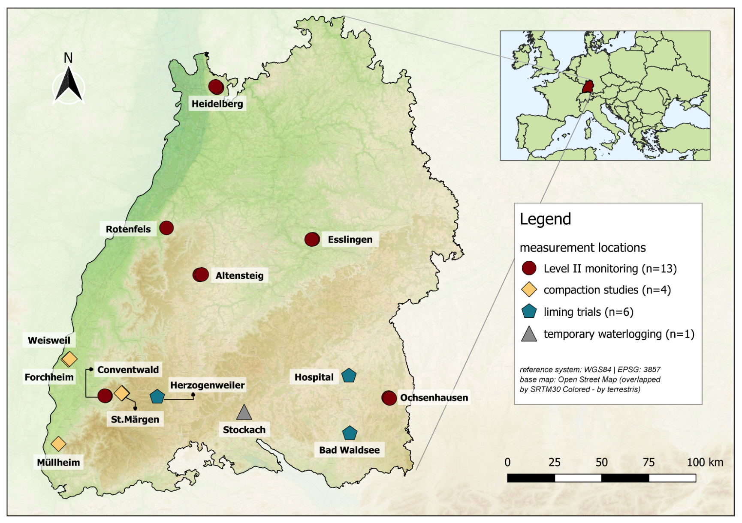
Study sites
Evaluation of ethylene occurrence using long-term soil gas data from temperate forest soils.
long-term measurements
series up to 22 years
24 surfaces
data from 1994 to 2021
EGU 2022 - SSS8.3 – Soil gases / Verena Lang / Forest Research Institute
Notes:
Therefore, the objective of this study was to comprehensively investigate ethylene occurrence in temperate forest soils based on soil gas studies over the past 30 years, finding out under what conditions ethylene can be detected.
Geographically, we are located in southwestern Germany. Soil gas time series of up to 22 years are mainly from areas of the forest environmental monitoring of the ICP Level II monitoring network. Project studies on soil compaction, liming and water saturation complement these data. In all, soil gas data are available from 24 plots from 1994 till 2021.

Slide 4
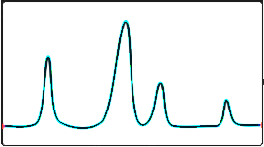
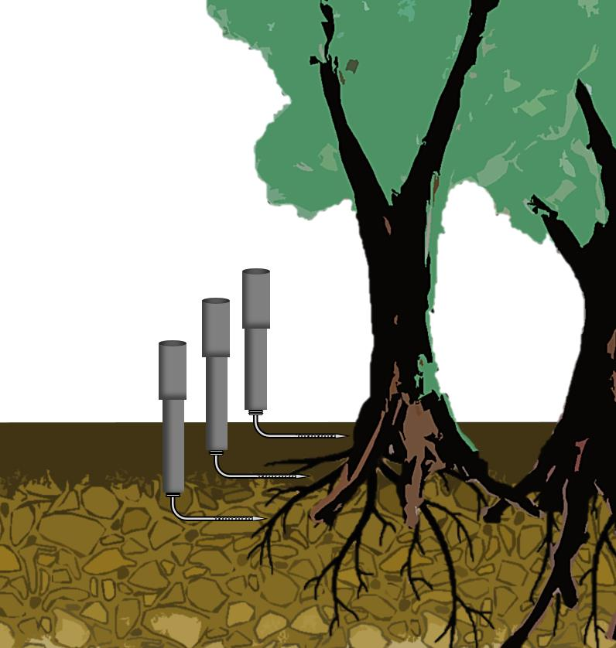
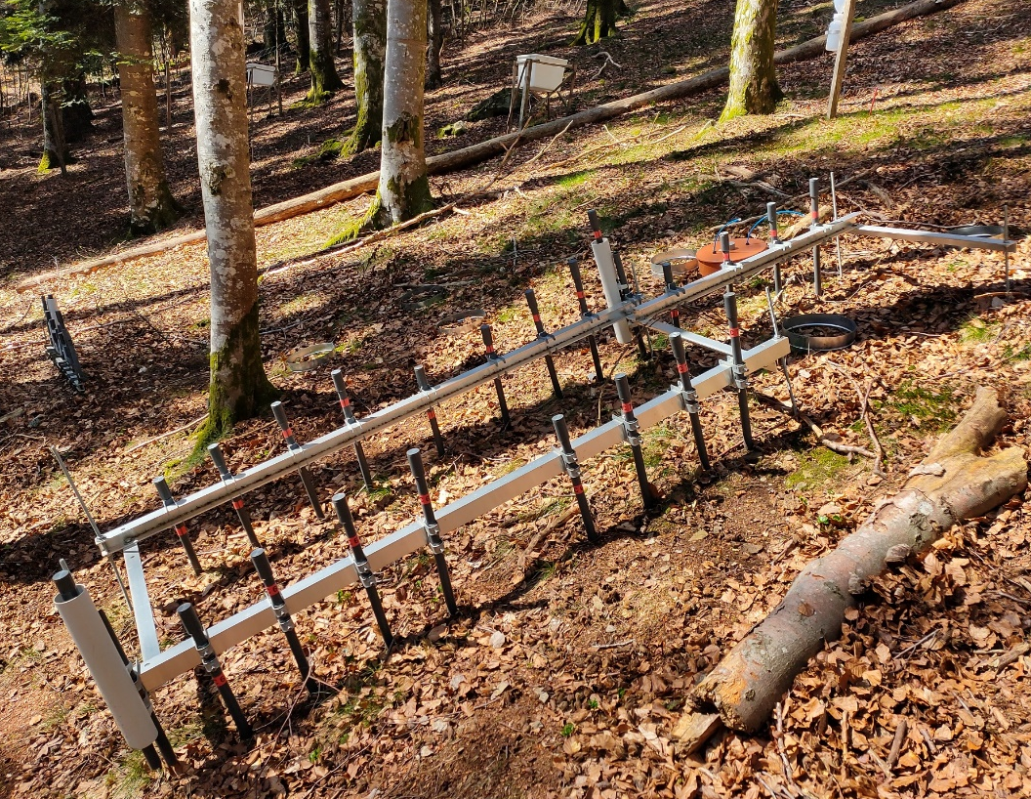

Method of soil gas sampling
O₂
N₂
Ar
Cap
CH₄
developed by Schack-Kirchner et al. (1993).
passive method of gas sampling
O₂
N₂
C₂H₄
CO₂
N₂
N₂O
PVC pipe
First presentation of our long-term measurement routine
+ fluxes CO₂ / O₂ / N₂O and CH₄
Holder for vial
Gas vial
Cannula
Perforated sampling pipe
(stainless steel)
Source according to: Maier et al. (2020): Long Term Soil Gas Monitoring as Tool to Understand Soil Processes.
EGU 2022 - SSS8.3 – Soil gases / Verena Lang / Forest Research Institute
Notes:
Soil gas is collected by passive gas collectors developed by Schack-Kirchner et al that were installed on the plots at various soil depths. The analysis of the soil gas concentrations was done in a min. 4-week rhythm using a gas chromatograph, which determines mass and greenhouse gases and just also, if present in sufficient quantities, ethylene. For those who are interested in more data from our long-term measurements, we recommend the paper by Maier et al 2020, in which our measurement routine and fluxes of other gases are presented in more detail.

Slide 5

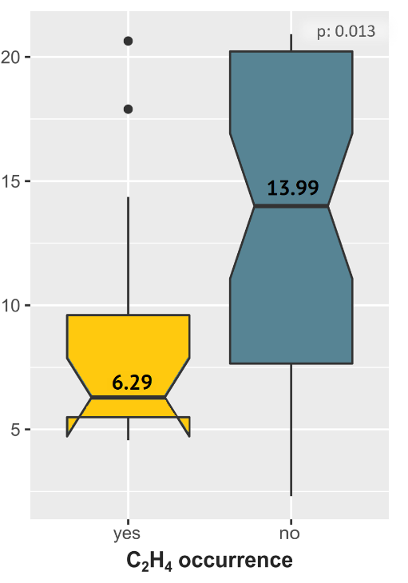
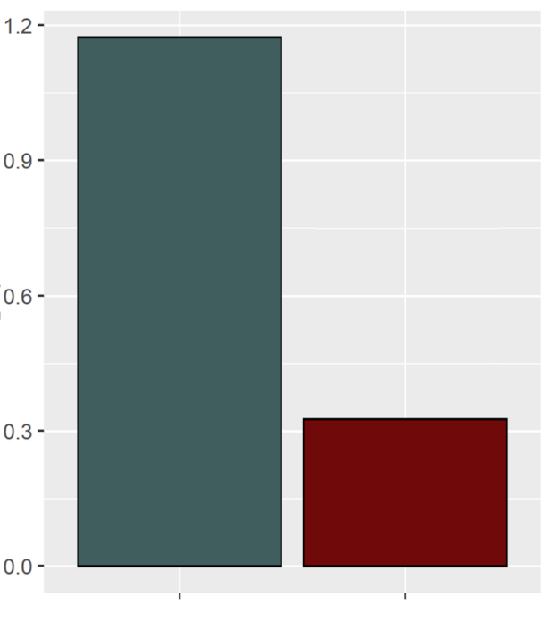




Results
96 % zero Measurements + values below limit of detection / quantification
confirmation of patterns known from laboratory experiments
ethylene potentially found at all sites
no temporal pattern –rather cluster in hot moments
compacted
waterlogged
undisturbed
spruce:
n: 153 / 13036
1.17 %
median: 0.81 ppm
n: 841 / 5703
14.75 %
median: 0.11 ppm
C₂H₄ occurence [%]
C₂H₄ [ppm]
O₂ [Vol%]
5 x
1 x
beech
n: 27 / 8278
0.33 %
median: 0.34 ppm
4 x
6 x
n: 262 / 3768
6.95 %
median: 0.04 ppm
spruce
beech
compaction influences occurrence and quality of C₂H₄
low O₂ content leads to accumulation of C₂H₄
low occurence of C₂H₄
tree species effect: more frequent occurrence of C₂H₄ under spruce trees.
EGU 2022 - SSS8.3 – Soil gases / Verena Lang / Forest Research Institute
Notes:
Before I present the results, the challenging data basis should be mentioned. The examined data sets have a very high number of zero measurements as well as measured values below the limit of detection or the limit of quantification. Thus, the extensive field measurements confirm the patterns known from laboratory studies and show that ethylene is potentially found at all sites and that the occurrence is not subject to a regular temporal pattern, but rather cluster in hot moments.
The accumulation of ethylene in soil air could be observed significantly more frequently in artificial compacted soils than in well-aerated forest soils where accumulation and thus detection is more difficult. The temporarily waterlogged site showed the highest C2H4 occurrence frequency with almost 27 %. In addition, an oxygen effect could be detected here. Low O2 levels favor the accumulation of ethylene in the soil.
In unaffected forest soils, ethylene occurs only very rarely. In addition, a tree species effect could be observed. Ethylene is measured far more frequently under spruce than under beech trees. This effect is not only evident in an overall view, but also in a pairwise comparison, in most areas of the same site usually the same soil but with different vegetation type. The reason for this difference is still unclear - but it is probably due to microbial differences rather than root densities.

Slide 6



THANKS!
Contact and further Information
Verena.Lang@forst.bwl.de
Martin.Maier@forst.bwl.de
https://www.fva-bw.de
FKZ: 2218WK58X4

Slide 7
Dealing with the "challenging" data situation?
data | All data | Zero values | > 0 and < LOD (> 0 and < 0.036) | ≥ LOD and < LOQ ≥ 0.036 and < 0.12) | ≥ LOQ (≥ 0.12)
Total number of measurements | 50922 | 49212 | 381 | 614 | 715
Share of measurements in total data set | 100 % | 96.64 % | 0.75 % | 1.21 % | 1.40 %
 | Total number of measurements > 0 ppm |  | 1710 (3.36 % of total data set)
 | Share of class in ethylene measurements > 0 ppm |  | 22.28 % | 35.91 % | 41.81 %
2 major challenges:
Very large number of zero measurements.
A high proportion of "censored data" among C₂H₄ measurements > 0 ppm (almost 60% of measurements are below the limit of detection (LOD), or below the limit of quantification (LOQ).
EGU 2022 - SSS8.3 – Soil gases / Verena Lang / Forest Research Institute

Slide 8

Choice of statistical methods
Development of different statistical methods:
Classification of the data set into 2 categories: "ethylene measurements" (C₂H₄ > 0 ppm) and "no ethylene measurements" (C₂H₄ = 0 ppm).
Further classification of measurements into corresponding C₂H₄ classes ( "0", "> 0 < LOD", " ≥ LOD < LOQ", " ≥ LOQ < 1", "≥1").
Performing non-parametric regression analyses.
Calculate the median and mean for C₂H₄ measurements > 0 ppm using the Maximum Likelihood Estimation (MLE) approach.
Perform linear regressions to predict C₂H₄ -occurrence given covariates.
EGU 2022 - SSS8.3 – Soil gases / Verena Lang / Forest Research Institute

Slide 9

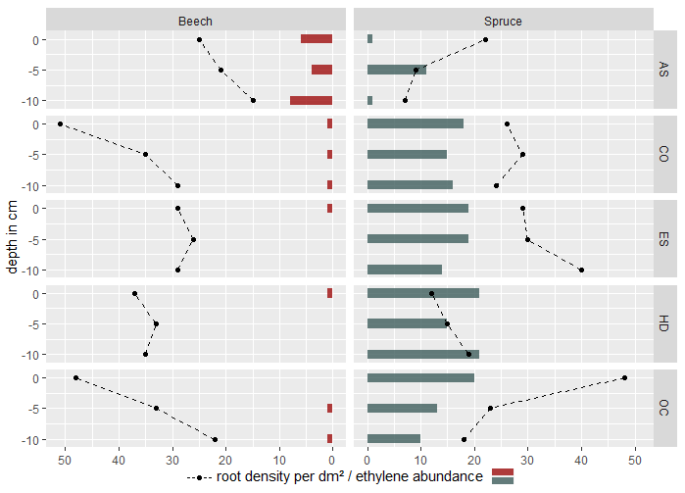
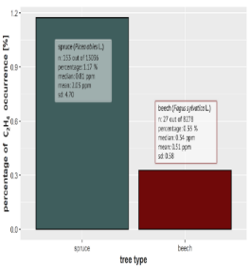

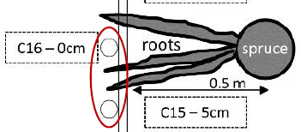
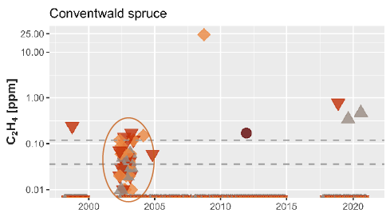
Root profile and ethylene occurence?
tree type effect?
EGU 2022 - SSS8.3 – Soil gases / Verena Lang / Forest Research Institute
Notes:
How can this tree species effect be explained? First of all, during the time series observation of the individual plots, certain gas samplers often became noticeable at which ethylene could be measured particularly frequently. When compared with location sketches made when the gas collectors were installed, most of these conspicuous gas samplers were located in the direct area of influence of a root registered at that time. This was exclusively the case on spruce areas. We then investigated in more detail the relationship between rooting intensity and ethylene occurrence. Pairwise comparison of the two plots of one site showed in 4 out of 5 cases a significantly higher ethylene concentration and abundance under spruce than under beech at the same and in some cases even lower root density. The tree species effect is therefore less explainable by the root profile than probably by microbial differences.

