Slide 1
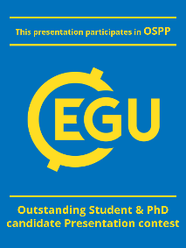
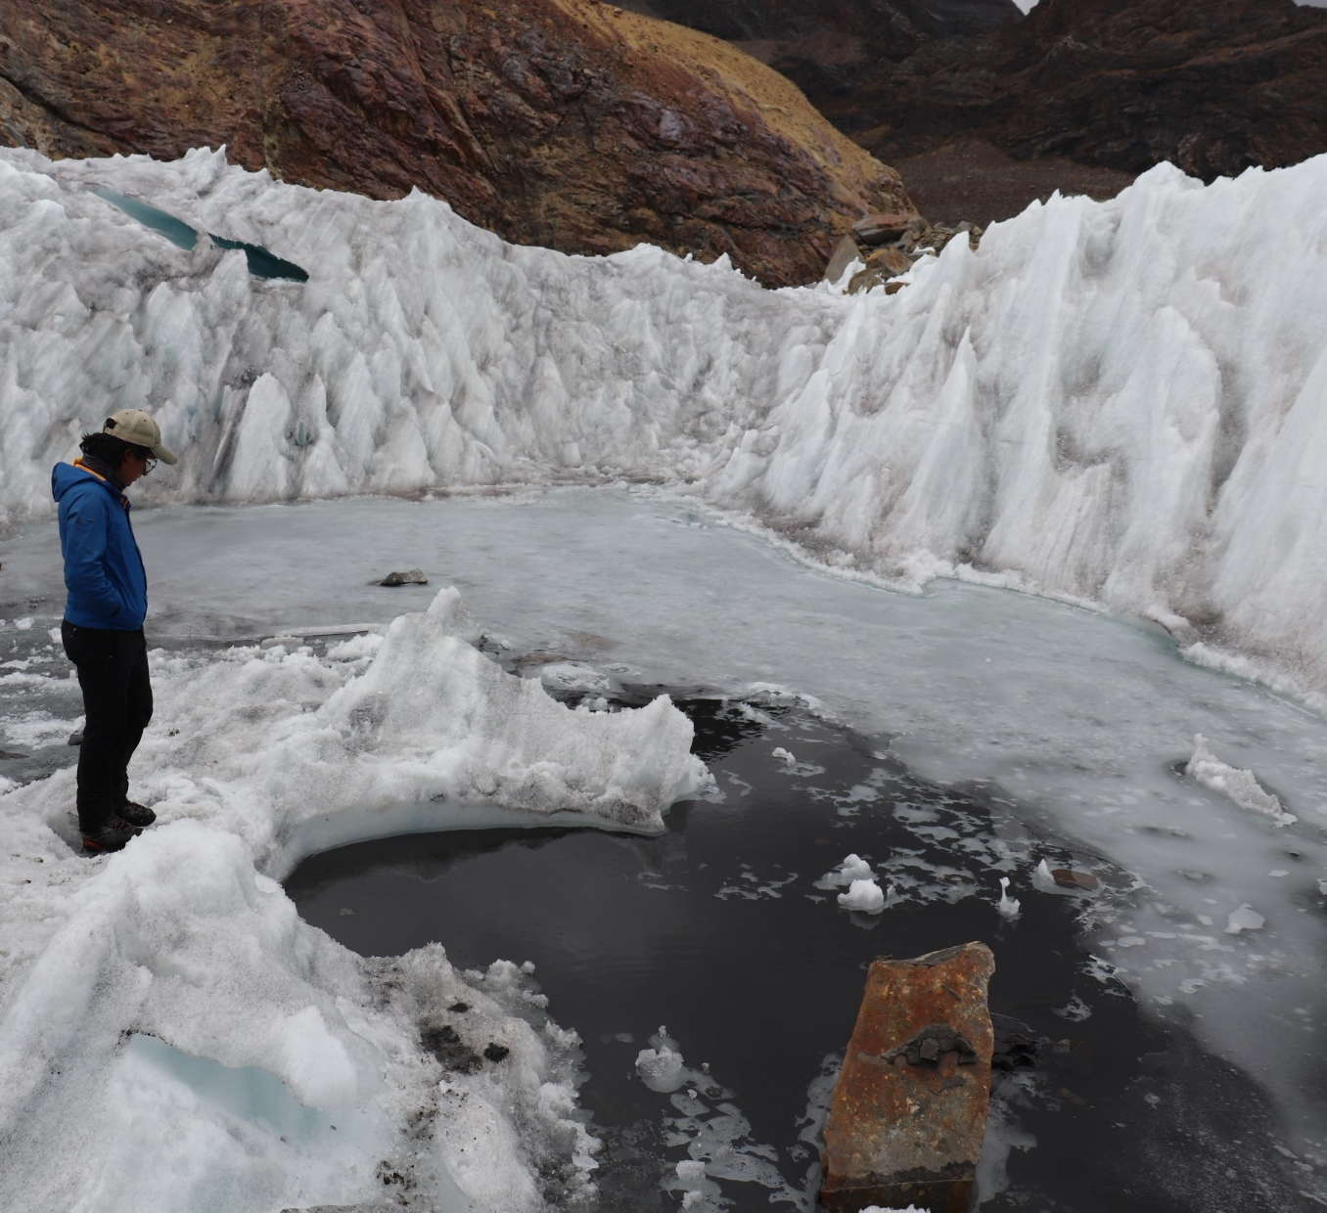
Title Slide
Catchment scale variation of contaminants in glacial sediments
from the Cordillera Blanca, Peru
Dylan B. Beard¹, Caroline Clason¹, Sally Rangecroft^{1,2}, Wilmer Sánchez Rodríguez³, and William Blake¹
¹School of Geography, Earth and Environmental Sciences, University of Plymouth, Plymouth, U.K.
²School of Geography, College of Life and Environmental Sciences, University of Exeter, Exeter, U.K.
³Universidad Nacional Santiago Antunez de Mayolo (UNASAM), Huaraz, Ancash, Peru

Slide 2
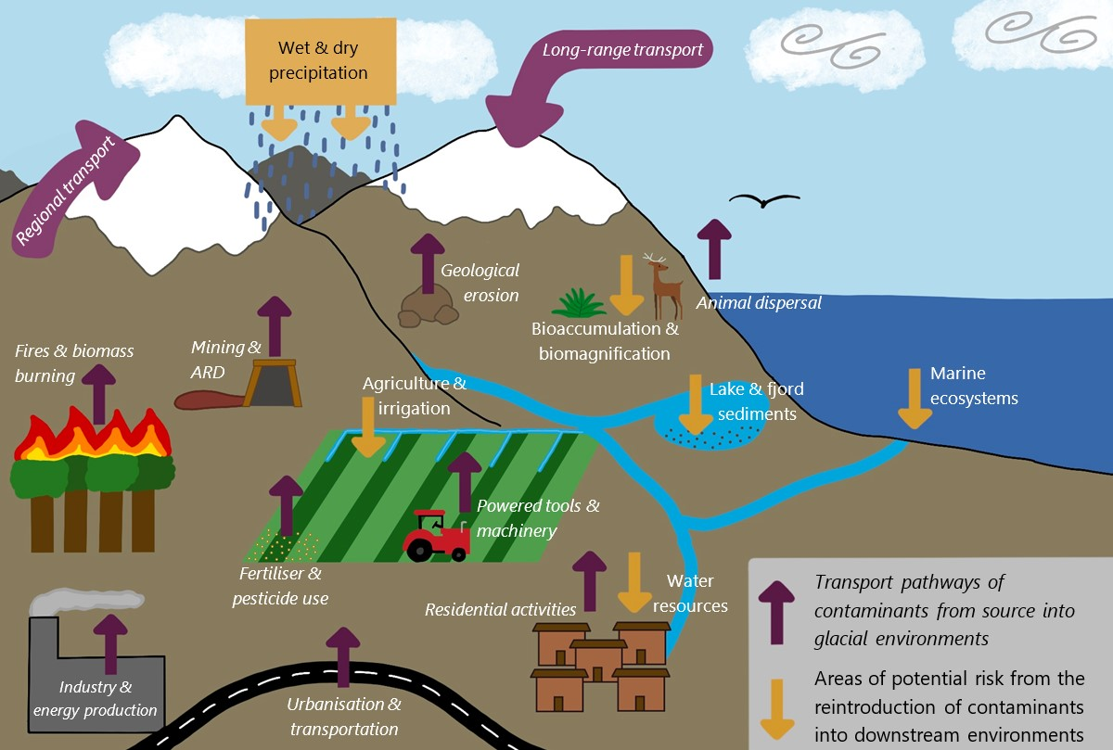
Background
Background
(Beard et al., Accepted – Progress in Physical Geography)
Contaminants have been found in all glaciers around the world
They are largely released through anthropogenic activities and are likely to increase in the future
Contaminant types and amount varies dependant on geographical location, precipitation levels and distance from source
They have the potential to impact plants, animals and humans downstream once released into meltwater

Slide 3
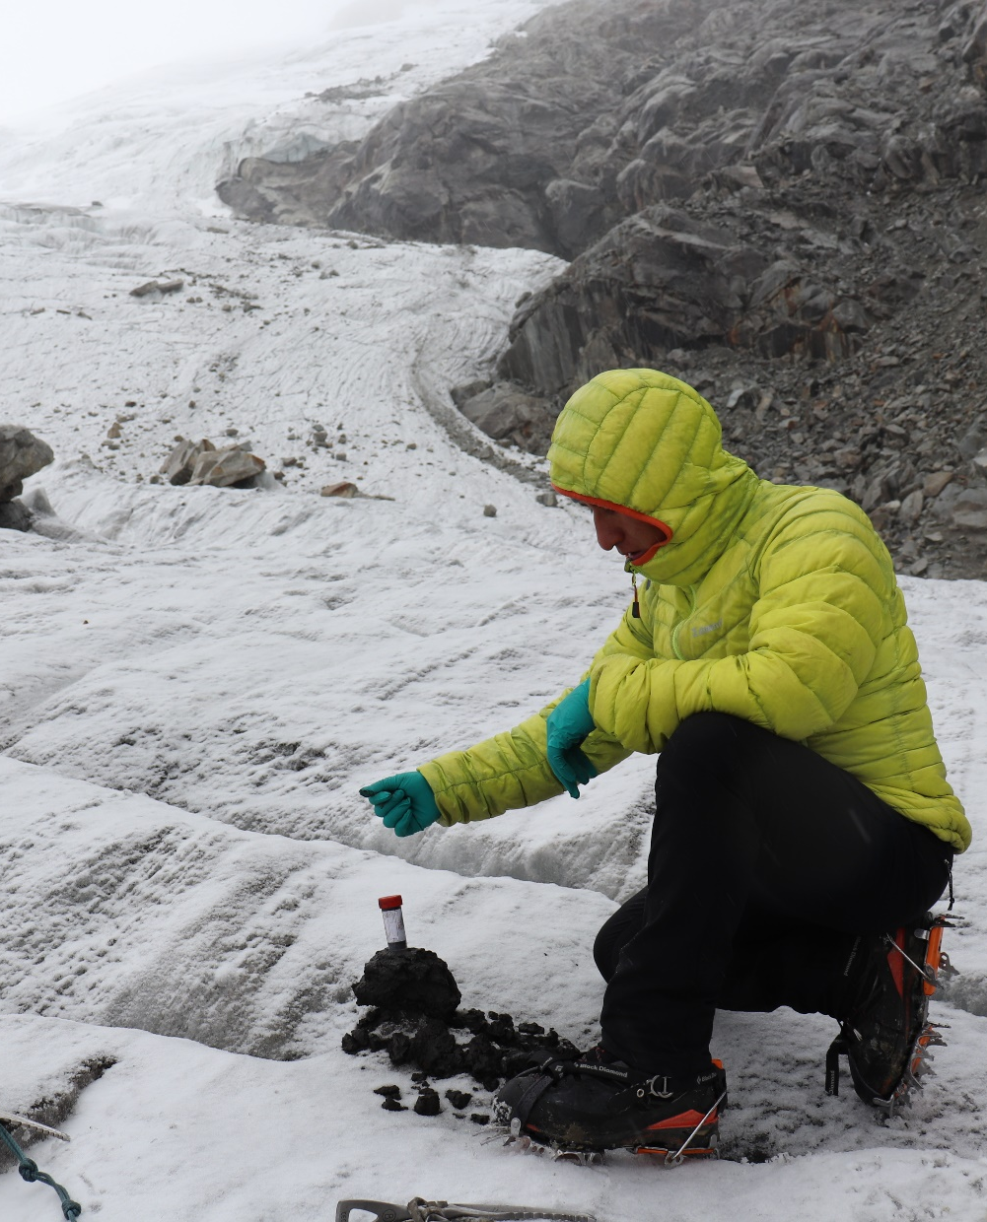
Aim and research questions
Aim and research questions
Aim: To determine the variation of contaminant (fallout radionuclide and potentially toxic element) loads from glacier sediments at both glacier and catchment scales within the Corderilla Blanca, Peru
Questions
Do fallout radionuclide and potentially toxic element loads vary between glaciers in the Corderilla Blanca?
Do these contaminant loads vary between samples taken from the same glacier?
How mobile are these contaminant loads and do they vary between different glaciers?
Is there a relationship between the organic content of glacial sediment and the quantity and/or mobility of the contaminants?

Slide 4
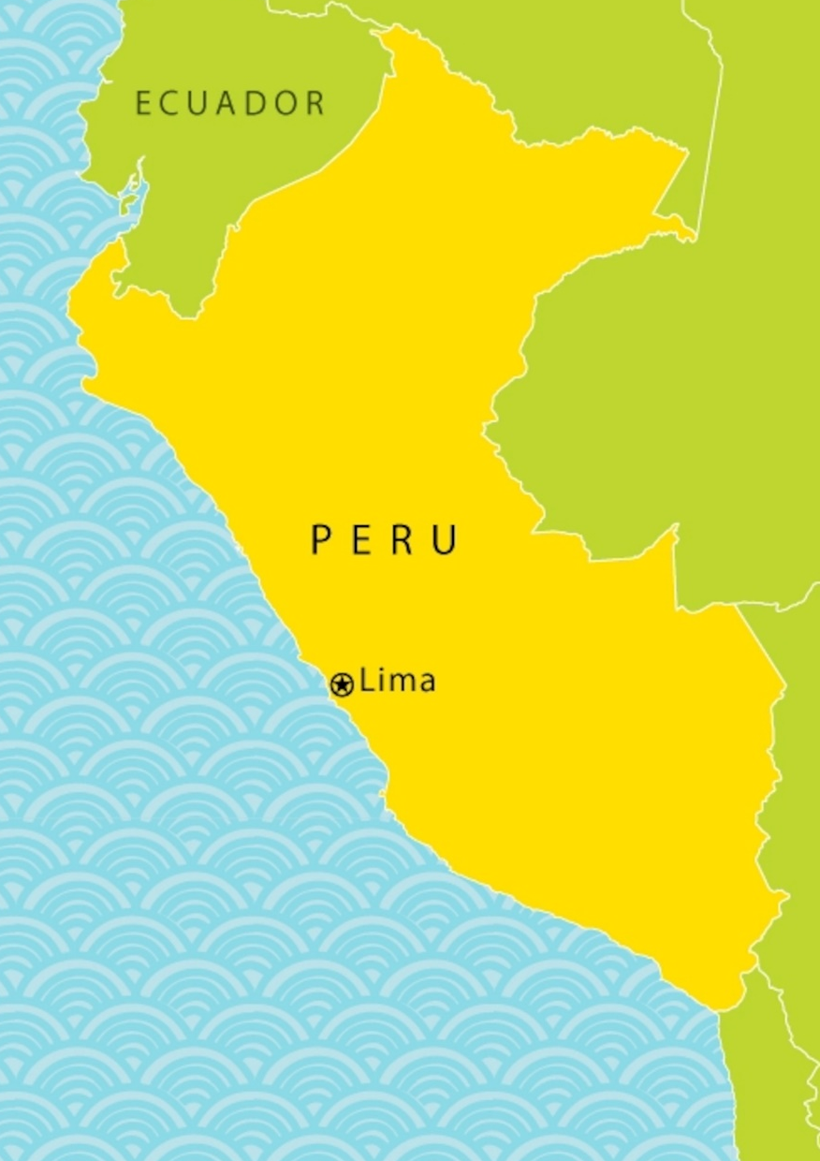
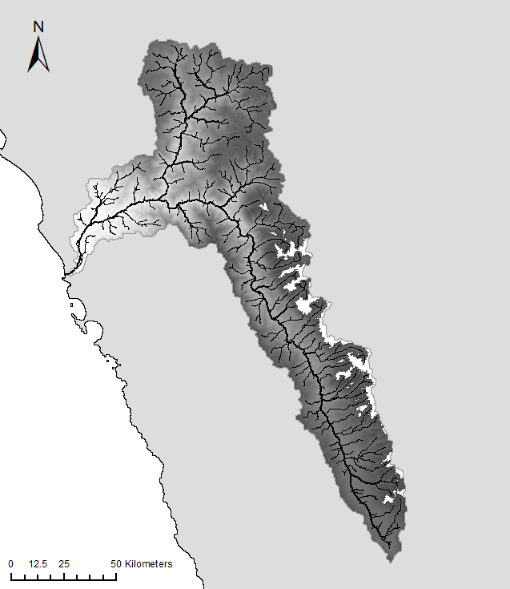

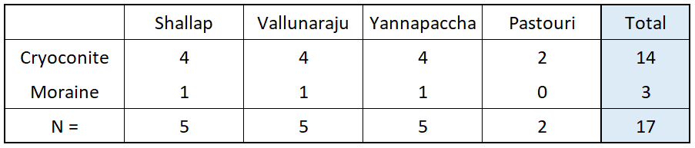

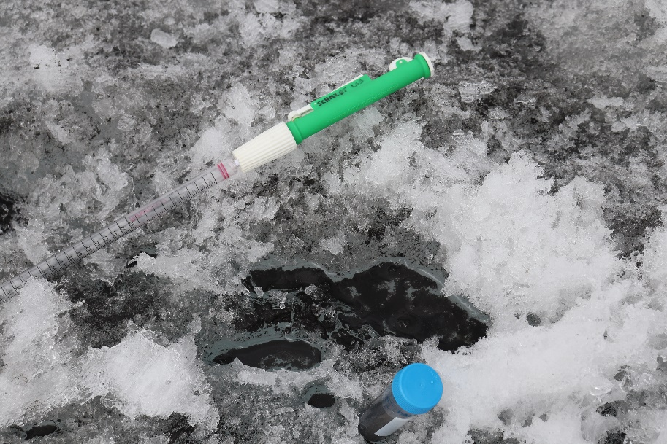
Sample locations
Sample Locations
The Rio Santa Catchment
Sample Collection
PERU
17 samples collected between October and December 2020 in the Corderilla Blanca, by Wilmer Sánchez Rodríguez
Yanapaccha
Cryoconite hole on Pastoruri glacier (Rodríguez, 2020)
Lima
Cordillera Blanca
Cordillera Negra
Vallunaraju
Shallap
Huaraz
Pastoruri
Cryoconite = windblown sediment found on glacier surfaces and in water filled holes

Slide 5
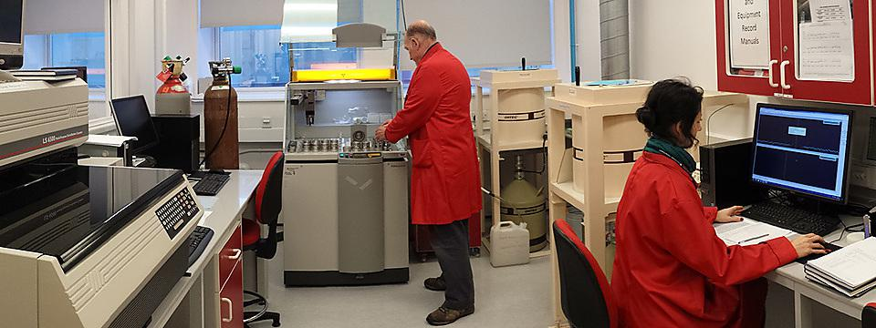

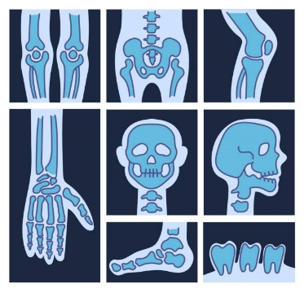
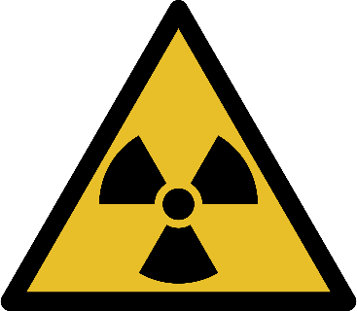

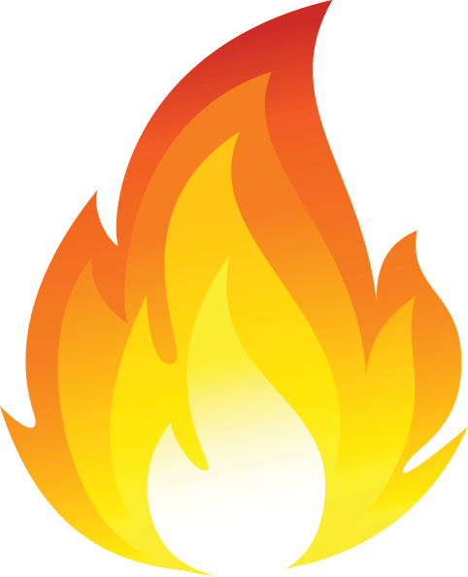
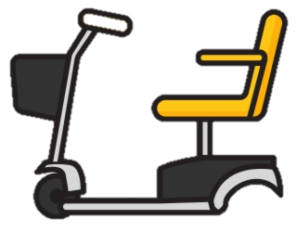
Methods
Methods
Sample Analysis
Samples were analysed at the Consolidated Radio-isotope Facility (CORIF), University of Plymouth, U.K.
Analytical Methods
In-progress
Coming soon!
Gamma spectroscopy for FRN activity
XRF for elemental composition
ICP-MS and ICP-OES for element mobility
LOI for organic content

Slide 6
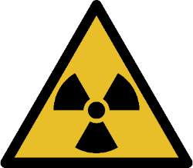
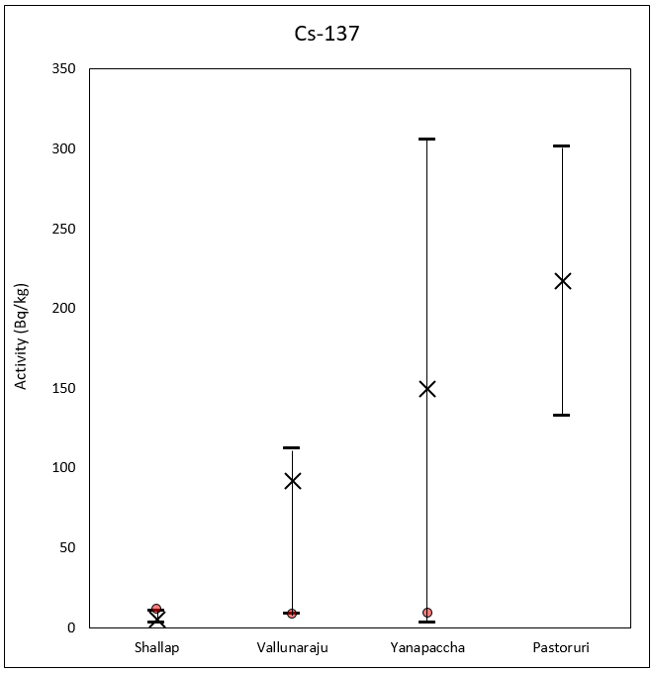
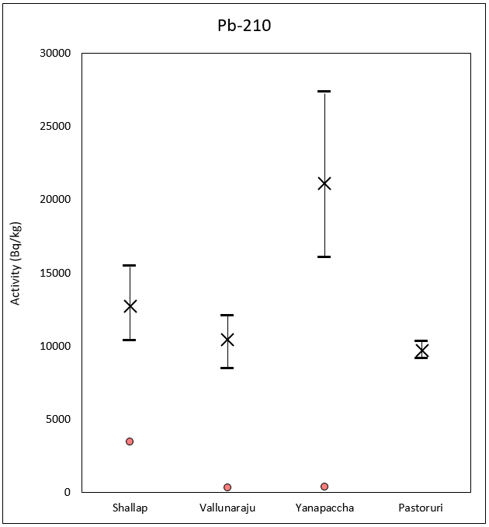
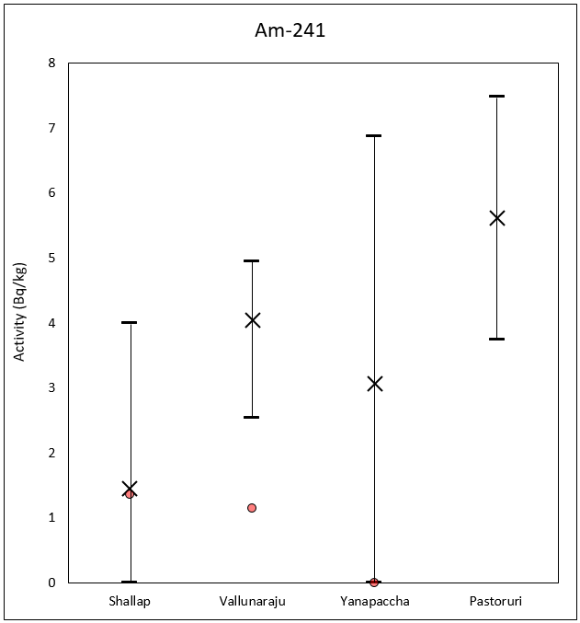

Fallout Radionuclide Activity
Fallout Radionuclide Activity
Moraine Sample
Cryoconite range: 2.7 – 305.7 Bq Kg⁻¹
Moraine range: 8.3 – 11.3 Bq Kg⁻¹
WHO*: 10 Bq L⁻¹
Cryoconite range: 8430 – 27353 Bq Kg⁻¹
Moraine range: 314.8 - 3443 Bq Kg⁻¹
WHO*: 0.1 Bq L⁻¹
Cryoconite range: 0 - 7.5 Bq Kg⁻¹
Moraine range: 0 – 1.4 Bq Kg⁻¹
WHO*: 1 Bq L⁻¹
*World Health Organization (2018) Management of radioactivity in drinking-water

Slide 7
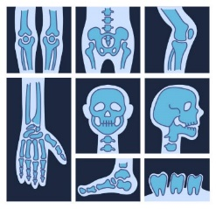
Elemental Composition of cryoconite (1/2)
Elemental Composition of cryoconite (1/2)
Larger compositional components are similar to each other
Smaller compositional components are more varied between cryoconite from different glaciers

Slide 8
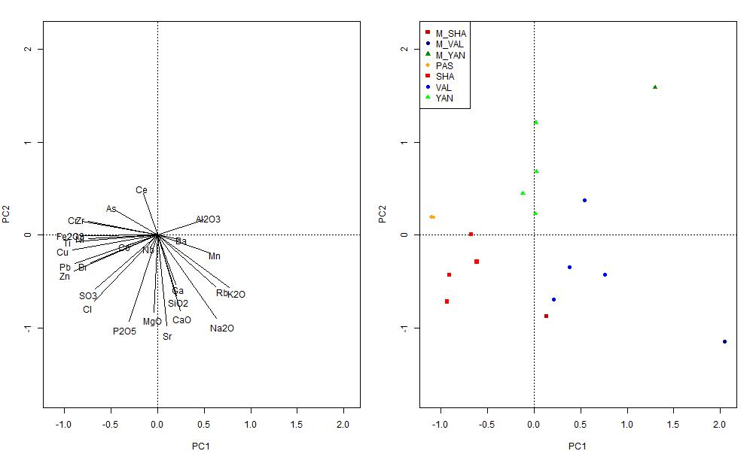
Elemental Composition of cryoconite (2/2)
Elemental Composition of cryoconite (2/2)
Cryoconite samples from all 4 glaciers are grouped and show similar differences in composition
Moraine samples are compositionally different to cryoconite samples from the same glacier
Moraine from Shallap shows similar composition to cryoconite from Vallunaraju
Yanapaccha
Moraine
Yanapaccha
Cryoconite
Pastoruri
Cryoconite
Vallunaraju
Cryoconite
Shallap
Cryoconite
Shallap
Moraine
Vallunaraju
Moraine
Cryoconite from different glaciers in the same region have different compositions

Slide 9
In progress: Element Mobility
In progress: Element Mobility
Stage 1 [of 4] extractions (0.5M acetic acid)
2900¹
1³
1³
123³
20000⁴
7.2²
10.9³
50³
12⁵
1.5²
32³
20²
EQS values (µg/l): 1. Health Canada (2019) 2. European Parliament and of the Council (2008) 3. Water Framework Directive (2014) 4. Environmental Protection Agency (2003) 5. World Health Organization (2017)

Slide 10
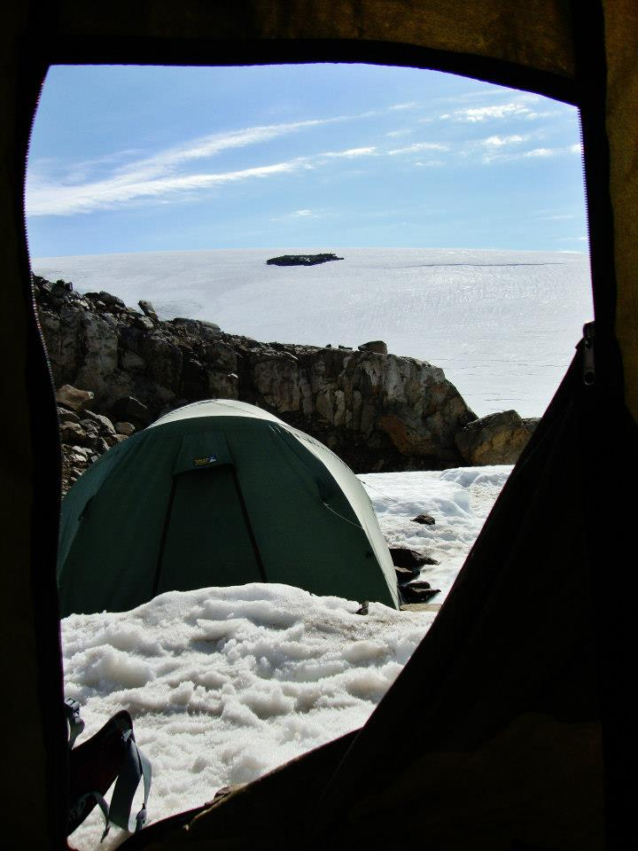
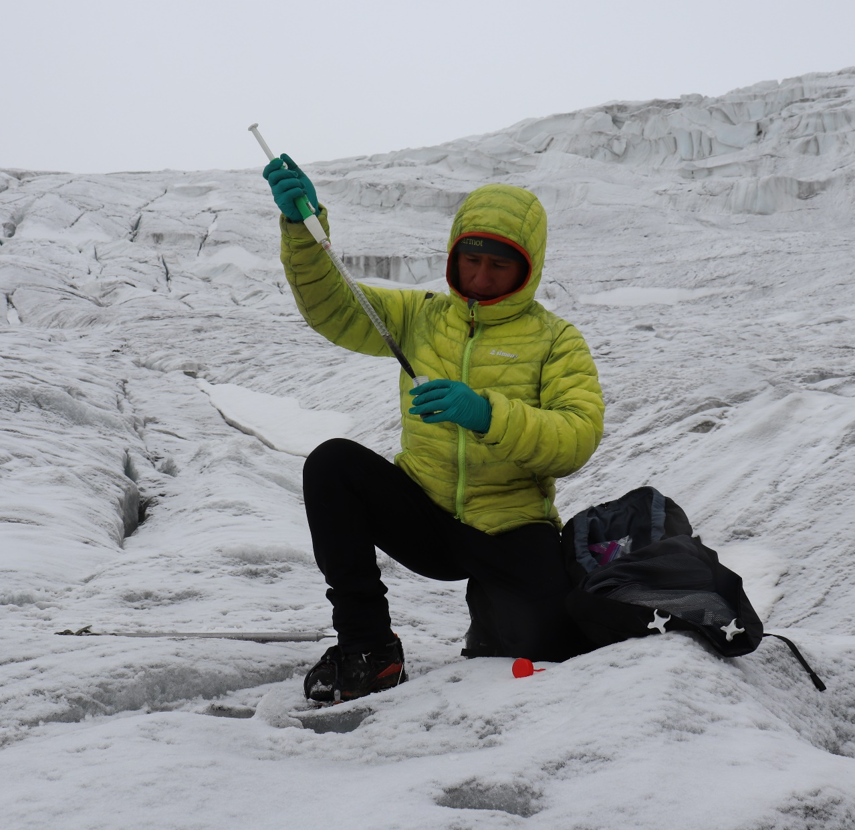
Take home message
Take home message
FRN activity and PTE quantities in glacial sediments have high variability at both glacier and catchment scales
FRN activity is higher in cryoconite than moraine samples
Some PTEs are found in greater amounts in cryoconite sediment, while others are greater in moraine sediment
Future research on the variability of contaminant mobility will improve out understanding of potential downstream impacts
Contaminant levels in glacial sediments vary both locally and globally and thus it is important to sample across multiple glaciers when looking at catchment scale risk from their release into downstream environments

Slide 11
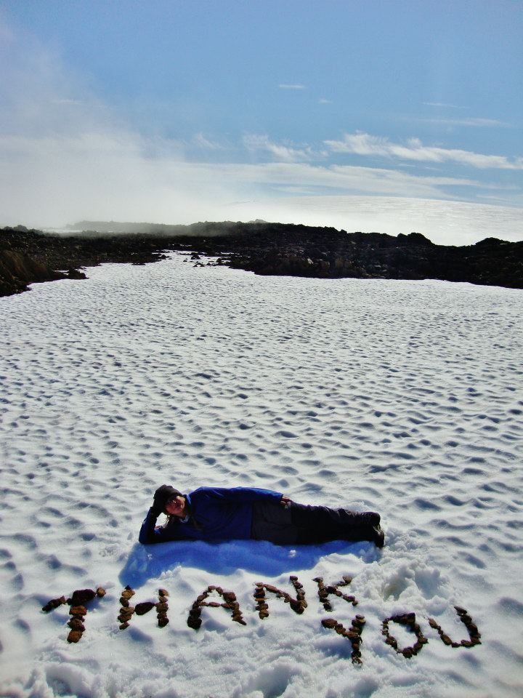
Questions?
Thank you!
Questions
?
Contact: Dylan.beard@plymouth.ac.uk
*Photography by Wilmer Sánchez Rodríguez and Dylan Bodhi Beard

