Slide 1



Recalculating the local magnitude of events in the Hungarian National Seismological Bulletin
Marietta Csatlós¹
Bálint Süle²
¹ ELTE Eötvös Loránd University, Institute of Geography and Earth Sciences, Department of Geophysics and Space Science, Budapest, Hungary
² Eötvös Loránd Research Network, Institute of Earth Physics and Space Science, Kövesligethy Radó Seismological Observatory, Budapest, Hungary
EGU22-9192
Session SM1.1
Contact author: csatlosmarietta@gmail.com
2022.03.25.

Slide 2
Motivation
2
Hungarian National Seismological Bulletin was redefined in 2018
New hypocenters [1]
No archivated amplitudes before 2015 → cannot calculate magnitudes
1996-2016 3 method were used to calculate local magnitudes
Future aim: The recalculated database gives the opportunity to perform the calibration of the local magnitude scale for the Hungarian region.

Slide 3
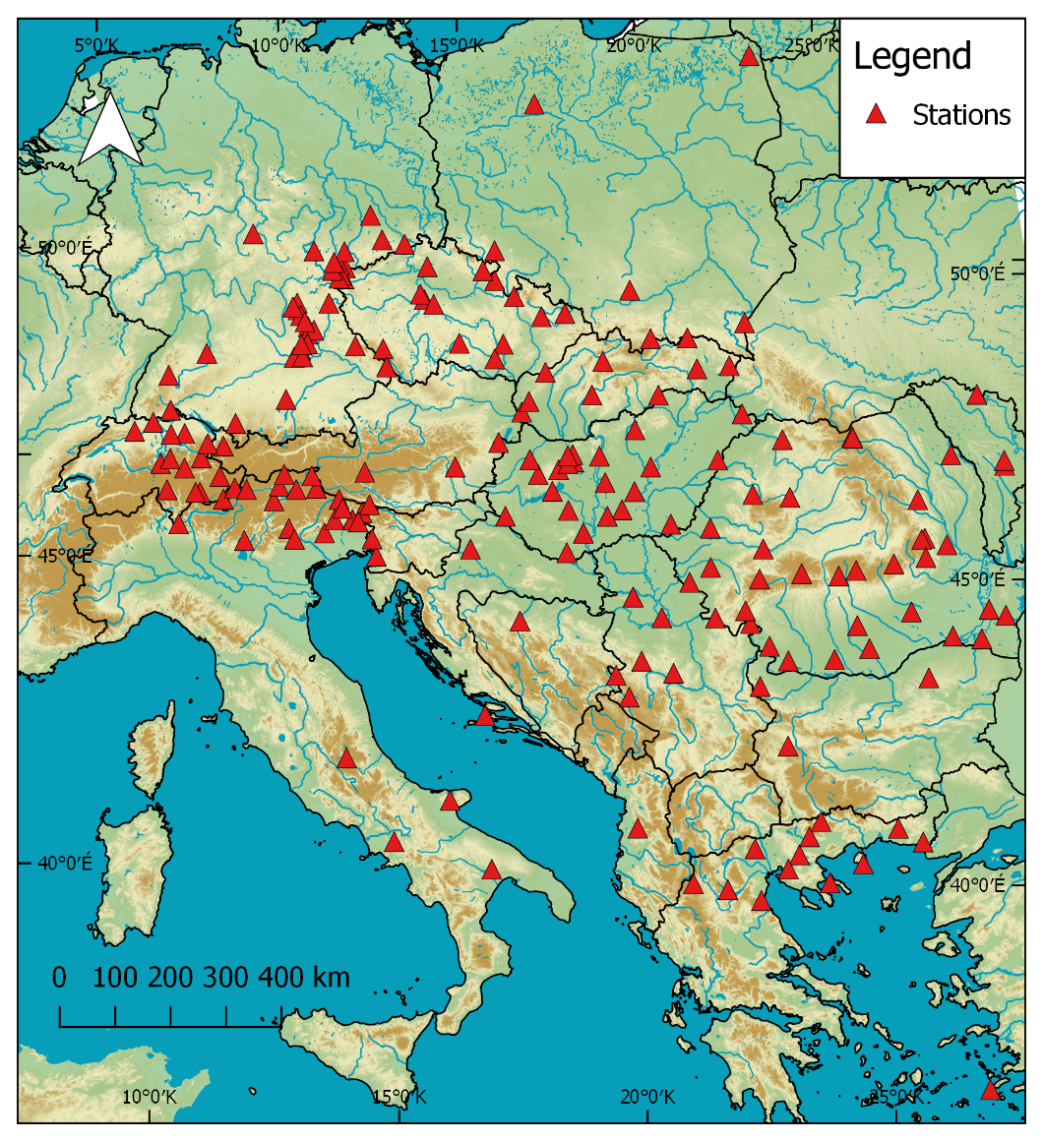
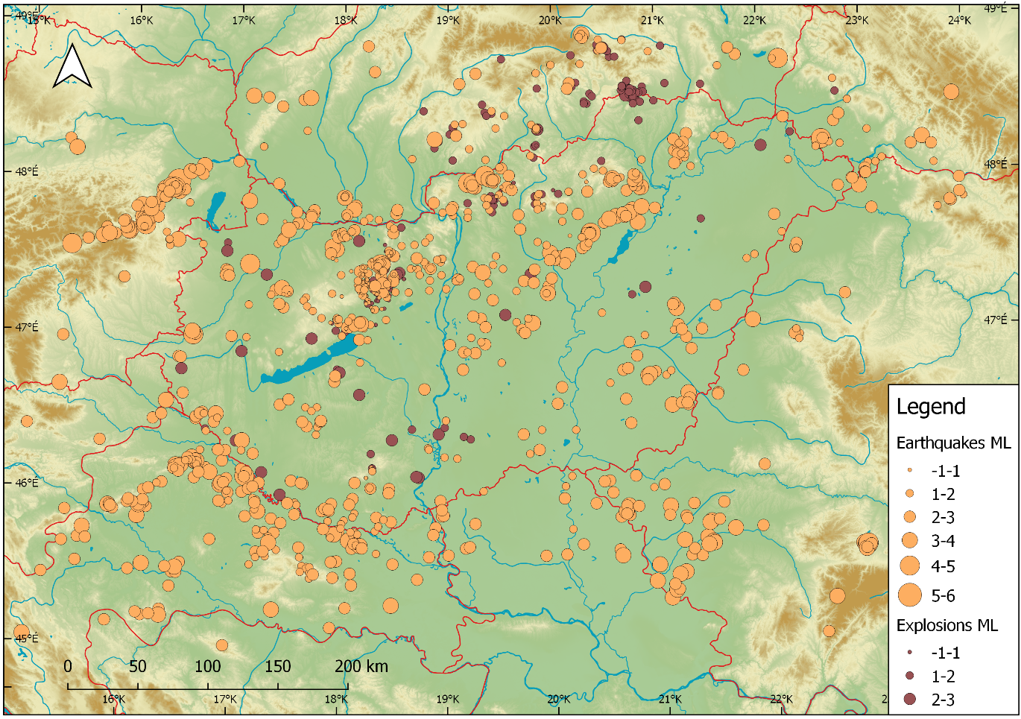
Data
3
Based on Relocated Hungarian National Seismological Bulletin 1996-2016. Two main condition: registrated P arrival time, and less than 600 km epicentral distance.
Figure 1 Calculated seismic events

Slide 4
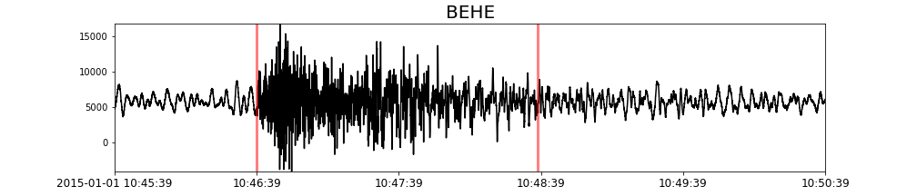
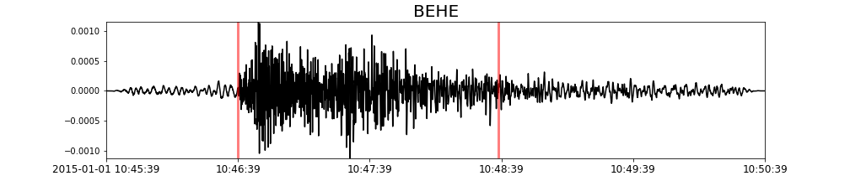

Local magnitude calculation
4
Magnitude used by SeisComp3 [2]:
Vertical component (mm)
Peak-to-peak or zero-to-peak * 2
-log10(A0) distance correction term
Static magnification (2800)
IASPEI standard [3]:
Horizontal component (nm)
Zero-to-peak
R: hypocentral distance
-2,09 constant contain the static magnification (2080 [4])

Slide 5
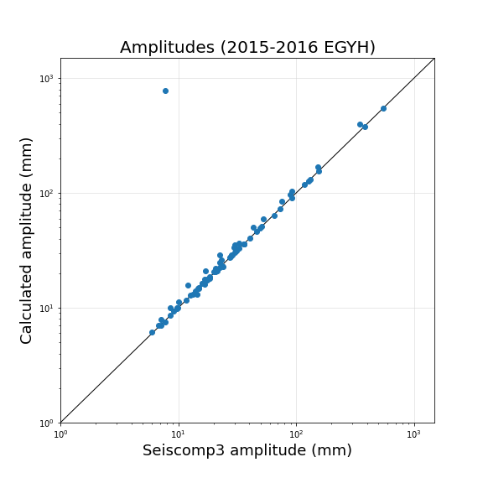
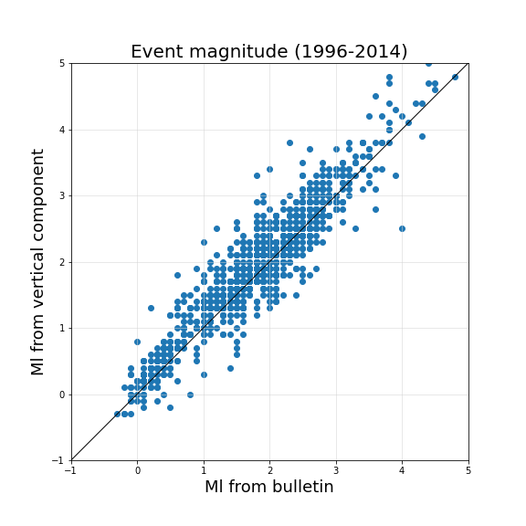
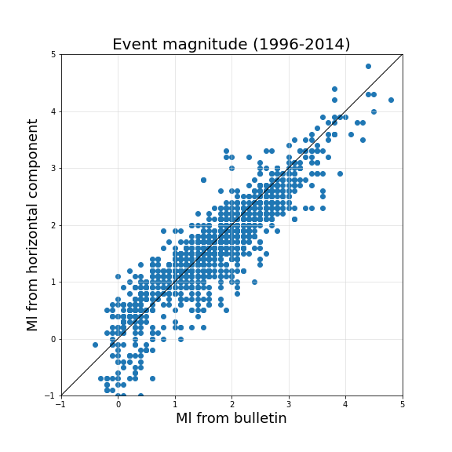
Testing and Results
5
Testing:
Comparsion of the calculated amplitudes with the amplitudes of SeisComp (2015-2016) Amplitude ratio is almost 1:1
Result:
SeisComp3 method and bulletin comparsion: Ml = 0,05 difference. IASPEI comparsion Ml = -0,15 difference.

Slide 6
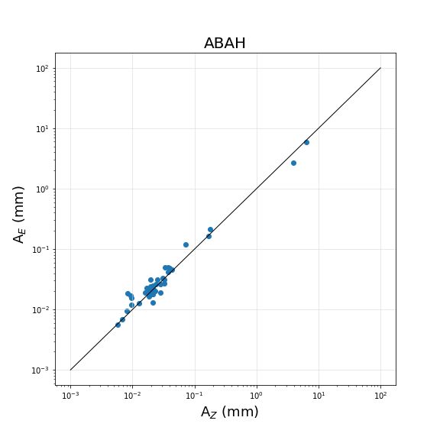

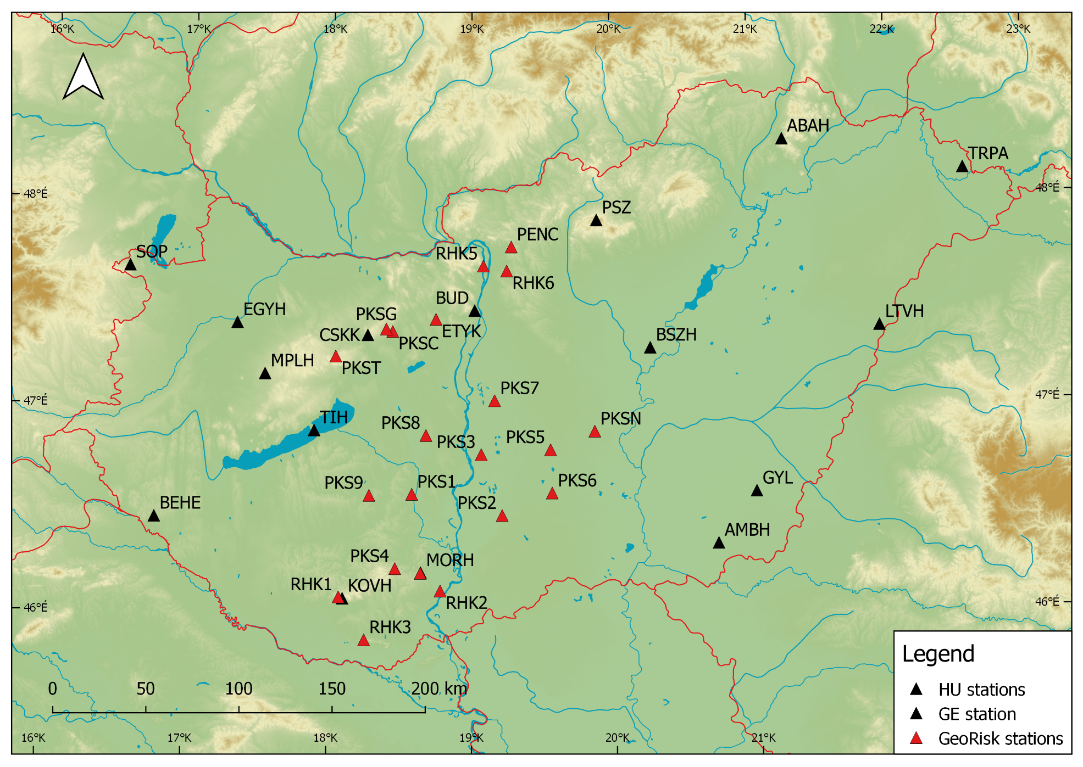
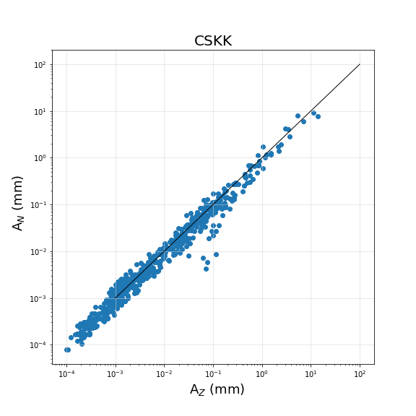
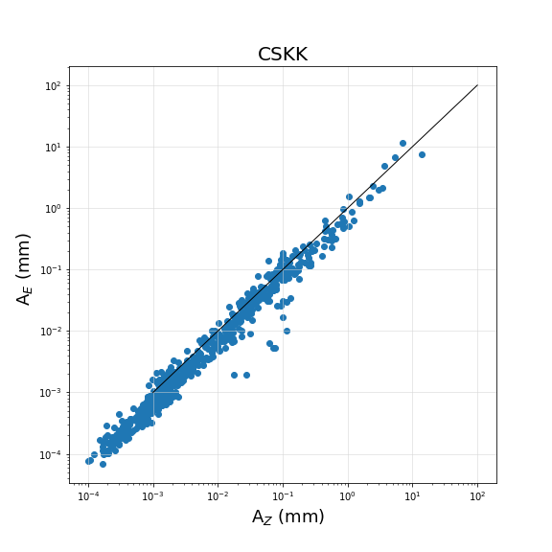
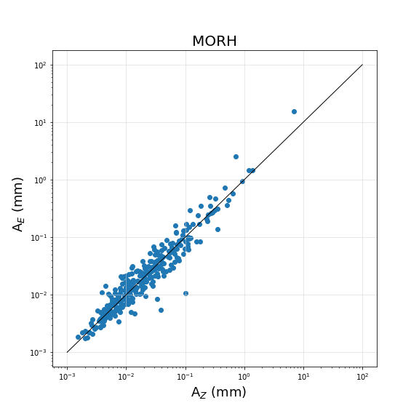
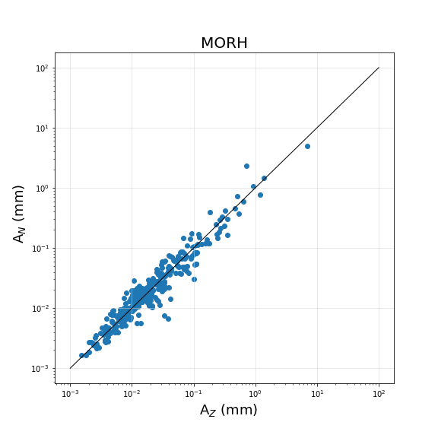
Geological relations
6

Slide 7
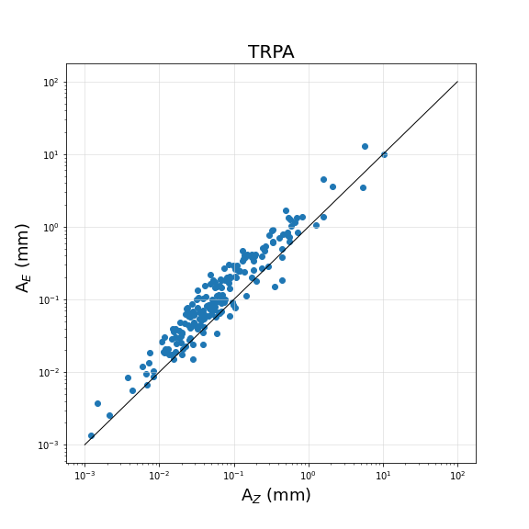

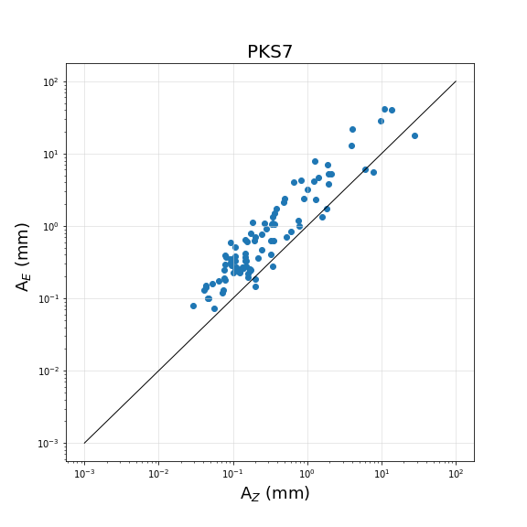
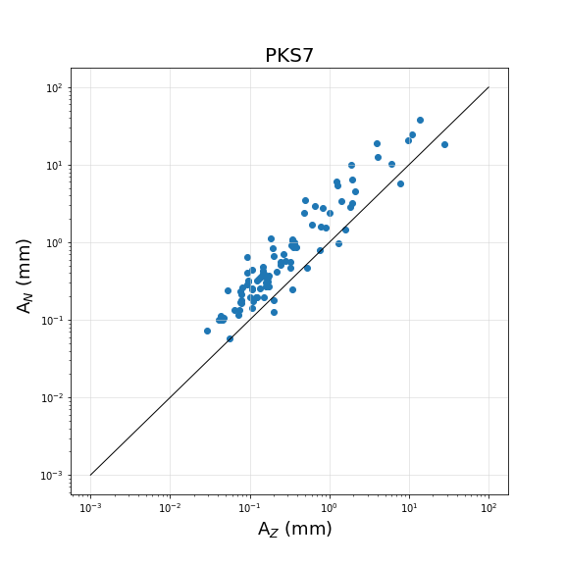
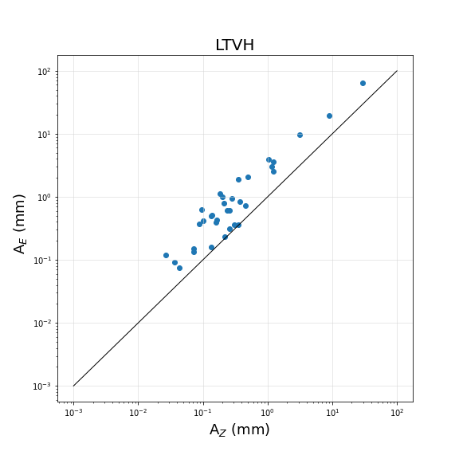
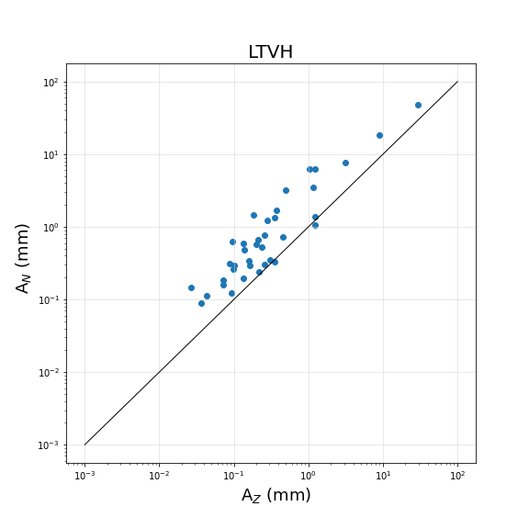
Geological relations
7

Slide 8
Conclusions
8
The magnitudes from the Hungarian National Seismological Bulletin were recalculated by the SeisComp3 method for the 1996-2014 period
Geological relations:
Thick sediment → Amplitudes in horizontal component are 2 or 3 times larger for the Great Hungarian Plain stations
Firm bed rock → difference is smaller
The local magnite scale correlation:
Suggestion for the Hungarian region: amplitudes should be measured on the vertical component

Slide 9
Acknowledgement & References
9
We are grateful to Georisk Ltd. for providing the waveform data recorded by the Paks Microseismic Monitoring Network. We thank the seismological research institutes and national agencies for the open source data centers (GEOFON, INGV, NIEP, BRG, EZH, RESIF, NOA, KOERI, IRIS).
[1] Bondár, I., Mónus, P., Czanik, C., Kiszely, M., Gráczer, Z., Wéber, Z., the AlpArrayWorking Group. 2018: Relocation of Seismicity in the Pannonian Basin Using a Global 3D Velocity Model. Seismological Research Letters. pp.2284-2293.
[2] www.seiscomp3.org - 2022.05.21.
[3] Bormann, P., Dewey, J. W. 2014: The new IASPEI standards for determining magnitudes from digital data and their relation to classical magnitudes. In: Bormann, P. (Ed.). New Manual of Seismological Observatory Practice 2 (NMSOP-2). Potsdam : Deutsches GeoForschungsZentrum GFZ. pp.1-44.
[4] Uhrhammer, R.A., Collins, E.R. 1990: Synthesis of Wood-Anderson seismograms from broadband digital records. Bulletin of the Seismological Society of America 80. pp.702–716.

Slide 10
Thank you for your kind attention!

