Slide 1





Optical properties and dominant types of aerosols in the marine environments surrounding the East Mediterranean - Middle East (EMME) region during the AQABA cruise
M., Pikridas, D.G. Kaskaoutis, N. Mihalopoulos, K. Barbounis,J. Lelieveld, J. Sciare

Slide 2
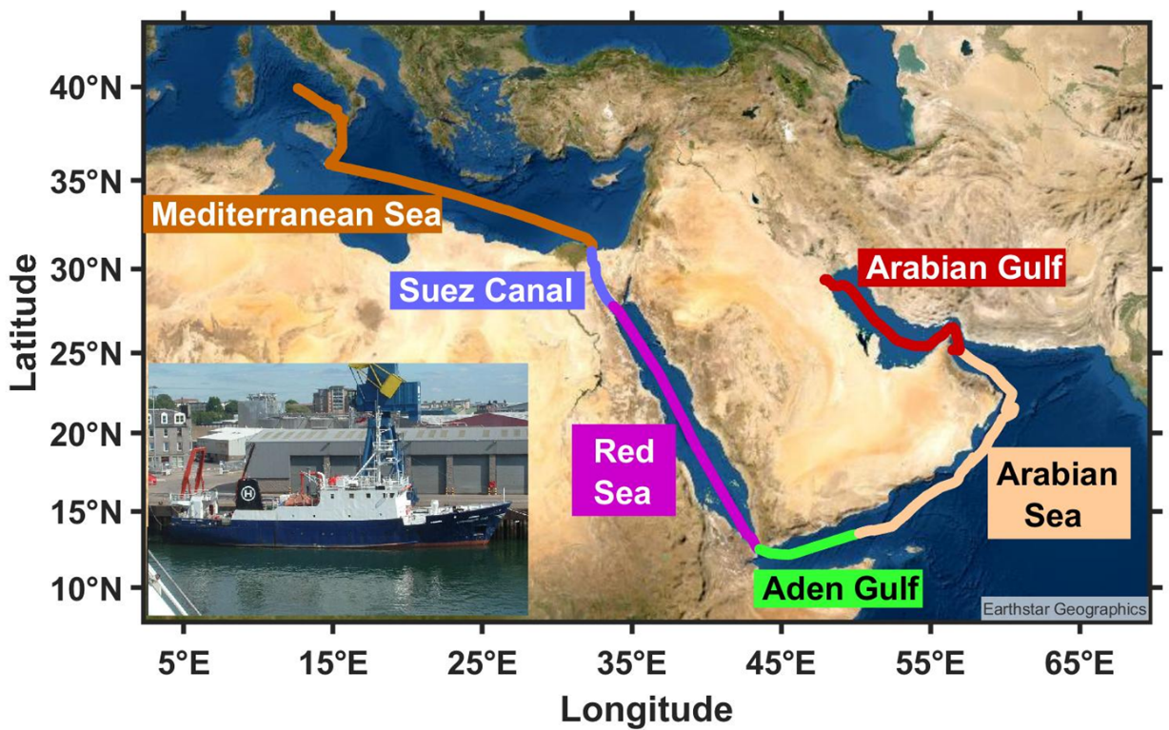
AQABA cruise: Objectives, scope, measurements
The route of the research vessel (insert photo) during the AQABA campaign (departure and return trips), labelling the different sub-regions.
Aims to explore the spatio-temporal variability of aerosols, atmospheric mixing state, sources and dominant types during 1 Jul. - 1 Sep. 2017.
Analysis of the aerosol spectral optical properties (scattering, absorption coefficients, single scattering albedo) in the marine boundary layer for PM₁ and PM₁₀ particles.
Measurements: Aethalometer (AE-33), Nephelometer (Aurora 4000 Ecotech), MARGA (Model 2 S, Metrohm Applikon)

Slide 3
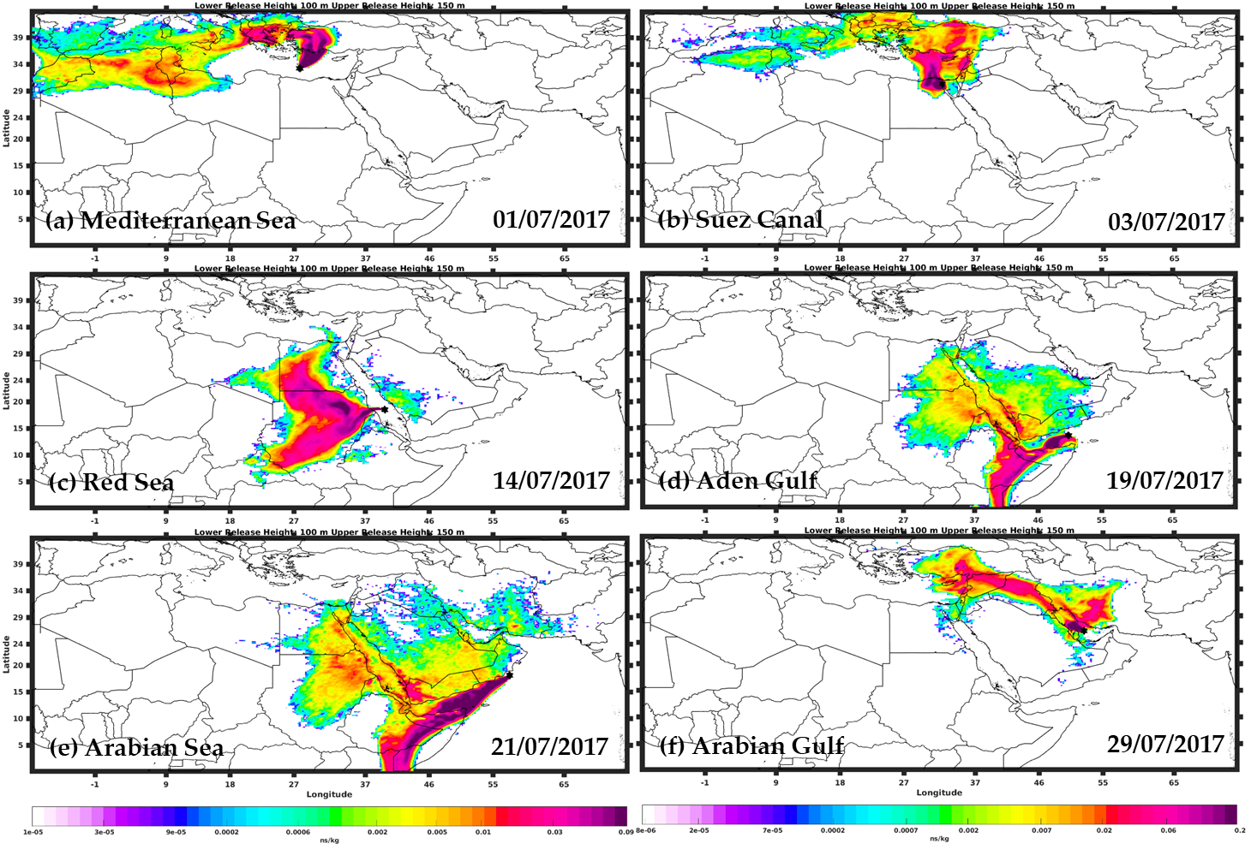
Sources of continental aerosols affecting marine EMME regions
FLEXPART air mass back trajectories at 12:00 UTC on specific days during the 1st cruise leg. Air mass back-trajectories indicated the potential impact of the continental emissions to oceanic regions.

Slide 4
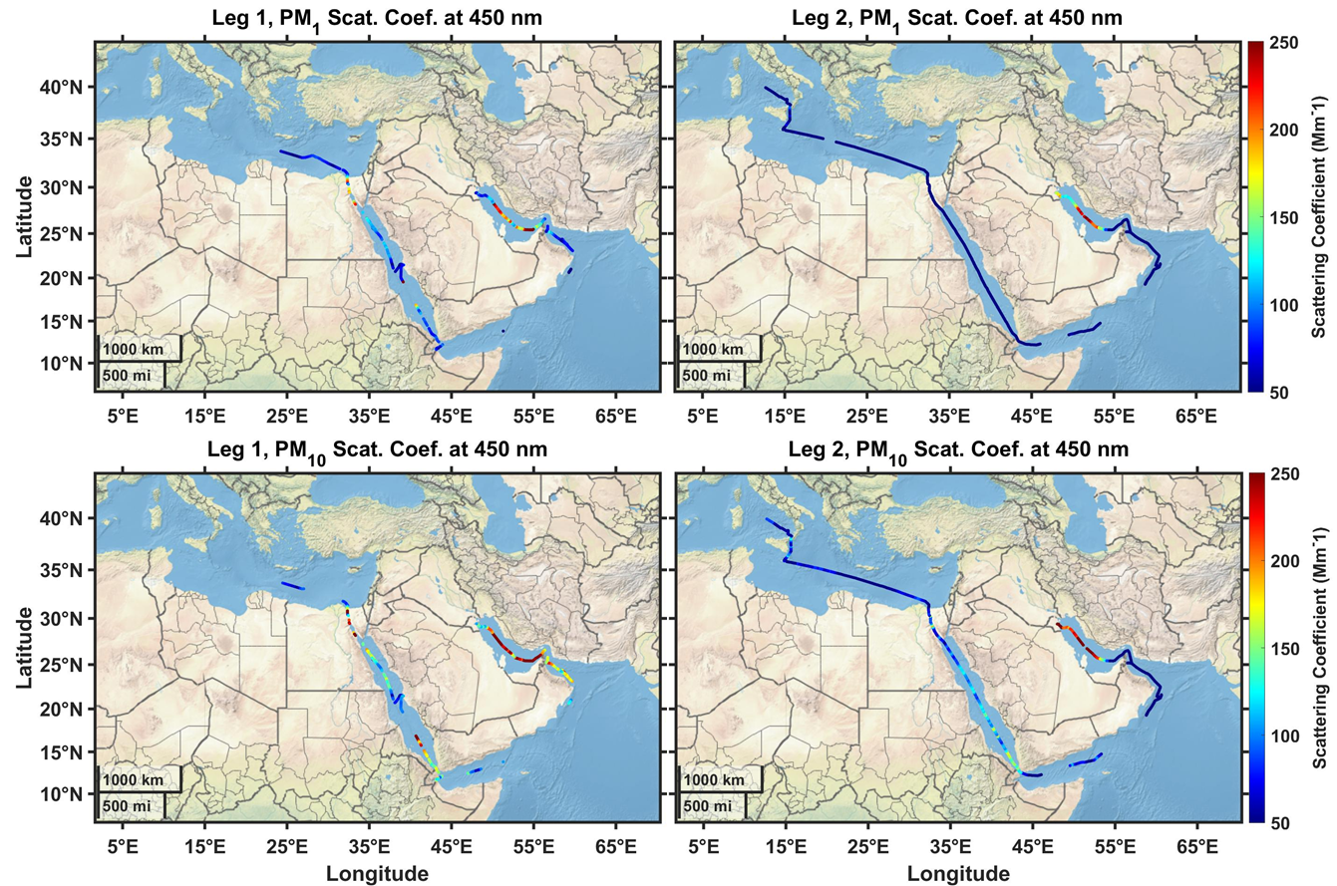
Aerosol scattering
Scattering coefficients for PM1 and PM10 particles exhibited higher values in the southern Red Sea, due to continental outflow from east Africa, and in the Persian Gulf due to mixing of natural dust with anthropogenic emissions from the industrial sector and oil refineries. The east Mediterranean exhibited moderate aerosol loading.

Slide 5
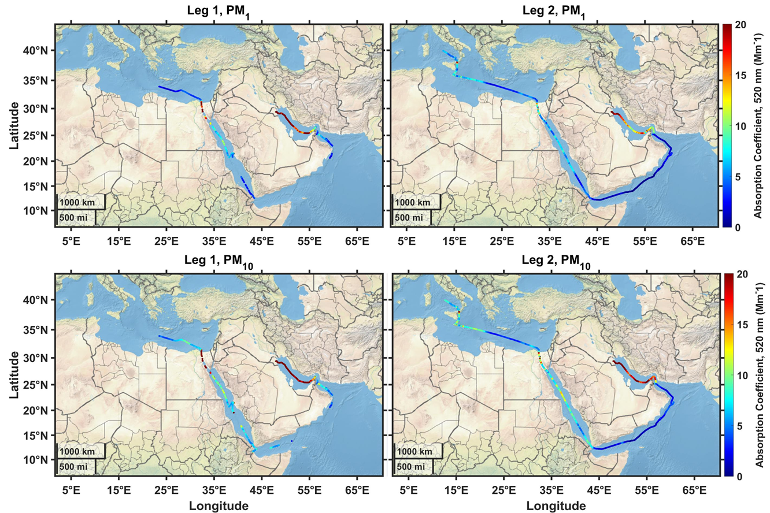
Aerosol absorption
Absorption coefficients for PM1 and PM10 particles exhibited higher values in the Persian Gulf due to enhanced BC emissions from the industrial sector and oil refineries. The east Mediterranean exhibited moderate-to-low absorption. Absorption Ångström Exponent (AAE) values close to 1, indicative of BC from fossil-fuel combustion.

Slide 6
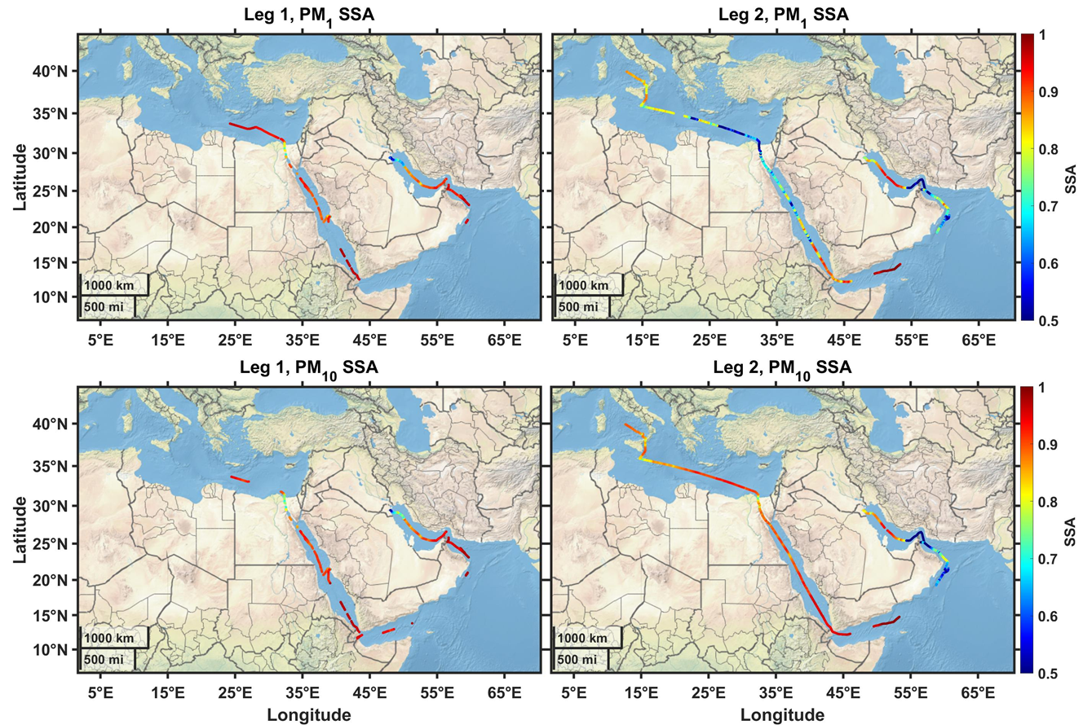
Aerosol single scattering albedo
Significant changes between SSA for PM1 and PM10 particles. Lower SSA for PM1, indicative of more absorbing aerosols, in the Persian Gulf, Suez Canal, parts of East Med.

Slide 7
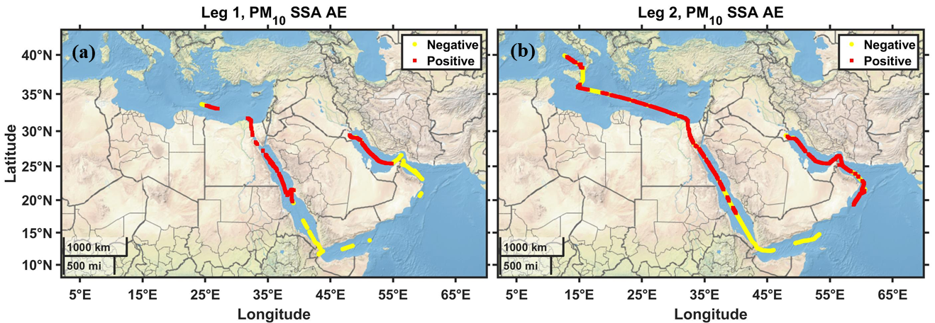
Spectral single scattering albedo
Positive (red) and negative (yellow) values of the wavelength exponent of SSA during the 1st (a) and 2nd (b) leg of the AQABA campaign. The yellow points show enhanced presence of dust.
Dominance of dust properties was observed over the southern Red Sea, parts of the western Arabian Sea, Oman Sea and from few measurements at central/east Med due to air masses coming from Libya.
The Persian Gulf exhibits positive SSA_AE values (decrease of SSA with wavelength, 450-635 nm), indicating dominance of anthropogenic aerosols and masking of dust properties.

Slide 8
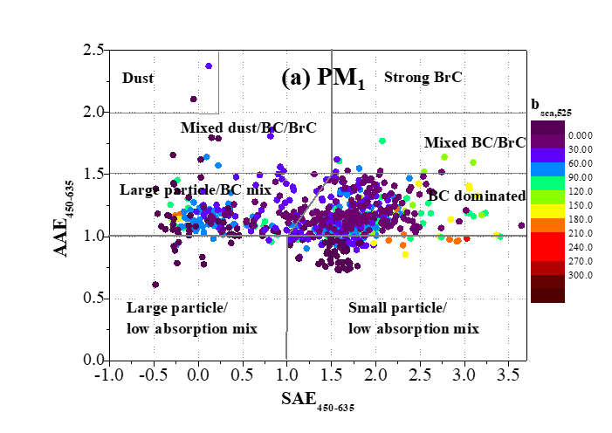
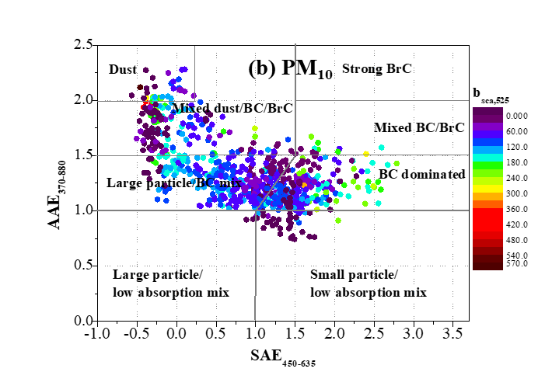
Aerosol types
SAE vs. AAE classification matrix for PM₁ (a) and PM₁₀ (b) particles as a function of the scattering coefficient (b_{sca,525}). Very different plots depending on particle size.
Using the SAE vs. AAE classification scheme, key aerosol types were identified along the ship cruise.
The results showed contrasting aerosol characteristics and types for the various sub-regions.

Slide 9
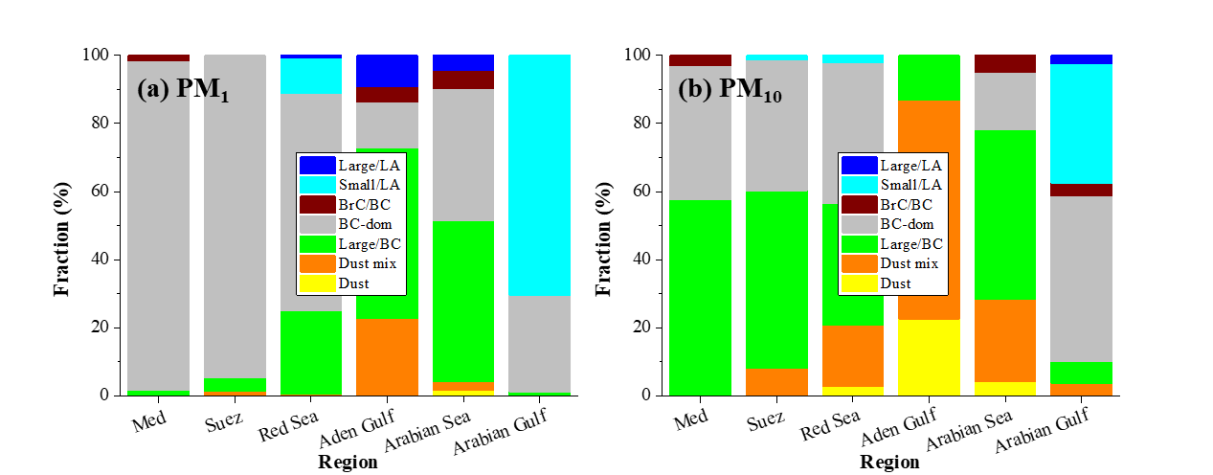
Aerosol types - Conclusions
The “BC-dominated” type clearly prevailed over the East Med. and Suez. Coarse particles mixed with BC dominated in the Gulf of Aden and the Arabian Sea, where the “dust type” also appeared.
In the Persian Gulf, the mixing of anthropogenic pollution with marine aerosols, resulted in a dominant “small/low absorption” aerosol type, characterized by fine aerosols with low spectral dependence of the absorption coefficient.
The particle size plays an important role on aerosol optical properties and types classification in the marine regions of EMME.

