Slide 1
Geoacoustic inversion of shipping noise at two closely spaced vertical arrays for estimation of gassy sediment parameters
Marina Yarina, Boris Katsnelson L .Charney School of Marine Sciences, University of Haifa, Haifa, Israel email: myarina@campus.Haifa.ac.il
bkatsnels@univ.Haifa.ac.il
Andrey Lunkov Prokhorov General Physics Institute of the Russian Academy of Sciences, Moscow, Russia e-mail: lunkov@kapella.gpi.ru
Oleg Godin
Physics Department, Naval Postgraduate School, Monterey, California, USA
E-mail: oagodin@nps.edu

Slide 2
Introduction
Gassy sediments:
Existence of gassy sediments is typical for many freshwater lakes, reservoirs and oil/gas fields on an ocean shelf. In lakes, the gas is primarily methane produced by biological activity.
Effect of gas bubbles on physical proprieties:
Gas bubbles increase the compressibility and, hence, decrease the sound speed in the bottom. Sound speed is very sensitive to the presence of gas. For muddy sediments, if the volume gas fraction is 1 %, the sound speed is about 100 m/s, that is much less than that in water. Sound reflection coefficient from such type of soft sediment is ~-0.6 even at the normal incidence. Only rather low frequency acoustic waves can penetrate into the bottom below the gassy layer.
Measurement methods:
A direct measurement of gas fraction in sediments is a quite difficult task. During a coring process, the sediment structure is being broken, even if the core is being frozen. Non-invasive acoustic methods can be a solution for this problem. By estimating the sound speed in sediments, the volume gas fraction can be inferred unambiguously.

Slide 3
Introduction
Goal of this work:
It was shown that in gassy sediment attenuation coefficient can be expressed through the sound speed in sediment. This work considers extraction of normal mode attenuation coefficients in a wide frequency band from research vessel noise, which was recorded by two synchronized vertical line arrays in the Sea of Galilee (also known as Lake Kinneret, Israel).

Slide 4






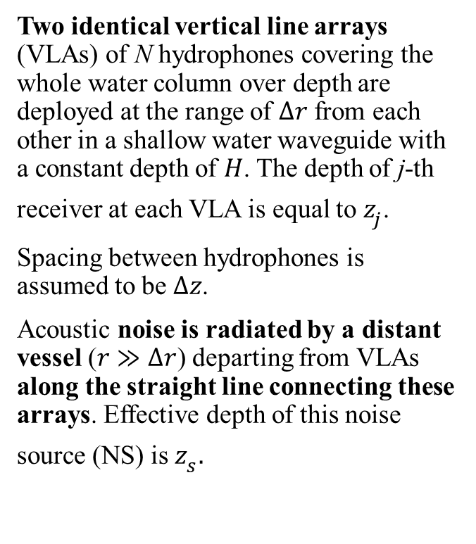

Ideal experimental scenario
Two identical vertical line arrays (VLAs) of N hydrophones covering the whole water column over depth are deployed at the range of $Δr$ from each other in a shallow water waveguide with a constant depth of $H$. The depth of j-th receiver at each VLA is equal to $z_{j}$.
Spacing between hydrophones is assumed to be $Δz$.
Acoustic noise is radiated by a distant vessel ($r≫Δr$) departing from VLAs along the straight line connecting these arrays. Effective depth of this noise source (NS) is $z_{s}.$
$$Δr$$
$$r$$
$$z_{j}$$
VLA
East
$$H$$
VLA
West
$$water column$$
$$bottom$$
Figure 1. The scenario for ship noise recording.

Slide 5
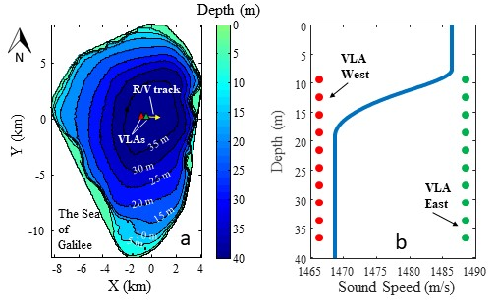
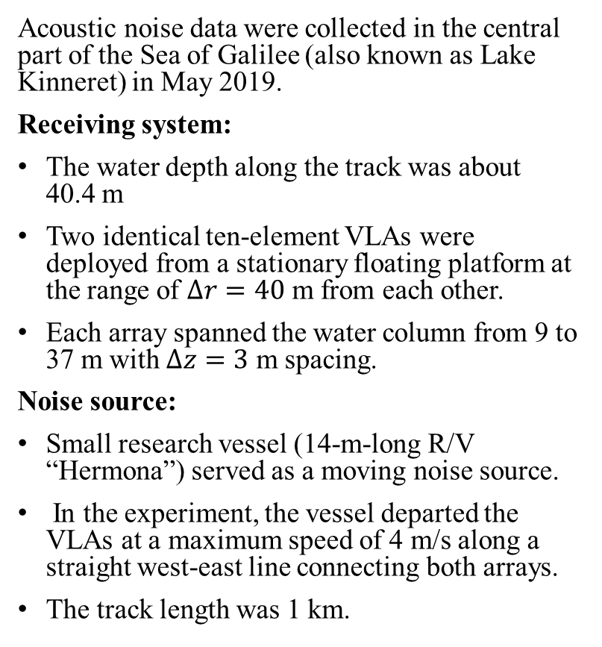
Experiment
Acoustic noise data were collected in the central part of the Sea of Galilee (also known as Lake Kinneret) in May 2019.
Receiving system:
The water depth along the track was about 40.4 m
Two identical ten-element VLAs were deployed from a stationary floating platform at the range of $Δr=40$ m from each other.
Each array spanned the water column from 9 to 37 m with $Δz=3$ m spacing.
Noise source:
Small research vessel (14-m-long R/V “Hermona”) served as a moving noise source.
In the experiment, the vessel departed the VLAs at a maximum speed of 4 m/s along a straight west-east line connecting both arrays.
The track length was 1 km.
Figure 2: (a) Bathymetric map of the Sea of Galilee, the VLAs locations (small triangles), and the research vessel track (arrow), (b) vertical sound speed profile and depth of VLAs elements.

Slide 6
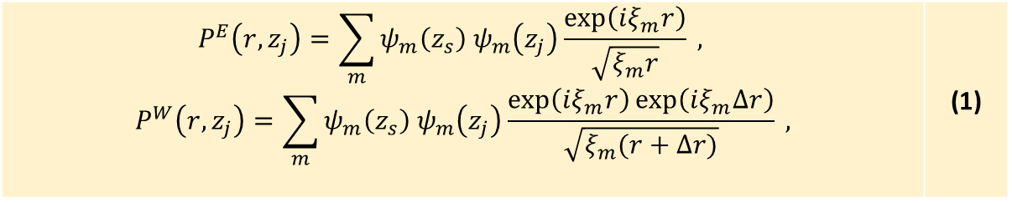
Mode filtration methodology
The array closest to NS is labelled as “East” (E).
The furthest is labelled as “West” (W).
For a given frequency ω=2πf, acoustic pressure at two VLAs due to NS at a range of r can be written as a sum of normal modes:
$$P^{E}\left(r,z_{j}\right)=\sum_{m}{ψ_{m}\left(z_{s}\right) ψ_{m}\left(z_{j}\right)\frac{\exp\left(iξ_{m}r\right)}{\sqrt{ξ_{m}r}} },$$ $$P^{W}\left(r,z_{j}\right)=\sum_{m}{ψ_{m}\left(z_{s}\right) ψ_{m}\left(z_{j}\right)\frac{\exp\left(iξ_{m}r\right)\exp\left(iξ_{m}Δr\right)}{\sqrt{ξ_{m}(r+Δr)}} },$$ | (1)
where ψm and ξm=qm+iαm are eigenfunction and eigenvalue of m-th mode, respectively. To carry out mode filtering, the following procedure is applied to both arrays.

Slide 7
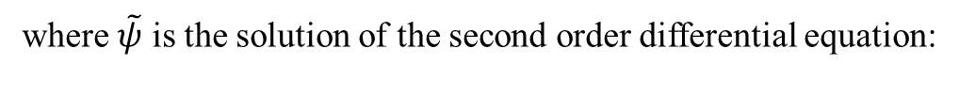
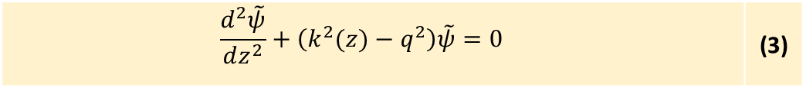
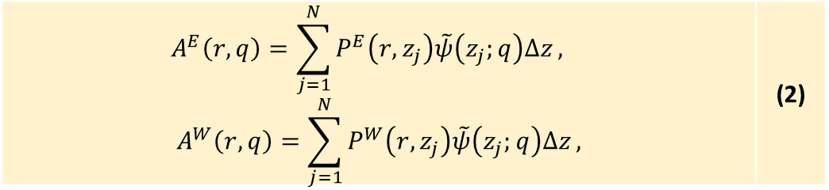
Modal amplitudes on two arrays, needed to calculate attenuation:
$$A^{E}\left(r,q\right)=\sum_{j=1}^{N}{P^{E}\left(r,z_{j}\right)\tilde{ψ}\left(z_{j};q\right)Δz},$$ $$A^{W}\left(r,q\right)=\sum_{j=1}^{N}{P^{W}\left(r,z_{j}\right)\tilde{ψ}\left(z_{j};q\right)Δz},$$ | (2)
where $\tilde{ψ}$ is the solution of the second order differential equation:
with an
$$\frac{d^{2}\tilde{ψ}}{dz^{2}}+\left(k^{2}(z)−q^{2}\right)\tilde{ψ}=0$$ | (3)
ψ0; q=0, kz=ω/c(z) is the depth dependent wavenumber in water, c(z) is the vertical sound speed profile.

Slide 8

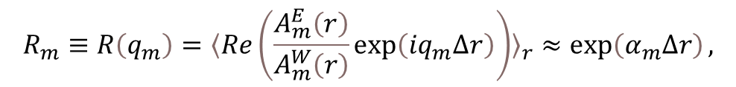
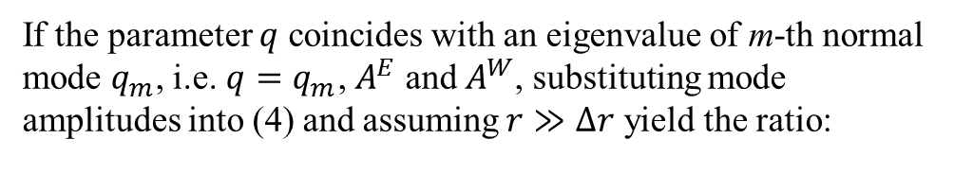
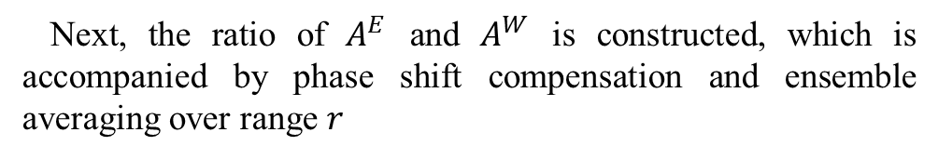
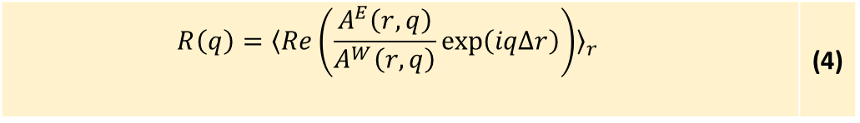
Phase compensation and calculation of attenuation coefficient
Next, the ratio of $A^{E}$ and $A^{W}$ is constructed, which is accompanied by phase shift compensation and ensemble averaging over range $r$
from which attenuation coefficient of m-th mode can be defined as:
$$R\left(q\right)={〈Re\left(\frac{A^{E}\left(r,q\right)}{A^{W}\left(r,q\right)}\exp\left(iqΔr\right)\right)〉}_{r}$$ | (4)
$$α_{m}=\frac{\ln{R_{m}}}{Δr}.$$
If the parameter $q$ coincides with an eigenvalue of m-th normal mode $q_{m}$, i.e. $q=q_{m}$, $A^{E}$ and $A^{W}$, substituting mode amplitudes into (4) and assuming $r≫Δr$ yield the ratio:
$$R_{m}≡R\left(q_{m}\right)={〈Re\left(\frac{A_{m}^{E}\left(r\right)}{A_{m}^{W}\left(r\right)}\exp\left(iq_{m}Δr\right)\right)〉}_{r}≈\exp\left(α_{m}Δr\right),$$

Slide 9
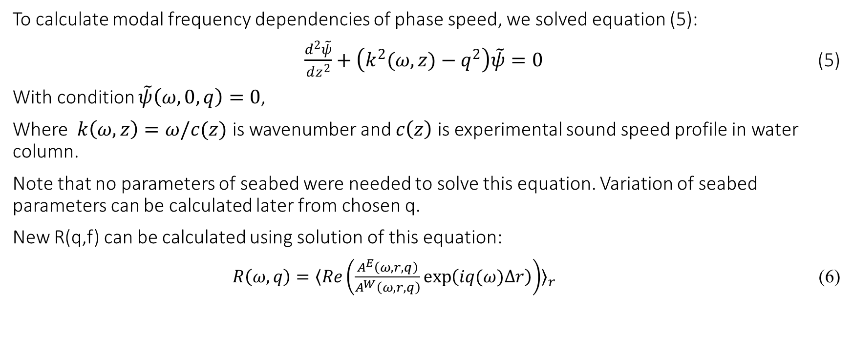
Phase speed frequency dependence
To calculate modal frequency dependencies of phase speed, we solved equation (5):
$\frac{d^{2}\tilde{ψ}}{dz^{2}}+\left(k^{2}(ω,z)−q^{2}\right)\tilde{ψ}=0$ (5)
With condition $\tilde{ψ}\left(ω,0,q\right)=0$,
Where $k\left(ω,z\right)=ω/c(z)$ is wavenumber and $c\left(z\right)$ is experimental sound speed profile in water column.
Note that no parameters of seabed were needed to solve this equation. Variation of seabed parameters can be calculated later from chosen q.
New R(q,f) can be calculated using solution of this equation:
$R\left(ω,q\right)={〈Re\left(\frac{A^{E}\left(ω,r,q\right)}{A^{W}\left(ω,r,q\right)}\exp\left(iq(ω)Δr\right)\right)〉}_{r}$ (6)

Slide 10
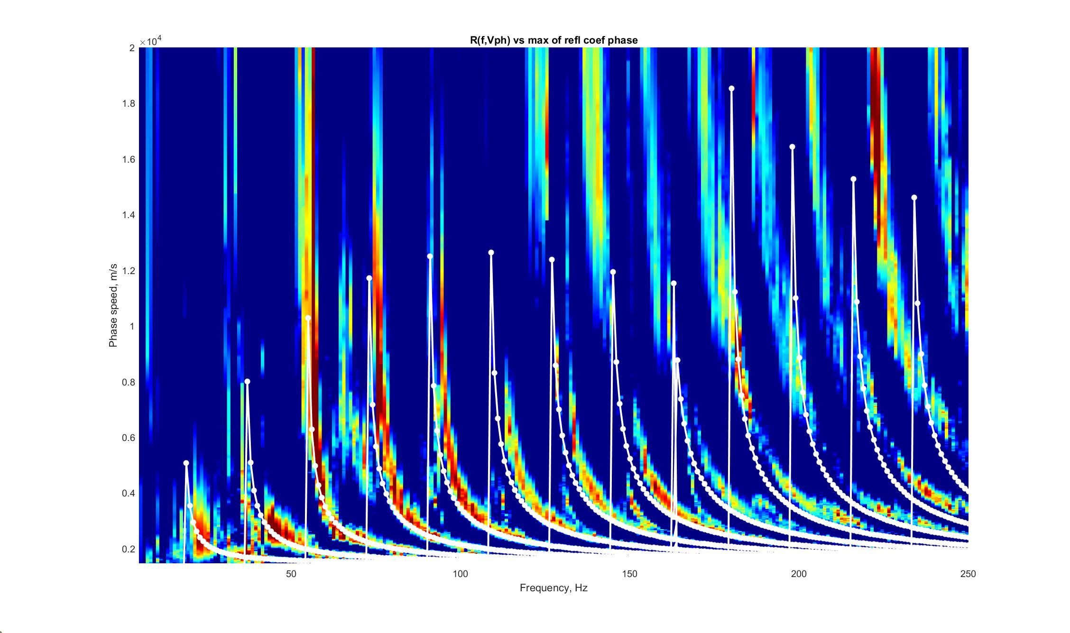

Slide 11
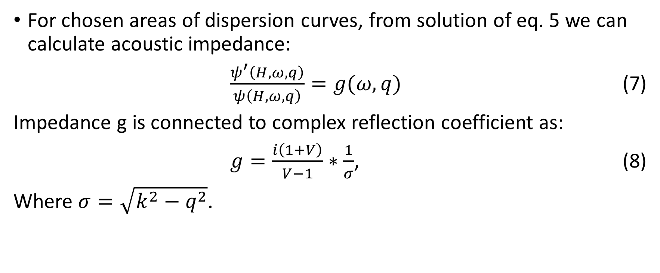
Logarithmic derivative linked to bottom impedance and reflection coefficient
For chosen areas of dispersion curves, from solution of eq. 5 we can calculate acoustic impedance:
$\frac{ψ^{′}\left(H,ω,q\right)}{ψ\left(H,ω,q\right)}=g(ω,q)$ (7)
Impedance g is connected to complex reflection coefficient as:
$g=\frac{i\left(1+V\right)}{V−1}∗\frac{1}{σ}$, (8)
Where $σ=\sqrt{k^{2}−q^{2}}$.

Slide 12
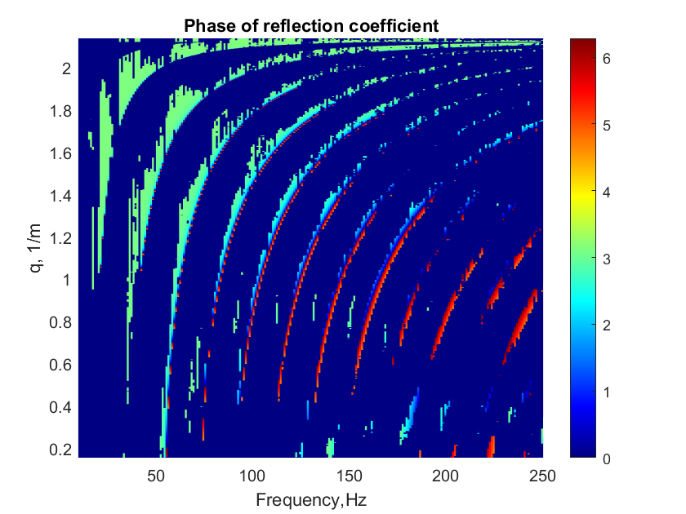
Phase of V on dispersion maxima
We found experimental dispersion dependencies of separate normal modes and plotted phases of reflection coefficients for each of them.
On this figure we see, that the phase changes after 5-6 modes. That proves the existence of layered bottom (sign of effective reflection coefficient changes).
Using those dependencies we are able to calculate bottom parameters, which is the goal of our future work.

Slide 13
Conclusions
We propose a new method of normal mode extraction and estimation of the sediment parameters from the shipping noise signal
and demonstrate the following advantages of using two synchronized vertical receiving arrays in an experiment in shallow water waveguide with low sound speed sediments:
Mode filtration can be carried out more reliably than using the single VLA
In order to find complex eigenvalues of individual modes, it is not necessary to know the exact position of ship along the track,
as well it is not necessary to keep the ship at the constant speed and power as we don`t need to know exact characteristics of sound source;
It is possible to estimate modal attenuation coefficients as a function of frequency down to cut-off frequency
Usage of phase of reflection coefficients can be useful in calculation of seabed parameters without assumptions about its stratigraphy.

