Slide 1

Carbon dioxide dynamics in a boreal forest ditch affected by clearcut forestry
Alberto Zannella¹, Karin Eklöf¹, Hjalmar Laudon², Eliza Maher Hasselquist², and Marcus Wallin¹
¹Department of Aquatic Sciences and Assessment, Swedish University of Agricultural Sciences, Uppsala, Sweden ²Department of Forest Ecology and Management, Swedish University of Agricultural Sciences, Umeå, Sweden

Slide 2
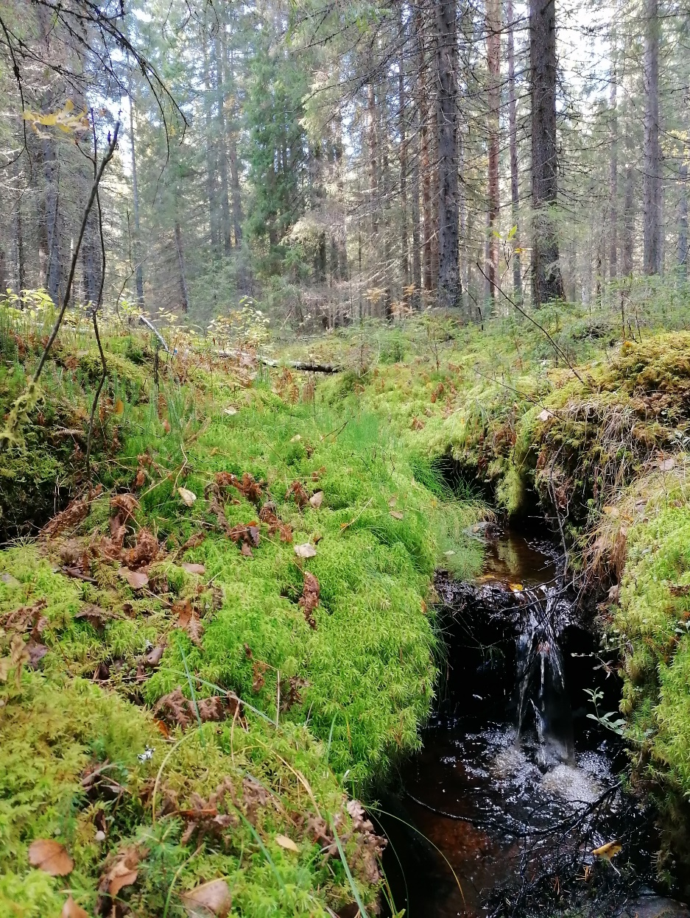
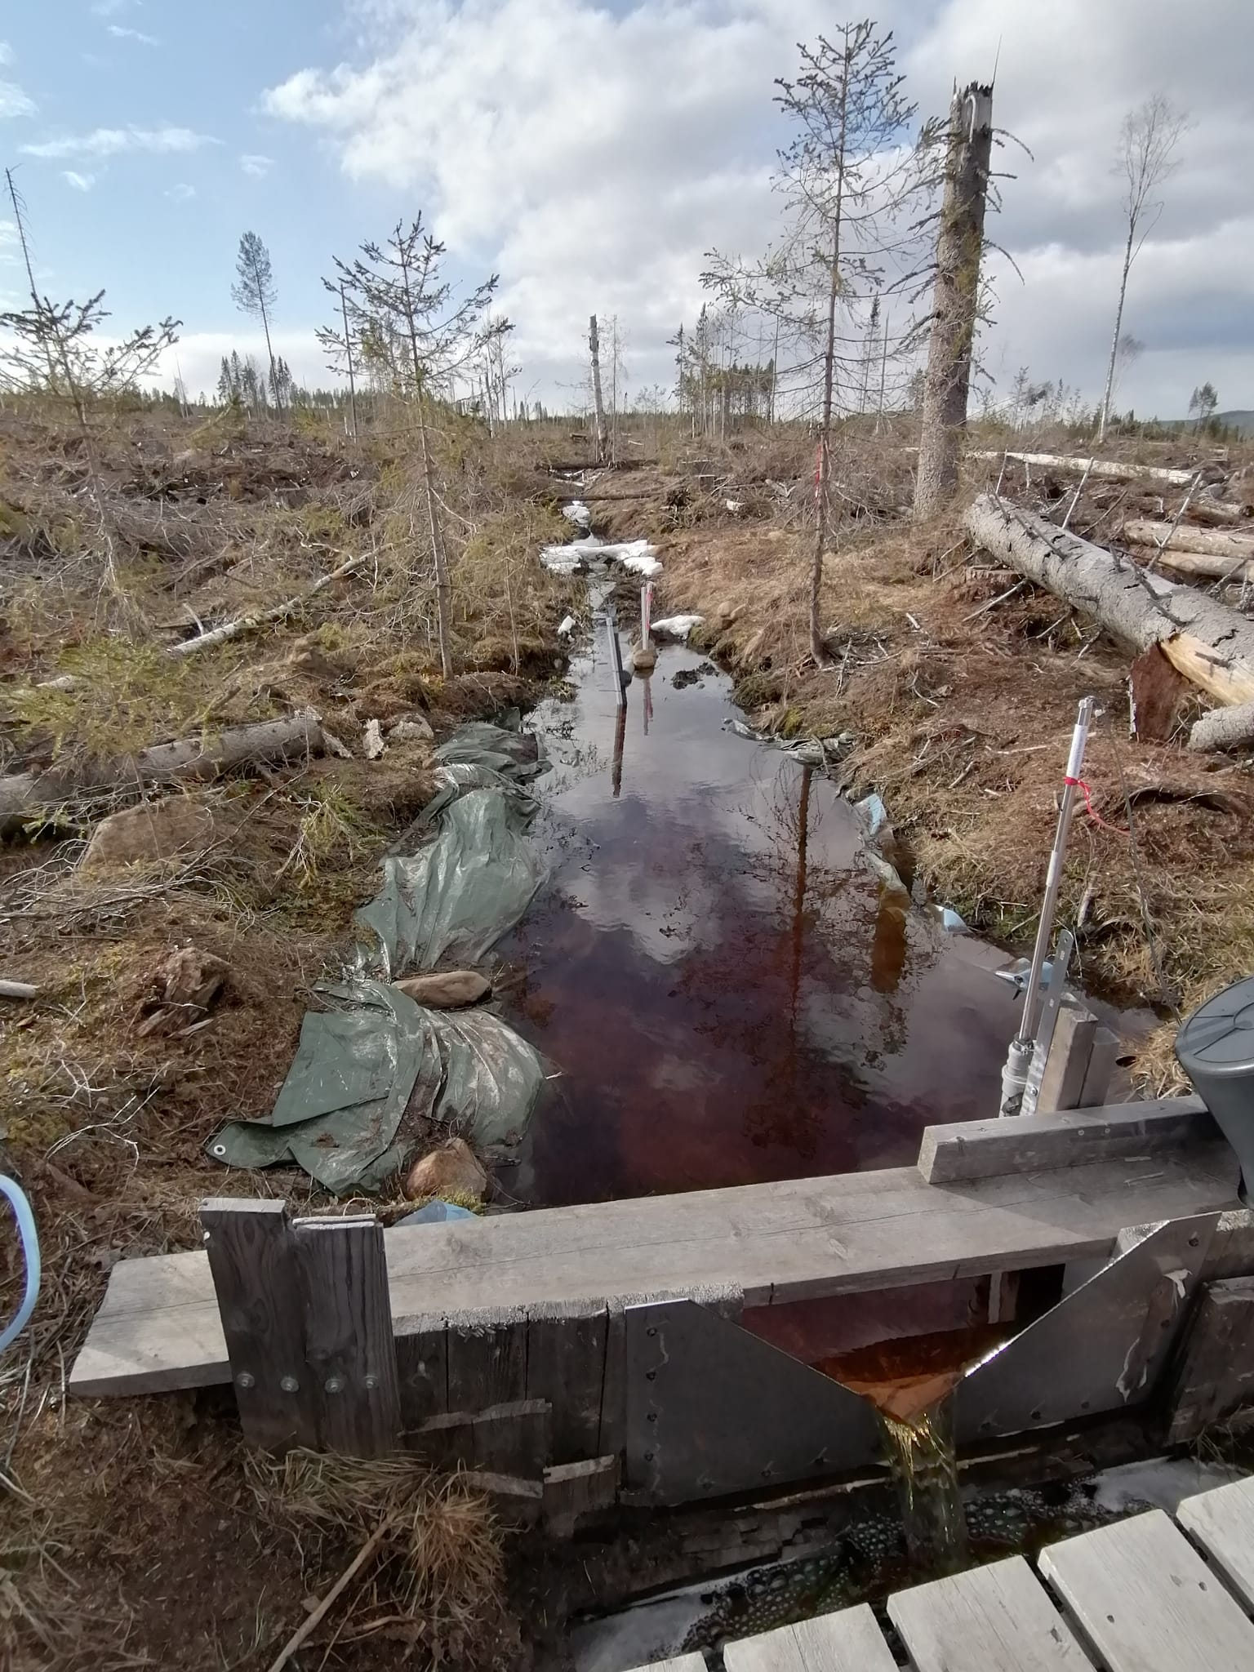
Introduction
Boreal forests carbon (C) cycle influenced by terrestrial sources and driven by hydrology;
Lateral C Export (LCE) identified as important component of boreal C cycling and CO₂ source
Changes in land use modifies CO₂ dynamics
LCE
What happens to CO₂ dynamics when we harvest all the trees?
Stream in a fully grown Swedish forest.
Stream in a fully harvested Swedish forest.

Slide 3
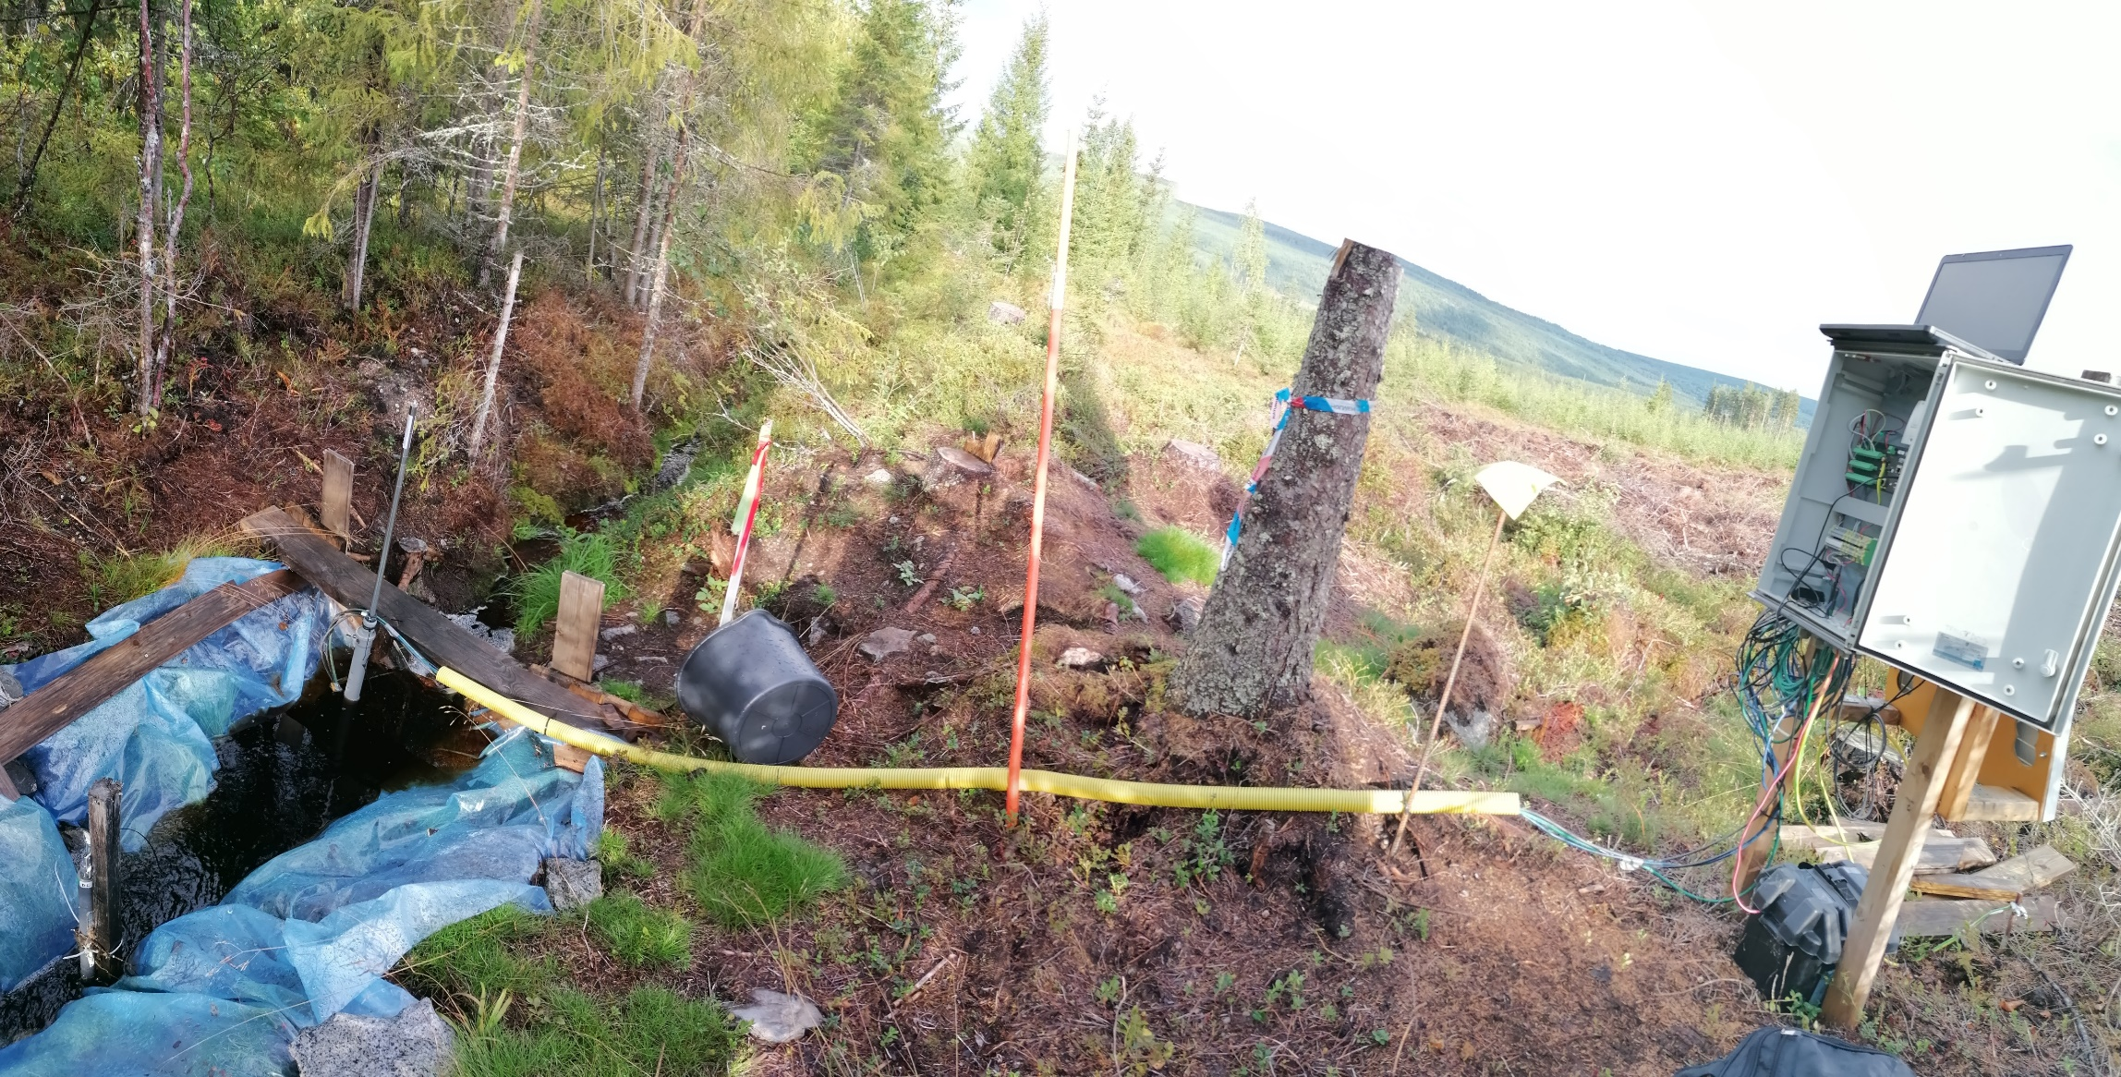
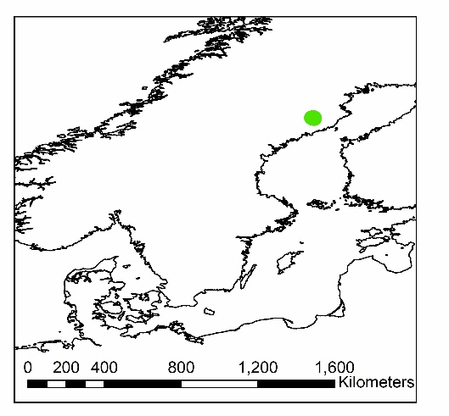
High-frequency (30 min)
CO₂
Water Temperature
Water Level
Electrical Conductivity
Precipitation (mm)
Air Temperature
Study design
Forest ditch draining a fully harvested catchment in the Trollberget Experimental Area, northern Sweden.
Data were collected during the snow-free season from May to October.

Slide 4
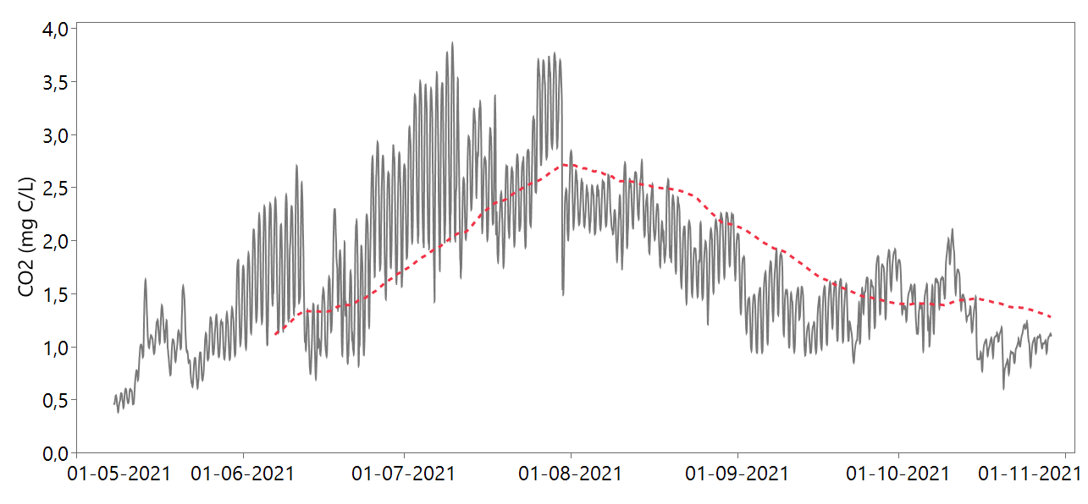
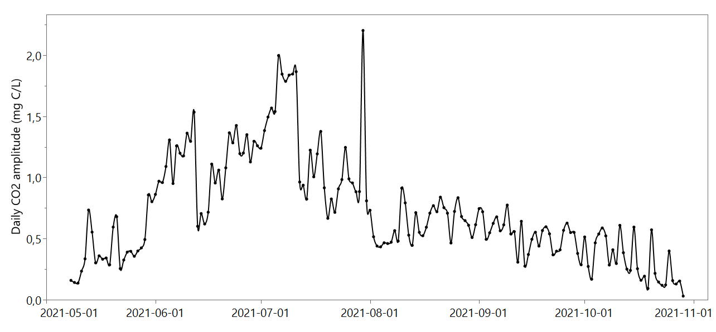
CO₂ timeseries
with 30d mov avg
CO₂ concentration range: 0.4-3.9 mg C L⁻¹ (median: 1.6 mg C L⁻¹)
Strong diel CO₂ cycles in early summer (up to 2.2 mg C L⁻¹)
Monthly CO₂ amplitudes ranged from 0.6 (October) to 2.2 mg C L⁻¹ (July)
Daily CO₂ amplitudes
Daily CO₂ cycles likely driven by aquatic primary production consuming CO₂ during daytime.

Slide 5
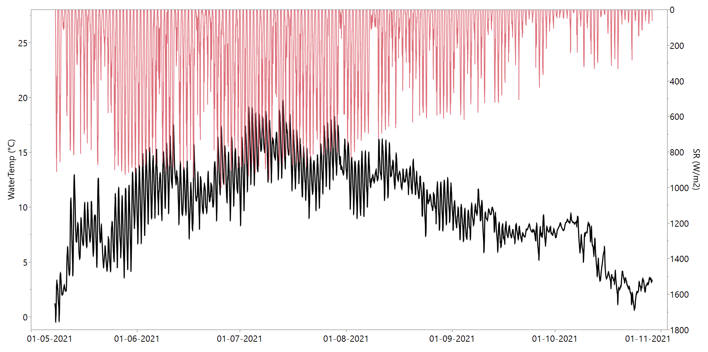
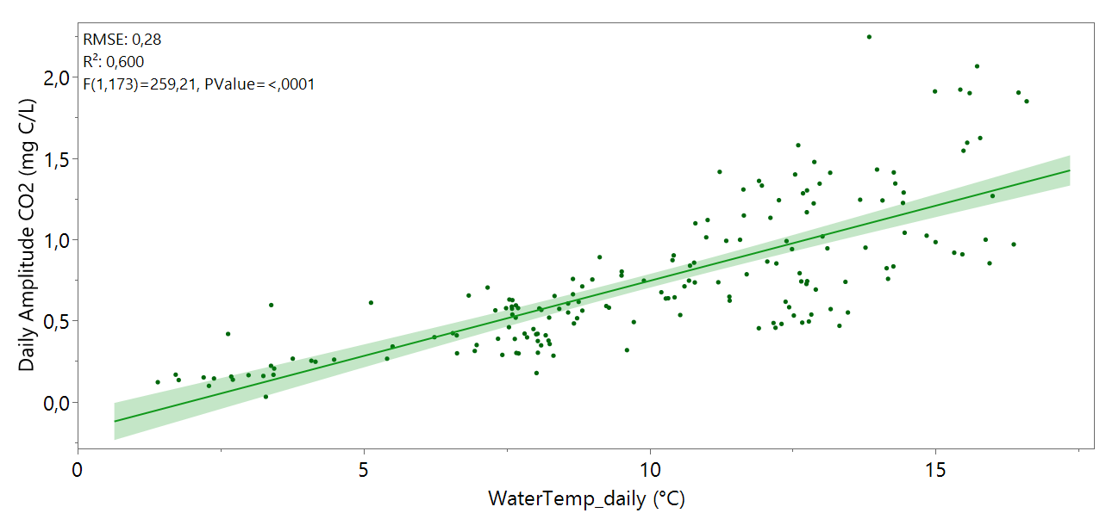
WaterTemp and incoming SR timeries
-Mean and median Water Temperature:
10°C and 10.4°C
-Max WaterTemp: 19.7 °C (13 July) and max incoming SR: 998 W/m² (25 June)
Daily CO2 amplitudes vs WaterTemp

Slide 6
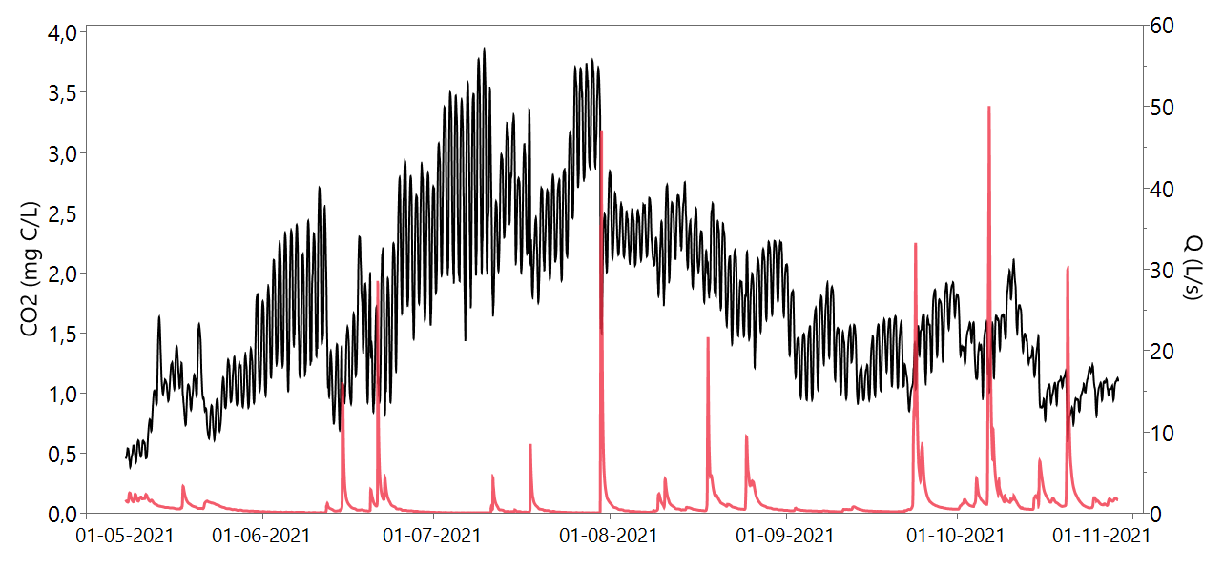
b
CO₂-discharge (Q)
Timeseries and hysteresis loops
d
c
a
a (17-19/5)
b (30/7-1/8)
c (24-26/8)
d (15-16/10)
CO₂ (mg C/L)
Q (L/s)

Slide 7
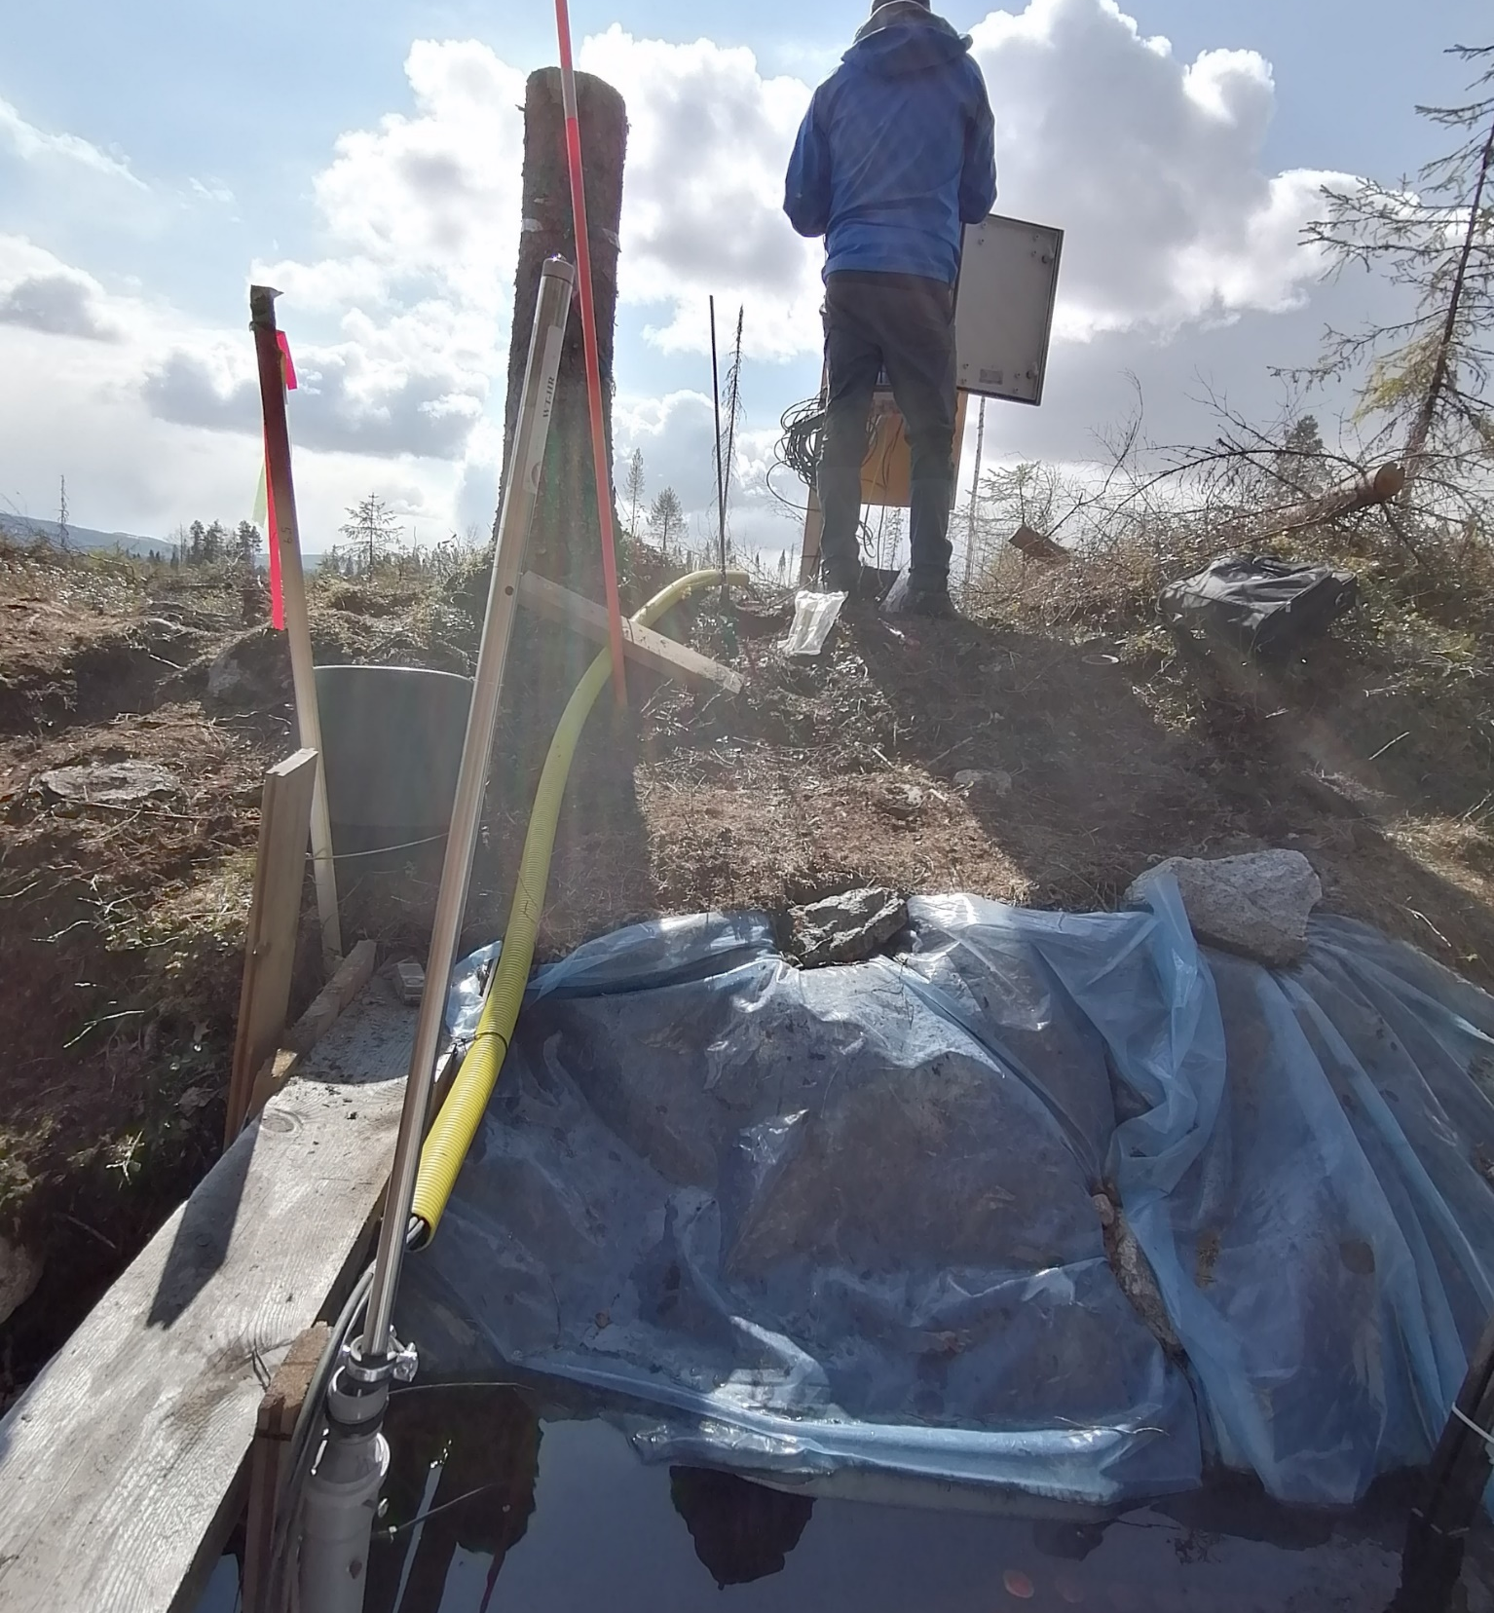
Conclusions
Growing season CO₂ dynamics in forest ditches affected by clear-cutting are high and controlled by a combination of hydrological and biological factors.
These high dynamics and the associated controls need to be considered when scaling ditch CO₂ emissions across boreal landscapes affected by clear-cut forestry.

Slide 8
Thank you for your attention
CONTACT DETAILS
Alberto Zannella
Department of Aquatic Sciences and Assessment
Swedish University of Agricultural Sciences, Uppsala, Sweden
alberto.zannella@slu.se
+393931854276

