Slide 1
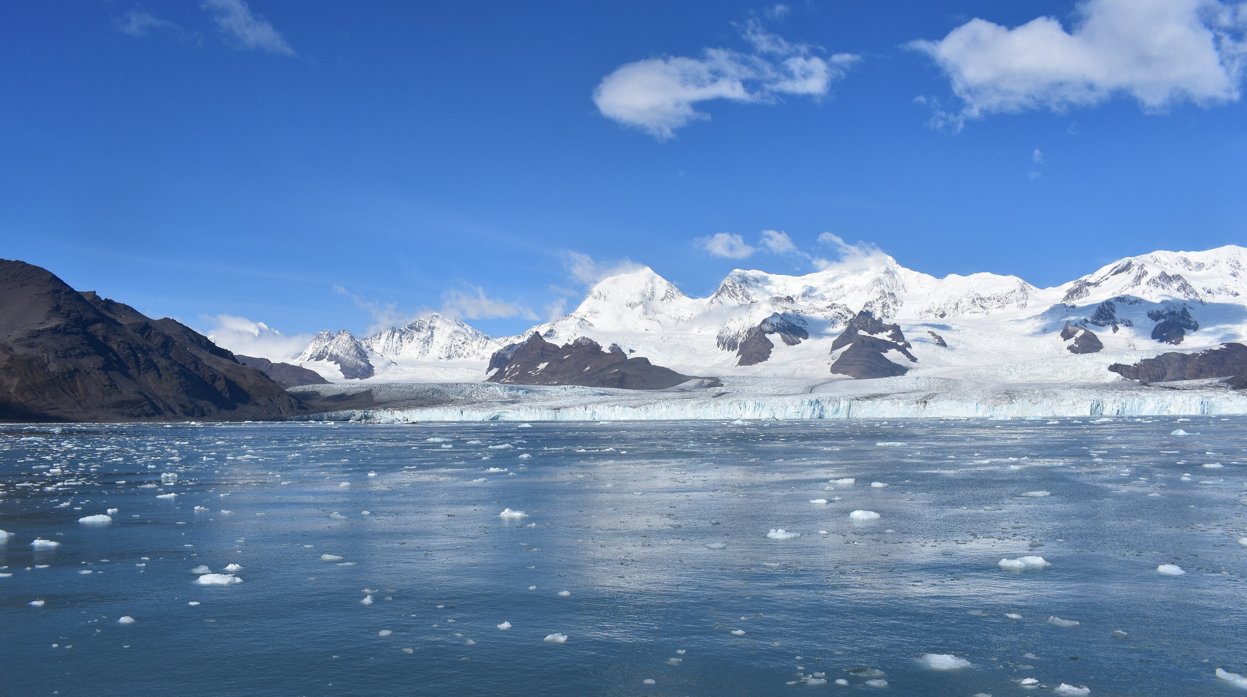




Impacts of variability in fjord circulation on glacier dynamics Cumberland Bay, South Georgia
Modelling buoyancy-driven circulation
Joanna Zanker
British Antarctic Survey, INSPIRE DTP University of Southampton
joazan@bas.ac.uk
Supervisors: Dr Emma Young (BAS)
Dr Ivan Haigh (NOC)
Dr Paul Brickle (SAERI)
South Atlantic Environmental Research Institute

Slide 2
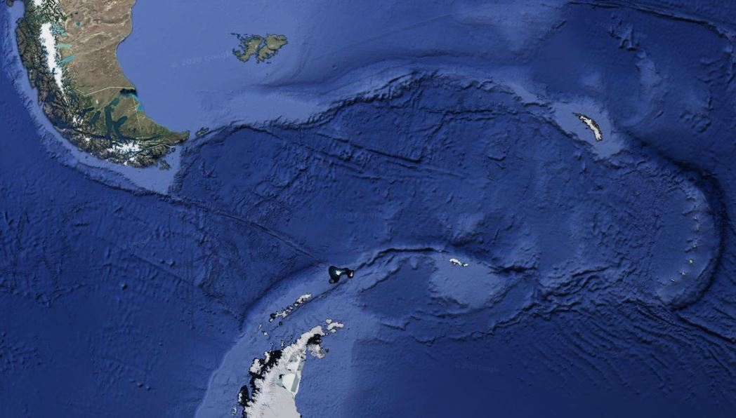
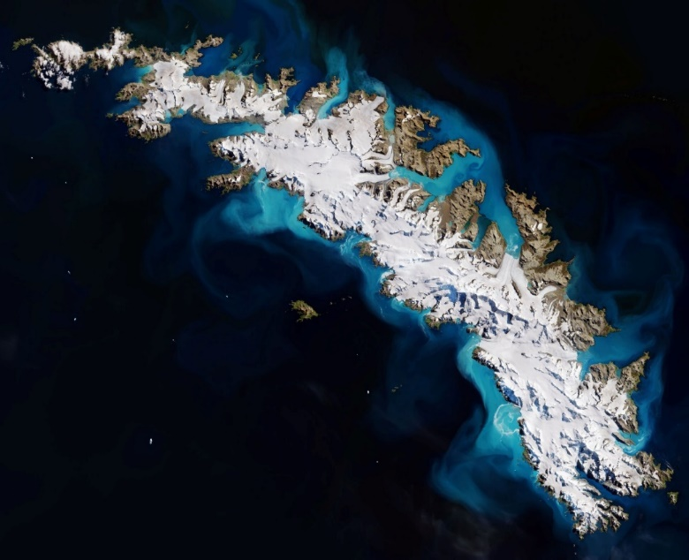
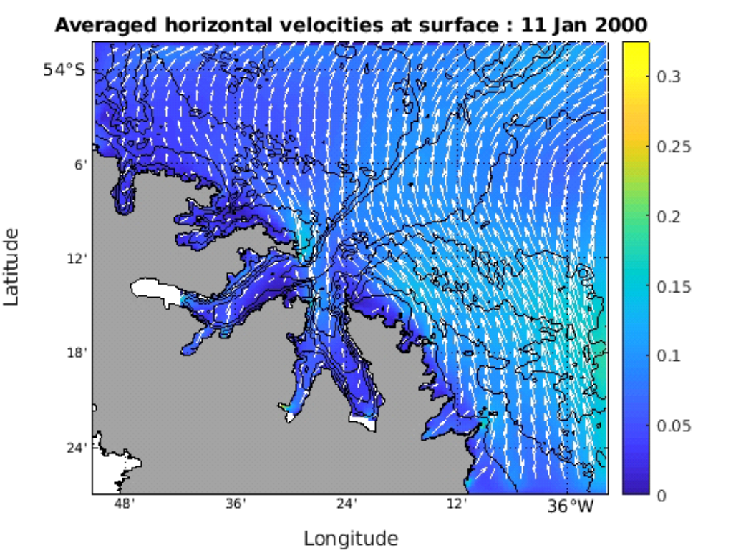


Background & motivation
1
Google Earth image
Example model flow fields
Satellite image of SG and Glaciers
CB
S. America
South Georgia
Antarctic Peninsula
N
South Georgia (SG) is an island in the Southern Ocean, lying in the path of the ACC in a belt of strong westerly winds and south of the Polar Front.
~160 m deep
Probable shallow inner sill
200 m horizontal resolution numerical model developed in NEMO4
Hypothesis: Differential retreat rate of glaciers is controlled by buoyancy-driven circulation from subglacial discharge.
West Bay
~70 m deep
Cumberland Bay (CB) largest fjord on SG, split into two arms, East and West Bay.
West Bay glacier has retreated significantly more than East Bay glacier over the past century.
East Bay

Slide 3
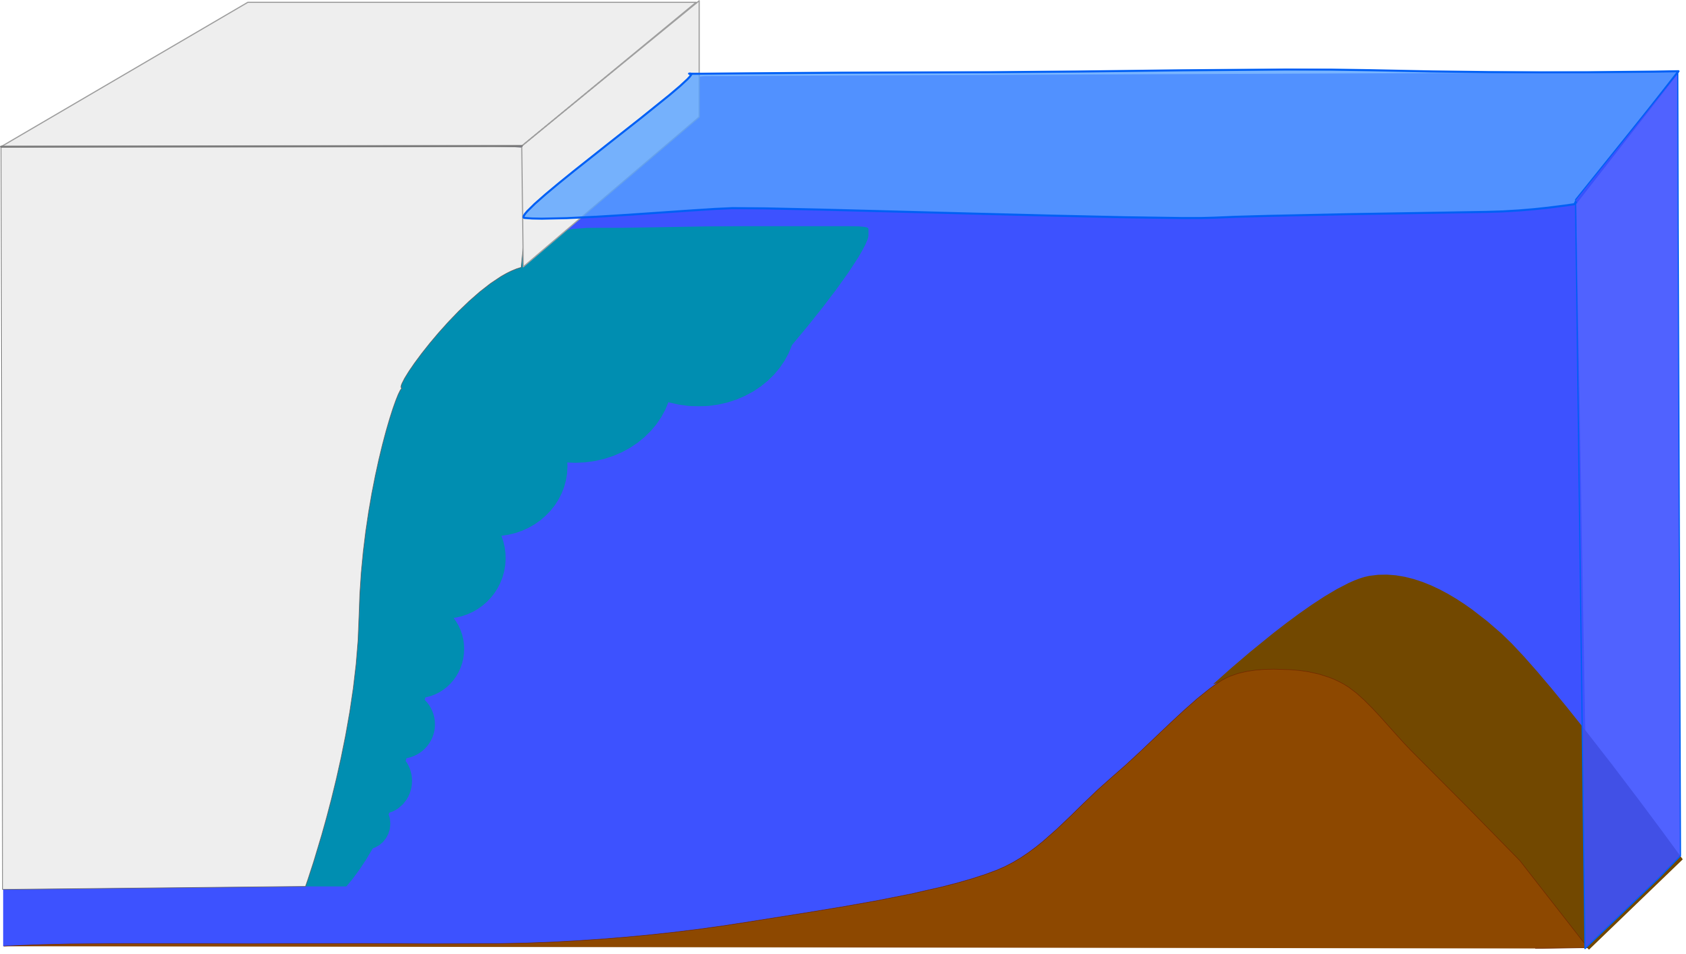






2
Surface freshwater runoff
Estuarine circulation
Grounded marine-terminating glacier
Buoyancy-driven circulation
Buoyant plume
Entrainment
Subglacial discharge
Sill
Problem - How to capture buoyancy-driven circulation in NEMO4 with hydrostatic assumption?

Slide 4


3
Solution
Offline plume model (Jenkins 2011) calculates properties plume (T, S, b, u) based on ambient ocean conditions* and theoretical climatological glacial melt cycle.
Daily average modified subglacial discharge inserted from surface down to the depth of neutral buoyancy.
Modified subglacial discharge, increased Q
Depth of neutral buoyancy
Simulates mixing at depth and large outflow near surface.
1 grid cell width
Glacier
No entrainment (inflow) at depth, not coupled
Cannot enter subglacial runoff at depth as the plume cannot be resolved (hydrostatic assumption).
(Fully coupled model not within scope of project)
* Ambient ocean conditions found from a model simulation with no freshwater runoff
T = temperature, S = salinity, b = width, u = speed

Slide 5
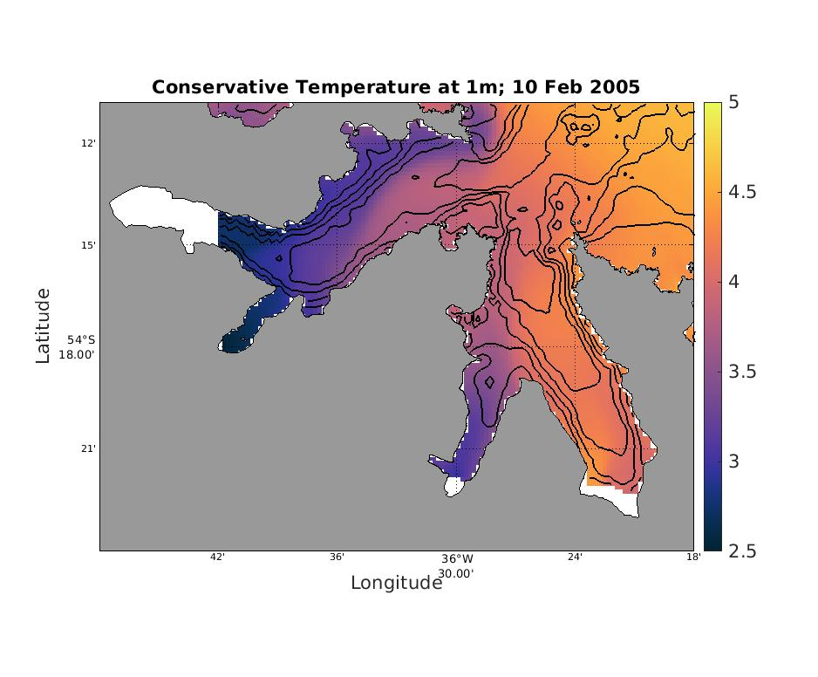
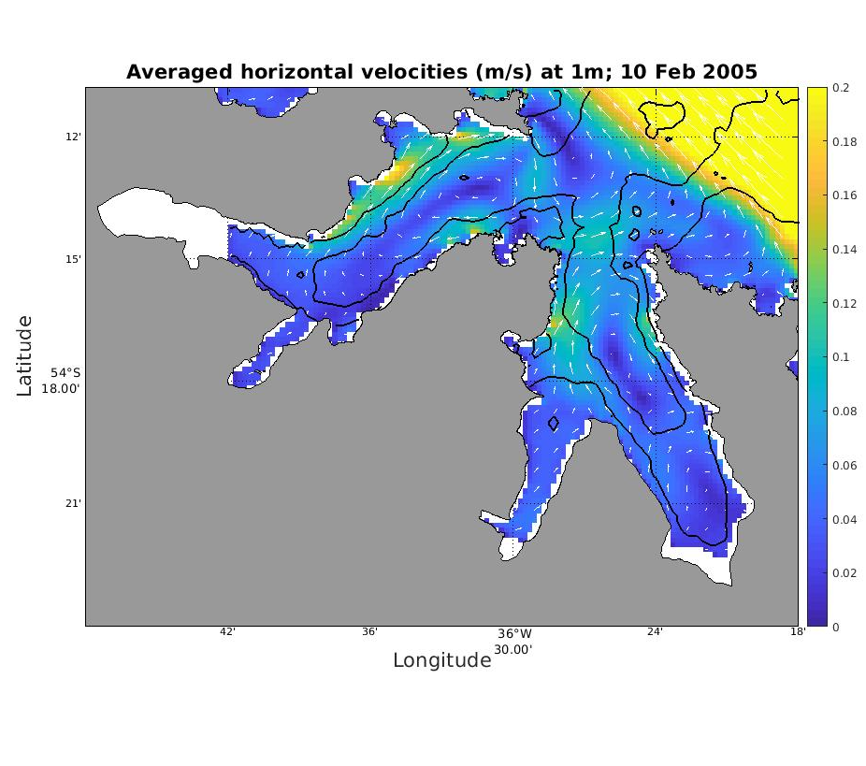
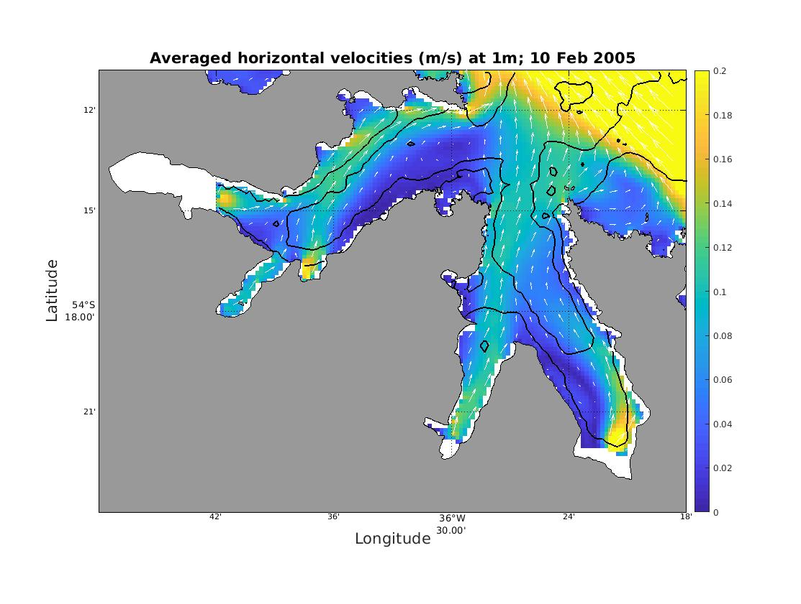
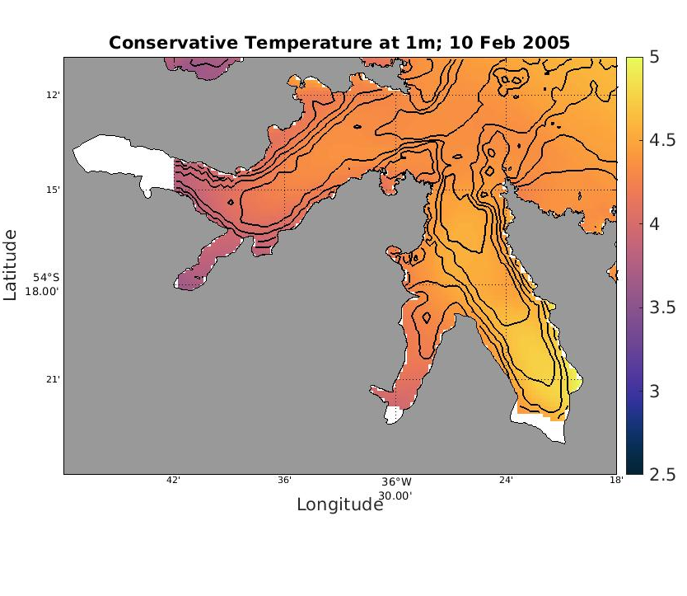
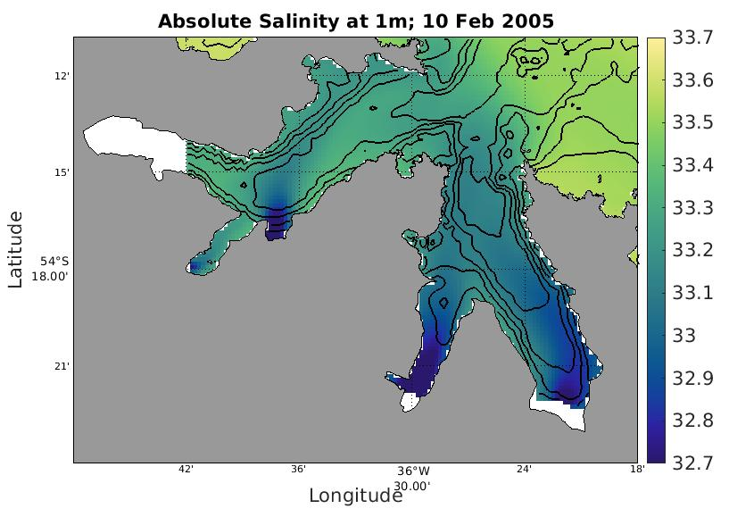
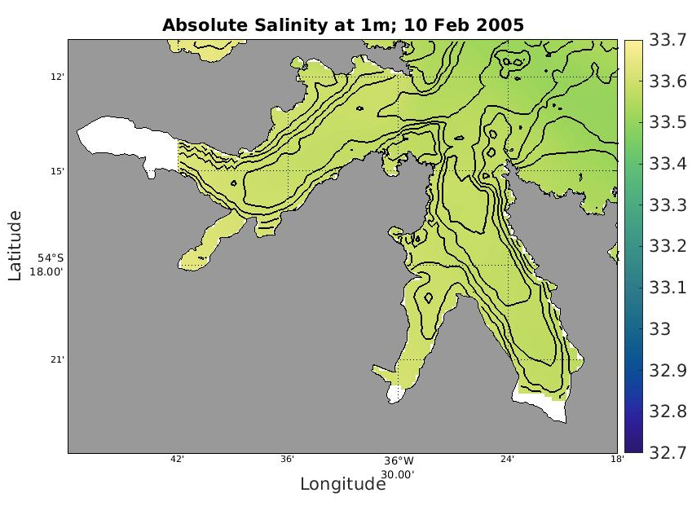
Initial results
No modified subglacial discharge
With modified subglacial discharge

Slide 6
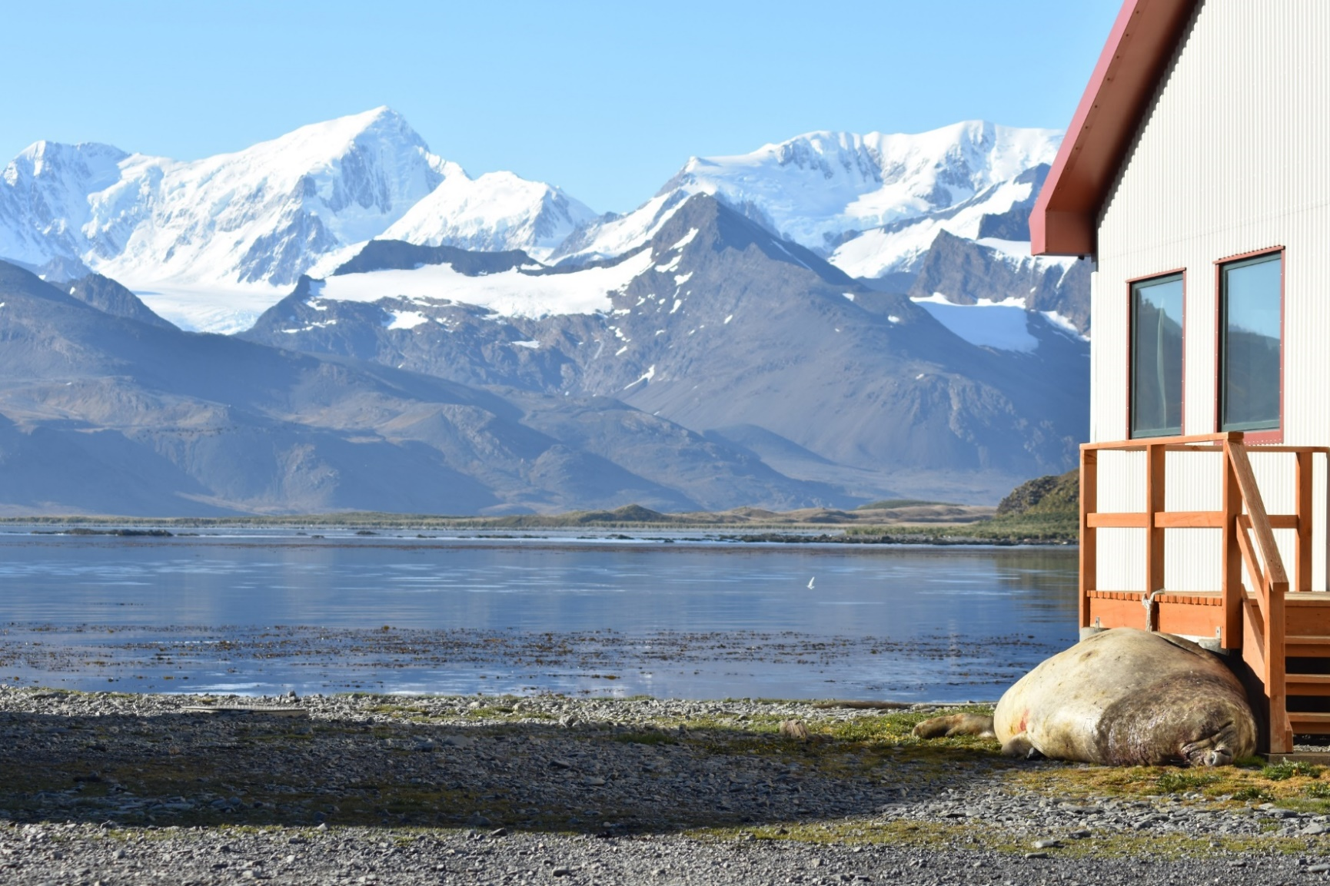
Work in progress …
5
Investigate heat and salt transports through cross-sections in East and West Bay
Insert artificial shallow sill in West Bay
Experiment with Föhn wind events
joazan@bas.ac.uk

