Slide 1

Interpretation of seismic reflection vintage lines from the Variscan Fold and Thrust Belt in the Aachen region, Germany:
Implications for geothermal exploration
Alexander Jüstel^{1,2}, Oliver Ritzmann¹, Frank Strozyk^{1,2}, Peter Kukla^{1,2}
1: Fraunhofer IEG, Fraunhofer Research Institution for Energy Infrastructures and Geothermal Systems IEG, Am Hochschulcampus 1, 44801 Bochum, Germany;
2: RWTH Aachen University, Geological Institute, Wüllnerstraße 2, 52062 Aachen, Germany
Notes:
Hello everyone, I am going to present the interpretation of seismic reflection vintage lines from the Aachen Fold and Thrust Belt in western Germany and its implications for Geothermal exploration in the area. This study is part of my PhD at Fraunhofer IEG and RWTH Aachen University under the supervision of Prof. Peter Kukla.

Slide 2
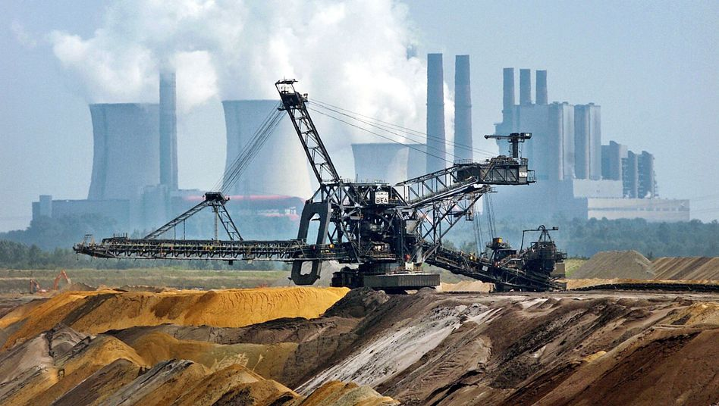
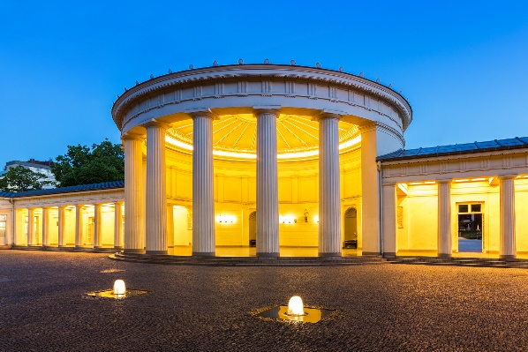
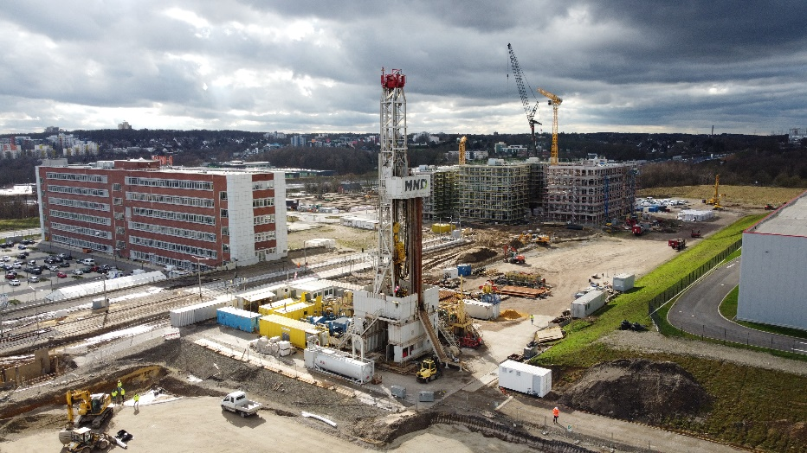
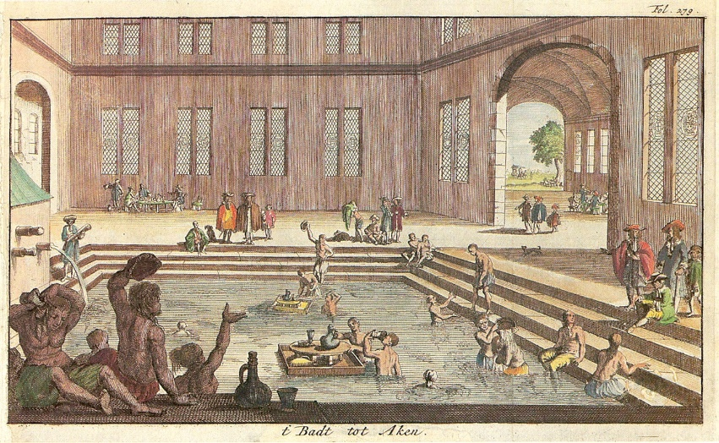
Motivation
Aachen area currently supplied with waste heat from Weisweiler coal power plant
Heat transition leads to an increased interest in geothermal energy
Aachen thermal springs as existing hydrothermal system
Complex subsurface → more exploration
https://www.spiegel.de/wirtschaft/soziales/nordrhein-westfalen-will-braunkohle-tagebau-garzweiler-ii-verkleinern-a-961390.html
Bochum. Dannenbaum
https://upload.wikimedia.org/wikipedia/commons/thumb/e/e1/Aachen_Kaiserbad_1682.jpg/240px-Aachen_Kaiserbad_1682.jpg
https://www.fotocommunity.de/photo/elisenbrunnen-aachen-rclassen/35233861
©Authors retain the copyright of all presented materials
Notes:
The Aachen area and the city of Aachen in particular is supplied with district heat or waste heat from the Weisweiler coal power plant, which is supposed to shut down in 2028. The ongoing heat transition in Germany leads to an increaesed interest in geothermal energy. And what we already know is that we have a working hydrothermal system, which the Romans already knew and which you can still visit in the city center of Aachen. However, this increased interest also makes more exploration activities of the rather complex subsurface necessary.

Slide 3
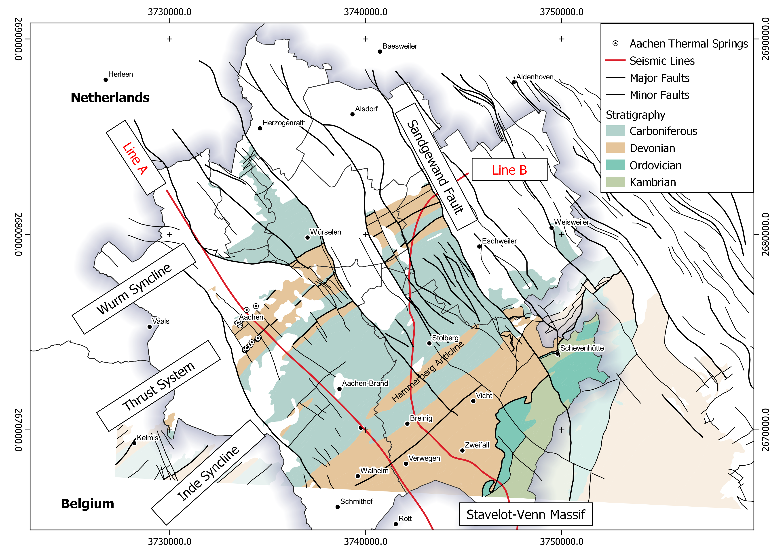
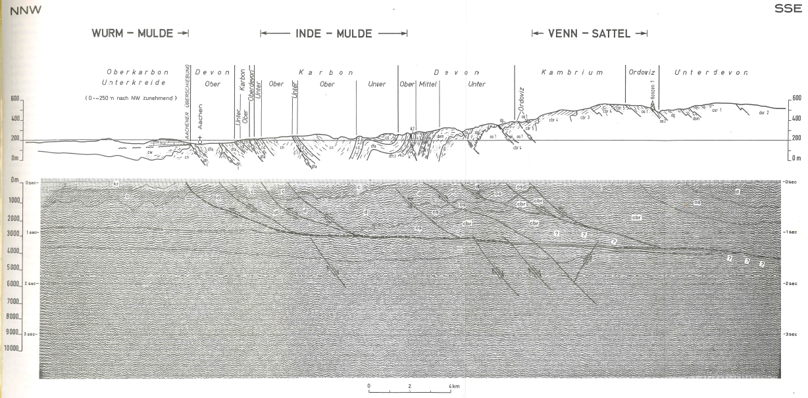
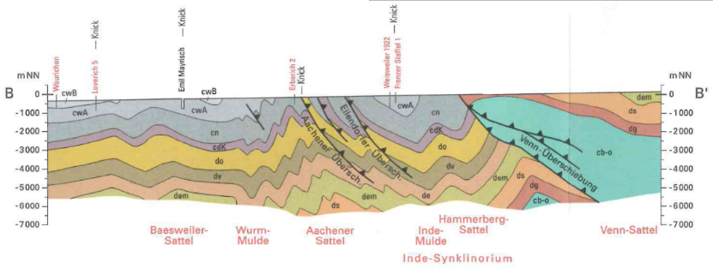
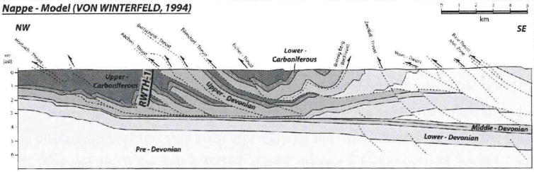
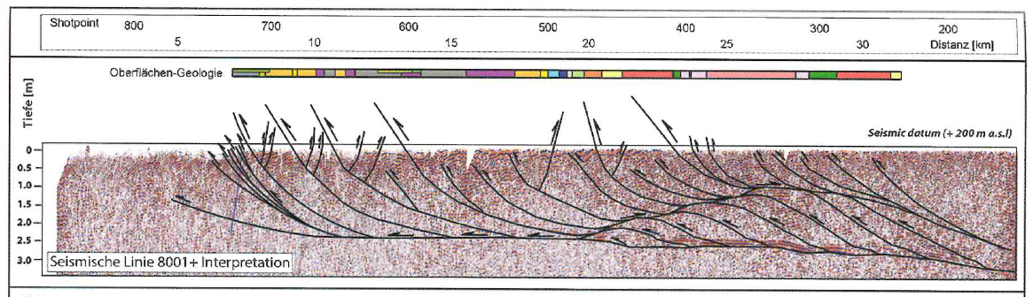
Geological Background and existing models
Thin-skinned
Thick-skinned
Durst, 1985
Ribbert & Wrede, 2005
Becker, 2008
Mösle & Becker, 2016
Fritschle et al., 2021
©Authors retain the copyright of all presented materials
Notes:
What does subsurface look like and what models already exist? Well, on the left side you can see an uncovered geological map of the Aachen area showing the Carboniferous and Devonian rocks of the Aachen fold and thrust belt represented by the Inde Syncline and the Thrust system itself. Two end member models exist which are shown by NW-SE trending cross sections on the right. The first includes thin skinned tectonics and a detachment, while the second one includes rather thick skinned tectonic processes. Lower Carboniferous and Upper/Middle Devonian Carbonates, here indicated in blue, are the current targets for geothermal exploration in the Aachen area.
The interpreted seismic lines A and B run NW-SE and roughly N-S through the Inde Syncline. Prior to a seismic attribute analysis and the interpretation, minor seismic conditioning was performed to enhance the image quality. In order to aid the interpretation of the data, structural data from surrounding outcrops was included in the process.

Slide 4
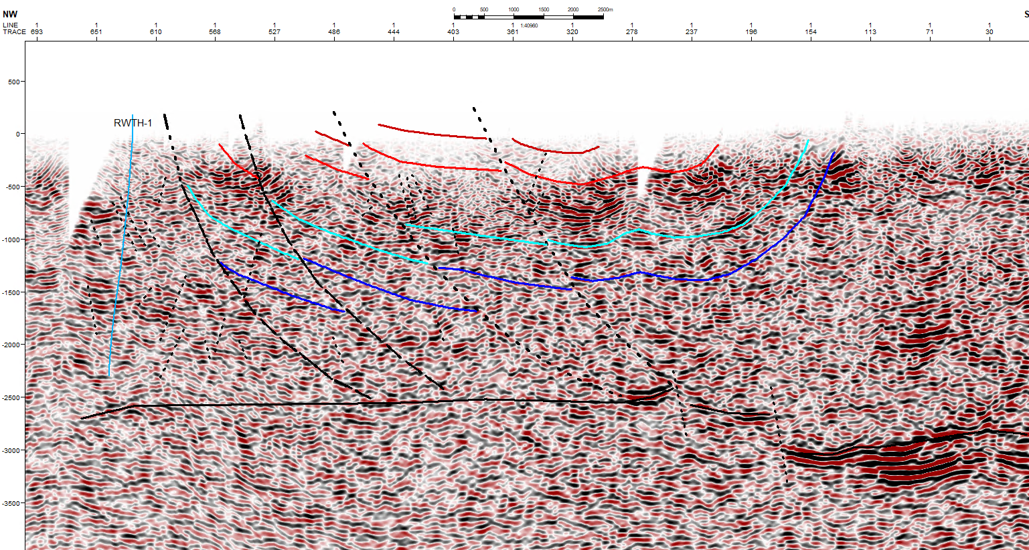
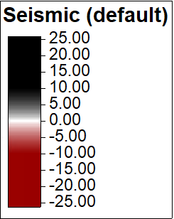
Results Line A
Wurm Syncline
Inde Syncline
Top/Base
Kohlenkalk
Hammerberg
Anticline
Burgholz
Syncline
Top/Base
Massenkalk
Stavelot-Venn
Massif
AC-
BS-
ED-
Eiche-Thrust
Venn Thrust
Depth [m]
Lower
Devonian
©Authors retain the copyright of all presented materials
Middle/Lower
Devonian
Detachment at
approx. -2,500 m!
Notes:
Looking at the results of the interpretation in line A, we can clearly see the structure of the thrust system on the left, the Inde Syncline in the center with the Hammerberg Anticline and the Burgholz Syncline adjacent to it. What is striking are strong reflectors at around 2.5 km to 3.0 km depth marking most likely a low velocity zone and the propsed detachment.

Slide 5
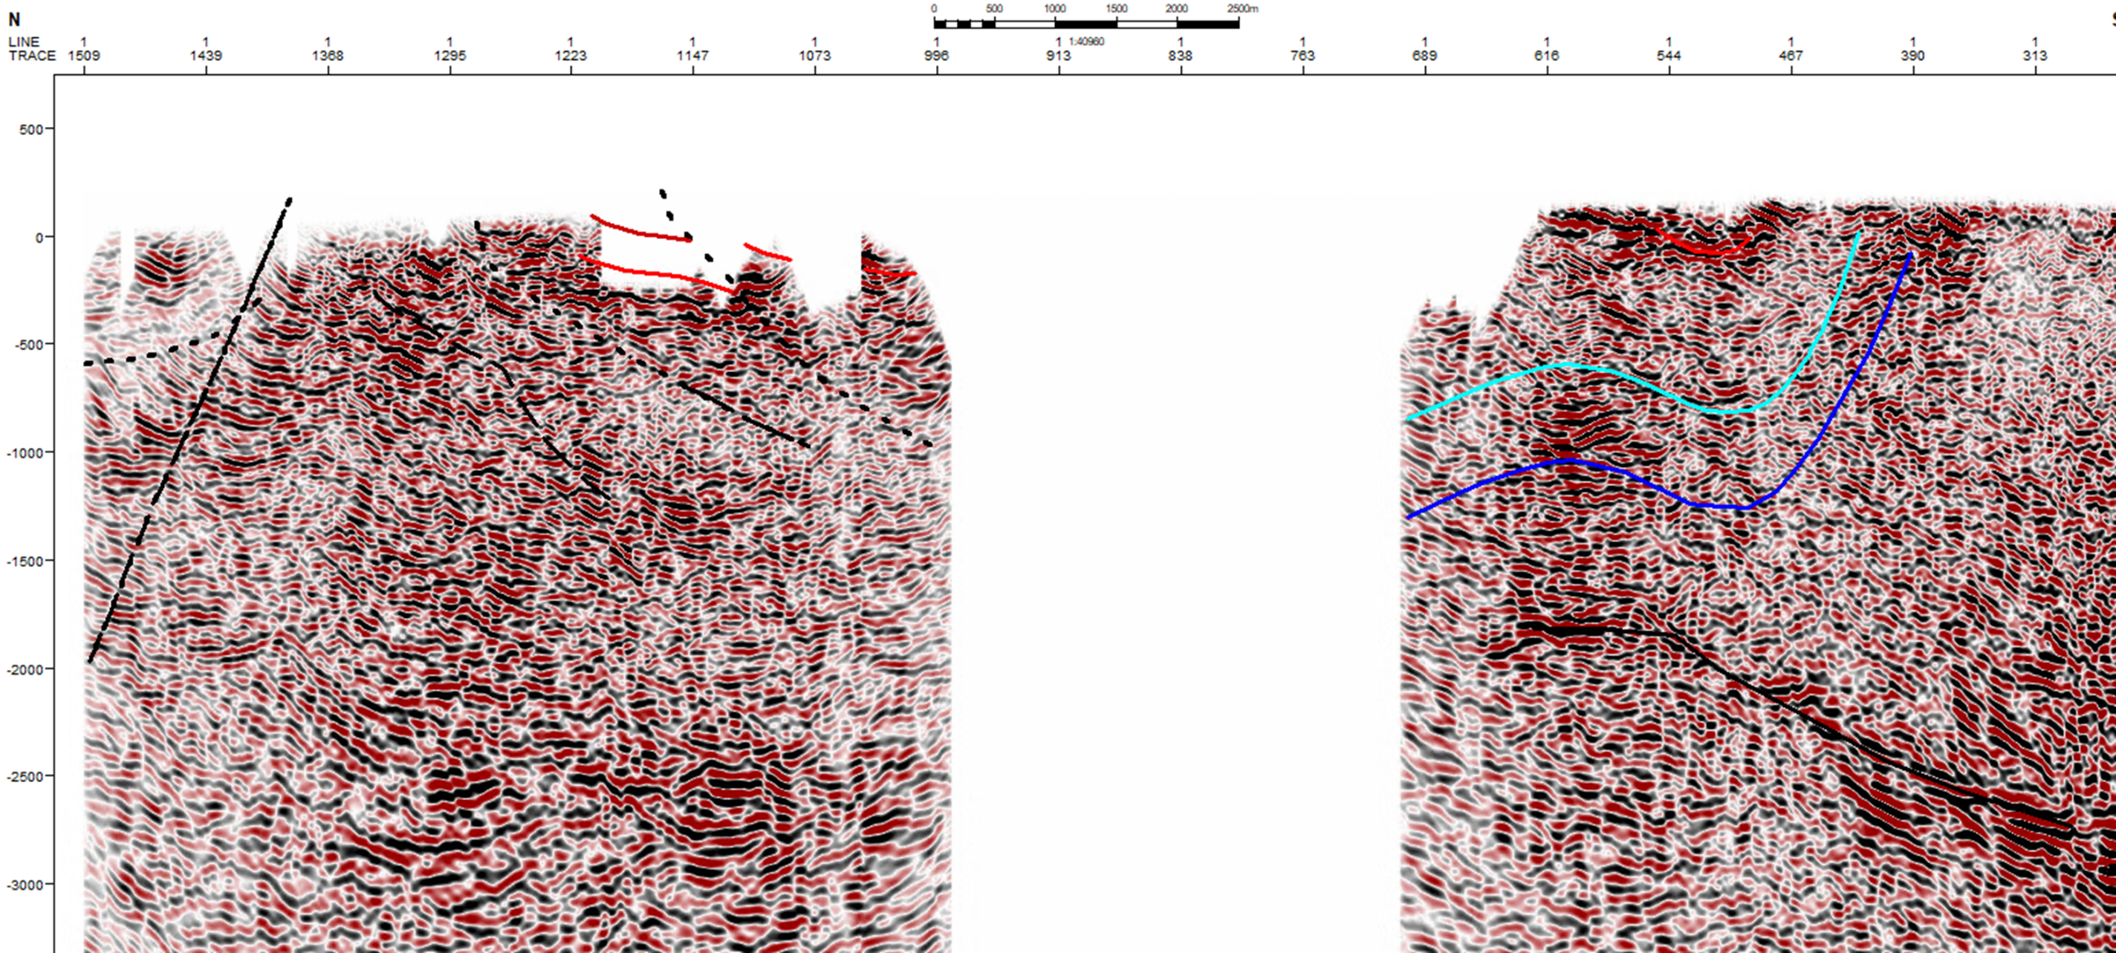
Results Line B
Top/Base
Massenkalk
AC-
AC-
BS-
ED-
Inde Syncline
Hammerberg
Anticline
Burgholz
Syncline
Top/Base
Massenkalk
Sandgewand Fault
Top/Base
Kohlenkalk
Acquisition Gap
Stolberg
Depth [m]
Middle/Lower
Devonian
Detachment at
approx. -1,750 m!
©Authors retain the copyright of all presented materials
Notes:
Looking at the results of the interpetation of the second line, line B, we have a large acquisition gap in the center of the Inde Syncline. However, the Hammerberg Anticline and the Burgholz Syncline are well defined. In the nothern part, the line becomes crooked and the interpretation of the thrust system becomes more challenging. However, the Tertiary Sandgewand Fault of the Lower Rhine Embayment can be clearly interpreted.
Strong reflectors can be also be found on this line. However, the depth decreased by about 750 m to 1750 m. This decrease in depth is thought the have caused the formation of the Hammerberg Anticline

Slide 6
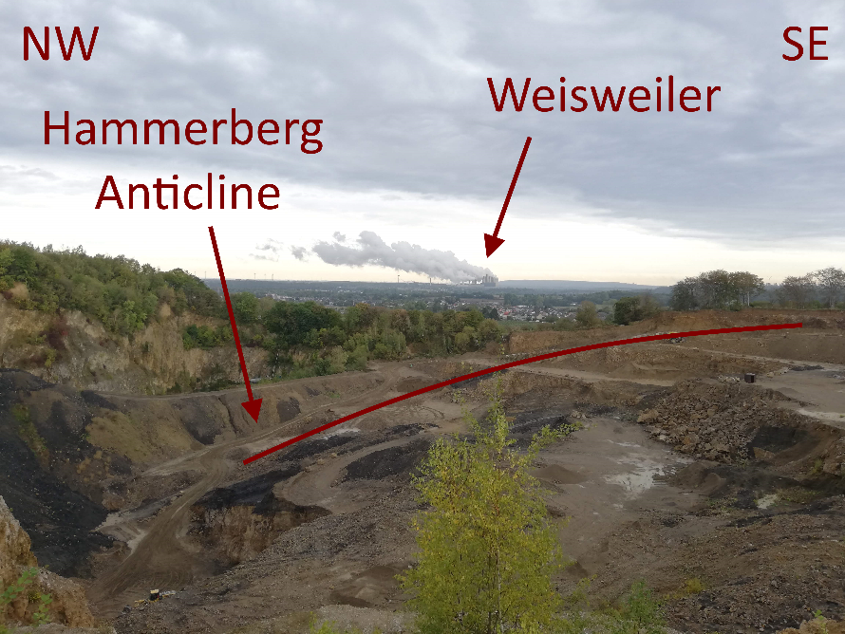

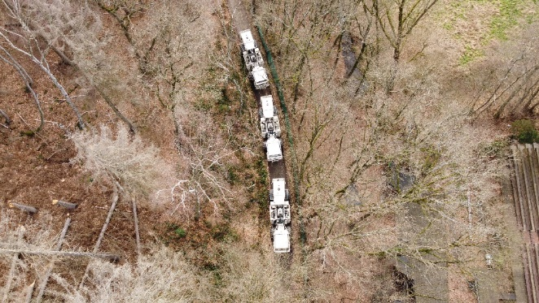
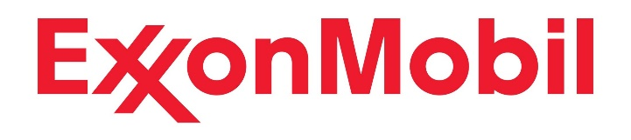
Conclusions
Surface-guided interpretation of the Aachen Fold and Thrust belt
Seismic interpretation favors thin-skinned tectonic models
Interpretation indicates pontential reservoirs at depth
AND……
Outlook
1,500 m deep exploration well in Weisweiler in Q4 2022/Q1 2023
2D seismic investigations in Belgium for E-Test
3D seismic investigations in the Aachen-Weisweiler area
Data graciously provided by:
©Authors retain the copyright of all presented materials
Notes:
What conclusions can be drawn from this? Well, it was possible to integrate surface data, for instance from the Hammerberg Anticline, into the seismic interpretation
The seismic interpretation favors the thin-skinned tectonic models and indicate the formation of the Hammerberg Anticline as a result of the depth decrease of about 750 m for the proposed detachment
The interpretation indicates potential reservoirs at depth but a more concise image of the subsurface is needed for future geothermal exploration. Therefore, a 1,500 m deep exploration well will be drilled at Weisweiler within the DGE Rollout Project, the colleagues from E-Test conduct a 2D seismic survey which will provide additional information for a survey design for a proposed 3D seismic campaign in the Aachen area in the near future

