Slide 1


Shallow crustal architecture of the foreland Kumaon Himalaya analysing high-resolution seismic data
EGU22-9287
https://doi.org/10.5194/egusphere-egu22-9287
EGU General Assembly 2022
Authors: Shashank Verma* and Dibakar Ghosal
Email Id: snarayan@iitk.ac.in*

Slide 2
Outline
Introduction to problem statement
Study Area and Geology
Data Acquisition and Methodology
Results and Interpretations
Concluding Remarks

Slide 3
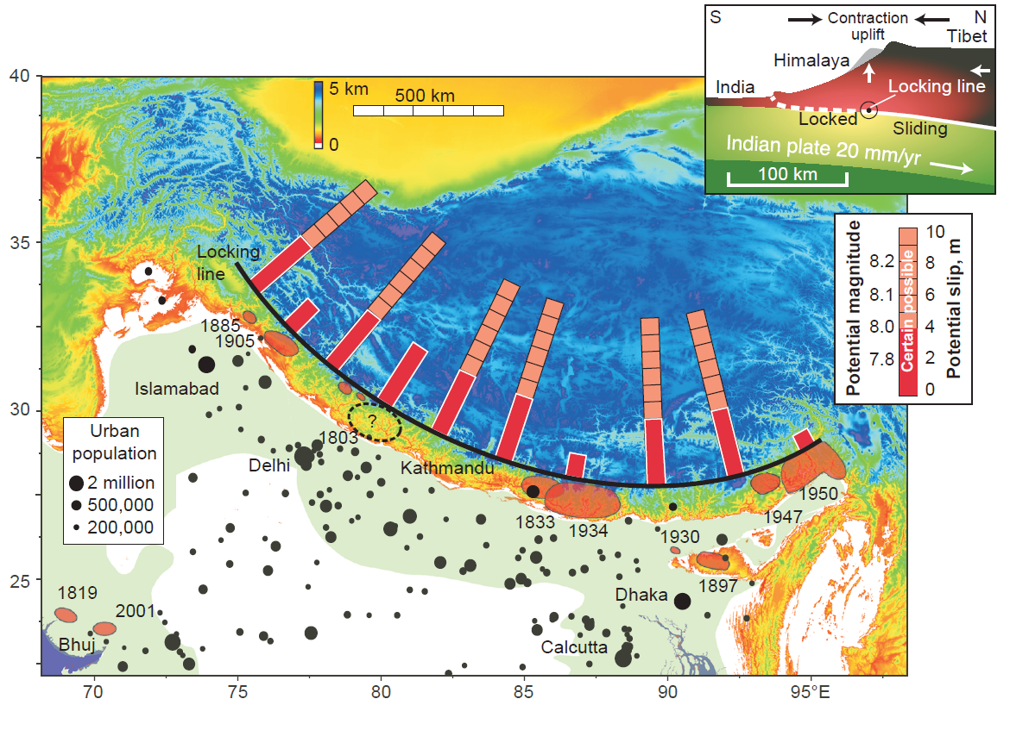
Introduction to Problem Statement
Himalayan Earthquake claimed several lives in the past and various studies suggest that the region is highly vulnerable to a great earthquake in the near future.
Three Crucial questions associated with an earthquake Hazard is
When, Time of the next event
Where, spatial location of the next event
What is the magnitude of the event
No direct method till date available to answer these questions. However, Integrated approach based on Paleoseismic studies, active Seismic, and Geodetic measurements proved to be useful method up to some extent (Ishiyama et al., 2007; Hubbard et al., 2014; McAuliffe et al., 2015)
In the Present study, we aim to demarcate the major structural unit, fault geometry, estimation of shortening across HFT identification of the fault propagation in the foreland as reported by Duvall, (2020) in the Central Nepal Himalaya
Source: Bilham et al., 2001

Slide 4
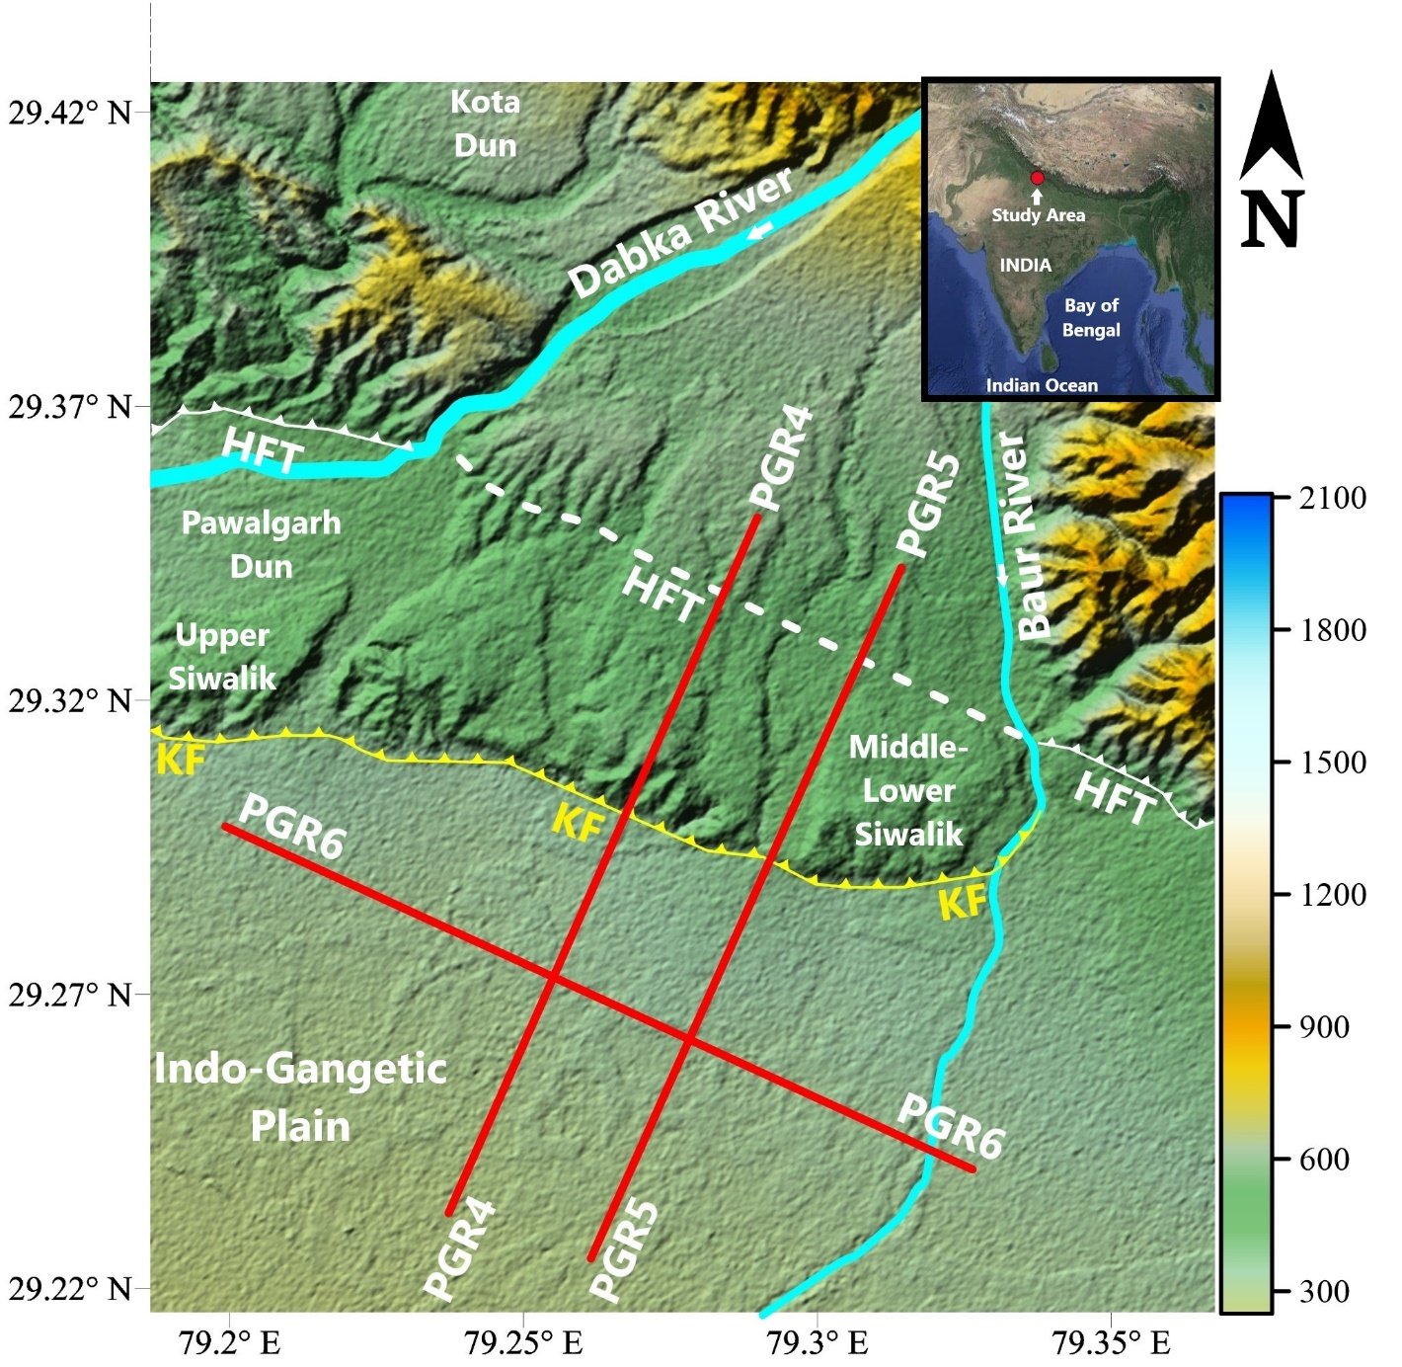
Study Area and General Geology
Study region in the Kumaon Himalaya and general stratigraphy of the region described by Nakata (1972), Karuna Karan & Ranga Rao (1976,1979)
Upper Siwalik: Formed ~5.26 – 0.5 Ma ago, that primarily composed of polymetric conglomerates, friable sandstones, mudstone with calcite cementation and interbeds
Middle Siwalik: formation aged between 11 to 5.3 Ma ago that is mainly composed of indurated sandstones with some clay interbeds (Tondon, 1976)
Lower Siwalik: Aged between 18-11 Ma deposited during Middle Miocene, primarily composed of Sandstone
Decollement: Northward dipping ~1-2° interface marking the boundary between under-thrusting Indian plate and overlying Himalayan wedge (Seeber et al., 1981; Pennock et al., 1989).

Slide 5
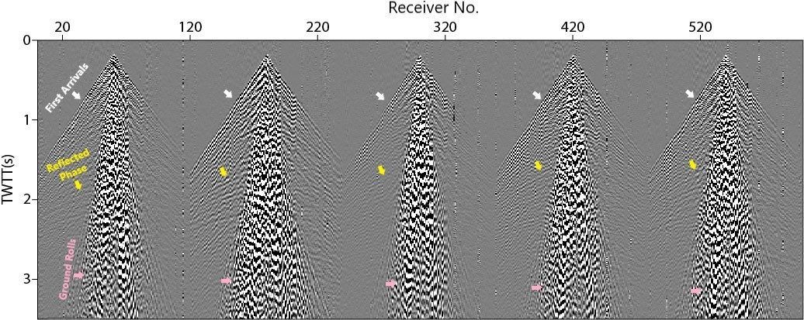
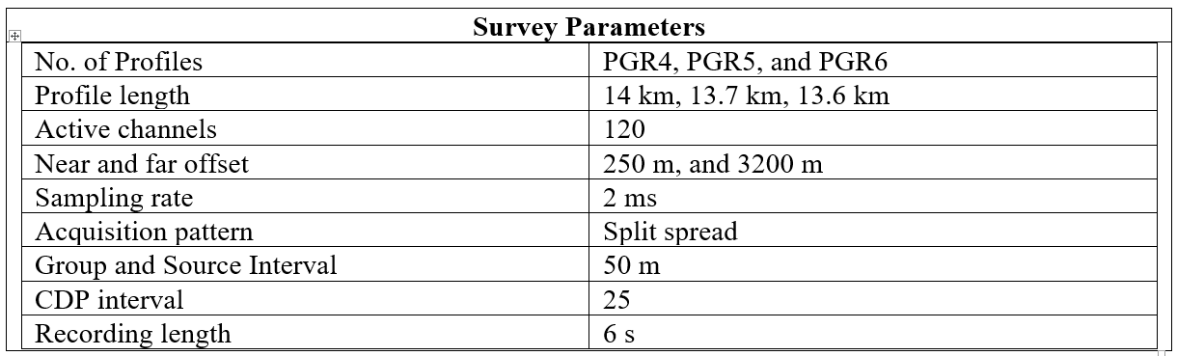
Data Acquisition and Methodology
Workflow
Raw Data
Pre-processing
Static correction
Raw shot gather of five shots
Ground roll elimination
Velocity analysis
Post-stack Time Migration

Slide 6
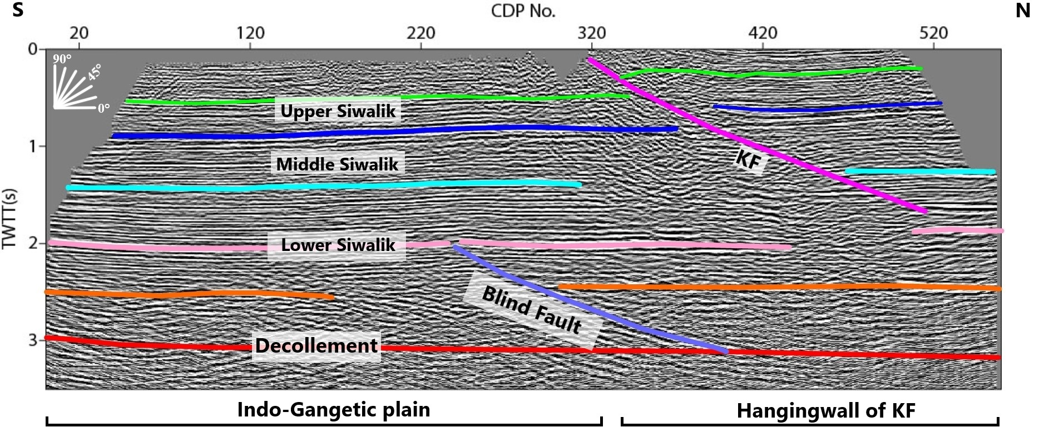
Results and Interpretations

Slide 7
Concluding Remarks
Himalayan fold thrust belt categorized as fault bend fold, and fault propagating into the foreland (Powers et al.,1998), Duvall et al. (2020) reported blind faults into the foreland depicting the developing tectonics of the region in the Central Nepal Himalaya
KF has significantly displaced the existing Siwalik formation having a northward dip ~ 30° – 24°, and developed folds ~ 3 km width towards the hangingwall of the KF
~ 800 m of Horizontal shortening estimated following methodology of the Lave and Avouac, (2000)
Signature of the blind thrust further south of the KF into the foreland that displaces the interbeds of the Lower Siwalik formation, this blind fault may rupture to the surface due to the future great earthquakes

Slide 8
Major References
Almeida, Rafael V., Judith Hubbard, Lee Liberty, Anna Foster, and Soma Nath Sapkota. "Seismic imaging of the Main Frontal Thrust in Nepal reveals a shallow décollement and blind thrusting." Earth and Planetary Science Letters 494 (2018): 216-225.
Duvall, Michael J., John WF Waldron, Laurent Godin, and Yani Najman. "Active strike-slip faults and an outer frontal thrust in the Himalayan foreland basin." Proceedings of the National Academy of Sciences 117, no. 30 (2020): 17615-17621.
Lavé, Jérôme, and Jean-Philippe Avouac. "Active folding of fluvial terraces across the Siwaliks Hills, Himalayas of central Nepal." Journal of Geophysical Research: Solid Earth 105, no. B3 (2000): 5735-5770.
Malik, Javed N., Sambit P. Naik, Santiswarup Sahoo, Koji Okumura, and Asmita Mohanty. "Paleoseismic evidence of the CE 1505 (?) and CE 1803 earthquakes from the foothill zone of the Kumaon Himalaya along the Himalayan Frontal Thrust (HFT), India." Tectonophysics 714 (2017): 133-145.
Powers, Peter M., Robert J. Lillie, and Robert S. Yeats. "Structure and shortening of the Kangra and Dehra Dun reentrants, sub-Himalaya, India." Geological Society of America Bulletin 110, no. 8 (1998): 1010-1027.

Slide 9
Thank You

