Slide 1
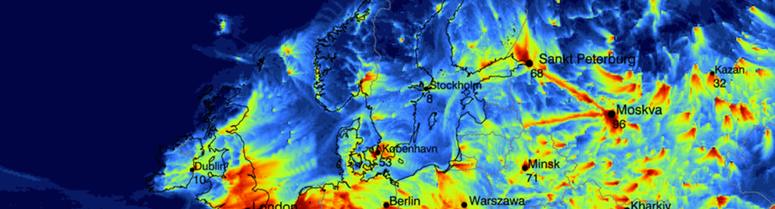



First detailed air pollution analyses by assimilating UAV observations with EURAD-IM
Air pollution modelling AS3.20| EGU General Assembly 2022
26.05.2022 I Hassnae Erraji, PhD Student, h.erraji@fz-juelich.de
Institute of Energy and Climate Research - Troposphere (IEK-8)
Co-authors: Philipp Franke, Sebastian Düsing, Tobias Schuldt, Marcel Buchholz, Andreas Schlerf, Lutz Bretschneider, Astrid Lampert, Andreas Wahner, and Anne Caroline Lange.
©Authors. All rights reserved.
Notes:
Hello everybody , my name is Hassnae I am a PhD student in the regional and inverse modeling group. Today I will present my phd topic and I will talk about

Slide 2
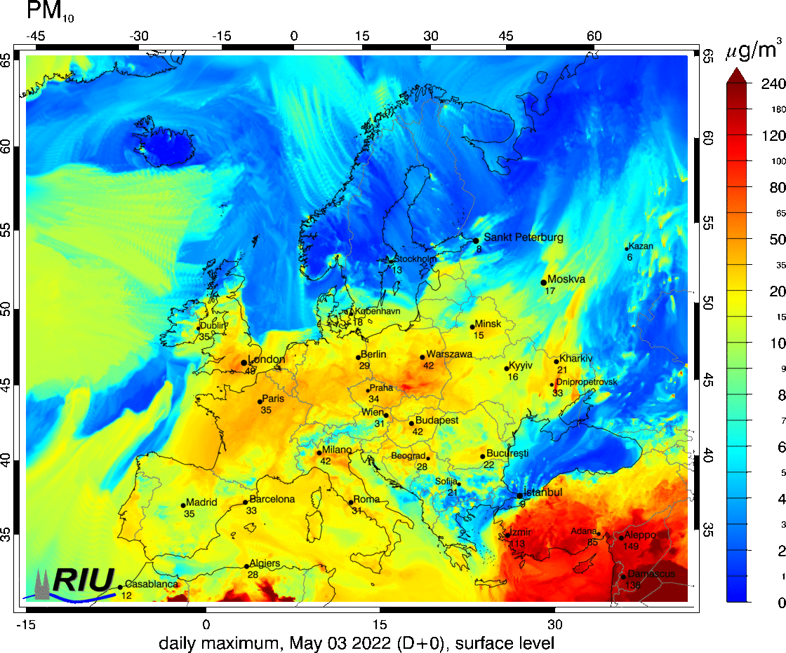




motivation
Air pollution
Air quality forecasting
harmful effects on human health, the ecosystem, and global warming
helps decision-makers to improve air quality and consequently public health, especially in urban areas
Atmospheric composition assessment:
New technology for atmospheric composition assessment:
Unmanned aerial vehicles (UAV)
+ measure near-surface vertical profiles of atmospheric pollutants with high temporal resolution.
+ are flexible, inexpensive, and able to perform measurements close to emissions sources.
- Limited spatial and temporal resolution
- prohibitively costly.
- not suitable for taking measurements close to pollutants sources as it can be dangerous or risky.
©Authors. All rights reserved.

Slide 3
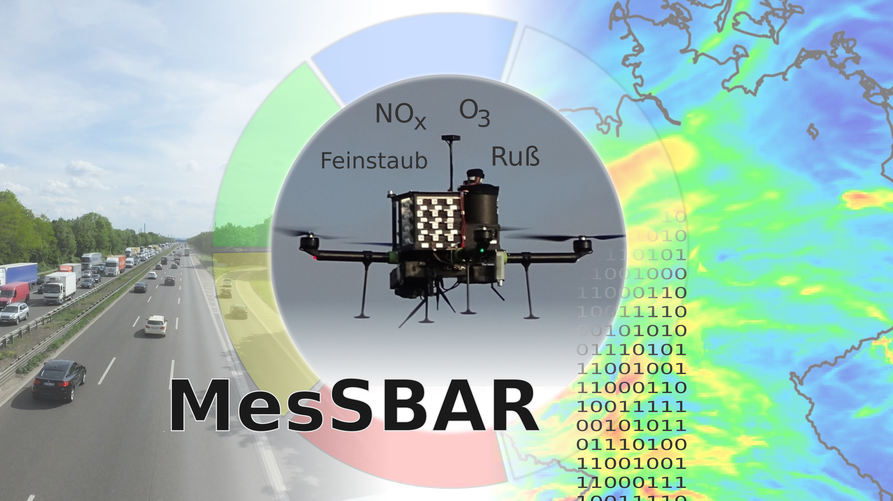


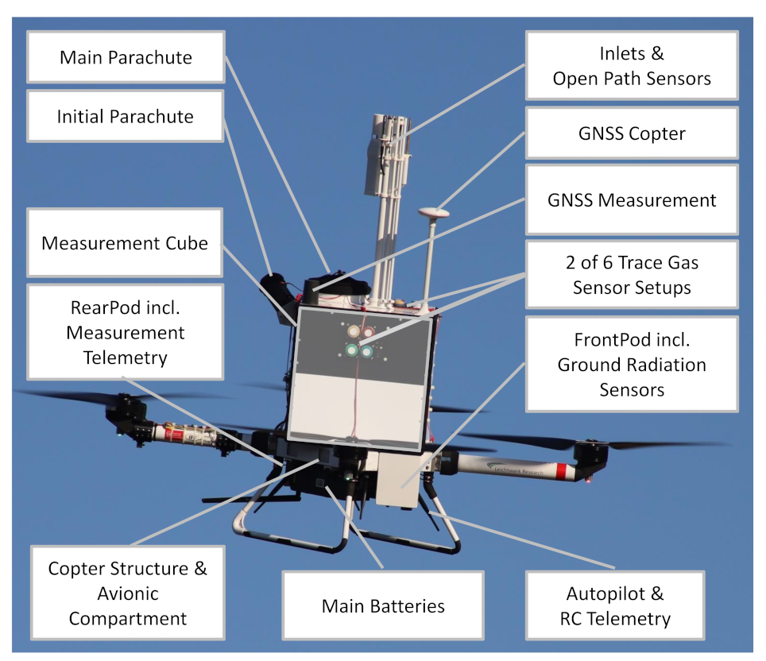
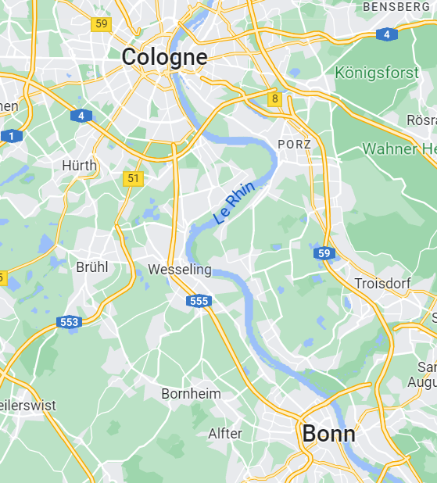




MesSBAR project
Aims of the project:
Development of highly automated pollutant drones carrying trace gases and aerosols instruments to measure near-surface vertical profiles of atmospheric pollutants.
Realize vertical profiles up to 1 km in height in Wesseling and Dresden, Germany.
Quantification of emission sources using Data Assimilation techniques with the EURAD-IM model.
Drone protype:
3 prototypes have been developed containing sensors for: Particulate matter, soot particle, NOx, CO and O₃, temperature, pressure and humidity, radiation, GPS.
Campaign measurements:
Image source : Bretschneider. L et al. Atmosphere (2022)
Image source : Google Maps
©Authors. All rights reserved.

Slide 4

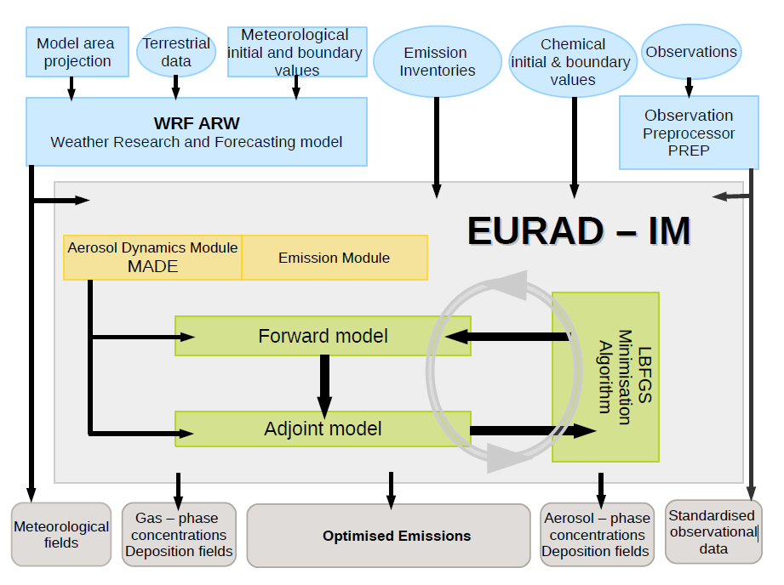
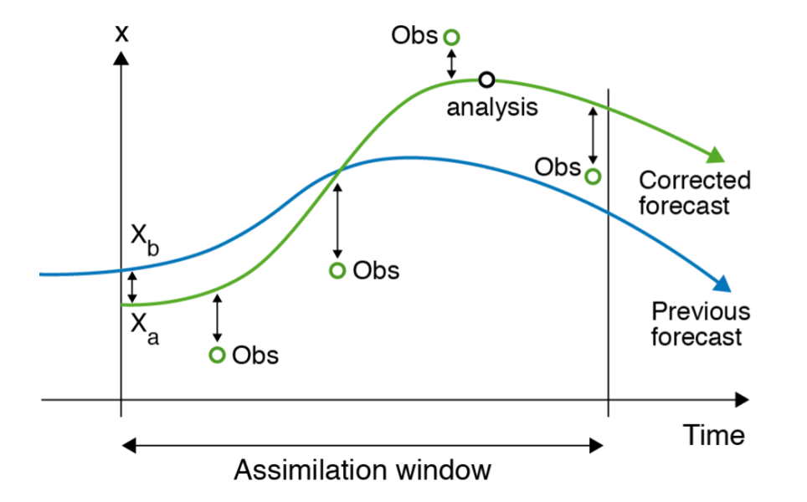
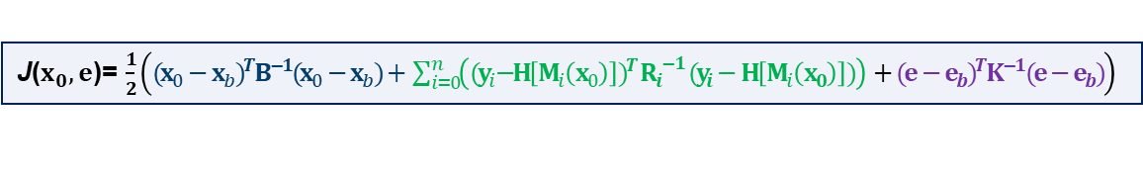
Eurad-im
European Air Pollution Dispersion – Inverse Model
Four-dimensional variational data assimilation technique (4d-var)
Data assimilation techniques provide the best estimate of the state of a physical system by combining modeling and observations.
Gas phase Chemistry Module
Data assimilation system
Image source : https://confluence.ecmwf.int/
The 4D-Var cost function :
Background
Observation
Emission
J($x_{0},e$)= $\frac{1}{2}\left({(x_{0}−x_{b})}^{T}B^{−1}(x_{0}−x_{b})+ \sum_{i=0}^{n}{\left({{(y}_{i}−H\left[M_{i}\left(x_{0}\right)\right])}^{T} {R_{i}}^{−1} (y_{i}−H\left[M_{i}\left(x_{0}\right)\right])\right)}+{(e−e_{b})}^{T}K^{−1}(e−e_{b})\right)$
©Authors. All rights reserved.

Slide 5
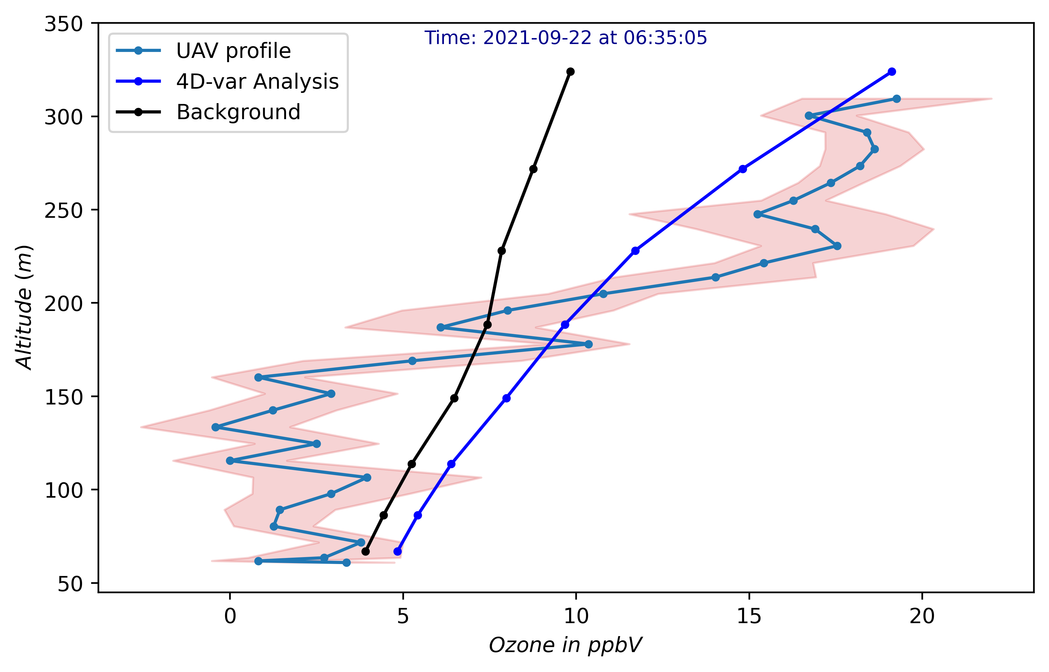
Ozone profile data assimilation
Modelling setup:
Horizontal resolution : 1 km x 1 km
Time resolution : 20 s
Vertical resolution : 30 layers/about 21 layers
below 2 km
Assimilated observations: O₃, PM10, PM2.5, PM1
Assimilation window: 00h-12h
Day : 22 sept 2021
The analysis is closer to the observation at high altitude, thus correcting where the model initially had the greatest error.
©Authors. All rights reserved.

Slide 6
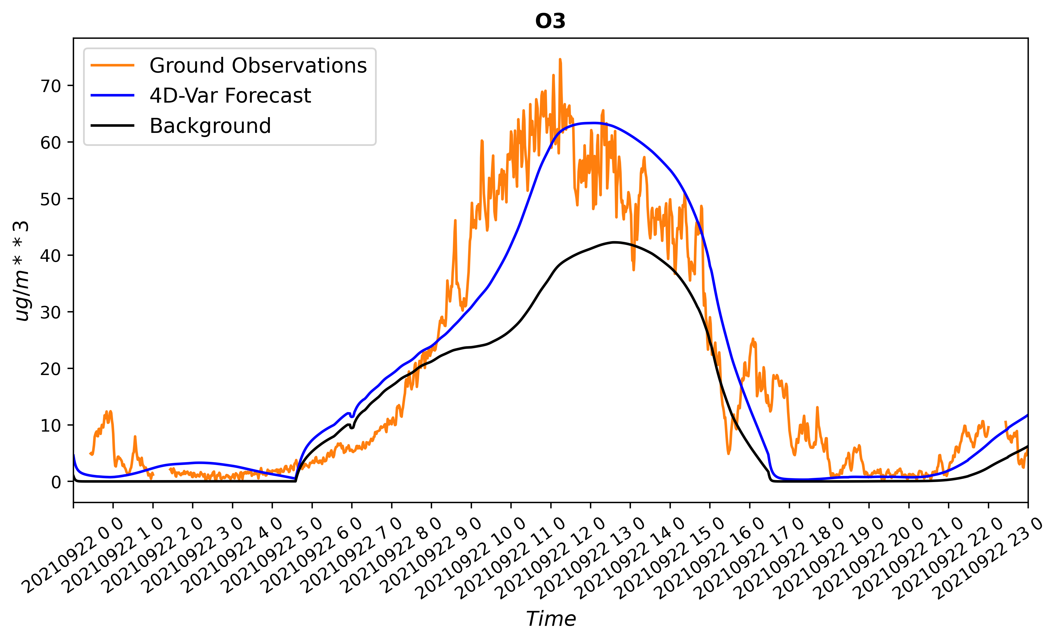
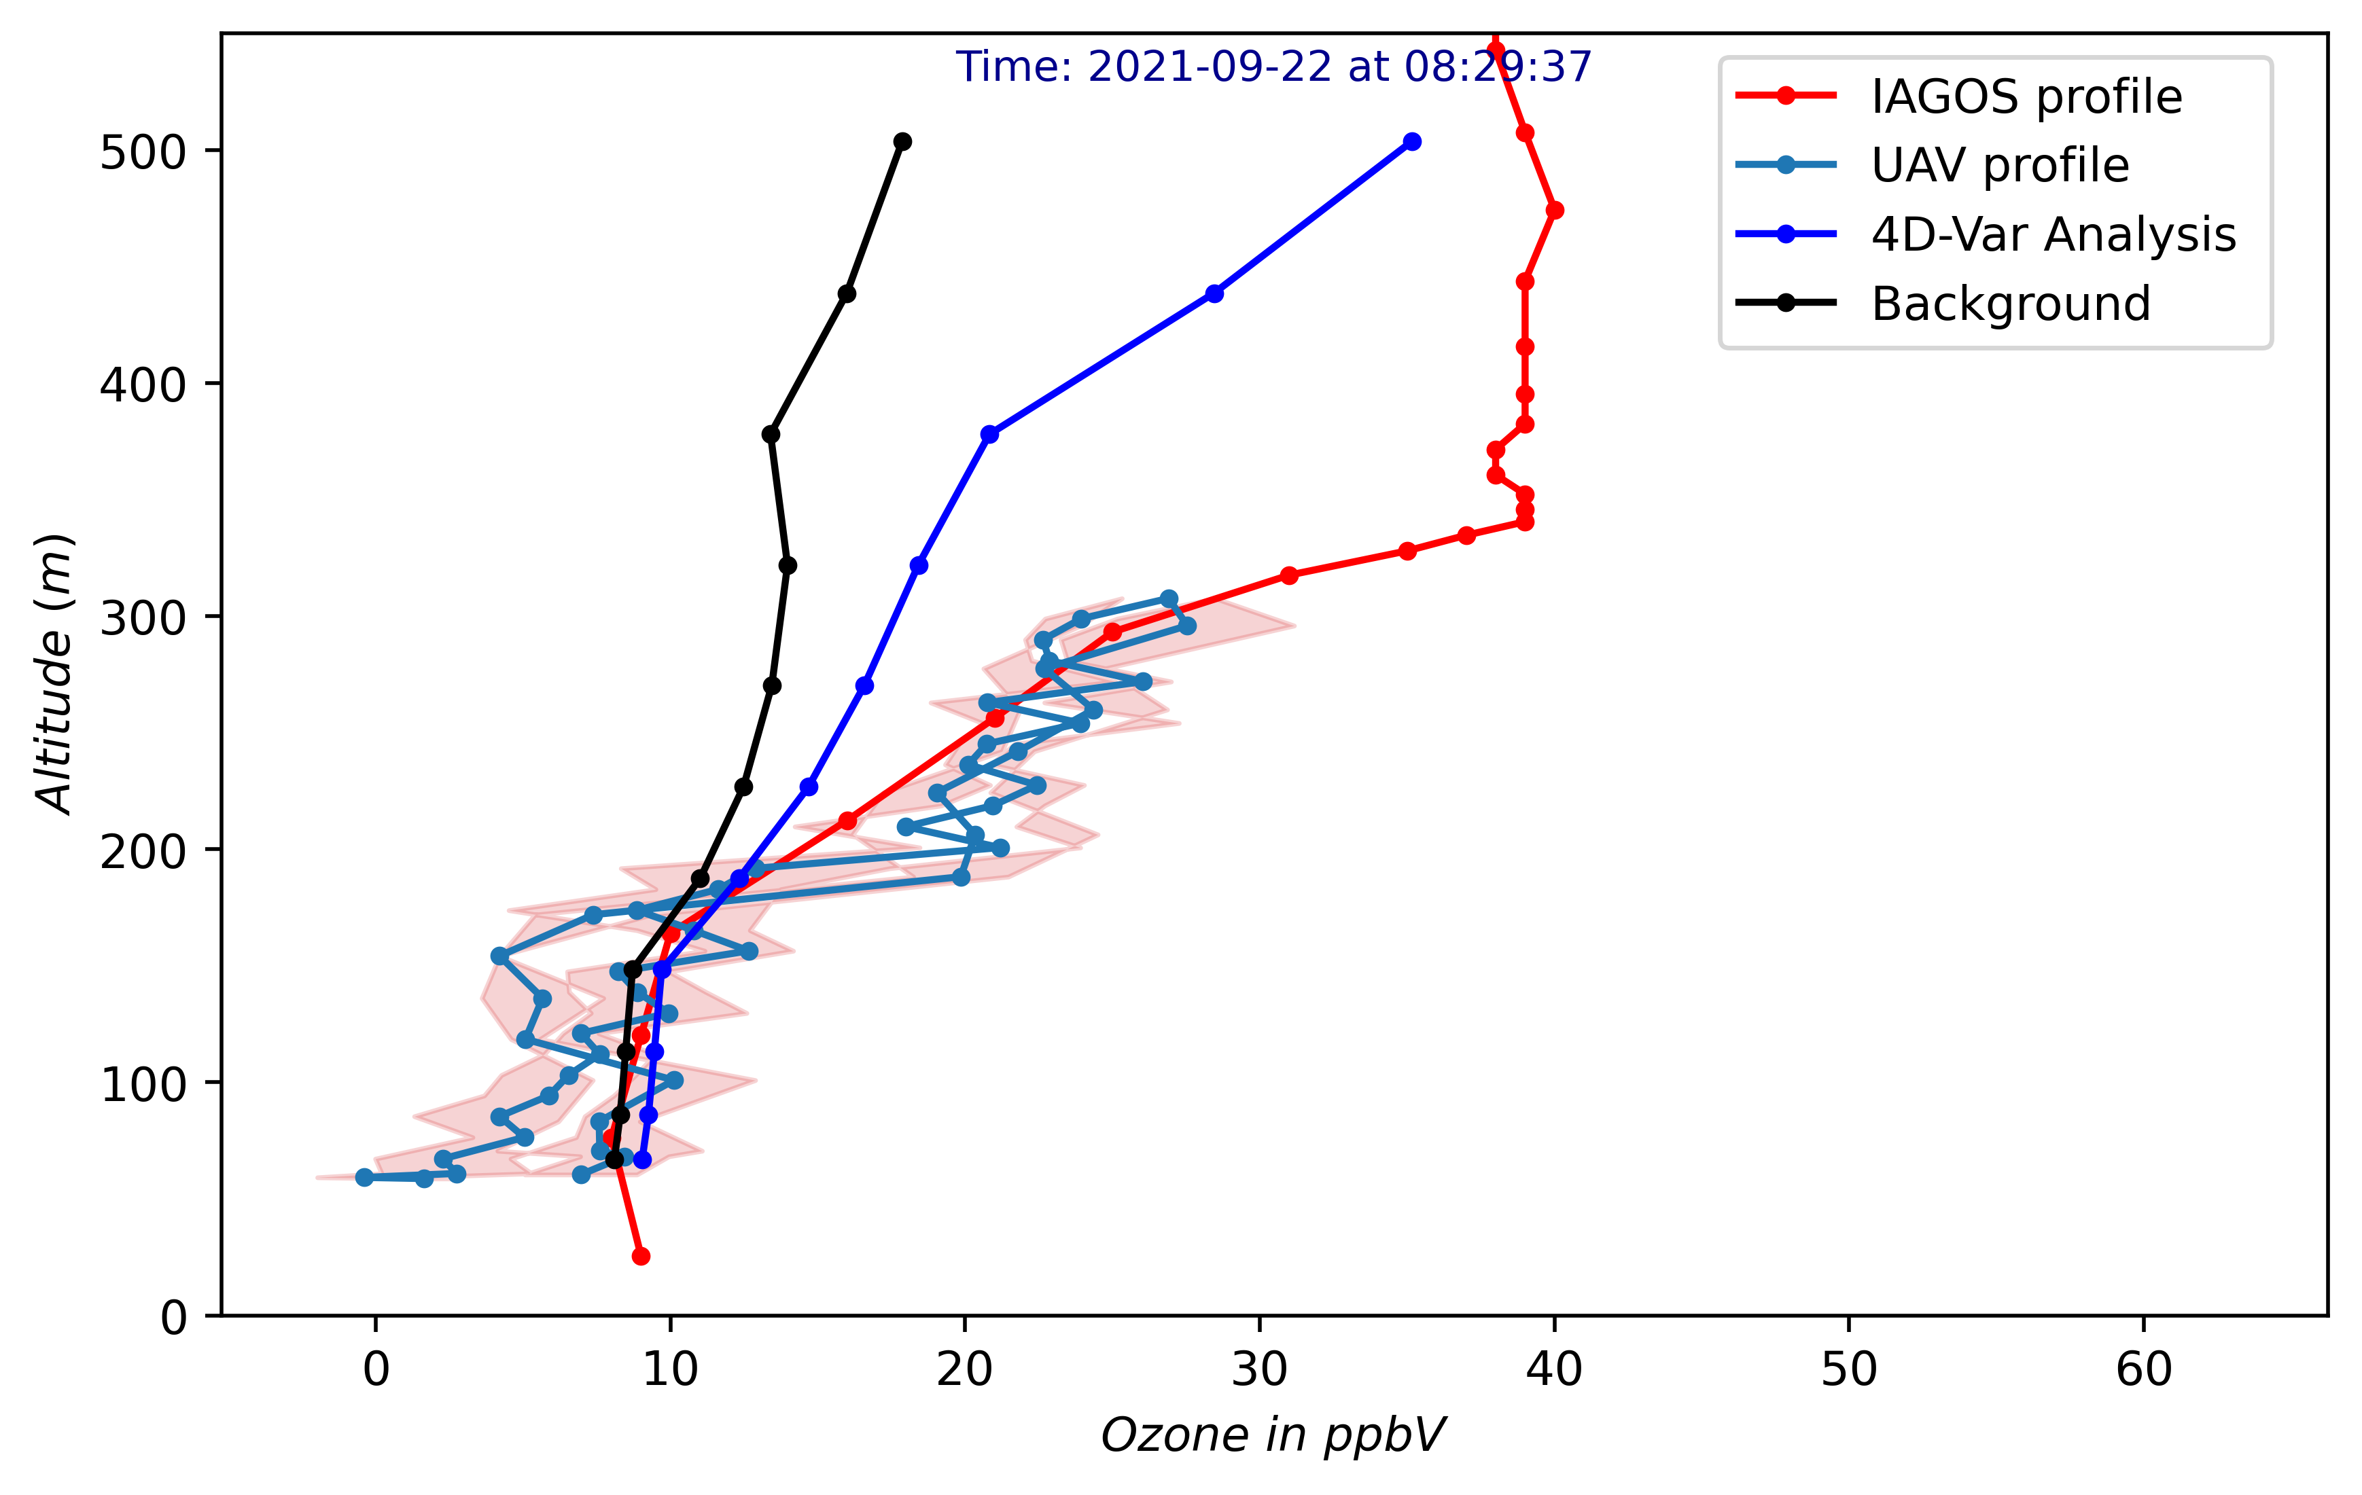
Validation of THE O3 analysis
Vertical profile: IAGOS O3 profile
Ground observations: O3 daily cycle
 | Bg | Ana
Bias | -5.67 | 0.87
RMSE | 14.17 | 12.31
Corr | 0.81 | 0.84
A validation against an IAGOS O₃ profile shows that the assimilation of drones measurement has remarkably improved the analysis at higher altitude.
The daily ozone cycle has been corrected especially in terms of the amplitude of the midday peak.
The BIAS significantly reduces in the analysis, the RMSE and correlation slightly improve.
© Authors. All rights reserved.

Slide 7
Conclusion
UAV assimilation leads to a significant correction of the analysis at higher altitudes.
The impact also affects the daily cycle of ground concentrations.
Future work:
Investigation of the impact of UAV measurements while assimilating them with additional observations (ground-based observations and airborne or satellite data).
Simulation of the entire week of the MesSBAR campaign for a more comprehensive statistic and a deeper insight into the performance of the system (forecast accuracy) over a longer period.
Study of the impact of the planetary boundary layer parameters and its presentation in the model using the UAV measurement.
Contact information :
h.erraji@fz-juelich.de

Slide 8
First detailed air pollution analyses by assimilating UAV observations with EURAD-IM
Air pollution modelling AS3.20| EGU General Assembly 2022
26.05.2022 I Hassnae Erraji, PhD Student, h.erraji@fz-juelich.de
Institute of Energy and Climate Research - Troposphere (IEK-8)
Co-authors: Philipp Franke, Sebastian Düsing, Tobias Schuldt, Marcel Buchholz, Andreas Schlerf, Lutz Bretschneider, Astrid Lampert, Andreas Wahner, and Anne Caroline Lange.
©Authors. All rights reserved.
Notes:
Hello everybody , my name is Hassnae I am a PhD student in the regional and inverse modeling group. Today I will present my phd topic and I will talk about

