Slide 1

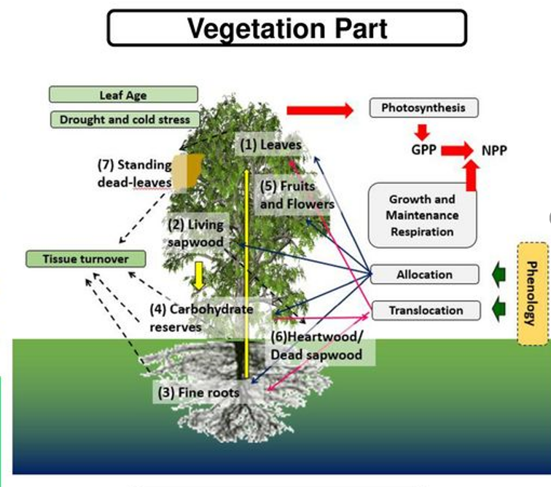
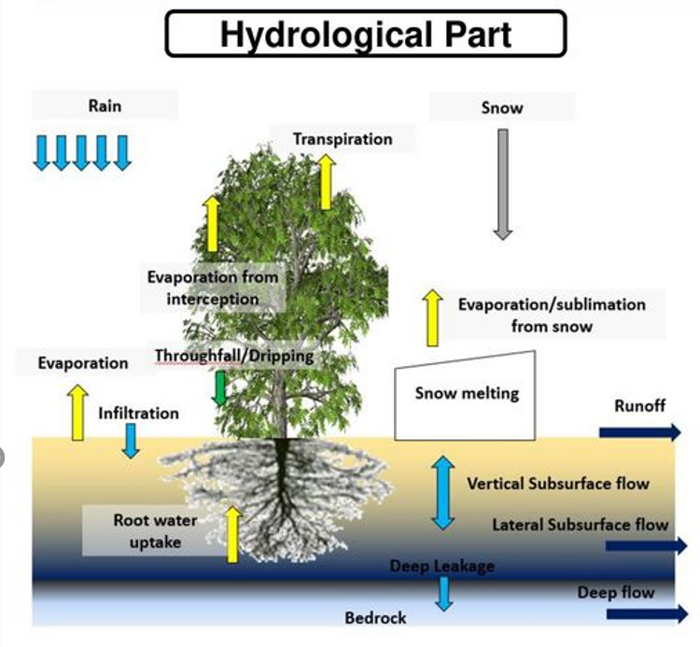
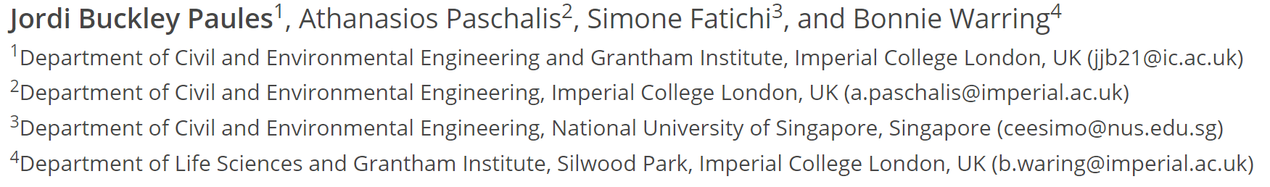


Improving crop representation in an ecohydrological model: a proof of concept
Tethys-Chloris (T&C): A mechanistic ecohydrological model
1/7
Notes:
T&C is a mechanistic process-based model. This means that we are intricately modelling the vast myriad of processes which make up the carbon, nutrient and hydrological cycles. Here, for example, crop behavior and development are deterministically derived from model inputs and processes, for example, if the CO2 concentration were to jump by say 200ppm, photosynthesis would be enhanced, and our orchids would produce some bigger juicier apples. Yum tasty. Although unfortunately its not quite that straightforward. But this is the general idea.
One of the benefits of using T&C compared to simpler crop models is that here we don’t use prescribed crop curves which allows us to study explicit physiological responses which specific crops may have to particular climate or nutrient strains. This is particularly cool to research under different climate change scenarios.
///
We should also note that the results from T&C are not necessarily always more accurate (compared to simpler models), in fact many times they aren’t, the aim with T&C is rather to better represent crop behavior and crop development in order to develop a better understanding. (

Slide 2

T&C - Crop
Crop Specifics
Phenology
Allometry
Management
2/7
Notes:
The aim here is that we wanted to ensure that each crop emerges and grows based on environmental constraints as opposed to based on a generalized and predefined growth curve. To do so we brought in crop-specific parameters such as phenology, allometry and management. Examples here are crop-specific growth states, timings of sowing and fertilization and harvest and how much of crops biomass is above or below ground biomass – basically leaf or roots.

Slide 3
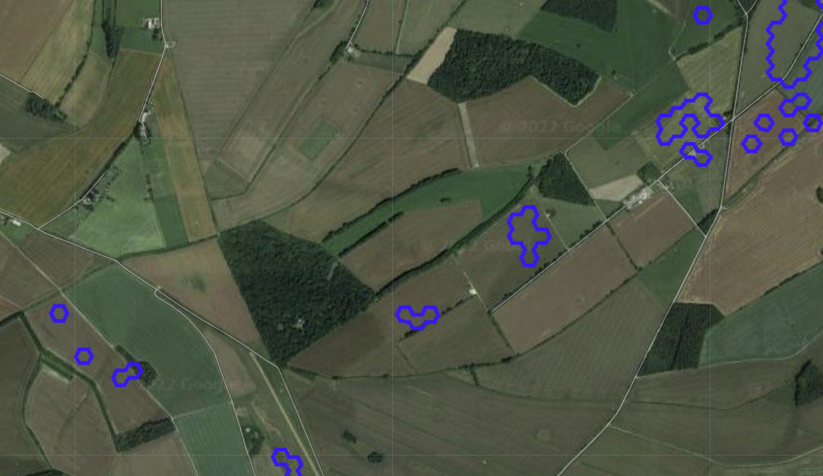

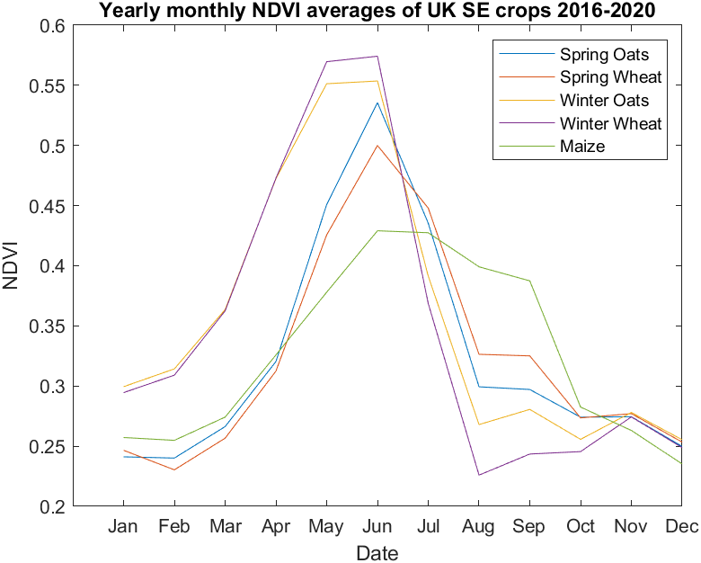
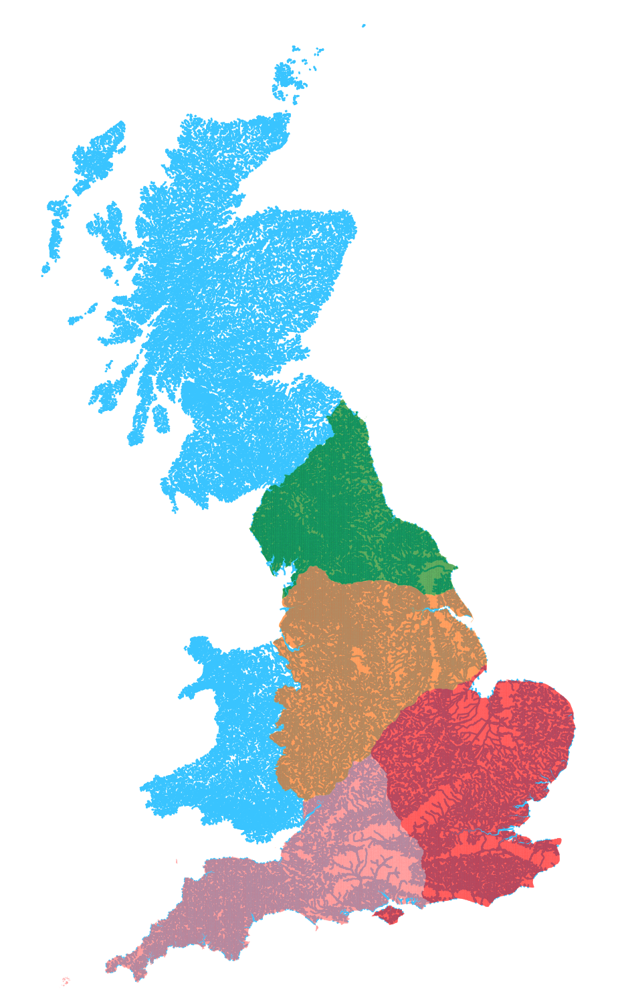


Model Validation
Crop Map of England (CROME)
3/7
Notes:
With complex models like T&C one rejoices in collecting heaps of data to run the model and when this hurdle is finally overcome then bam, we need to collect even more data to validate it ! The joys !
Here we used NDVI observed from Sentinel 2 (10m resolution) to validate T&C crop growth. We calculated the average NDVI for all the Maize fields in the SE of the UK (red area on the map) over a four-year period. To know which fields are maize we used the crop map of England dataset. All of this was run using GEE which is absolutely brilliant.
I then conducted a sanity check – I’ve found this is always a good thing to do ! As we can appreciate on the right we are capturing the expected general trend in crop growth. Maize is clearly the crop which is harvested latest, this is what makes it so dangerous for diffuse pollution as the ground is left bare into late autumn when it rains a lot and leaching occurs, very interesting stuff here but another topic.
///////
Overall CROME accuracy is about 86 percent, nut for e.g maize it is 79%. – not too bad but shifts our focus onto trends.

Slide 4
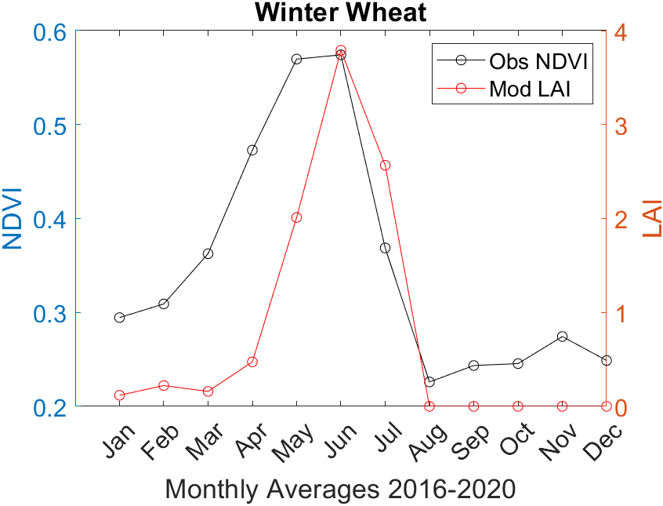
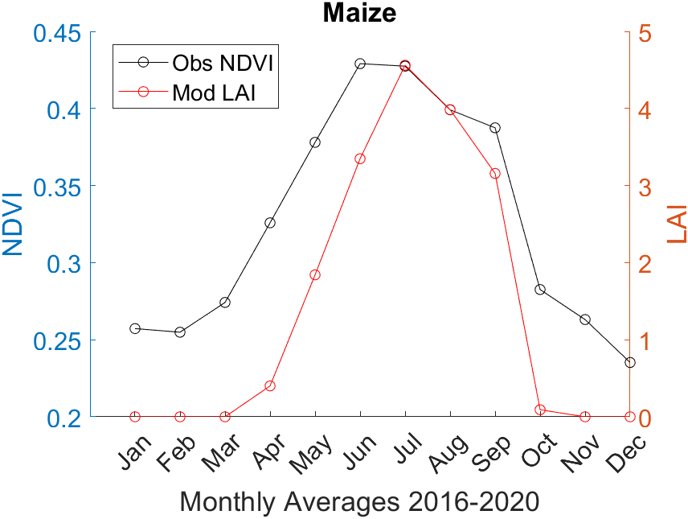
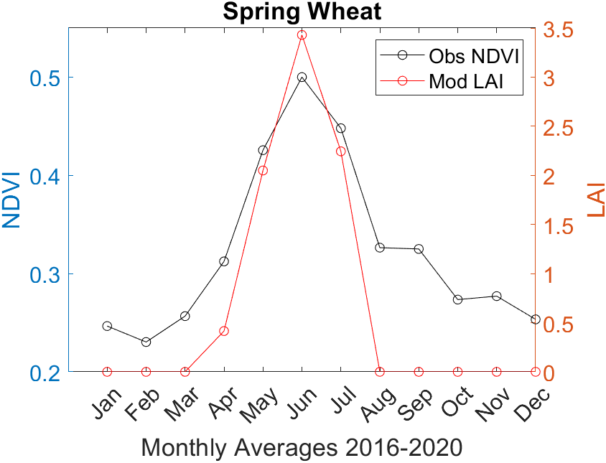
Findings – South East UK
H
S
4/7
Notes:
Here are our first findings, hot off the press. We capture the general pattern which is pleasing, however, crops which overwinter are slightly more challenging and require more user input in terms of tweaking parameters. Another tricky part is the huge variation in when farmers sow and harvest or fertilize crops thought the year, we are modeling maize as one unit for SE UK but the management practices can be very different in fields just meters apart.
//
Other points:
Ndvi is measure of greenness so have to adjust parameters
Wheat is sown on about 2/5ths of Britain's arable land.
Maize is generally sown mid-April time and harvesting is carried out towards the end of September or into October of what the colour is… maize isn’t necessarily green either – easy when one crop grows on the same firld during one calendar year – however it gets more complicated with crops sown the previous year…

Slide 5
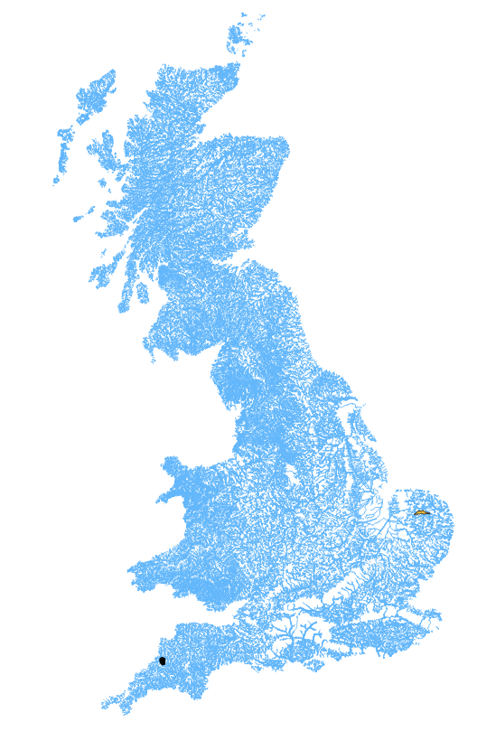
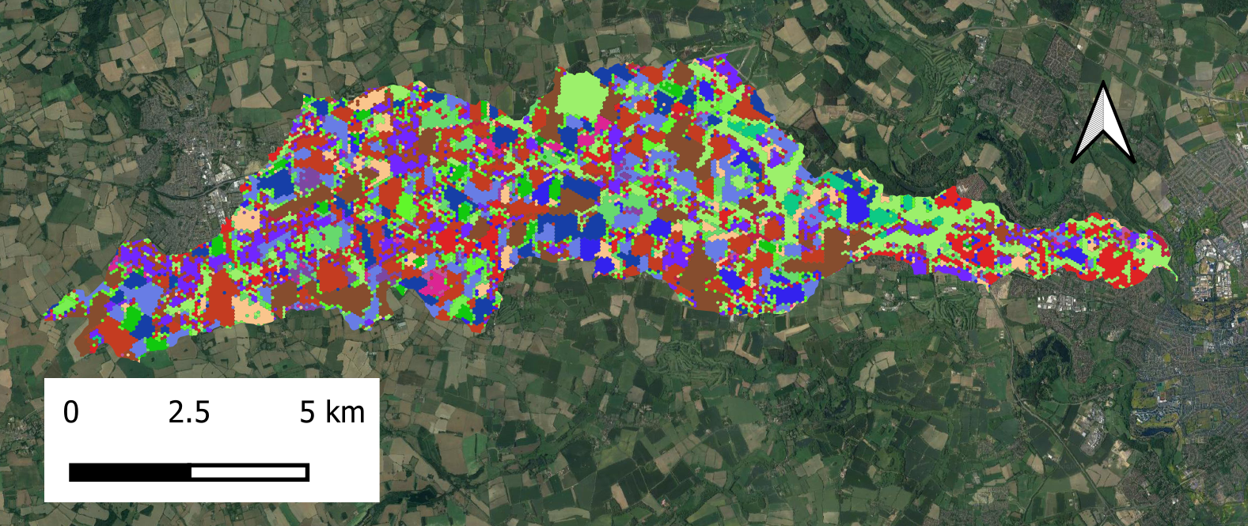



Case Study
Norwich
Winter Oilseed
Winter Wheat
35%
31%
Trees
Spring Barley
34%
5/7
Notes:
Ultimately, we would like to validate T&C crop using a handful of distinct complex catchments, this is one of our first attempts situated just to the West of Norwich. Notan ideal catchment as there is quite a bit of baseflow but we do try and account for this – an area of working progress.
Another point worthy to mention is that as illustrated, agriculture in the UK tends to be very spatially heterogenous, there are both practical and legal reasons for this but in terms of the modelling this makes it somewhat challenging. So here what we did is we ran T&C as a lumped model and assigned the land use over the whole catchment as belonging to one of the most dominant crops.

Slide 6
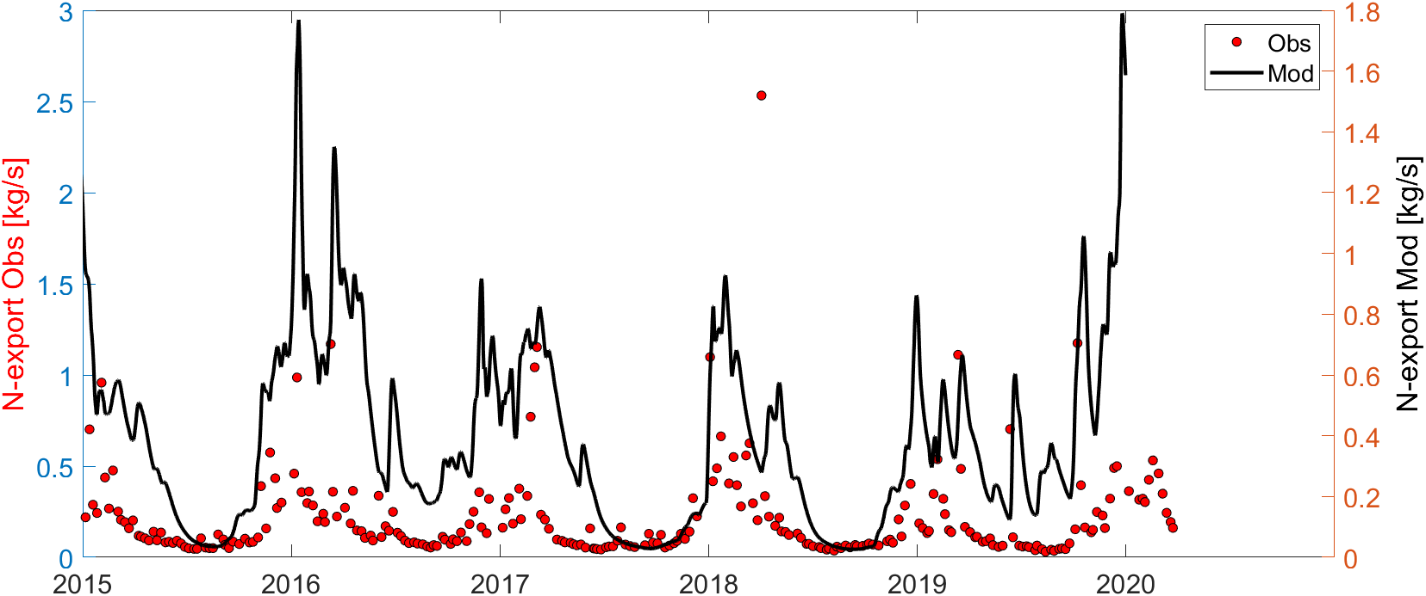
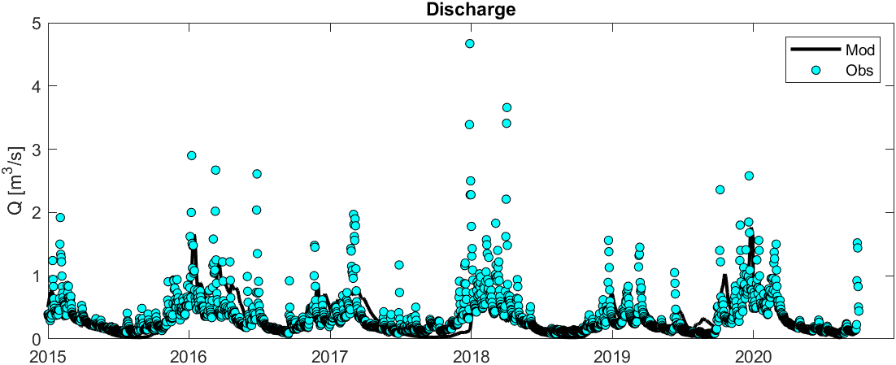
Norfolk Catchment
6/7
Notes:
This is literally hot off the press….

Slide 7



Difficult to validate crop models in UK as crop land is so spatially heterogenous.
Recent developments in geospatial processing open new horizons in agricultural modelling.
Crop-specific representation in agricultural models has much potential.
7/7
Notes:
Take home points – overall this is a fascinating field to be studying, there is great scope for potential and the applications are many. Any questions please do ask and if youd like to have a chat about any of this please do stop me !
Difference between aquacrop and T&C – difference is that they have prescribed crop curves – don’t see plant physiological responses. Every behaviour emerges from environemnal stresses/ factors. Not necessarily about more accurate results but behaviour of crop development is better represented and naturally derived from model. Below ground – we have an explicit component of N and P – similar to DNDC and ecosys nodellign project . ---- we don’t currently do N dynacsd in streams. But first order catchments so this is limited.
Some trends are captured but not perfect. Discharge is quite good as would expect. The interesting thing would be to compare this for example using a general “grassland type cover” and then vs individual crop specific.

