Slide 1




ASSESSING PHYSICAL PROCESSES OF PERMEABLE PAVEMENTS WITH A LARGE-SCALE LABORATORY MODEL
Giulia Mazzarotto, Matteo Camporese and Paolo Salandin
giulia.mazzarotto.1@phd.unipd.it
Financial support from Alto Trevigiano Servizi S.p.a.
Session HS5.10
Green infrastructure for sustainable urban hazard management

Slide 2



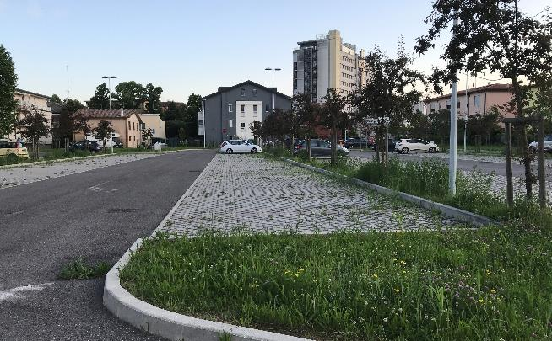
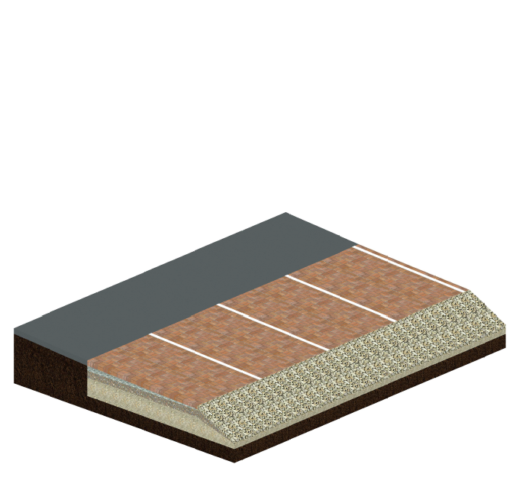
INTRODUCTION: REALITY IN THE LAB
WHY PERMEABLE PAVEMENTS?
Flexible and tailored solution that allows water quantity and quality management, dual use of space and no additional land take. Common solution for sidewalks, bike lanes, and low traffic pavements (e.g. parking areas) …
Study aim
Reproduce physical processes occurring on permeable pavements by a 1:1 model

Slide 3
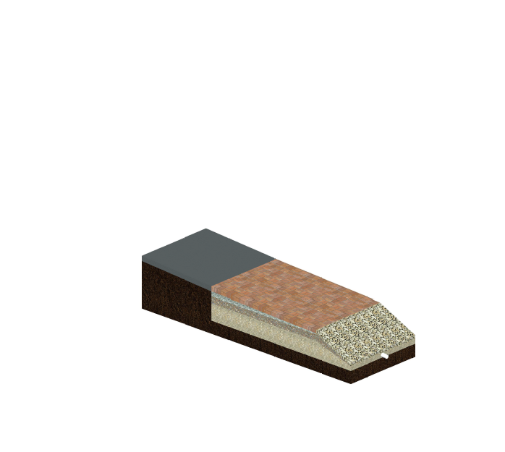
INTRODUCTION: REALITY IN THE LAB
WHY PERMEABLE PAVEMENTS?
Flexible and tailored solution that allows water quantity and quality management, dual use of space and no additional land take. Common solution for sidewalks, bike lanes, and low traffic pavements (e.g. parking areas) …
Study aim
Reproduce physical processes occurring on permeable pavements by a 1:1 model
FEATURES
Impermeable area for runoff production
Permeable area
Sloped ramp lined with stones

Slide 4
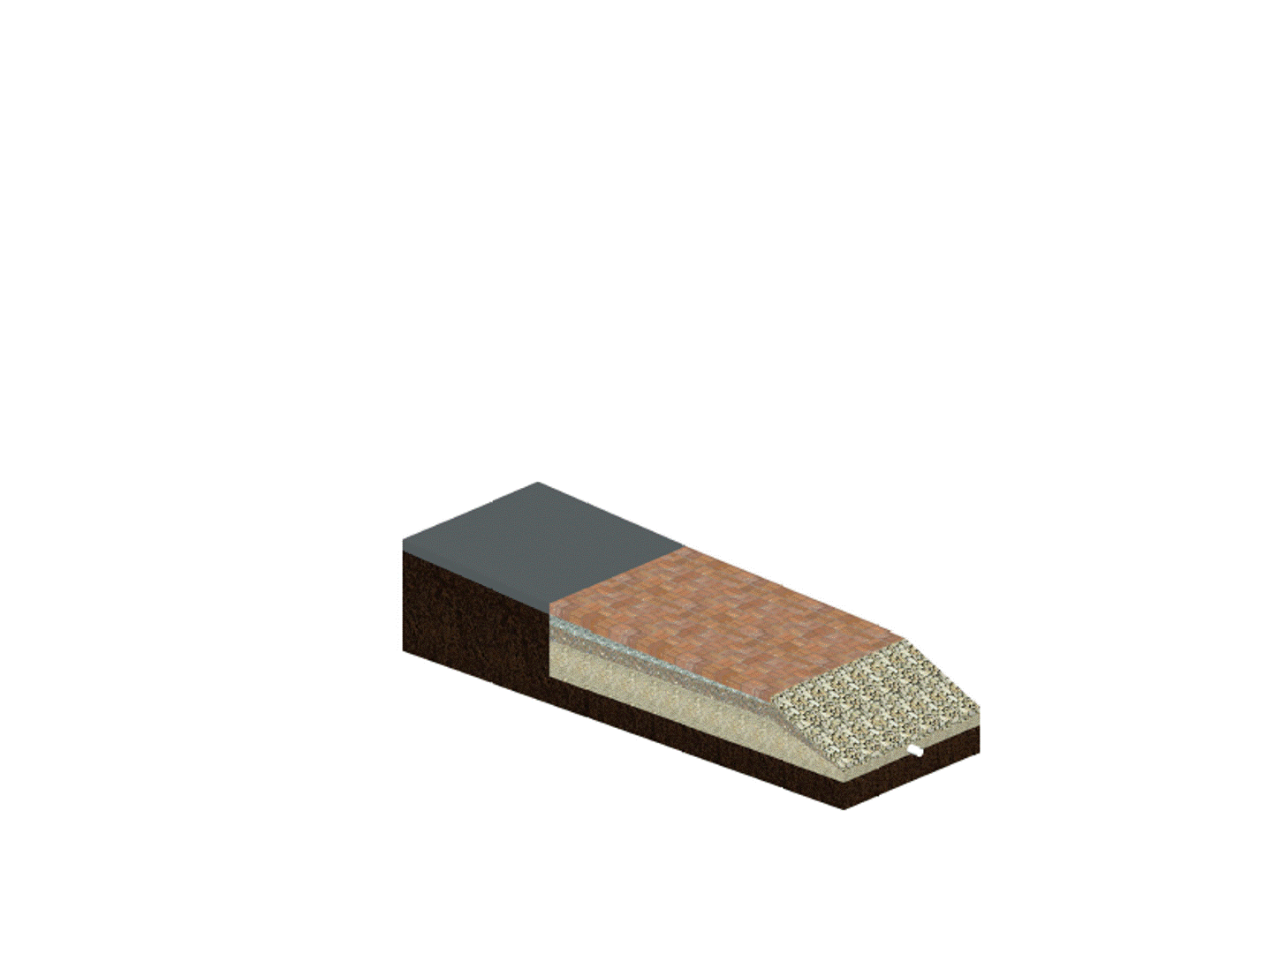
INTRODUCTION: REALITY IN THE LAB
WHY PERMEABLE PAVEMENTS?
Flexible and tailored solution that allows water quantity and quality management, dual use of space and no additional land take. Common solution for sidewalks, bike lanes, and low traffic pavements (e.g. parking areas) …
Study aim
Reproduce physical processes occurring on permeable pavements by a 1:1 model
FEATURES
Impermeable area for runoff production
Permeable area
Sloped ramp lined with stones

Slide 5
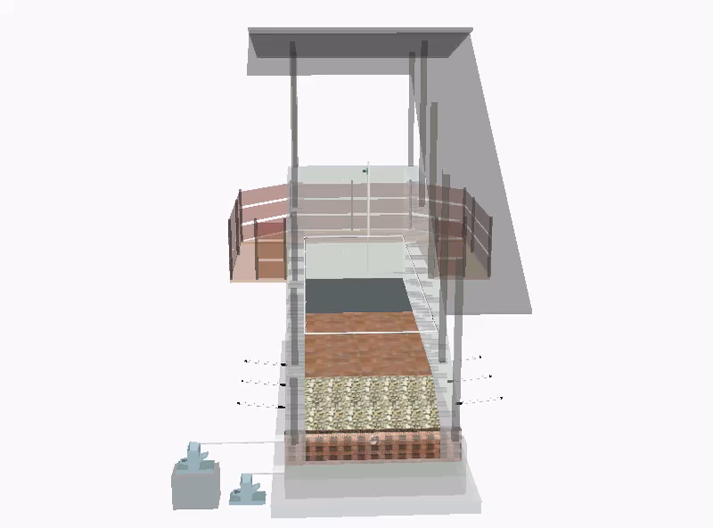
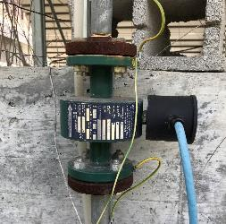
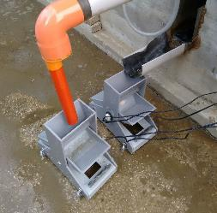
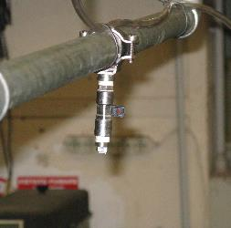
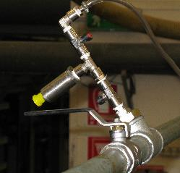
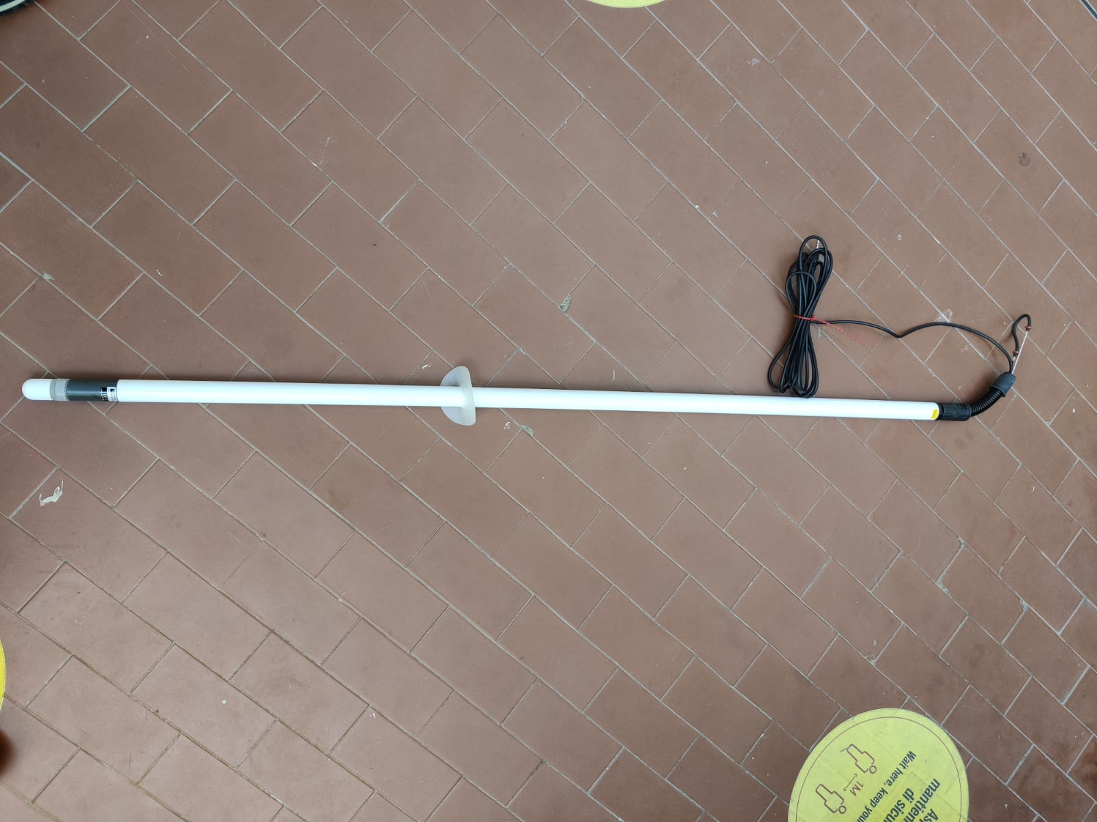
INSTRUMENTS & SENSORS
1
flow meter
2
tipping bucket flow gauge
9
FullJet nozzles
2
TL14 pressure transducers
6
Teros 32 tensiometers
Notes:
Frequenza acquisizione dati sistema complessivo, marche sensori

Slide 6

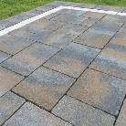



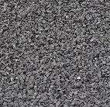
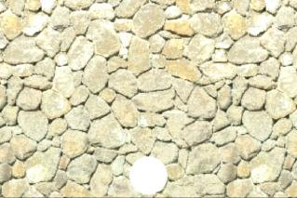
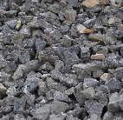
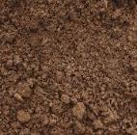

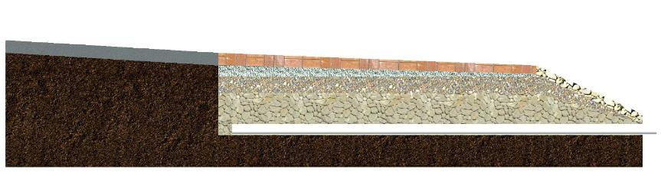
FILTER PACKAGE LAYERS
FILTER PACKAGE
currently PICP
240x120x80 cm³
8 cm
Bedding layer
ASTM #8 (2.36-9.5 mm)
5 cm
15 cm
Upper sub-base layer
ASTM #57 (4.75-25 mm)
Lower sub-base layer
AASHTO #3 (25-50 mm)
40 cm
Drain pipe
DN100
Native soil
Sand and clay
A
30 cm
Section A-A
A

Slide 7

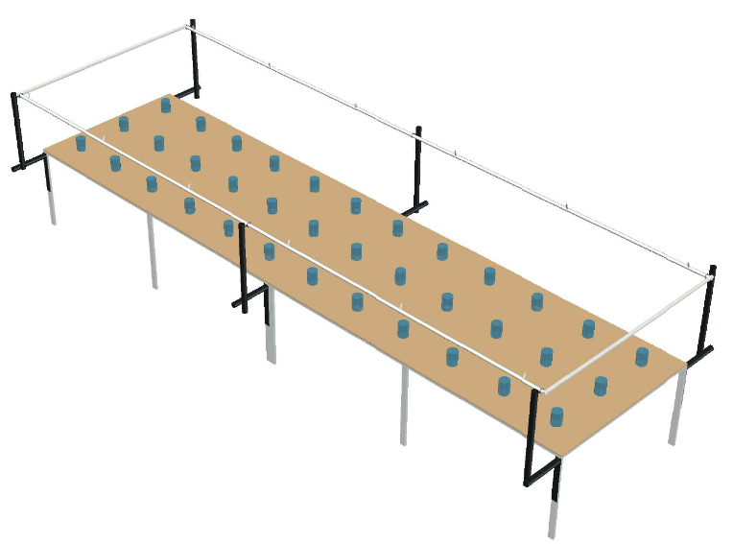
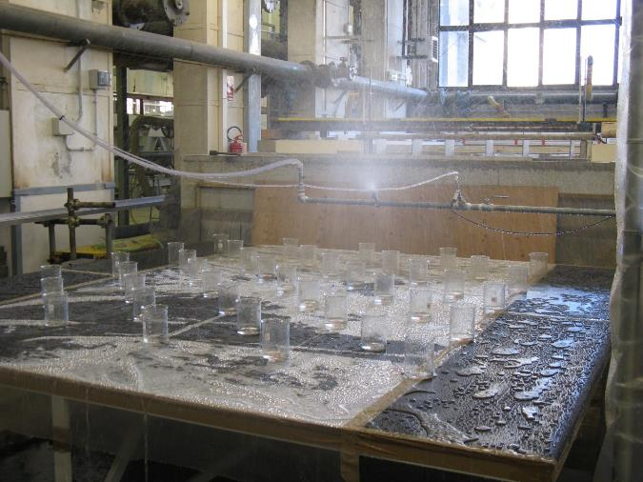
RAINFALL SIMULATOR
CURRENTLY TESTING …
50 cm
… to define optimal configuration that gives the highest degree of rainfall’s uniformity
One-loop pipe network with d_{int}= 2.54 cm
Up to 18 nozzles
36 bekers placed every 50 cm on a 6×1.5 m²
300 cm
150 cm
PARAMETERS
α: inclination of the nozzle with respect to the vertical direction
H: height of the nozzle with respect to the planar surface
P: pressure
c_{N}: nozzles’ configuration (for different positions)
Notes:
Rainfall intensity between 50 and 150 mm/h

Slide 8
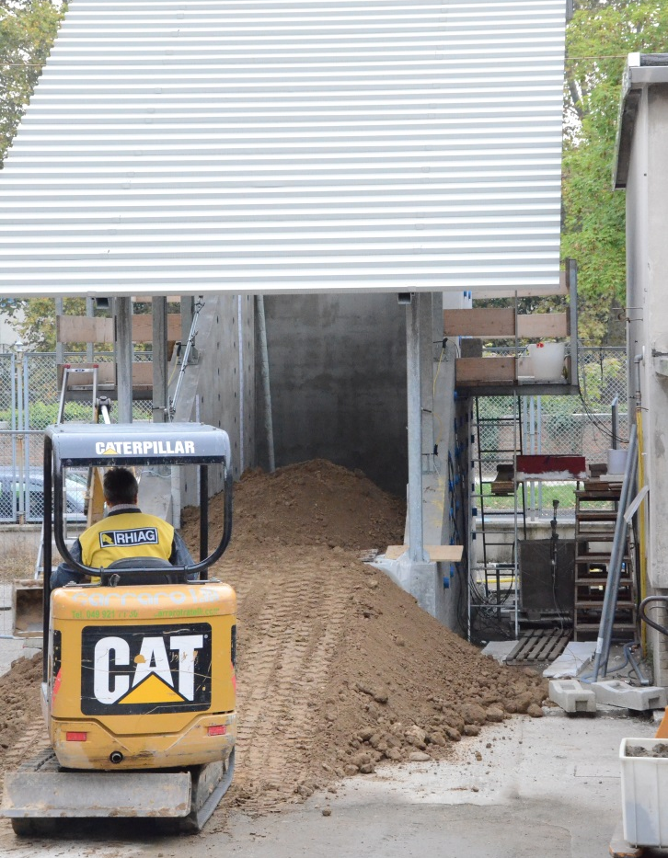
RAINFALL SIMULATOR
CURRENTLY TESTING …
… WAITING FOR THE MODEL BUILDING
… to define optimal configuration that gives the highest degree of rainfall’s uniformity
One-loop pipe network with d_{int}= 2.54 cm
Up to 18 nozzles
36 bekers placed every 50 cm on a 6×1.5 m²
Notes:
Rainfall intensity between 50 and 150 mm/h

Slide 9
TO EARLY FOR CONCLUSIONS, BUT…
QUESTIONS/SUGGESTIONS?
Giulia Mazzarotto, Matteo Camporese and Paolo Salandin
giulia.mazzarotto.1@phd.unipd.it
Financial support from Alto Trevigiano Servizi S.p.a.
Session HS5.10
Green infrastructure for sustainable urban hazard management

