Slide 1
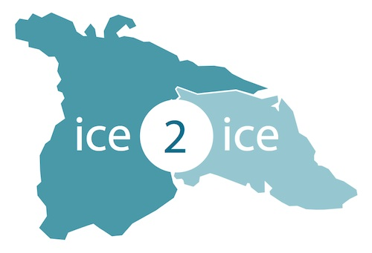
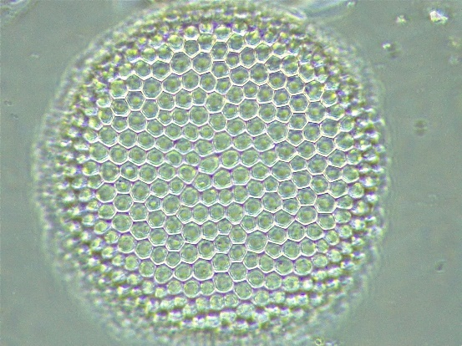


Exploring the use of diatoms as a new environmental proxy in Arctic coastal ice cores:
A first case study using the RECAP ice core
Eliza Cook – Niels Bohr Institute
Jackie Zhu – University College London
Viv Jones – University College London

Slide 2
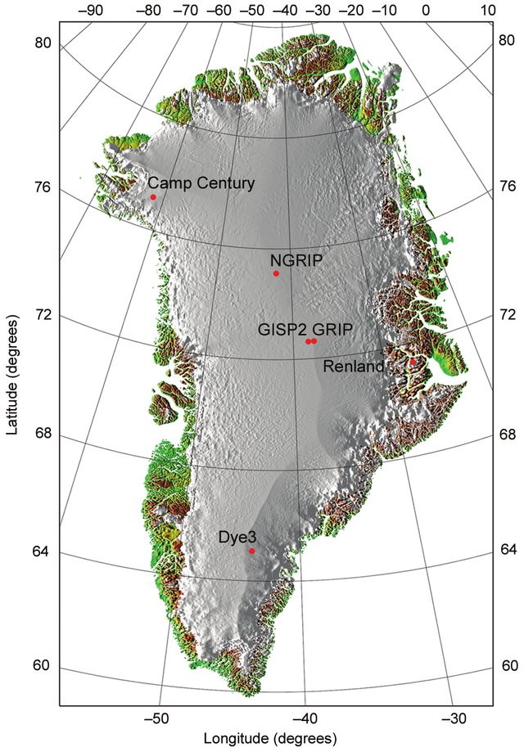
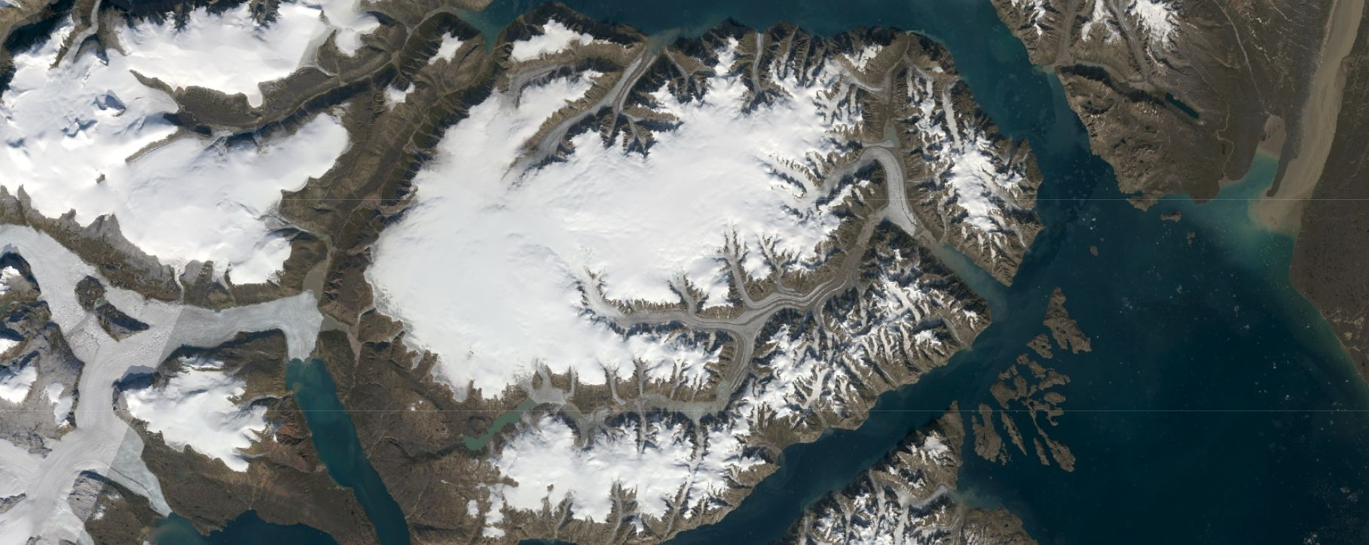
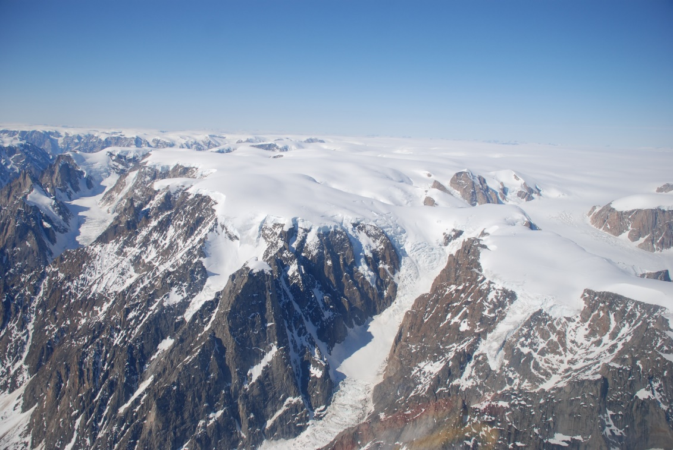
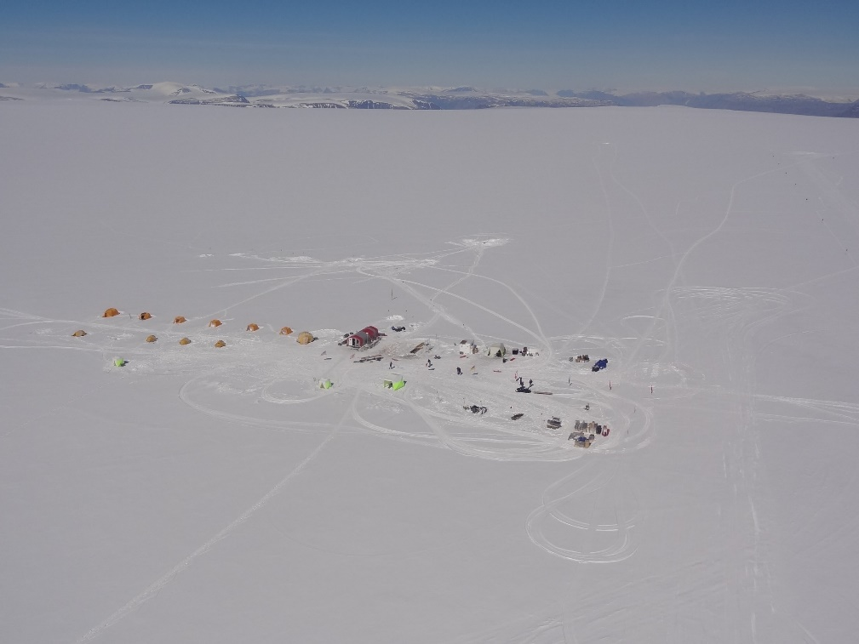
20 km
2015 RECAP: Renland
562 m record back to Eemian.

Slide 3
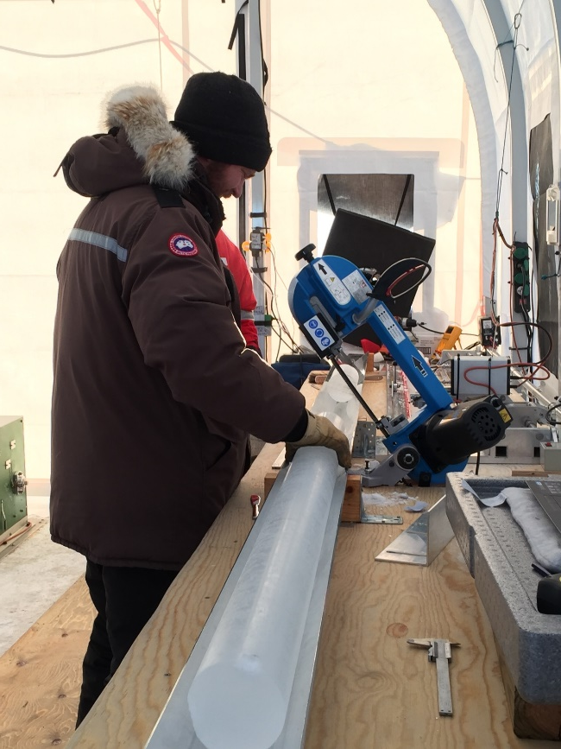
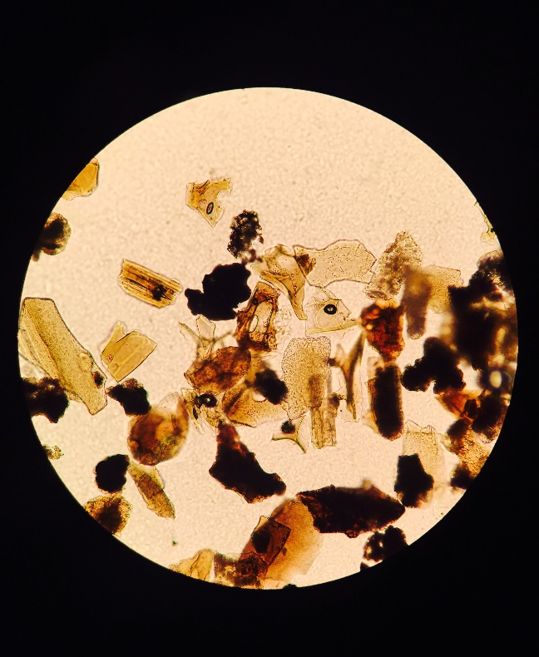
Context:
RECAP is an isolated ice cap (isolated from the Greenland ice sheet) and climate is sensitive to temporal changes of the coastal environment /Eastern Greenland climatic change
Tephra Analysis > Diatom identification
A thin strip of ice was taken from the size of each 55cm core bag, cut into 11 cm and stored for tephra (volcanic ash) processing
This ice was melted and centrifuged and any particles were mounted onto microscope slides and covered in epoxy.
Diatoms identified in low concentrations ( a few diatom valves present per sample)
Important obs. Diatoms not prevalent in other deep ice cores from Greenland inland ice (NEEM, NGRIP, GRIP, or EGRIP)
Collaboration initiated with Viv Jones from UCL and a trial study was carried out by MSc Jackie Zhu (:Little Ice Age: 1530-1940 AD)

Slide 4
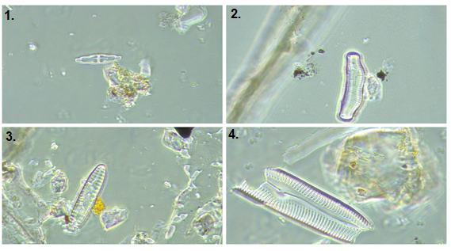
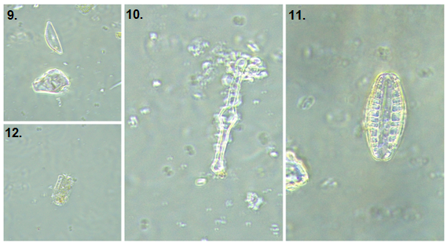
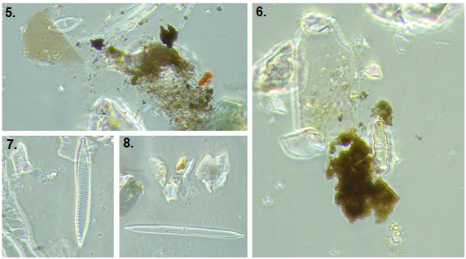
Continuous record of Diatoms found in RECAP ice core over last 500 years
Diatoms: Ubiquitous photosynthetic eukaryotes, found worldwide in different ecosystems: terrestrial, freshwater and marine (including Arctic)
Siliceous cell wall = ensures that diatoms are well preserved in various records – e.g. lake, marine, ice.
Individual taxa sensitive pH, salinity, nutrients, temperature, precipitation etc. = Some important spp. Have narrow tolerance ranges, observed in modern Training Sets.
These are key factors that make diatoms ideal and reliable biological indicators for palaeoenvironment reconstruction

Slide 5
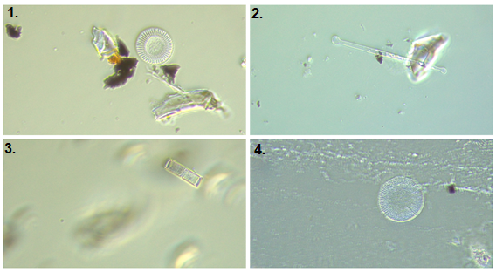
Sample Preparation summary:
UCL: Trialled best technique for mounting ice core diatoms (Sample from ‘dirty’ outer curved edge of Ice core).
Diatoms were still low concentrations so melted samples were amalgamated to obtain at 4-5 years resolution
= a countable diatom sample.
Natural settling method (phytoplankton chamber) was first tested – no cleaning process. Clumping of unwanted materials prevented identification.
Chemical cleaning necessary to remove unwanted minerals/dust:
5ml H2O2 (30%) added to sample and placed in 50ºC water bath: 2 days
At end, 1-2 drops hydrochloric acid (HCl) to remove carbonates
Washed with mQ and centrifuged 4 X. Water siphoned off and resulting material mounted on slide with naphrax and coverslip
Blank Sample Tests:
Blank tube tests were introduced throughout sample prep sessions: to rule out any diatoms introduced by lab contamination
RESULT= No diatoms present! ☺
Confident that the diatoms came from the ice core meltwater

Slide 6
LIA Diatom Taxa in RECAP:
The highest abundance was
found in family Naviculaceae, Fragilariaceae,
Aulacoseiraceae,
Achnanthaceae, Melosiraceae, Stephanodiscaceae
Accounted for around 86% of the total number of counted valves
1006 diatoms belonging to 93 species, 36 genera and 11 families were observed and identified.
(1530-1940 AD)
% valve abundance/sample

Slide 7
LIA Diatom Groups (1530-1940 AD)
Predominantly freshwater, benthic then planktonic spp.
Aerophilic spp. Present throughout LIA assemblage
Very few marine planktonic, although appear throughout LIA
only a couple of benthic marine spp in LIA record..
Max 70 diatoms 5yr interval. Low volume samples
Highest conc. 1740-1860 AD – coldest part LIA
Diatom counts/ 5 yrs

Slide 8
A CLIMATE SIGNAL?
Pattern doesn’t relate very well to the delta-¹⁸O record for LIA
Need to investigate dust and other proxies from the Renland ice core?

Slide 9
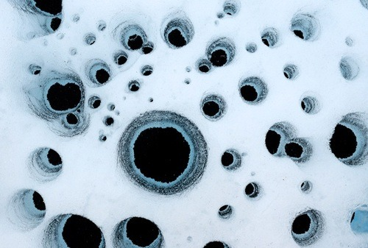
Some Initial Messages:
Our trial demonstrates the near coastal, lower elevation location of Renland is a well placed to receive diatoms
This study offers presents the very first continuous paleo-record of diatoms found in a Greenland ice core
A significant number of freshwater benthic , aerophilic and freshwater planktonic species persisted and survived the colder, dustier and perhaps drier interval: AD 1600 until the end of the Little Ice Age
We observe periods (i.e. AD 1600-1700) of higher of marine/brackish species influx (i.e. sea ice living diatoms e.g.Actinocyclus normanii).
What are the sources?
Lakes? Streams? Deglaciated catchments/ice margins?, Sea ice??
Cryconite = some species commonly found in cryconite holes (in situ growth)
Transport mechanisms?
Wind? Storminess? In situ growth?

Slide 10
What is the significance of a RECAP diatom record?
Diatoms living on the ice might respond to climate change (eg increased growth within cryconites)
Diatoms blown onto the ice might reflect climate change
Drier terrestrial conditions?
More input with windier conditions
Sea ice – greater/lesser

