Slide 1




Geochemical features of river flow into Lake Onego
Natalia Kulik¹. Natalia Efremenko¹. Natalia Belkina¹. Vera Strakhovenko². and Ekaterina Gatalskaya¹
¹ Northern Water Problems Institute. Laboratory of Hydrochemistry and Hydrogeology. Petrozavodsk. Russian Federation
² V.S. Sobolev Institute of Geology and Mineralogy of the Siberian Branch of the RAS. Novosibirsk. Russian Federation
The study was supported by
RFBR grant #19-05-50014. RSF research project #18-17-00176 and by the Federal Budget. within the State Assignments nos. 121021700116-6

Slide 2
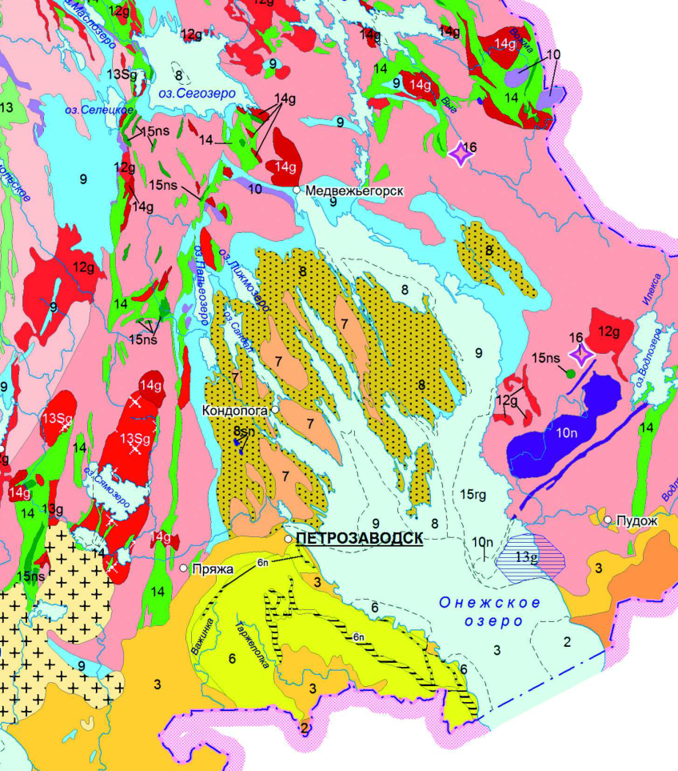
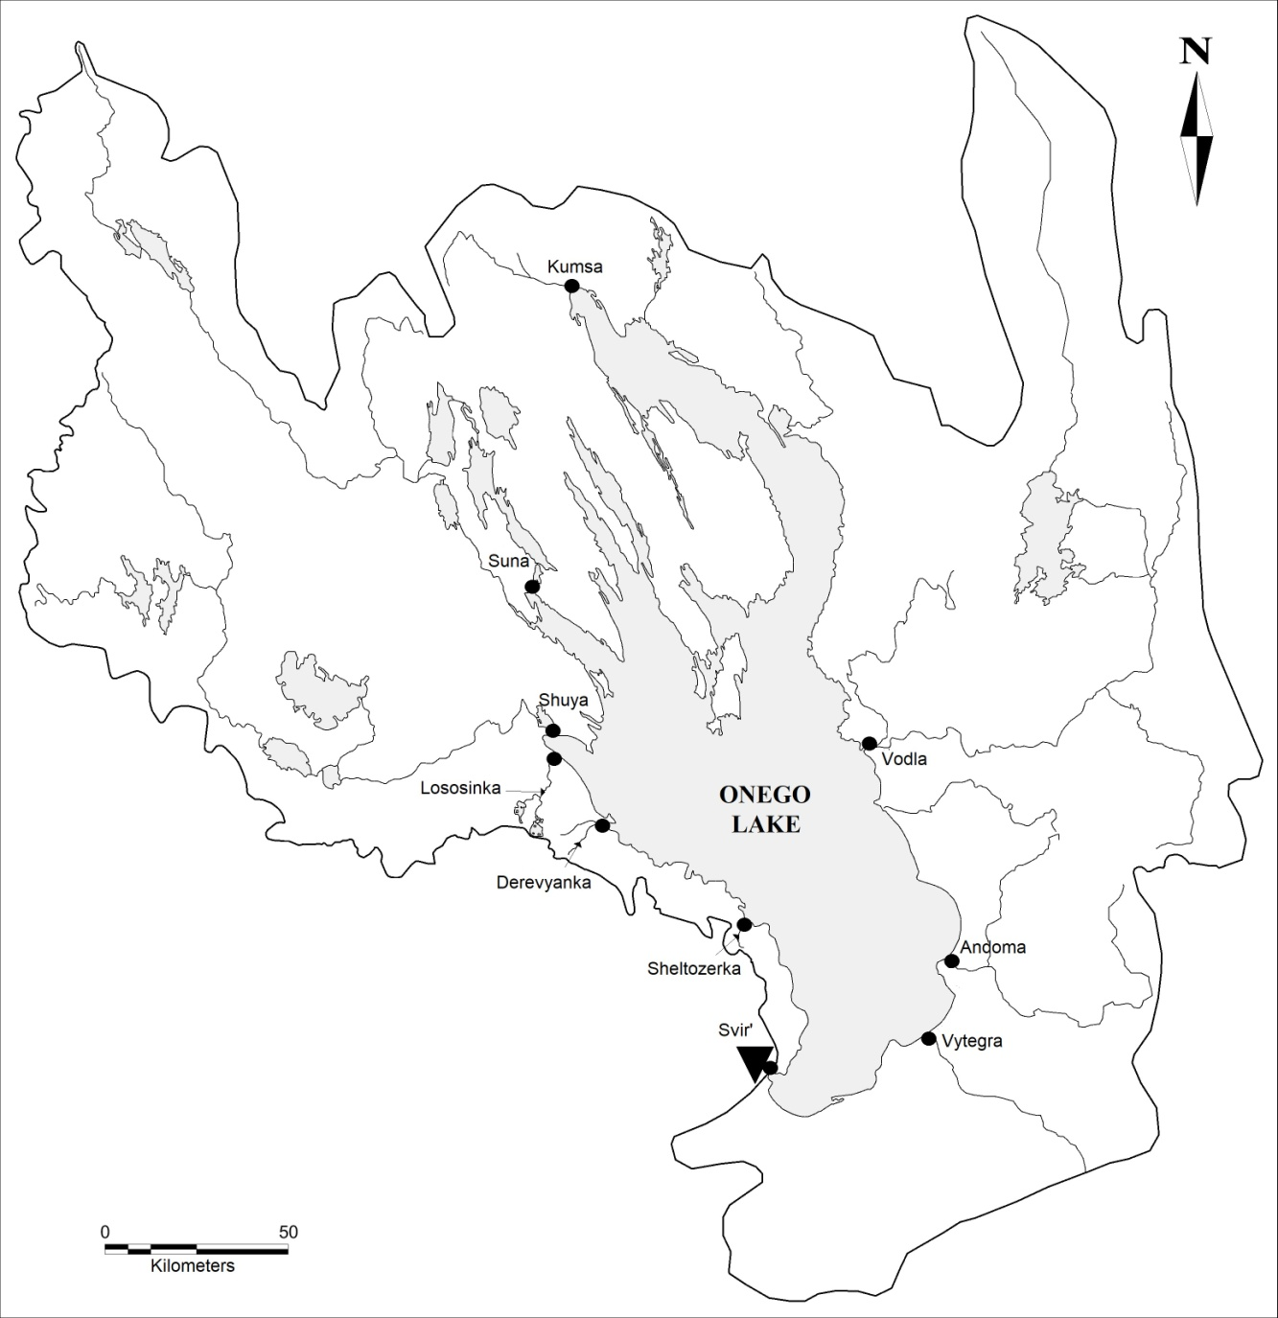
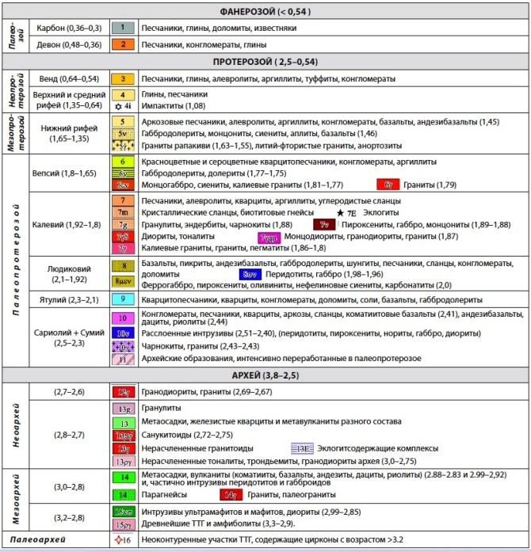
Objects of research
(Atlas of
Karelia. 2021)

Slide 3
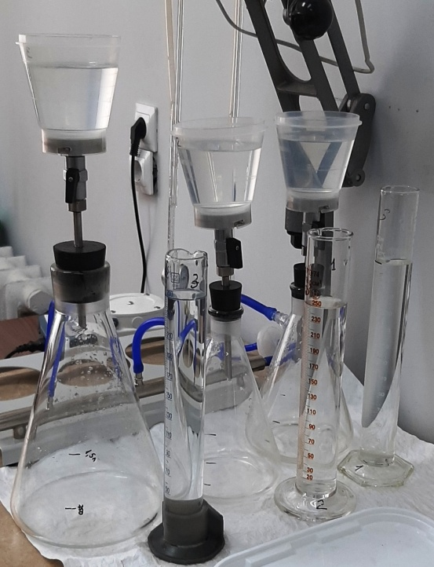
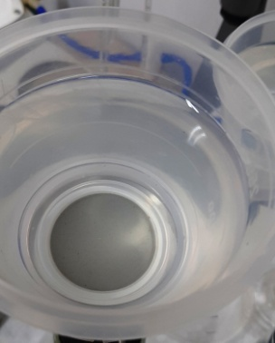
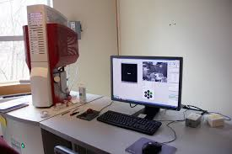
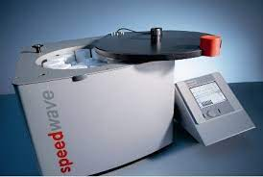
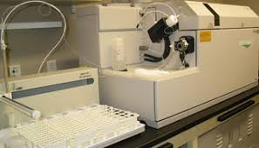
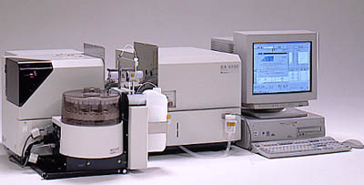
Methods
Sampling was carried out from the surface horizon into ten-liter polyethylene cans.
Separation of suspended matter into dimensional fractions:
By sequential filtration through membrane filters with different pore diameters
The morphology. phase and chemical composition of the selected samples of suspended matter. sedimentary material. bottom sediment were studied using electron scanning microscopy (SEM)
Scanning electron microscope MIRA 3 LMU (TESCAN. Czech Republic). including the INCA Energy 450+ microanalysis system based on the X-MAX 80 energy dispersive spectrometer (Oxford Instruments Nano Analysis. UK)
Opening of samples for micro-component analysis
SpeedWave 4
The micro-component composition in water and aqueous suspended matter was analyzed:
AAS (АА6800. Shimadzu)
ICP-MS (Agilent 7500a)

Slide 4
Average concentrations of dissolved metals in river waters during the observation period. μkg/l
Element | I |  |  |  |  | II |  |  | III |  | Rivers of the world*
 | Northwest |  |  | North | West | Southeast | Southwest |  | South
 | Lososinka | Shuya | Suna | Kumsa | Vodla | Andoma | Derevyanka | Sheltozerka | Vytegra | Svir’
Cr | 0.44 | 0.79 | 0.49 | 0.29 | 0.51 | 0.67 | 1.01 | 0.60 | 0.54 | 0.33 | 0.70
Mn | 32 | 44 | 4.8 | 14 | 33 | 39 | 53 | 32 | 45 | 4.3 | 34
Fe | 545 | 521 | 205 | 238 | 539 | 63 | 820 | 985 | 289 | 49 | 66
Co | 0.09 | 0.14 | 0.02 | 0.06 | 0.11 | 0.19 | 0.23 | 0.18 | 0.12 | 0.06 | 0.148
Ni | 0.98 | 0.82 | 0.48 | 0.53 | 0.88 | 1.18 | 1.93 | 0.92 | 0.98 | 0.59 | 0.80
Cu | 1.23 | 1.84 | 0.99 | 0.82 | 0.91 | 1.32 | 7.25 | 1.45 | 1.55 | 1.20 | 1.48
Zn | 2.81 | 4.21 | 0.86 | 3.26 | 1.98 | 4.38 | 5.65 | 3.00 | 1.87 | 3.11 | 0.60
As | 0.41 | 0.51 | 0.19 | 0.29 | 0.31 | 0.36 | 0.41 | 0.31 | 0.43 | 0.17 | 0.62
Mo | 0.16 | 0.15 | 0.06 | 0.07 | 0.04 | 0.13 | 0.17 | 0.03 | 0.21 | 0.06 | 0.42
Cd | 0.01 | 0.01 | 0.01 | 0.01 | 0.01 | 0.02 | 0.02 | 0.01 | 0.01 | 0.01 | 0.08
Sb | 0.03 | 0.06 | 0.03 | 0.02 | 0.02 | 0.03 | 0.06 | 0.03 | 0.03 | 0.05 | 0.07
Ba | 8.5 | 8.10 | 4.7 | 7.2 | 8.8 | 15.2 | 15.5 | 11.2 | 22.6 | 6.3 | 23
Pb | 0.35 | 2.50 | 0.62 | 0.19 | 0.38 | 0.30 | 0.41 | 0.33 | 0.34 | 0.15 | 0.08
Note: the average value of the elemental content of dissolved metals in river waters is given in accordance with the literature data * – Gaillardet. 2004

Slide 5
The average content of metals in suspended matter from the water of the surface horizon of the inflows of Lake Onego
(Fe – µkg/mg; other metals – µkg/g)
Element | I |  |  |  |  | II |  |  | III | Rivers of the world*
 | Northwest |  |  | North | West | Southeast | Southwest |  | South
 | Lososinka | Shuya | Suna | Kumsa | Vodla | Andoma | Derevyanka | Sheltozerka | Vytegra
Cr | 85 | 97 | 111 | 78 | 134 | 59 | 81 | 89 | 132 | 108
Mn | 8925 | 3773 | 3000 | 18084 | 11350 | 6251 | 4611 | 6549 | 2350 | 1606
Fe | 90 | 65 | 70 | 106 | 166 | 82 | 92 | 106 | 102 | 50
Co | 24 | 12 | 13 | 21 | 30 | 26 | 34 | 36 | 24 | 19
Ni | 56 | 19 | 112 | 73 | 94 | 48 | 46 | 39 | 60 | 65
Cu | 53 | 31 | 239 | 99 | 98 | 43 | 106 | 56 | 38 | 59
Zn | 372 | 39 | 314 | 221 | 361 | 90 | 101 | 119 | 71 | 157
As | 23 | 7 | 11 | 30 | 32 | 12 | 12 | 14 | 31 | 21
Mo | 2 | 1 | 3 | 13 | 13 | 1 | 7 | 4 | нет | 3
Cd | 5 | 4 | 13 | 7 | 26 | 3 | 6 | 3 | 8 | 0.85
Sb | 1 | 2 | 1 | 24 | 8 | 7 | 1 | 8 | 2 | 1.6
Ba | 323 | 166 | 413 | 516 | 723 | 297 | 394 | 457 | 413 | 447
Pb | 47 | 31 | 192 | 45 | 73 | 59 | 34 | 52 | 37 | 268
* – the average value of the elemental content in the suspended matter of the rivers of the world according to the literature data is given (Gordeev. Lizicyn. 1978; Savenko. 2006; Viers. 2009; Chudaeva. Chudaev. 2011; Shevchenko [et al.]. 2010; Puzanov. 2009)

Slide 6
The average content of suspended matter in the surface water layer of the tributaries of Lake Onego
Geological structure | Coast | River | Suspended matter . mg/l
 |  |  | >0.8 μm | 0.45 <∅<0.8 μm | >0.45 μm
The Archean-Proterozoic Fennoscandian Crystalline Shield (I) | Northwest | Lososinka (upper reaches) | 11.01 | 0.87 | 18.91
 |  | Lososinka (mouth) | 6.97 | 0.93 | 5.69
 |  | Shuya | 7.31 | 0.64 | 6.74
 |  | Suna | 1.20 | 0.25 | 1.66
 | North | Kumsa | 1.72 | 0.23 | 1.91
 | West | Vodla | 4.79 | 1.94 | 2.30
Junction of geological structures (II) | Southeast | Andoma | 6.85 | 1.17 | 8.76
 | Southwest | Derevyanka | 6.67 | 3.35 | 16.26
 |  | Sheltozerka | 8.63 | 1.17 | 14.50
The East European Platform (III) | South | Vytegra | 10.43 | 0.56 | 5.64
 |  | Svir‘ (Source) | 1.85 | 0.13 | 0.96

Slide 7
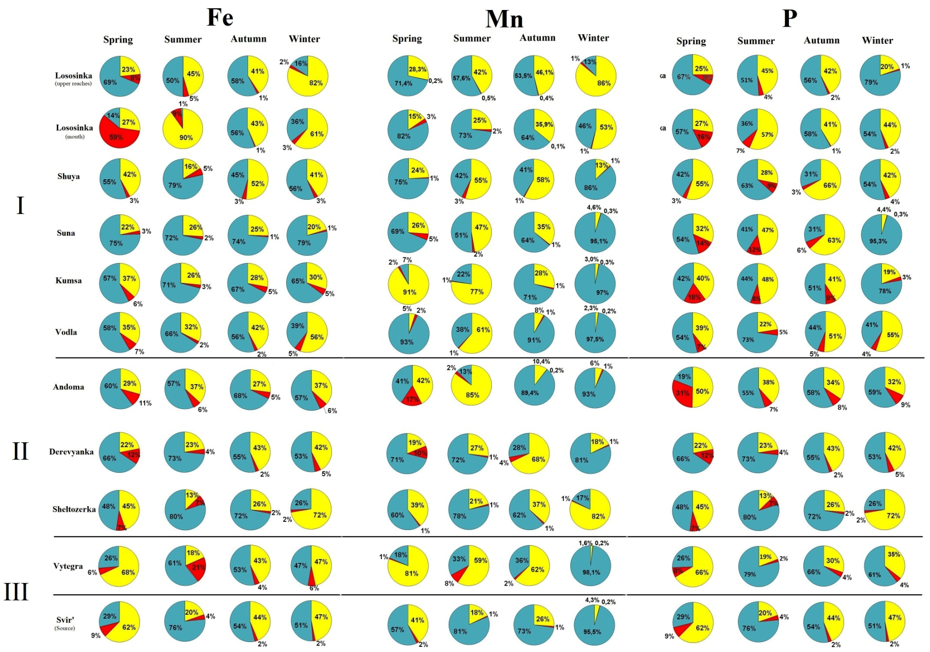
Seasonal redistribution of forms of Fe. Mn and P content in rivers

Slide 8
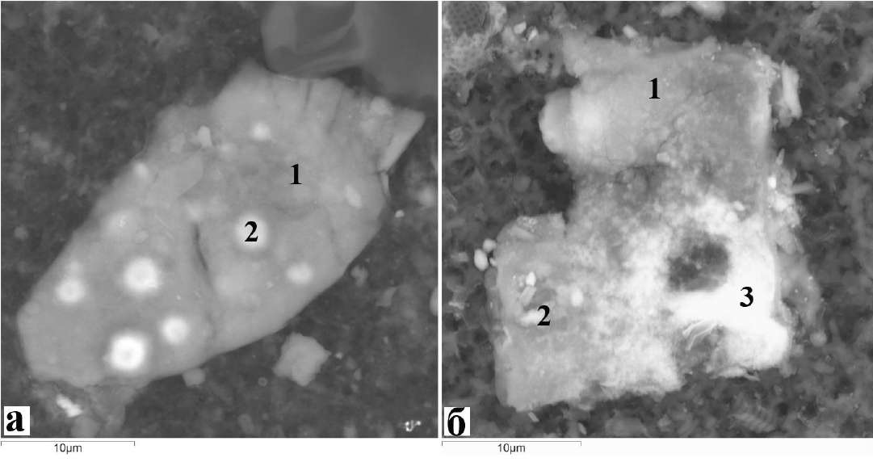
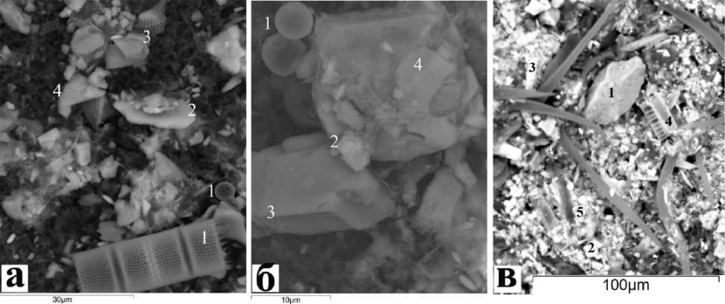
Suspended matter from the water of the surface horizon of the inflows of Lake Onego
Electron microscopic examination (SEM) of samples of river suspension on filters showed the level of concentration of the mineral component. corresponding in general to the rivers of the Arctic territories (Savenko. 2007; Maslov. Shevchenko. 2019. etc.).
Micrographs (using the MIRA 3 Tescan SEM) of river suspension samples on filters selected in the Andoma River (a). the Salmon River (b): (a) 1 – coarse-flaked chlorite aggregate (Mg. Fe). 2 – latent-flaked ferruginous chlorite grains; (b) 1– fine-flaked illite aggregate (Mg. Fe). 2 – latent scaly grains of ferruginous illite; 3 – fine-fiber aggregate of manganese hydroxides
Micrographs (using the MIRA 3 Tescan SEM) of river suspension samples on filters selected in the Shuya River (a). Vodla River (b). Sheltozerka River (c): (a) 1 – shells and biodetrite of diatoms. 2 – muscovite. 3 – quartz. 4 – potassium feldspar; (b) 1– shells and biodetrite of diatoms. 2 - hydroxides Mn and Fe. 3 - oligoclase. 4 – quartz; (c) 1 – quartz. 2 – potassium feldspar. 3 – epidote. 4 – shells and biodetrite of diatoms. 5 – illite (Mg. Fe).

Slide 9
Conclusion
In 2020-2021. work continued on the study of the suspended matter of the lake and the suspended matter entering Lake Onego with river runoff: to assess the flow of substances into Lake Onego with river waters. work continued on the survey of 9 of its tributaries and the Svir’ River. among them three large rivers Vodla. Shuya and Suna. which provide 68% of the water runoff into the lake.
Despite the similarity of the main chemical characteristics due to the common climatic conditions of the entire catchment basin. due to the heterogeneity of its geological and geomorphological structure and hydrographic features. the chemical composition and regime of river waters within the region differs.

Slide 10
Thank you for
your
attention!

