Slide 1





Antarctic contribution to future sea-level rise with a three-dimensional ice-sheet model
The contribution from Yelmo to ISMIP6
26/05/2022
Antonio Juárez-Martínez, Javier Blasco, Marisa Montoya, Jorge Álvarez-Solas and Alexander Robinson
https://doi.org/10.5194/egusphere-egu22-9448

Slide 2
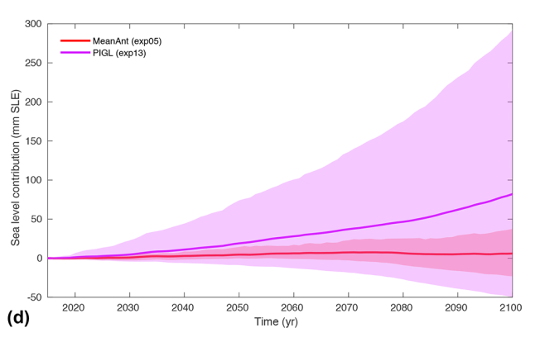
1. Motivation
Sea level contribution and simulation spreads from Seroussi et al (2020). Figure 12d.
Explore the future evolution of Antarctica with the ice-sheet model Yelmo: https://github.com/palma-ice/yelmo. Robinson et al (2020).
Consider two periods: 2100 (comparison with ISMIP6; Seroussi et al, 2020) and 2500 (an extension). Starting from 2015.

Slide 3
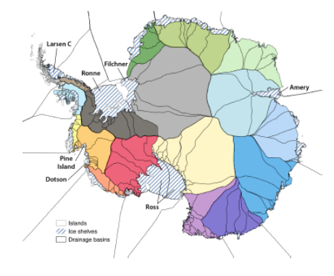
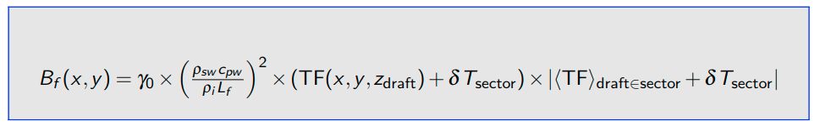
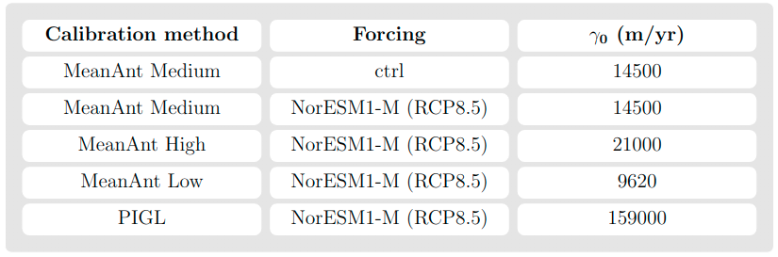
2. Methodology
Basal melt parametrization
Jourdain et al (2020)
Experiments
MeanAnt (Mean Antarctic observations)
PIGL (Pine Island GLacier observations)

Slide 4
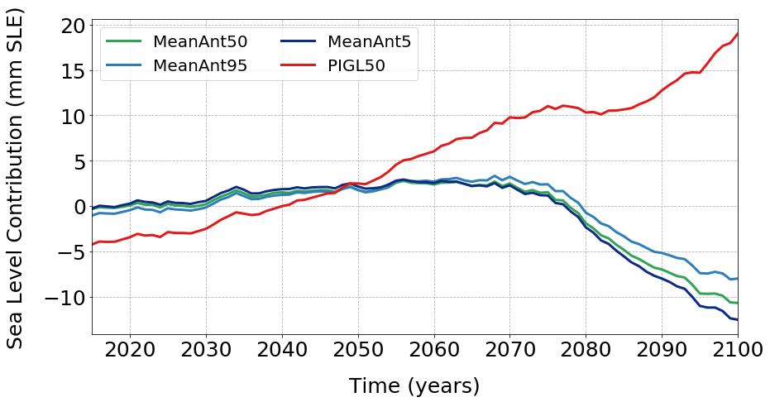
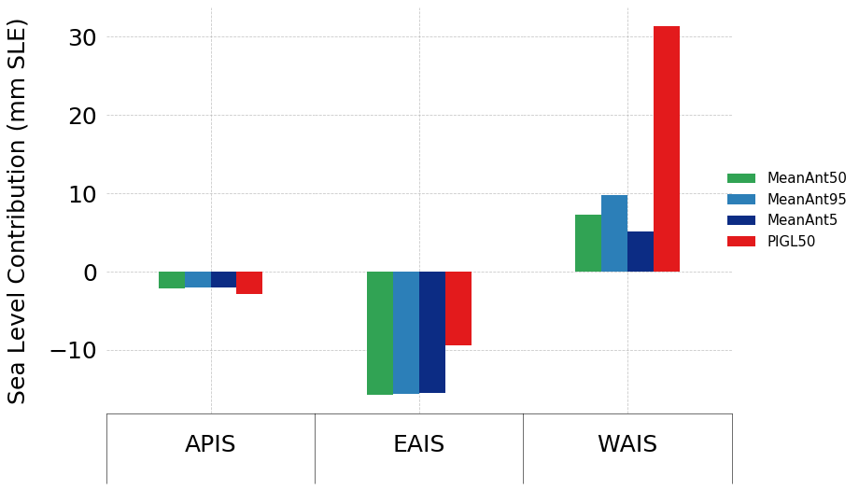
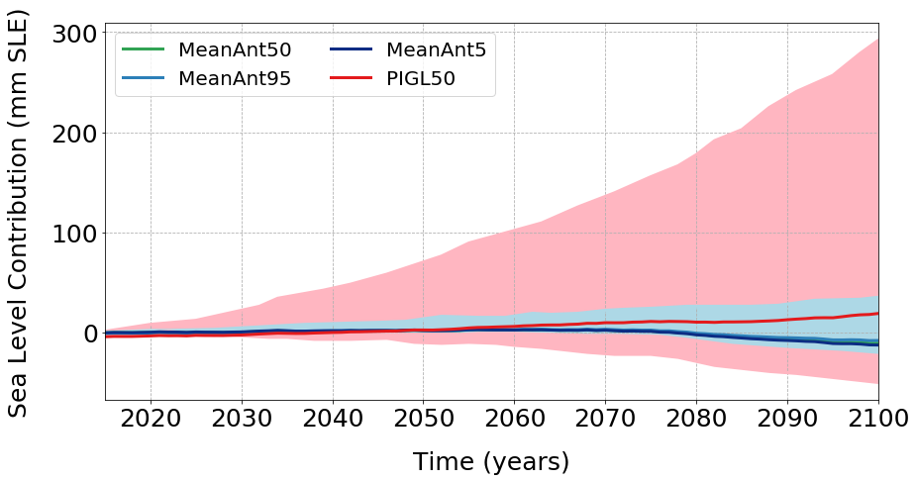
3. Results | Evolution until 2100
The WAIS is the main contributor to sea level rise
Shaded regions from Seroussi et al (2020)

Slide 5
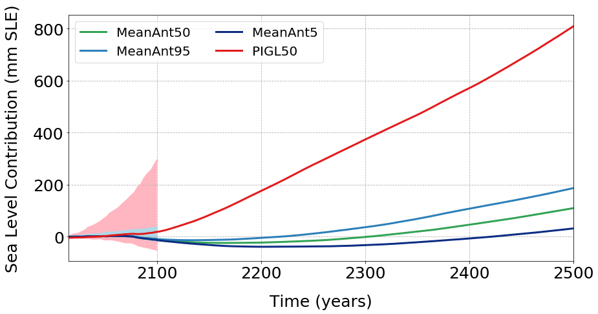
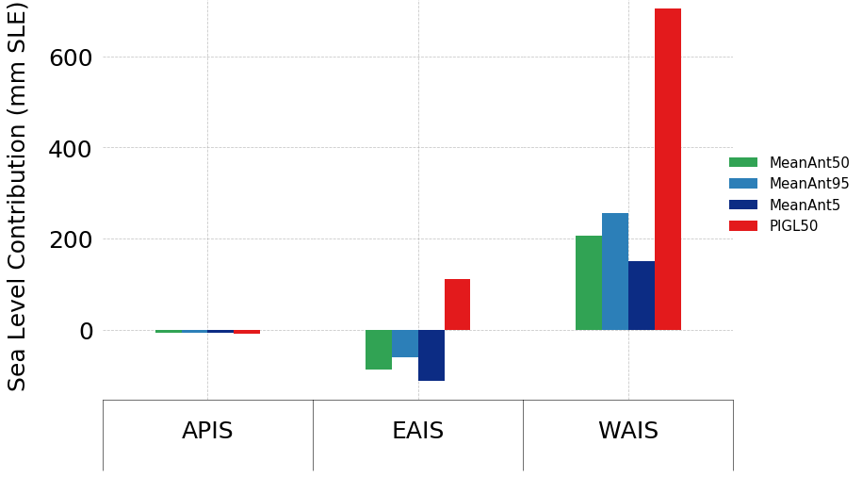
4. Results | Evolution until 2500 (I)
Shaded regions from Seroussi et al (2020)

Slide 6
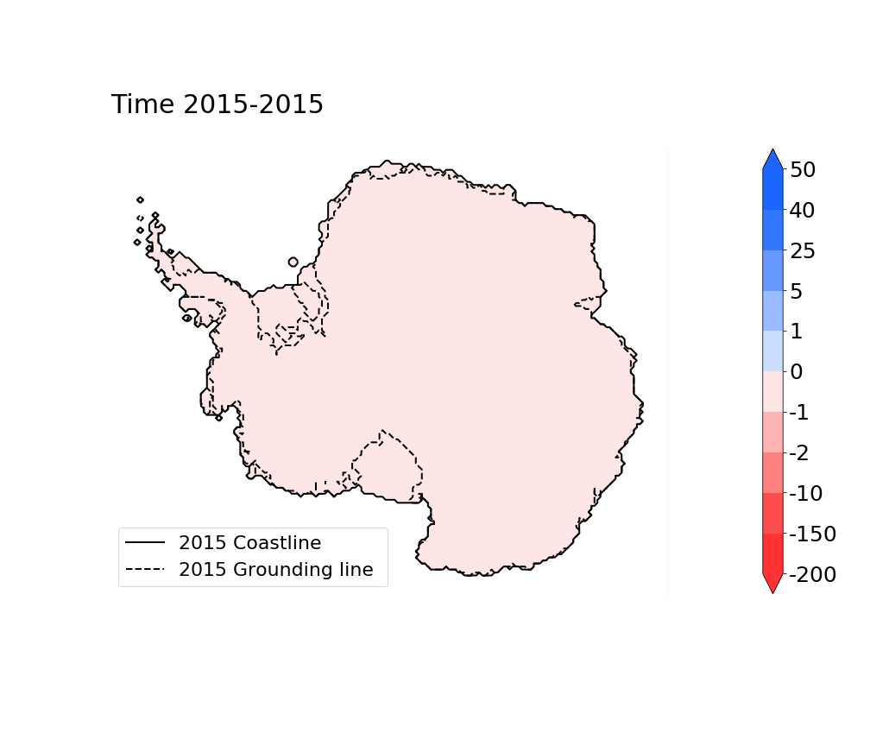
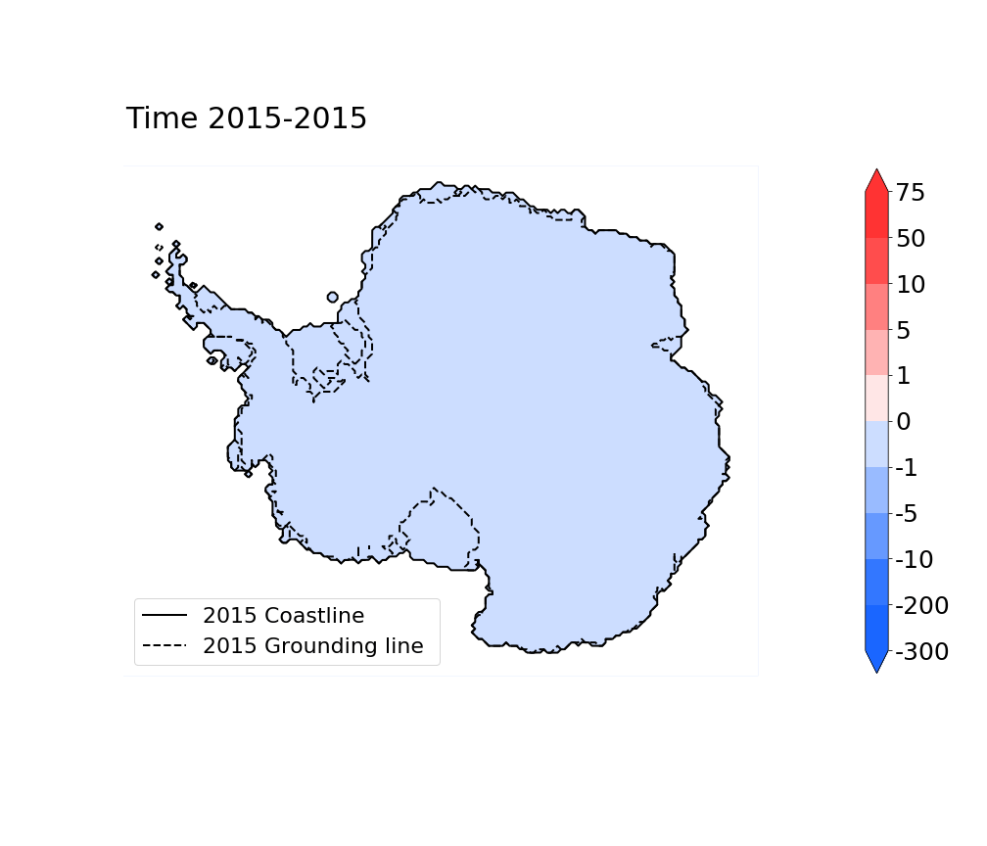
4. Results | Evolution until 2500 (II) with PIGL
Ice Thickness Anomalies (m)
Surface Velocity Anomalies (m/yr)
The grounding line migrates

Slide 7
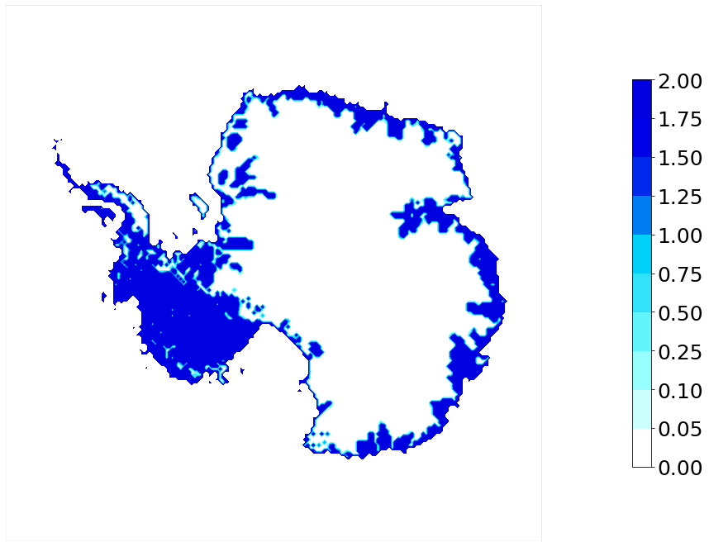
5. Conclusions and future work
Implementation in Yelmo of a submodule for subglacial hydrology ⇒ basal sliding and dynamics.
Strong dependency in the calibration of basal melting uncertainty
In the range of the results achieved by Seroussi et al (2020) for ISMIP6.
In 2100, sea level rise between -12.5 mm and 19 mm. In 2500, sea level could surpass 80 cm.
WAIS the main contributor. EAIS counterbalance effect.
Height of water (m)

Slide 8


