Slide 1
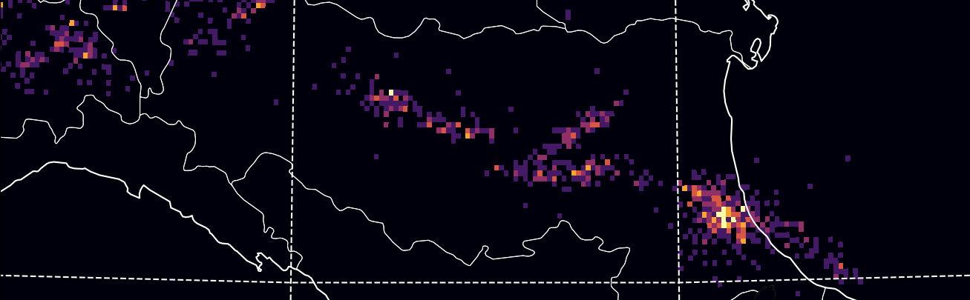
An idealized study of convection initiation along orographic drylines
Stefano Serafin¹ and Emily Potter^{1,2}
¹University of Vienna, Department of Meteorology and Geophysics
²University of Innsbruck, Department of Atmospheric and Cryospheric Sciences (ACINN)
lightning flash data courtesy of ALDIS

Slide 2
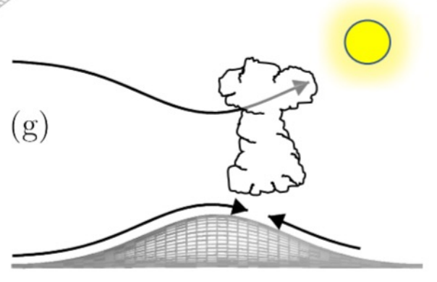
Ingredients for deep moist convection: Convective available potential energy + lifting to cause convective initiation
Mountain waves cause leeside pressure perturbations and uplift. When is the uplift large enough for convection initiation?

Slide 3
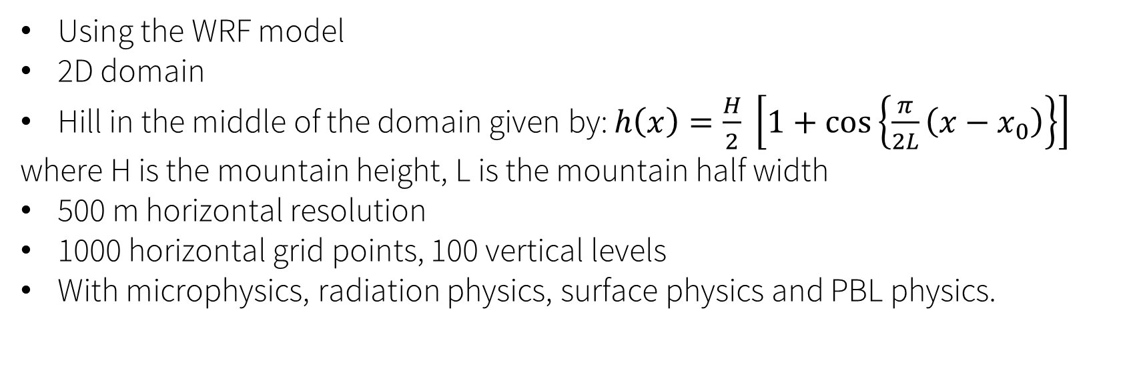
Idealised modelling setup /1
Using the WRF model
2D domain
Hill in the middle of the domain given by: $h\left(x\right)=\frac{H}{2} \left[1+\cos\left\{\frac{π}{2L}\left(x−x_{0}\right)\right\}\right]$
where H is the mountain height, L is the mountain half width
500 m horizontal resolution
1000 horizontal grid points, 100 vertical levels
With microphysics, radiation physics, surface physics and PBL physics.
Notes:
The idealised modelling setup uses the WRF model in idealised mode. There’s a 2D domain with a cosine hill in the centre. We use half a km horizontal resolution with 1000 grid points.

Slide 4
Idealised modelling setup /2
Preliminary set of simulations: dry atmosphere!
5 values of L from 1 to 20 km.
5 values of N from 0.005 to 0.015 1/s.
H = 1000 m and U = 10 m/s are kept constant.
Governing dimensionless quantities: NH/U (nonlinearity, mountain wave amplitude, range: 0.5-1.5) and NL/U (hydrostaticity, range: 0.5-30).
We diagnose the location and magnitude of the maximum boundary-layer uplift

Slide 5
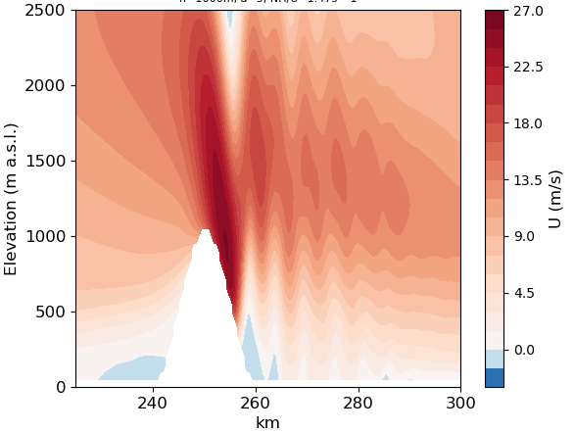
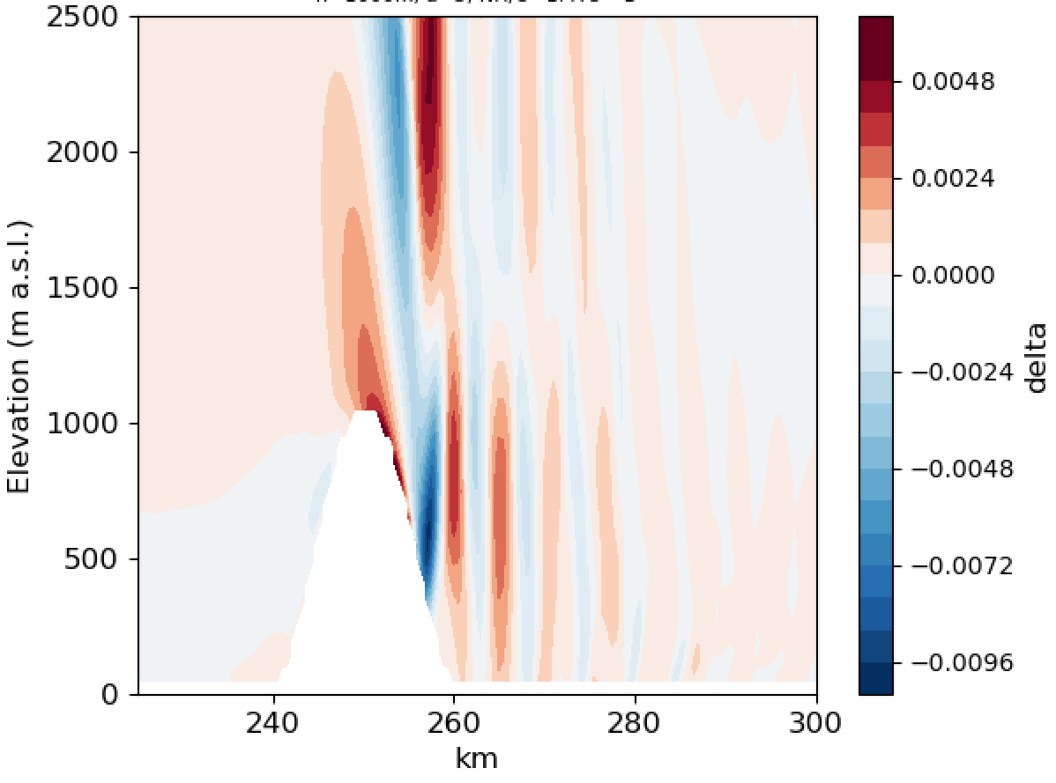
Measuring uplift
Following the work of Kirshbaum and Schultz (2018), we use the Boussinesq mass-continuity equation to determine uplift $w$ through the height integral of the negative horizontal divergence $−∇∙u_{h}={−u}_{x}=−δ$
An example with $N\sim 0.015 s^{−1}, L=5 km$, with U and $δ$ averaged from hour 2 to 4
Notes:
In order to measure vertical uplift, we use the boussinesq mass continuity equation to equate vertical uplift with horizontal divergence. The boussinesq mass continuity equation states that if you integrate delta from the ground to the top of the hill height, say, you get the negative vertical velocity at that hill height. Here’s an example of a run with a constant brunt-Vaisala frequency of 0.015 and a halfwidth of 5 km. On the lee side of the mountain, there is initially a hydraulic jump, and then a wave-like pattern with rotors near the surface. This rotor formation was initially found by Sachsperger and others who showed that increasing nonlinearity by increasing the brung-vailsala frequency increased the strength of the rotors on the lee side of mountains, when a no-slip condition is present at the surface.

Slide 6
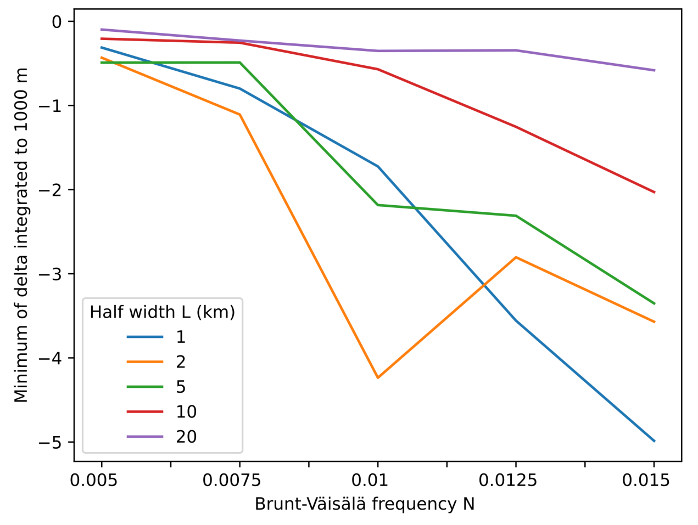
Impact of wind speed and stratification
Leeside convergence is most pronounced in highly nonlinear and moderately non-hydrostatic flow, consistent with previous results on atmospheric rotors (Sachsperger et al., 2016).
Notes:
This plot shows the outcome from a number of setups, with half widths ranging from 1 km to 20 km, and initial buoyancy profiles ranging from a brunt Vaisala frequency of 0.005 to 0.015. all runs use a constant background windspeed of 10 m/s. This is the divergence delta, integrated from the ground to 1000 m (the mountain top height), then the absolute minimum (maximum convergence, corresponding to maximum uplift) in the horizontal direction is found. While Sachsperger focussed on rotor strength, showing that narrower mountains produced stronger rotors, here we are more likely to be measuring the strength of the initial hydraulic jump. In general, narrower mountains and a higher brunt-Vaisala frequency correspond to greater convergence.

Slide 7
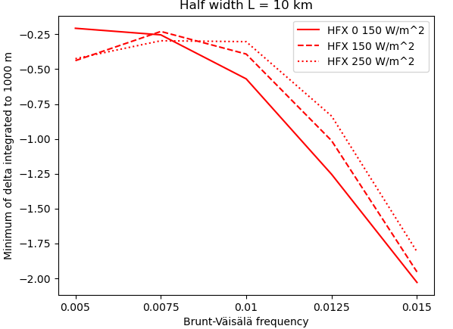
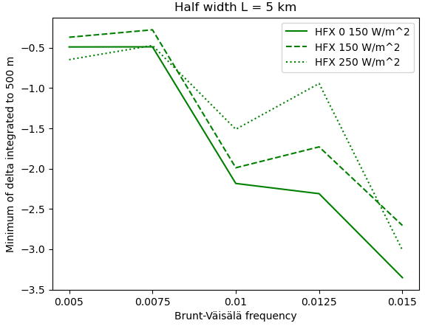
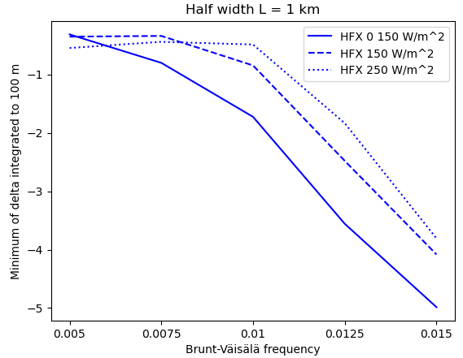
Impact of surface heating
Minimum of delta integrated to 1000 m
Minimum of delta integrated to 1000 m
Minimum of delta integrated to 1000 m
Adding a constant positive heat flux (daytime conditions) decreases the maximum uplift, although this is not fully consistent in all experiments.
Notes:
Why is this? Increased heat flux decreases strength of initial hydraulic jump, while increasing rotor strength? But why the decrease in the hydraulic jump? Just because it’s increasing mixing, or something?

Slide 8
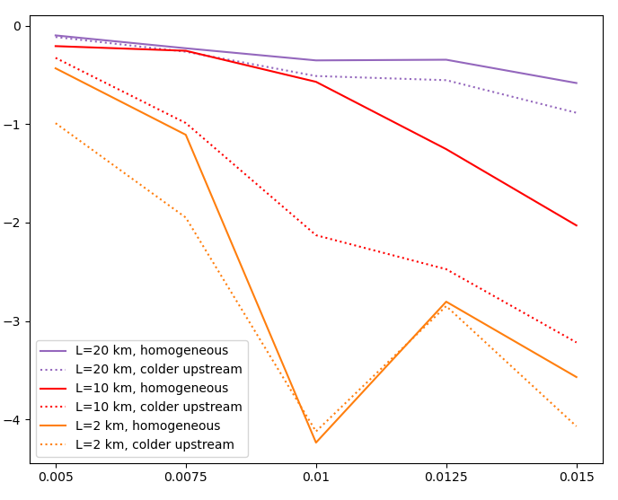
Impact of cross-mountain buoyancy gradients
Minimum of delta integrated to 1000 m
Brunt-Väisälä frequency
Colder air upstream enhances lee-side convergence.

Slide 9
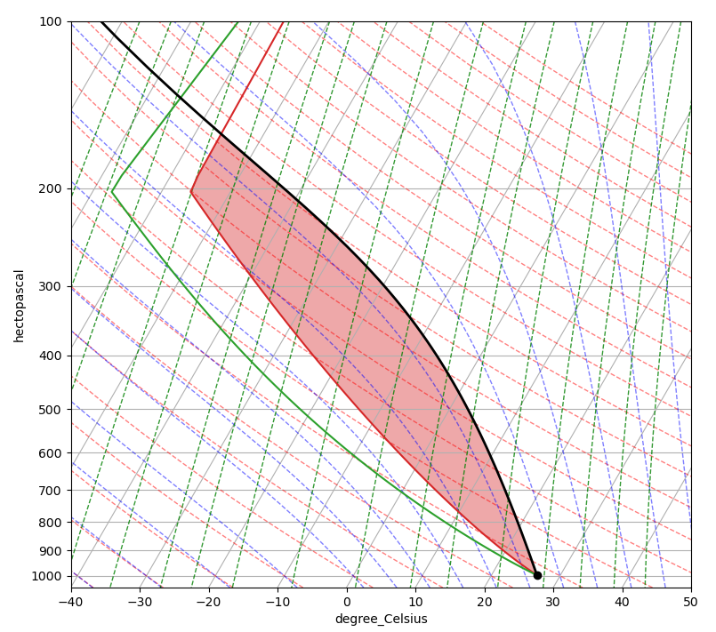
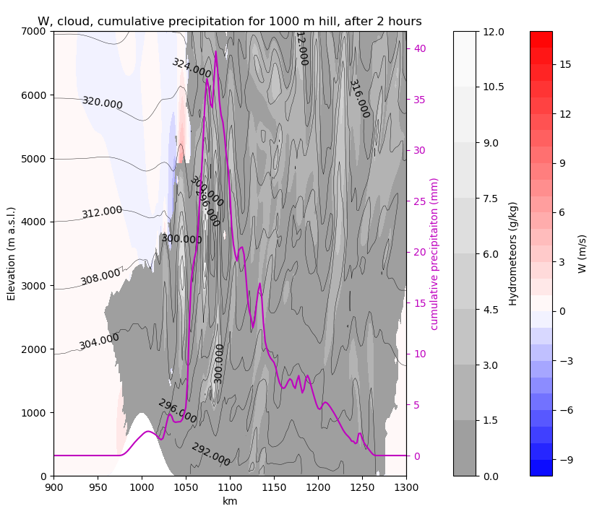
Adding low-level moisture and CAPE
Proof of concept adapted from Weisman and Klemp (1982): It is possible to get lee side storms in this 2D idealised setup

Slide 10
Future work
Use a momentum budget analysis to determine the drivers of the change in divergence.
Systematic study with moist soundings.
Determine the optimum environmental conditions for lee-side convection initiation.
Notes:
This plot shows the outcome from a number of setups, with half widths ranging from 1 km to 20 km, and initial buoyancy profiles ranging from a brunt Vaisala frequency of 0.005 to 0.015. all runs use a constant background windspeed of 10 m/s. This is the divergence delta, integrated from the ground to 1000 m (the mountain top height), then the absolute minimum (maximum convergence, corresponding to maximum uplift) in the horizontal direction is found. While Sachsperger focussed on rotor strength, showing that narrower mountains produced stronger rotors, here we are more likely to be measuring the strength of the initial hydraulic jump. In general, narrower mountains and a higher brunt-Vaisala frequency correspond to greater convergence.

