Slide 1




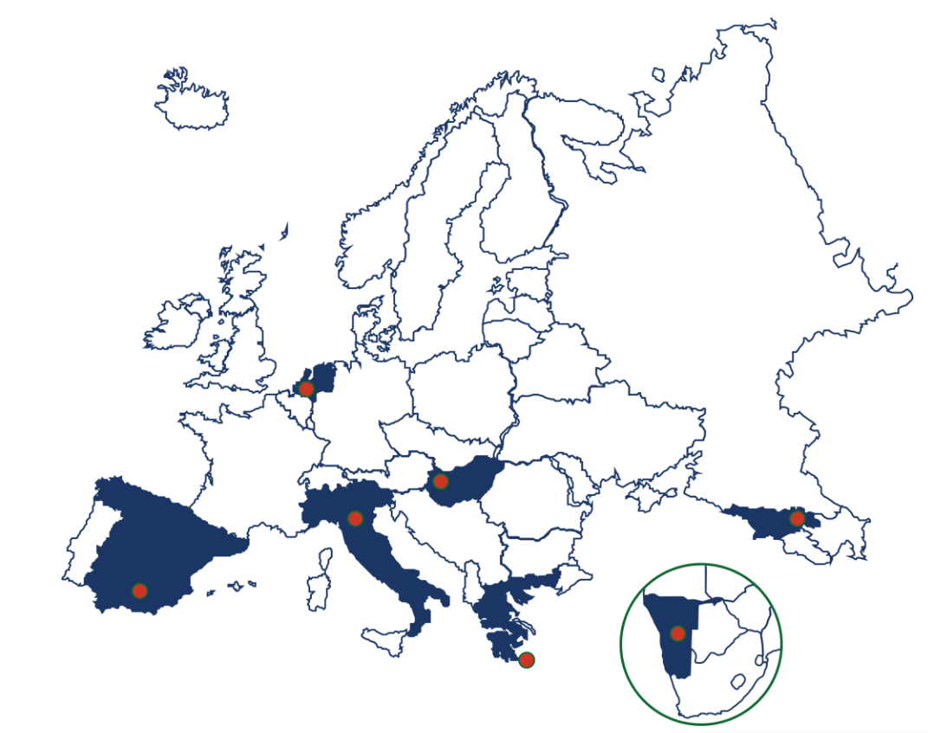
Conceptualizing the interactions between climate information and adaptation across Europe
Riccardo Biella ¹ ²
Giuliano Di Baldassarre ¹ ²
Maurizio Mazzoleni ³
Luigia Brandimarte ⁴
Centre for Natural Hazards and Disaster Science
Department of Earth Sciences, Uppsala University
Vrije Universiteit Amsterdam
Royal Institute of Technology, Stockholm
Figure form: https://icisk.eu/living-labs/
Notes:
Good morning everyone, I am here to present my current work titled Conceptualizing the interactions between climate information and adaptation across various European contexts
One might think that access to climate information can only lead to positive societal outcomes. However, the climate services community of practices has highlighted possible challenges stemming from the use of climate information in adaptation

Slide 2
CHALLENGES IN THE USE OF CLIMATE INFORMATION
UNFAIR ADVANTAGE
INEQUALITY IN ACCESS
Cost
Resources
Capacity
Social norms
Notes:
For example:
Different actors can have unequal access to information due to limitations such as cost, internal capacity, or social norms.
This can favour player able to access Climate Information, leading to scenarios where the rich get richer at the expenses of the less fortunate.

Slide 3
CHALLENGES IN THE USE OF CLIMATE INFORMATION
SYSTEM DYNAMICS
ARCHETYPES
Success to the Successful
UNFAIR ADVANTAGE
+
-
Resources A
Competitivity of A/B
Resources B
INEQUALITY IN ACCESS
+
-
Cost
Resources
Capacity
Social norms
Resource
Time
Notes:
Here, I use a system dynamic archetypes to model this scenario characterized by paired reinforcing feedback loops, whereby the growth of one actor leads to the decline of another one.
This emerging behaviour quickly accelerates and spirals out of control. This is often referred to as The success of the successful scenario.
This is a type of system dynamic archetype, which basic system configuration found in many real world complex systems, showing emerging – often unexpected - properties.

Slide 4
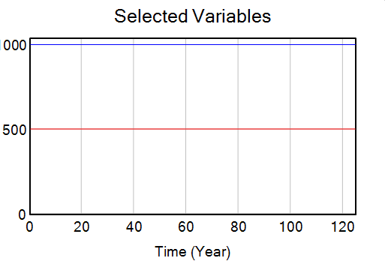


Scenario 0 - Baseline
Resources of A and Resources of B
Resources
Resources A
Resources B
+
+
+
-
Competitor A
Competitivity of A/B
Competitor B
100%
A
A
A
Income A
Income B
-
+
-
-
Cost A
Cost B
Resources
B
B
B
0%
Year=0
Year=75
Year=125
Time
Resources A
Resources A
Notes:
Let’s put this into practice in a context relevant to climate information.
Let’s imagine a simple system where two competitors compete over limited resources
and where the amount of resources they own determines their competitivity, which in turns leads to higher income, which allows them to accumulate resource.
Production costs reduce their income, balancing out their resource accumulation.
On the right hand, we can see how the system develops over the runtime of the scenario.
Despite the two competitors starting at two different resource levels (A being twice as large as B), the larger costs associated with A keeps the system in a state of equilibrium and prevents the Success to the Successful dynamics form emerging.

Slide 5
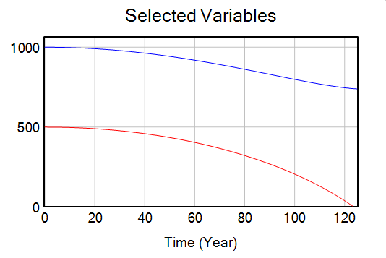
Scenario 1 - No Adaptation
Resources of A and Resources of B
CC Impact
+
+
Resources
Resources A
Resources B
+
+
+
-
Competitor A
Competitivity of A/B
Competitor B
100%
A
CC
CC
Income A
Income B
-
+
-
-
A
Cost A
Cost B
A
Resources
B
B
0%
Year=0
Year=75
Year=125
Time
5
Resources A
Resources A
CC impact
Notes:
Let’s now introduce Climate Change as a progressively increasing variable reducing the resources of both competitors equally.
What we observe is a progressive decline of the resources of both competitors over time, and a significant reduction of the total amount of resources.
Here, both competitors are affected equally, but it is B paying the ultimate price by the end of the runtime of the scenario, and the behaviour of the success to the successful remerges.

Slide 6
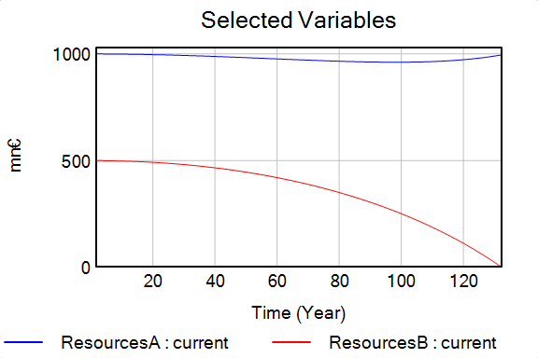
Scenario 2- Costly Adaptation
Resources of A and Resources of B
CC Impact
+
+
Adaptation A
(Tailored)
+
+
Resources
Resources A
Resources B
Adaptation B
(Free)
+
+
+
-
Competitor A
Competitivity of A/B
Competitor B
+
100%
+
A
CC
CC
+
Income A
Income B
A
-
+
-
-
A
Cost A
Cost B
Resources
B
B
0%
Year=0
Year=75
Year=125
Time
6
Resources A
Resources A
CC impact
Notes:
Now to a scenario where both competitors can carry out adaptation.
However, competitor A (having more resources) is able to afford tailored climate information, leading to more effective adaptation, while competitor B relies of free climate information, which (while having no costs) is less effective.
While adaptation reduces the effects of CC on the total amount of resources, competitors B still pays the highest price, being completely outcompeted by A.
This is as the different access in the type of adaptation that the two competitors were able to carry out gives clear advantages to competitor A, which by the end has even expanded, to the expenses of B.
In this case, the success of the success dynamics are not only present, but amplified.

Slide 7
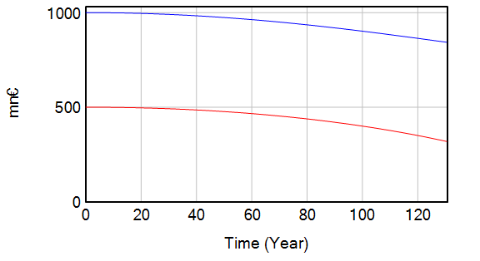
Scenario 3 - Subsidized Adaptation
Resources of A and Resources of B
CC Impact
+
+
Adaptation A
(Tailored)
+
+
Resources
Resources A
Resources B
Adaptation B
(Tailored
& Subsidized)
+
+
+
-
Competitor A
Competitivity of A/B
Competitor B
100%
+
CC
CC
CC
+
A
CC
Income B
A
+
Income A
-
-
A
-
+
+
Cost A
Cost B
+
Resources
B
B
B
50%
0%
Year=0
Year=75
Year=125
Time
7
Resources A
Resources A
CC impact
Notes:
Finally – Let’s explore a possible solution scenario
Here, both competitors access to the same tailored adaptation as A, but ´the costs of B’s adaptation are partially subsidized by A’s income (50% of its cost).
Here, neither competitor gains a clear advantage over the other. Instead both are able to make it through the runtime of the scenario.
This solution, while not prefect, effectively dampens the success to the successful emerging system behaviour.

Slide 8
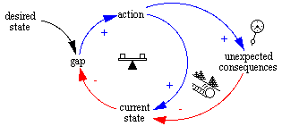
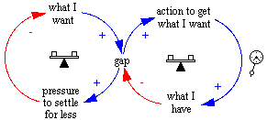
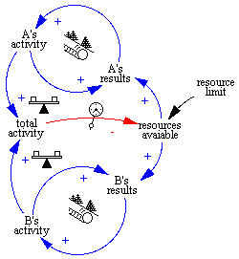
Fixes That Fail
Needs of transformative adaptation
Drifting Goals
Long-term
vs
short-term
SYSTEM DYNAMICS
ARCHETYPES
CHALLENGES
Accuracy and reliability
Tragedy of the Commons
Sustainability
Bellinger, G. (2004). The Way of Systems. https://www.systems-thinking.org
Notes:
So, I hope I was able to show you how climate service providers and decision makers should keep in mind the adaptation needs of different actors.
As, understanding the mechanisms of complex emerging system behaviours is instrumental in designing policies verted at fostering adaptation without compromising other social values.
To this end, system dynamics archetypes can be an effective diagnostic tool to explore challenges in the use of climate information in adaptation.
However, this presentation only aimed at offering a preview in the use of ONE archetype to explore ONE type of challenge. Yet, this approach can shed a light onto the other challenges found in the real world.

Slide 9
Guiding Questions
What unintended consequences can stem from the use of climate information in adaptation?
Explore these challenges across the living labs of the I-CISK project
Figure form: https://icisk.eu/living-labs/
Notes:
In my research I explore what types of unintended consequences can stem from the use of climate services in adaptation across various European contexts thank to the partner LLs of the I-CISK project.
Which is a EU project aiming at co-creating the future human centred climate services.

Slide 10
Where climate change is enhancing social inequalities,
adaptation should focus on reducing them
Corresponding author:
Riccardo Biella
riccardo.biella@geo.uu.se
Notes:
And I wanted to leave you with this message:
As more and more evidence is showing how Climate Change is enhancing social inequalities. Climate information should allow adaptation to reduce them.
Thank you very much.

