Slide 1




Cluster Analysis of Velocity Profiles around Hudson Bay using Unsupervised Machine Learning
Akash Kharita¹, Amy Gilligan²
Indian Institute of Technology Roorkee
University of Aberdeen
Session SM5.4: Advances in the understanding of the crustal structure through passive and active seismological methodologies
EGU General Assembly 2022, Vienna, Austria, 23–27 May 2022, EGU22-9491, https://doi.org/10.5194/egusphere-egu22-9491, 2022.

Slide 2
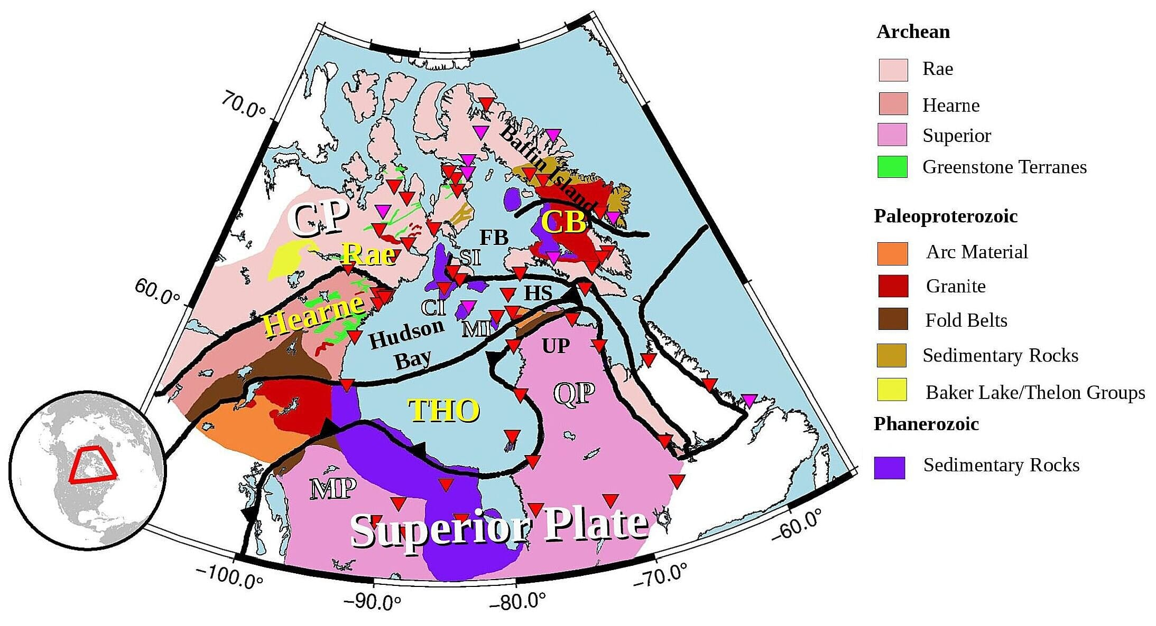
Data and Region

Slide 3
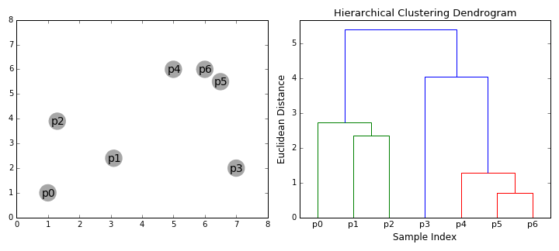
Hierarchical Agglomerative Clustering

Slide 4
Choice of Linkage

Slide 5
Optimum Number of Clusters

Slide 6
Different Inversion Parameters

Slide 7
Azimuthal Variations

Slide 8
Final Results

Slide 9
New Insights

Slide 10
Thanks!
Questions?

