Slide 1
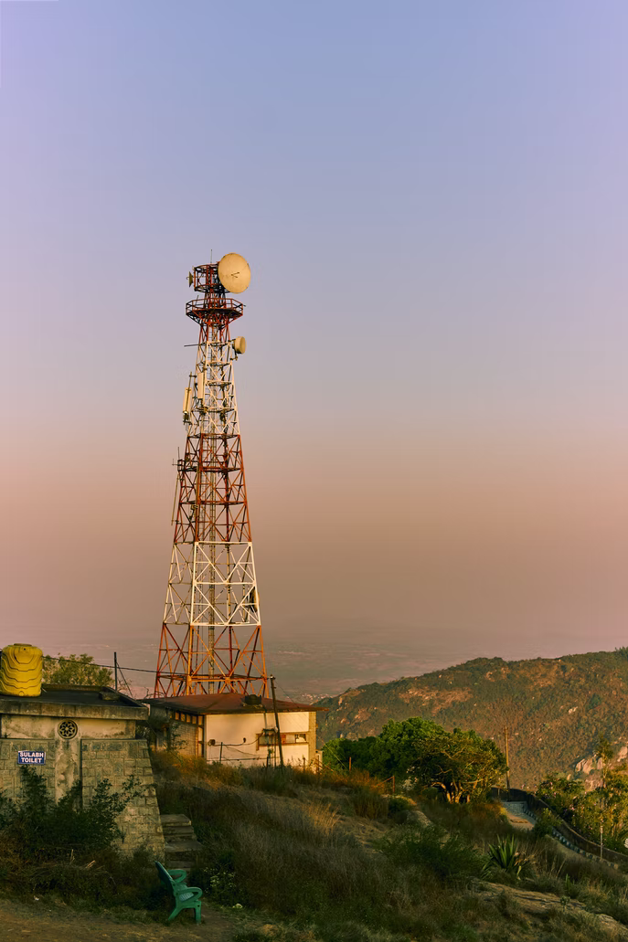




Considering local network characteristics and
environmental conditions improves rainfall
estimates from Commercial Microwave Links
in Sri Lanka
Bas Walraven¹, Aart Overeem², Hidde Leijnse², Miriam Coenders¹,
Rolf Hut¹, Luuk van der Valk¹, Remko Uijlenhoet¹
¹ Department of Water Management, Faculty of Civil Engineering and Geosciences, Delft University of Technology,
Delft, The Netherlands
² R&D Observations and Data Technology, Royal Netherlands Meteorological Institute (KNMI), De Bilt, The Netherlands
EGU General Assembly 2022
Source: Unsplash

Slide 2
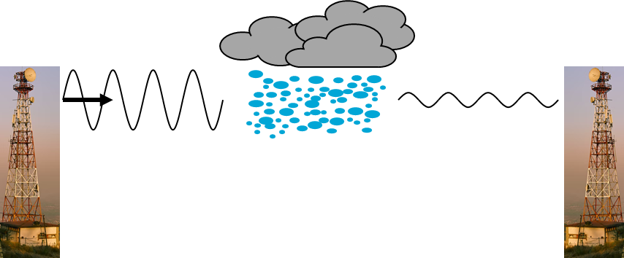
Commercial Microwave Links as opportunistic sensors of rain

Slide 3
Commercial Microwave Links as opportunistic sensors of rain
RAINLINK
Open source R package ‘RAINLINK’ available: https://github.com/overeem11/RAINLINK

Slide 4
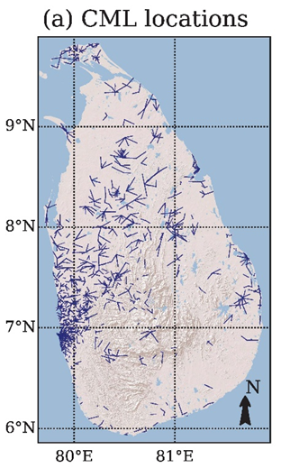
Rainfall monitoring with CMLs in the tropics: Sri Lanka
3.5 month dataset (Sep. – Dec. 2019)
~1140 link paths
(Overeem et al., ERL2021)

Slide 5
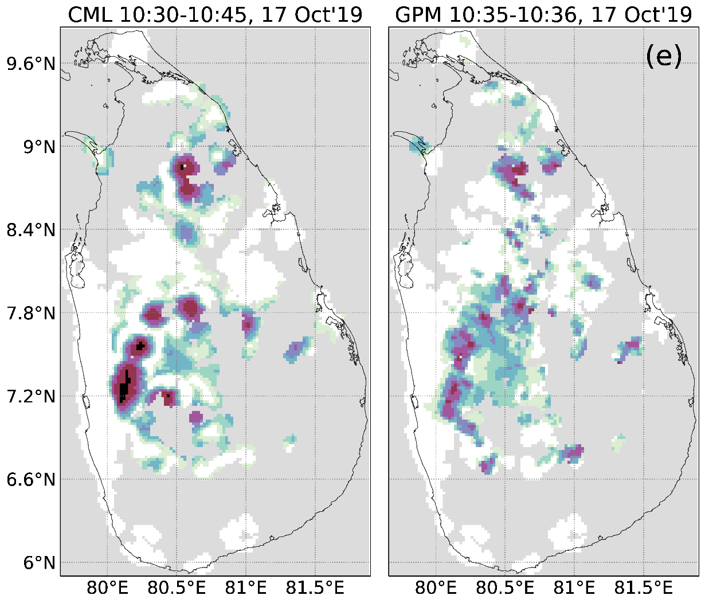
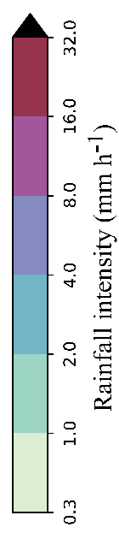
Sri Lanka: rainfall maps from CMLs
RAINLINK parameters tuned to Dutch CML network & weather characteristics
(Overeem et al., ERL2021)

Slide 6
Sri Lanka: CMLs vs satellite radar
RAINLINK parameters tuned to Dutch CML network & weather characteristics
(Overeem et al., ERL2021)

Slide 7
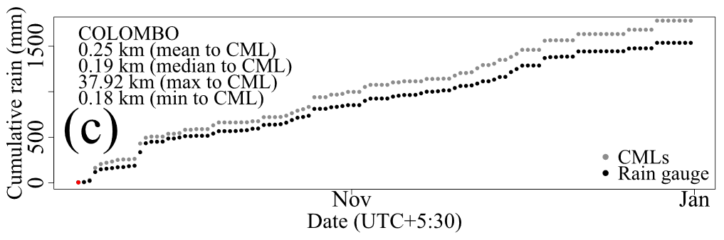
Room for improvement locally
COLOMBO
(Overeem et al., ERL2021)

Slide 8
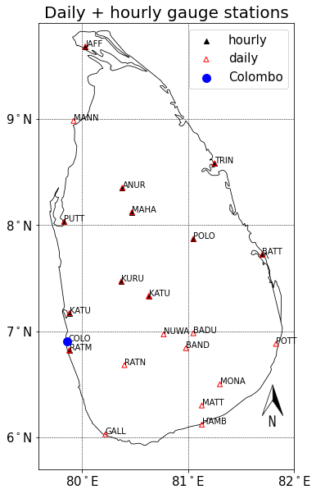
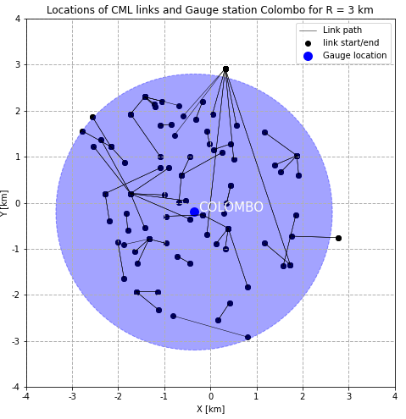
Sri Lanka: optimizing parameters locally
Optimizing the wet-antenna attenuation (A_{a}) and
the coefficient that determines contribution of minimum and maximum attenuation in 15 min period (α)
Figure by MSc student Karlijn Schoenmaker

Slide 9
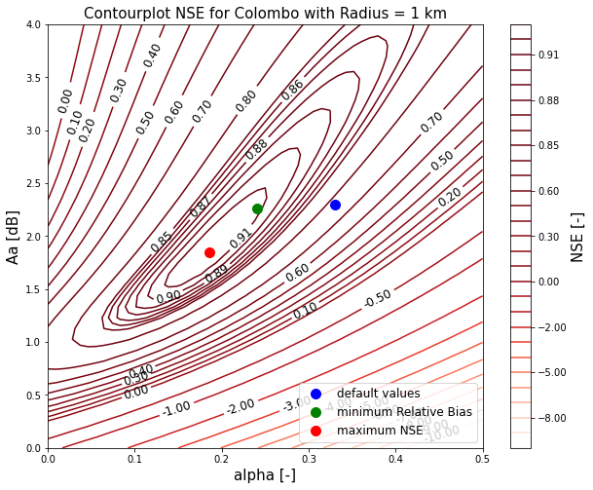
Sri Lanka: optimizing parameters locally
Figure by MSc student Karlijn Schoenmaker

Slide 10
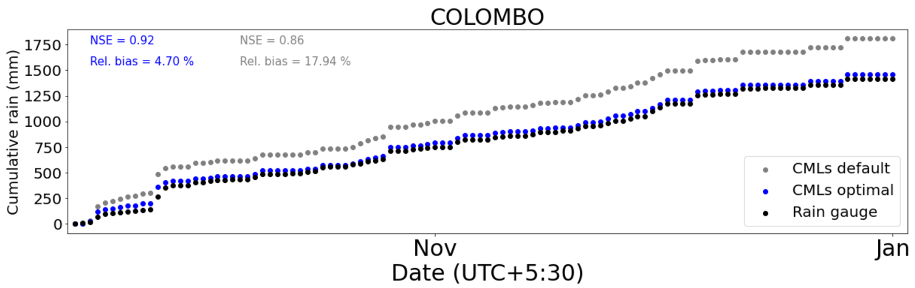
Improved rainfall estimation
Outlook:
(Spatially varying) optimization of other parameters
Application in rainfall nowcasting and in validation of satellite rainfall products in the tropics
Figure by MSc student Karlijn Schoenmaker

Slide 11
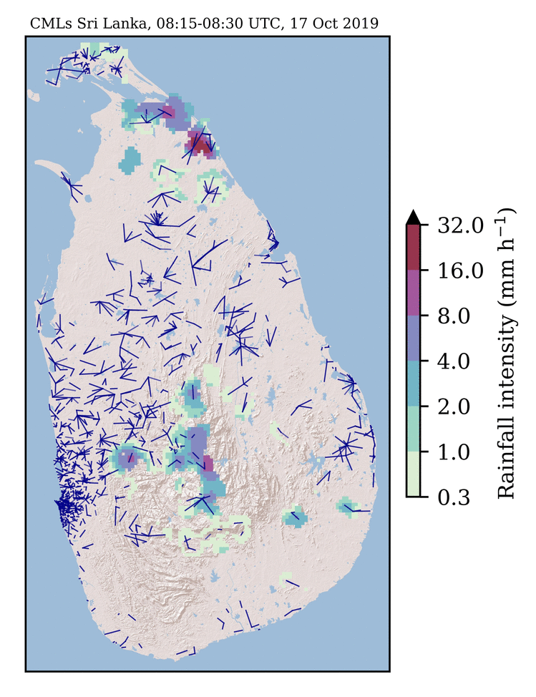

Thank you!
For questions or discussion please reach out to:
B.Walraven@tudelft.nl

