Slide 1
Retrieval of Ice Cloud Properties for Sentinel-5 Precursor and Sentinel-4 Measurements
Ana del Águila*, Ronny Lutz, Víctor Molina García, Fabian Romahn, Diego Loyola
Remote Sensing Technology Institute
Earth Observation Center (EOC)
German Aerospace Center (DLR)
EGU 2022 | 27 May 2022

Slide 2
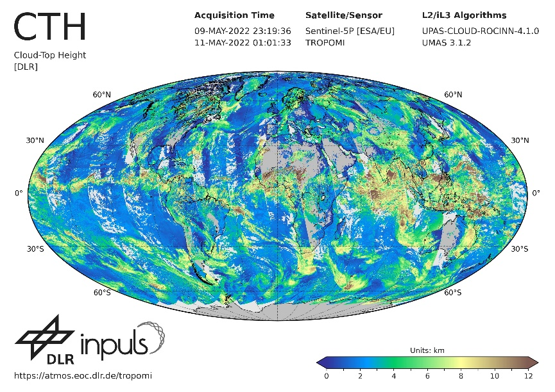
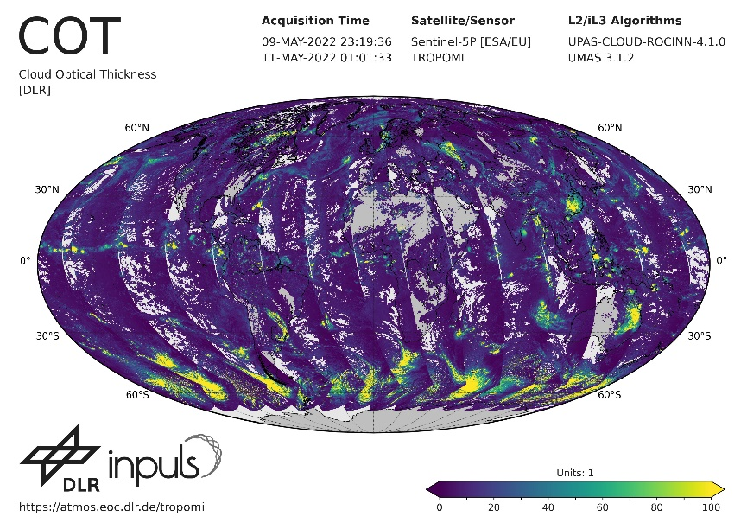
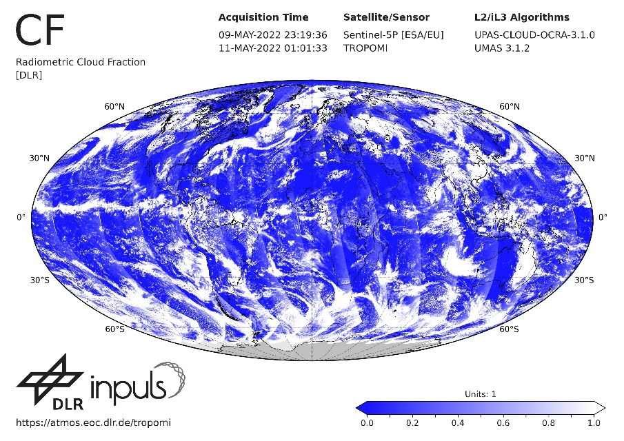
Motivation
The operational DLR cloud retrievals currently take all clouds as water clouds
Study of ice clouds properties to perform accurate ice cloud retrievals in satellite-based systems
Understand the role of ice clouds in climate change
Provide precise information about ice clouds for better climatological predictions
Notes:
Up to date, the state of the art retrieves water clouds but climatological models n

Slide 3
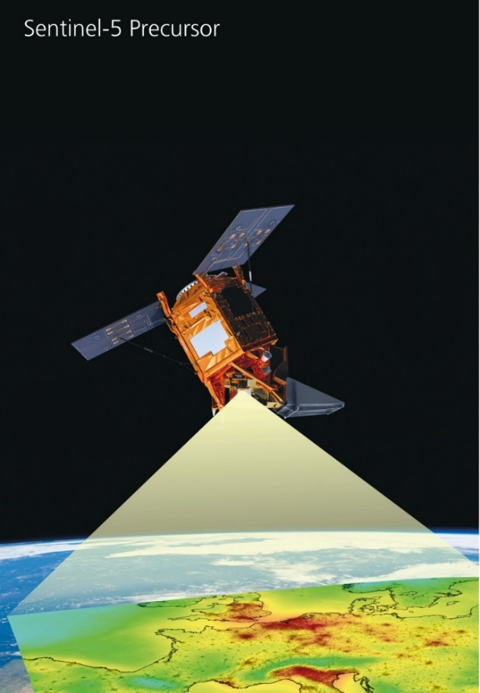
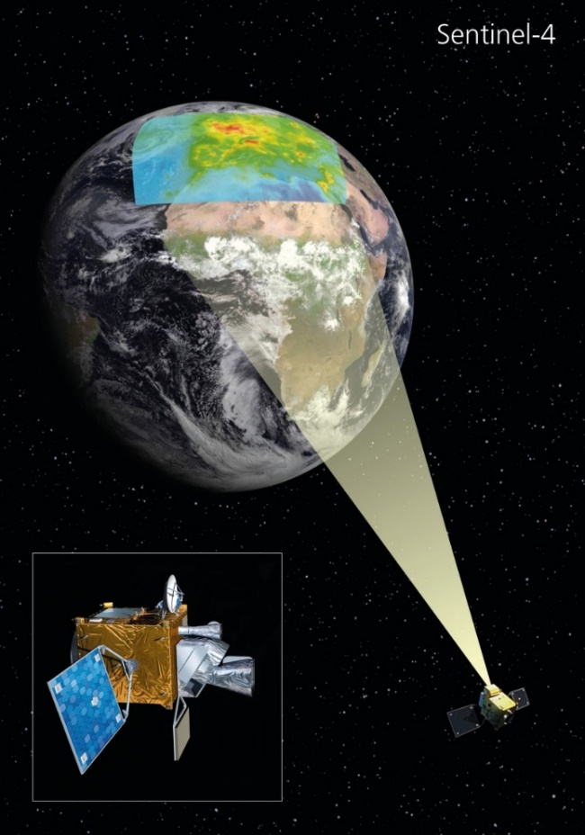
Missions: Sentinel-5P and Sentinel-4
Orbit
sun-synchronous polar
Temporal resolution and coverage
daily global
Instrument
TROPOMI
Spatial resolution
3.5 x 5.5 km²
Spectral coverage
UV-VIS-NIR-SWIR
Spectral resolution
0.25-0.5 nm
Orbit
geostationary
Temporal resolution and coverage: hourly Europe
Instrument
UVN
Spatial resolution
8 x 8 km²
Spectral coverage:
UV-VIS-NIR
Spectral resolution
0.12-0.5 nm

Slide 4
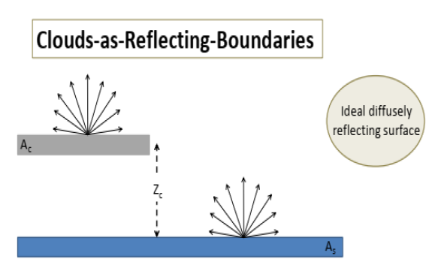
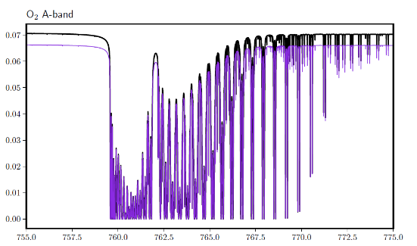
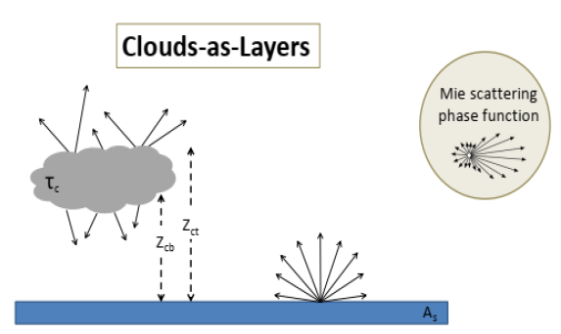
ROCINN (Retrieval Of Clouds Information using Neural Networks) Algorithm overview
Retrieved parameters
Cloud Top Height (CTH)
Cloud Optical Depth (COD)
Cloud Albedo (CA)
CRB
CAL
NN approach
Forward model uses VLIDORT RT code
NN are parametrized using smart sampling
The inversion is done with Tikhonov regularization
Fitting window:
O₂ A-band [758-771] nm

Slide 5
Ice cloud parameterization
Integration of VLIDORT 2.8.3 with ice clouds:
Ice cloud parametrization: Bryan Baum (UW-Madison, https://www.ssec.wisc.edu/ice_models/)
Bulk properties and phase function of ice crystals of an effective diameter: D_{eff} = 25 µm at 760 nm
Bryan Baum et al., 2014. Ice cloud single-scattering property models
with the full phase matrix at wavelengths from 0.2 to 100 µm.
JQSRT (DOI: 10.1016/j.jqsrt.2014.02.029)
ROCINN retrieval:
Noise addition to convolved spectra
A-priori values: CTH = 5 km, COT = 25
Variables | Parametrization
D_{eff} | 25 µm
Total area | 448.0 µm²
IWC | 0.0004355 gm⁻³
Extinction efficiency | 2.0755
SSA | 1.0
Asymmetry parameter | 0.7835
Number of ice angles | 498
Notes:
General habit mixture_ severly rough_ all wavelengths_ full phase matrix 25
5

Slide 6
Test scenarios | Ice cloud simulations: Sentinel 4
Test scenarios adapted from L2OP version1 of UVN
Location | Day | CF | SA (765 nm) | SH (km) | SZA (º) | VZA (º)
1 Helsinki | 20 June | 1 000 | 0.401 | 0.000 | 70.29 | 71.34
4 North Atlantic | 21 June | 0.575 | 0.057 | 0.000 | 39.19 | 64.07
6 Milano | 20 Dec | 1.000 | 0.218 | 0.152 | 70.88 | 53.08
8 English Channel | 24 Dec | 1.000 | 0.059 | 0.000 | 79.06 | 57.47
9 Desert | 22 Dec | 0.770 | 0.505 | 0.628 | 55.31 | 37.27
11 Rabat | 24 June | 1.000 | 0.318 | 0.220 | 45.14 | 40.12
13 NE-Germany | 23 June | 1.000 | 0.582 | 0.026 | 84.49 | 62.66
14 Benkovski | 23 Dec | 1.000 | 0.222 | 0.298 | 70.85 | 55.55
15 Paris | 20 June | 1.000 | 0.363 | 0.0926 | 27.19 | 56.05
16 Madrid | 22 June | 0.795 | 0.241 | 0.701 | 18.21 | 46.84
Simulations:
COD: 20, 5
CTH: 8, 10, 12 km
Fully cloudy (42) vs.
Partially cloudy (18)
Success criteria
 | Threshold | Goal
CF | 20% | 10%
CTH | 1 km | 0.5 km
COD | 30% | 20%
For SZA<60º, VZA<60º, CF>10%, COD>5

Slide 7
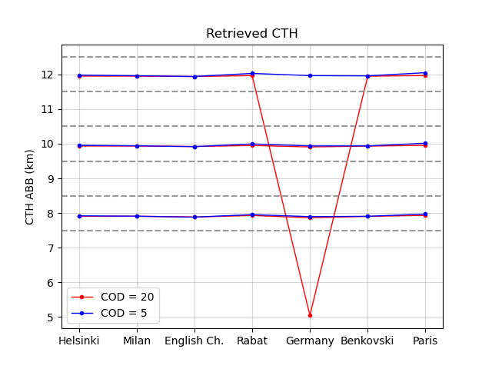
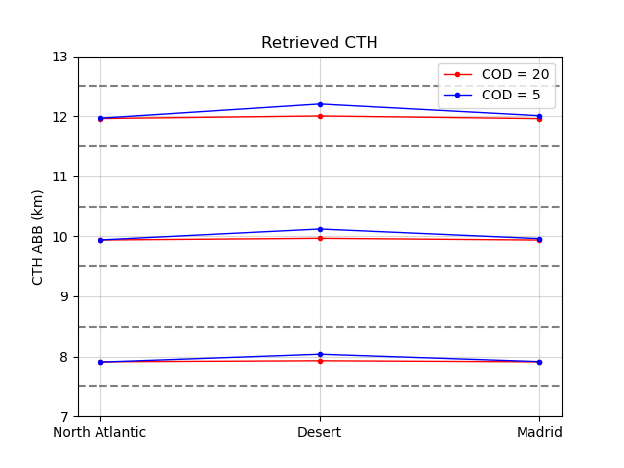
Results | Retrieval of ice cloud
CTH retrieval
Fully cloudy
Partially cloudy
SZA = 84.49º
The retrieved CTH accomplish the goal of 0.5 km (horizontal dashed gray lines) for success criteria

Slide 8
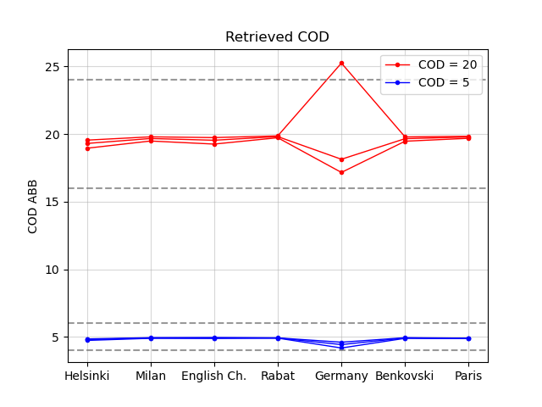
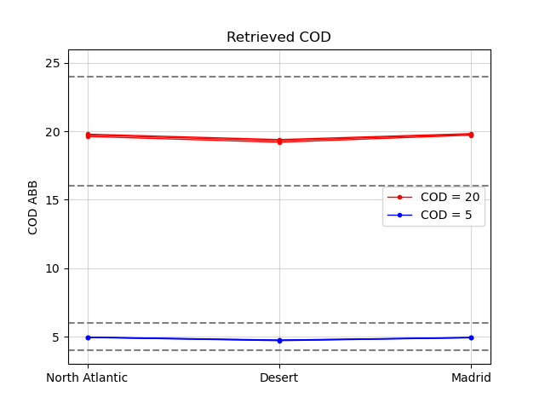
Results | Retrieval of ice cloud
COD retrieval
Fully cloudy
Partially cloudy
SZA = 84.49º
The retrieved COD accomplish the goal of 20% (horizontal dashed gray lines) for success criteria

Slide 9
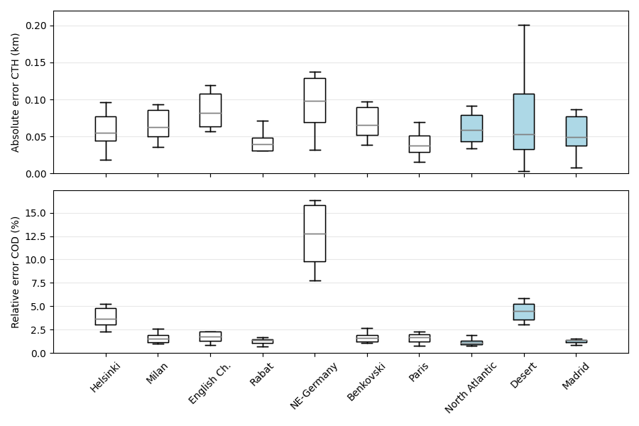
Results | Retrieval of ice cloud
Error assessment
*

Slide 10
Results | ROCINN retrieval for ice clouds vs. water clouds with ice presence
Above threshold
Above goal
Meet success criteria
CTH
 |  | ABB ICE CLOUD |  | ABB WATER CLOUD
Location | True CTH (km) | Retrieved CTH (km) | Absolute error (km) | Retrieved CTH (km) | Absolute error (km)
Helsinki | 12 | 11.96 | 0.04 | 15.00 | 3.00
Germany | 10 | 9.91 | 0.09 | 5.02 | 4.98
Milan | 8 | 7.91 | 0.09 | 8.56 | 0.56
Rabat | 8 | 7.93 | 0.07 | 8.35 | 0.35
Madrid | 10 | 9.97 | 0.03 | 11.13 | 1.13
Desert | 12 | 12.01 | 0.01 | 13.26 | 1.26
COD
 |  | ABB ICE CLOUD |  | ABB WATER CLOUD
Location | True COD | Retrieved COD | Relative error (%) | Retrieved COD | Relative error (%)
Helsinki | 20 | 19.55 | 2.26 | 2.00 | 90.02
Germany | 20 | 18.13 | 9.33 | 24.59 | 22.95
Milan | 5 | 4.90 | 1.99 | 5.01 | 0.10
Rabat | 20 | 19.72 | 1.38 | 32.86 | 64.30
Madrid | 20 | 19.31 | 3.43 | 20.44 | 2.21
Desert | 5 | 4.93 | 1.31 | 6.09 | 21.89
When ice clouds are present, the error of the retrieval is considerably reduced by using ROCINN for ice clouds as opposed to ROCINN for water clouds

Slide 11
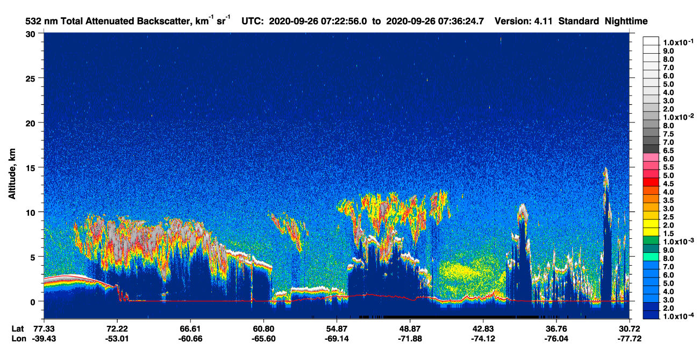
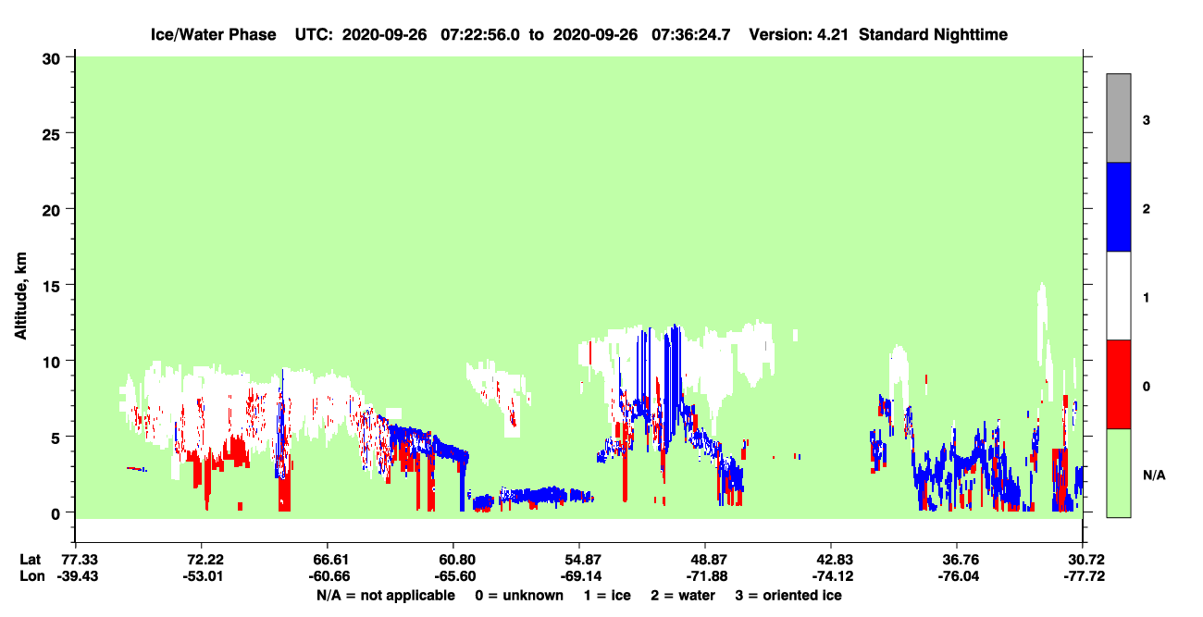
Ice cloud retrieval for TROPOMI | Validation against CALIPSO
Study case: 26.09.2020
Ice cloud has been retrieved with CTH between 8-9 km

Slide 12
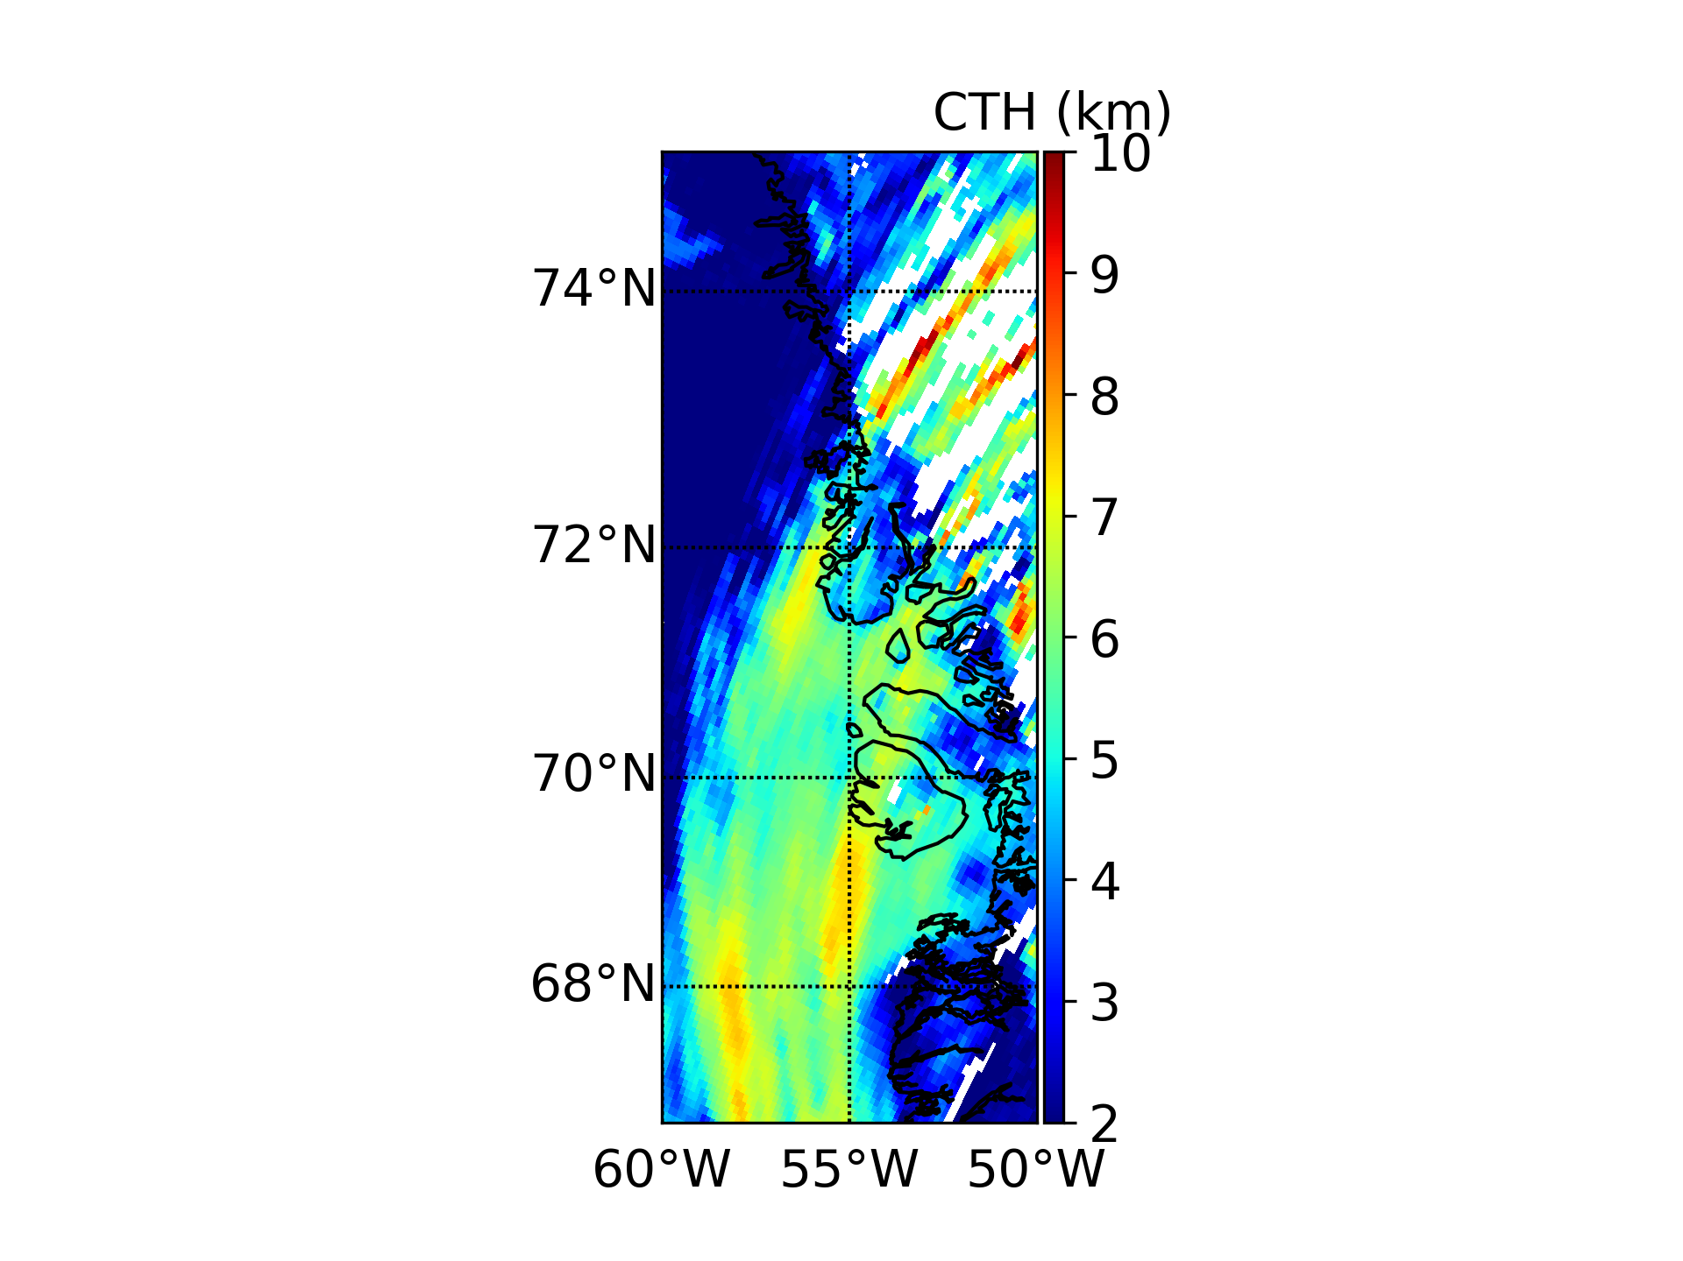
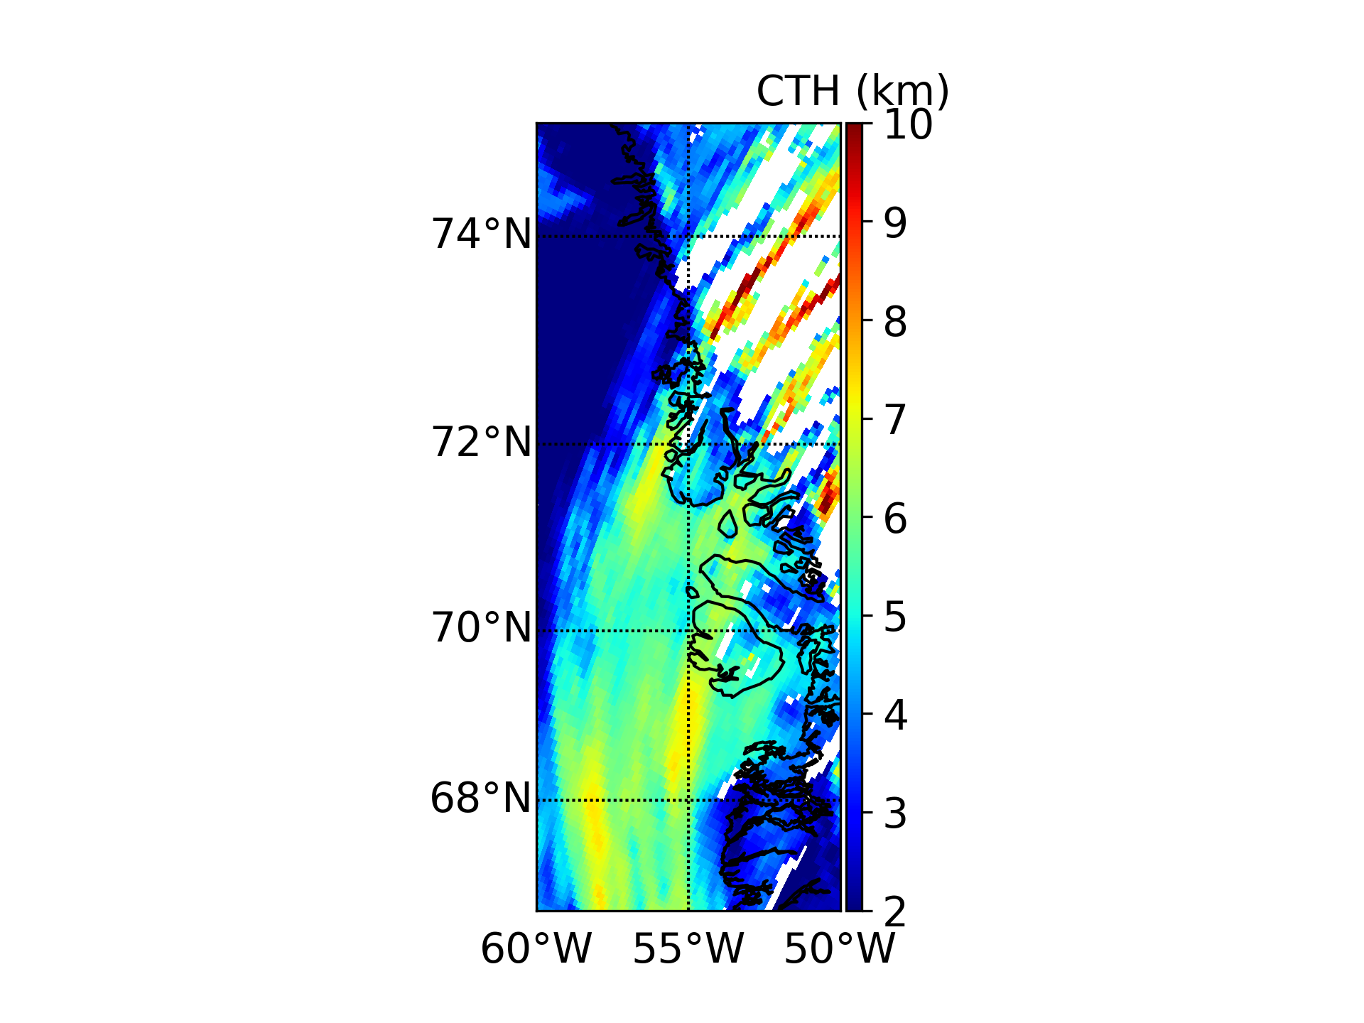
Results | Retrieval of ice cloud vs. water cloud for TROPOMI CTH retrieval
Water cloud Ice cloud
The ice cloud CTH is above 8 km while for water clouds is approximately 7.5 km

Slide 13
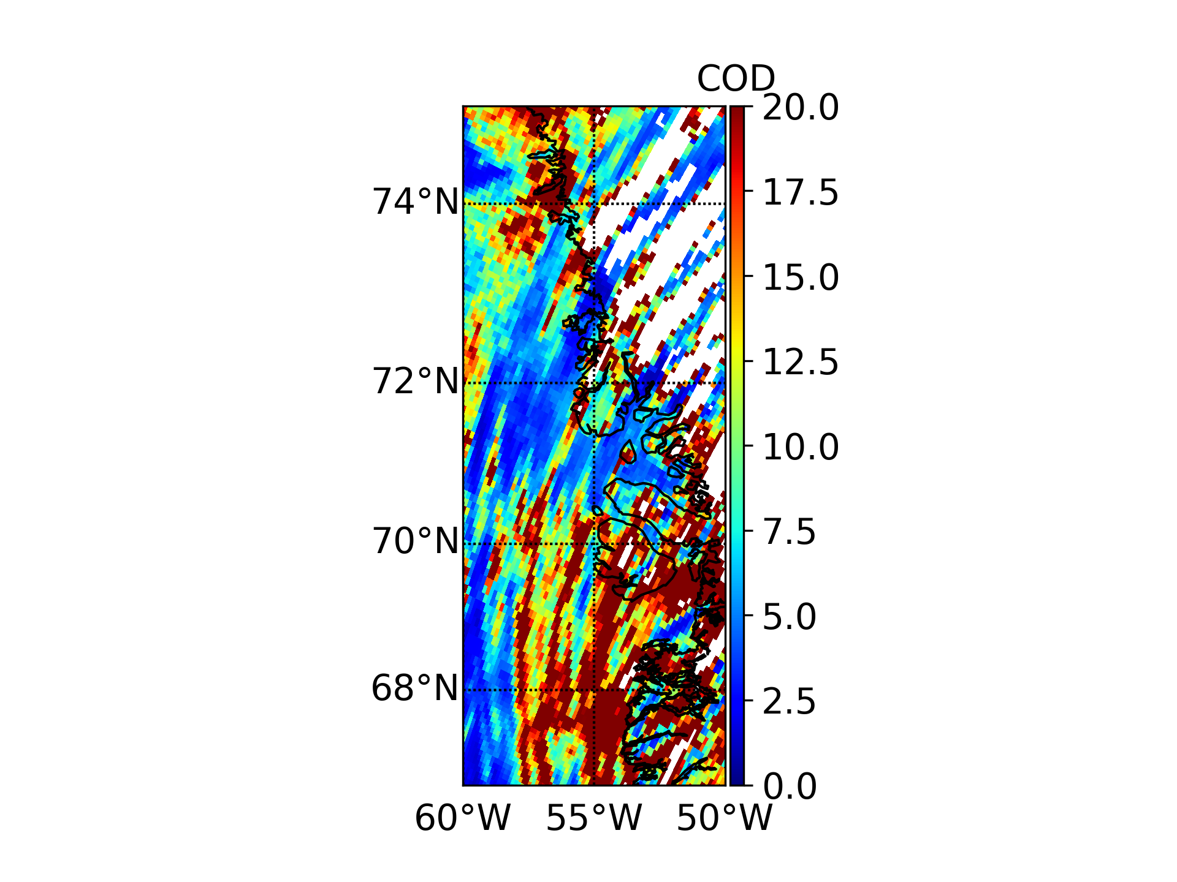
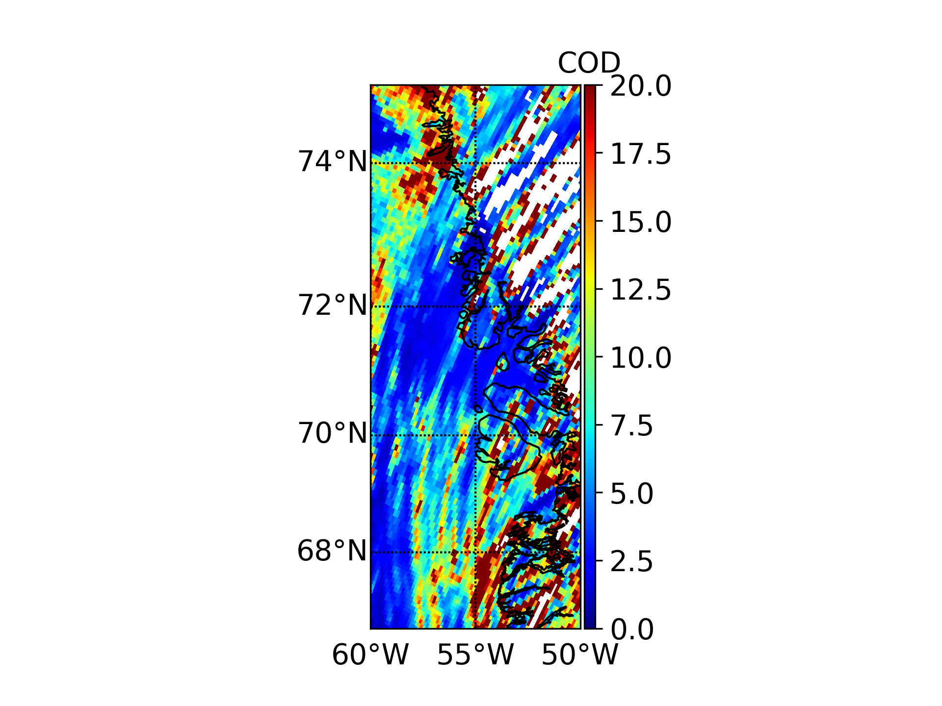
Results | Retrieval of ice cloud vs. water cloud for TROPOMI COD retrieval
Water cloud Ice cloud
The retrieval of water clouds tends to overestimate the COD values

Slide 14
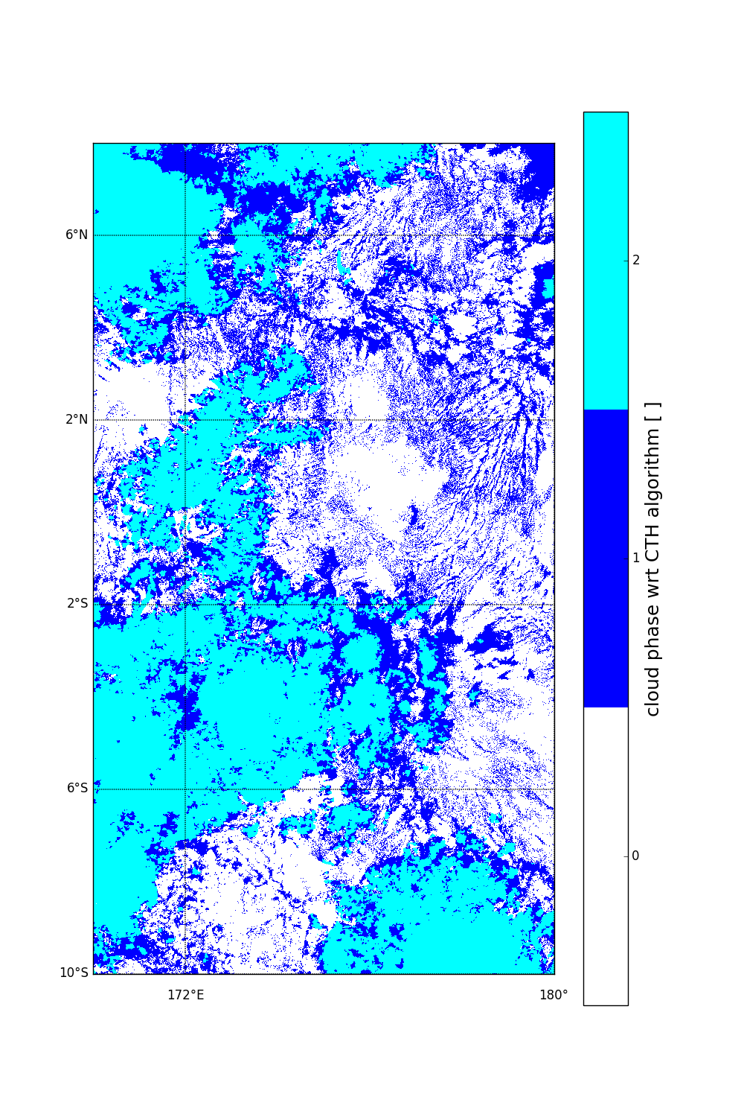
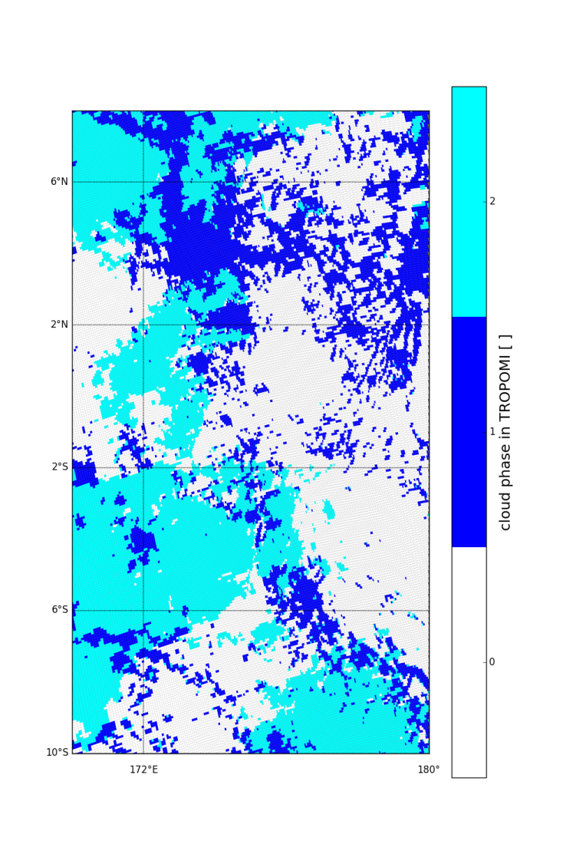
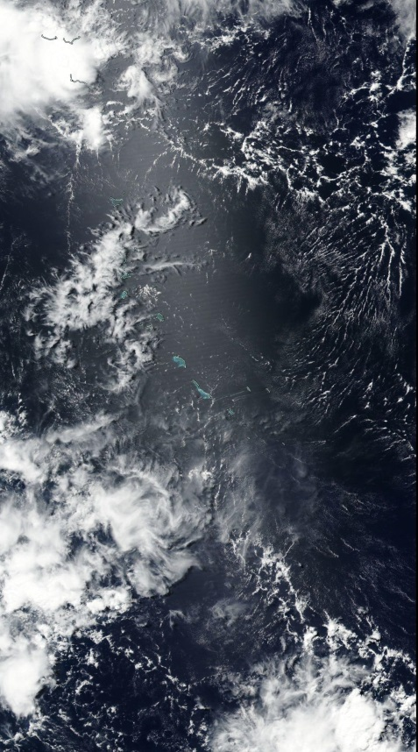
Cloud phase flag
A cloud phase flag will be added to the S4 cloud product to decide which ROCINN CAL retrieval mode to run
Such a flag is already included in the operational TROMPOMI L2 CLOUD product
VIIRS true color image
VIIRS cloud phase
TROPOMI cloud phase

Slide 15
Conclusions
Several test scenarios adapted from Level 2 operational data are used to investigate the performance of ROCINN for retrieving ice clouds
The retrieved CTH and COD errors obtained with ROCINN_CAL for ice clouds meet the success criteria
The ROCINN_CAL for ice clouds implementation will considerably reduce the uncertainties when ice clouds are present vs. using ROCINN_CAL water cloud and the overall retrieval
Further investigations are necessary to improve the ice clouds retrieval for TROPOMI on S5P and the UVN sensor on S4
Thank you!
ana.delaguilaperez@dlr.de

