Slide 1

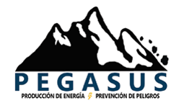

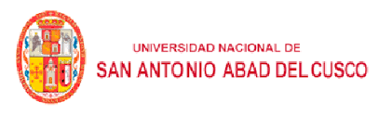









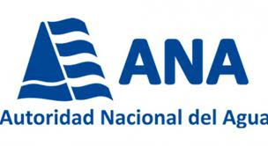

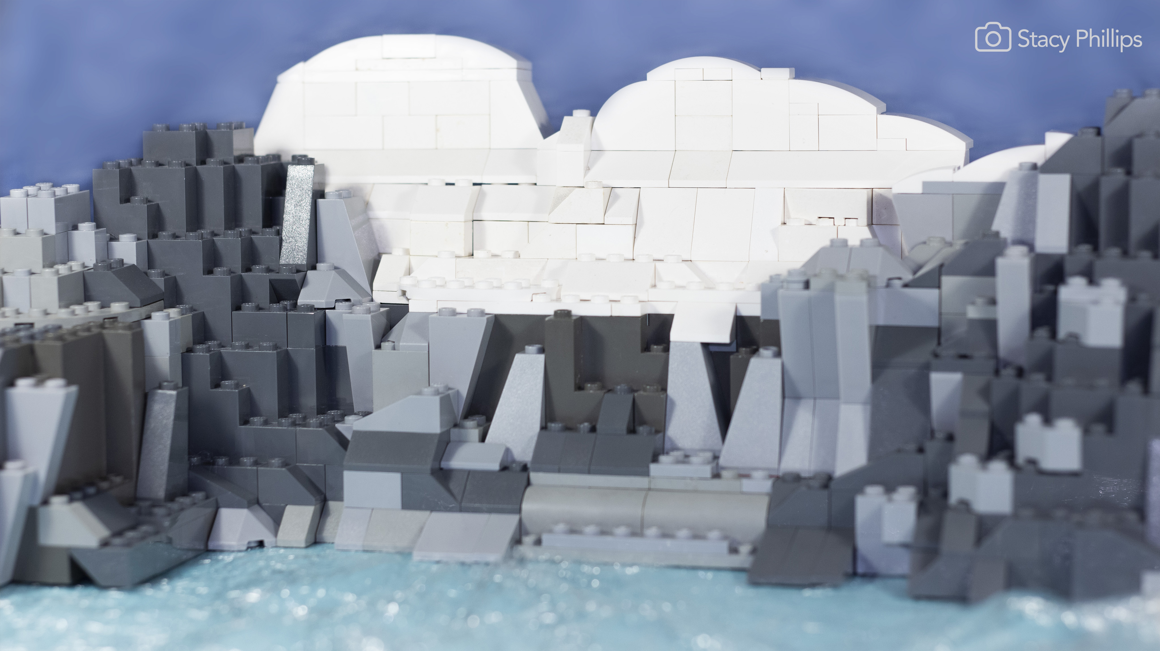
Introduction on how to use this presentation template
Projected increases in climate extremes and temperature-induced drought over the Peruvian Andes, 1980-2100
Emily Potter
Catriona Fyffe
Andrew Orr
Duncan Quince
Andrew N. Ross
Sally Rangecroft
Katy Medina
Helen Burns
Alan Llacza
Gerardo Jacome
Robert Hellström
Joshua Castro
J. Scott Hosking
Alejo Cochachin
Nilton Montaya
Cornelia Klein
Edwin Loarte
Francesca Pellicciotti

Slide 2
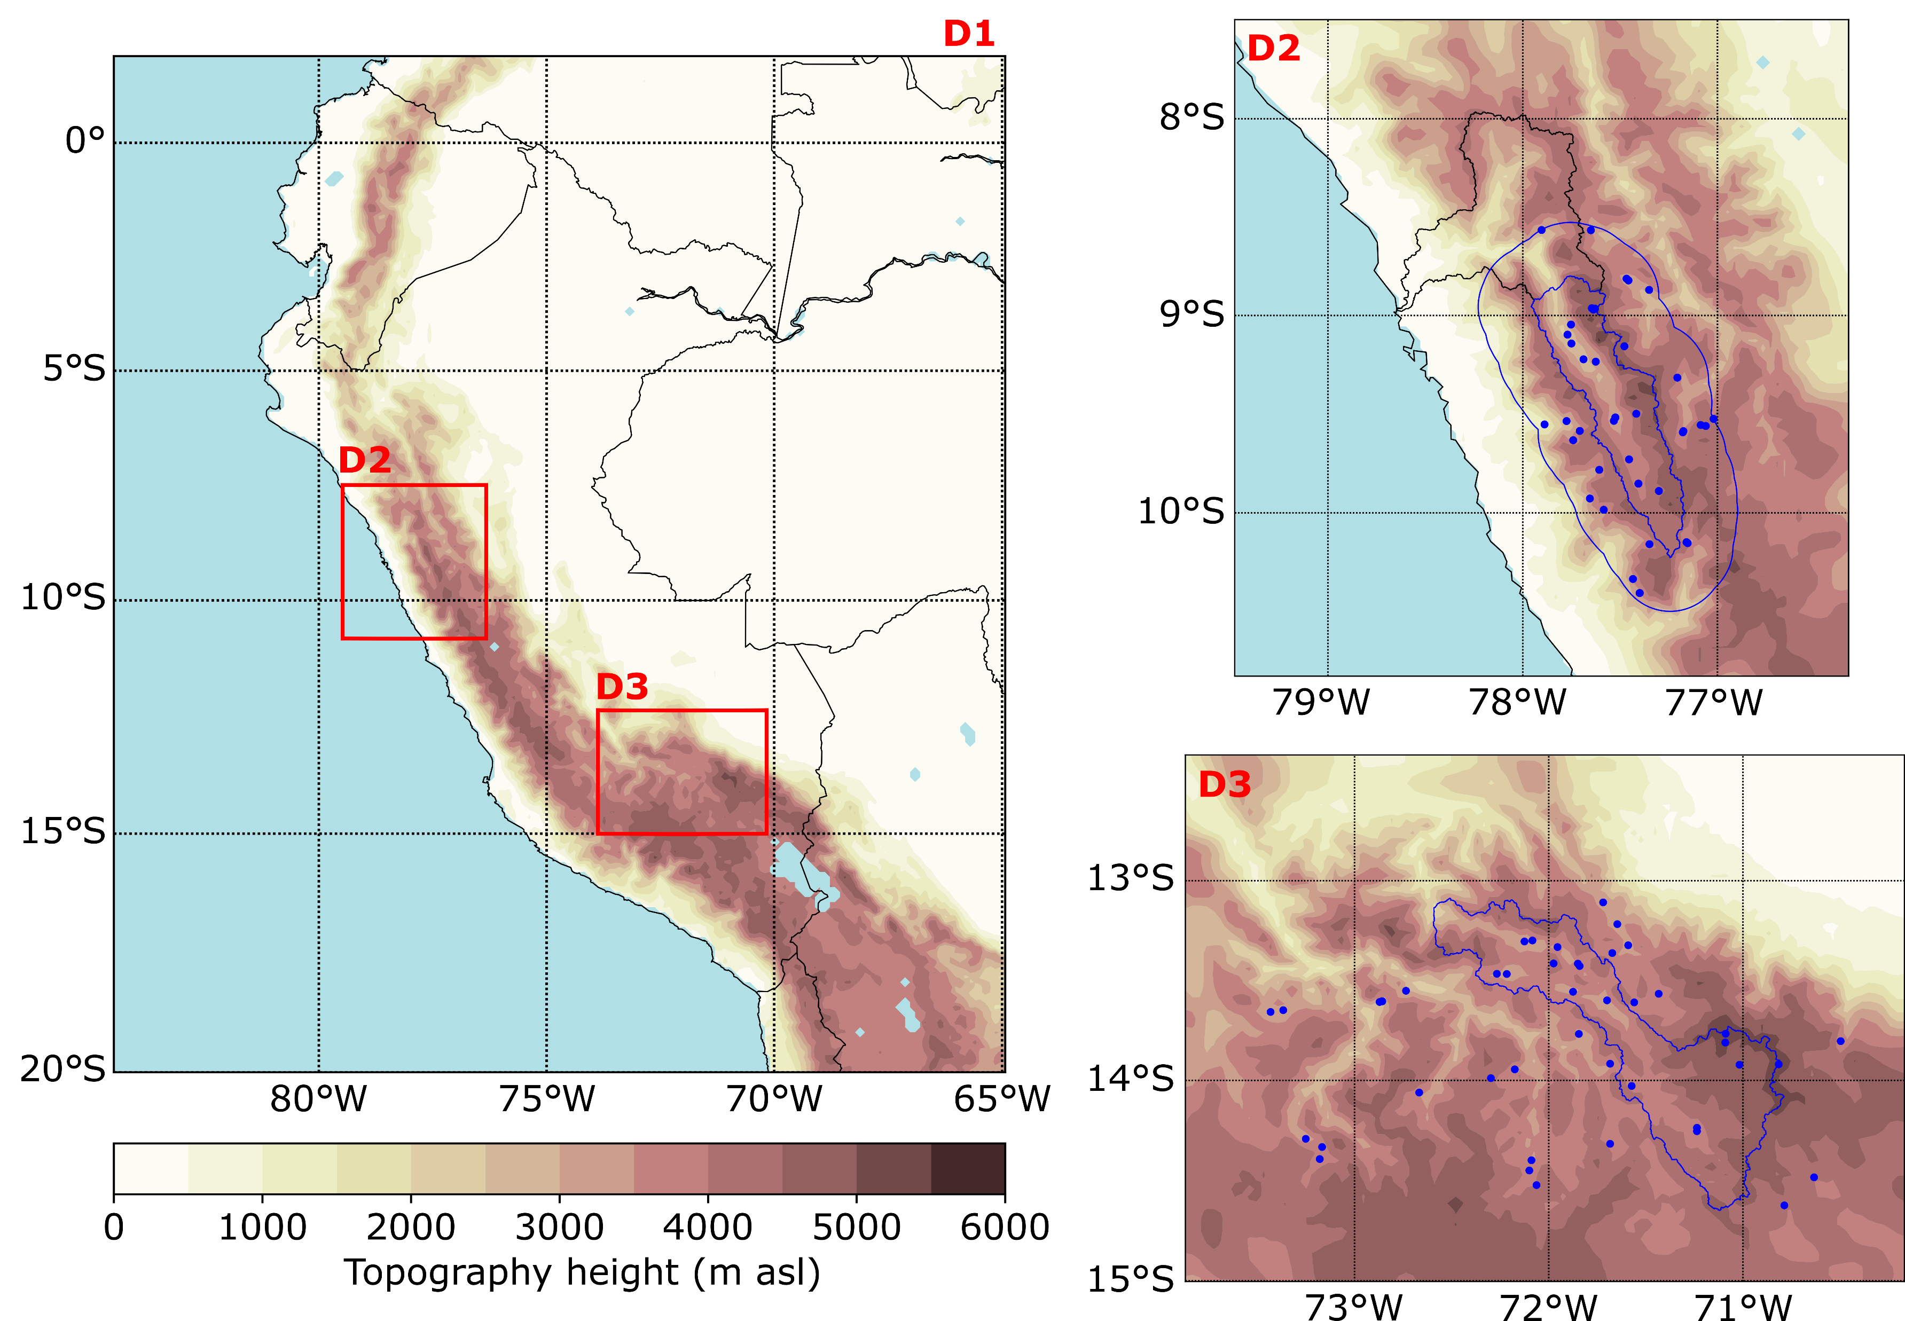
Methods
Past climate trends: bias-corrected weather research and forecasting (WRF) model.
Future climate trends: statistical downscaling of 30 CMIP5 models, using the WRF output as historical truth, following Cannon et al., (2015).
Fig. 1: The three WRF model domains (D1-D3). Elevation is showed as filled contours, and the ocean (and other water bodies) is shown in blue. The left-hand plot shows the outer domains (at 12 km horizontal resolution) covering all of Peru, and the right-hand plots show the two inner domains. D2, at 4 km resolution, covers the full Rio Santa River Basin outlined in black, with the upper Rio Santa outlined in blue, focused on in this research. Station data is taken from a 30 km boundary around the upper Rio Santa, outlined in blue. The Vilcanota-Urubamba basin is shown in blue outline in D3. The locations of all the stations used in the bias-correction are shown as blue dots.
Cannon, Alex J., Stephen R. Sobie, and Trevor Q. Murdock. "Bias correction of GCM precipitation by quantile mapping: How well do methods preserve changes in quantiles and extremes?." Journal of Climate 28.17 (2015): 6938-6959.

Slide 3
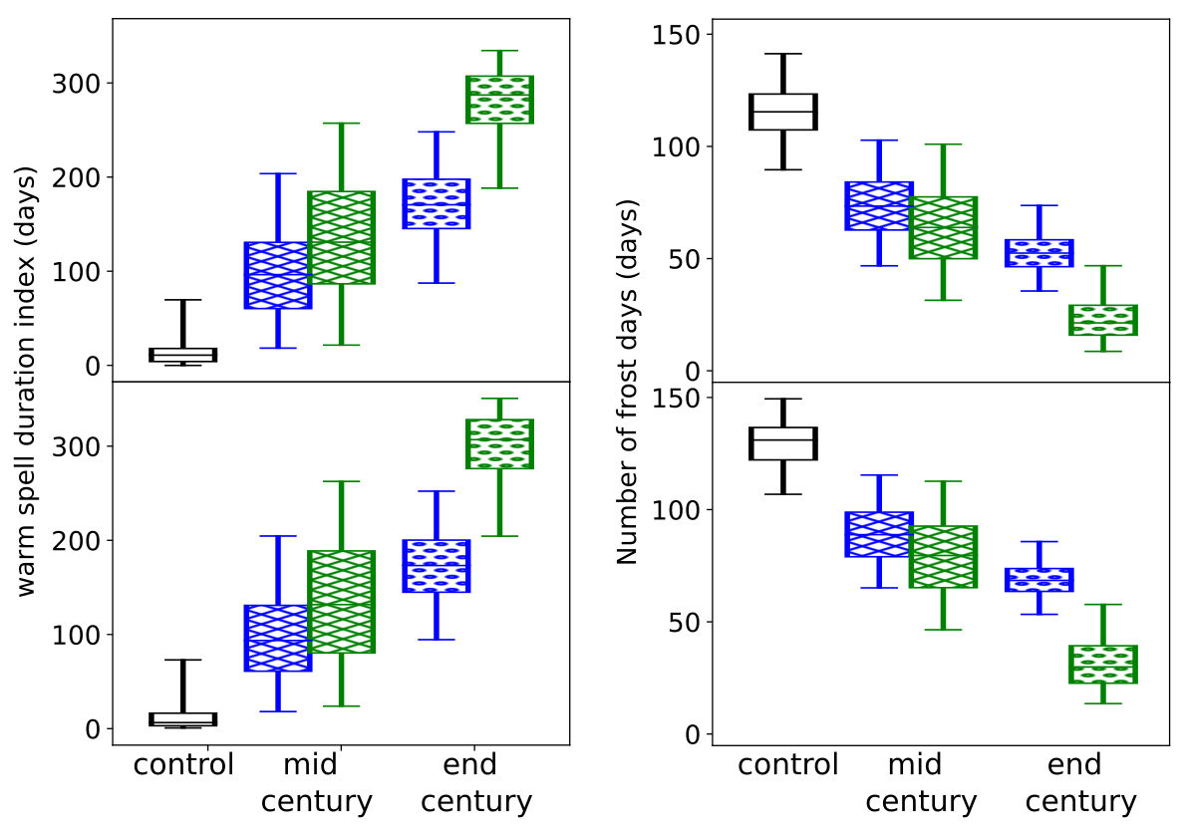
There will be a future increase in warm spells, and decrease in frost days
Under the highest emissions scenario, almost every day of the year will be in the top 10 % of those seen from 1980-2018. Under RCP4.5, the increase is up to around half the days of the year.
Frost days (nighttime temperatures < 0°C) will decrease to almost none (averaged over the valley).

Slide 4
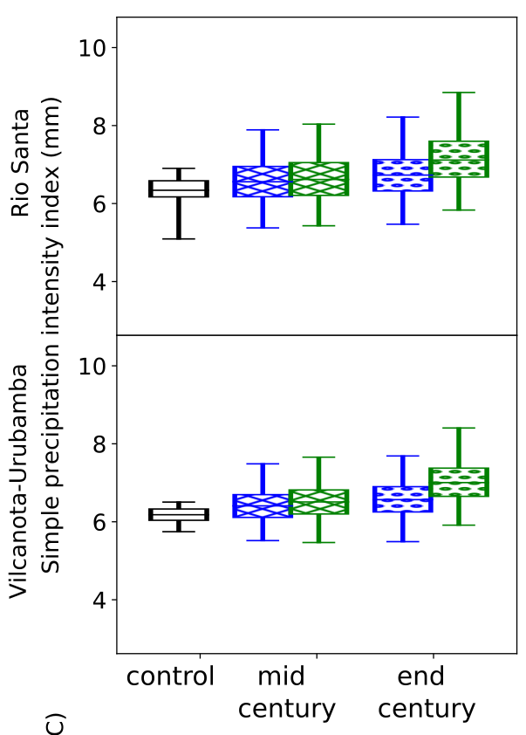
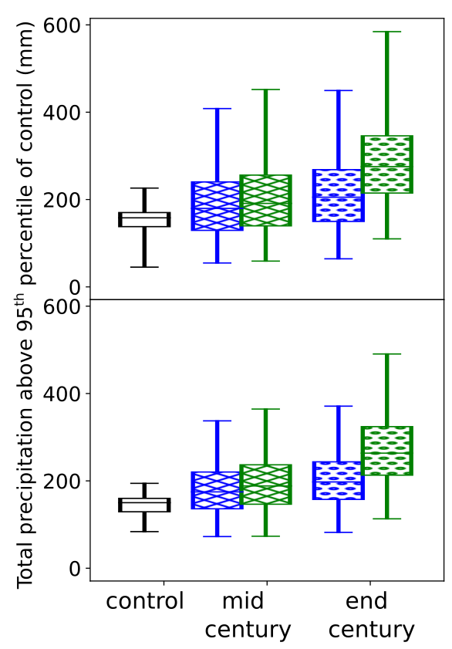
Extreme precipitation will increase more than average precipitation
By the end of the century under RCP 8.5, the average precipitation on wet days will increase by just over 10 % in both regions.
By contrast, the total precipitation falling on very wet days will increase by around 75 % in both regions.

Slide 5
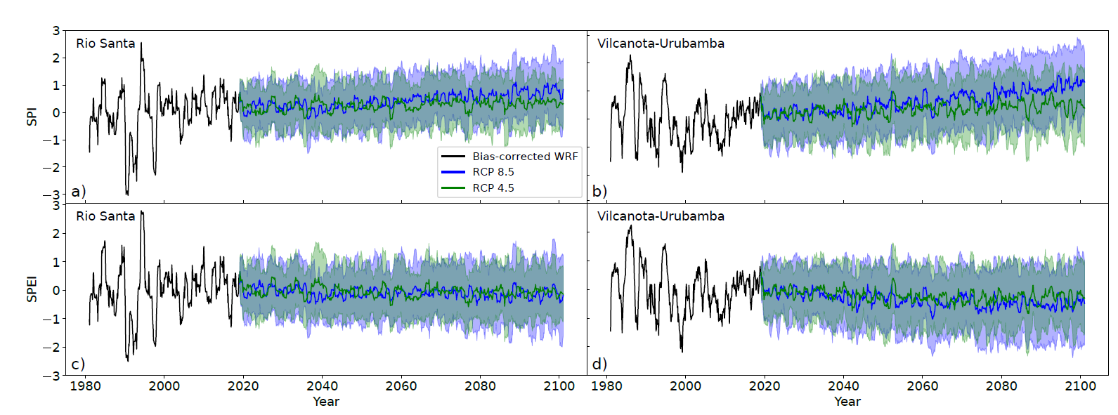
Meteorological droughts will increase, when the effects of increasing temperature are included
Considering precipitation only, meteorological droughts are expected to decrease.
But including increased evapotranspiration due to temperature change, the number of meteorological drought months is expected to rise from 96.1 to 174.0 in the Rio Santa, and from 110.2 to 211.3 in the Vilcanota-Urubamba, by end of the 21st century under RCP 8.5.

Slide 6

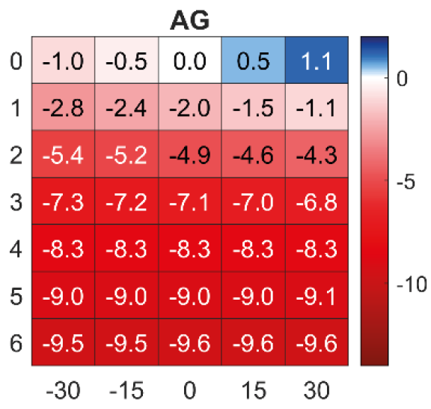

Temperature increase is likely to accelerate glacier loss
Figure from Fyffe et al., (2021): “The energy and mass balance of Peruvian glaciers.”
Under RCP 8.5, the CMIP5 projections shown here suggest an increased warming of 3.5 °C and increased precipitation of around 11 %.
This could lead to an increase in melt of over 7 m w.e./year.
Catriona L. Fyffe, Emily Potter, Stefan Fugger et al., (2021). The energy and mass balance of Peruvian glaciers. JGR-Atmospheres (in press).

Slide 7
Soon to be submitted for publication!
Data (soon) available at the Polar Data Centre
Emily R. Potter, Catriona Fyffe, Andrew Orr, Duncan Quincey, Andrew N. Ross, Sally Rangecroft, Katy Medina, Helen Burns, Alan Llacza, Gerardo Jacome, Robert Å. Hellström, Joshua Castro, J. Scott Hosking, Alejo Cochachin, Nilton Montaya, Edwin Loarte, and Francesca Pellicciotti Projected increases in climate extremes and temperature-induced drought over the Peruvian Andes, 1980-2100
Acknowledgements
This research Funded by NERC (grants NE/S013296/1 and NE/S013318/1, respectively) and CONCYTEC through the Newton-Paulet Fund.
We acknowledge the World Climate Research Programme’s Working Group on Coupled Modeling, which is responsible for the CMIP models.
We thank SENAMHI, UNASAM, ANA, UNSAAC, and Compañia Minera Antamina for the observational data.

