Slide 1
Analyzing Input Data Influence in Local Techno-Economic Analyses for Power-to-Methane Plants
Grégoire Klaus, MSc
Technoligie Campus Freyung – TH Deggendorf, Germany
THE EGU General Assembly 2022
EGU General Assembly 2022, Vienna, Austria, 23–27 May 2022t
May 25th, 2022
Notes:
Results about to cas tow studies in germany
Welcome. In today's presentation,I will talk about the input data for the energy model. I will not talk into detail about power to methane plants or the energy model itself.

Slide 2
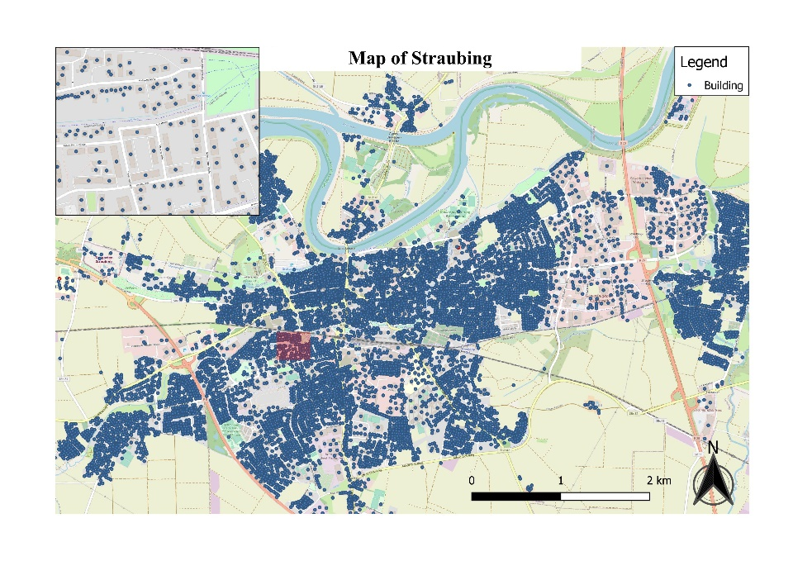
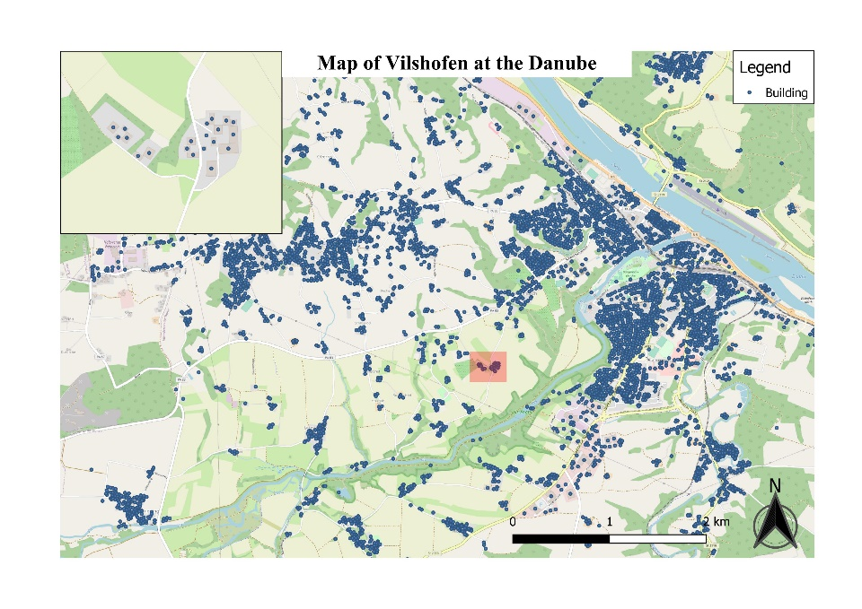
OSM-data classifcation
Study area
Figure 1: OSM-building Data of Straubing
Figure 2: OSM-building Data of Vilshofen
Notes:
This article presents the results of two optimization models for two case studies regions in Germany.
Straubing has 48.000 habitants
Vilshofen has 16.000 habitants
Data was collected from Both cities

Slide 3
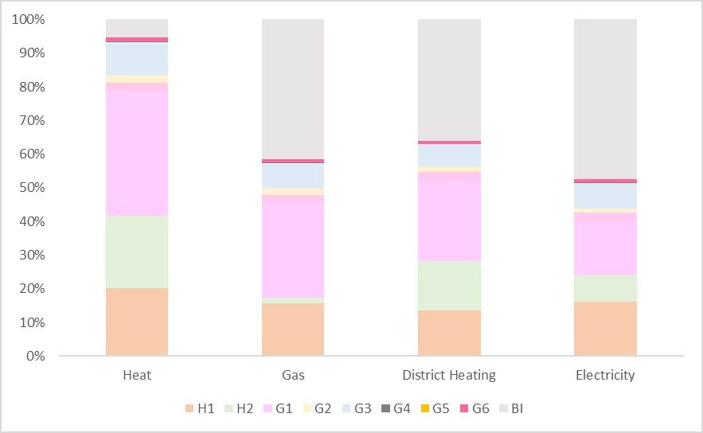
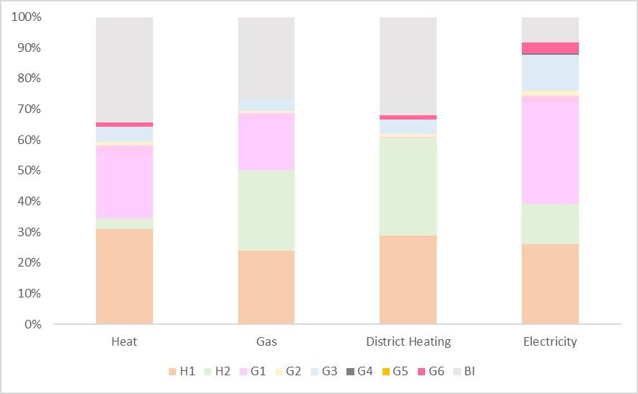
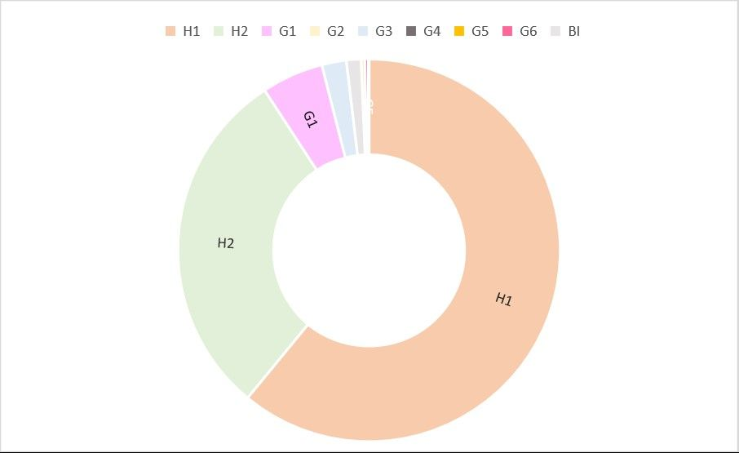
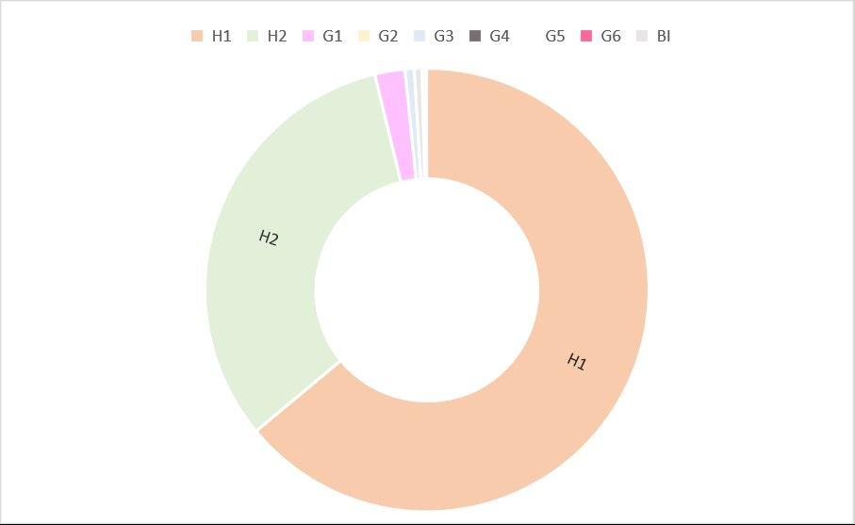
Osm-data/ ENergy demand
Figure 3: Demand Share by Region and Building Category [Straubing]
Figure 4: Demand Share by Region and Building Category [Vilshofen]
Figure 5: Share of Building category by Region [Straubing]
Figure 6: Share of Building category by Region [Vilshofen]
Notes:
In the next slide, let's look at the distribution of OSM data and electricity demand.
The electricity demand can be obtained for each municipality as an annual value.
The electricity demand was calculated on the basis of the OSM-data building classification.
Straubing 300.000 Mwh/a
Vilshofen 100.000 MWh/a
Looking at Figure 5 and 6, we can see that the share of building group H1 is quite identical.
Looking at Figure 5 and 6, one can see that the share of the building group is quite identical. An exception is G1. Due to the OSM data and the classification, a proportional consumption can be calculated.
Profile G1 - Commercial weekdays 8 a.m. - 6 p.m.

Slide 4
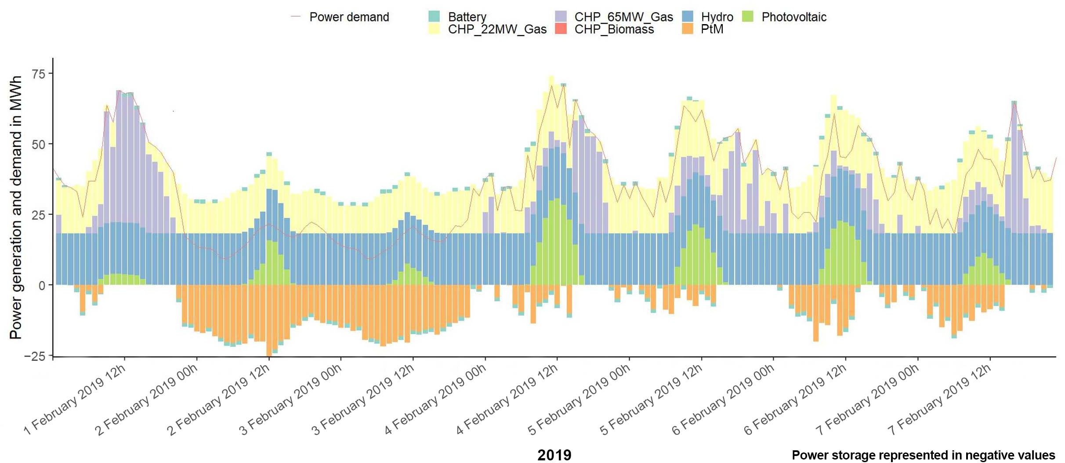
Energy System Modell [Calliope]
Figure 7: Energy simulation for the year 2019 in Straubing
Notes:
show the exemplary course of the demand curves for electricity and heat from the 1-7th February in 2019,
Describe technologies.
mixed integer linear programming model (MILP) Technolgies used are already proved by other authors
Close system no conxtion to the grid
CHP small one better eficeny in heat other CHP better of electricity (check)
PV and Battery, Biomass are realsitc
CHP_Biomass is not used because pricing and efficiency
Island modell /isoltes system
See how many hours Ptm is running
How much regional energy can be used for ptm
a typical winter week.
They show that the electricity demand (in kWh) is significantly lower on weekends than the average weekly consumption

Slide 5
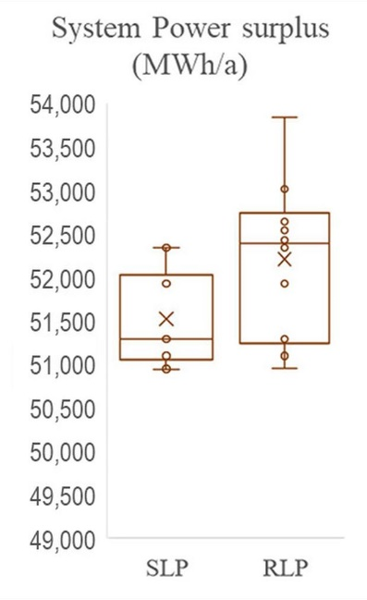
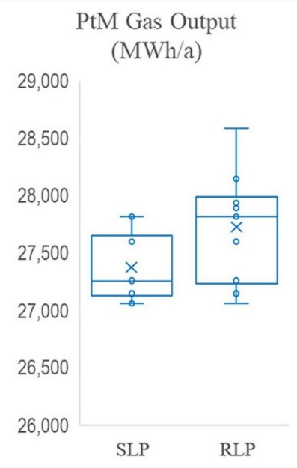
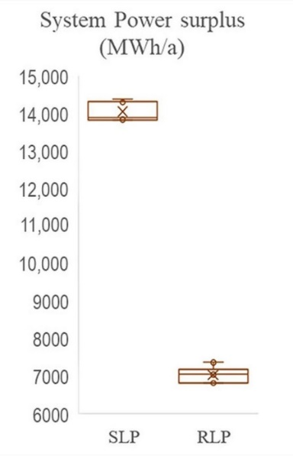
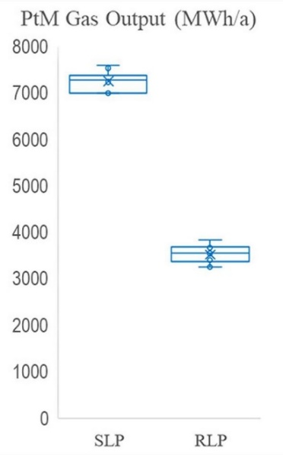
Results
Straubing
Vilshofen
Figure 8: System Power surplus [Straubing]
Figure 9: PtM Gas Output [Straubing]
Figure 10: System Power surplus [Vilshofen]
Figure 11: PtM Gas Output [Vilshofen]
Notes:
Aufzeigen dass eine Abweichung besteht aber es nicht geewiss ist ob gut oder schlecht
5 modells run over 5 years . Influence of weather data
Point of view of company. SLP
Wahrscheinlich ist es
SLP and RLP can provide us with different results deppending on the region
RLp needs a lot of data
SLP
Deviation between the cities of Straubing and Vilshofen. In Straubing it is clearly better to use RLP load profiles in Vilshofen it is not.
From this study it is not possible to determine which profiles are better for modelling PtM plants.

Slide 6
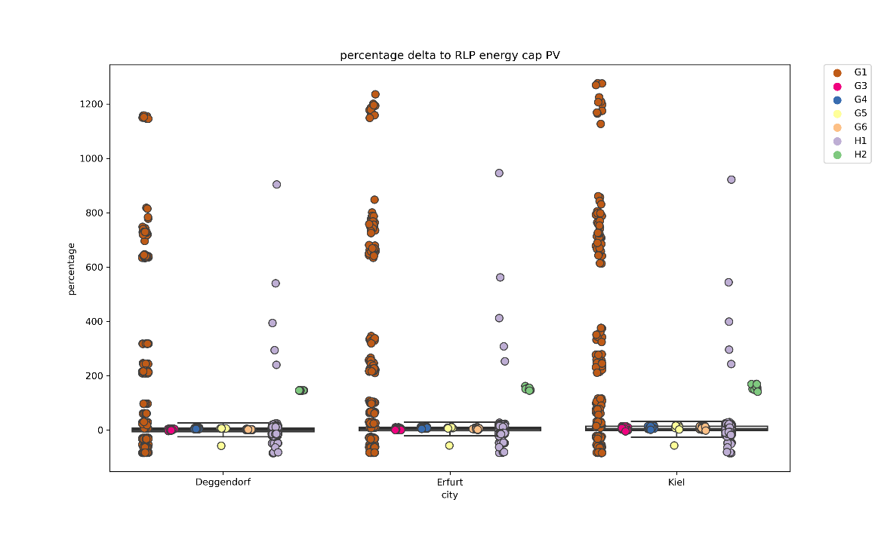
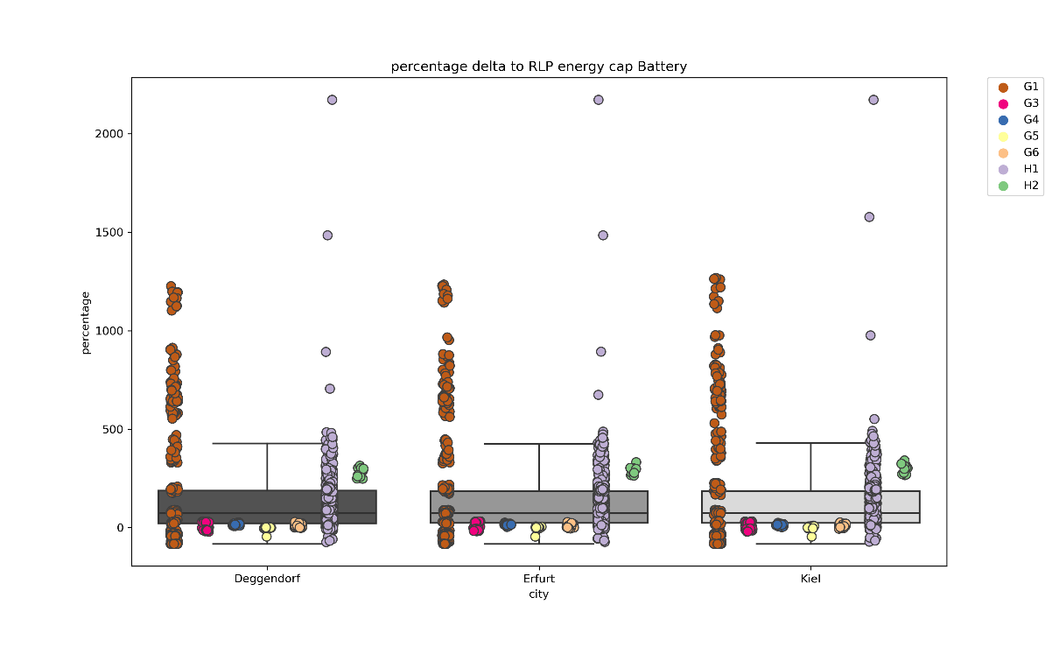
Current study [RLP Vs. SLP]
Figure 12: percentage delta to RLP [energy_cap PV]
Figure 13: percentage delta to RLP [energy_cap Battery ]
Notes:
Result of a Energy_modell we used different input data for the cities….. Electricity consumption remained the same for all cities.
delta [kWh] = RLP –SLP
In this study, 100 RLP load profiles were compared with SLP load profiles and the delta was calculated.
If the values are in the negative range, this means that the RLP load profile is smaller than the SLP load profile by the corresponding percentage.
Toy Modell to see how the technolgies well change according of the use of different Load profiles (SLP, RLP)
The models ran for 10 years and have adjusted weather data for each location over 10 years.
We used toy models to detect

Slide 7
Thank you
Author:
Prof. Dr. Javier Valdes
Technische Hochschule Deggendorf Tel.: +49 8551 91764 40
Mail: javier.valdes@th-deg.de
Co-Author:
Robert Bauer, M.Eng.
THD - Technische Hochschule Deggendorf
Tel.: +49 8531/91404-445
Mail: robert.bauer@th-deg.de
Co-Author:
Grégoire Klaus, M.Sc.
Technische Hochschule Deggendorf Tel.: +49 8551/91764-44
Mail: gregoire.klaus@th-deg.de
?
Any questions

