Slide 1

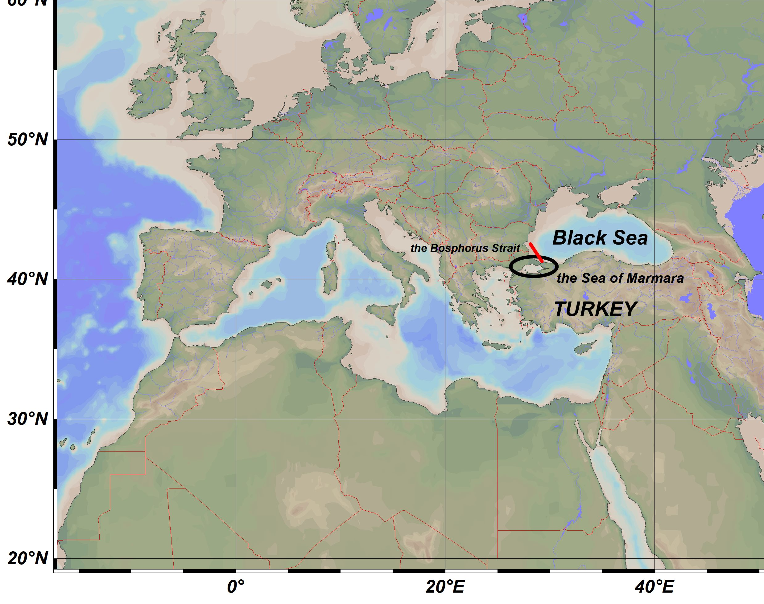


Seafloor iron mobilization across the deep-water redox gradients of the Black Sea and the Sea of Marmara
Nimet Alımlı, Mustafa Yücel
Institute of Marine Sciences, Middle East Technical University, Turkey
nimet@ims.metu.edu.tr
Middle East Technical University
Institute of Marine Sciences
funded by
TUBITAK 2247 ERC Supporting Programme – DEEPREDOX Project

Slide 2
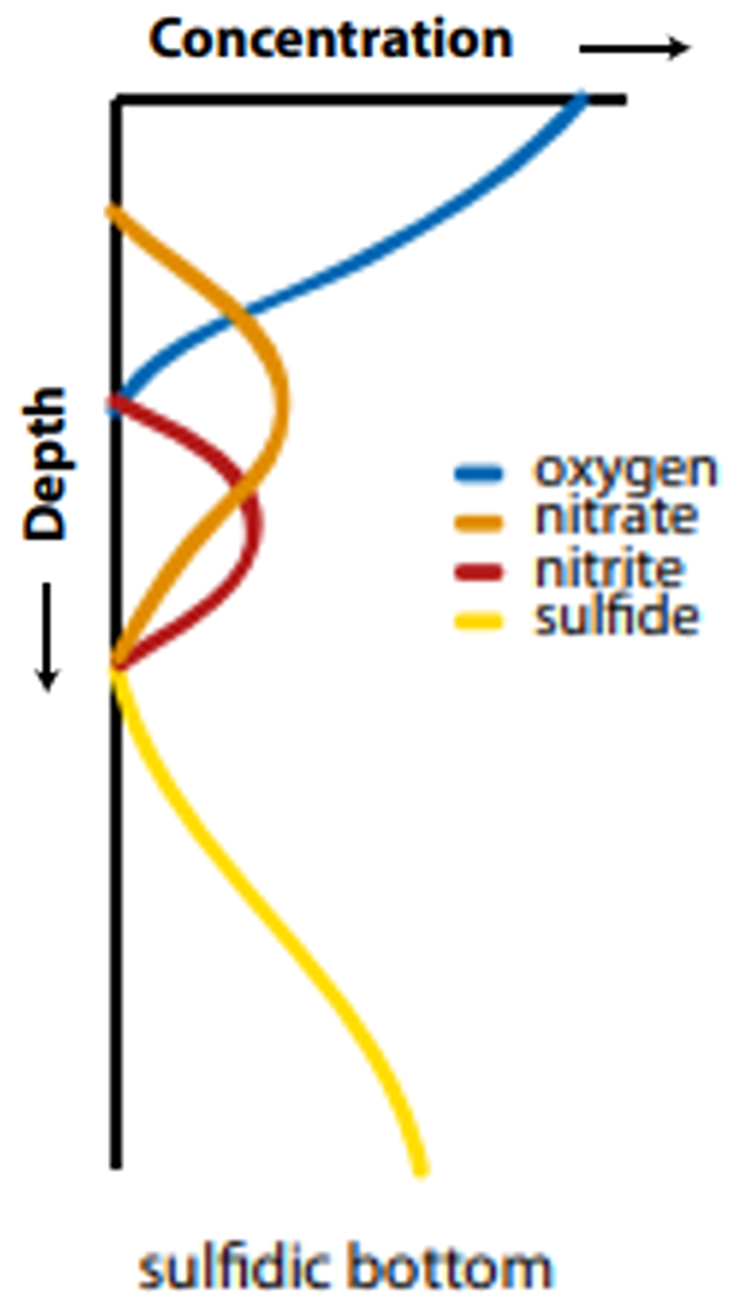
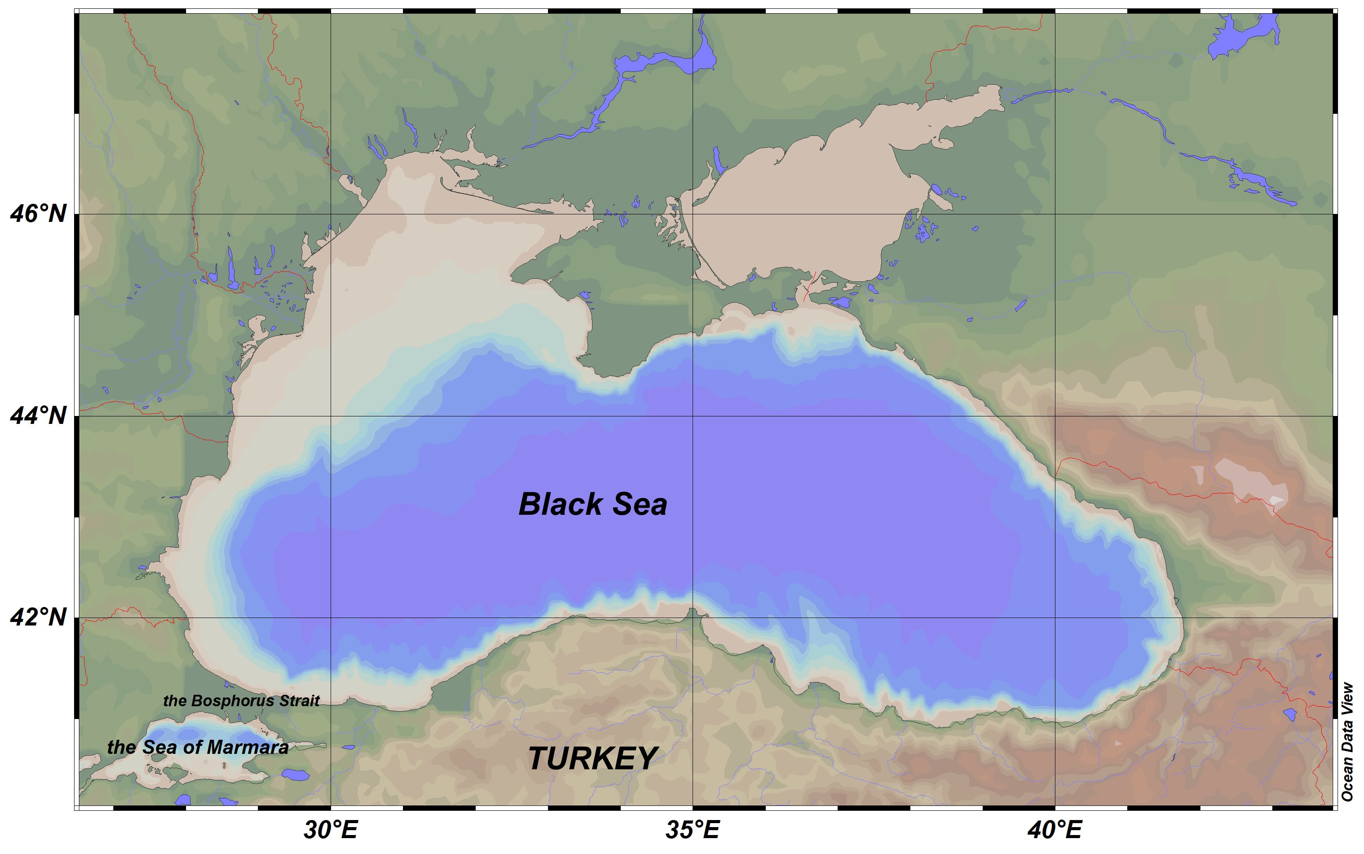
Black Sea
Semi-enclosed basin
Largest and oldest euxinic area on Earth
Oxic, sub-oxic and sulfidic areas
Ulloa et al. 2012

Slide 3
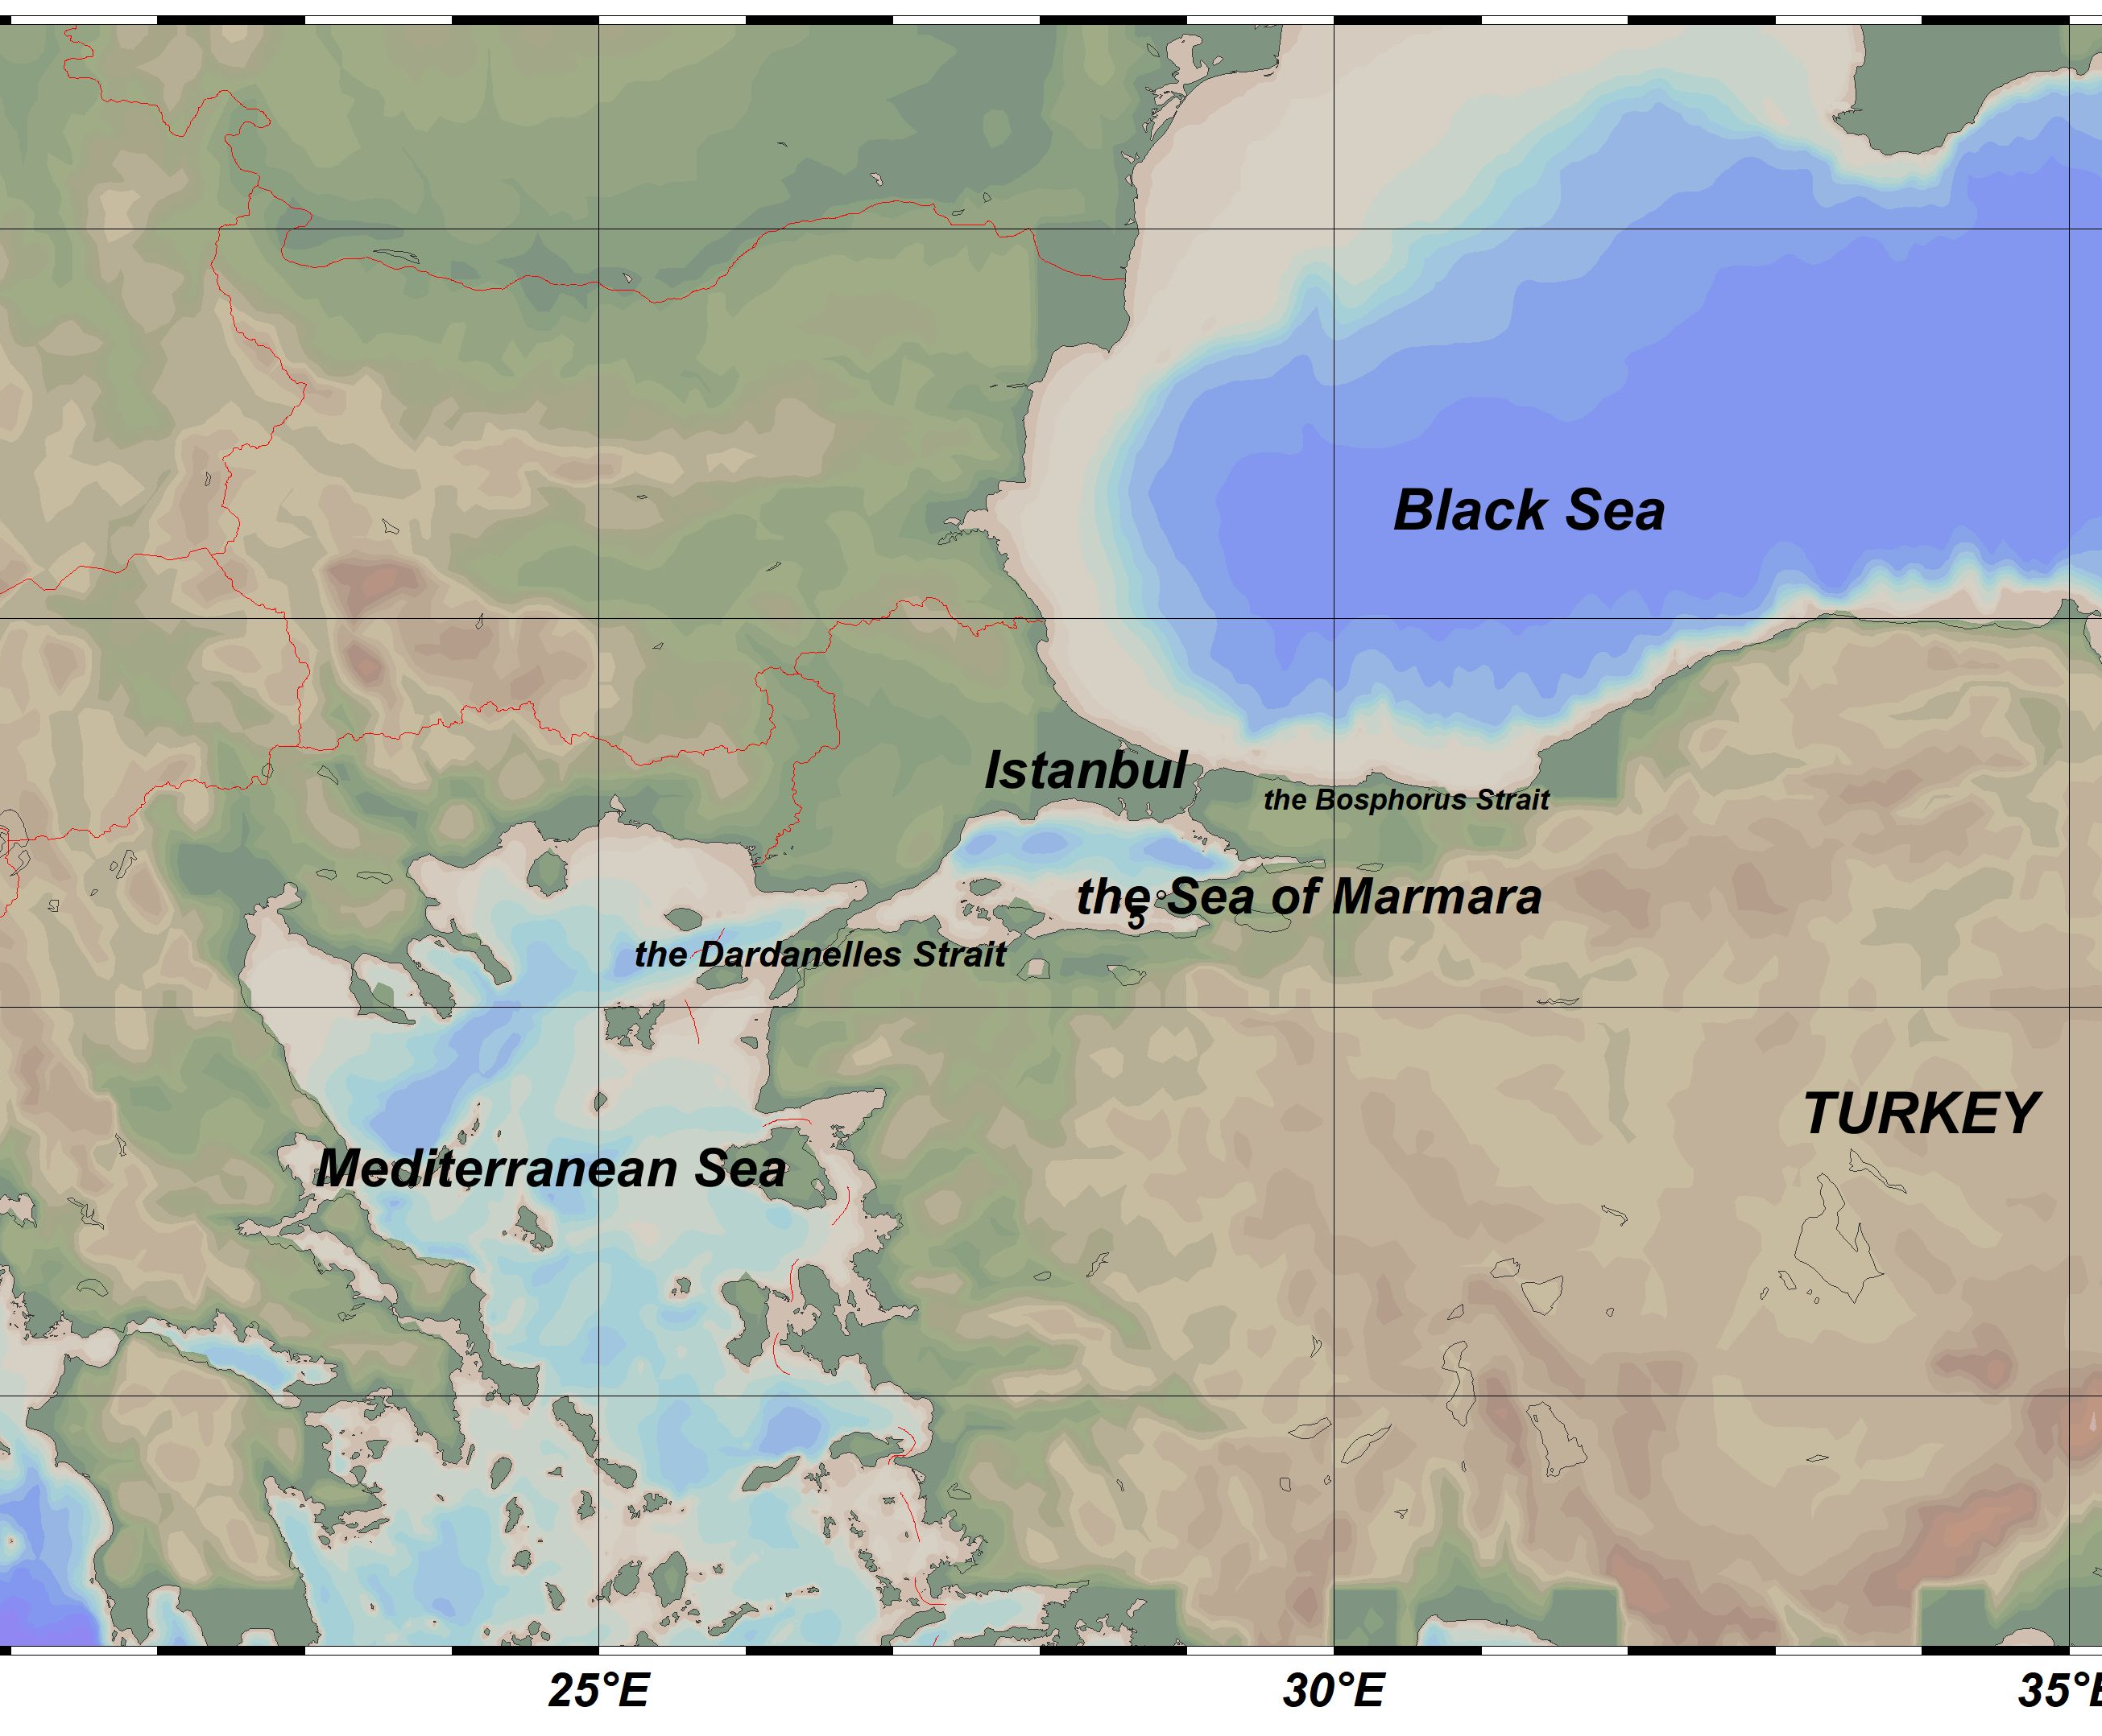
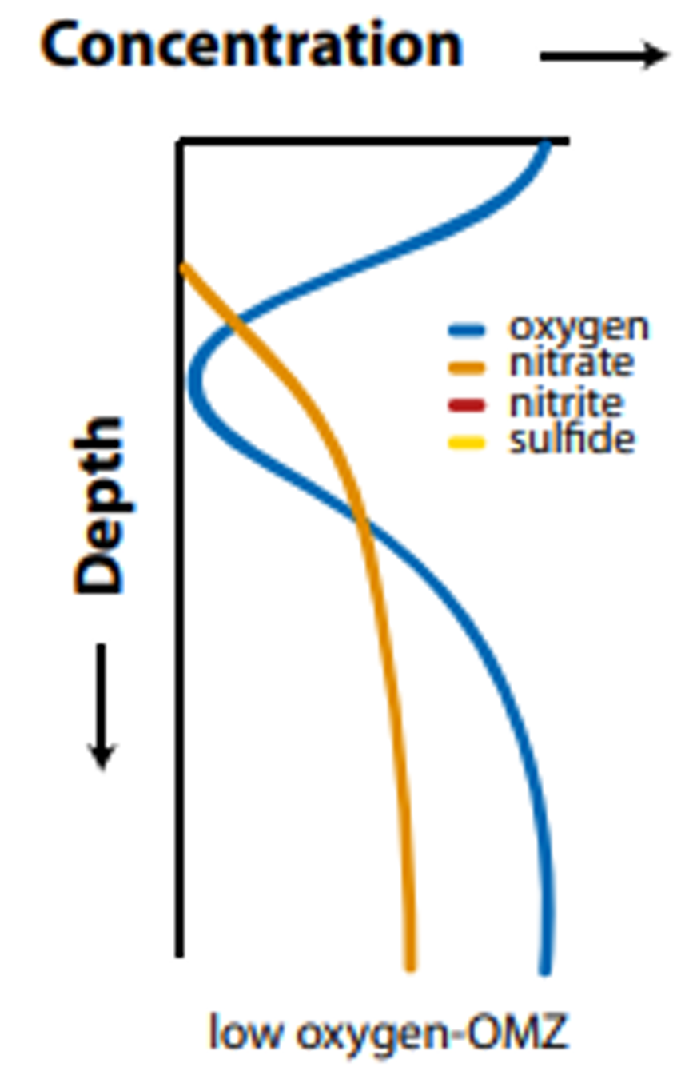
The Sea of Marmara
Located in between Mediterranean and Black Sea
Under influence of industry
What is the…
…benthic iron mobilization patterns in Black Sea and the Sea of Marmara?
…the interplay between different size fractions of iron?
Decreasing oxygen since 1980s
Permanent hypoxic areas
In risk of becoming OMZ
Sea of Marmara
Black Sea
Ulloa et al. 2012

Slide 4
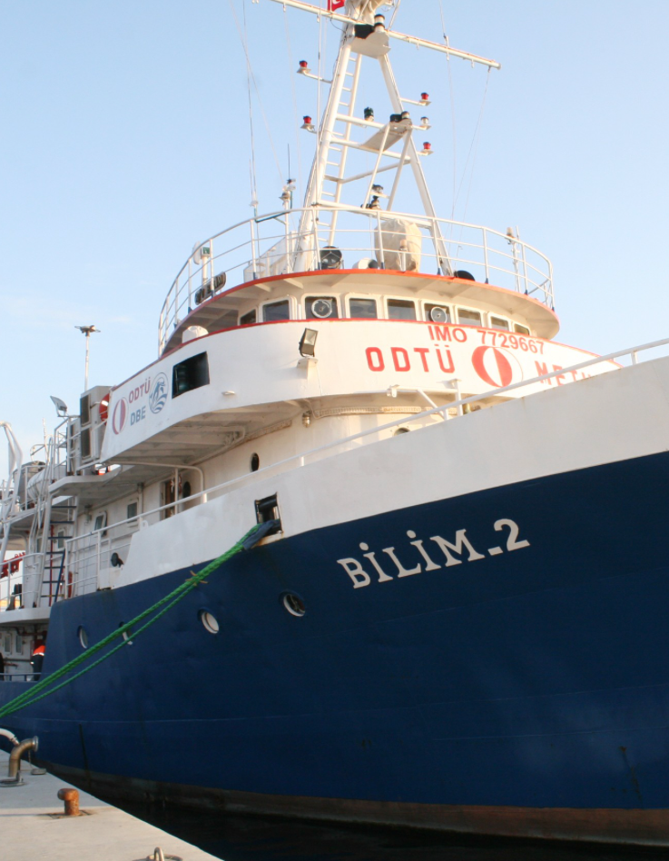
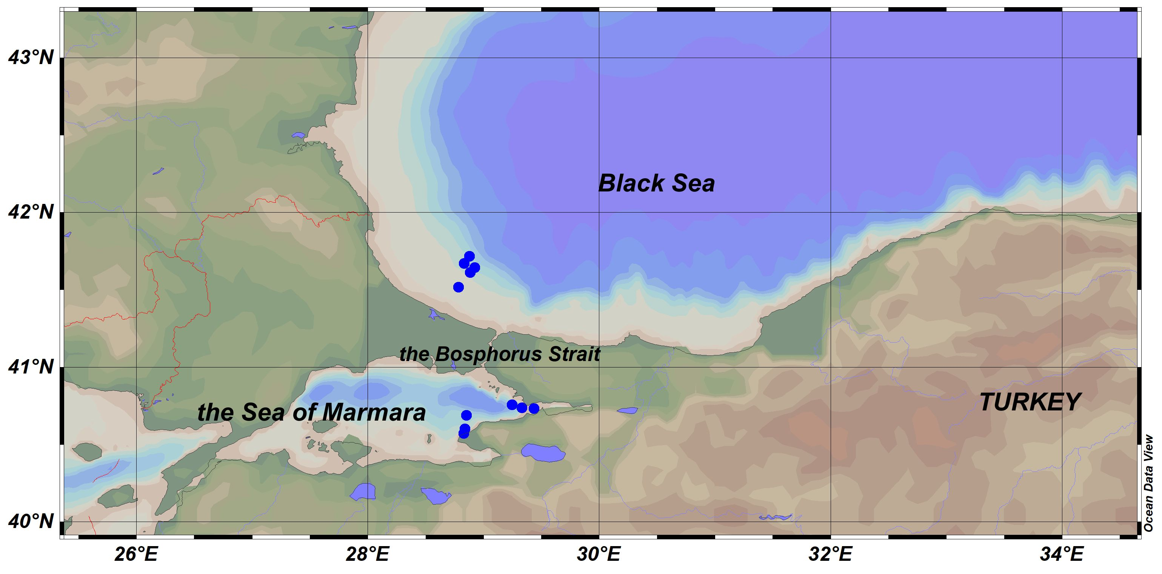
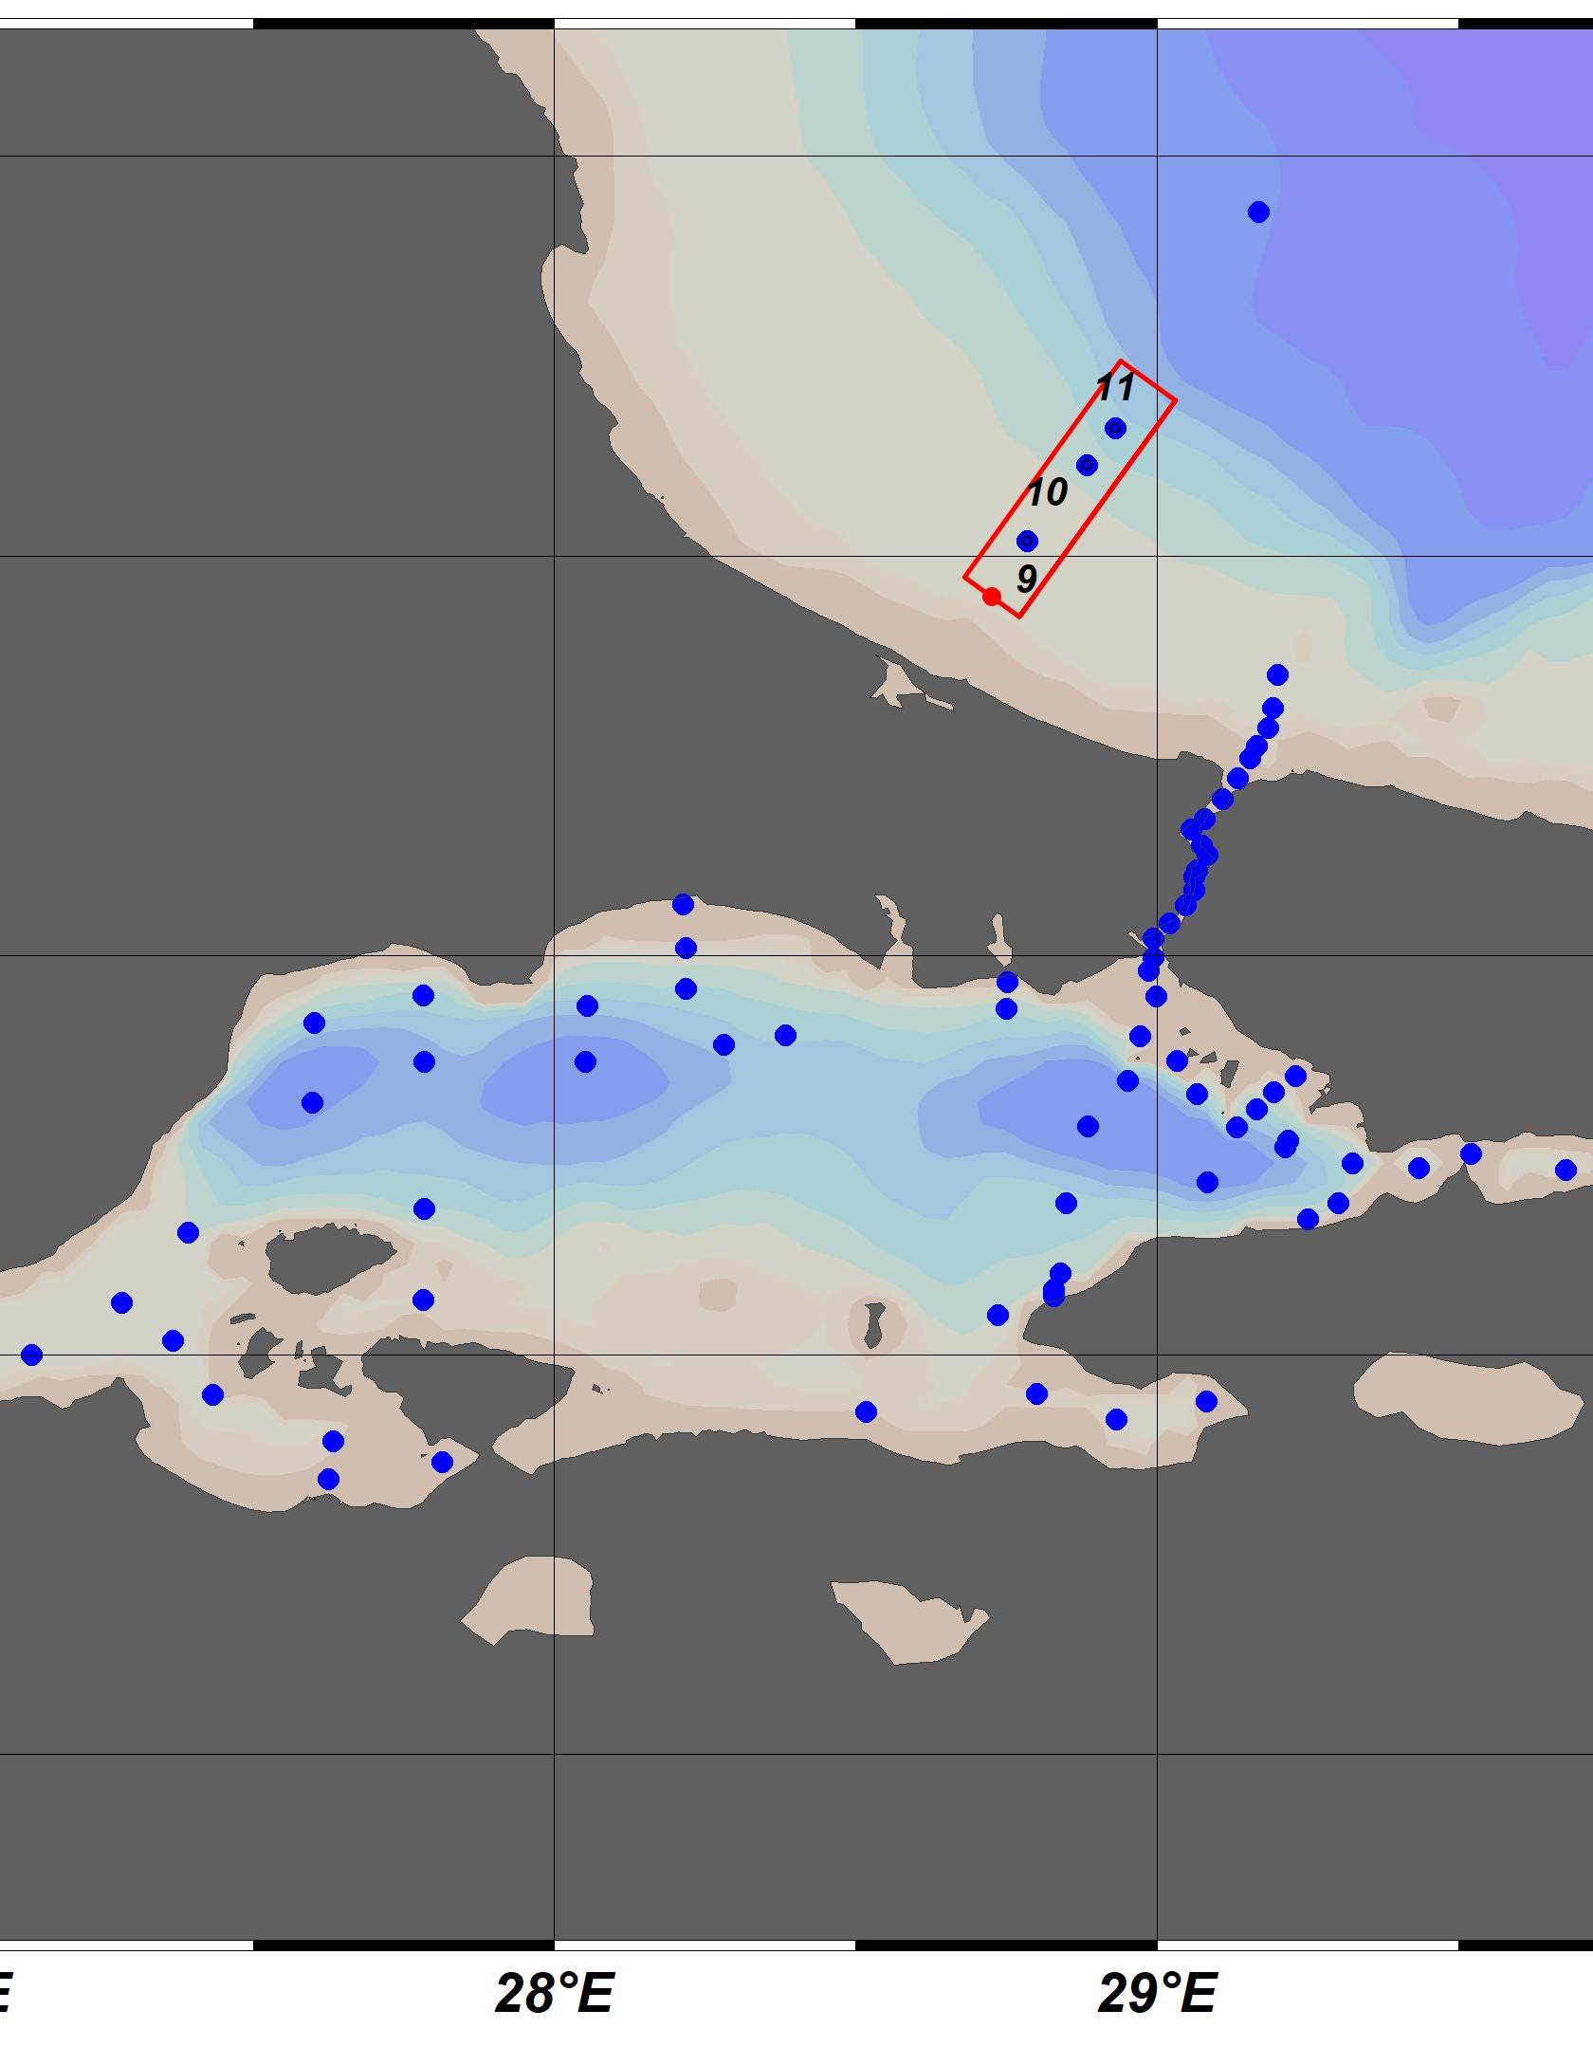
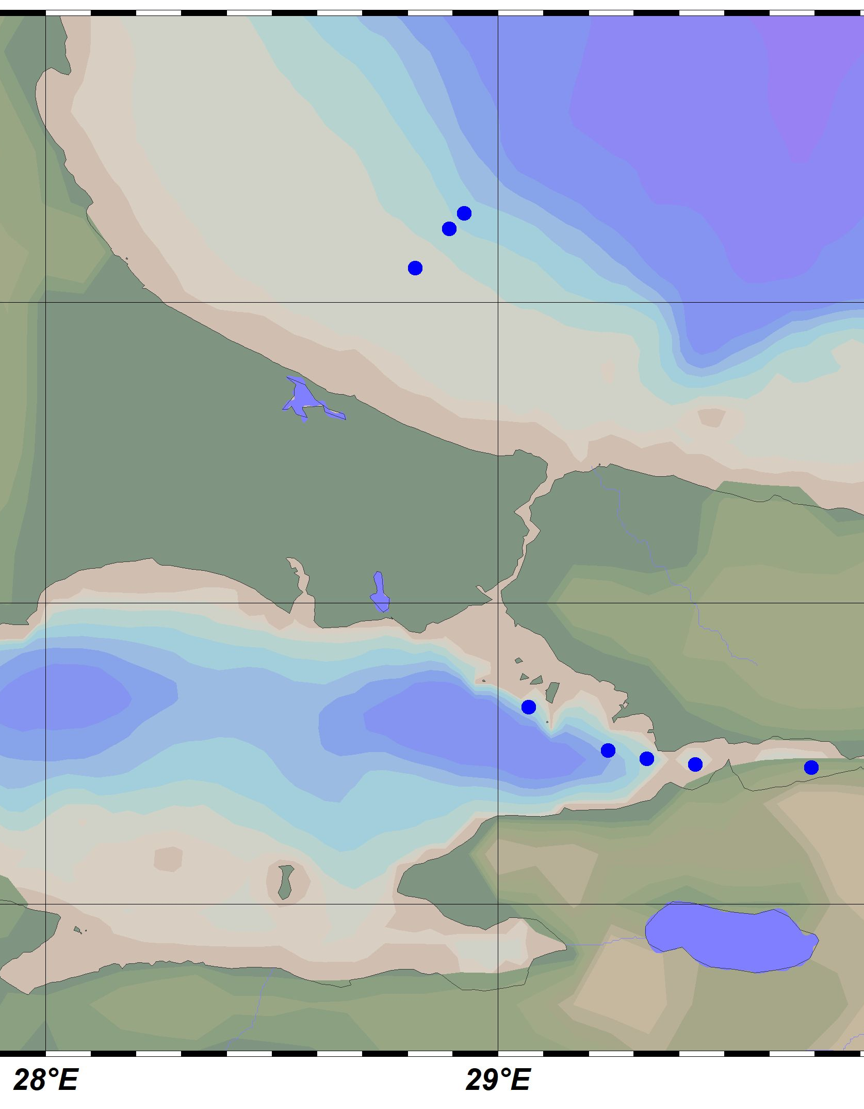
Study Area
Several cruises done to Black Sea and Marmara with R/V Bilim-2 in the last years
In this presentation, I will share results from December 2020 cruise
December2020
July 2019
June 2021

Slide 5
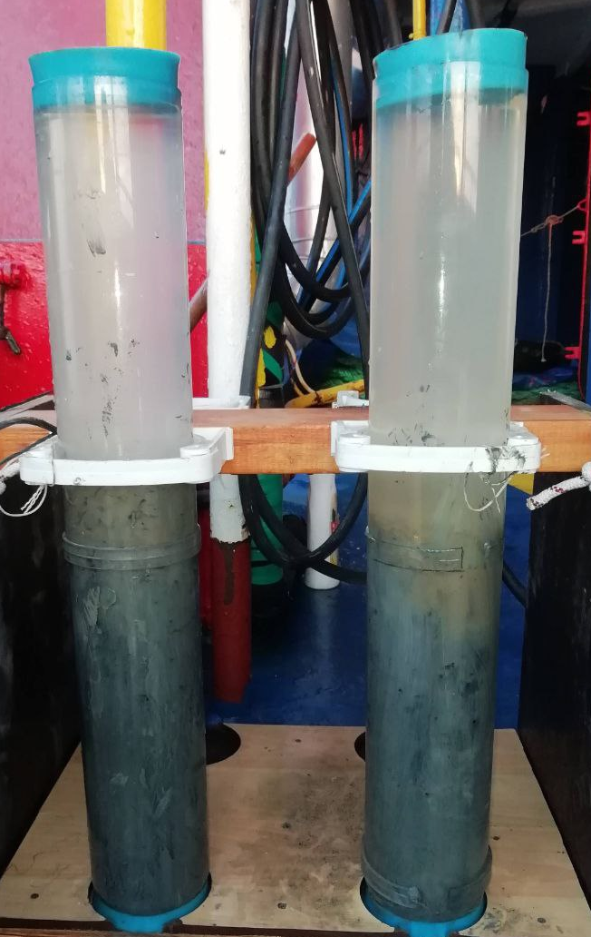
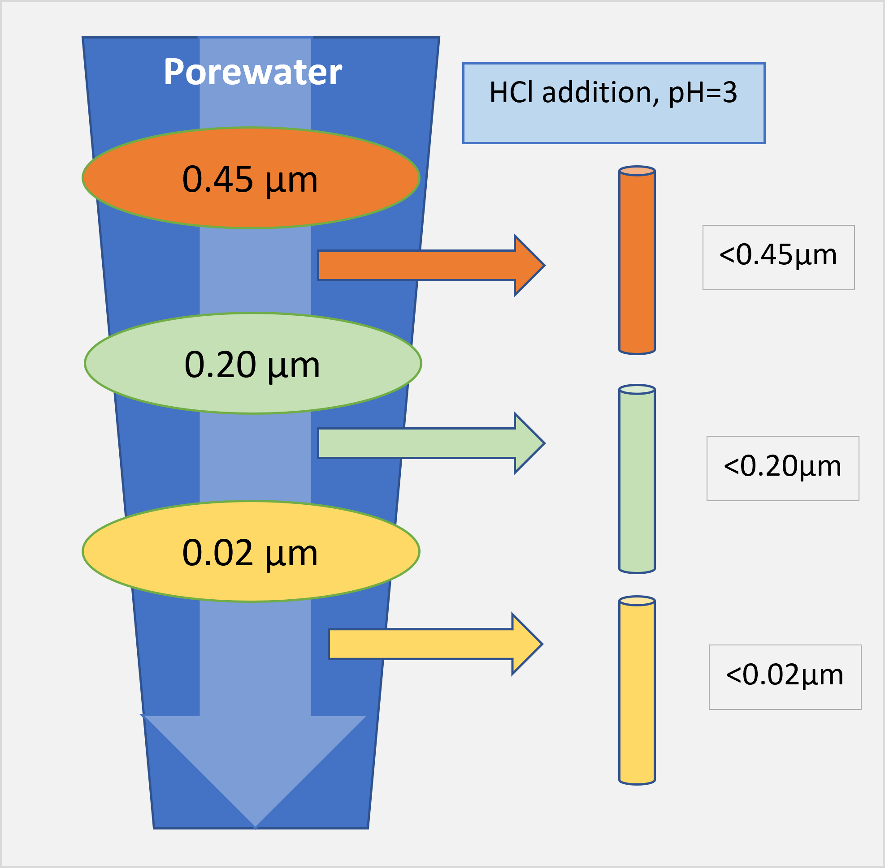
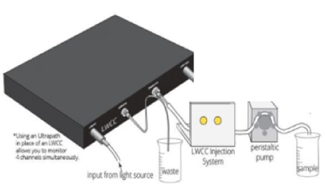
Material and Method
Spectrophotometric ferrozine method
For low level detections: Liquid Waveguide Capillary Cell (50cm)
sequential filtration for colloidal fraction
Method previously applied to hydrothermal vent fluids (Yücel et al., 2011; Findlay et al., 2019).
dFe
cFe
sFe
Credit:https://www.wpiinc.com/lwcc-3050-liquid-waveguide-capillary-cell-50-cm-pathlength

Slide 6
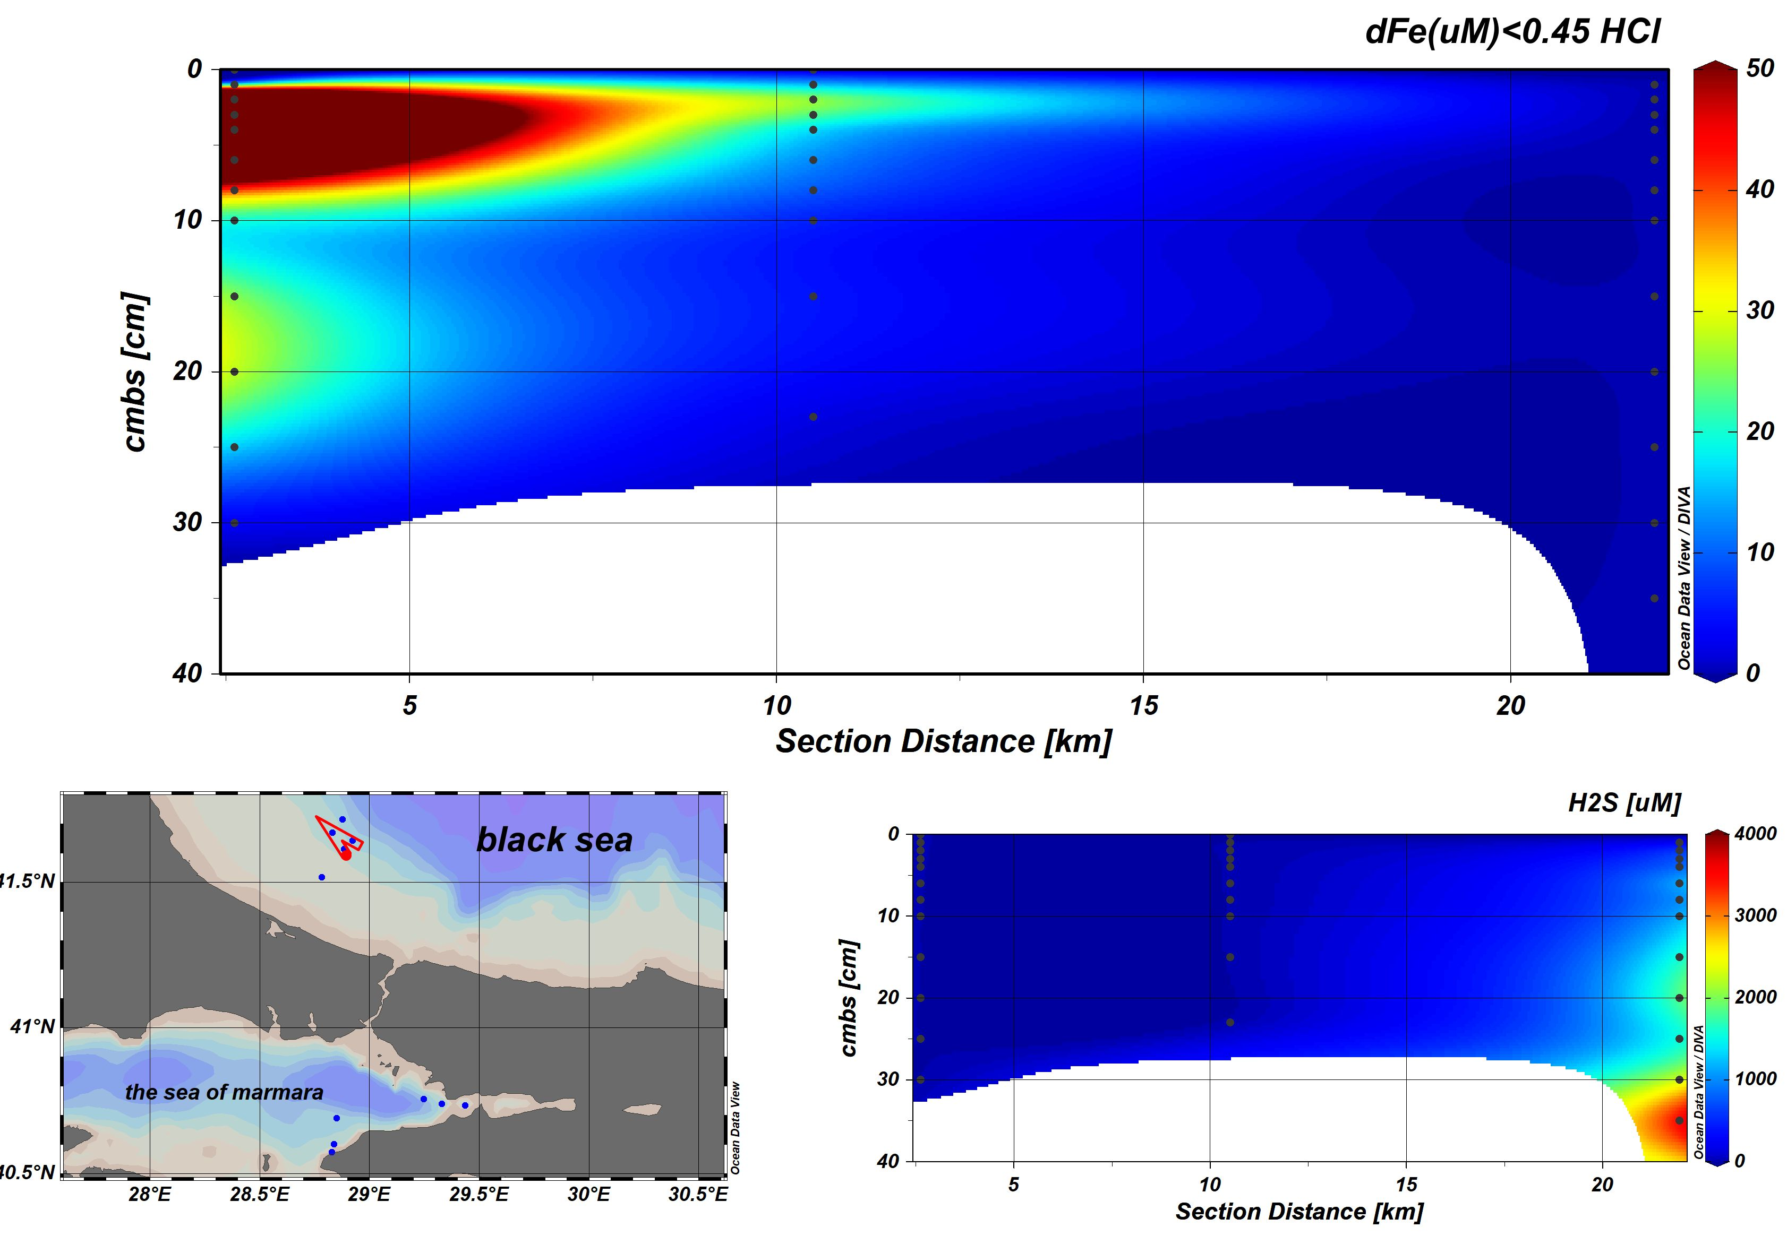
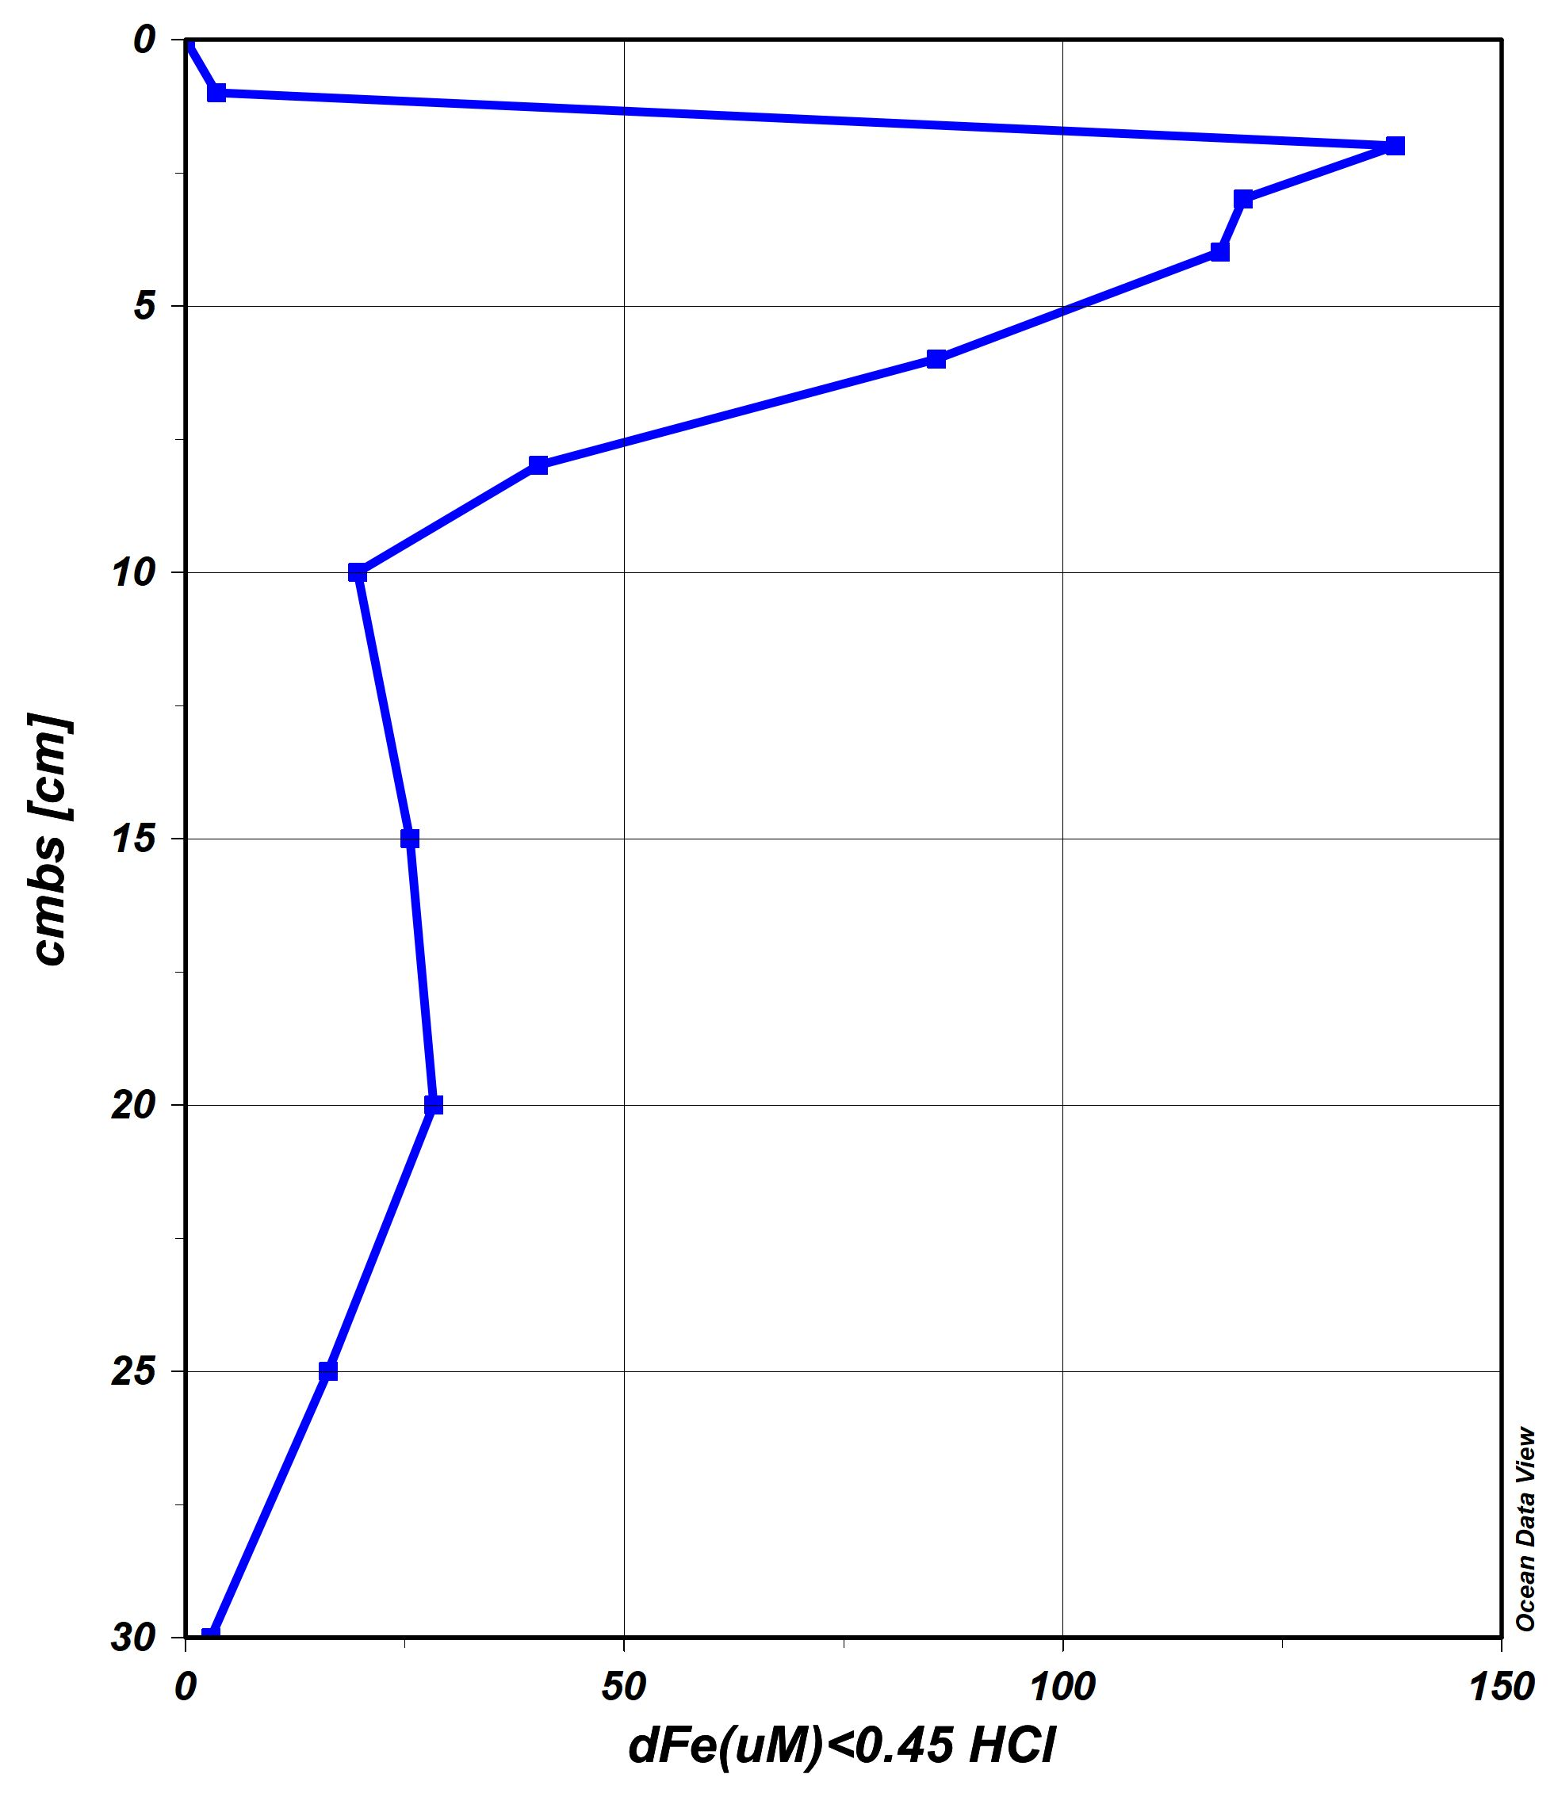
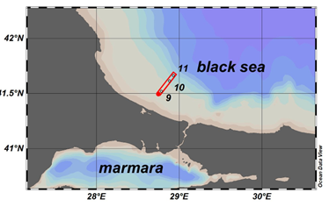
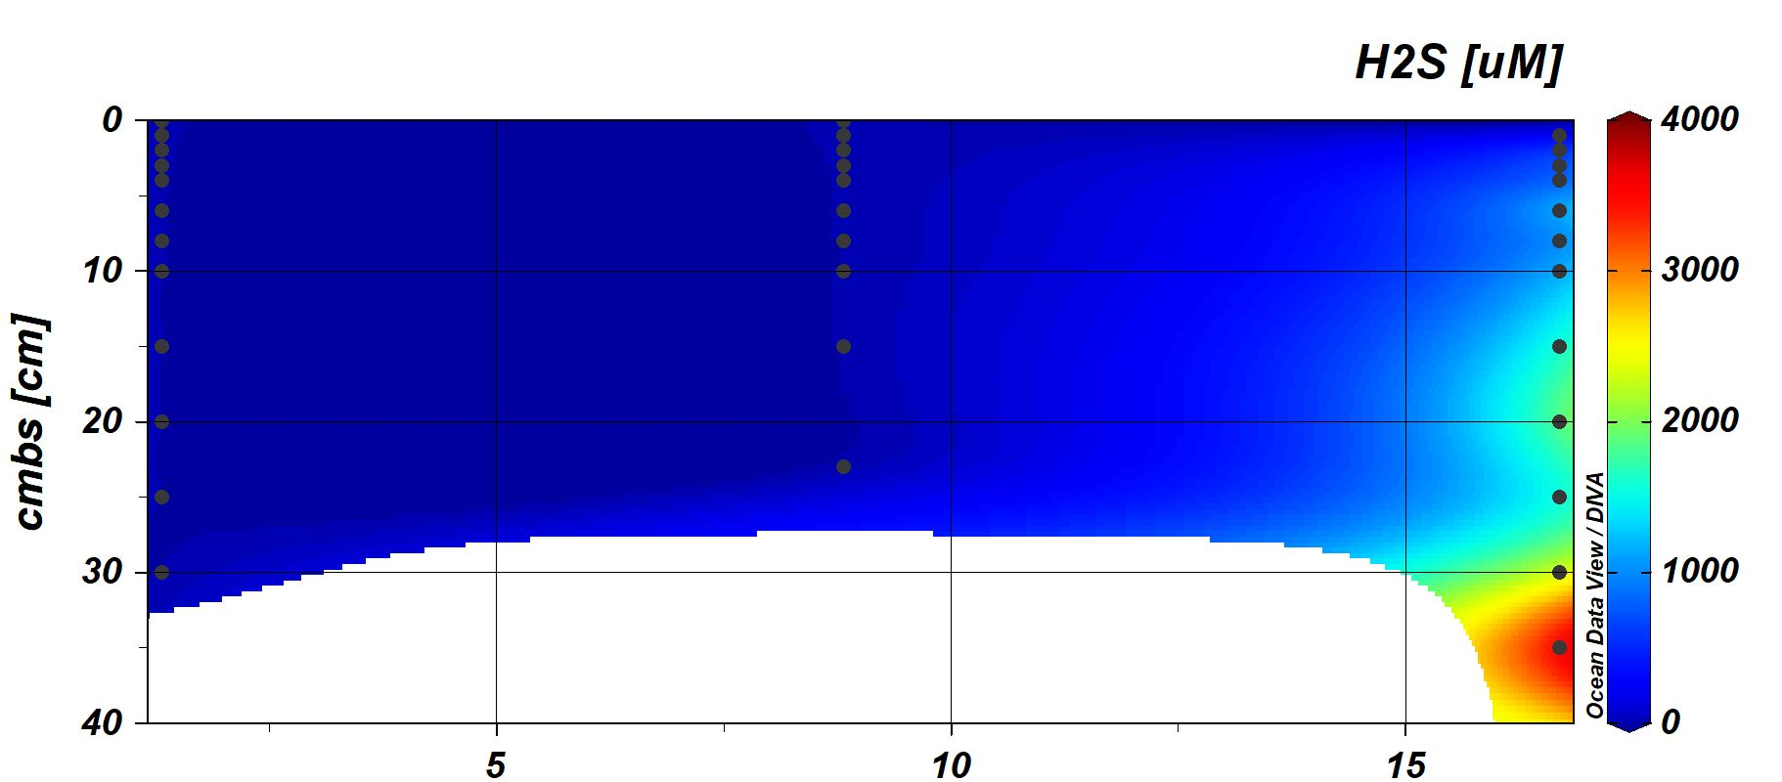
Black Sea porewater dFe
oxic suboxic sulfidic
shelf open
High level of iron mobilization on the upper sediment of the oxic and sub-oxic bottom
Low level dFe due to high levels of H₂S concentrations in the sediment
dFe
137.93µM
0.3- 0.05 µM
H₂S

Slide 7
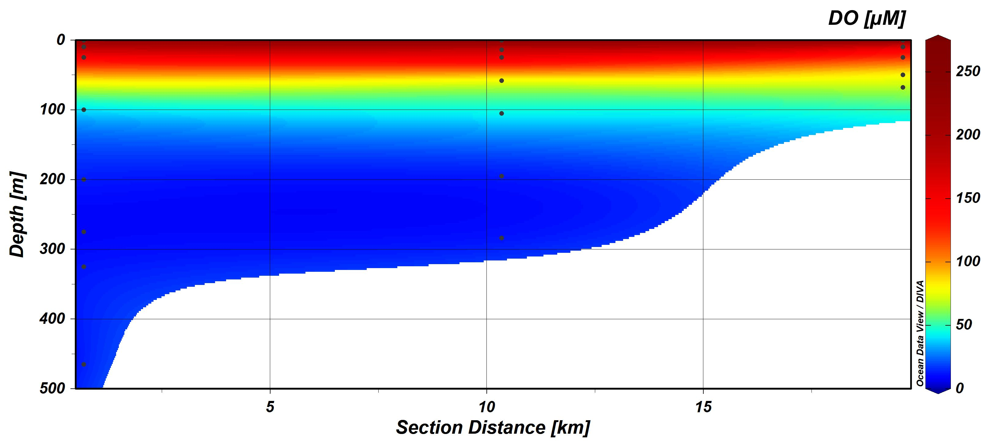
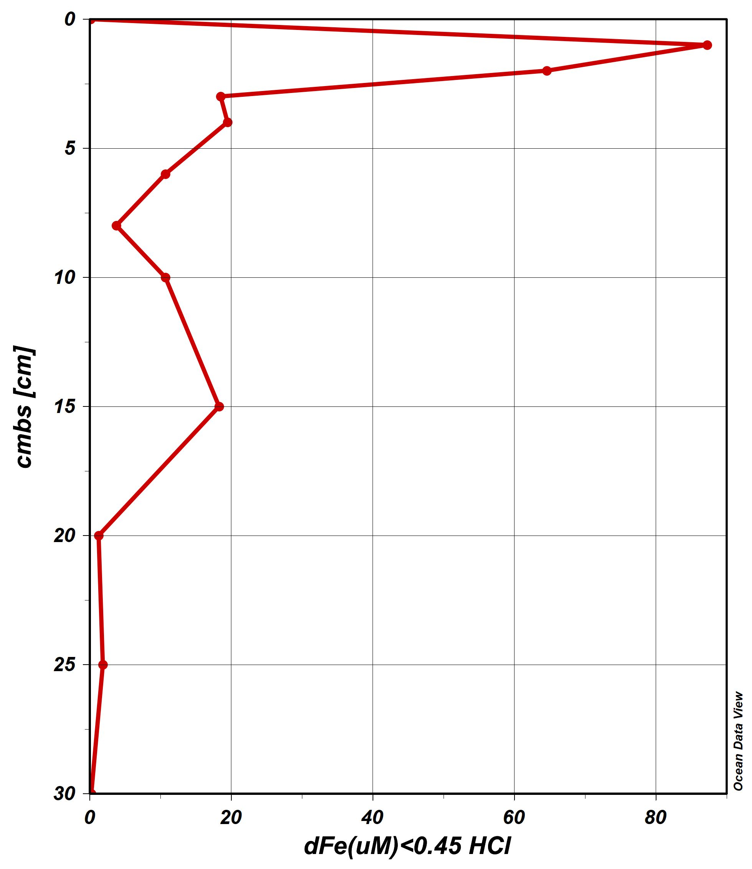
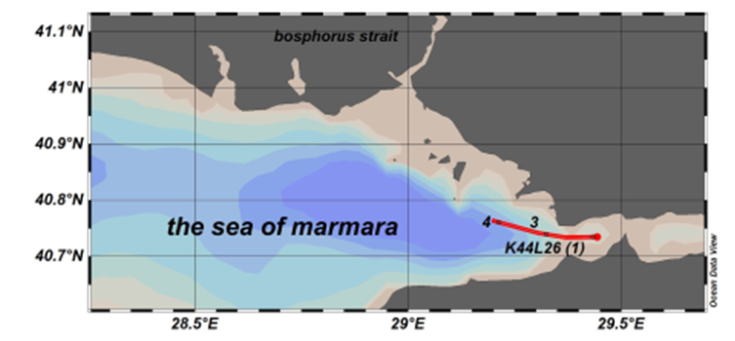
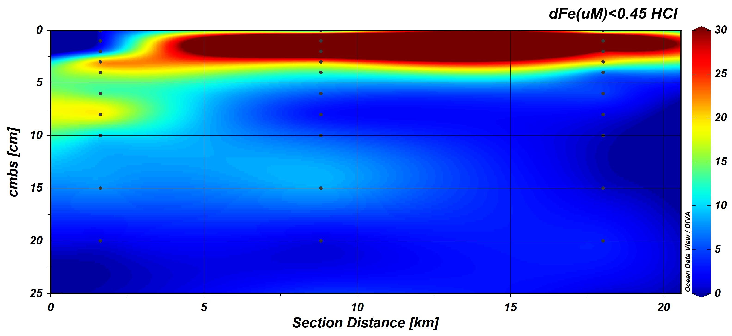
the Sea of Marmara porewater dFe
transect
watercolumn
Decreasing oxygen levels at bottom, rises dissolved iron from sediment
dFe gives maximums as 63uM and 86uM
sediment

Slide 8
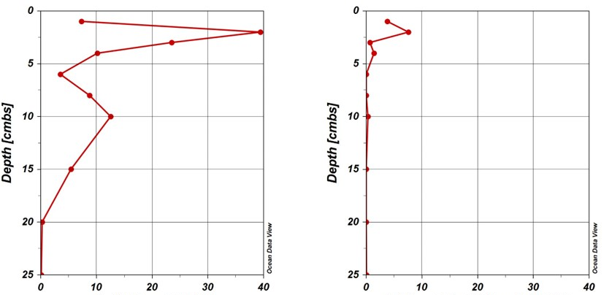
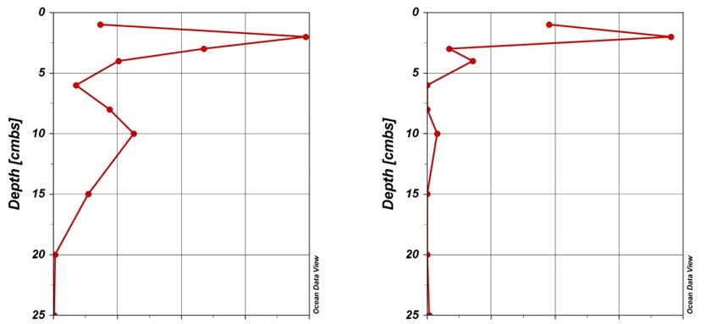
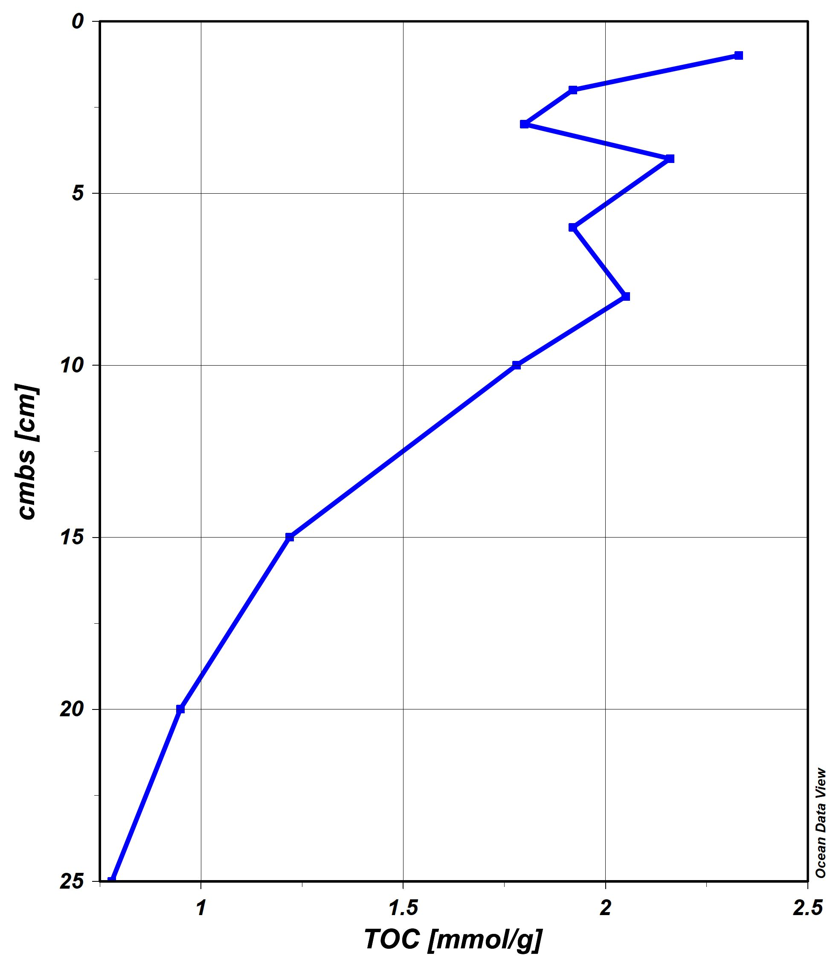
Size Fraction: cFe in Black Sea
Similar distribution and the presence of cFe can be related to higher TOC levels
TOC (mmol/g)
Soluble Fe < 0.02µm
0.02µm< Colloidal Fe <0.20µm

Slide 9
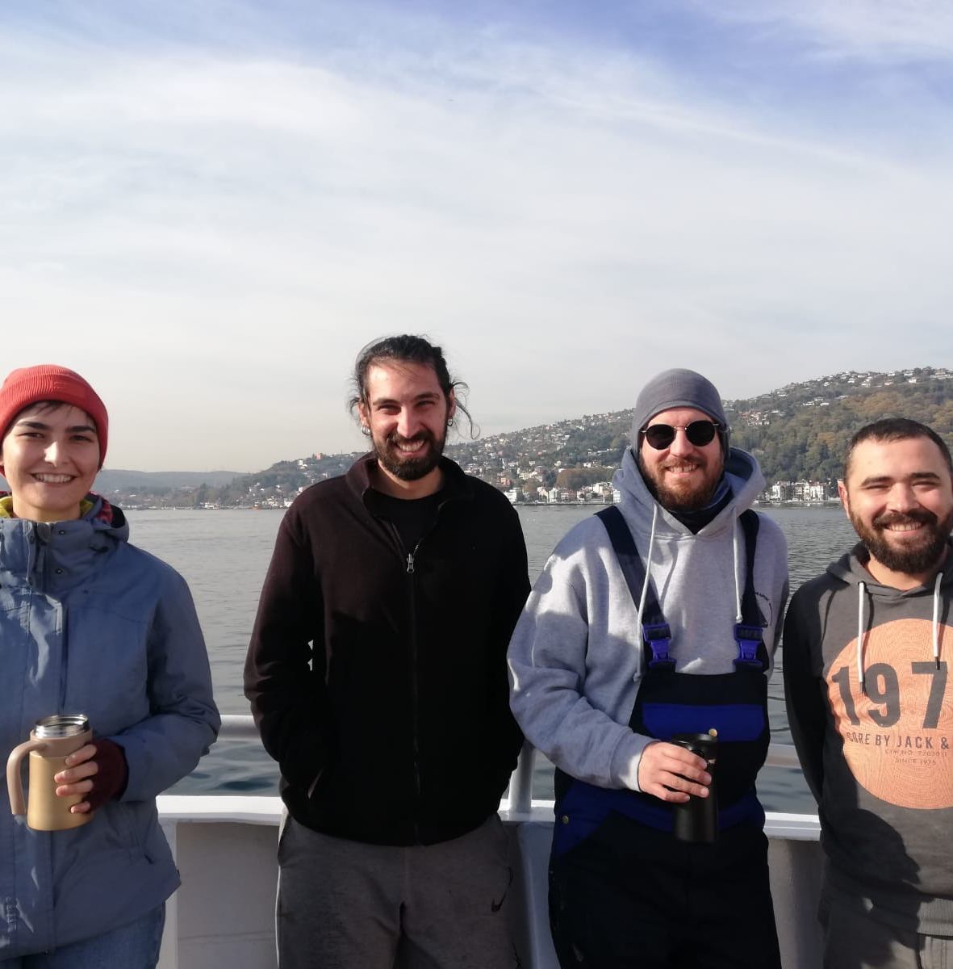

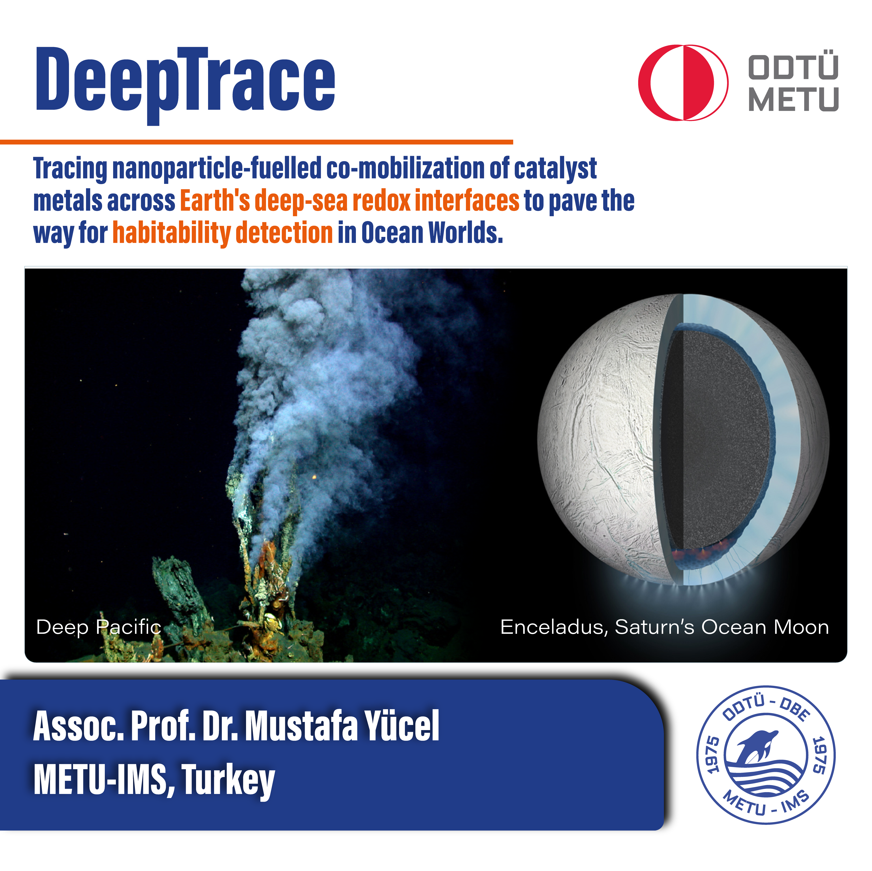
To conclude
Low-oxygen levels (even in recently deoxygenated areas) at seafloor mobilizes iron at the upper part of the sediment
The characteristics of the colloidal iron pool in the pore waters of the Sea of Marmara and Black Sea sediments differ from the nanomineral-dominated hydrothermal vent iron (Yucel et al., 2021)
organic fractions may play a greater role in mobilizing iron colloids from sediments of deoxygenated basins.
If you are interested in these questions and study it, contact me to work with us in our new ERC Project DEEPTRACE
nimet@ims.metu.edu.tr
https://www.deepsearedox.com/

