Slide 1


Combination of integral transforms by spectral weighting – an overview
Martin Pitoňák¹, Michal Šprlák¹, Pavel Novák¹
¹NTIS-New Technologies for the Information Society, Faculty of Applied Sciences, University of West Bohemia, Plzeň, Czech Republic
EGU 2022, Vienna, 23-27 May 2022

Slide 2
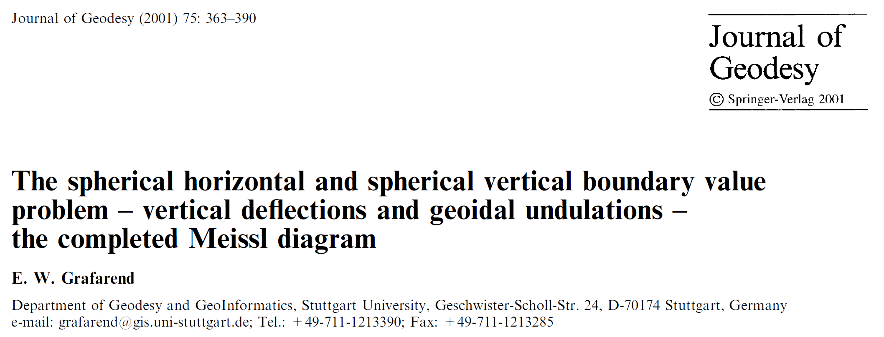
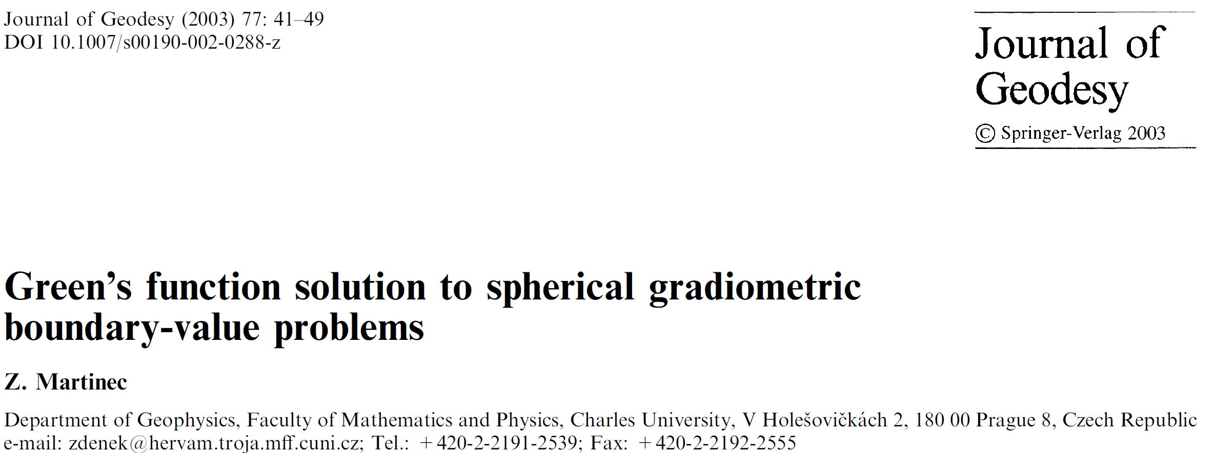
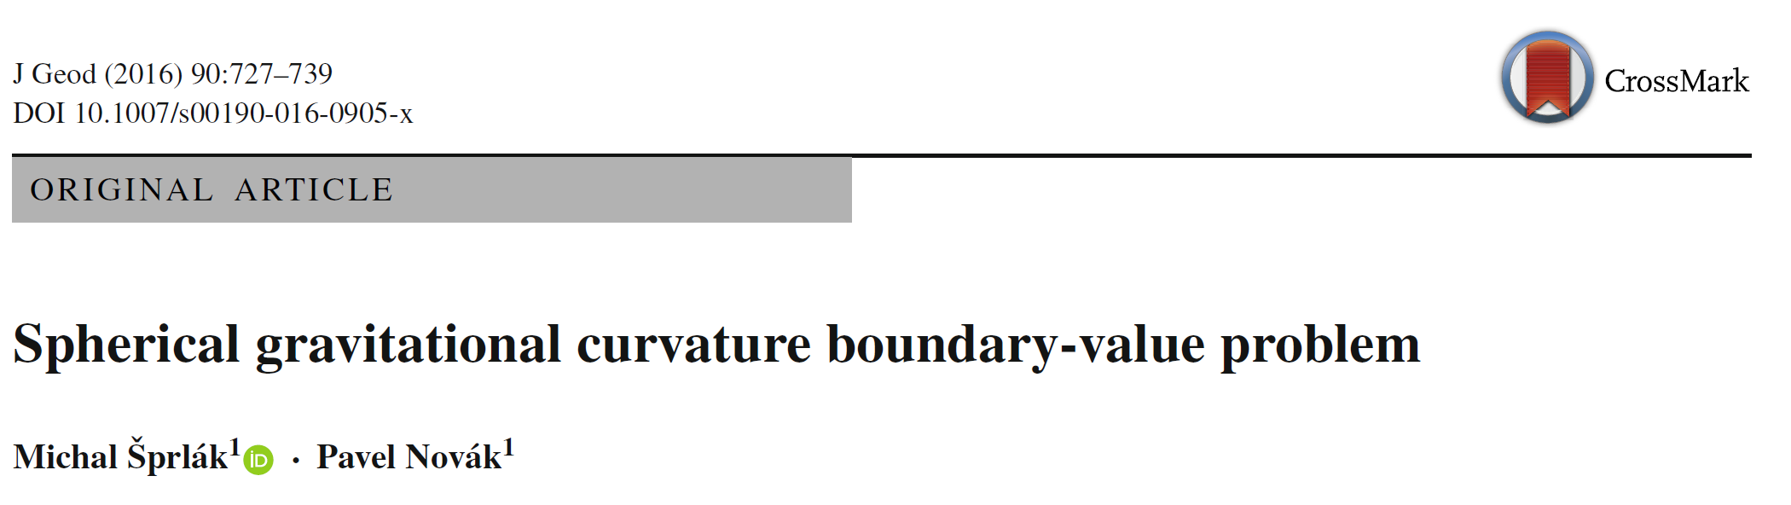
Motivation:
Pitoňák et al.
Combination of integral transforms by spectral weighting – an overview
2/16

Slide 3
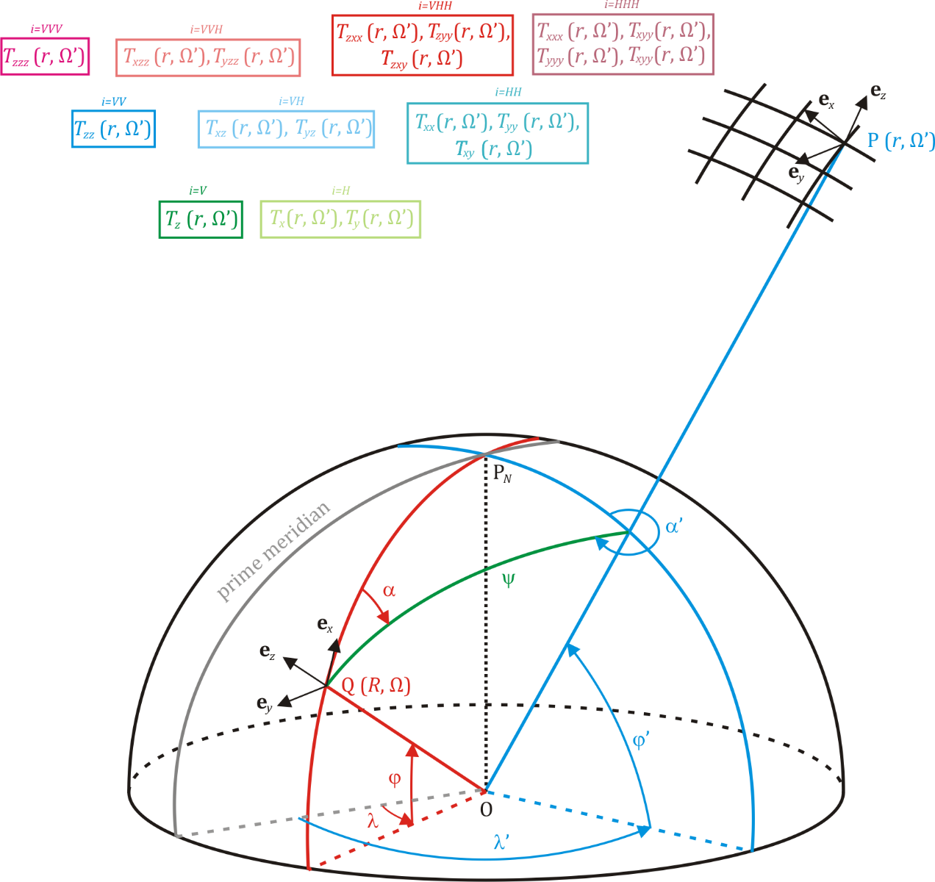
Motivation:
- How we could combine corresponding groups of
the gravity vector and the gravitational tensor of the first- and second-order?
- Could we benefit from this combination?
Pitoňák et al.
Combination of integral transforms by spectral weighting – an overview
3/16

Slide 4
Theoretical background (integral transforms):
We can write the following relations for the spherical horizontal and spherical vertical:
for the spherical gradiometry BVP:
Pitoňák et al.
Combination of integral transforms by spectral weighting – an overview
4/16

Slide 5
Theoretical background (integral transforms):
and for the gravitational curvature BVP:
Pitoňák et al.
Combination of integral transforms by spectral weighting – an overview
5/16

Slide 6
Theoretical background: the least-squares spectral weighting and combination
The spectral weights are obtained as the least-squares solution to the following problem:
The spectral weights for the one-group estimator are defined as:
The spectral weights for the two-group estimator are defined as:
The spectral weights for the N-group estimator are defined as:
Pitoňák et al.
Combination of integral transforms by spectral weighting – an overview
6/16

Slide 7
Theoretical background: least-squares spectral weighting and combination
$$N −number of all groups in combination$$
Number of group (K) | Number of different combinations
1 (one-group estimator) | 9
2 (two-group estimator) | 36
3 (three-group estimator) | 84
4 (four-group estimator) | 126
5 (five-group estimator) | 126
6 (six-group estimator) | 84
7 (seven-group estimator) | 36
8 (eight-group estimator) | 9
9 (nine-group estimator) | 1
Pitoňák et al.
Combination of integral transforms by spectral weighting – an overview
7/16

Slide 8
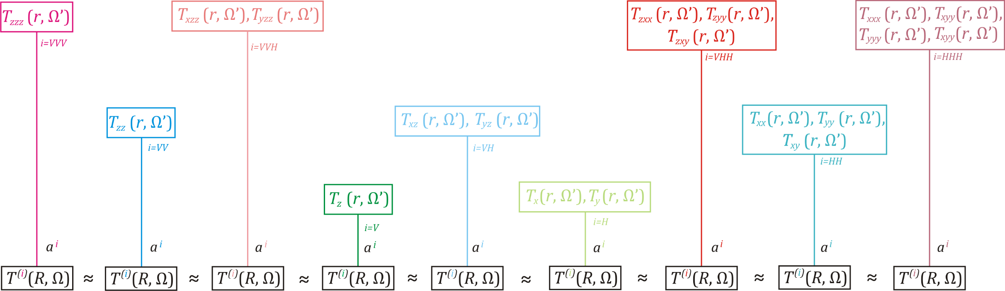
Theoretical background: one-group estimator
Pitoňák et al.
Combination of integral transforms by spectral weighting – an overview
8/16

Slide 9
Theoretical background: one-group estimator
Pitoňák et al.
Combination of integral transforms by spectral weighting – an overview
9/16

Slide 10
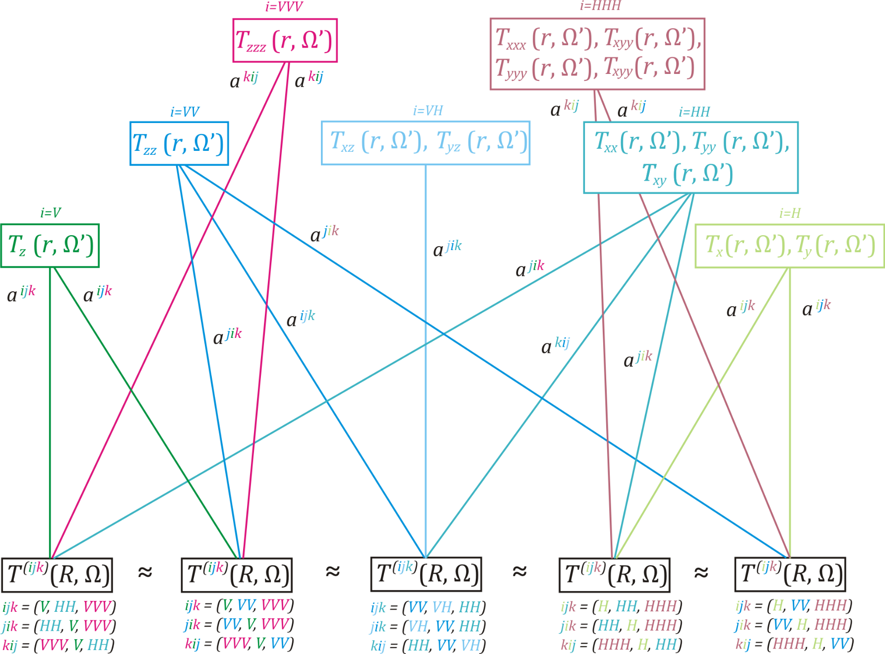
Theoretical background: three-group estimator
Pitoňák et al.
Combination of integral transforms by spectral weighting – an overview
10/16

Slide 11
Theoretical background: three-group estimator
Pitoňák et al.
Combination of integral transforms by spectral weighting – an overview
11/16

Slide 12
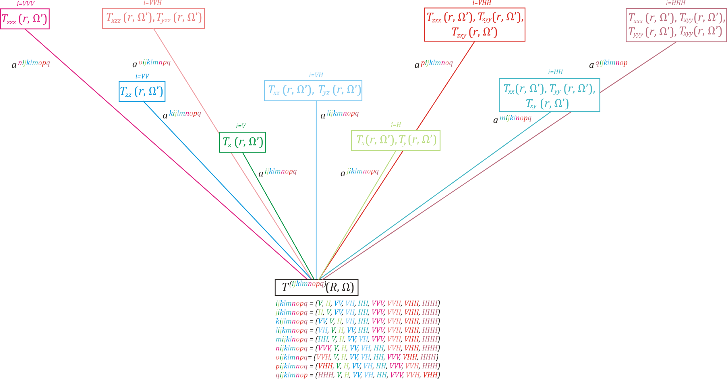
Theoretical background: nine-group estimator
Pitoňák et al.
Combination of integral transforms by spectral weighting – an overview
12/16

Slide 13
Theoretical background: nine-group estimator
Pitoňák et al.
Combination of integral transforms by spectral weighting – an overview
13/16

Slide 14
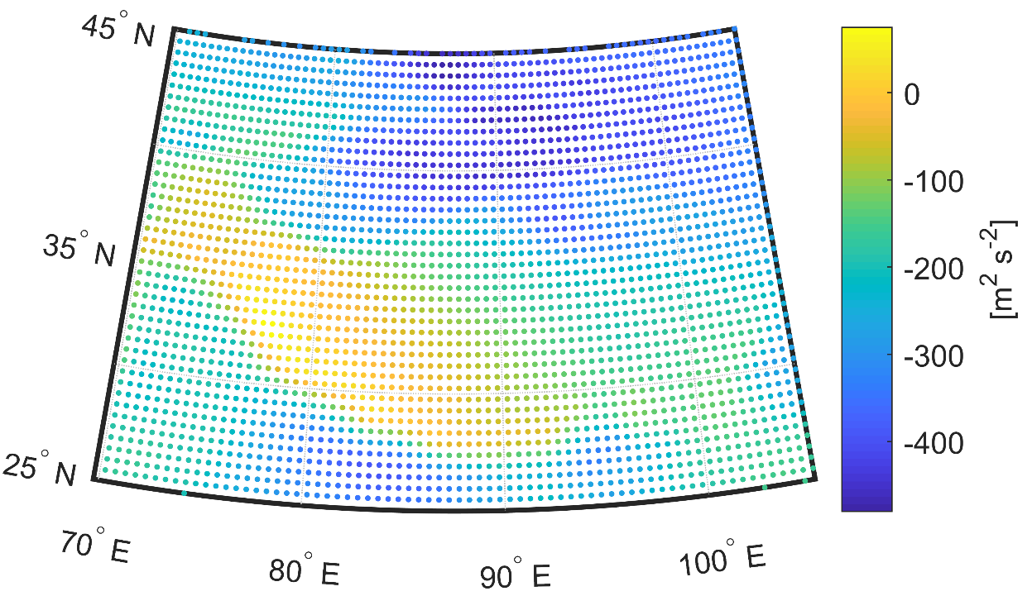
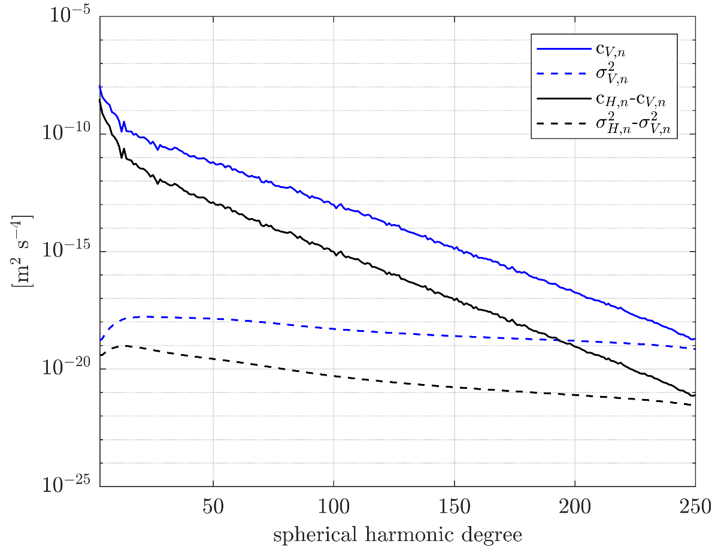
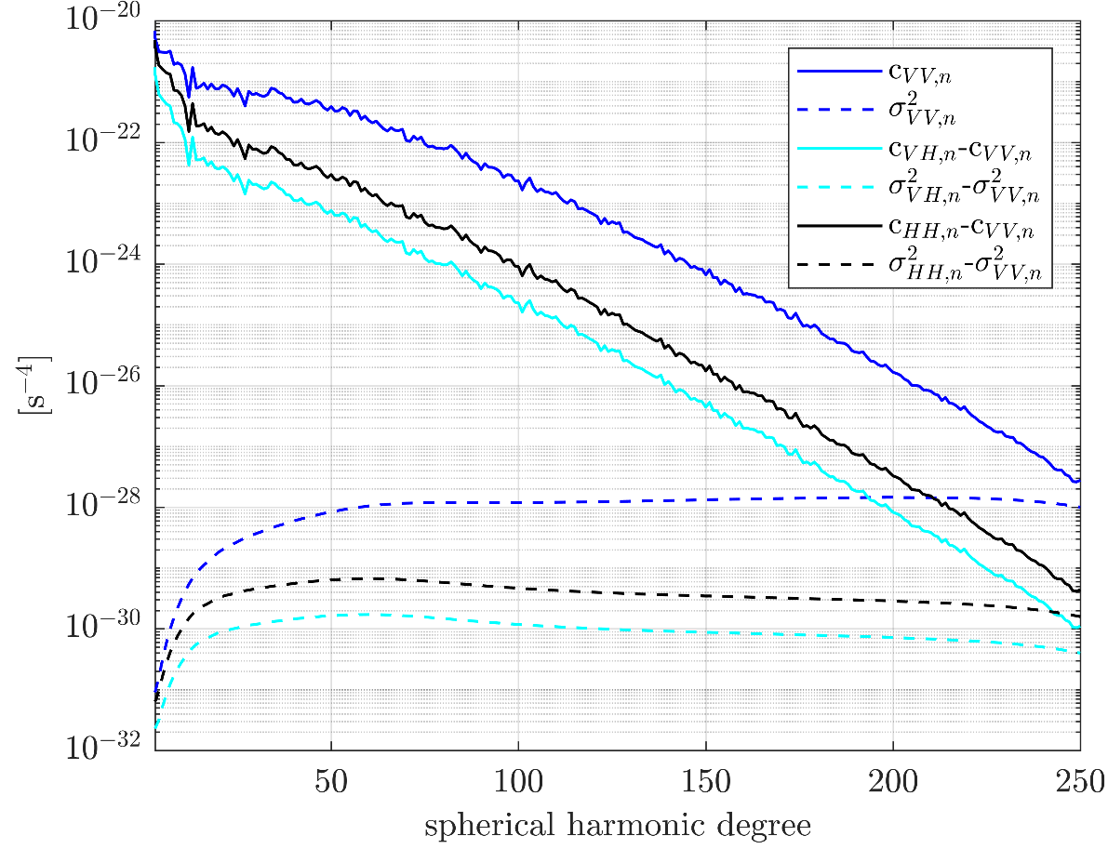
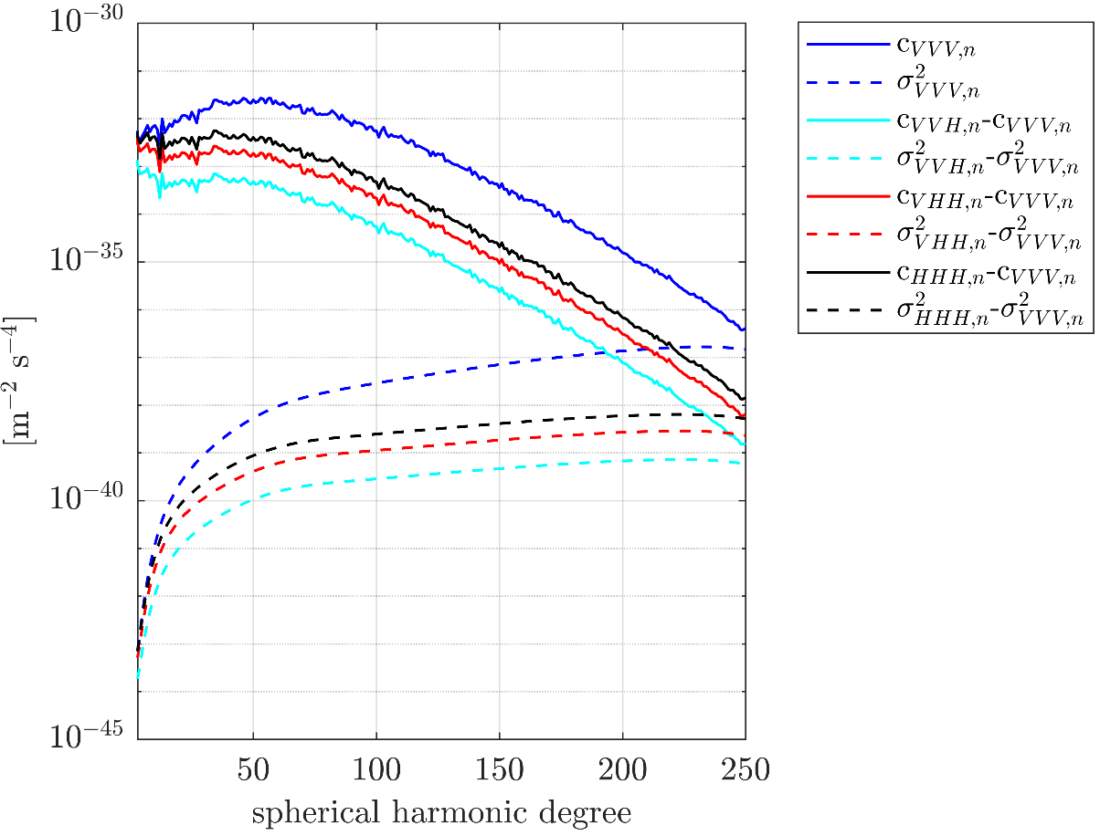
Numerical experiment: inputs
- Input model: TIM_R6e d/o 250 (Zingerle et al., 2019),
- Input data: T_{x}, T_{y}, T_{z},
T_{xx}, T_{xy}, T_{xz}, T_{yy}, T_{yz}, T_{zz},
T_{xxx}, T_{xxy}, T_{xxz}, T_{xyy}, T_{xyz}, T_{xzz}, T_{yyy}, T_{yyz}, T_{yyz}, T_{zzz}
regular equiangular grid located at the satellite level r = 6633850 m and limited by with the regular step of 0.2°
- Out data: T located at the Brillouin’s sphere R = 6383850 m
Pitoňák et al.
Combination of integral transforms by spectral weighting – an overview
14/16

Slide 15
Results:
 | V | H | VV | VH | HH | VVV | VVH | VHH | HHH
STD | 0,337 | 0,116 | 0,295 | 0,004 | 0,009 | 0,098 | 0,001 | 0,001 | 0,005
MIN | -1,098 | -0,250 | -1,160 | -0,010 | -0,017 | -0,148 | -0,003 | -0,005 | -0,013
MAX | 1,361 | 0,218 | 1,130 | 0,009 | 0,016 | 0,145 | 0,001 | 0,002 | 0,009
MEAN | 0,001 | -0,002 | -0,002 | 0,000 | -0,001 | 0,001 | -0,001 | 0,000 | -0,003
one-group estimator
 | (V, HH, VVV) | (V, VV, VVV) | (VV, VH, HH) | (H, HH, HHH) | (H, VV, HHH)
STD | 0,009 | 0,098 | 0,009 | 0,004 | 0,005
MIN | -0,017 | -0,148 | -0,017 | -0,011 | -0,013
MAX | 0,016 | 0,145 | 0,016 | 0,008 | 0,009
MEAN | -0,001 | 0,001 | -0,001 | -0,003 | -0,003
three-group estimator
 | (V, H, VV, VH, HH, VVV, VVH, VHH, HHH)
STD | 0,003
MIN | -0,009
MAX | 0,006
MEAN | -0,003
nine-group estimator
Pitoňák et al.
Combination of integral transforms by spectral weighting – an overview
15/16

Slide 16
Conclusion and discussion:
The spectral combination method works like the weighted mean
Horizontal derivatives of disturbing gravitational potential influence results more than vertical derivatives,
Higher-order derivatives of disturbing gravitational potential influence results more than lover-order derivatives
For more details about the integral transforms by spectral weighting , please see
Pitoňák M, Eshagh M, Šprlák M, Tenzer R, Novák P (2018). Spectral combination of spherical gravitational curvature boundary-value problems. Geophysical Journal International 214(2): 773-791.
Pitoňák M, Novák P, Eshagh M, Tenzer R, Šprlák M (2020). Downward continuation of gravitational field quantities to an irregular surface by spectral weighting. Journal of Geodesy 94: 62.
Pitoňák M, Šprlák M, Ophaug V, Omang OCD, Novák P (2022). Validation of space-wise GOCE gravitational gradient grids using the spectral combination method and GNSS/levelling data. Submitted to Surveys in Geophysics (under review).
Thank you for your attention
pitonakm@ntis.zcu.cz
Pitoňák et al.
Combination of integral transforms by spectral weighting – an overview
16/16

