Slide 1



Evaluation of Multi-Source Satellite Products in Simulating Precipitation
over the Tensift Basin in Morocco
25/05/2022
Wiam.salih@um6p.ma
SALIH Wiam¹, Abdelghani CHEHBOUNI¹, Terence Epule EPULE¹ & EL Mahdi ELKHALKI¹
1-International Water Research Institute (IWRI), Mohammed VI Polytechnic University (UM6P), Lot 660, Hay Moulay Rachid, Benguerir 43150, Morocco

Slide 2




Outline:
I- Introduction and Problematic
II- Methodology
III- Results
IV- Analyses And Conclusions

Slide 3
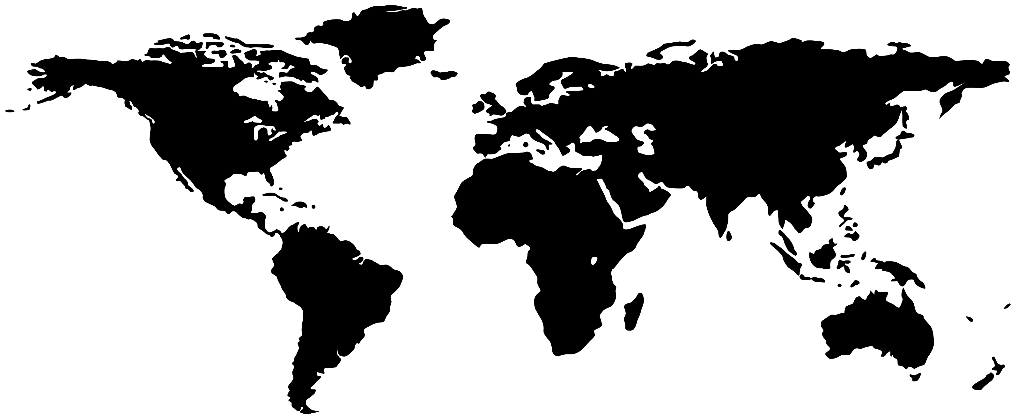

Introduction
INTRODUCTION & PROBLEMATIC METHODOLOGY RESULTS ANALYZES & CONCLUSIONS
Impact of climate change on water resources in the Tensift basin
High resolution for hydro-meteorological events is required
Hence, the interest of satellite
Products
The problematic of this work revolves around the performance of Satellite Products
Objective
Statistical Comparison of various rainfall products from 7 satellites and 6 Rain Gauges at three-time steps (Daily, Monthly, Annually) in the Tensift basin over the period 2007 and 2019
Table 1: Spatial Resolution of satellite and reanalysis data
Satellite Products | SR
Persiann (CHRS/ NASA/NOAA) : IR (GEO: GOES GMS-5, METEOSAT )+ MOP (LEO) | 0.25°
Persiann CDR : IR+NCEP+GPCP | 0.25°
TRMM: (NASA) : MOP+ IR +GPCP | 0.25°
ARC2: (CPC) IR+ GTS | 0.1°
RFE2: (NOAA) MO+ IR+ satellite SSM+ GTS | 0.1°
ERA5: (ECMWF) | 0.25°
CHIRPS: (FEWS NET) IR+ TMPA+ GTS+ GPCC | 0.05°
Figure 1: Tensift Basin’s location.

Slide 4



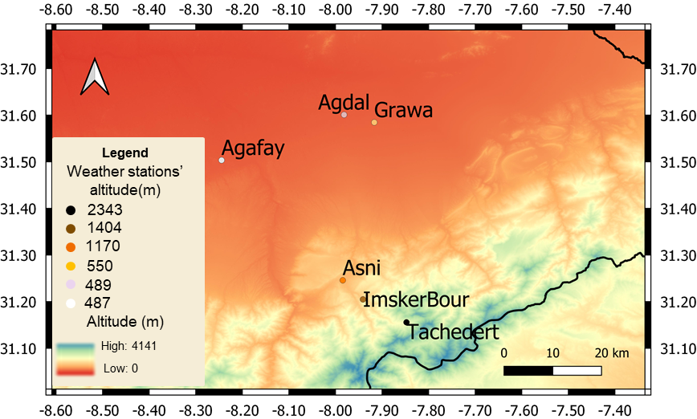
Methodology
INTRODUCTION & PROBLEMATIC METHODOLOGY RESULTS ANALYZES & CONCLUSIONS
Selection of satellite Products Data:
PERSIANN (CHRS iRain), PERSIANN CDR (RainSphere) , TRMM3B42 ( NASA), ARC2 (EUMETSAT), RFE2 (NOAA), CHIRPS ( FEWS NET) , and ERA5 (ECMWF) .
Visualisation of the data:
Taylor diagrams.
Standardized precipitation index (SPI):
Based on Monthly precipitation from the six weather stations in order to determine the onset, duration, and magnitude of the meteorological drought.
Collection of precipitation observations data:
Comparison and analysis of the data:
Tachedert (2343 m), Imskerbour (1404 m), Asni (1170 m), Grawa (550 m), Agdal (489 m), and Agafay (487 m). (LMI TREMA)
Nash-Sutcliffe Efficiency Coefficient, Bias, Root Mean Square Error (RMSE), Root Mean Square Deviation (RMSD), the standard deviation, the Correlation Coefficient (R) and the Coefficient of Determination (R²).
Scatterplots.
Figure 2: Location of Weather Stations in Tensift Basin.
Collection of satellite Products Data:
PERSIANN (CHRS iRain), PERSIANN CDR (RainSphere) , TRMM3B42 ( NASA), ARC2 (EUMETSAT), RFE2 (NOAA), CHIRPS ( FEWS NET) , and ERA5 (ECMWF) .
Visualisation of the data:
Taylor diagrams.
Standardized precipitation index (SPI):
Based on Monthly precipitation from the six weather stations in order to determine the onset, duration, and magnitude of the meteorological drought.
Collection of precipitation observations data:
Comparison and analysis of the data:
Tachedert (2343 m), Imskerbour (1404 m), Asni (1170 m), Grawa (550 m), Agdal (489 m), and Agafay (487 m).
Nash-Sutcliffe Efficiency Coefficient, Bias, Root Mean Square Error (RMSE), Root Mean Square Deviation (RMSD), the standard deviation, the Correlation Coefficient (R) and the Coefficient of Determination (R²).
Scatterplots.

Slide 5
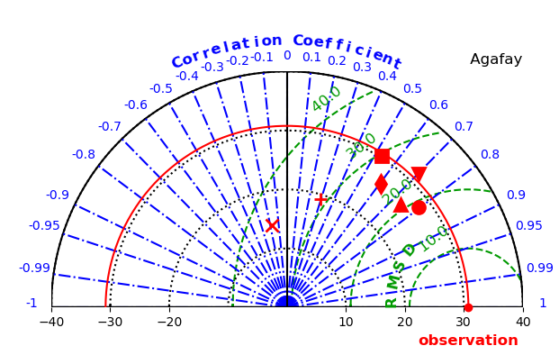
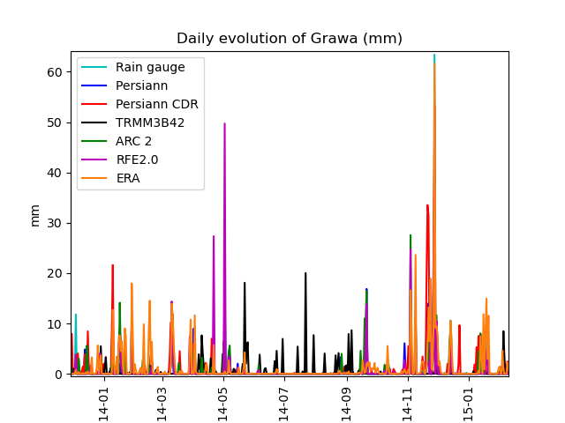
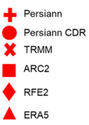
Results
INTRODUCTION & PROBLEMATIC METHODOLOGY RESULTS ANALYZES & CONCLUSIONS
Figure 3: Taylor diagram of monthly precipitation
of Grawa weather station
Figure 4: Daily evolution of Grawa at the wettest year (2014).
PERSIANN CDR product is a valuable source of information for water managers, irrigation planning and drought management in the Tensift basin.
TRMM underestimates precipitation during heavy rainfall and overestimates it during low rainfall.
The performance of the satellite products is better at low altitudes, due to changes in snow cover, winds, orography, and clouds, and during wet seasons.
SPI shows that the Tensift basin has experienced 13 drought periods over the study period, with the longest event of 12 months was from Marsh 2015 to February 2016 and the most intense event with the highest drought severity (19.6) and the lowest SPI value (-2.66) was in 2019.

Slide 6
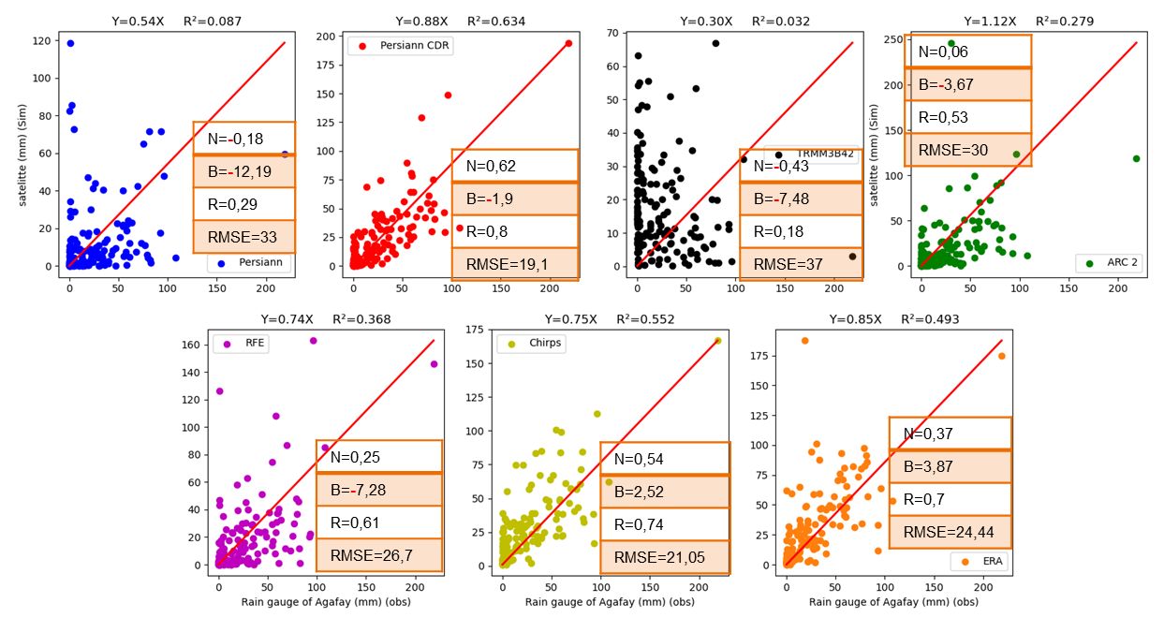
Discussion
INTRODUCTION & PROBLEMATIC METHODOLOGY RESULTS ANALYZES & CONCLUSIONS
Three-time steps
(Daily–Monthly–Annually)
Three Altitudes
(High-Medium-Low)
Monthly and Annualy Rainfall
Persiann CDR
Low- Medium- High Altitude
High Altitude
Daily Rainfall
The comparison of the satellite products and weather station data, shows some discrepancies that can be explained by the mismatch between the associated spatial resolutions.
Low Altitude
Medium Altitude
Low and negative Nash values may be due to insufficient weather stations in the study area since most of the satellite algorithms are based on a calibration of the output products to the ground observations.
RFE2
ERA5
Figure 5: Scatterplots of the monthly satellite products and
the Agafay (487m) weather station data.
This work has been limited to analyzing the effect of climate change due to the limited historical data since the weather stations are recent (May 2007), but this issue has been fixed by analyzing climate variability based on SPI, Taylor diagrams, and some statistics criteria (Nash, RMSE, R, R²).

Slide 7
Conclusion
INTRODUCTION & PROBLEMATIC METHODOLOGY RESULTS ANALYZES & CONCLUSIONS
PERSIANN CDR is the best satellite product to be used to study the effects of climate variability in the Tensift basin given its ability to estimate rainfall rates over a wide spatial and temporal range.
The disparities between the products suggest that further work should be carried out to improve their determination as a function of altitude and weather conditions.
The biased estimation of TRMM makes the interpretation of the comparison of the annual rates challenging, hence the need to, firstly, develop more robust precipitation comparison approaches in the future, secondly, correct the bias.
Low and negative Nash values highlight the need to use more weather stations in the Tensift basin.
Due to the limited historical observed data it will be interesting to predict future precipitation to have a slower series, in order to study the impact of climate change on water resources using the combination of volumetric and predictive methods.
To improve knowledge on the effects of climate change on water resources in the Tensift basin. It would be important to validate different satellite products of temperature and weather station data in the same basin.

Slide 8




Thank you for your attention
Wiam.salih@um6p.ma

Slide 9
Evaluation of Multi-Source Satellite Products in Simulating Precipitation
over the Tensift Basin in Morocco
25/05/2022
Wiam.salih@um6p.ma
SALIH Wiam¹, Abdelghani CHEHBOUNI¹, Terence Epule EPULE¹ & EL Mahdi ELKHALKI¹
1-International Water Research Institute (IWRI), Mohammed VI Polytechnic University (UM6P), Lot 660, Hay Moulay Rachid, Benguerir 43150, Morocco

