Slide 1
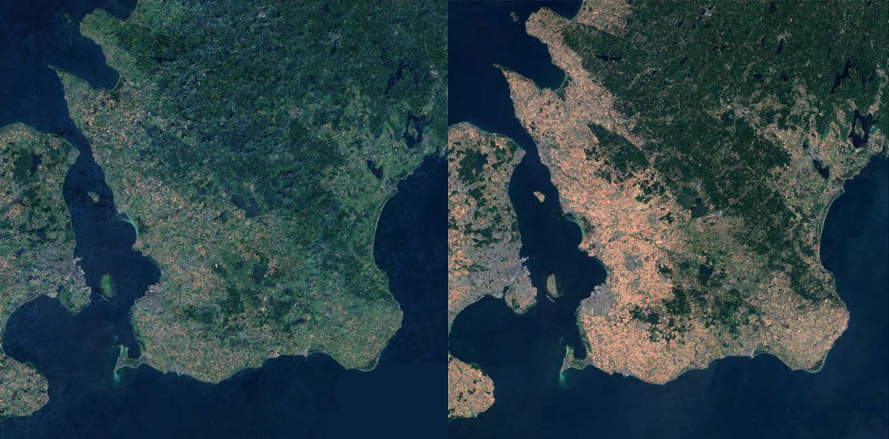
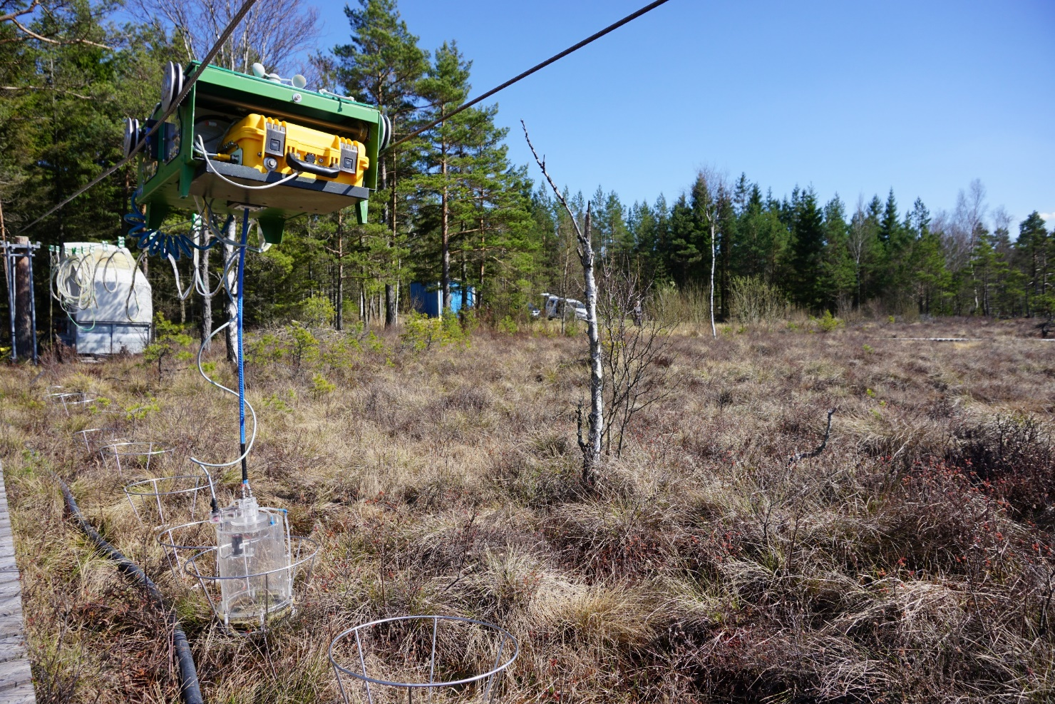


Methane producing and reducing microorganisms display a high resilience to drought in a Swedish hemi boreal fen
Presented by: Joel D. White
Department of Physical Geography and Ecosystem Scieince
Lund University

Slide 2
Background
Models are forecasting increased precipitation at northern latitudes to be more concentrated and less frequent with longer periods of dryer hotter weather in between
These events often result in a lowering of the water table depth which expose methanogenic anaerobes to oxidative stress
We have observed decreased CH₄ emissions from many wetlands
However, we have very little knowledge on how these microbial communities respond to drought disturbance

Slide 3
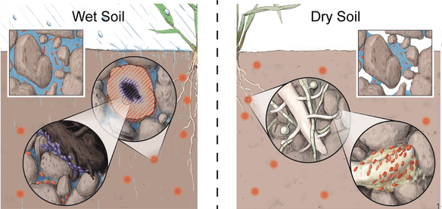
Factors affecting CH₄ flux in peatlands
Normal conditions
Drought conditions
i) water table depth ii) plant species composition iii) soil temperature iv) substrate availability
Lower water table depth
Oxidative stress
Increased peat temperature
Build up of phenol oxidase that can remove phenolic inhibitors to anerobes
(Tecon and Or, 2017)

Slide 4
Aims of the research
Determine whether the proportion of methanogenic / methanotrophic community shifts towards higher methanotrophic abundances when exposed to drought conditions
Determine whether / how the structure and function of the microbial community respond to drought and who is driving the change

Slide 5
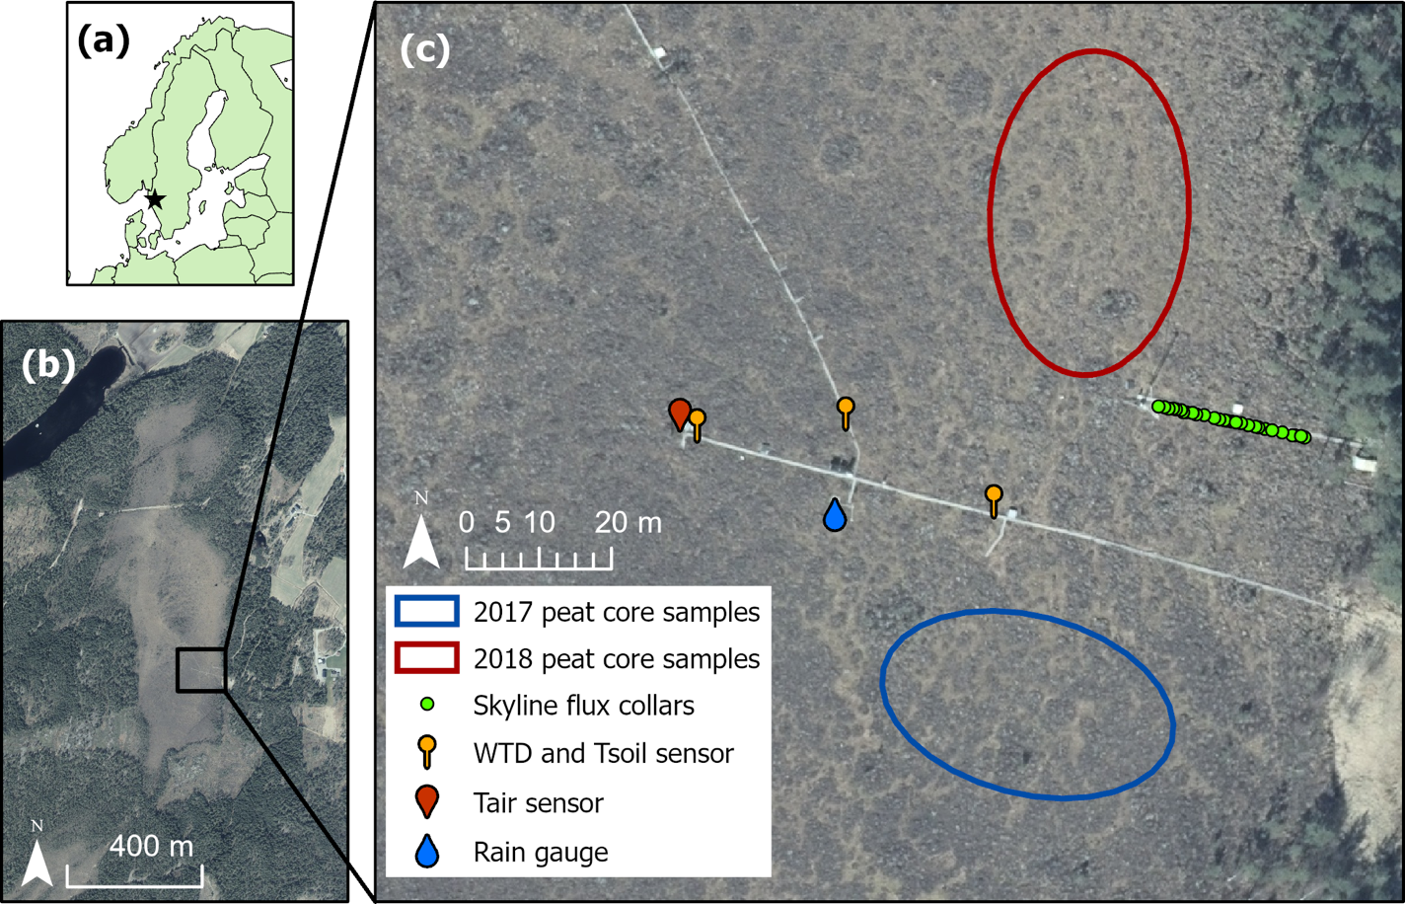
Experimental design
Environmental variables
Air temperature
Soil temperature
Precipitation
Water table depth
CH₄ fluxes
SkyLine2D system
Captured metagenomics
- target key CH₄ genes involved in metabolism
Figure 1: (a) Location of Mycklemossen (black star) within Sweden (b) aerial photo of Mycklemossen, black square shows location of (c) map of peat core and ancillary measurement locations. Map data sources: © EuroGeographics and © Lantmäteriet.

Slide 6
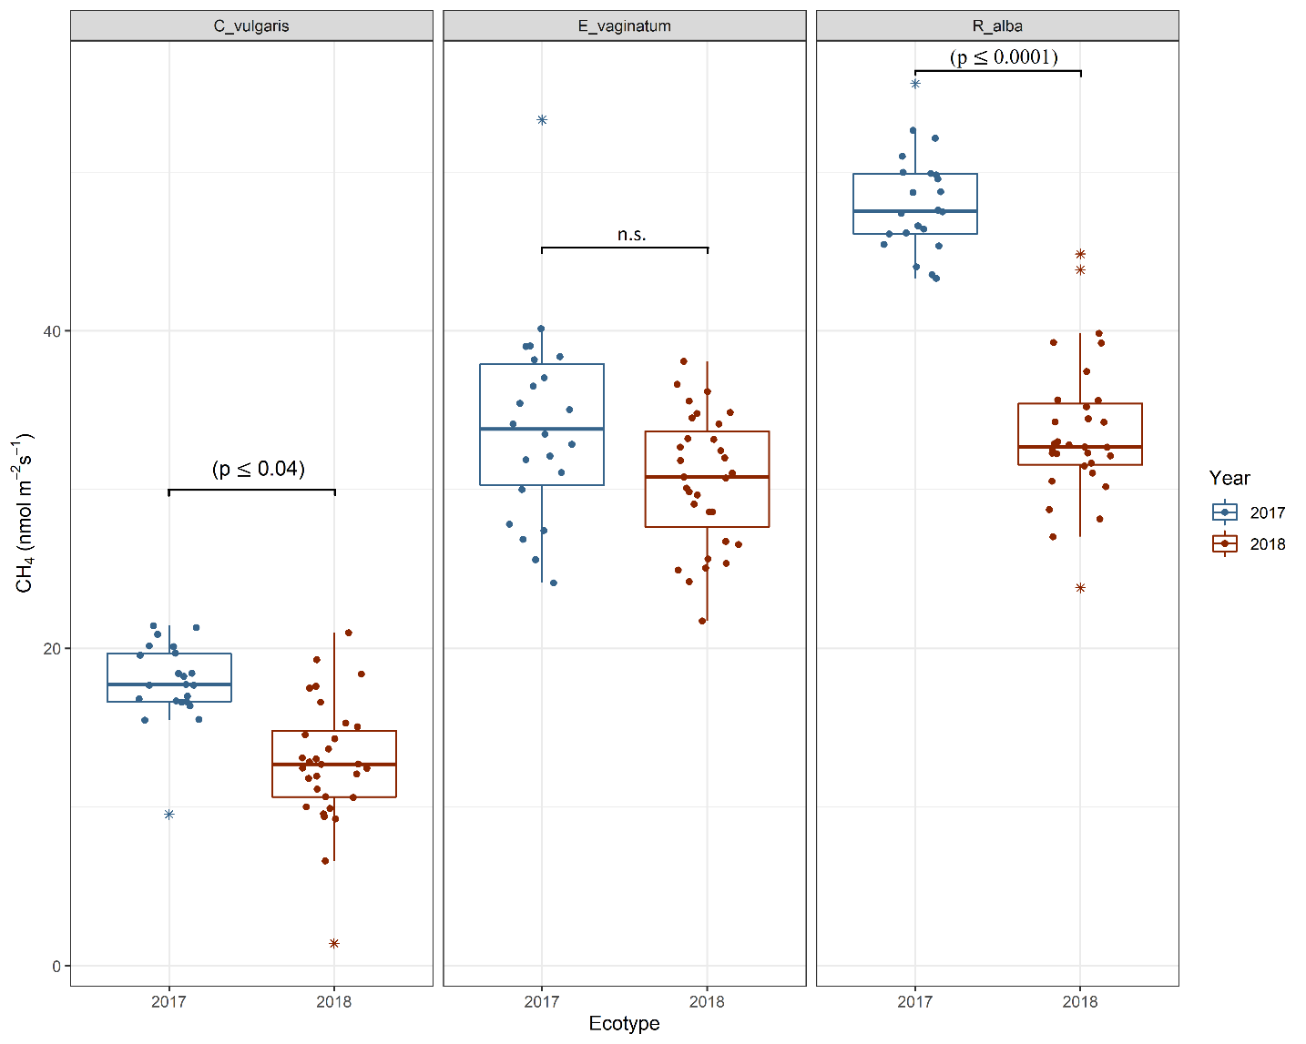
Results
Figure 4: Boxplots of daily mean CH₄ flux measured during the peak growing season (May to October) in 2017 (blue) and 2018 (red) at Mycklemossen mire. The boxes show quartiles and the median, the whiskers denote data within 1.5 times of the interquartile range. Colored stars denote outliers while significant differences (p<0.05)

Slide 7
Results
Table 1: Results of taxonomic contribution of each species (%) to the dissimilarity between each group (SIMPER analysis) between 2017 and 2018. Taxa are ranked according to their average contribution to dissimilarity between years. Average abundances, percentage of cumulative contribution and Permutation p-value (Probability of getting a larger or equal average contribution in random permutation of the group factor) are also included. A cut-off at a cumulative dissimilarity of 70% was applied (2017 n = 17; 2018 n = 10).
Significant variations in the abundances of methanogens and methanotrophs were observed (R² 0.36, p ≤ 0.003)
The proportion of methanogens to methanotrophs during 2017 was 59% and 41%
The proportion of methanogens reduced by 13.5% during drought
All methanotrophs significantly increased, including the type I, II and Verrucomicrobia
Interestingly, the average abundance of all methanogens and methanotrophs increased during the drought
Genus | Average contribution to dissimilarity |  | SD | Avg. 2017 | Avg. 2018 | Percentage contribution | p-value
Methylocella* |  | 0.12 | 0.089 | 2539 | 8108 | 20% | 0.001
Methanoregula |  | 0.09 | 0.085 | 4267 | 5968 | 36% | 1
Methylosinus |  | 0.08 | 0.050 | 2386 | 5602 | 49% | 0.031
Methanosarcina* |  | 0.05 | 0.032 | 1529 | 4142 | 58% | 0.006
Methylococcus |  | 0.03 | 0.022 | 814 | 2495 | 64% | 0.001
Methylacidiphilum |  | 0.03 | 0.020 | 568 | 1935 | 69% | 0.001
*faculative methanogn / Methanotrophs

Slide 8
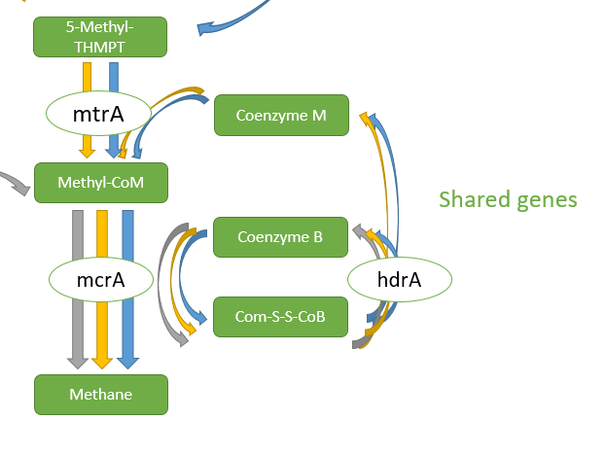
Results
Significant variations in CH₄ metabolism genes were observed between drought and non-drought years (R² = 0.12, p ≤ 0.036)
106 functional genes coding for CH₄ metabolism were captured
Genes including cutL, hdrA, fdhA, coxS, frmB, mvhA, metF and cutM were all significantly more abundant in 2018
Genes that did not increase during 2018 included frhA, mcrA, frhG, hdrB, fwdB, mtd, mtrE and mtrH.
Figure 6: Nonmetric Multidimensional Scaling (NMDS) of functional genes using Bray-Curtis distances. Solid dots indicate individual samples while the largest dots indicate the mean of all samples. Samples analyzed at KO level 4 and colored by year 2017 (n = 17) and 2018 (n = 10).

Slide 9
Take home message
The resilience of methanogens and methanotrophs to the effects of drought is high
Facultative microbes respond differently to drought events due advantageous genomic traits giving a competitive edge under oxidative stress - e.g. facultative methanogen Methanosarcina and methanotroph Methylocella - oxygen-detoxifying enzymes such as catalase, superoxide dismutase, superoxide reductase
Peatlands dominated by the ecotype E. vaginatum yield the highest fluxes of CH₄ under drought conditions and methanogenesis does not completely cease during drought. - deep rooting zone and plant mediated transport may contribute to this

Slide 10




Thank you for listening.
Thank you for your attention.
joel.white@nateko.lu.se
@JoelDWhite1
Department of Physical Geography & Ecosystem Science, Lund University

