Slide 1
Simultaneous Cross-energy Ion Response and Wave Generation after the Impact of An Interplanetary Shock
Yu-Xuan Li^{1,2}, Chao Yue^{1*}, Qianli Ma^{3,4}, Qiu-Gang Zong^{1, 2}, Xu-Zhi Zhou¹, Jianjun Liu², Zejun Hu², Li Li¹, Jie Ren¹, Yong-Fu Wang¹, Ying Liu¹
Institute of Space Physics and Applied Technology, Peking University, Beijing, China
Polar Research Institute of China, Shanghai, China
Center for Space Physics, Boston University, Boston, MA, USA
Department of Atmospheric and Oceanic Sciences, University of California, Los Angeles, CA, USA

Slide 2
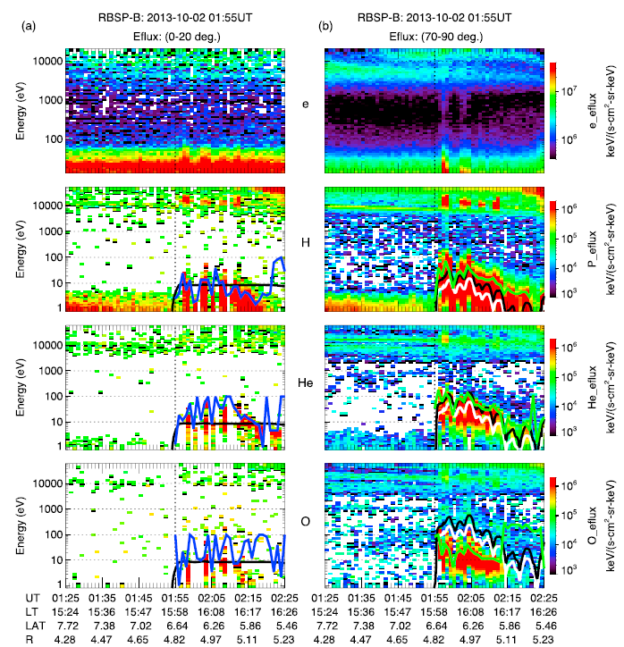
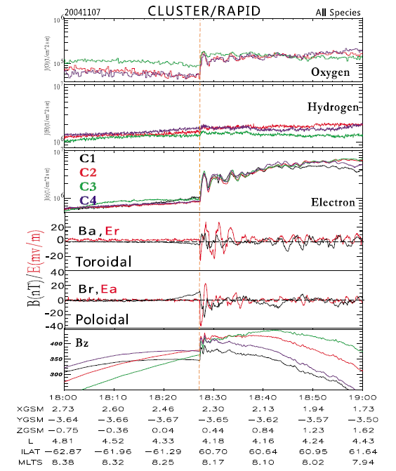
Background
Shock effects on the ion:
Field reconfiguration
ExB drift
Betatron acceleration
Radial transport
…
Wave-particle interaction
ULF wave
EMIC wave
...
[Yue et al., 2016]
[Zong et al., 2012]

Slide 3
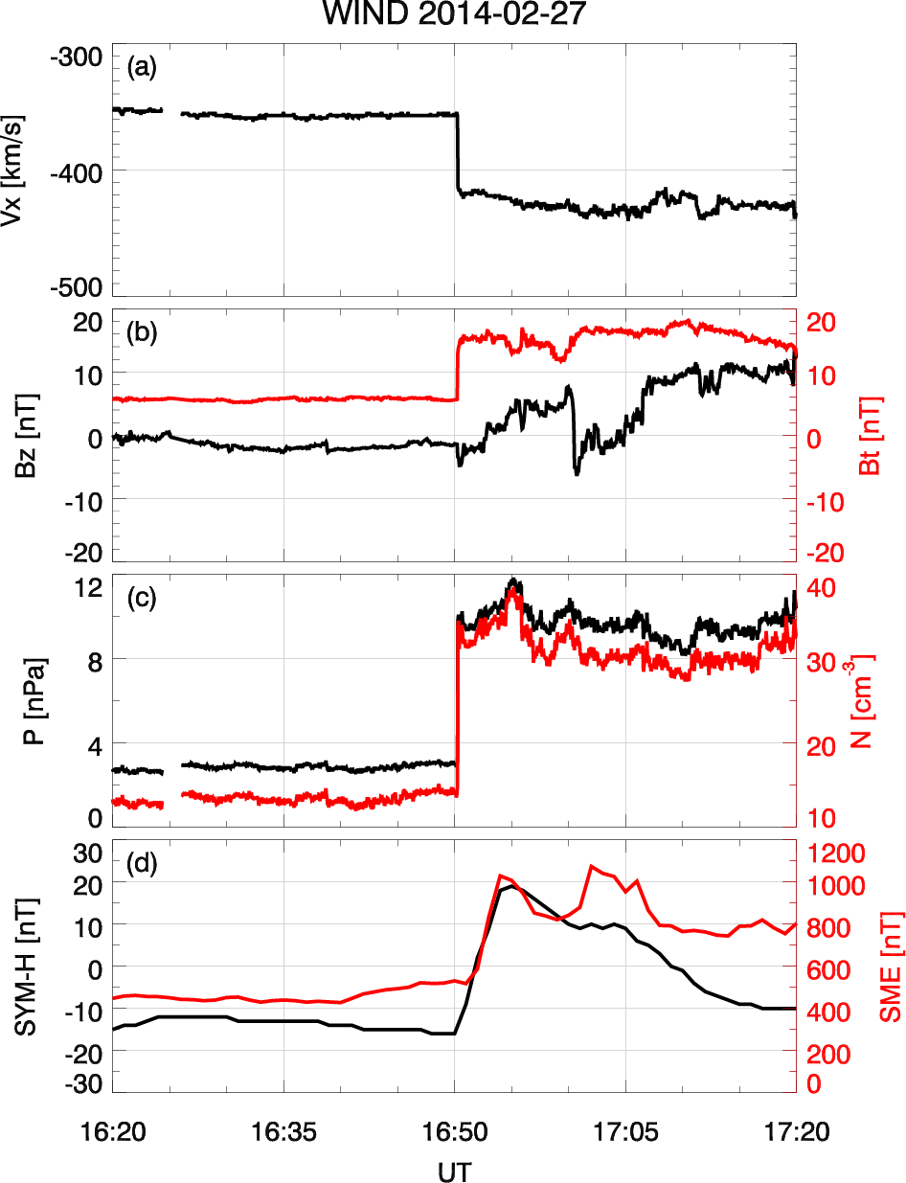
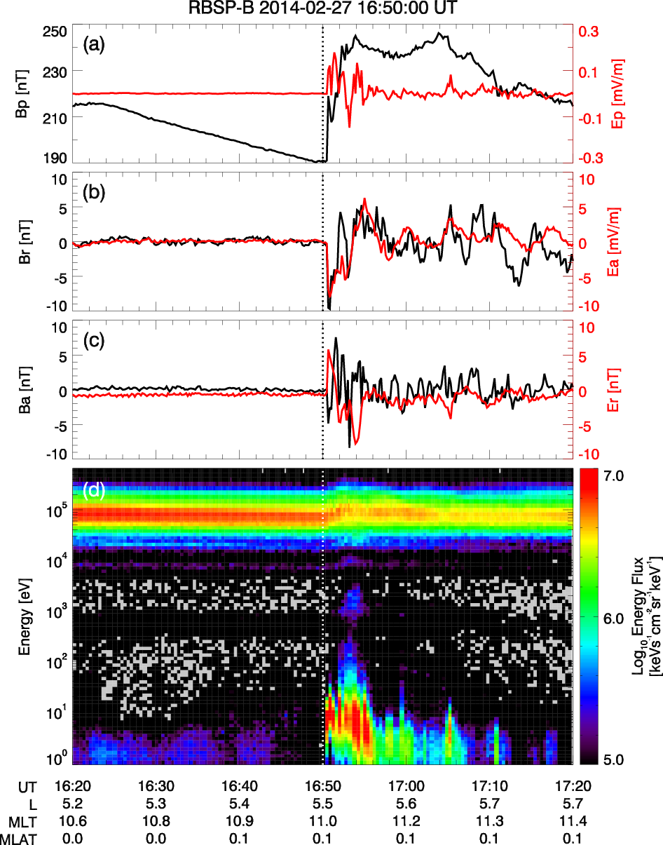
Overview
2014-02-27 16:50:00 UT
Significant enhancement of plasma density and dynamic pressure in the solar wind.
Field oscillations and proton variations in the equator at the noon sector of the magnetosphere.

Slide 4
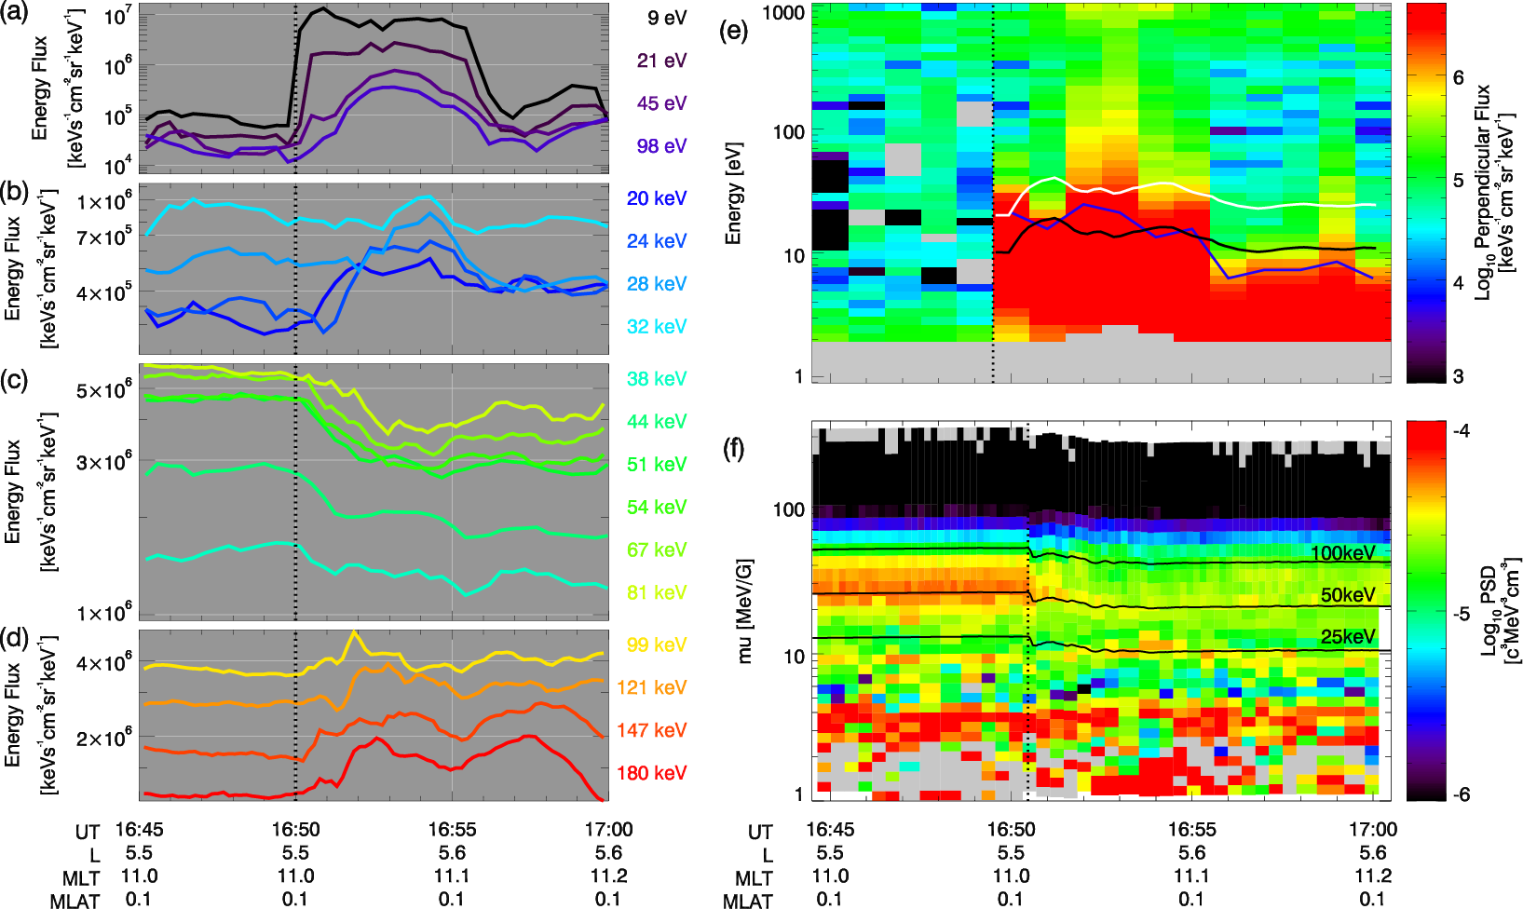

Proton Response
Low energy (<100 eV) protons were accelerated by ExB drift & betatron acceleration.
Stable PSDs for high and low $μ$: adiabatic variation of corresponding protons.

Slide 5
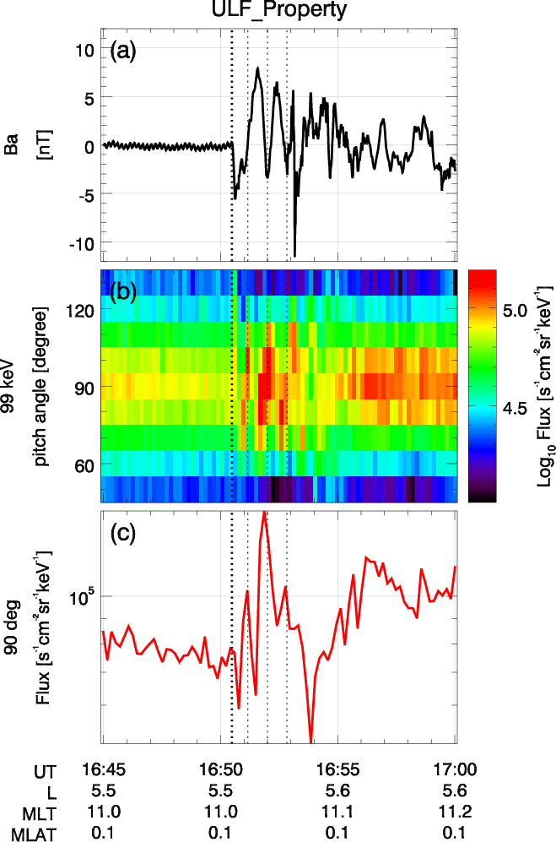
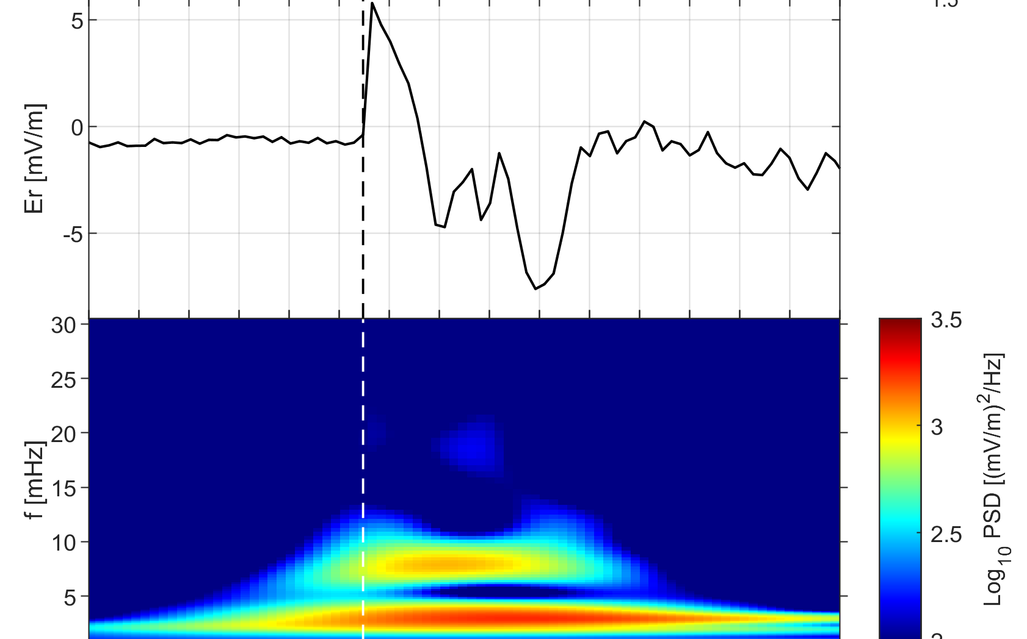
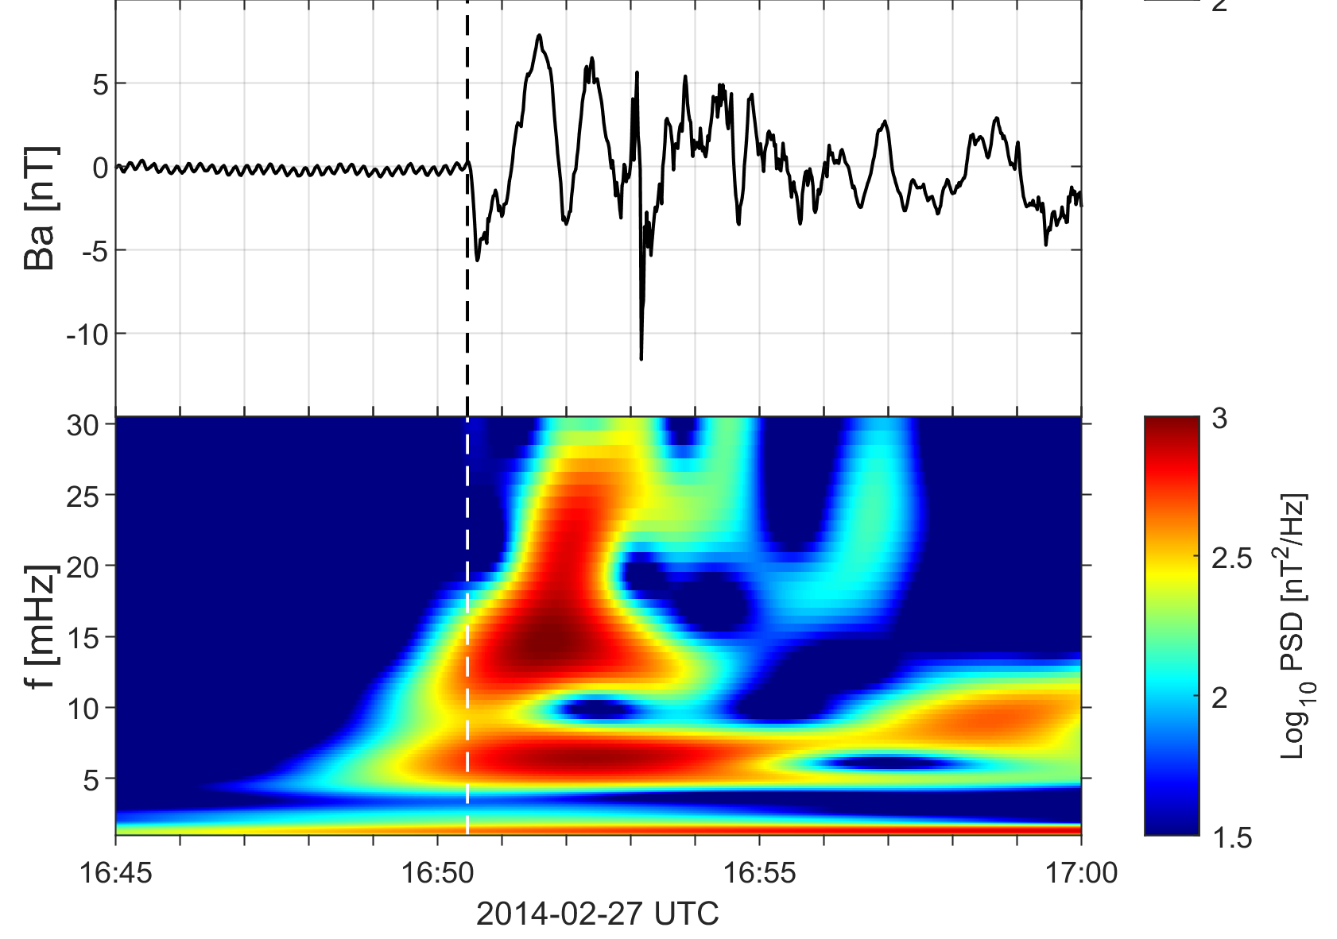
ULF Wave
Second-harmonic pc4 toroidal ULF wave
Diagonal stripes for protons in the equator. Why?

Slide 6
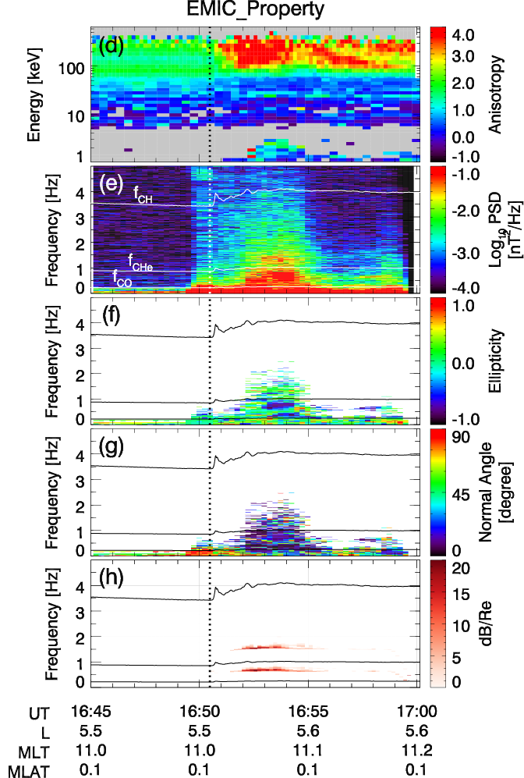
EMIC Wave
High anisotropy for >100keV protons
Negative ellipticity and parallel propagation.
Growth of hydrogen band and helium band EMIC wave was reproduced assuming background ion composition of H+: He+: O+ = 70%: 10%: 20%.

Slide 7
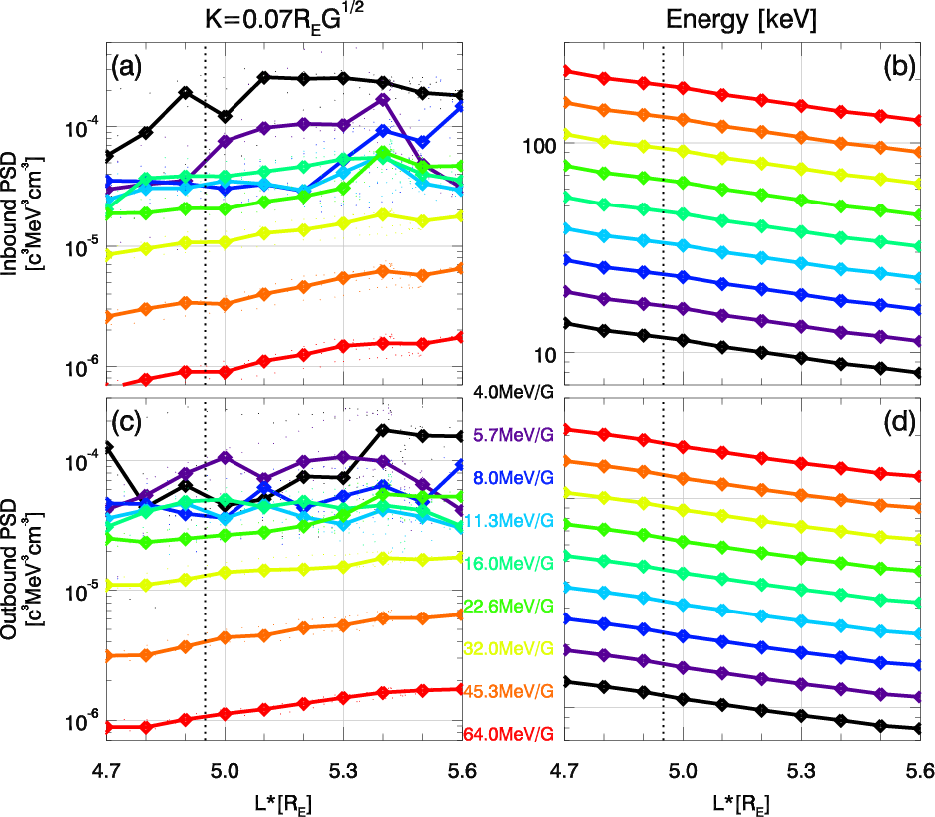
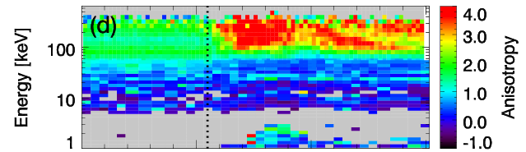
Radial Gradient Effect
Positive gradient for 16.0-64.0 MeV/G (50-200keV) protons
EMIC wave scattering was more critical for the decay of 50 -100 keV protons

Slide 8
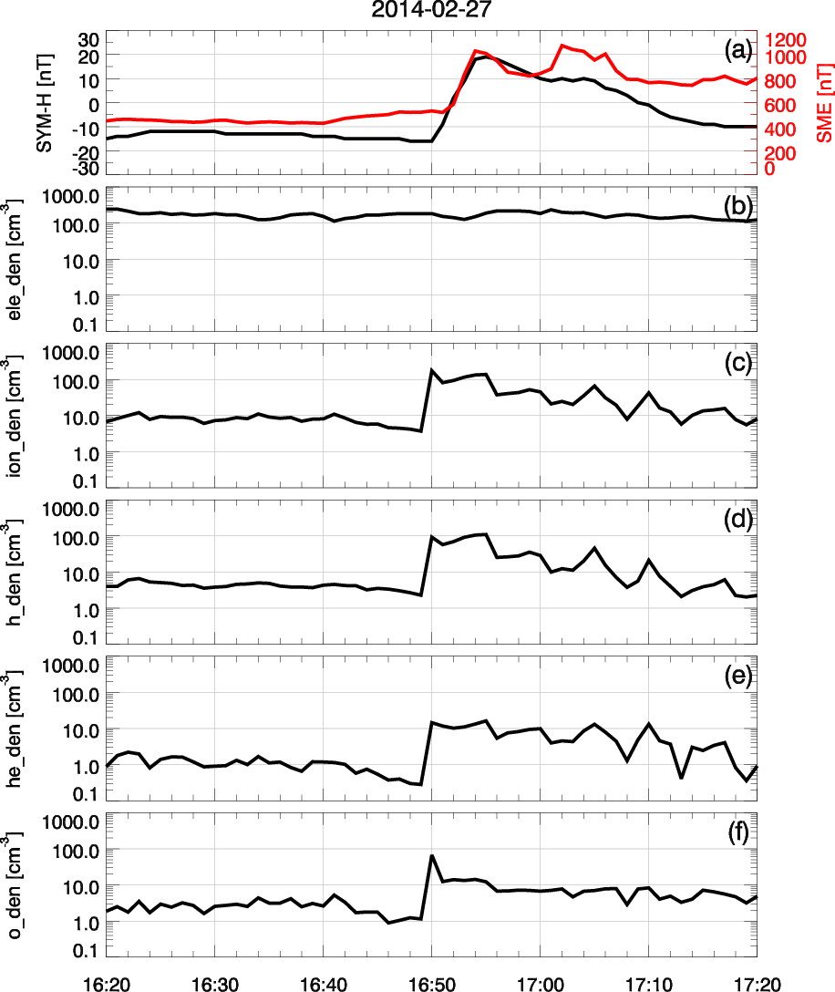
Ion density enhancement
N_{i} ~ N_{e} ~ 100 cm⁻³
Background “invisible” ions were detected and their characteristics can be determined.

Slide 9
Summary
The IP shock arrival could influence ions of multiple energies simultaneously through adiabatic and non-adiabatic processes.
Both cold protons and keV protons could experience ExB drift and betatron acceleration caused by the IP shock, while the observational characteristics are related to their initial PSD distributions.
IP shock may trigger ULF wave and EMIC wave simultaneously, modulating ~100keV proton fluxes and scattering ~50 keV protons, respectively.

