Slide 1


Unconventional Water Resources: A golden opportunity to mitigate the mismatch between water supply and water demand
Zahra Karimidastenaei
Abstract ID: EGU22-965ECS
DOI: https://doi.org/10.5194/egusphere-egu22-965
Co authors:
Tamara Avellán, Mojtaba Sadegh, Bjørn Kløve, and Ali Torabi Haghighi

Slide 2

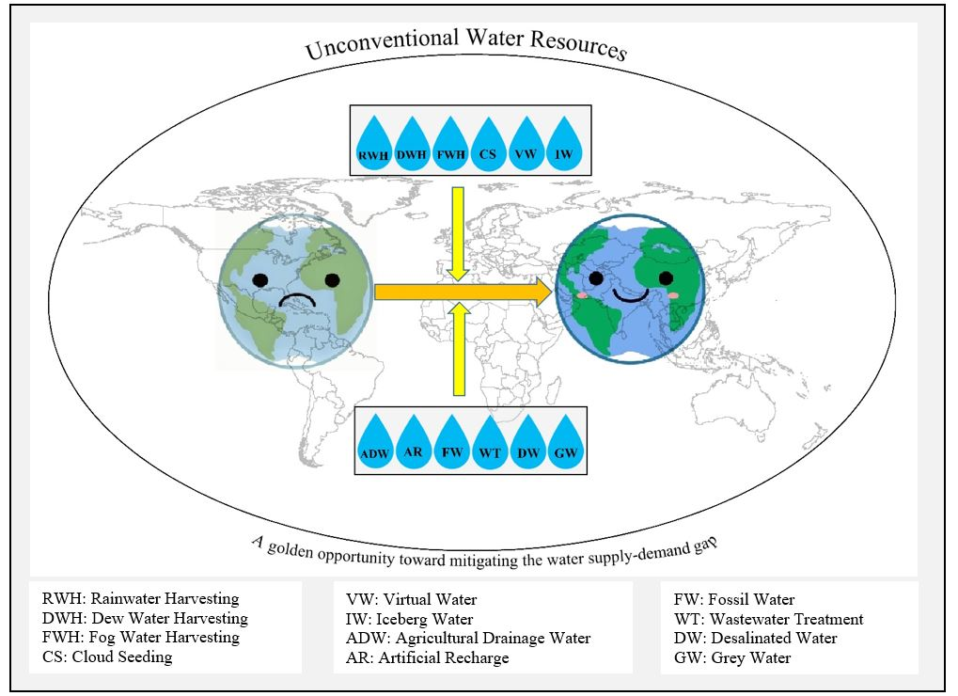
Introduction
Water scarcity
Unconventional Water Resources (UWRs) as an alternative water source

Slide 3
Objectives
Understand the importance of unconventional water resources in narrowing the water demand and supply gap in water-scarce areas.
Learn about different types of unconventional water resources and their potential uses under specific situations.
Develop an understanding of the relevance of certain unconventional water resources in their area/country.

Slide 4
The grouping of the UWRs
Atmospheric Unconventional Water (AUW) resources, including fog water, dew water, cloud seeded water, and rainwater.
Processed Unconventional Water (PUW) resources, including desalinated water, wastewater treated, greywater treated, and agricultural drainage water
Transferred Unconventional Water (TUW) resources, including iceberg towed water and virtual water.
Unconventional Ground Water (UGW) including artificial recharge and fossil water.

Slide 5
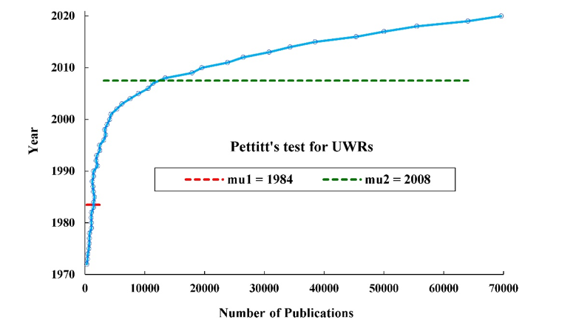
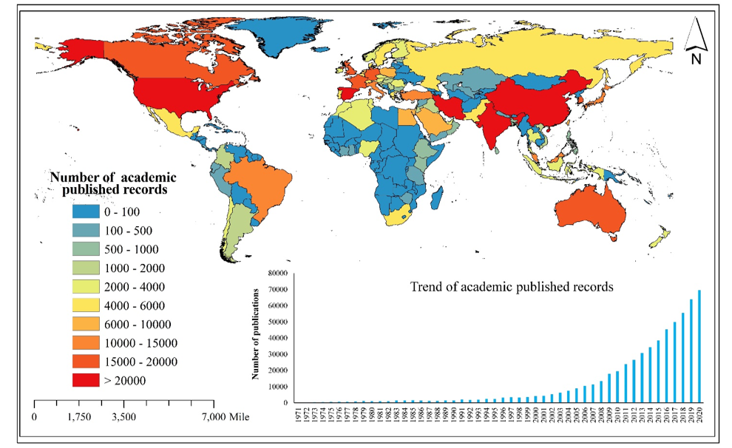
The global distribution of published academic records on UWRs and Pettit's test.

Slide 6
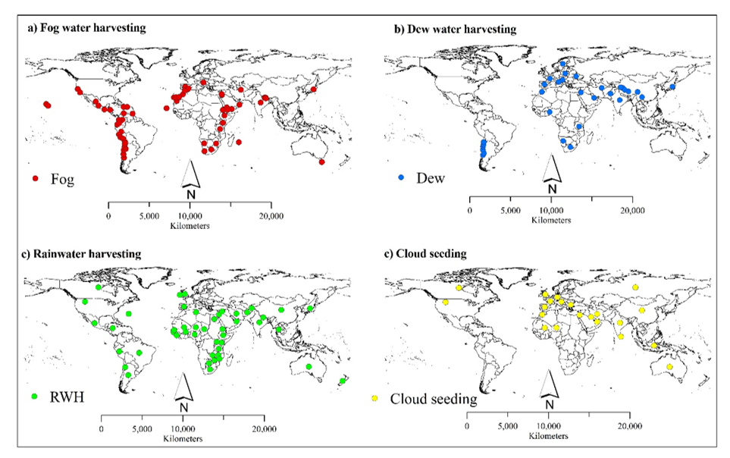
Maps with locations of UWRs utilizations

Slide 7
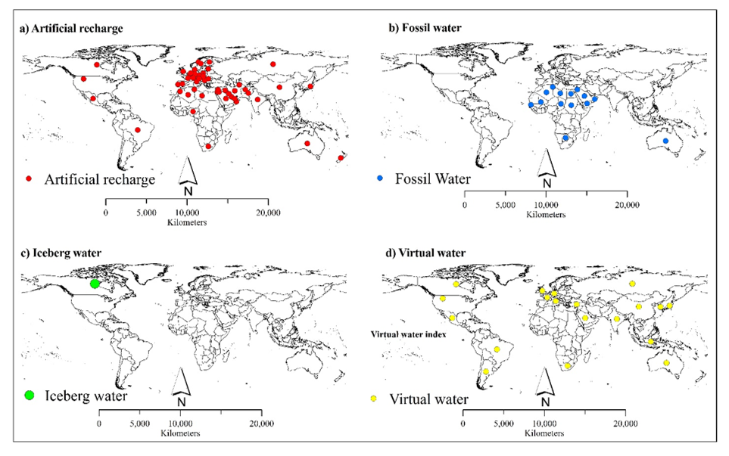
Maps with locations of UWRs utilizations

Slide 8
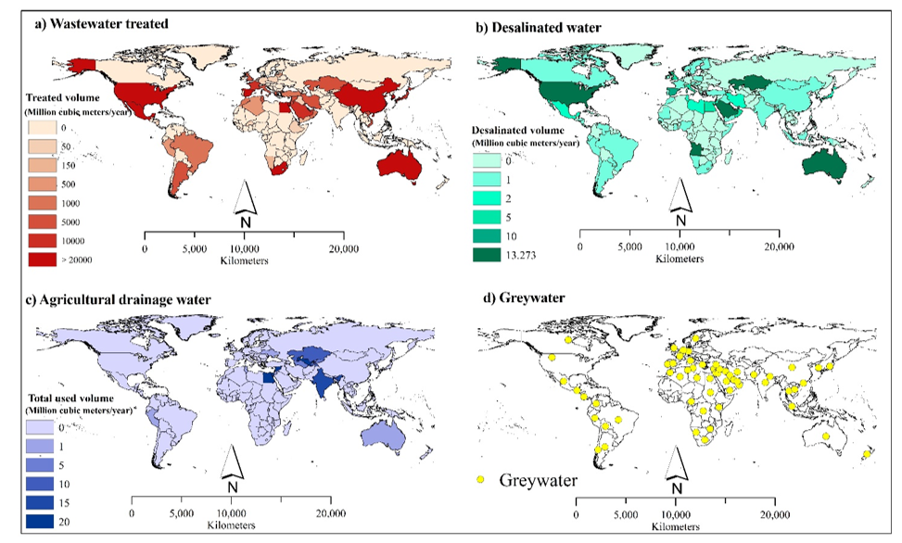
Maps with locations of UWRs utilizations
(a) some UWRs have clear geographic limitations
(b) some UWRs overlap in their geographic distribution
(c) some are practiced only in certain contexts
(d) some UWRs are negligible in their abundance/implementation

Slide 9

Cost/benefit analysis
It is difficult to compare the costs of UWRs utilizations globally, due to variations in the materials and labour costs, maintenance, additional resource costs, presence or absence of subsidies, and efficiency of UWRs systems in a given location.

Slide 10
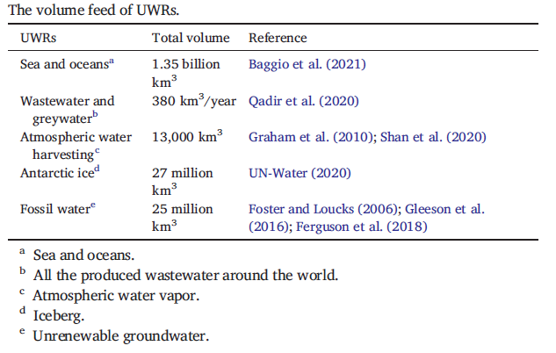
Closing the water supply-demand gap
Desalination
Wastewater treatment
Fog and dew water

Slide 11


Acknowledgment
This work was supported by the Maa- ja vesitekniikan tuki r.y. (MVTT) project number 42563, to which the authors would like to express their deep gratitude.

Slide 12

Thank you so much for your attention

