Slide 1
CH₄ emission preprocessing for high resolution modelling of concentrations with the ICON-ART model
Franziska Roth, Buhalqem Mamtimin, Anusha Sunkisala and Andrea Kaiser-Weiss
Notes:
Hello, I’m Franziska Roth from the German Weather Service. I present our CH4 emission preprocessing for high resolution modelling of concentrations with the ICON-ART model.

Slide 2
CH₄ emission preprocessing for high resolution modelling of concentrations with the ICON-ART model
Observation-based emission verification
Comparing modelled atmospheric concentrations to observed ones
Modelling with numerical weather prediction model ICON
Anthropogenic greenhouse gas emissions provided by Copernicus/TNO
Notes:
The overall goal is a future observation-based emission verification. For this, modelled atmospheric concentrations are compared to observed ones. We model our concentration fields with the numerical weather prediction model ICON.
For example, we use anthropogenic greenhouse gas emissions provided by Copernicus/TNO. As they are in a different grid, we have to pre-process these emissions for the purpose of including them into the ICON model.

Slide 3
CH₄ emission preprocessing for high resolution modelling of concentrations with the ICON-ART model
Common interpolation methods are not suitable
Cause errors
Smooth gradients
Not mass preserving
Each data point is split into synthetic high-resolution points
Original emissions are refined, before mapping to target grid
Method is referred here as “preprocessing emissions”
Notes:
Common interpolation methods are not suitable for our task. They cause errors, may smooth gradients or may not preserve mass.
An alternative is to split each data point into synthetic high-resolution points. They cover the area, the original data point is representing. That means, the original point emissions are refined, before they are mapped to the target grid. This method is referred here as “preprocessing emissions”.

Slide 4
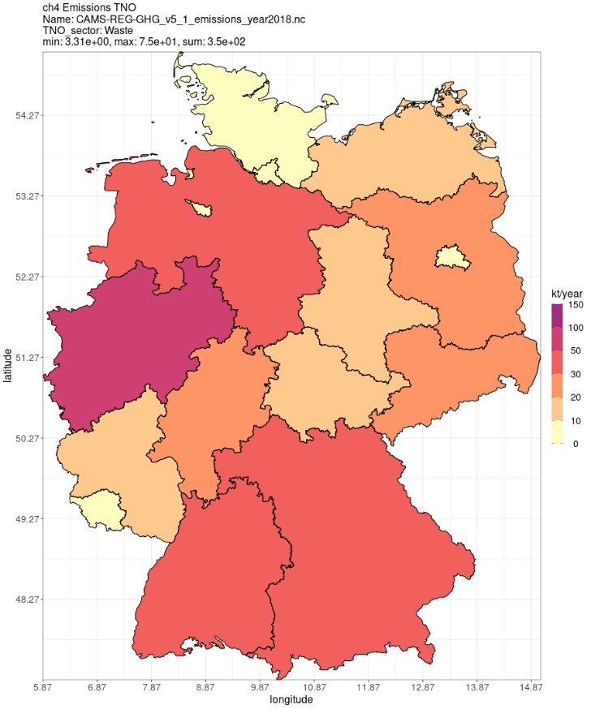
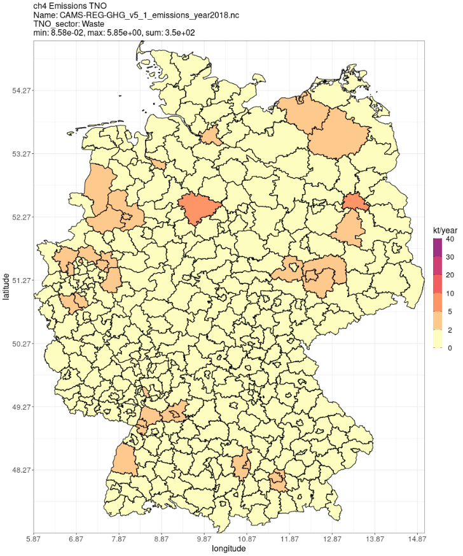
CH₄ emission preprocessing for high resolution modelling of concentrations with the ICON-ART model
Sector: Waste
Refined with 49 points
Effect could reach up to 100%
Our example: absolute deviation of 10%
Notes:
For example, here you see the Copernicus/TNO emissions mapped onto administrative units of Germany. In this example, you see the sector Waste.
We refined the Copernicus/TNO emissions with 49 points, because 49 square km is the original resolution of the data. Even for the large German federal states the “Bundesländer”, which span several hundreds of km, it makes a difference of several percent if we employ refinement with the pre-processor. The effect is larger for the smaller administrative units, the counties, in German called “Landkreise”, which may span only a few km.
Depending on chance, for emissions located at the county border, the effect could reach close to 100%. In our example, we find a mean absolute deviation of 10%.
The issue gets larger with higher resolution.

Slide 5
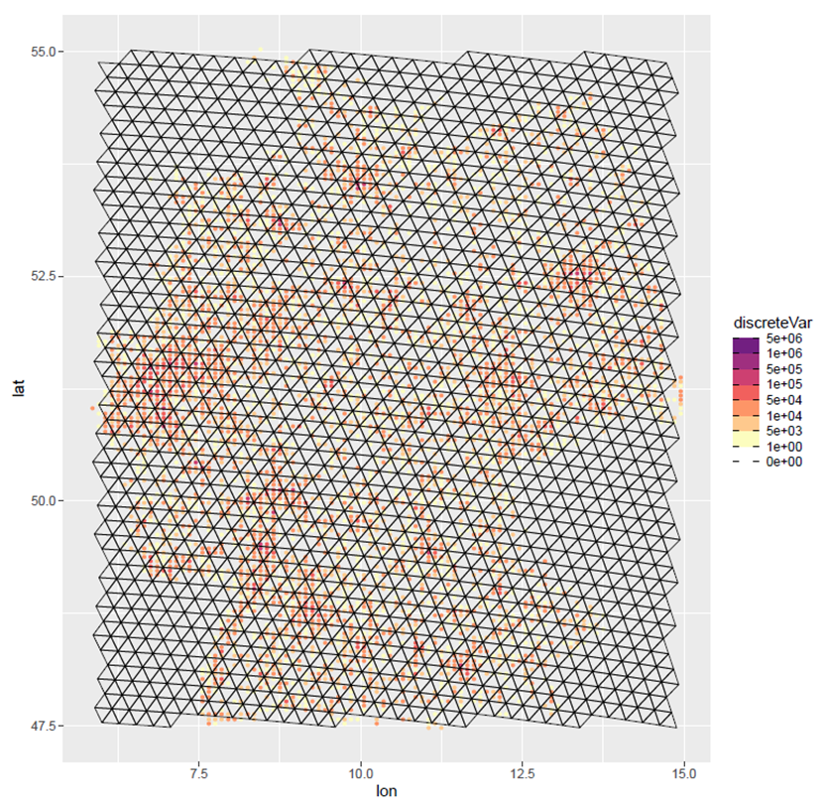
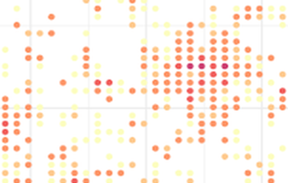
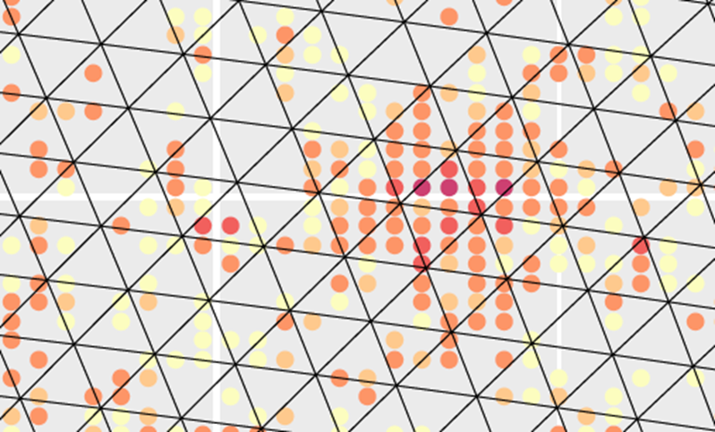
CH₄ emission preprocessing for high resolution modelling of concentrations with the ICON-ART model
Emission data can fall in one or more ICON triangular cells
Summing up in a single ICON cell is not precise
Notes:
If we want to include the emissions into our model, they need to be mapped onto the ICON triangular grid in a mass conserving manner.
Here you see triangular grid cells with an area of about 170 square km. Our input grid from Copernicus/TNO data has a resolution of 49 square km.
The original data point actually represents an area, which can fall in one or more ICON triangular cells. Without refining, summing up the emission points in a single ICON cell is not precise.

Slide 6
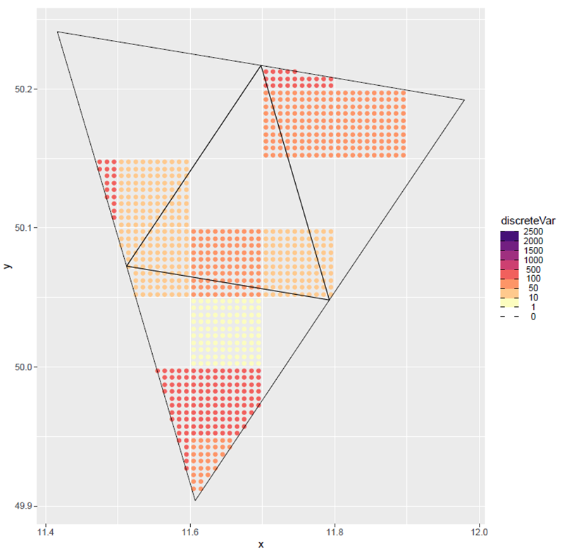
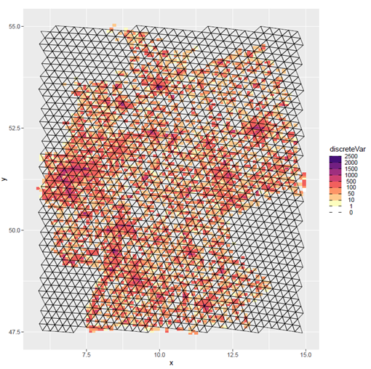
CH₄ emission preprocessing for high resolution modelling of concentrations with the ICON-ART model
Emission strength is split into 100 synthetic points
Mapping of the emissions into single ICON grid cells becomes much more accurate
Notes:
We spread the emission strength of the original data point over several synthetic points, covering the area representing the original data point. In this example, we choose a refinement of 10 multiplied by 10.
Therefore, the pre-processor allows much more accurate mapping to a single ICON cell.

Slide 7
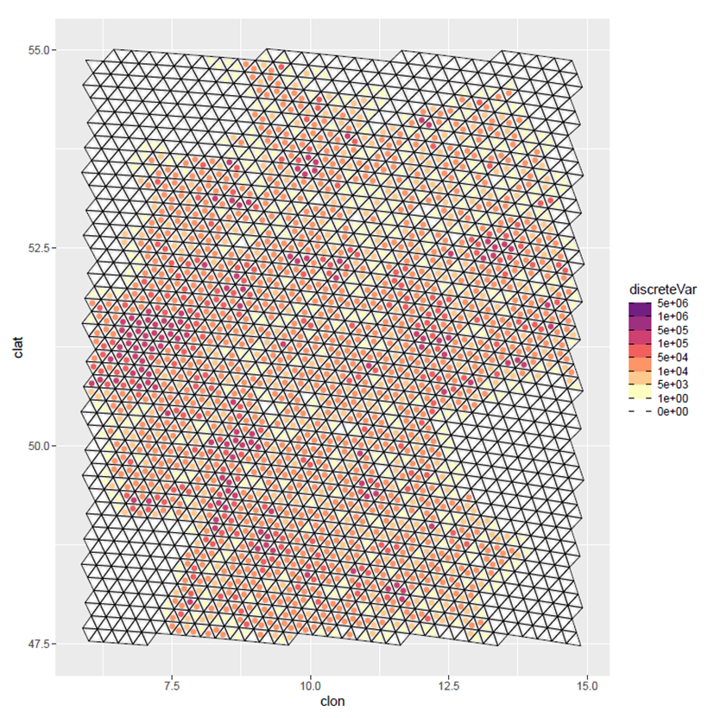
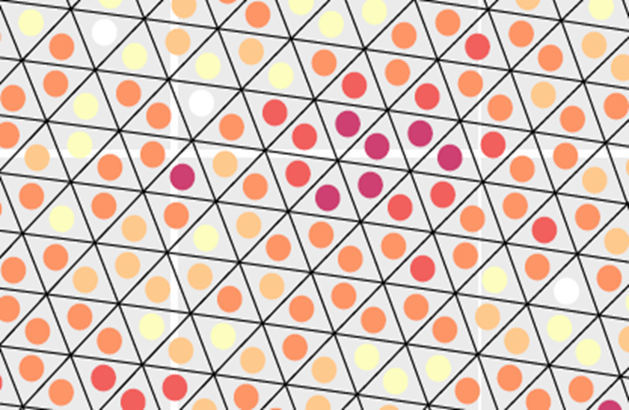
CH₄ emission preprocessing for high resolution modelling of concentrations with the ICON-ART model
ICON cell midpoint:
emission sum over each grid cell
Notes:
The preprocessed emission data has the latitude and longitude of the ICON cell midpoint assigned and the respective emission sum over each grid cell.

Slide 8
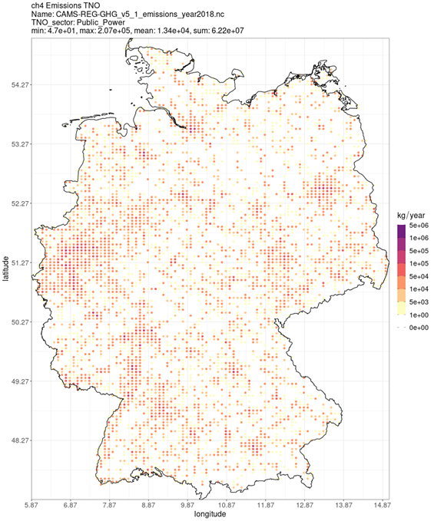
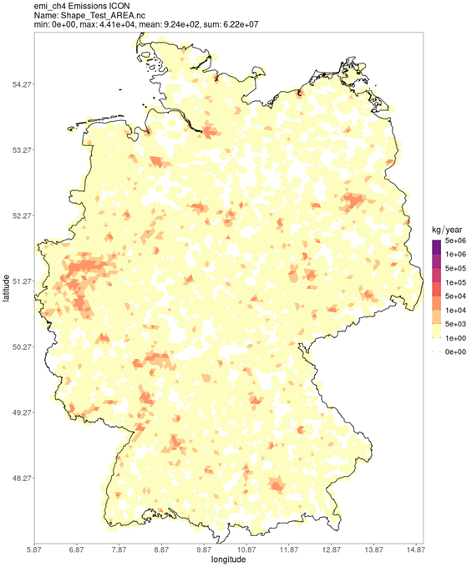



CH₄ emission preprocessing for high resolution modelling of concentrations with the ICON-ART model
Original point emissions over Germany
Preprocessed emissions over Germany
Result can be used as input for the ICON concentration modelling
Notes:
On the left-hand side are the original point emissions over Germany and on the right-hand side are the preprocessed ones. In the middle you can see a magnified cut-out over Germany. The preprocessed emissions can be used directly for concentration modelling in ICON.

Slide 9
CH₄ emission preprocessing for high resolution modelling of concentrations with the ICON-ART model
Summary
Geo-localization error without a pre-processor could be up to nearly 100%
Pre-processor refinement was chosen to get a geo-localization error below 2%
A mass-conserving pre-processor with appropriate resolution is important for greenhouse gas concentration modelling
We acknowledge discussions with Martijn Schaap (TNO/FUB) for the idea for our pre-processor. We also acknowledge the collaboration with Sabine Banzhaf (FUB) in the HoTC project, funded by the German Federal Ministry for Digital and Transport.
Notes:
We showed here that, in unfortunate circumstances, the geo-localization error without a pre-processor could be up to nearly 100%. We chose a pre-processor refinement to get a geo-localization error below 2%. In summary, it is important to choose a mass-conserving pre-processor with appropriate resolution for greenhouse gas concentration modelling.
We acknowledge discussions with Martijn Schaap (TNO/FUB) for the idea for our pre-processor. We also acknowledge the collaboration with Sabine Banzhaf (FUB) in the HoTC project, funded by the German Federal Ministry for Digital and Transport.
Thank you for your attention.

