Slide 1





Soil aggregation impacts bacterial community assembly and suppression of Ralstonia disease in tomato
EGU-9700
Menghui Dong
May, 2022
Ecology & Biodiversity Group, Institute of Environmental Biology, Utrecht University, Utrecht, The Netherlands
College of Resources and Environmental Sciences, Nanjing Agricultural University, Nanjing, China

Slide 2
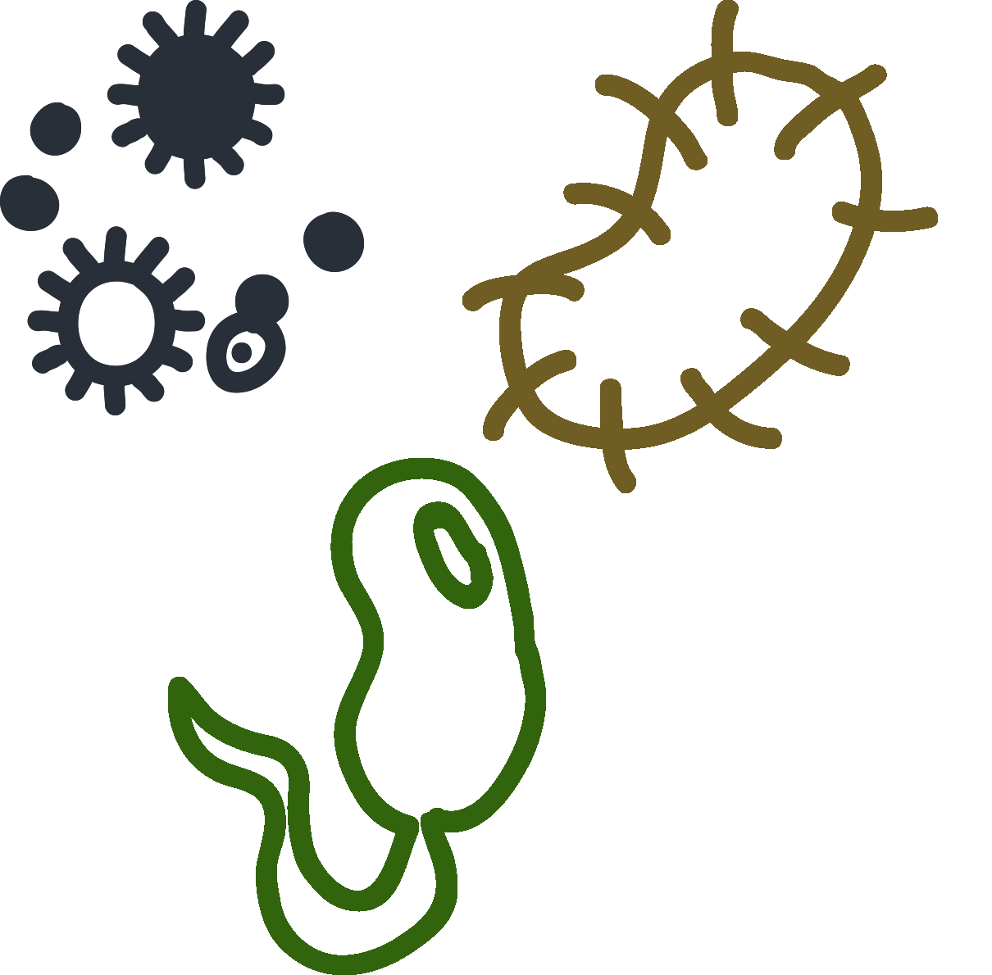
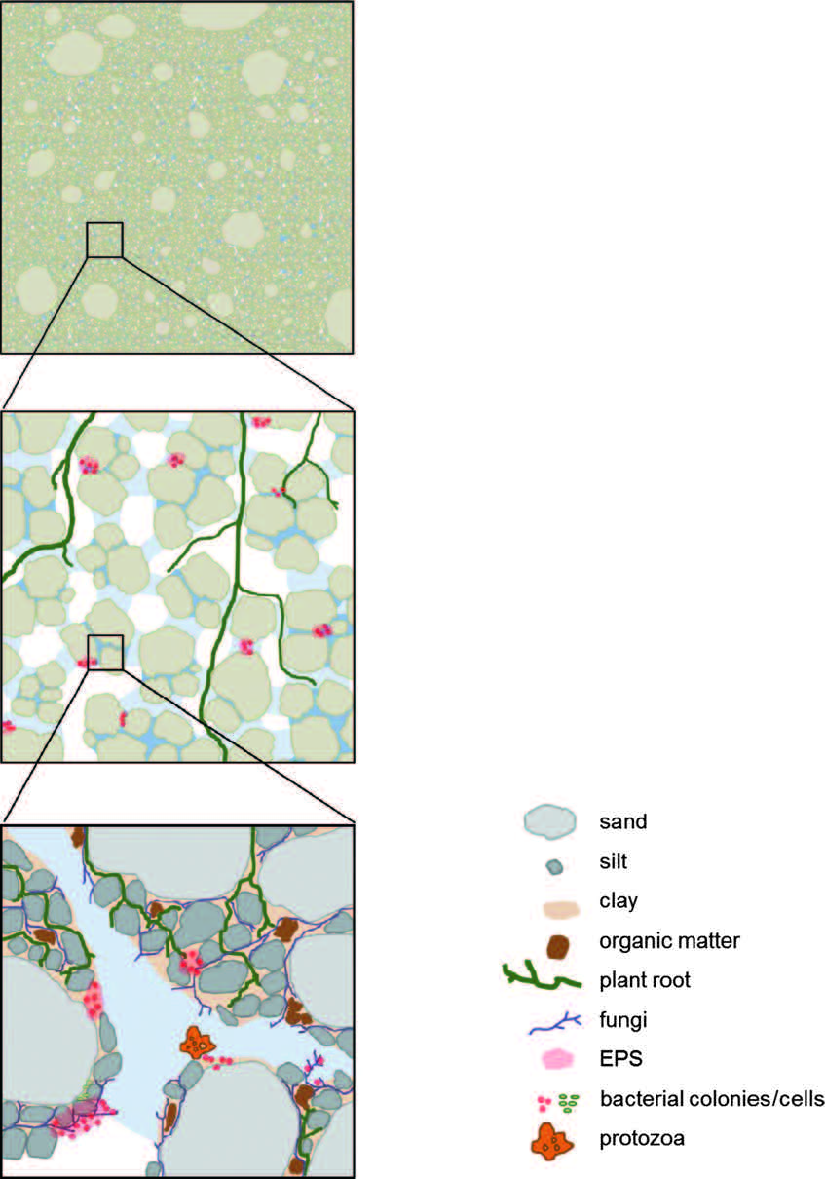
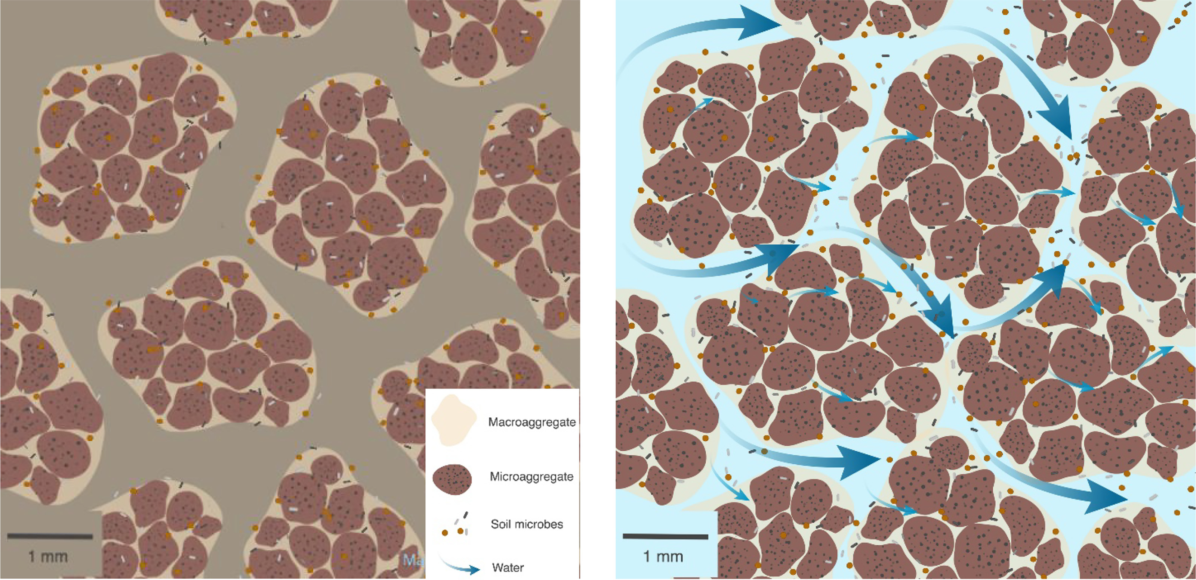
Background – Soil aggregates, micro-scale heterogeneous habitat for microbes
Soil aggregate – a key element of soil structure
Heterogeneous
micro-environments:
Pore size,
Gas,
Water,
Organic matter
……
Diverse habitats
Soil microorganisms
Self-contained “microbial villages”
Microbial ecology
and Evolution
Vos, et al., 2013
Wilpiszeski, et al., 2019
Notes:
Soil aggregation is a key element of soil structure. They have heterogeneous micro-environment including pore size, gas, water, organic matter, inorganic nutrients, and so on. So different sizes of soil aggregates could be diverse habitats to support different soil microorganisms.
Soil aggregates to microbes, are like self-contained “microbial villages”. Microbial communities within soil aggregates are relatively isolated from others, making difference in microbial ecology and evolution among different sizes.
But Relevance of these microbial difference in agriculture remains unclear.

Slide 3
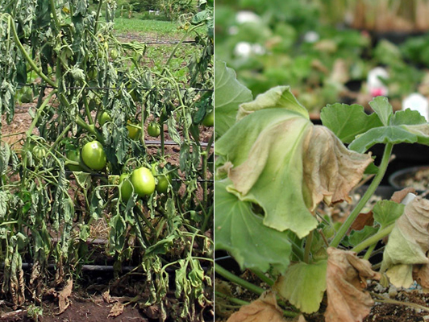
Background – Disease suppression
Plant disease causes ~20% losses in crop production every year
Bacterial wilt disease caused by Ralstonia solanacearum is a serious threat to more than 200 crops worldwide
Soil-borne
pathogen
Soil microbiome
？
Soil aggregates
Bio-organic fertilization can enhance the suppression via manipulation of microbiome
Typical soil samples
-whole soil core
Raaijmakers and Paulitz, 2009
a loss of virtual information on
microbial habitats and in-situ interaction
Vos, et al., 2013
Notes:
In agriculture, plant disease caused about 20% losses in crop production every year. Bacterial wilt disease caused by Ralstonia solanacearum is a serious threat to more than 200 crops worldwide Soil microbiome play an important role in the control of plant disease. Evidence has shown that bio-organic fertilizer can enhance the suppression via manipulation of microbiome. But normally we took the whole soil as one sample, which ignored the heterogeneity among soil aggregates and caused a loss of virtual information on microbial habitats and in-situ interaction.

Slide 4
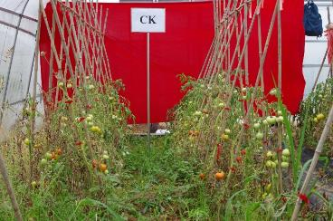
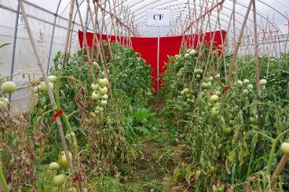
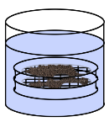
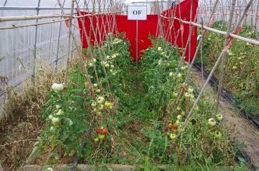
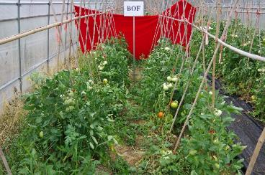

Design – Tomato monoculture field
Nanjing, China
CK: no fertilizer CF: chemical fertilizer
OF: organic fertilizer BF: bio-organic fertilizer
7th cropping cycle
sampled
after harvest
Wet sieving
Mi: <0.25mm
SMa: 0.25-1mm
MMa: 1-2 mm
LMa: >2 mm
ATCG
Sequencing
Notes:
To do so, we collect samples from tomato monoculture fields, which input with no fertilizer, chemical fertilizer, organic and bio-organic fertilizer. We separated them into different soil aggregates and did sequencing on them.

Slide 5
Soil aggregates distribution
CK: no fertilizer
CF: chemical fertilizer
OF: organic fertilizer
BF: bio-organic fertilizer
Total: whole soil
LMa: >2 mm
MMa: 1-2 mm
SMa: 0.25-1mm
Mi: <0.25mm
Organic amendments
Decrease the abundance of micro-aggregates
Increases the abundance of large macro-aggregates
Dong, et al., 2020. Biology and Fertility of Soils
Notes:
Firstly, in our fields, the organic amendments significantly impacted the soil structure. They decreased the abundance of micro-aggregates and increased the largest fraction.

Slide 6
Soil aggregates impact the composition of bacterial and fungal communities
CK: no fertilizer
CF: chemical fertilizer
OF: organic fertilizer
BF: bio-organic fertilizer
Total: whole soil
LMa: >2 mm
MMa: 1-2 mm
SMa: 0.25-1mm
Mi: <0.25mm
Larger impact on bacterial community
Dong, et al., 2020. Biology and Fertility of Soils
Notes:
As we expected, soil aggregates and fertilization exactly impact both the bacterial and fungal community composition.
But relatively, soil aggregate has a stronger impact on the bacterial community than fungal.

Slide 7
Fine-scale ecological processes: stochasticity vs determinism
Soil aggregation also impact the ecological processes
-mediate the balance between stochastic and deterministic process
LMa: >2 mm MMa: 1-2 mm SMa: 0.25-1mm Mi: <0.25mm
Dong, et al., 2020. Applied Soil Ecology
Notes:
Soil aggregation also impacts the ecological processes, we found that aggregate size significantly mediates the balance between stochastic and deterministic processes.
Homogeneous selection is dominant among all sizes of soil aggregates and has the highest proportion in medium macro-aggregates.
While dispersal limitation is also found among samples, which may be caused by the relative isolation of soil aggregates.

Slide 8
Fine-scale potential function: Ralstonia disease suppression
What does the different assemblages among soil aggregates cause? Relevance in agriculture?
Different Ralstonia disease incidences
Disease related
Bacterial OTUs
Totally different results will get if we look for beneficial bacteria via the whole soil sample or aggregate sample
Venn plot
Dong, et al., 2020. Biology and Fertility of Soils
Notes:
Different assemblies were found in different sizes of soil aggregates, but what do they cause? What’s their relevance in agriculture?
In my field, the serious threat also comes from Ralstonia disease, and we got different disease incidences among treatments.
If we want to find some beneficial bacteria inside, normally we do the correlation test, but totally different results will get if we look for beneficial bacteria via the whole soil sample or aggregate sample, most of correlated OTUs are unique to individual fractions.

Slide 9
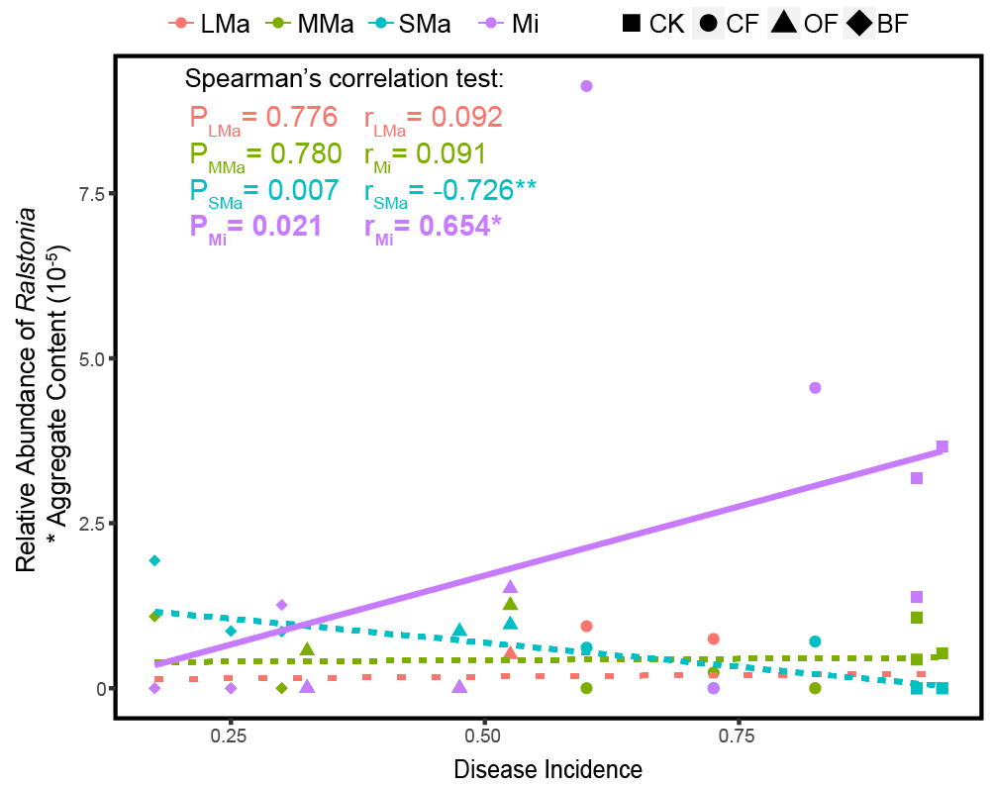


Fine-scale potential function: Ralstonia disease suppression
Which soil aggregate is the most important one?
CF soil
(in high incidence)
LMa: >2 mm
MMa: 1-2 mm
SMa: 0.25-1mm
Mi: <0.25mm
Micro-aggregates have higher density of pathogen
BF soil
(in low incidence)
Micro-aggregates show difference between two treatments
10^6 CFU/g Ralstonia solanacearum
1 week later
Real-time qPCR
Dong, et al., 2020. Biology and Fertility of Soils
Notes:
So which soil aggregate is the most important one in this case?
We detected the relative abundance of Ralsotnia genus among soil aggregates, and find that only in micro-aggregates, it showed significantly positive correlation with disease incidence.
So would the micro-aggregate be the most important one?
We furtherly verified it in lab. We collect the soil from chemical and bio-organic fertilization field, which have high and low incidence respectively. Then we invaded them with a lots of pathogen and inoculated them in lab. After one week, we collect the samples and detect the density of pathogen via qPCR.
Firstly, of course the density of pathogen in whole soil showed higher abundance in chemical fertilization soil than in bio-organic fertilization soil due to the different suppression of two soils. Then, in aggregates, micro-aggregates showed higher density of pathogen than other three fractions. Moreover, only in micro-aggregates, the pathogen density showed significant difference between fertilization treatments.
So, yes, in this case, the micro-aggregate maybe the important fraction to disease suppression.

Slide 10
Conclusion
Community composition
Soil aggregation significantly impacts
Ecological process of determinism and stochasticity
Function of disease suppression
Increase abundance of large macro-aggregates
-Which contains less pathogen
Bio-organic amendment enhance disease suppression via
Manipulate bacterial community in microaggregates
- Enhance its disease suppression
Thanks for your attention!
Acknowledgement Prof. Geroge A. Kowalchuk Utrecht University
Prof. Rong Li Nanjing Agricultural University
Prof. Qirong Shen Nanjing Agricultural University
Notes:
In summary, soil aggregation sig…..
Bio-or,,,,……

