Slide 1


PV and wind power simulation with ERA5 and ERA5-land – a multi-country analysis
Katharina Gruber
Luis Ramirez Camargo
Johannes Schmidt
Institute for Sustainable Economic Development – INWE
Department for Economics and Social Sciences – WiSo
University of Natural Resources and Life Sciences, Vienna

Slide 2
Research aim
How well are ERA5 data suited for simulation of wind power generation and how do they compare to MERRA-2?
How well are ERA5-land data suited for simulation of PV power generation and how do they compare to MERRA-2?
What is the impact of spatial and temporal aggregation?
Can the Global Wind Atlas reduce the error in wind power simulation?
Notes:
Focus on regions outside of europe

Slide 3
Climate data
 | Reanalysis | Availability | Resolution | Simulated country
Wind power simulation | ERA5 GWA | Global, since 1950 Global | Hourly, 0.25° x 0.25° 250m x 250m | Brazil, New Zealand
PV simulation | ERA5-land | Global, since 1950 | Hourly, 0.1° x 0.1° | Chile
Both | MERRA-2 | Global, since 1980 | Hourly, 0.5° x 0.625° | Brazil & New Zealand / Chile
Notes:
Resolution, model
Countries!

Slide 4
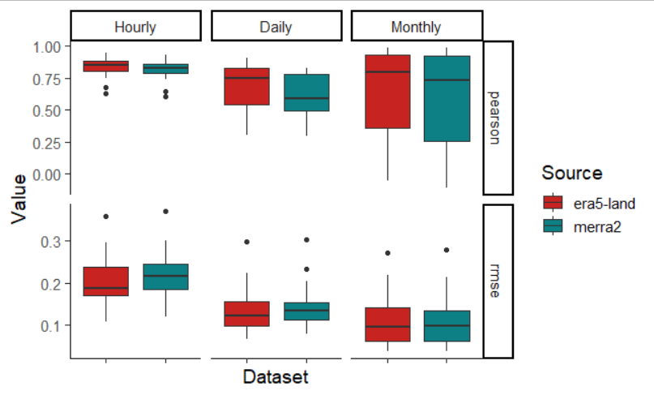
Results: Chile PV ERA5-land vs. MERRA-2 & temporal aggregation
correlation
Dataset
ERA5-land
MERRA-2
RMSE
Notes:
ERA5 vs. MERRA-2: era5 slightly better, but small difference
RMSE decreases from hourly to monthly,
Daily correlations worse because diurnal pattern well represented, but not variations between days, short timeseries
Spatial aggregation: correlations increased, RMSE reduced

Slide 5
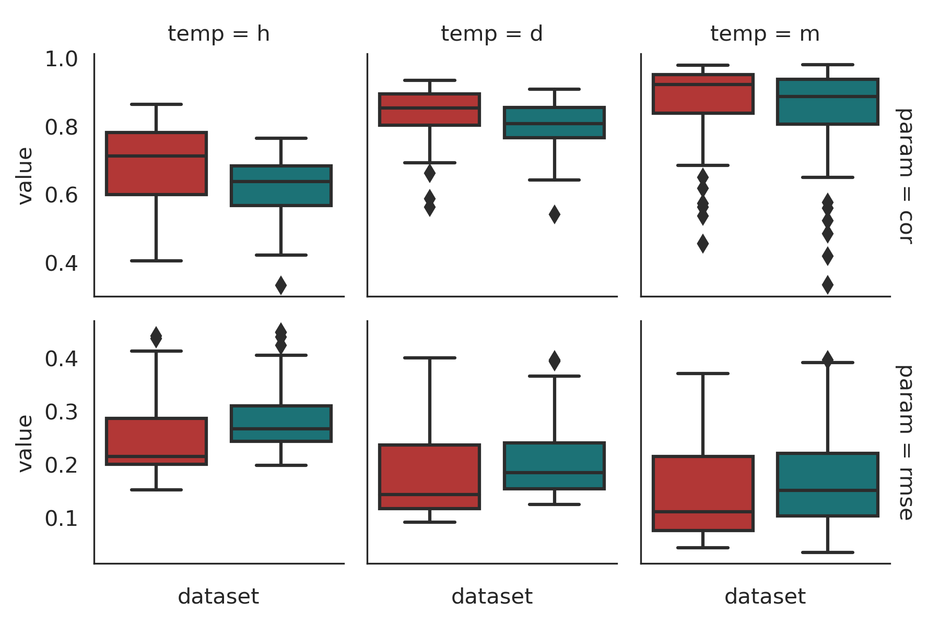
Results: Brazil wind power ERA5 vs. MERRA-2 & temporal aggregation
Hourly
Daily
Monthly
correlation
Dataset
ERA5
MERRA-2
RMSE
Notes:
ERA5 vs. MERRA2: era5 better hourly and daily, monthly no large difference
Corr. Increases, RMSE decreases from hourly to monthly
Spatial aggregation: non significant tendency of increased correlations and reduced RMSEs

Slide 6
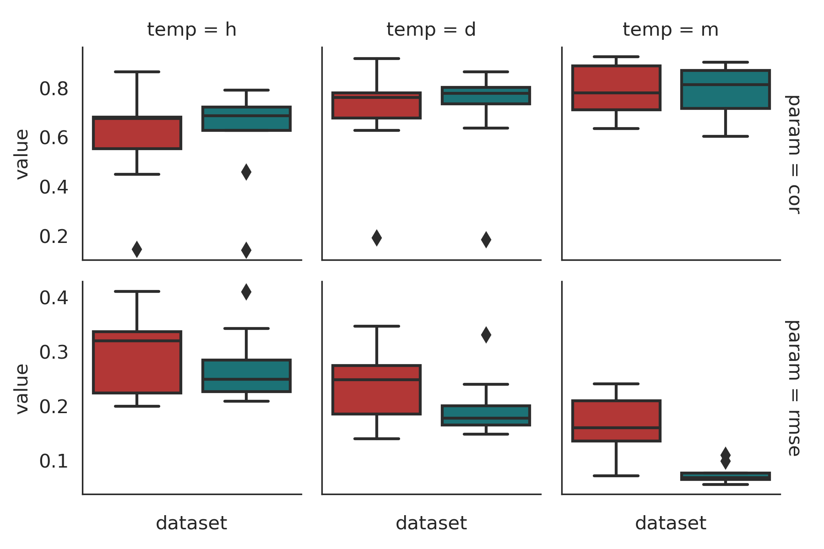
Results: New Zealand wind power ERA5 vs. MERRA-2 & temporal aggregation
Hourly
Daily
Monthly
correlation
Dataset
ERA5
MERRA-2
RMSE
Notes:
Tendency of higher correlations and lower RMSEs with MERRA-2 than with ERA5, but correlations on similar level
Correlation increases, RMSE decreases from hourly to monthly
Spatial correlation: no clear tendency

Slide 7
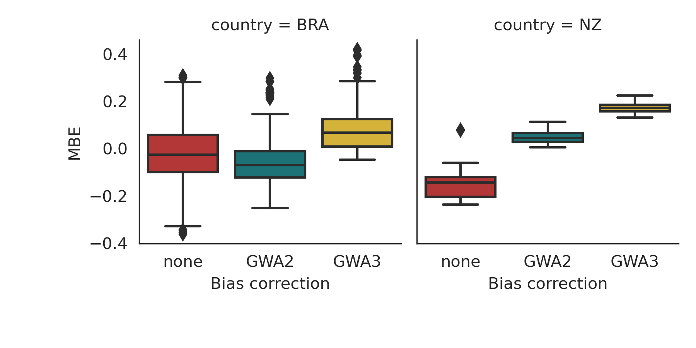
Results: Bias correction with GWA
Brazil
New Zealand

Slide 8
Conclusion
ERA5 and ERA5-land deliver satisfactory wind power and PV simulation results and usually outperform MERRA-2
Spatial and temporal aggregation have unclear impacts
GWA3 can be used for bias correction
Results are different in three countries
ERA5/ERA5-land vs. MERRA-2
Aggregation
Effect of GWA
→ Further research in other case study areas needed

Slide 9
References
Ramirez Camargo et al (2020): Simulation of multi-annual time series of solar photovoltaic power: Is the ERA5-land reanalysis the next big step? DOI: 10.1016/j.seta.2020.100829
Gruber et al (2022): Towards global validation of wind power simulations: A multi-country assessment of wind power simulation from MERRA-2 and ERA-5 reanalyses bias-corrected with the Global Wind Atlas, DOI: 10.1016/j.energy.2021.121520

Slide 10

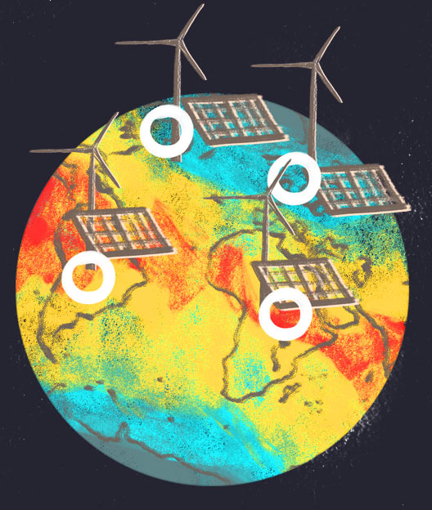

Thank you!
Katharina Gruber
katharina.gruber@boku.ac.at
https://refuel.world/
We gratefully acknowledge support from the European Research Council – “reFUEL” ERC-2017-STG 758149

Slide 11
Method
Nearest Neighbour
Usage
Interpolation climate variables
PV
wind power
Mean approximation
GWA bias correction
both
Log wind profile¹
Extrapolation to height
Power law
Ryberg power curve model⁴
PV_LIB^{2,3}
PV/wind power simulation
Data cleaning
Validation
¹ 25m/s roughness length (scattered obstacles)
² Ryberg et al. (2019): The future of European onshore wind energy potential: Detailed distribution and simulation of advanced turbine designs
DOI: 10.1016/j.energy.2019.06.052
³ fixed/tracking determined by clustering; panel: Silevo_Triex_U300_Black, inverter: ABB__MICRO_0_3_I_OUTD_US_240_240V
⁴ Holmgren et al. (2018): pvlib python: a python package for modeling solar energy systems DOI: 10.21105/joss.00884
Notes:
Data cleaning PV:
- Over 70h below 50% average annual and below 70% average monthly
Visual inspection
Of 57 stations 23 remained after data cleaning
Classification:
9 fixed
14 tracking

Slide 12
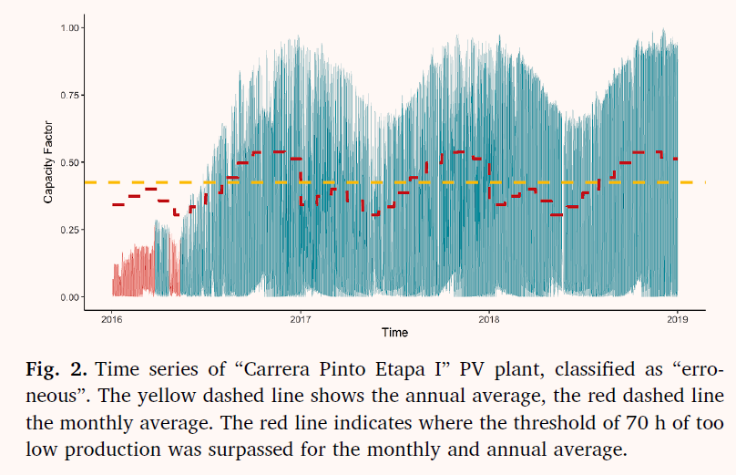
Erroneous time series PV

Slide 13
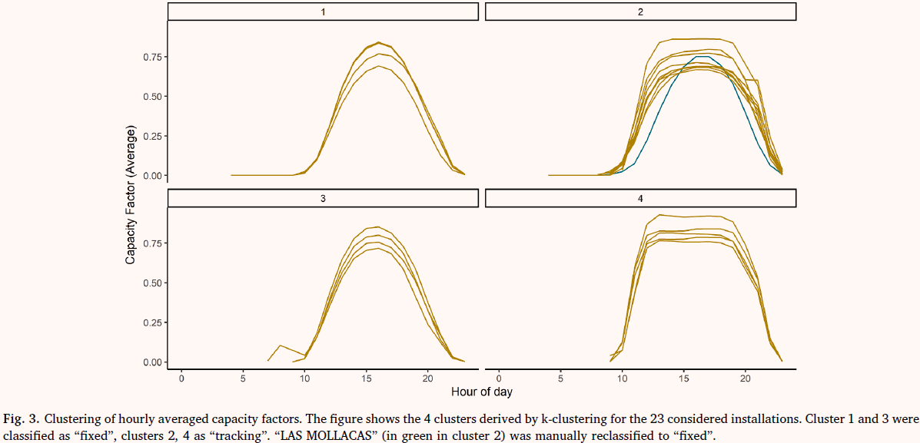
Clustering PV profiles

Slide 14
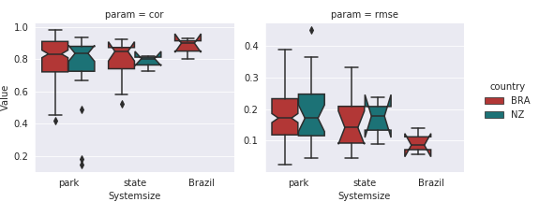
Results: Spatial aggregation wind powe
correlation
RMSE
1.0
0.8
0.6
0.4
0.2
0.4
0.3
0.2
0.1
country
Value
Brazil
New Zealand
park state Brazil
Systemsize
park state Brazil
Systemsize
park state Brazil
Systemsize

