Slide 1










European Geosciences Union
General Assembly 2022
Vienna , 27 May 2022
Using disdrometers data to evaluate GPM-DPR products over Italy
Elisa Adirosi¹, Federico Porcù², Mario Montopoli¹, Luca Baldini¹, Alessandro Bracci^{1,2}, Vincenzo Capozzi³, Clizia Annella³, Giorgio Budillon³, Edoardo Bucchignani⁴, Alessandra Lucia Zollo⁴, Orietta Cazzuli⁵, Giulio Camisani⁵, Renzo Bechini⁶, Roberto Cremonini⁶, Andrea Antonini⁷, Alberto Ortolani^{7,8}, Samantha Melani^{7,8}
¹ National Research Council of Italy, Institute of Atmospheric Sciences and Climate (CNR-ISAC), Rome, Italy
² Department of Physics and Astronomy “Augusto Righi”, University of Bologna, Bologna, Italy
³ Department of Science and Technology, University of Naples “Parthenope”, Naples, Italy
⁴ Meteorology Lab, Centro Italiano Ricerche Aerospaziali (CIRA), Capua, Italy
⁵ Regional Agency for the Protection of the Environment of Lombardia (ARPA Lombardia), Milano, Italy
⁶ Regional Agency for the Protection of the Environment of Piemonte (Arpa Piemonte), Torino, Italy
⁷ Laboratory of Environmental Monitoring and Modelling for the sustainable development (LaMMA), Sesto Fiorentino (Florence), Italy
⁸ National Research Council of Italy, Institute for the Bioeconomy (CNR-IBE), Sesto Fiorentino (Florence), Italy
Notes:
1
1

Slide 2
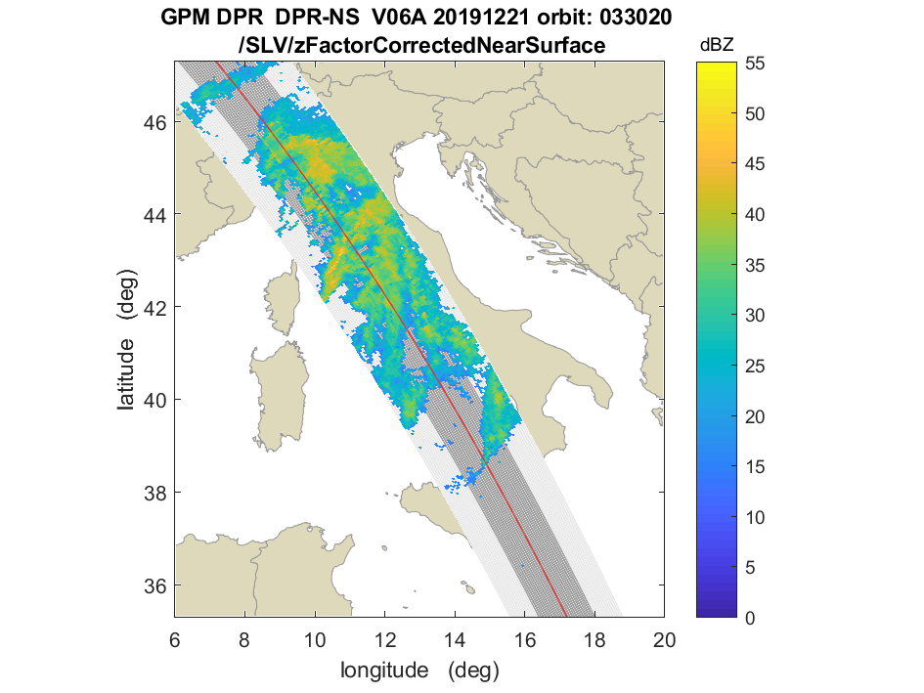
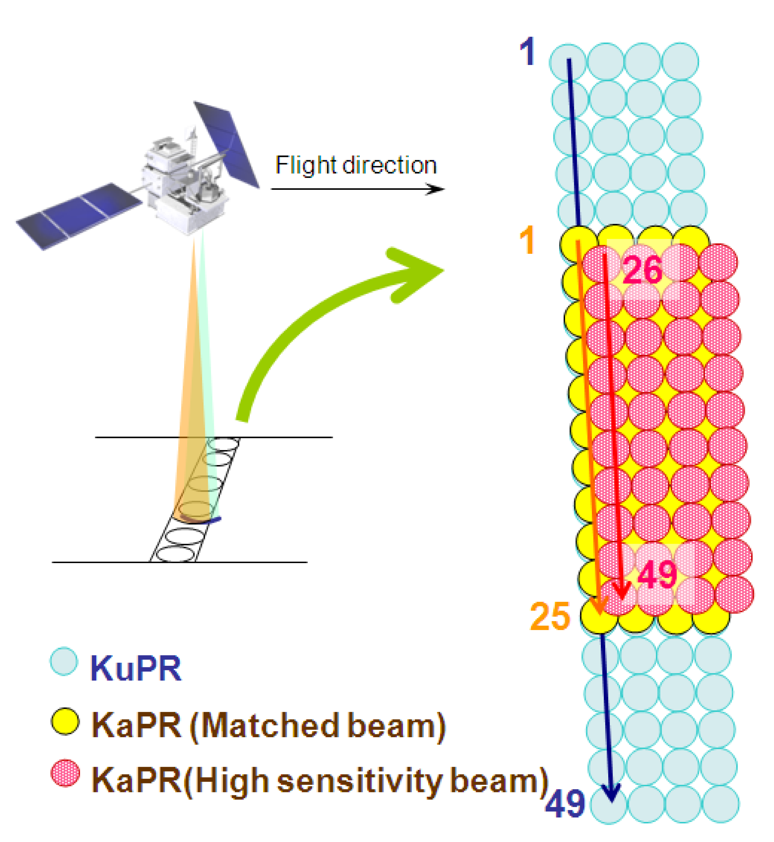
GPM (Global Precipitation Measurement) precipitation products
Dual-Frequency Precipitation Radar (DPR):13.6 GHz and 35.5 GHz.
Footprint of 5 km and swath of 245 km (for Ku band) and 125 km (for Ka band).
Scan modes: Normal Scan (NS), Matched Scan (MS), High Sensitivity (HS)
Example of Z from GPM DPR on 21 December 2019
GPM DPR Products: precipitation Level 2 (L2) products (version 6A), in particular the dual-frequency products 2ADPR-NS, 2ADPR-MS and 2ADPR-HS, and the single frequency products 2AKa-MS, 2AKa-HS and 2AKu-NS.
Variables: precipRateNearSurface (R), zFactorCorrectedNearSurface (Z), paramDSD (N_{w} e D_{m}). All the variables have been obtained at the first available (i.e. clutter free) bin near the ground that in our analysis range between 0.60 km and 1.48 km.
From ”GPM/DPR Level-2 Algorithm Theoretical Basis Document”

Slide 3

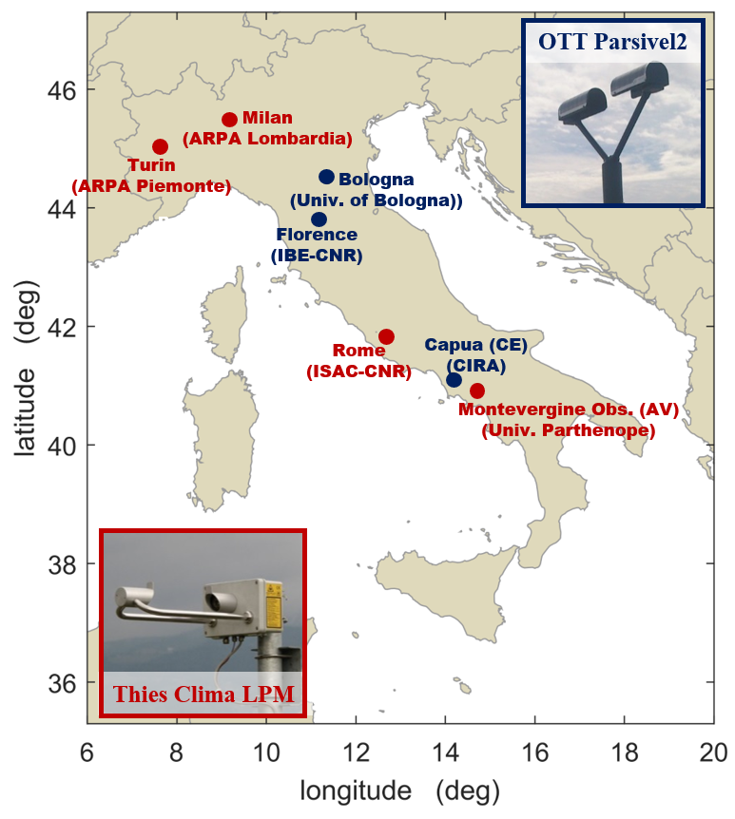
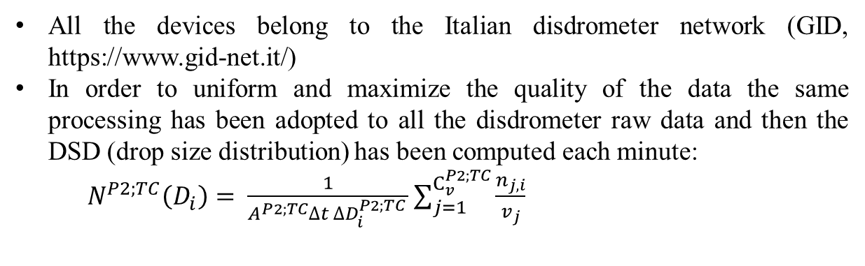
Ground based devices: disdrometers
All the devices belong to the Italian disdrometer network (GID, https://www.gid-net.it/)
In order to uniform and maximize the quality of the data the same processing has been adopted to all the disdrometer raw data and then the DSD (drop size distribution) has been computed each minute:
$N^{P2;TC}\left(D_{i}\right)= \frac{1}{A^{P2;TC}∆t ∆D_{i}^{P2;TC} }\sum_{j=1}^{C_{v}^{P2;TC}}{\frac{n_{j,i}}{v_{j}}}$
R, Z_{ka}, Z_{ku}, D_{mas}, N_{w}
Only for two sites the disdrometer measurements are available form 2014 (i.e. launch of the GPM core satellite)
In total more that 580.000 1-minute sample are available form ground based devices.
2D scatterplot of disdrometer based R vs D_{m}. Black and red lines represent the relations adopted by GPM algorithms for DSD parameter estimation.

Slide 4
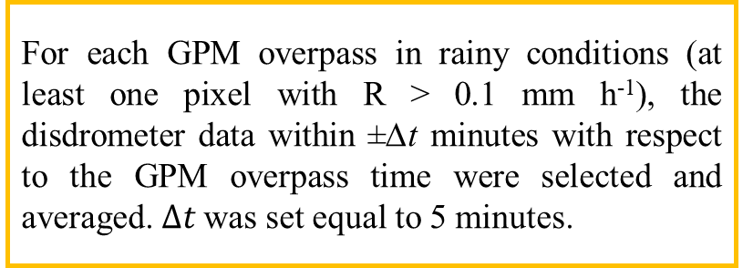
GPM and disdrometer comparison strategies
Selection of the GPM pixels
Point
Mean
- Selection of the 5 × 5 km² DPR pixel at ground that contains
the location of the disdrometer.
- The disdrometer measurement is taken as representative of the areal estimate.
- DPR pixels whose centers are within 5 km from the disdrometers are averaged.
- The possible mismatch between DPR pixel aloft and disdrometer at ground due to advection is limited.
- Among the DPR pixels in a 3 × 3 box around the disdrometer, the one whose reflectivity value is closest to that estimated by the disdrometer is selected.
- This should provide the best match.
Optimal
Selection of the matched minutes
GPM Product | # minutes (Point) | # minutes (mean) | # minutes (optimal)
DPR NS | 54 | 61 | 68
DPR MS | 29 | 31 | 36
DPR HS | 11 | 17 | 19
Ka HS | 11 | 17 | 20
Ka MS | 22 | 28 | 33
Ku NS | 53 | 61 | 68
Disdrometer data
For each GPM overpass in rainy conditions (at least one pixel with R > 0.1 mm h⁻¹), the disdrometer data within ±∆t minutes with respect to the GPM overpass time were selected and averaged.$∆t$ was set equal to 5 minutes.

Slide 5
Results (1/2)
Scatterplot of R, Z_{ka}, Z_{ku}, D_{mas} e N_{w} obtained from disdrometer data (x-axis) and from GPM products as reported in the legend (y-axis).
R
Considering all the DPR products and all the comparison modes, NMAE ranges between 30.3% and 63.4%
The maximum rainy intensity is 10 mm h⁻¹
Z
Ku-band shows an higher dispersion of the data with respect to Ka-band.
The bias values are small for both the frequencies.
For the optimal comparison mode NMAE values are less than 10%.
D_{mas}
NMAE values are less than 29% although the correlation coefficients are low.
GPM algorithms overestimate small D_{mas} and underestimate D_{mas} >1.5 mm.
N_{w}
The agreement in terms of 10log₁₀N_{w} is not good. Similar results have been shown in the literature.

Slide 6
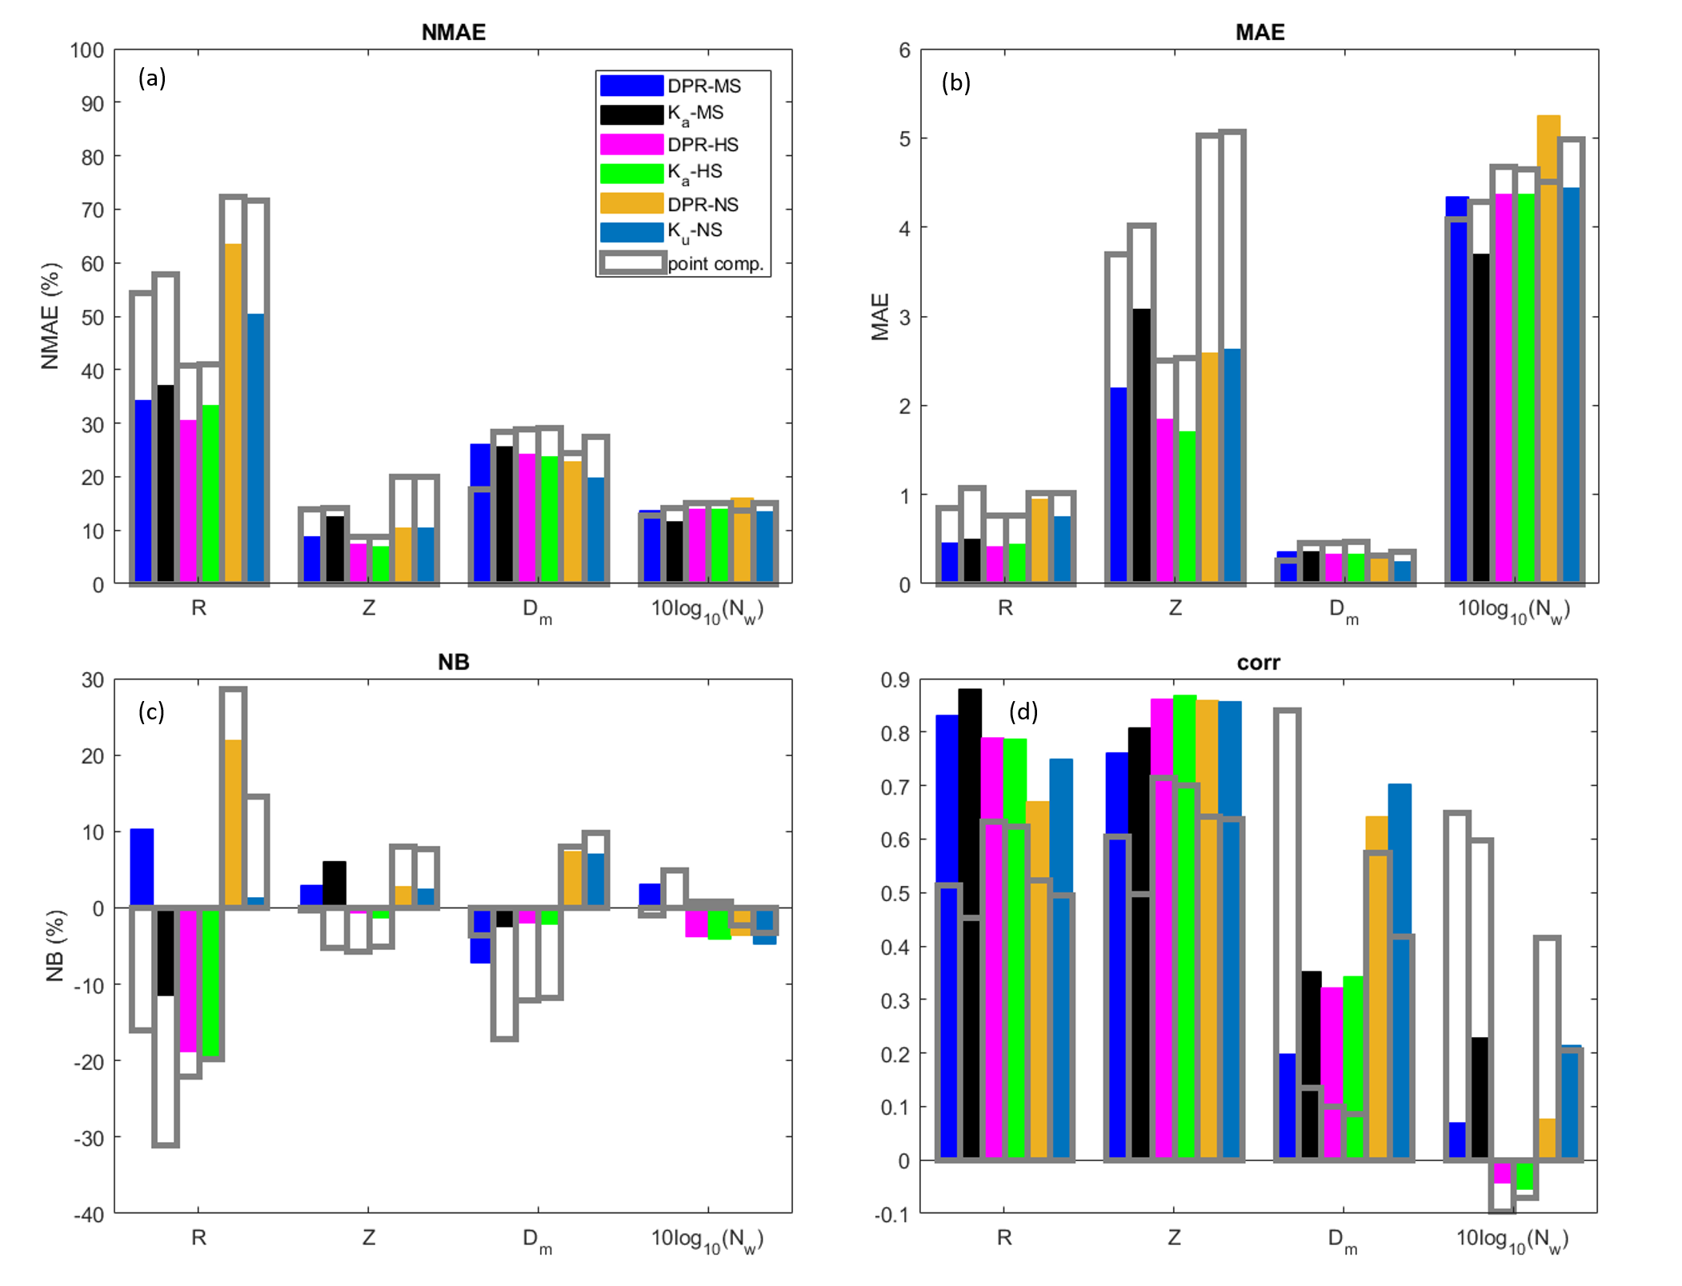
Results (2/2)
NMAE, MAE, NB and correlation coefficient
In this case only the GPM overpasses where all the DPR products are available (i.e. the ones in single and double frequency).
The agreement between satellite and ground-based estimates depends on the considered precipitation variable.
The optimal comparison mode (colored bars) provides, in most of the cases, better results with respect to the point comparison mode (grey bars).
The comparison shows limited differences in the performances of the different GPM products, although in most cases, the dual-frequency algorithms present the better performances.
Reference: Adirosi, E.; Montopoli, M.; Bracci, A.; Porcù, F.; Capozzi, V.; Annella, C.; Budillon, G.; Bucchignani, E.; Zollo, A.L.; Cazzuli, O., Camisani, G., Bechini, R., Cremonini R., Antonini, A., Ortolani, A., Baldini, L.; Validation of GPM Rainfall and Drop Size Distribution Products through Disdrometers in Italy. Remote Sens. 2021, 13, 2081. https://doi.org/ 10.3390/rs13112081

Slide 7
Conclusions and future works
The first validation study of the GPM DPR products (V06) in Italy with disdrometer data has been presented. In particular:
different comparison strategies have been presented and evaluated,
the agreement between disdrometer data and different DPR GPM products have been reported in terms of rainfall rate (R), radar reflectivity (Z), and DSD parameters (D_{mas} and N_{w}). In particular, for R, Z and D_{mas} the agreement is good, while N_{w} satellite estimates need to be improved.
Recently a new version of the GPM DPR products is available, namely Version 07A, where, along with an upgrade of the retrieval algorithm, the dual-frequency retrievals are available in the full swath (i.e. 245 km long). In the near future:
the validation of V07 with disdrometers over Italy will be provided
other disdrometer sites will be added to the ground based devices used for the validation of GPM DPR products over Italy

