Slide 1

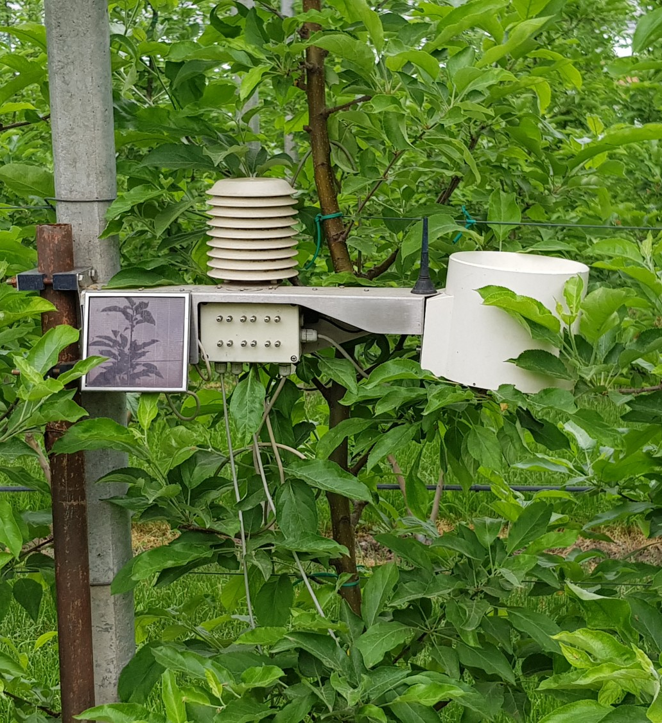



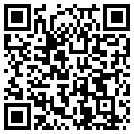
FAIRNESS Project - FAIR NEtwork of micrometeorological measurements
EGU 2022 – SESSION CL3.2.1: Urban climate, urban biometeorology, and science tools for cities
Dragan Milošević¹, Branislava Lalić², Stevan Savić³, Benjamin Bechtel⁴, Mark Roantree⁵, and Simone Orlandini⁶
1 Climatology and Hydrology Research Centre, University of Novi Sad, Novi Sad, Serbia (dragan.milosevic@dgt.uns.ac.rs)
2 Faculty of Agriculture, University of Novi Sad, Novi Sad, Serbia (branka@polj.uns.ac.rs)
3 Climatology and Hydrology Research Centre, University of Novi Sad, Novi Sad, Serbia (dragan.milosevic@dgt.uns.ac.rs)
4 Ruhr-University Bochum, Bochum, Germany (benjamin.bechtel@rub.de)
5 Dublin City University, Glasnevin, Dublin, Ireland (mark.roantree@dcu.ie)
6 University of Florence, Firenze, Italy (simone.orlandini@unifi.it)
CA20108 - FAIRNESS
www.cost.eu

Slide 2
Problem(s) to be solved
CA20108 - FAIRNESS
Reliable micrometeorological data plays a central role in assessing and modelling trends and effects of climate change and adverse weather on the environment
Enormous efforts have already been made unsuccessfully to centralise data from ground-based micro- and local meteorological measurements and to make them available for public use
However, beyond specific initiatives, micrometeorological data is rarely open and available data for various applications and user groups
Micrometeorological data are usually collected as part of scientific projects and observational networks developed for different purposes, but they often “languish” in reports and institutional data silos
EGU 2022 – SESSION CL3.2.1: Urban climate, urban biometeorology, and science tools for cities

Slide 3
Solutions to the problem
CA20108 - FAIRNESS
To address this shortfall, FAIRNESS Cost Action will establish a micrometeorological knowledge share platform (Micromet_KSP) to provide:
  compiled inventory of available and quality proven micrometeorological in situ data sets at the European level and beyond,
  measurement and data management recommendations designed to meet FAIR principles and avoid temporal and spatial gaps,
  examples of rural and urban FAIR data sets and
  Q&A exchanged between Action members, stakeholders, specialised user groups and the general public
EGU 2022 – SESSION CL3.2.1: Urban climate, urban biometeorology, and science tools for cities

Slide 4
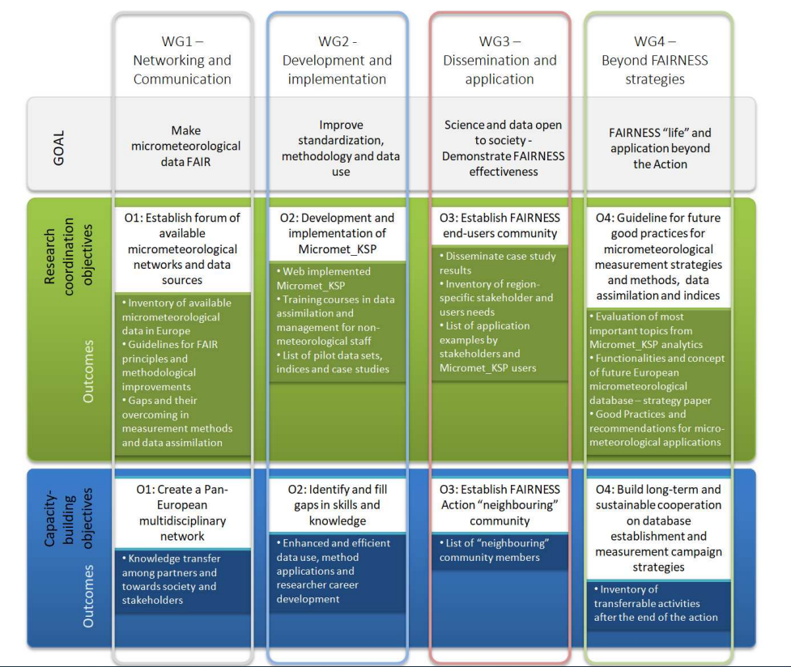

Slide 5
FAIRNESS networks (stations and people)
CA20108 - FAIRNESS
FAIRNESS targets are, primarily, networks of Automated Weather Stations installed in urban, suburban and rural areas which manage dedicated projects, specialised agencies, regional or national government offices for specific applications in the sectors of urban-, forest-, and environmental meteorology and agrometeorology
Addressing identified challenges requires an effective transboundary network of researchers, stakeholders, and civil society to identify and fill knowledge gaps, standardise, optimise, and promote new environmentally-tailored measurement and control procedures, enhance research effectiveness and improve dissemination.
EGU 2022 – SESSION CL3.2.1: Urban climate, urban biometeorology, and science tools for cities

Slide 6
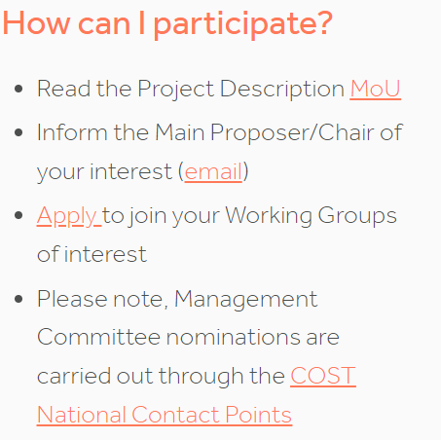
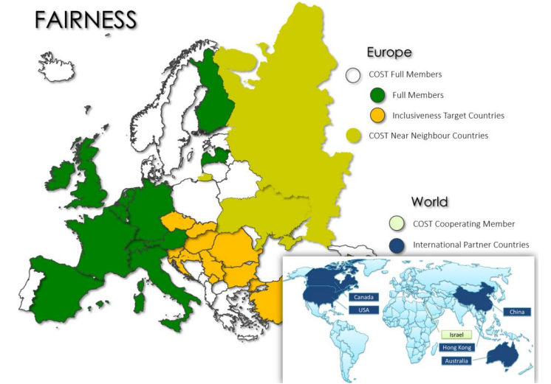
FAIRNESS Project invites you to join us!
CA20108 - FAIRNESS
FAIRNESS consortium includes 65 partners from 28 countries in Europe, Asia, Australia, and North America, and invites interested stakeholders and data users/contributors to join during the lifetime of the project (2021-2025)
Apply to join the project:
  https://www.cost.eu/cost-action/fair-network-of-micrometeorological-measurements/#tabs+Name:Description
EGU 2022 – SESSION CL3.2.1: Urban climate, urban biometeorology, and science tools for cities

Slide 7
dr Dragan Milošević, UNI Novi Sad (Serbia)
E-mail: dragan.milosevic@dgt.uns.ac.rs
Connect on LinkedIn and Twitter
CA20108 - FAIRNESS
Thank you!
EGU 2022 – SESSION CL3.2.1: Urban climate, urban biometeorology, and science tools for cities

