Slide 1

Modelling Aboveground Biomass at local and national scale with in-situ and remote sensing data
Luca Foresta, Niels Anders,
Sake Alkema, Rens Masselink, Vincent Schut, Sacha Takacs, and Arjen Vrielink
foresta@satelligence.com

Slide 2
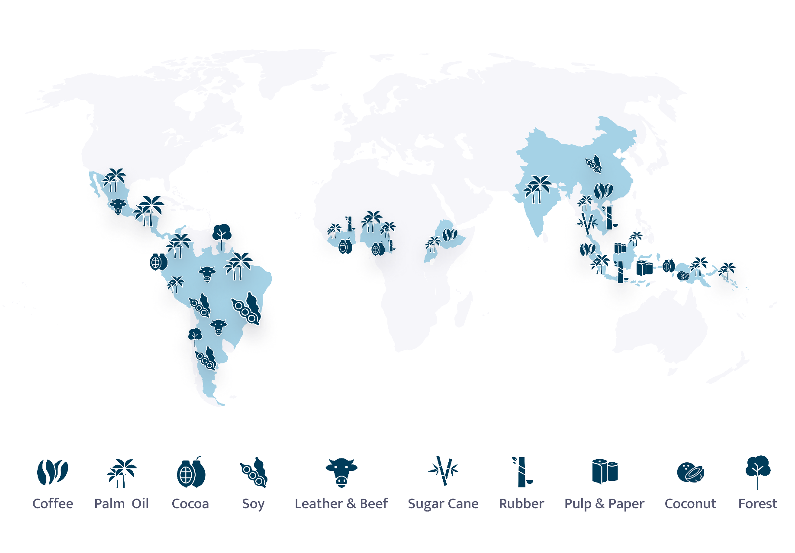
Foresta et al - Modelling Aboveground Biomass at local and national scale with in-situ and remote sensing data
About us
We identify deforestation
&
carbon risk
in
supply chains
of all major commodities
Incorporated in latest deforestation-free EU Regulation

Slide 3
Carbon Modelling
Methods

Slide 4
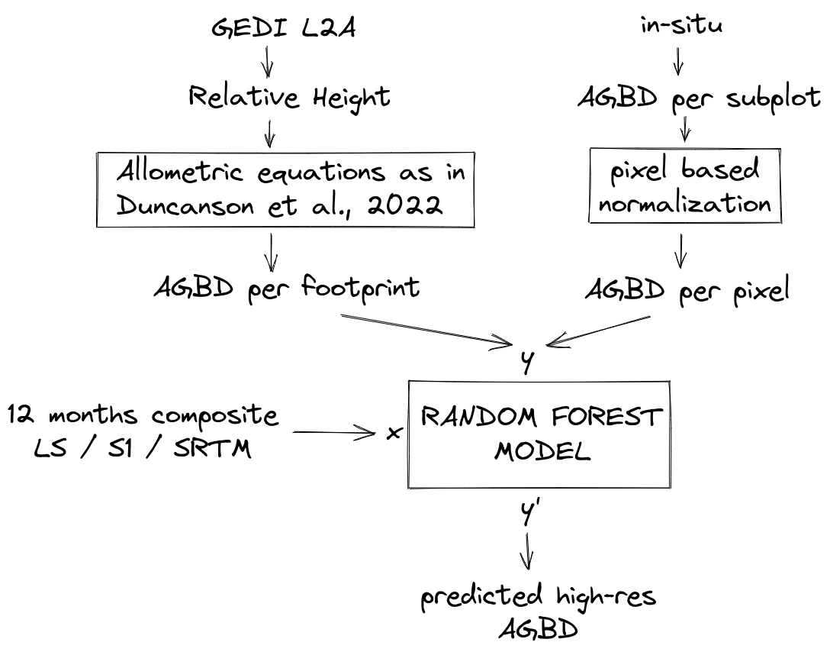
Foresta et al - Modelling Aboveground Biomass at local and national scale with in-situ and remote sensing data
Modelling chart

Slide 5
Foresta et al - Modelling Aboveground Biomass at local and national scale with in-situ and remote sensing data
Modelling chart
Relative height to AGBD
Calculate AGBD based on published strata models at regional scale
L4B: 1 km grid too coarse
L4A: Plant Functional Type determined at 500 m res
(more later)

Slide 6
Foresta et al - Modelling Aboveground Biomass at local and national scale with in-situ and remote sensing data
Modelling chart
Expand in-situ subplot AGBD to pixel contributions
Find band B with highest correlation with input AGBD
Create pixel weights based on the normalized reflectance
Multiply each subplot biomass to pixel weights

Slide 7
Foresta et al - Modelling Aboveground Biomass at local and national scale with in-situ and remote sensing data
Modelling chart
Model features
Band combinations used in this presentation:
- national model
LS: all bands
S1: VV-VH
SRTM
- in-situ model
S1: VV, VH, VV-VH
S2: RED, NIR, SWIR1, SWIR2

Slide 8
Carbon Modelling
Results

Slide 9
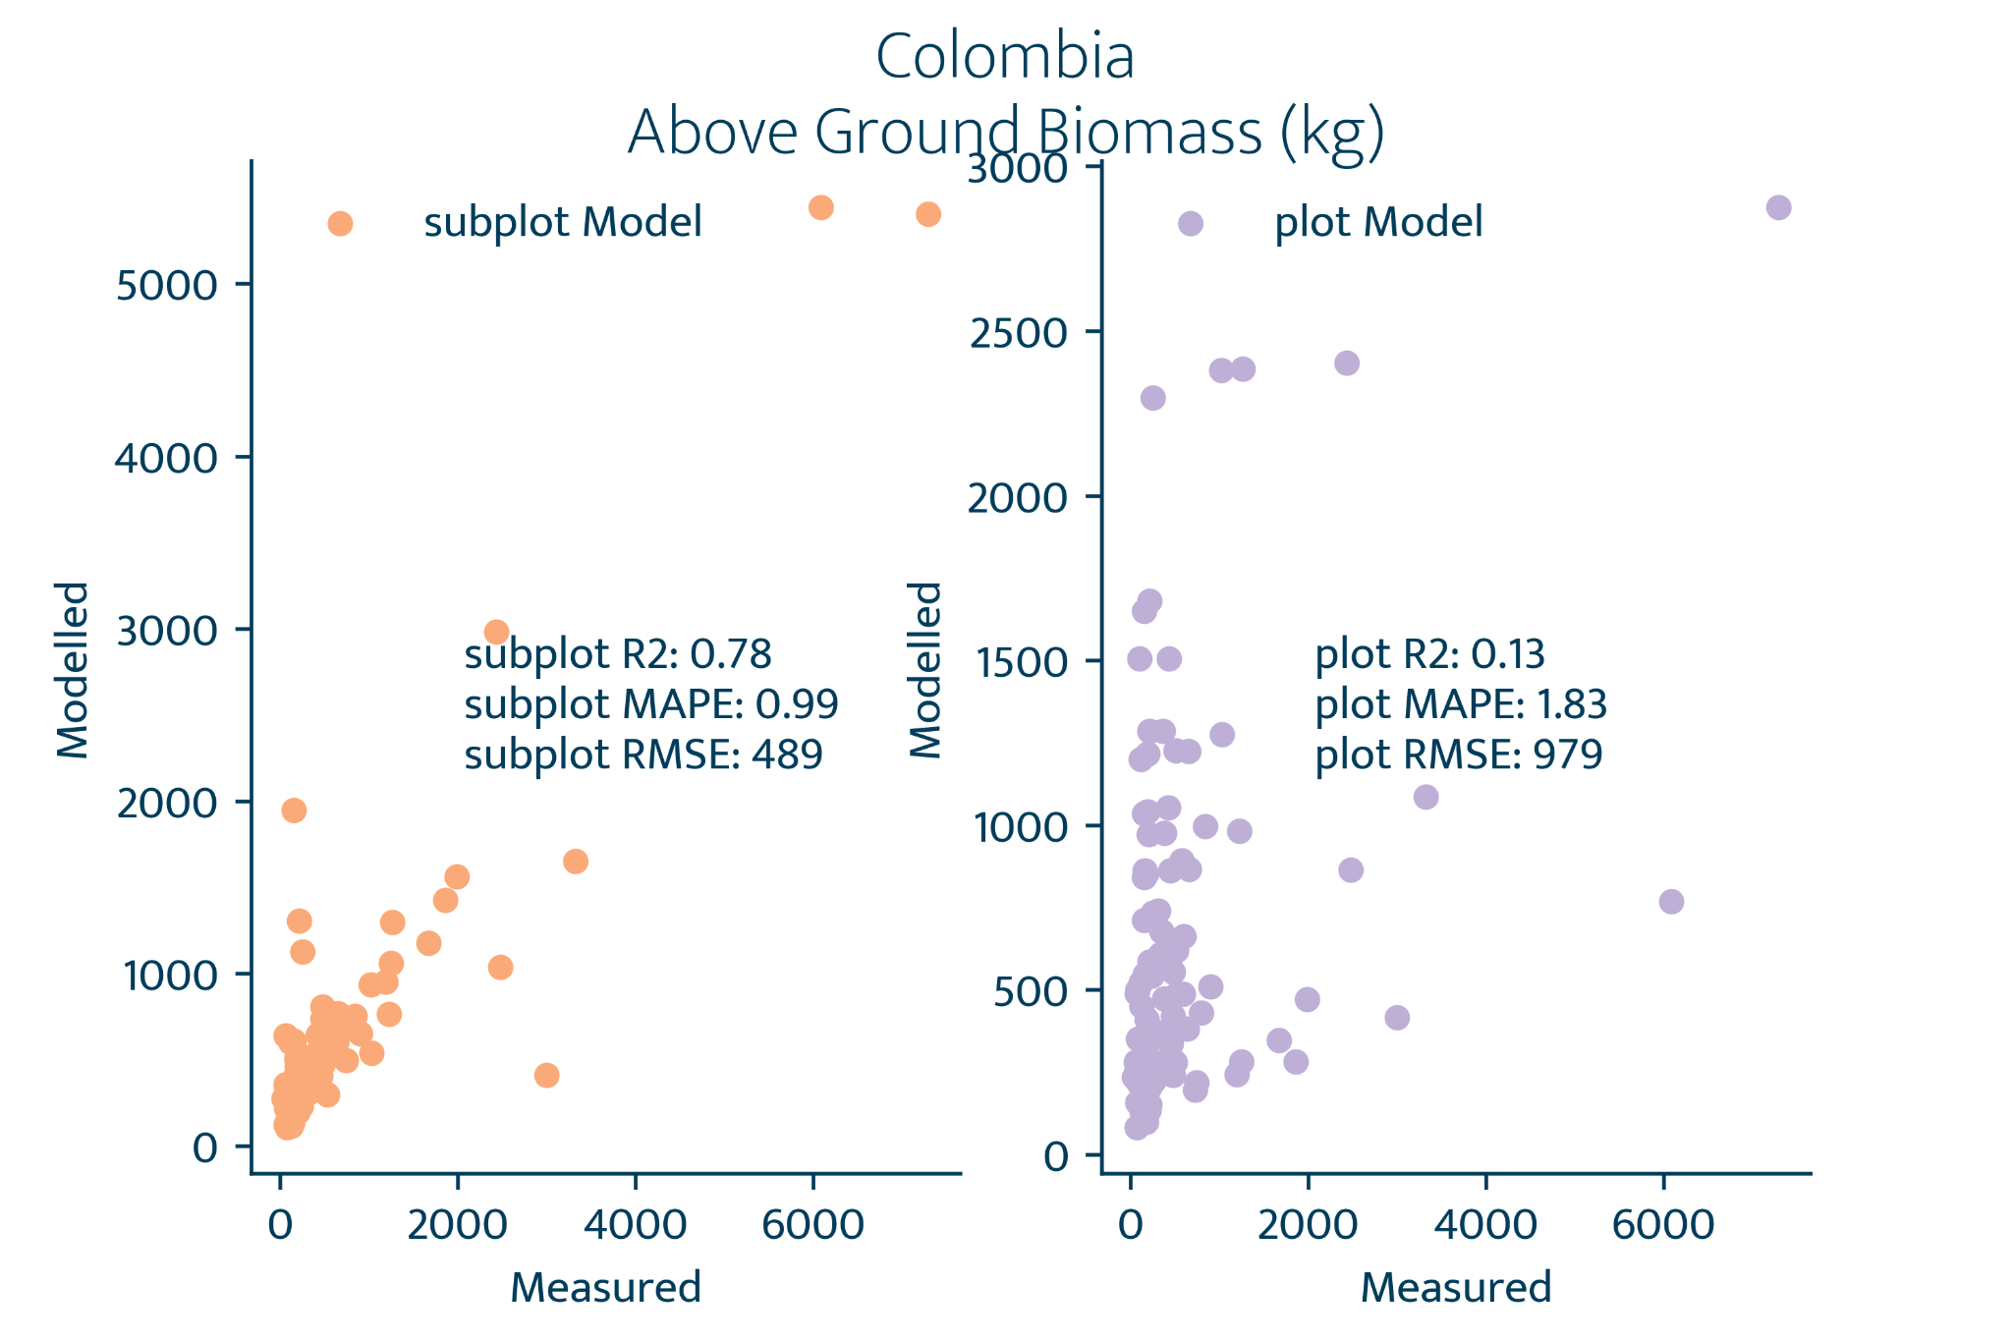
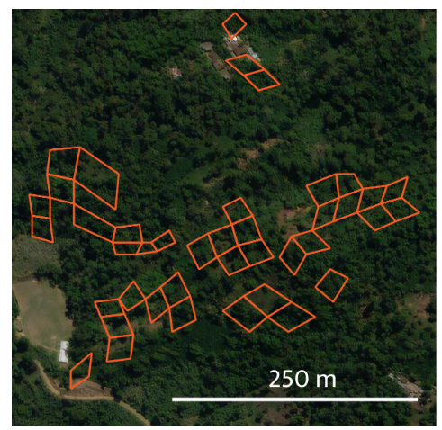
Foresta et al - Modelling Aboveground Biomass at local and national scale with in-situ and remote sensing data
Local model - Colombia
Distribute subplot tot biomass to pixels
In-situ biomass for 343 subplots
NIR to normalize pixels
Biomass values for 5015 pixels
Selected subplots in AOI

Slide 10
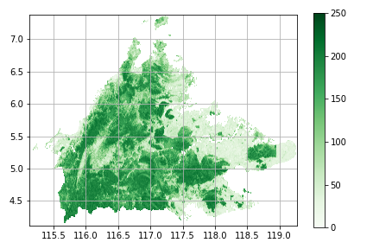

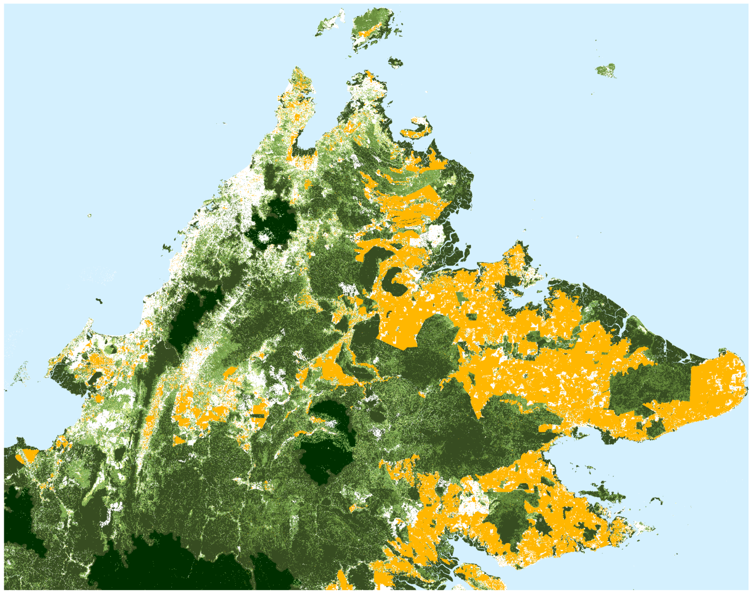
Foresta et al - Modelling Aboveground Biomass at local and national scale with in-situ and remote sensing data
“National” model - Sabah, Malaysia
R2 = 0.55
RMSE = 61 T C / ha
Modelled AGBD 2021
Land classification 2019
t / ha

Slide 11
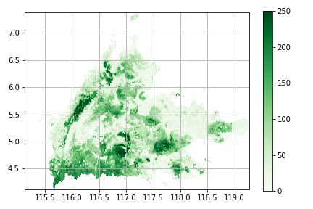
Foresta et al - Modelling Aboveground Biomass at local and national scale with in-situ and remote sensing data
“National” model - Sabah, Malaysia
AGBD [palm oil] overestimated
AGBD[degraded forest] overestimated
AGBD [primary forest] higher end underestimated
Modelled AGBD 2021
Asner et al., 2016 - ALS data
Land classification 2019
t / ha

Slide 12
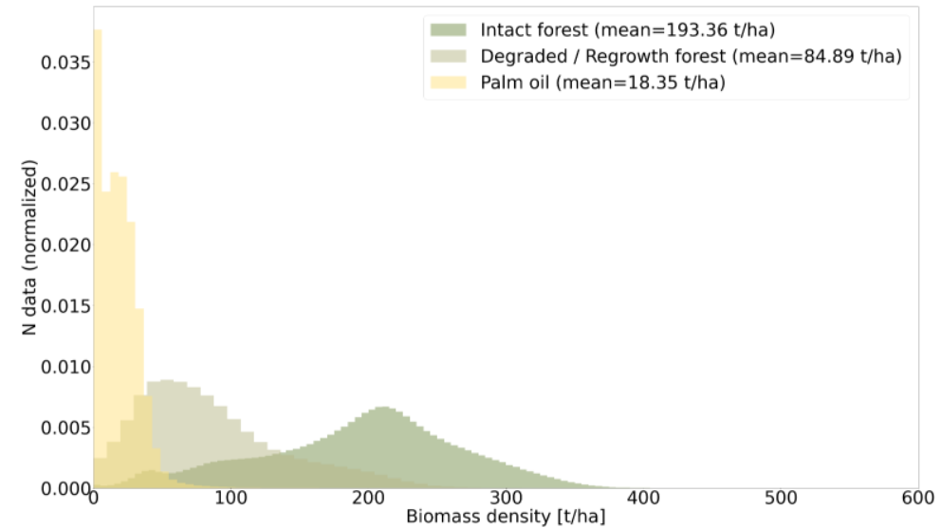
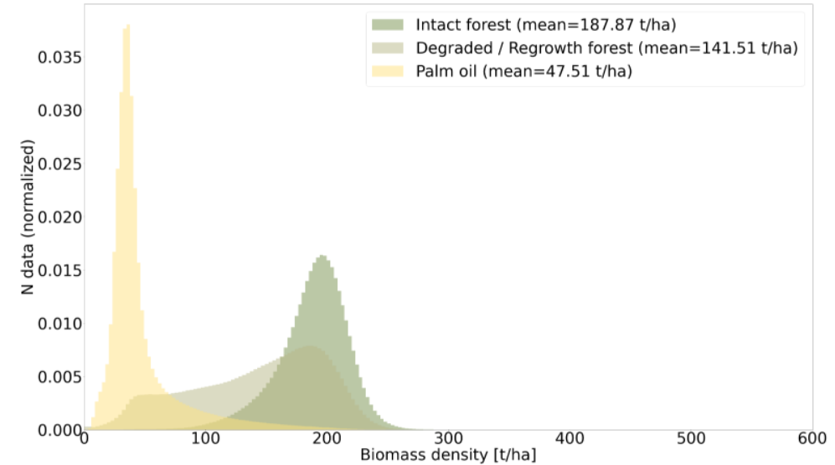
Foresta et al - Modelling Aboveground Biomass at local and national scale with in-situ and remote sensing data
“National” model - Sabah, Malaysia
AGBD [palm oil] overestimated
Asner et al., 2016 - ALS data
Modelled AGBD 2021

Slide 13
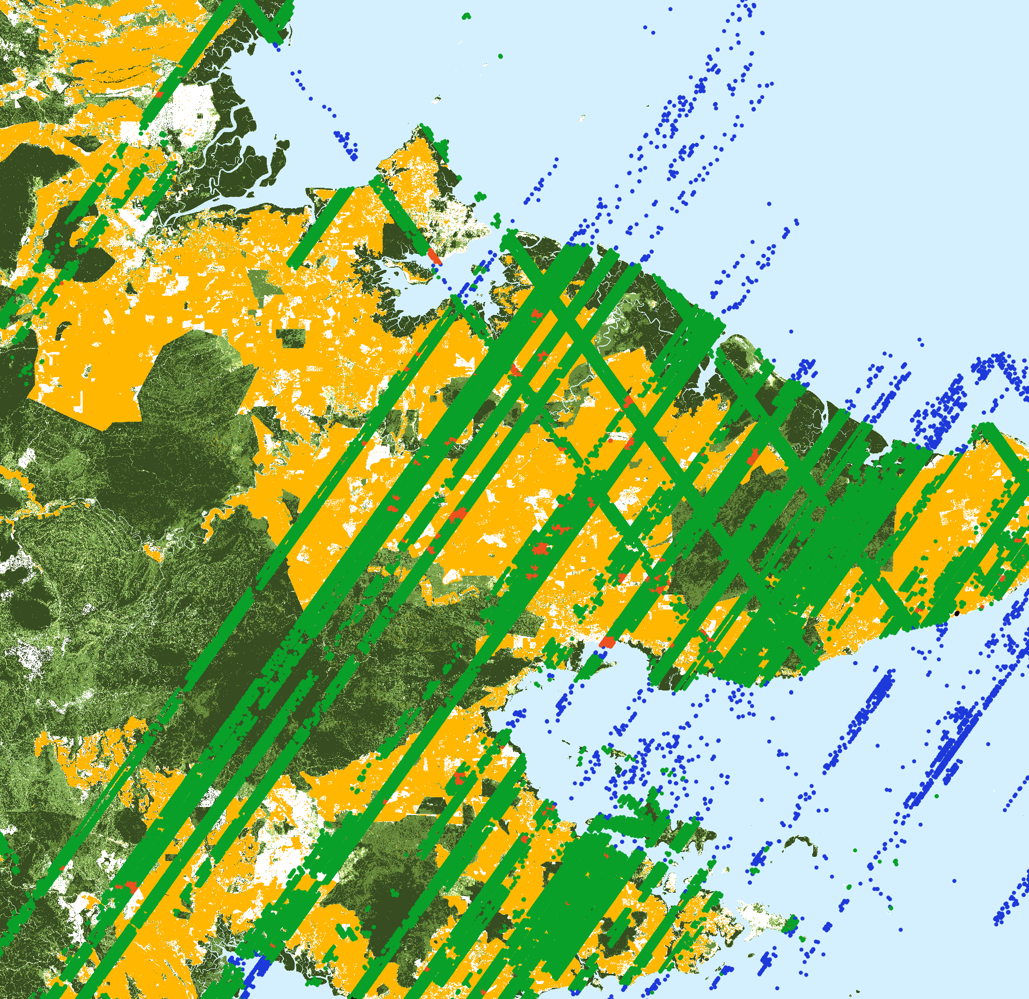
Foresta et al - Modelling Aboveground Biomass at local and national scale with in-situ and remote sensing data
“National” model - Sabah, Malaysia
AGBD [palm oil] overestimated
PFT in GEDI L2A (based on MODIS 500 m classification) is Evergreen Broadleaf
Our land classification at 30 m improves mean value from ~80 T C / ha to ~47 T C / ha
Palm oil allometric equation from Nunes et al., 2017
Modelled AGBD 2021
GEDI tracks over palm oil
t / ha
GEDI L2A PFT (MODIS based)
evergreen broadleaf tree
shrubs
water

Slide 14
Foresta et al - Modelling Aboveground Biomass at local and national scale with in-situ and remote sensing data
“National” model - Sabah, Malaysia
AGBD [degraded forest] overestimated
Allometric equation for EBT most likely overestimate AGBD for heavily degraded forest Investigate updated equation for this conversion
Asner et al., 2016 - ALS data
Modelled AGBD 2021

Slide 15
Foresta et al - Modelling Aboveground Biomass at local and national scale with in-situ and remote sensing data
“National” model - Sabah, Malaysia
AGBD [intact forest] higher end underestimated
noise filters selectively remove more high-end Relative Height values
-> Training dataset biased towards lower biomass values
Asner et al., 2016 - ALS data
Modelled AGBD 2021

Slide 16
Foresta et al - Modelling Aboveground Biomass at local and national scale with in-situ and remote sensing data
Future work
Use S2 instead of LS as feature for national models (already in processing)
Correct EBT allometric equation for degraded forest (or investigate alternatives)
Integrate satellite and in-situ data (plus ALS) whenever possible
Use topographic correction for optical data (remove artificial high biomass on steep slopes)

Slide 17
Thank you for your attention
Luca Foresta, Niels Anders, Sake Alkema, Rens Masselink, Vincent Schut, Sacha Takacs, and Arjen Vrielink
www.satelligence.com
luca.foresta@satelligence.com

