Slide 1

BLOSM: Boron-based
Large-scale Observation of Soil Moisture
Edward van Amelrooij
Nick van de Giesen
n.c.vandegiesen@tudelft.nl
This project has received funding from the European Union’s Horizon 2020 Research and Innovation Programme under grant agreement No.776691. The opinions expressed in this presentation are of the authors only and no way reflect the European Commission’s opinions. The European Union is not liable for any use that may be made of the information.

Slide 2
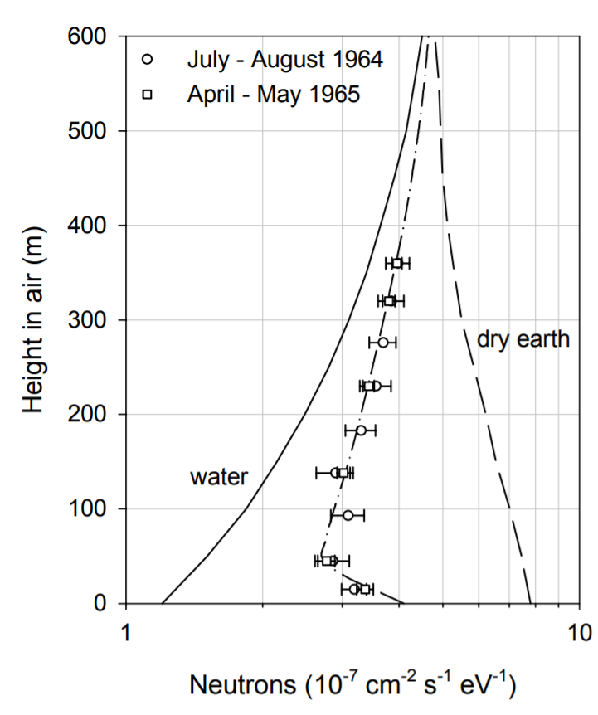
BLOSM
Soil moisture
Cosmic rays:
Fast (20,000 km/s)
Thermal (200 km/s)
Hendrick and Edge (1966)

Slide 3
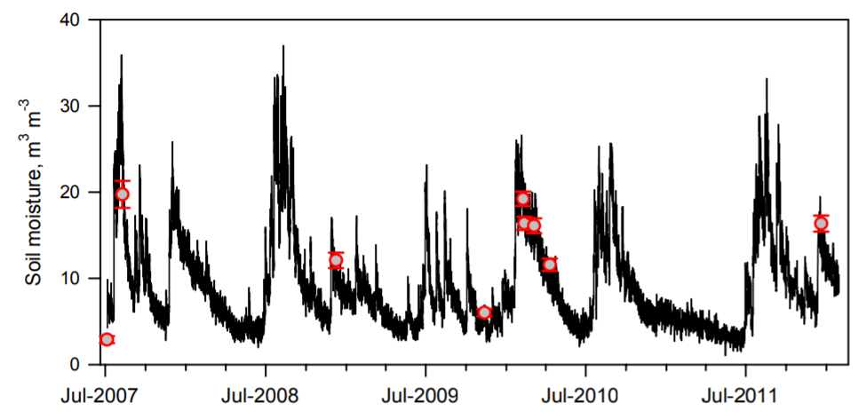
BLOSM
Soil moisture
Cosmic rays:
Fast (20,000 km/s)
Thermal (200 km/s)
Zreda et al. (HESS, 2012) COSMOS

Slide 4
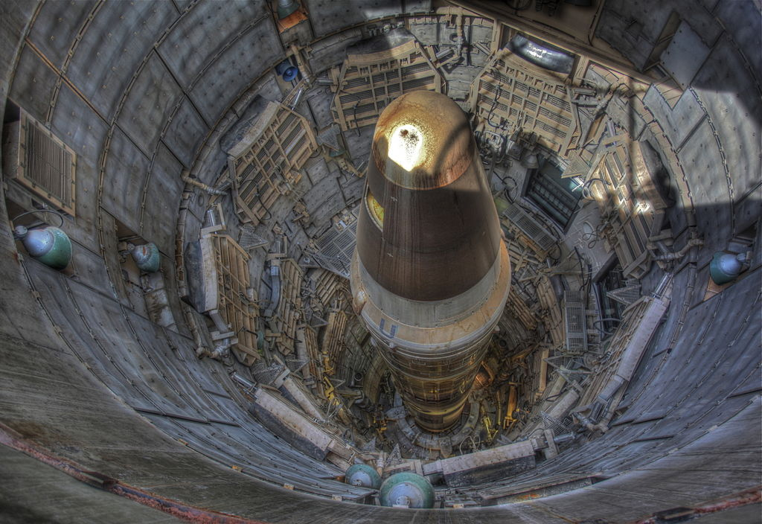
BLOSM
Soil moisture
³He

Slide 5

BLOSM
Soil moisture
Boron: 20% ¹⁰B !!!

Slide 6
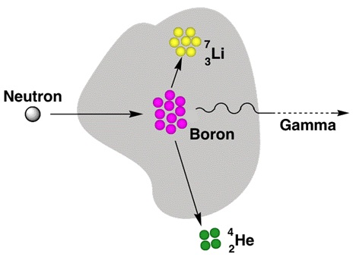
BLOSM
Soil moisture
¹⁰BN
Thermal
Alpha particle

Slide 7
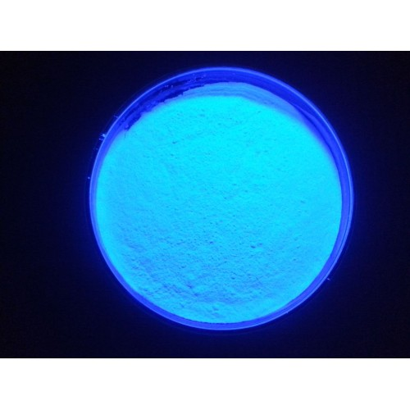
BLOSM
Soil moisture
ZnS(Ag)
Fluoresces

Slide 8
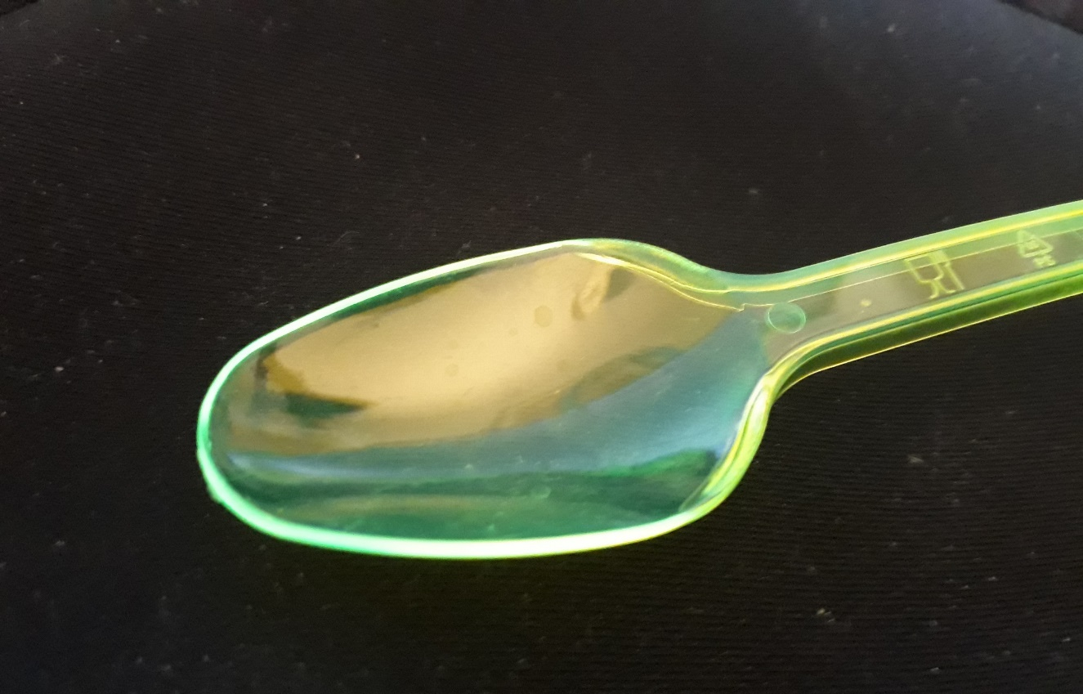
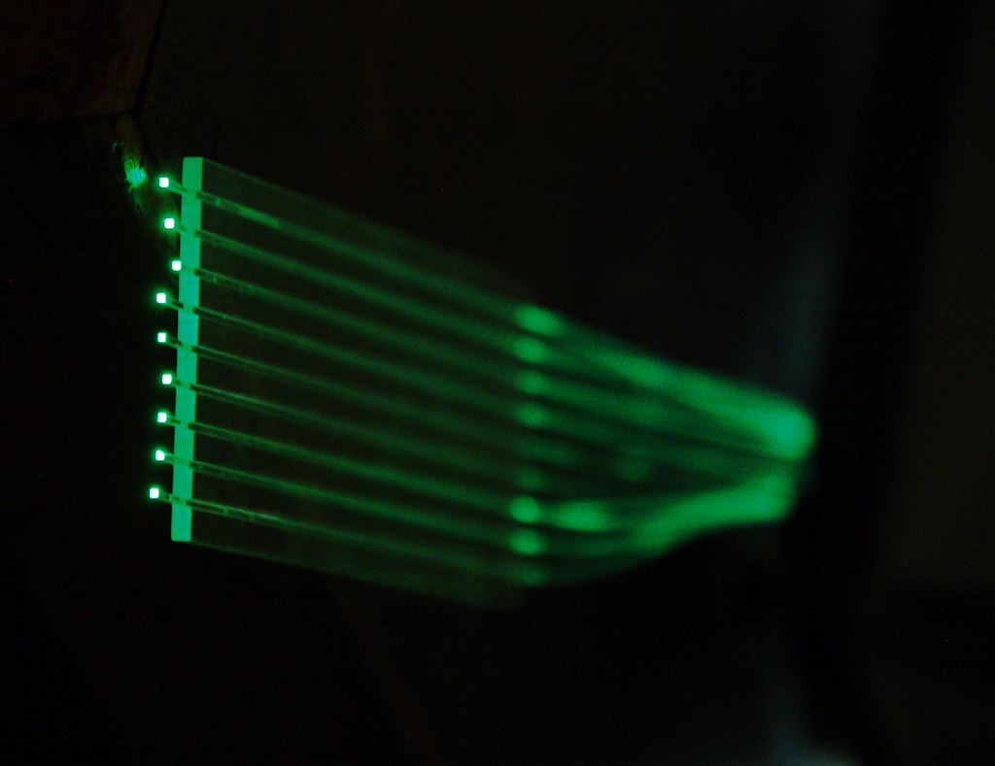
BLOSM
Soil moisture
Wavelength
Shifting
Fibers
Kuraray

Slide 9
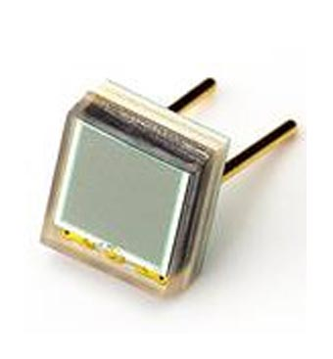
BLOSM
Soil moisture
Silicon Photon Multiplier (SiPM)
$100 muon detector (Spencer Axani, MIT)

Slide 10
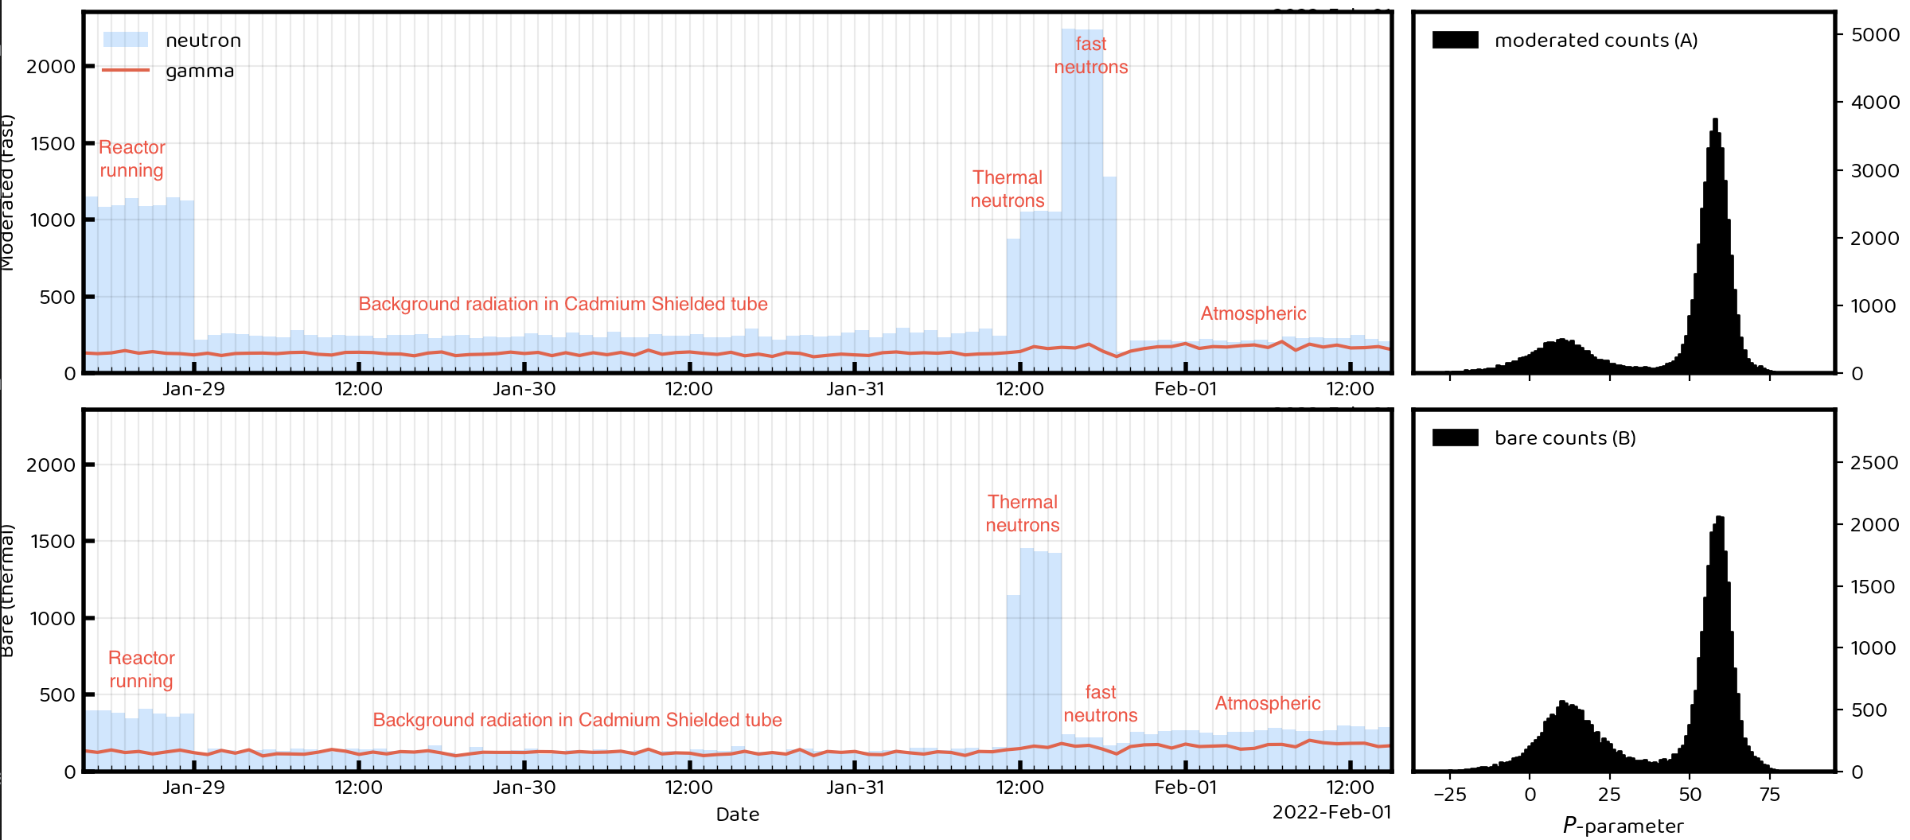
BLOSM
Fast + thermal Thermal only

Slide 11
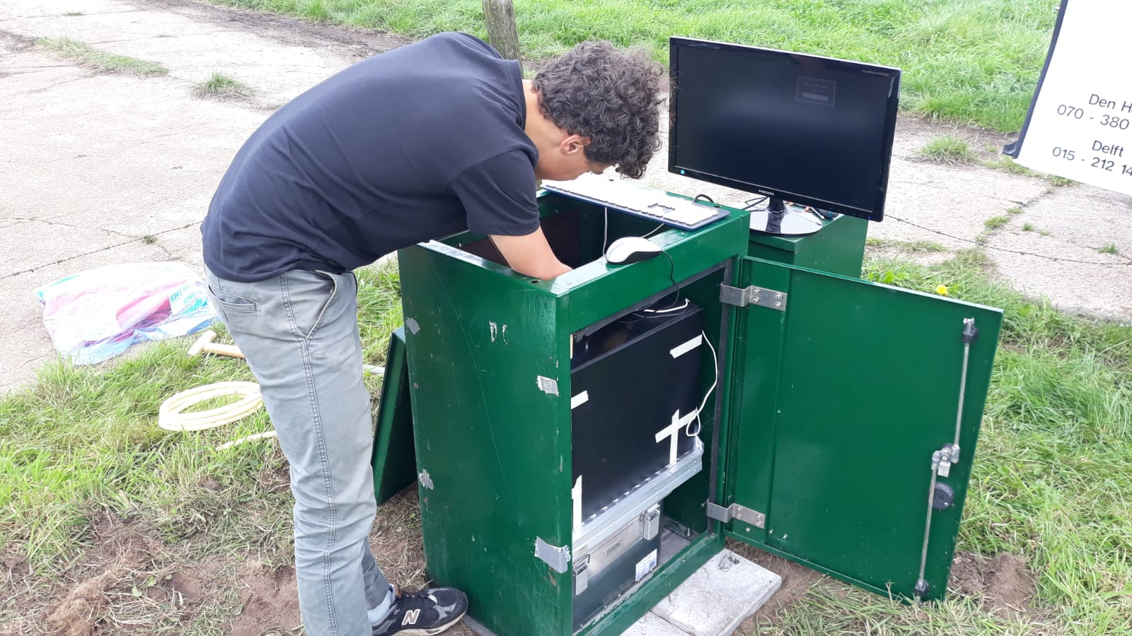
BLOSM
Soil moisture
Field

Slide 12
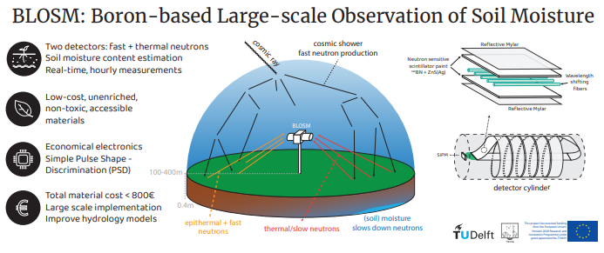
BLOSM
Validation

Slide 13


Nick van de Giesen
n.c.vandegiesen@tudelft.nl
BLOSM
YOU ARE INVITED!
This project has received funding from the European Union’s Horizon 2020 Research and Innovation Programme under grant agreement No.776691. The opinions expressed in this presentation are of the authors only and no way reflect the European Commission’s opinions. The European Union is not liable for any use that may be made of the information.

