Slide 1




Session CL3.2.6
Climate extremes, biosphere and society: impacts, cascades, feedbacks, and resilience
Contrasting farmers’ perception of climate change and climatic data: How (in)consistency supports risk reduction and resilience?
Sandra Ricart and Andrea Castelletti
Politecnico di Milano
Claudio Gandolfi
University of Milan
May 27, 2022

Slide 2
INTRODUCTION, AIM AND METHODS
Timely and accurate climate change perception determines farmers’ actions
However, perception may not be consistent with the direction and significance of observational data, conditioning farmers’ adaptive capacity.
How the literature measures and contrast
both issues?
Farmers’ experience
vs
Meteorological data
A systematic mapping
Scopus library catalogue
2000-2021 slot
PRISMA protocol
Bibliometrics (VOSviewer + R bibliometrix package): 147 papers
Literature review (exploratory content analysis): 98 papers (only case studies)

Slide 3
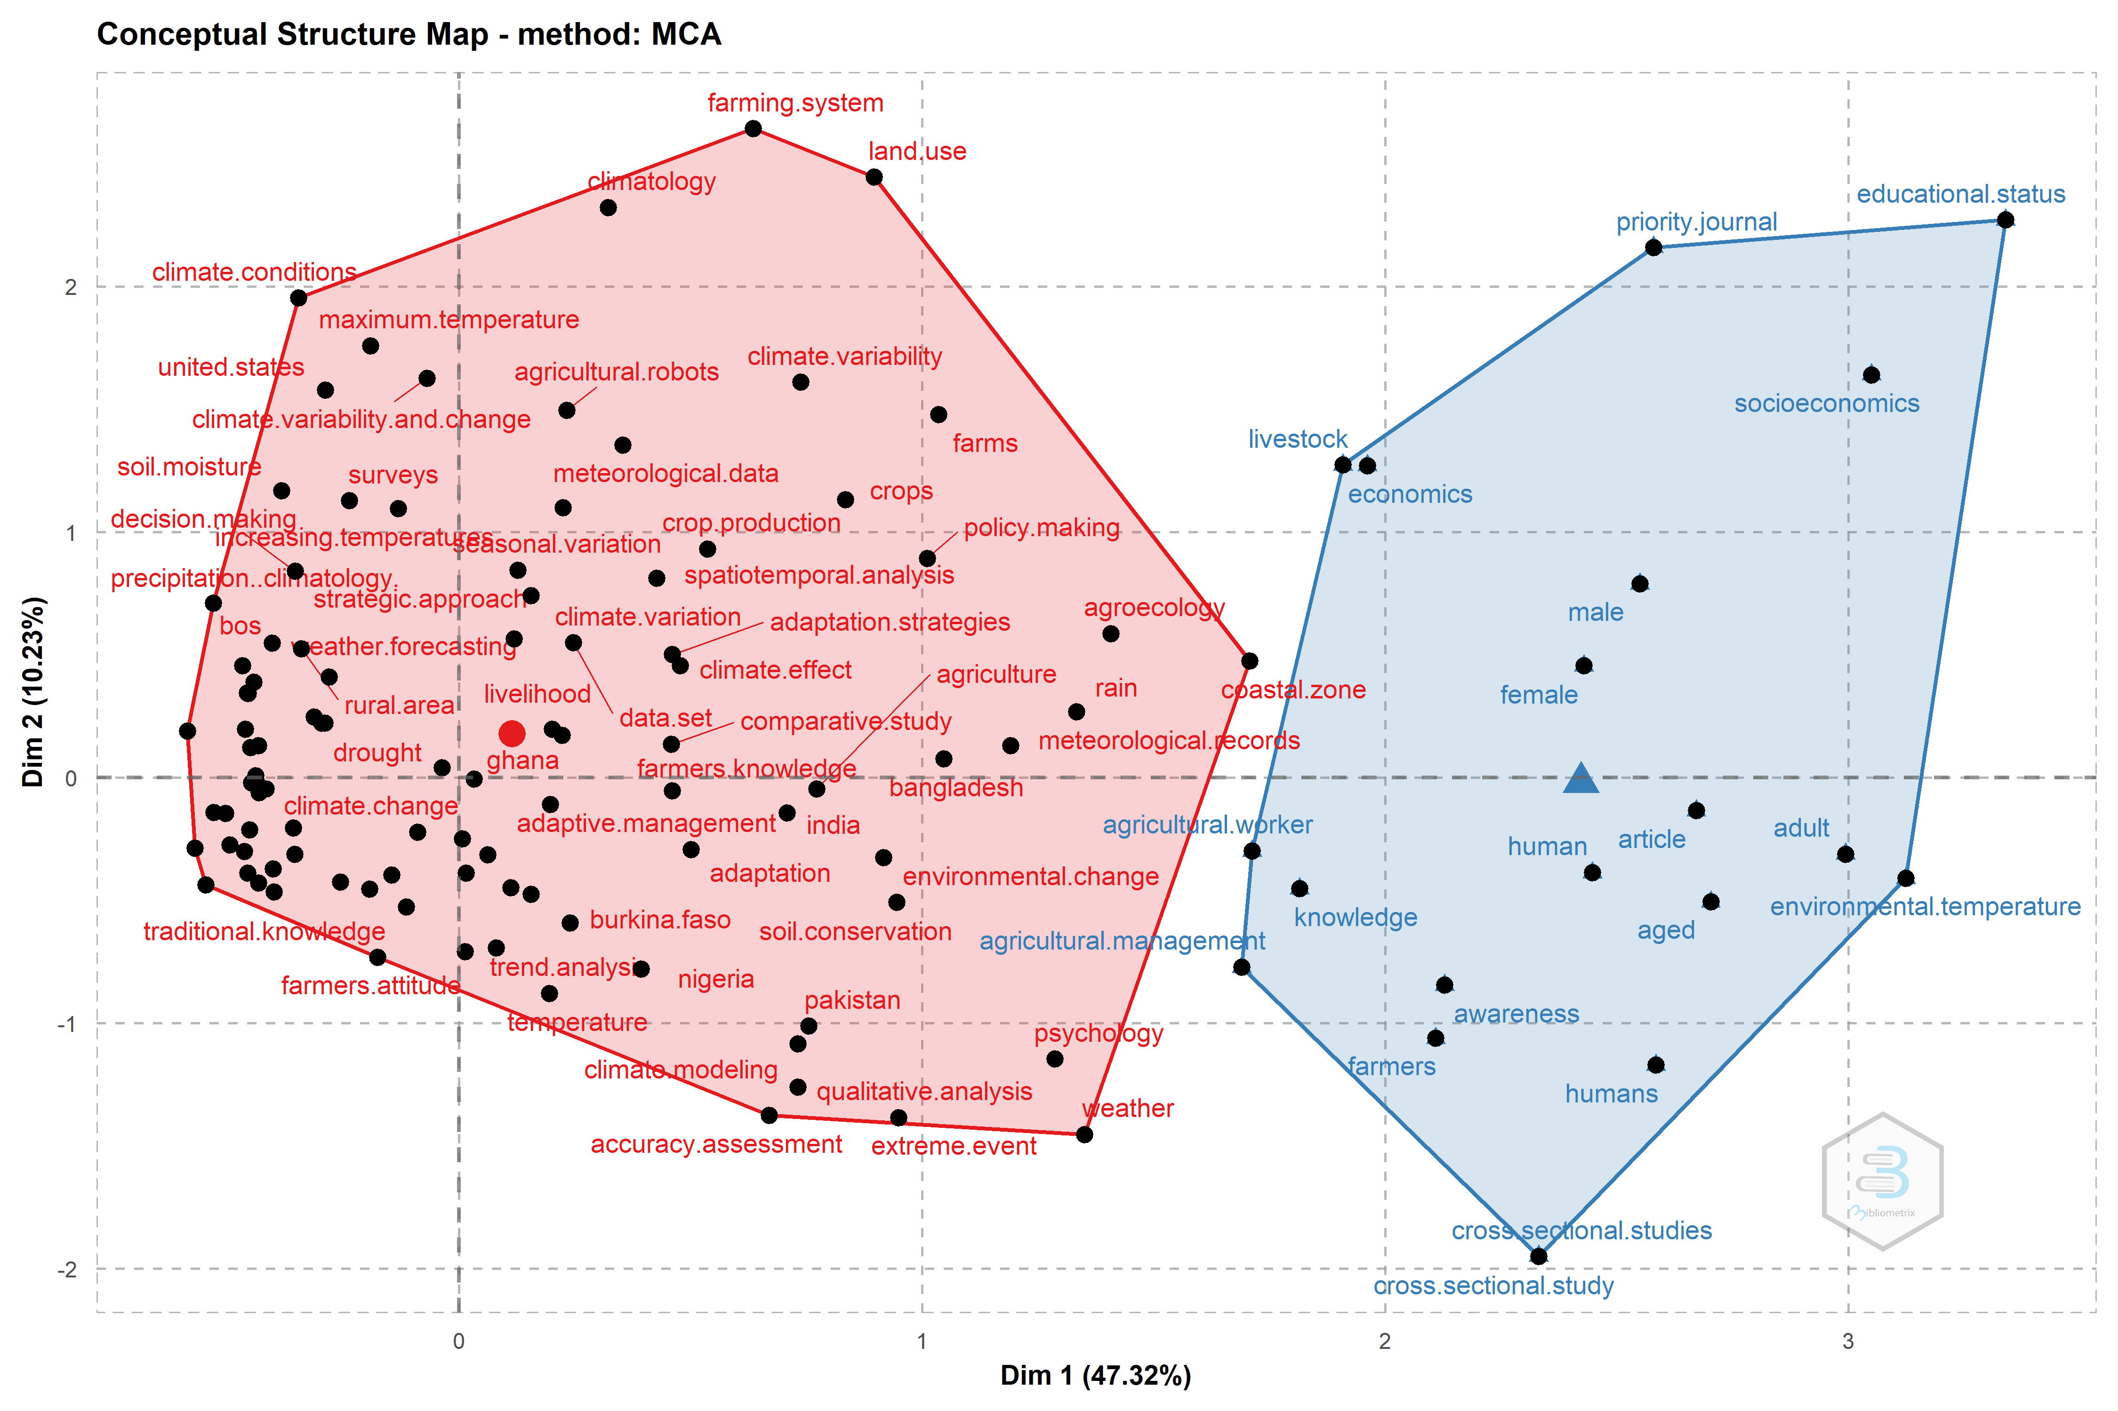
RESULTS - BIBLIOMETRICS
Keywords co-occurrence analysis
2 clusters (conceptual structure)
Red cluster (triple-loop)
observed data (e.g., weather forecasting, extreme events)
agricultural impacts (e.g., soil moisture)
adaptation measures (e.g., strategies, decision-making)
Blue cluster: farmers’ profiles (e.g., gender, age, education)
adaptive capacity & risk perception
farmers’ profile & climate change awareness
crops production vulnerability (ppt/t° patterns)
forecasting affects on decision-making
4 clusters (co-occurrence)

Slide 4

RESULTS – LITERATURE REVIEW
Data collection tools
Farmers’ experience
Surveys (89%)
Focus group (52%)
Interviews (49%)
National meteo services + stations
data ≥30 years (85%)
Conceptual barrier: hardly understanding ‘climate change’ or ‘global warming’
High comprehension of weather patterns
t° ppt
drought risk concerns (frequency/severity)
Tools combination (70%)
(90%)
(75%)
Climate data covering extreme events
Accuracy perceived vs observed data
Two dimensions (t° + ppt patterns)
t° (+summer) (75%)
ppt + erratic patterns (40%)
Identify spatial micro-climate differences is challenging
Mostly consistent considering 3 statements:
t° (79%) ppt (36%)
rainfall variability (delayed or untimely) (34%)
Discrepancy summer/annual rainfall trends

Slide 5
IDENTIFIED GAPS AND FURTHER RESEARCH
The literature is extensive, fast-growing, and spans several disciplines
Research gaps
Global South
focus
Conceptual mismatch
Limited/missing meteo data
Geographical dissonance
Keep track climate variability
Traditional knowledge overlook
farmers’
memory
vulnerable populations
stations far from case study
5
‘normal pattern’
‘drought’
4
3
2
1
Regular studies on farmers’ perceptions can become a proxy to support or validate instrumental climate data time series
especially when meteo data is
unavailable
low quality
recent periods

Slide 6







Session CL3.2.6
Climate extremes, biosphere and society: impacts, cascades, feedbacks, and resilience
Contrasting farmers’ perception of climate change and climatic data: How (in)consistency supports risk reduction and resilience?
Sandra Ricart, Andrea Castelletti
Department of Electronics, Information and Bioengineering
Politecnico di Milano
Claudio Gandolfi
Department of Agricultural and Environmental Sciences
University of Milan
Contact information
Sandra Ricart
sandra.ricart@polimi.it
www.modfabe.deib.polimi.it
@modfabe

