Slide 1




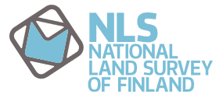
4Map4Health Forest Structure Mapping and Tree Species Classification using Laser Scanning Data for Bark Beetle Risk Assessment
Yi-Chen Chen, Markus Hollaus, Sigrid Netherer, Peter Surový, Juha Hyyppä

Slide 2
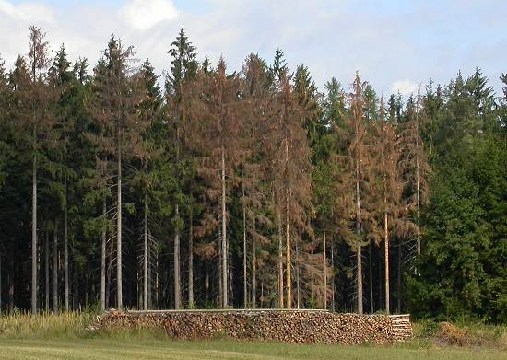
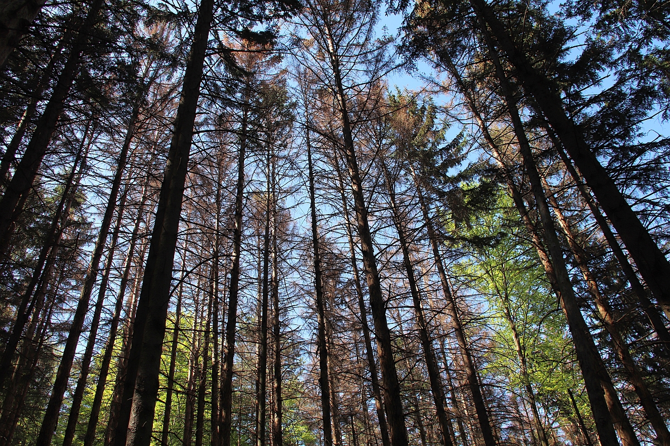
Background
Forest is one of the most important natural resources
However, some threats can make huge economic losses
Fire, pest, …
Management is key
© http://bfw.ac.at/rz/bfwcms2.web?dok=5234

Slide 3
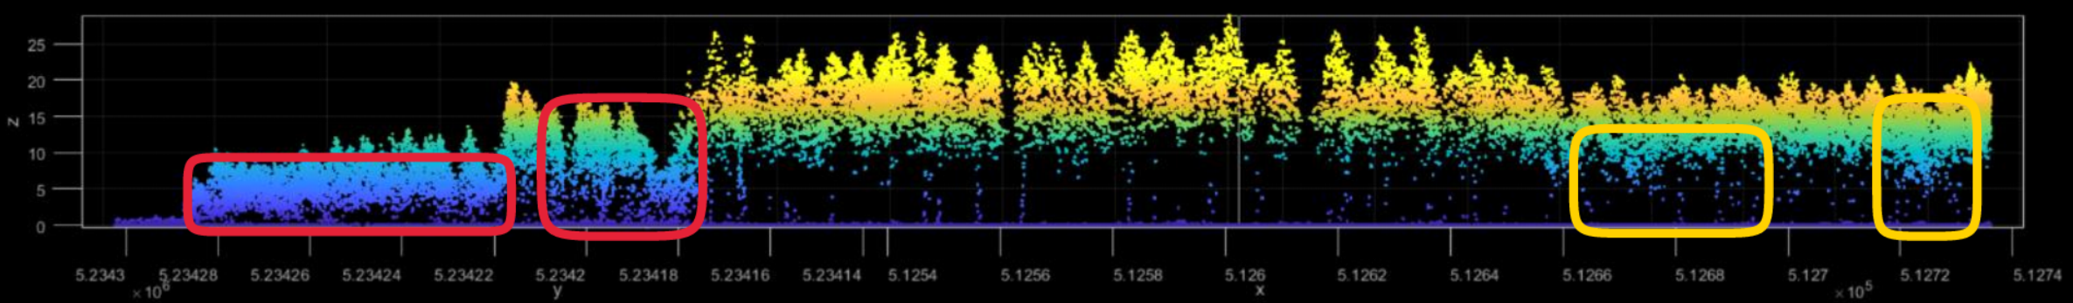
Aim
Explore the future multitemporal and multispectral laser scanning data in terms of forest application
Forest health status
Tree species
Forest risk – Bark beetle

Slide 4
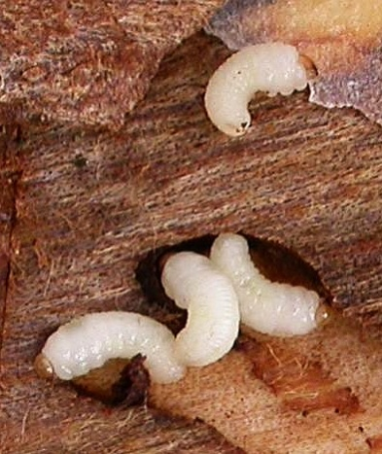
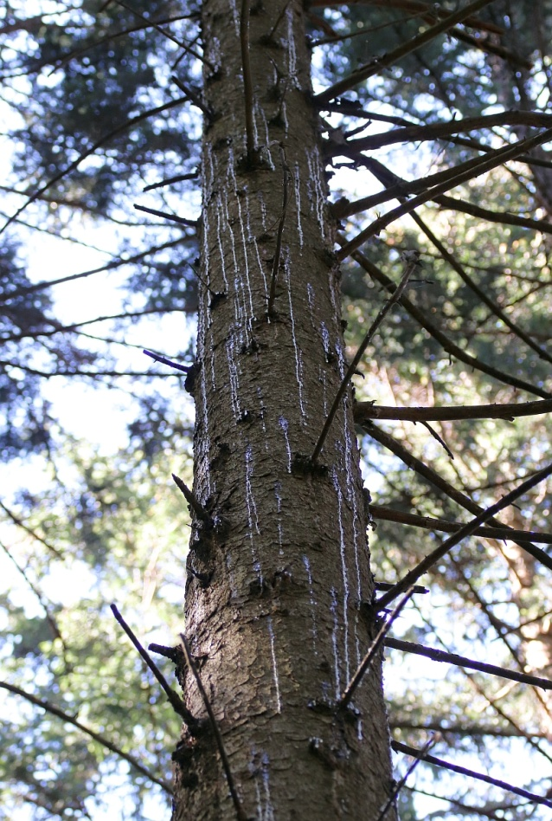
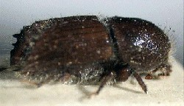
Bark Beetle Infestation
Increasing outbreak
Main factors
Higher temperature
Drought stress
Need: risk assessment framework
Early detection
Risk maps
© http://bfw.ac.at/rz/bfwcms2.web?dok=5234

Slide 5
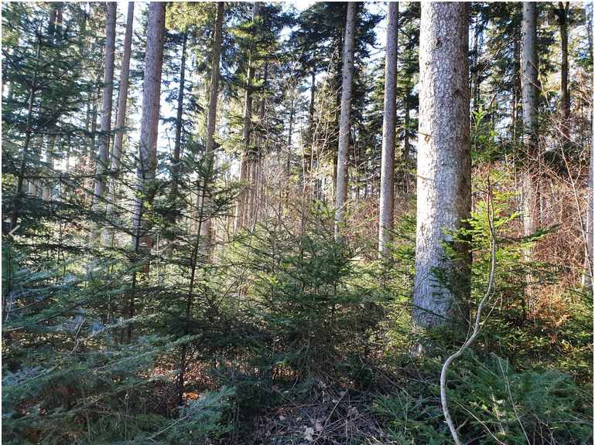
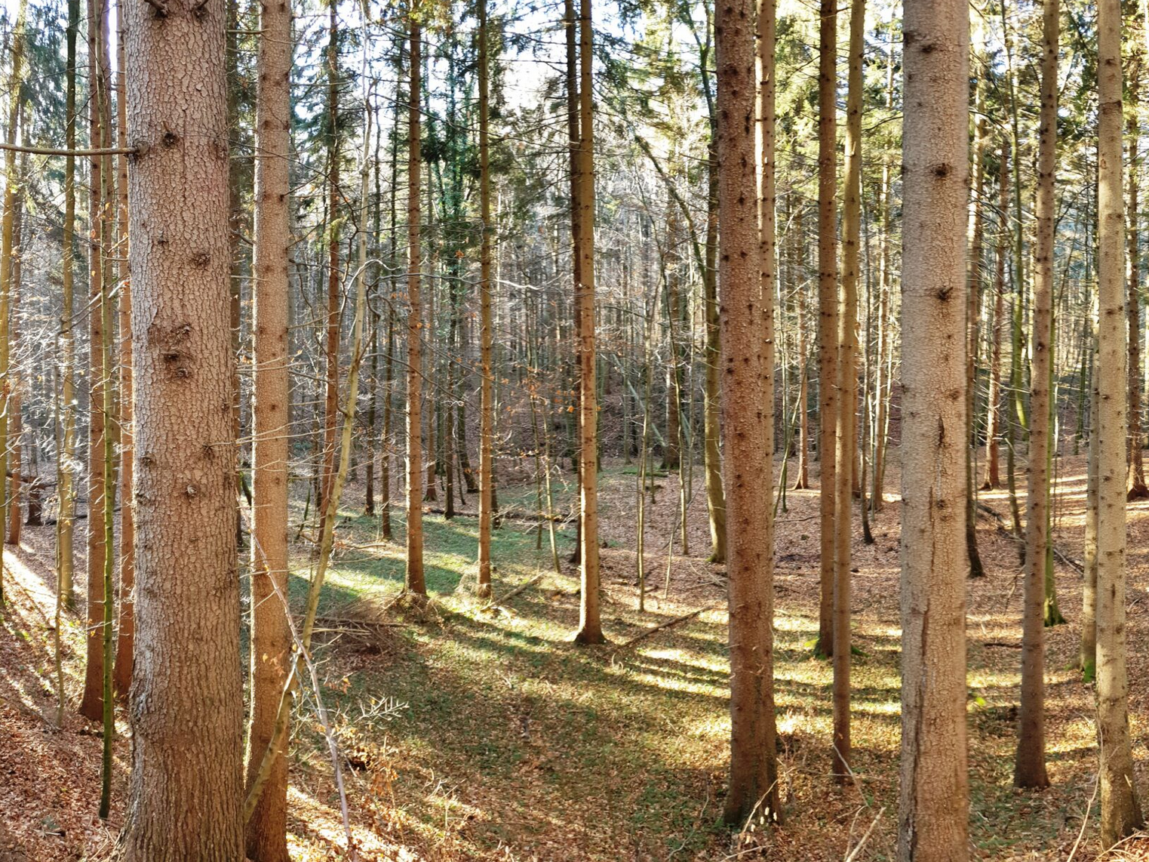
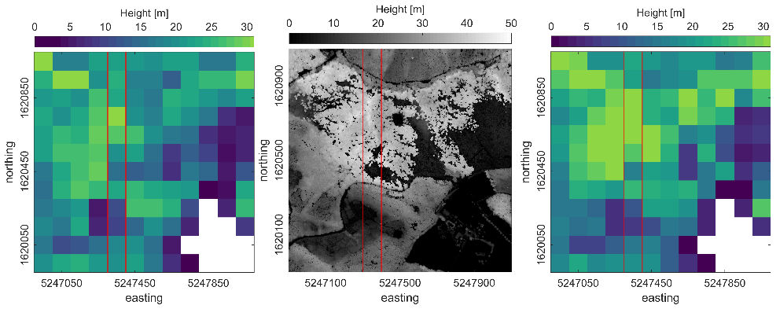
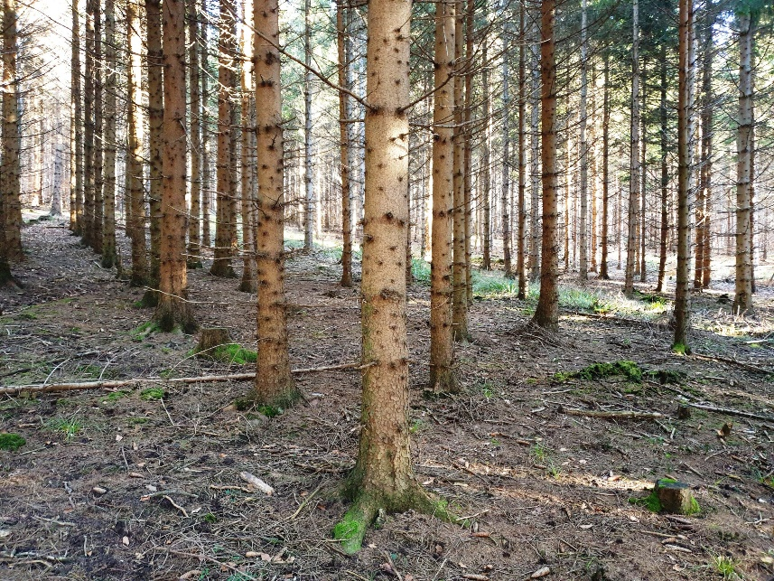
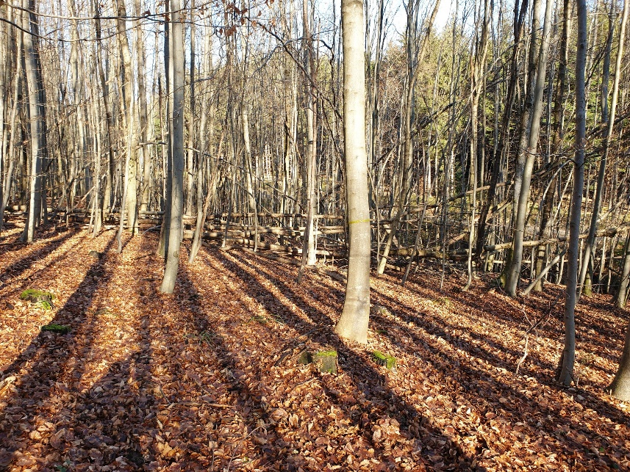
Major Challenges
Tree species classification on single tree level Multispectral
Forest gaps due to lower temporal resolution Multitemporal
Bruggisser et al. (2021)
SilviLaser 2021 Benchmark

Slide 6
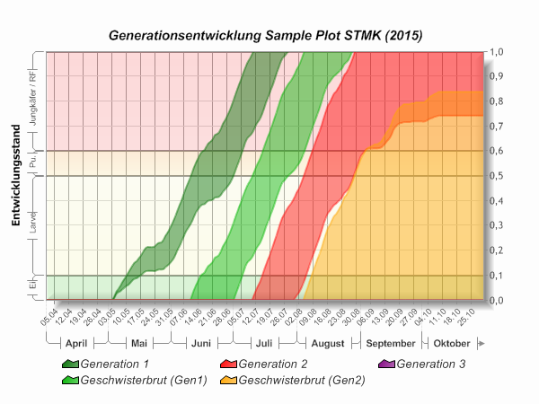
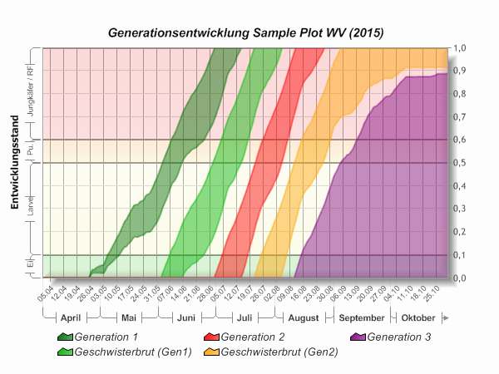
Ongoing Work
2 test sites in Austria
Data acquisition
Multispectral airborne laser scanning (MS-ALS)
Terrestrial laser scanning (TLS)
Multitemporal remote sensing
Climate/weather, soil, air
Model
PHENIPS: real time modelling of bark beetle phenology
https://ifff-server.boku.ac.at
Netherer et al. (2018)

Slide 7
Thank you for your attention!
Contact
Hollaus Markus markus.hollaus@geo.tuwien.ac.at
Yi-Chen Chen yi-chen.chen@geo.tuwien.ac.at
Sigrid Netherer sigrid.netherer@boku.ac.at

