Slide 1










A biogeochemical approach to build a perceptual hydrological model for a small peri-urban catchment
Olivier Grandjouan, Flora Branger, Matthieu Masson, Benoit Cournoyer, Marina Coquery
Session HS2.2.1 – 24 may 2022

Slide 2
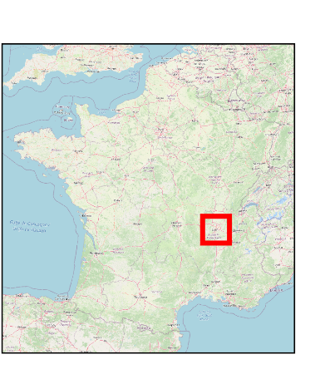
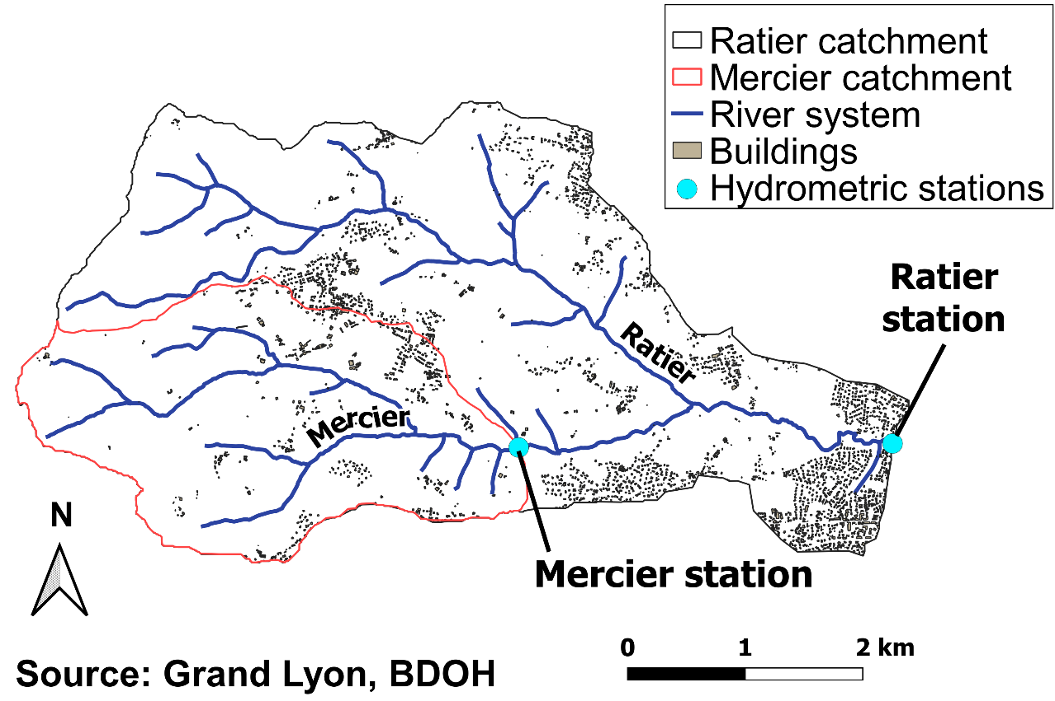
Goals and method
Development of a biogeochemical approach to better understand main hydrological contributions on a peri-urban catchment
Set up of a perceptual model to reproduce our understanding of the catchment behaviour
Site : Ratier watershed, 19 km²
Data : major parameters, dissolved metals, and microbiological parameters
Monthly sampling (2017-2019) at two stations

Slide 3
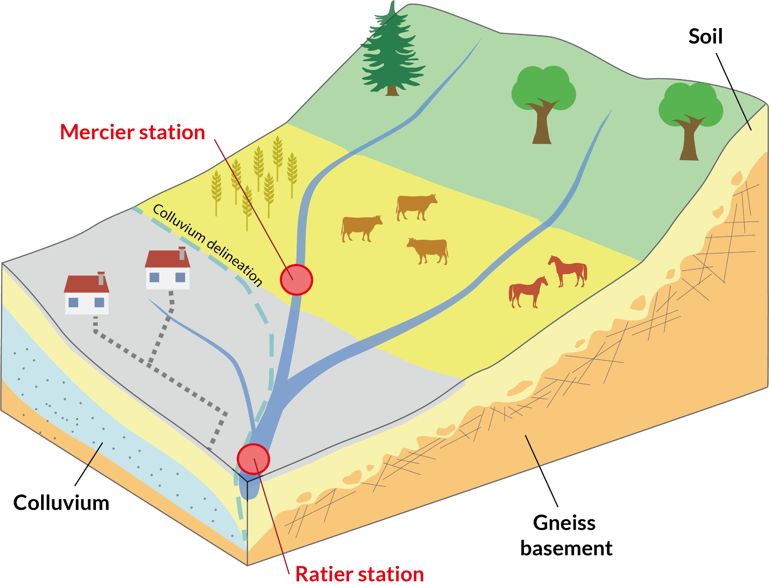
Build of a hypothetical perceptual model of the Ratier catchment
3 main hydrological contributions
D
Direct surface runoff
Not represented in monthly samples
S
Subsurface flow
G
S
G
Groundwater flow

Slide 4
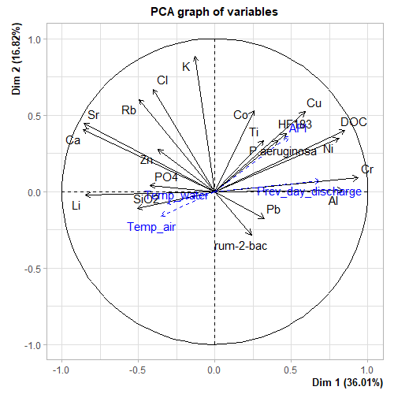
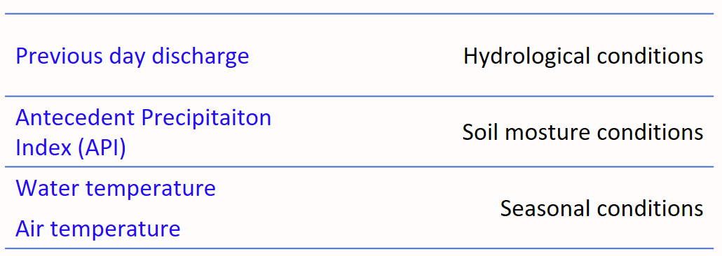
Source identification their biogeochemical signature
3 . Principal components analysis (PCA)
1. Correlation analysis
Identification and grouping of parameters with similar behaviour
Simplification of dataset for further analysis
n = 26
S
Cu
Sr
HF183
DOC
2. Hydro-climatologic indicators
Ca
API
G
P.aeruginosa
Ni
Cr
Linking concentration with hydrologic and climatologic conditions
Prev_day_discharge
Li
Al
HF183 : human-specific Bacteroides
rum-2-bac : ruminant-specific Bacteroides
P.Aeruginosa : bacteria linked to sewage network

Slide 5
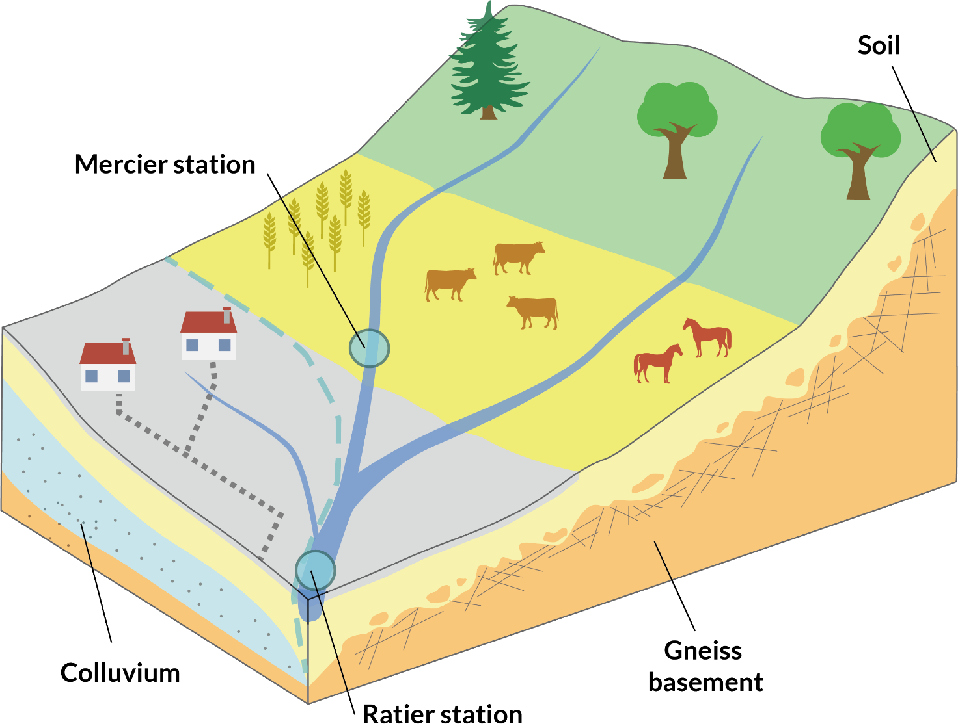
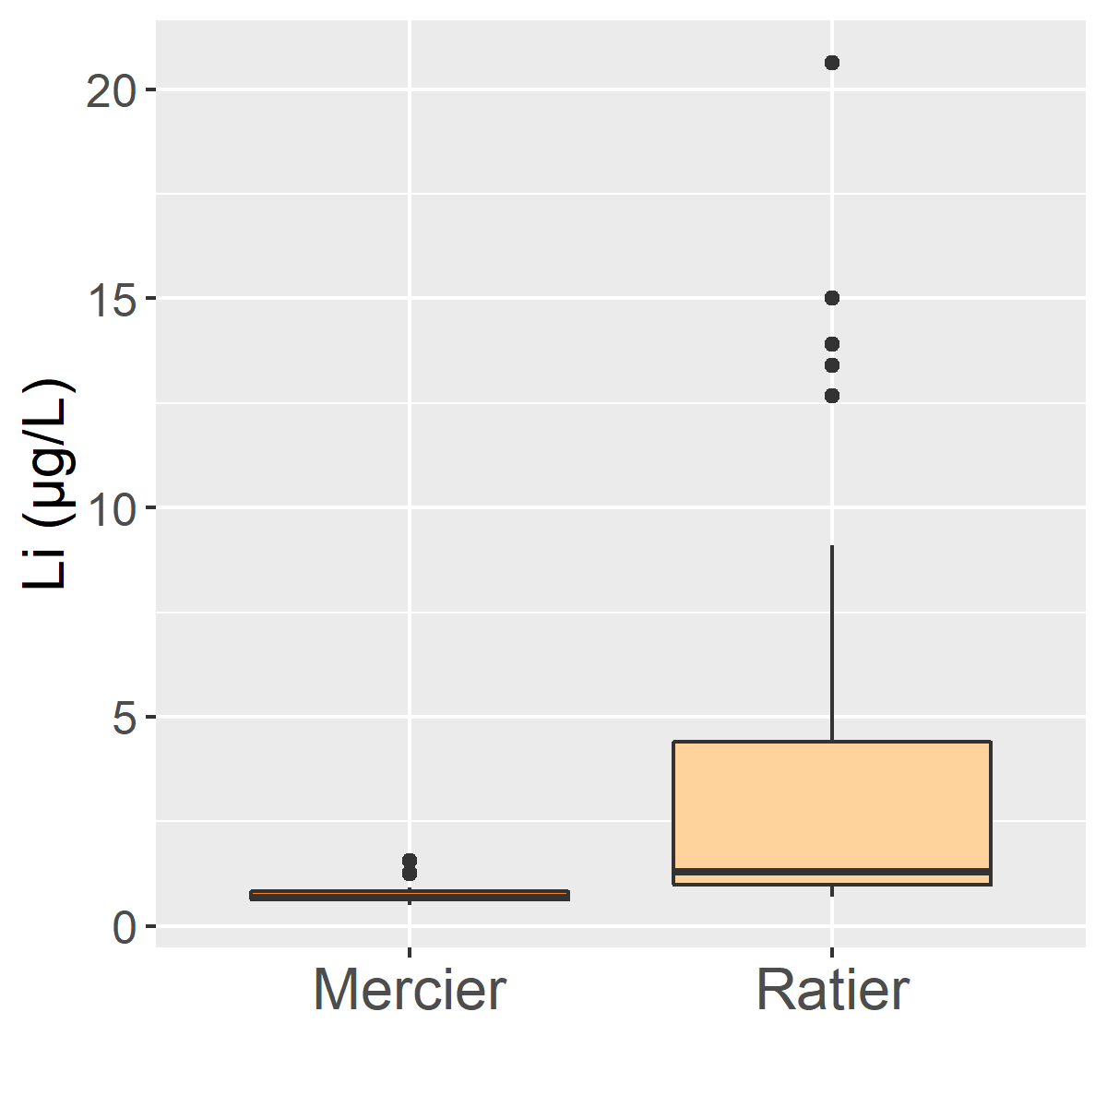
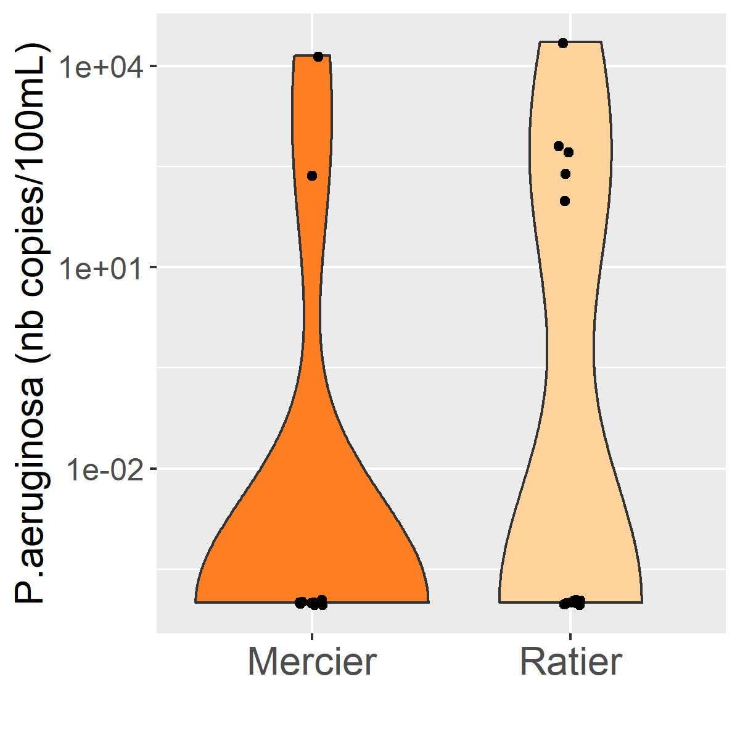
Completion of the perceptual model based on the results
2 main hydrologic contributions :
groundwater (Ca²⁺, Li…) and subsurface (DOC, Cr, P.aeruginosa…)
P.aeruginosa
Tukey test
a
b
Tukey test
a
a
n = 24
n = 26
n = 12
n = 13
Lithium (µg/L)
P. aeruginosa (nb copy/100mL)
P.aeruginosa
Ca²⁺, Sr
DOC, Cr, Al
Li
2 groundwater contributions : gneiss aquifer (Ca²⁺, Sr) and colluvium aquifer (Li)
Sewage overflow not only found at the downstream urban part

Slide 6
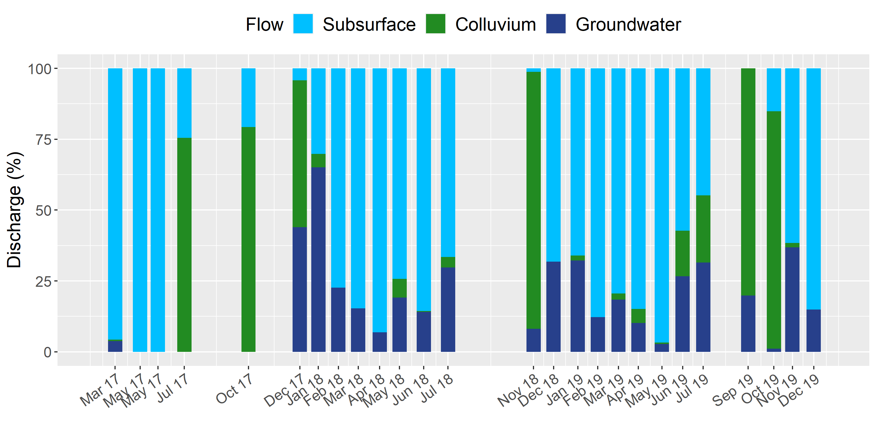
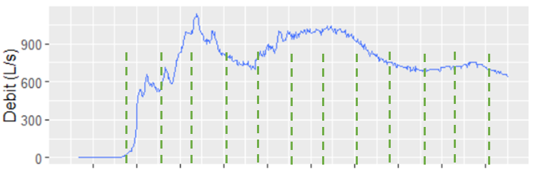
From perceptual to mixing and distributed hydrological model
1
Estimate volume contribution using biogeochemical mixing models (package nnls on R)
First results
2
Enhance flow decomposition with hydrological event sampling
18h event sampling
Discharge (L/s)
3
Compare with results from a distributed hydrological model
15:00
17:00
19:00
21:00
23:00
03:00
05:00
07:00
03-10-21 13:00
04-10-21 01:00

Slide 7
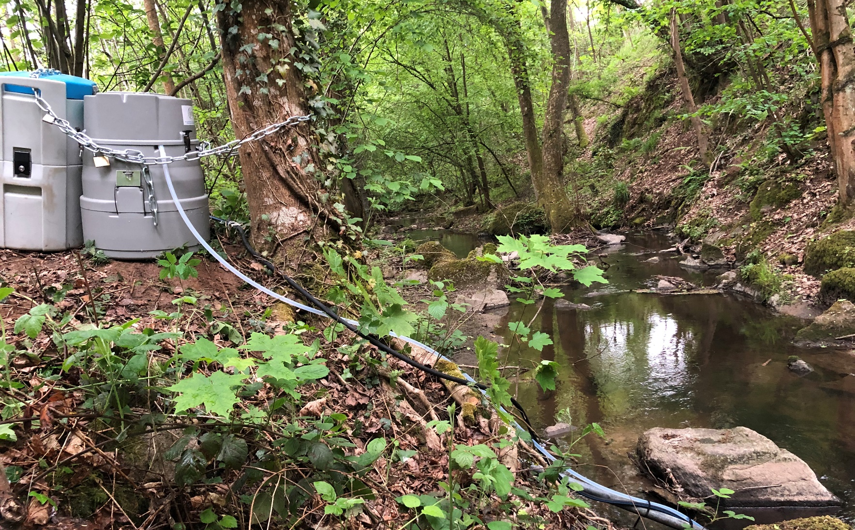
Thank you for your attention !
Link to the ANR Project : https://anr.fr/Projet-ANR-21-CE34-0013

