Slide 1




FLOATING DOPPLER WIND LIDAR MOTION SIMULATOR FOR HORIZONTAL WIND SPEED MEASUREMENT ERROR ASSESSMENT
Salcedo-Bosch, A.¹, Rocadenbosch, F.^{1,2}, Sospedra, J. ³
¹ Universitat Politècnica de Catalunya (UPC),
CommSensLab-UPC, Department of Signal Theory and Communications (TSC)
² Institute for Space Studies of Catalonia (IEEC)
³ Laboratori d’Enginyeria Maritima, Universitat Politècnica de Catalunya
Contact author: andreu.salcedo@upc.edu
2022, Salcedo-Bosch, A.; Rocadenbosch, F.; Sospedra, J (EGU22-9818)

Slide 2
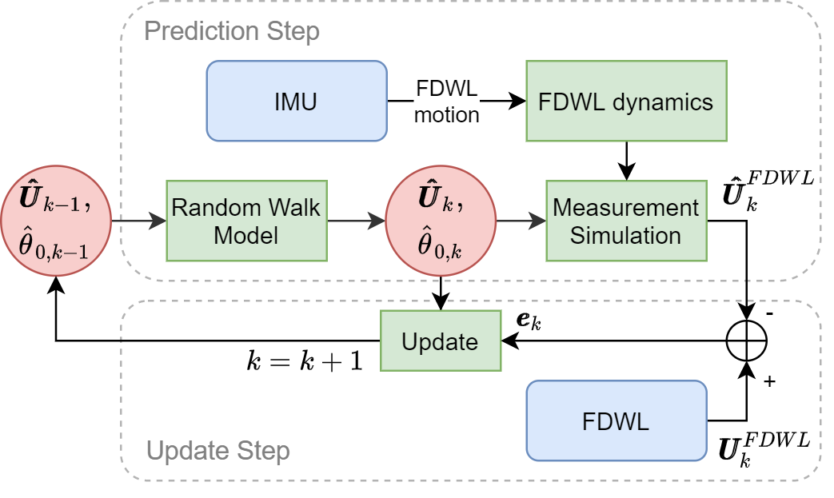
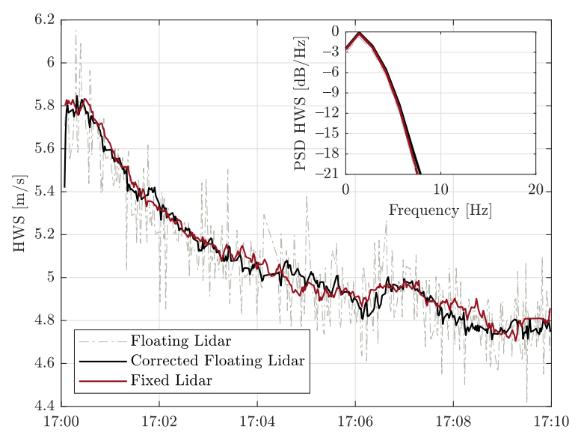
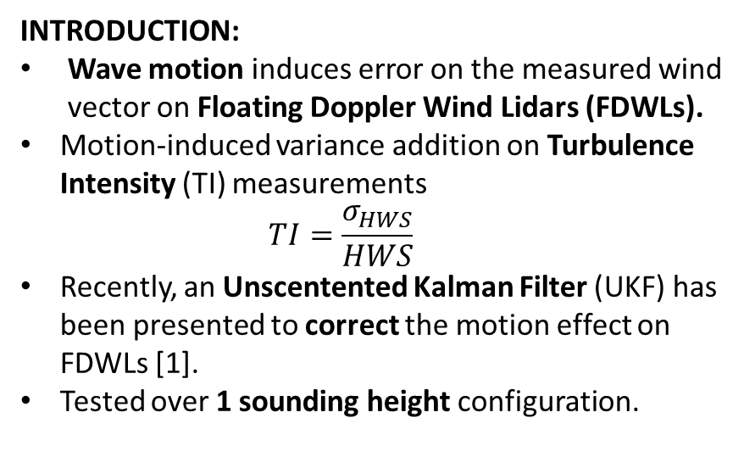
Motion-correction Unscented Kalman Filter
INTRODUCTION:
Wave motion induces error on the measured wind vector on Floating Doppler Wind Lidars (FDWLs).
Motion-induced variance addition on Turbulence Intensity (TI) measurements
  $$TI=\frac{σ_{HWS}}{HWS}$$
Recently, an Unscentented Kalman Filter (UKF) has been presented to correct the motion effect on FDWLs [1].
Tested over 1 sounding height configuration.
OBJECTIVE: Study UKF performance when sounding at multiple heights.
  Re-use previously existing single-height data.
[1] Andreu Salcedo-Bosch, Francesc Rocadenbosch, and Joaquim Sospedra, “A robust adaptive unscented kalman filter for floating doppler wind-lidar motion correction,” Remote Sens., vol. 13, no. 20, 2021.
2022, Salcedo-Bosch, A.; Rocadenbosch, F.; Sospedra, J (EGU22-9818)

Slide 3
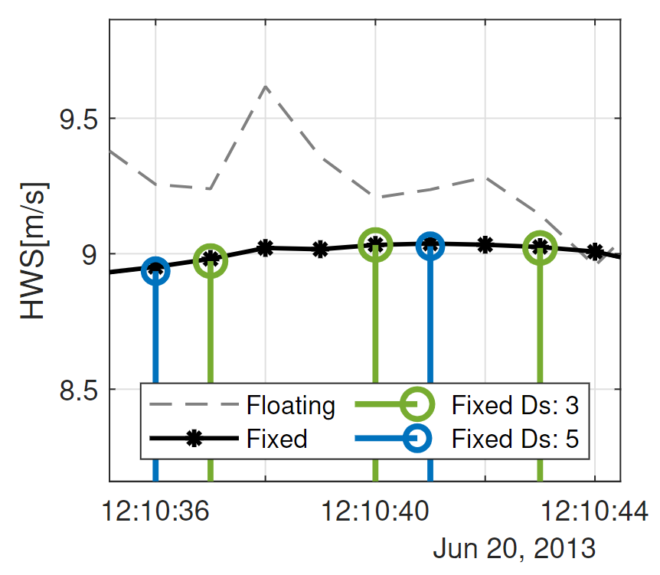
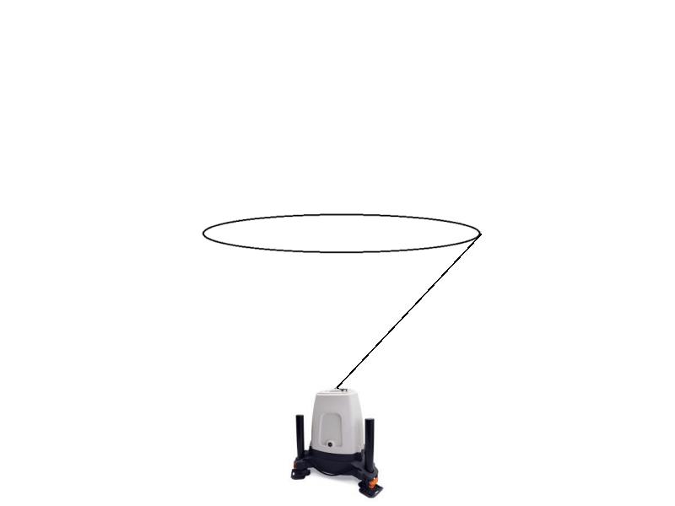
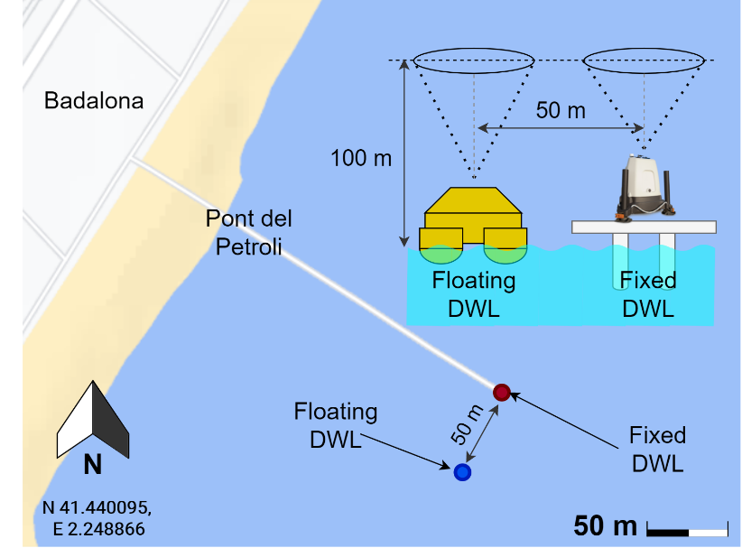
Model of DWL as wind profiler
Downsampling
OBJECTIVE: Study UKF performance when sounding at multiple heights.
  Re-use previously existing single-height data.
Multiple lidar sounding heights -> emulated by downsampling the single-height temporal series.
  E.g. This means to measure height #1 every n=3 scans.
Experimental data from “Pont del Petroli” campaign.
  FDWL vs. Fixed lidar (50-m appart).
  1, 3, and 5 sounding heights considered
Height 3
Height 2
Height 1
2022, Salcedo-Bosch, A.; Rocadenbosch, F.; Sospedra, J (EGU22-9818)

Slide 4
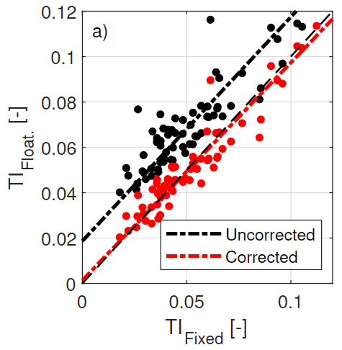
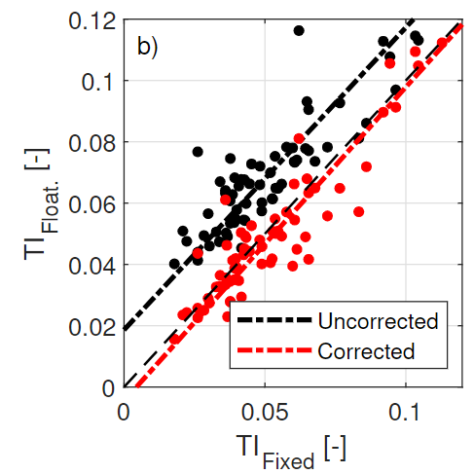
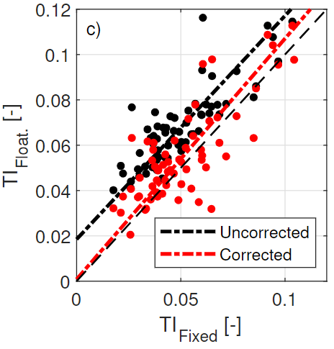
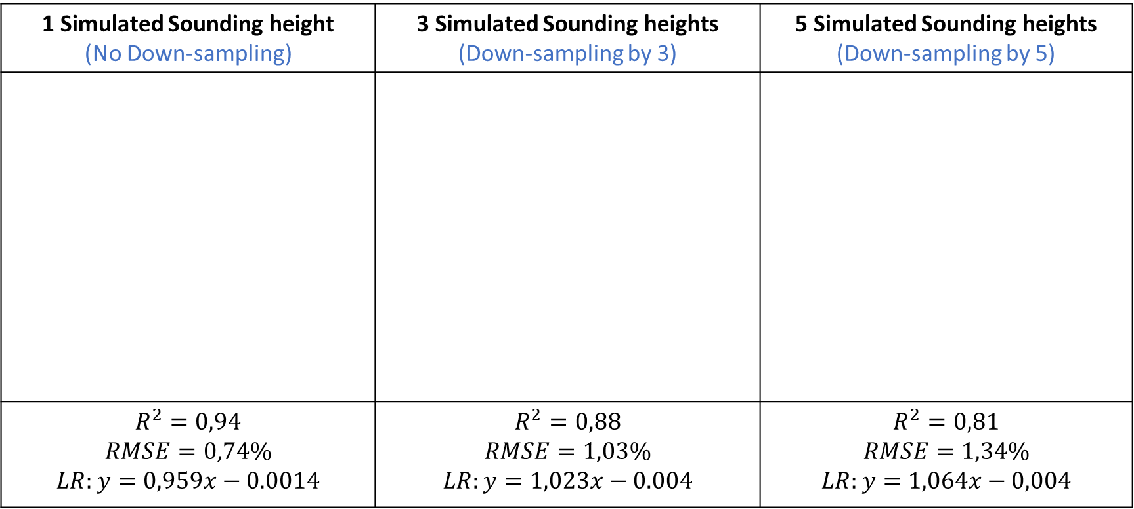
Performance of the motion-correction filter using down-sampled data from Single-Height PdP measurements
1 Simulated Sounding height (No Down-sampling) | 3 Simulated Sounding heights (Down-sampling by 3) | 5 Simulated Sounding heights (Down-sampling by 5)
$$R^{2}=0,94$$ $$RMSE=0,74\%$$ $$LR:y=0,959x−0.0014$$ | $$R^{2}=0,88$$ $$RMSE=1,03\%$$ $$LR:y=1,023x−0.004$$ | $$R^{2}=0,81$$ $$RMSE=1,34\%$$ $$LR:y=1,064x−0,004$$
2022, Salcedo-Bosch, A.; Rocadenbosch, F.; Sospedra, J (EGU22-9818)

Slide 5
Conclusions
The performance of the lidar motion-correction filter when sounding at multiple heights was studied by
  Downsampling single-height data by a factor 1, 3, and 5.
  144 data records from PdP campaign.
In all sounding height configurations, the filter was able to remove the apparent turbulence addition.
  The higher the number of sounding heights, the higher the reduction on the statistical indicators achieved.
  When sounding at 3 (5) heights -> 0,88 (0,81)
Needed to test the filter with experimental FDWL data at multiple sounding heights.
2022, Salcedo-Bosch, A.; Rocadenbosch, F.; Sospedra, J (EGU22-9818)

Slide 6





ACKNOWLEDGEMENTS
Spanish Government–European Regional Development Funds project PGC2018-094132-B-I00 and H2020 ACTRIS-IMP (GA-871115).
European Institute of Innovation and Technology (EIT)
KIC InnoEnergy project NEPTUNE.
“Agència de Gestió d’Adjuts Universitaris i de la Recerca (AGAUR)”, Generalitat de Catalunya, under Grant no. 2020 FISDU 00455.
CommSensLab-UPC.
2022, Salcedo-Bosch, A.; Rocadenbosch, F.; Sospedra, J (EGU22-9818)

