Slide 1


Structurally controlled regional groundwater circulation: Origin of geothermal springs in Sri Lanka
Dilshan Bandara, Thomas Heinze, Jeroen Smit, and Stefan Wohnlich
Institute of Geology, Mineralogy and Geophysics
Ruhr University, Bochum
dilshan.bandara@rub.de
EGU-2022– 23.05.2022

Slide 2
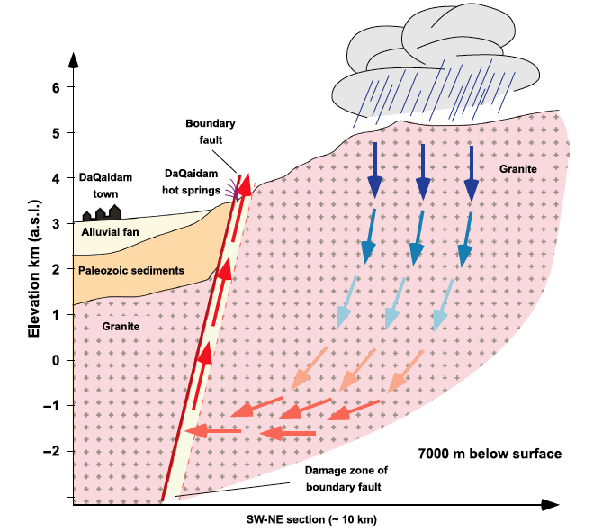
Orogenic geothermal systems
Water recharge at higher altitudes (> 1000 m)
=> Topographically induced hydraulic head
Depth of circulations 3-7 km, up to 10 km
Fluid Path steep or vertical faults
Heat source background heat flow
Recharge – spring distance 10- 15 km
10 – 15 km
(Stober et al., 2016, Geofluids )

Slide 3
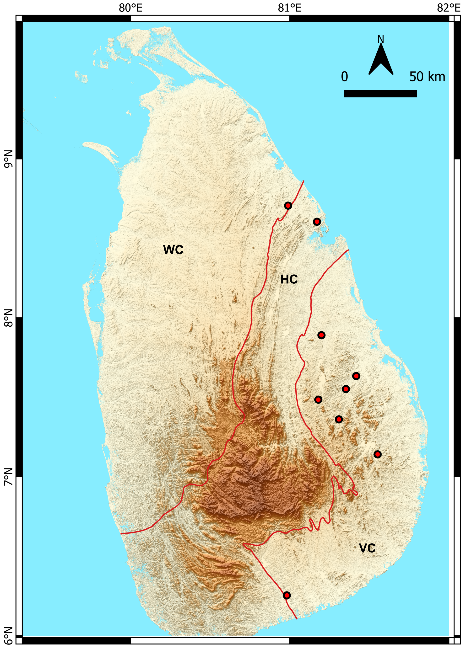
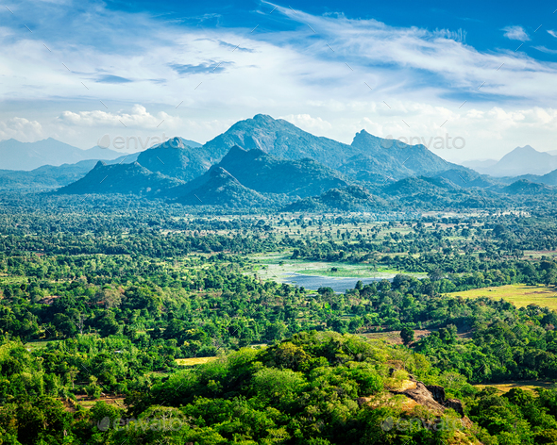
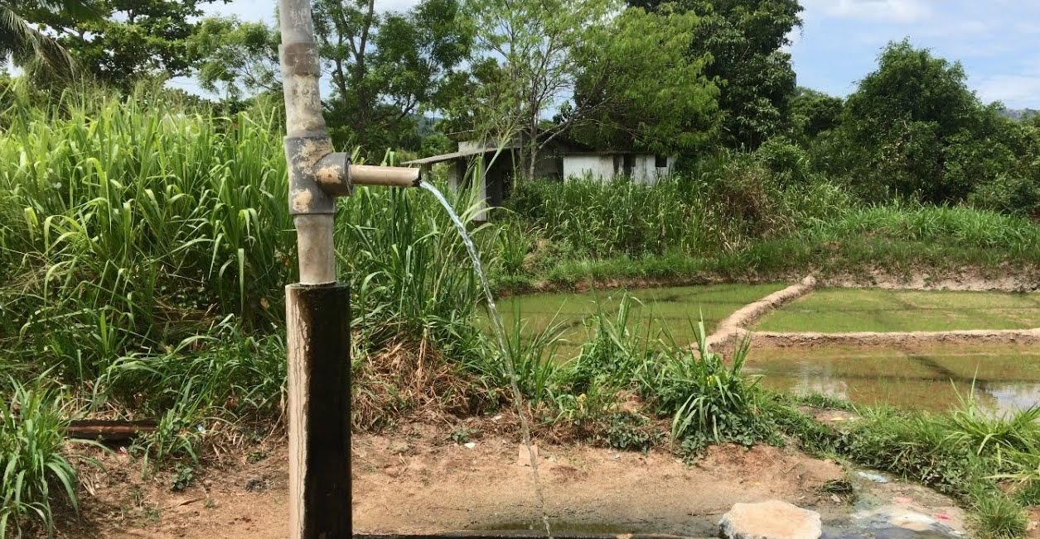
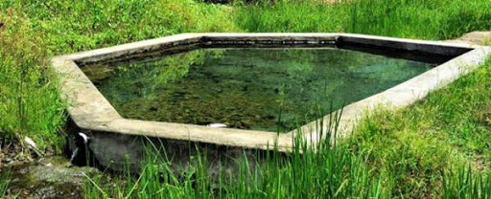
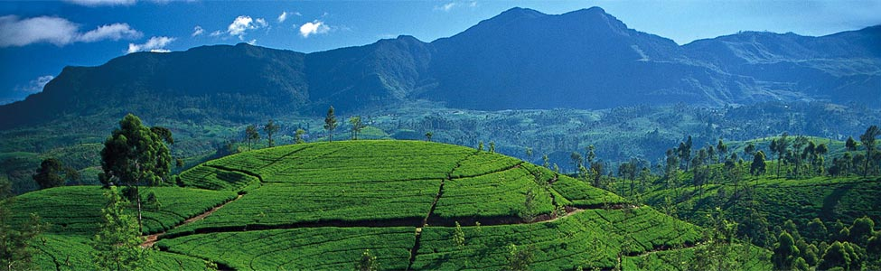
Orogenic geothermal systems in Sri Lanka
www.traveltriangle.com
EGU-2022– 23.05.2022

Slide 4
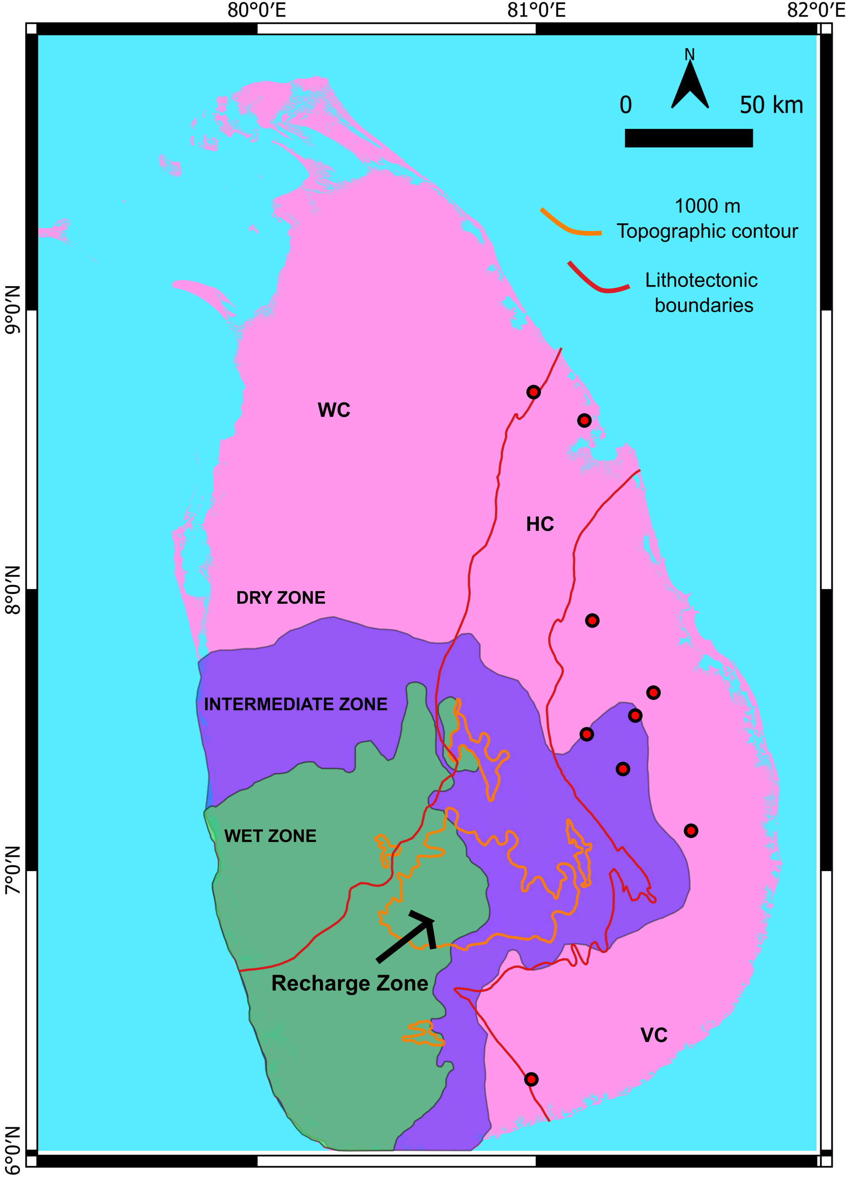
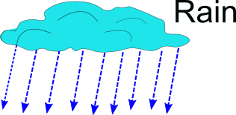
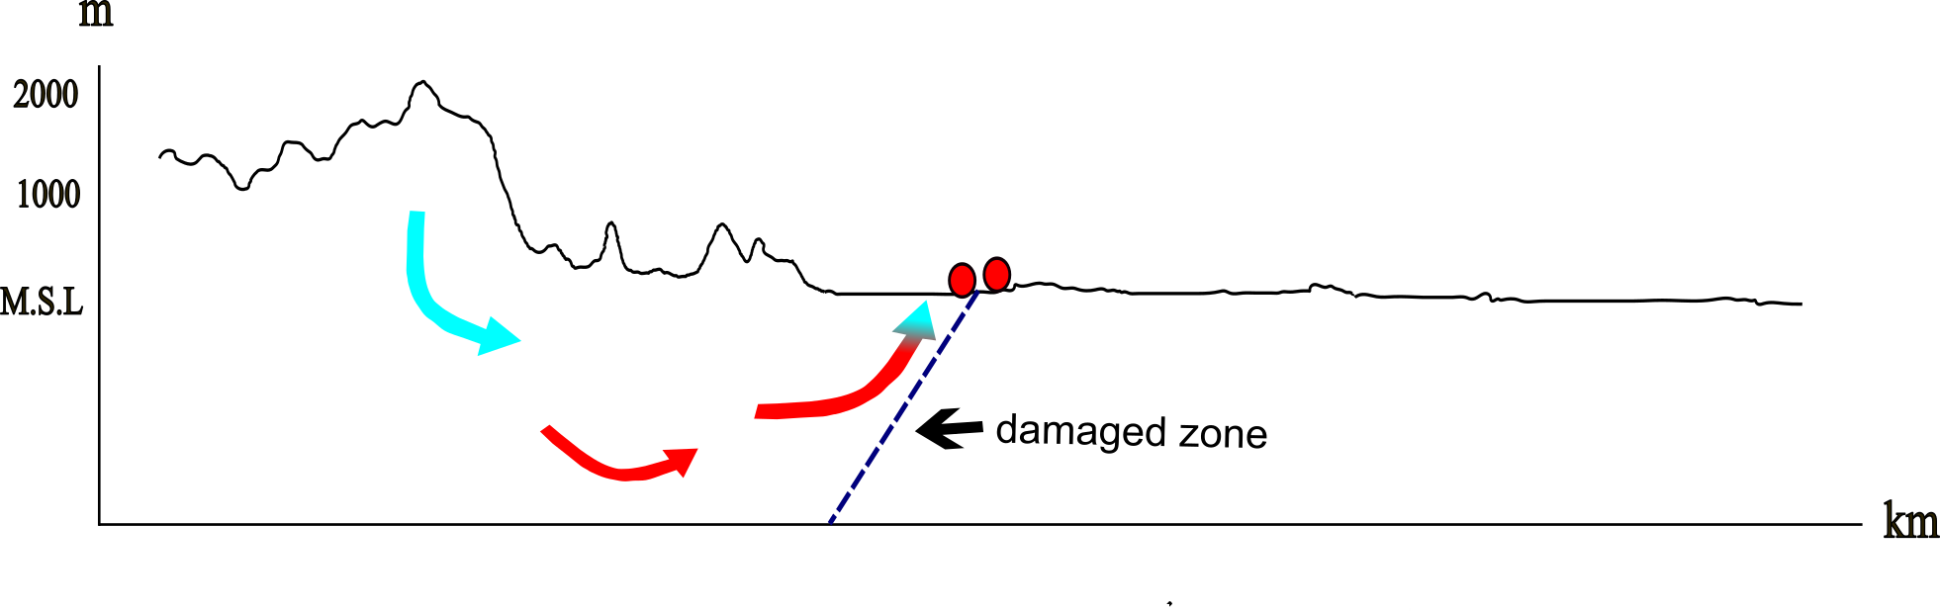
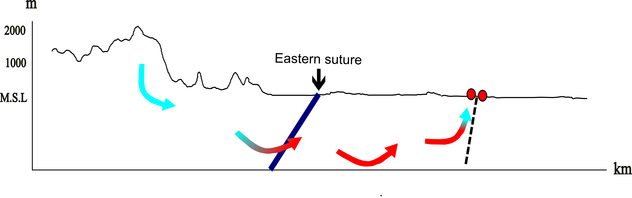
Geothermal springs in Sri Lanka
Typical system
10-15 km
Sri Lanka
100 km

Slide 5
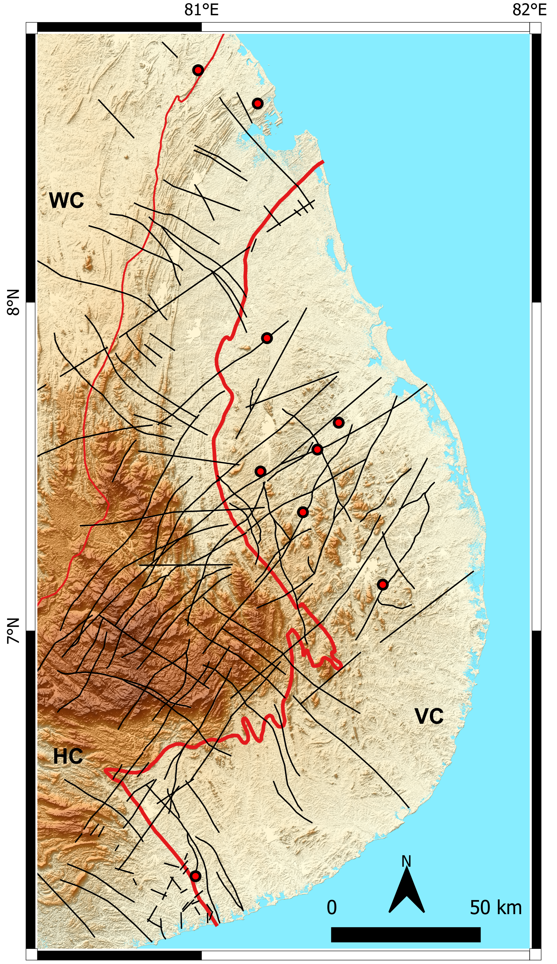
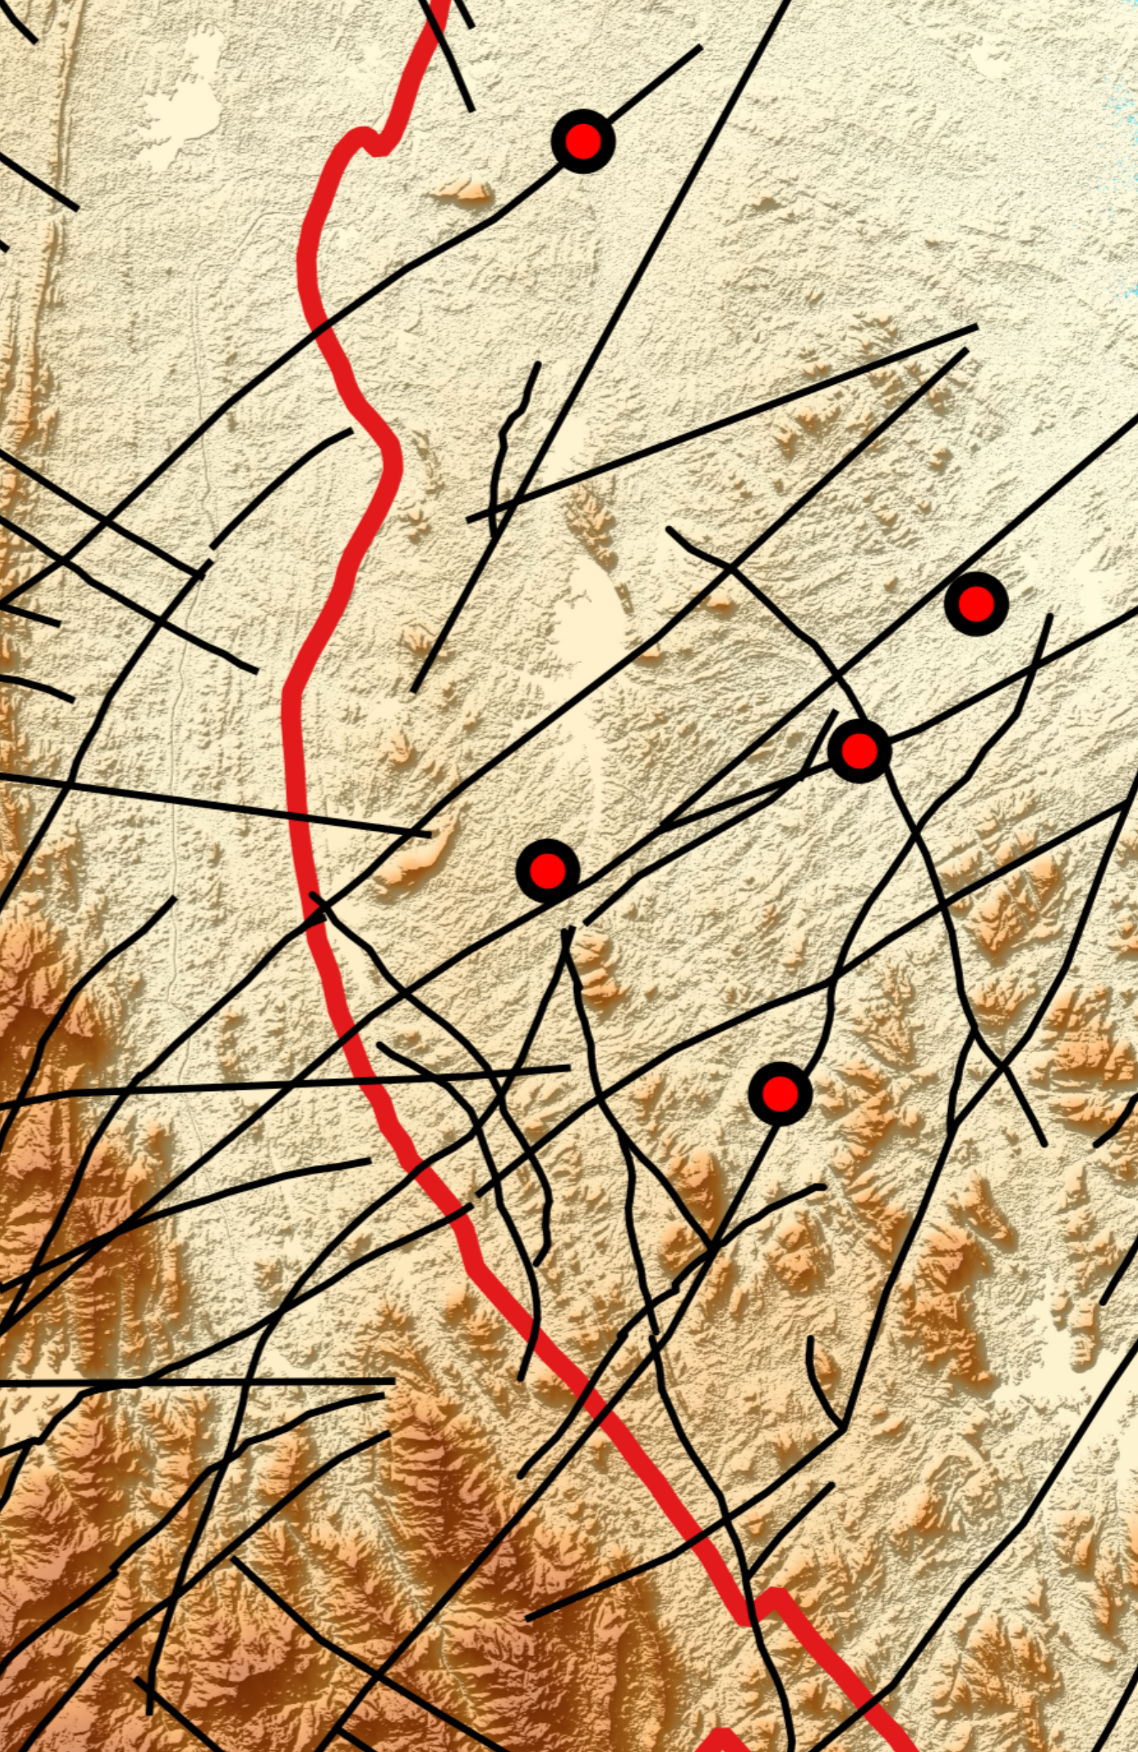
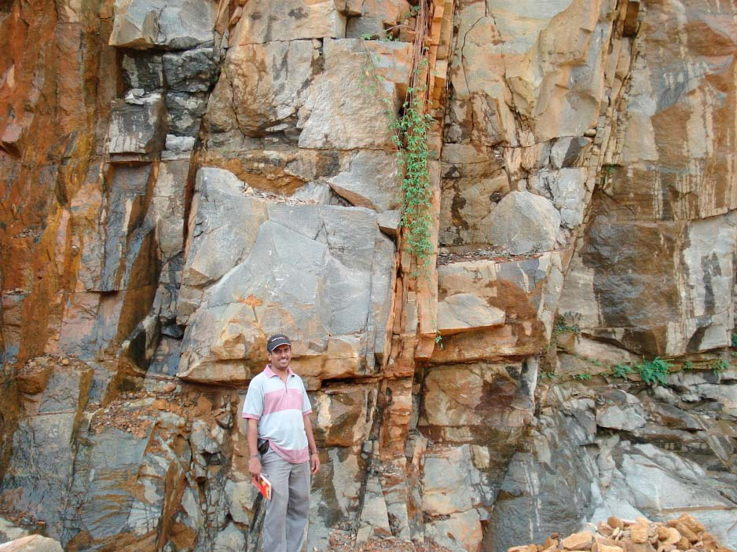
Faults as fluid flow paths
Vertical or sub vertical strike slip faults
Crosscut the Eastern suture
Fault zones up to 600 m wide
Young, little mineralization
Emmel et al., 2012, JGR

Slide 6
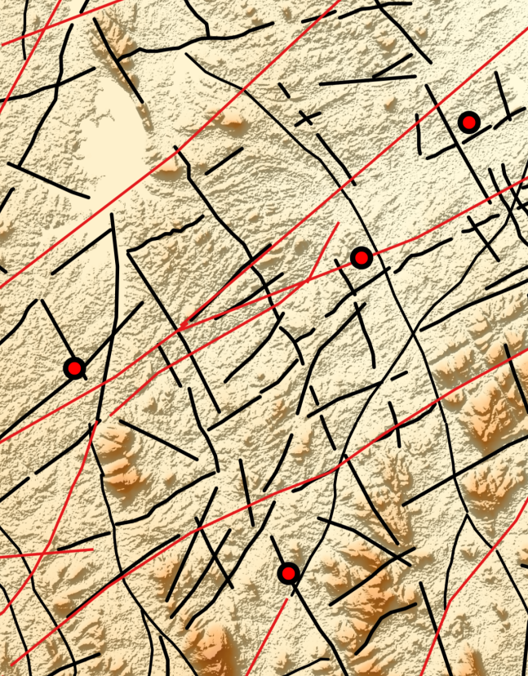
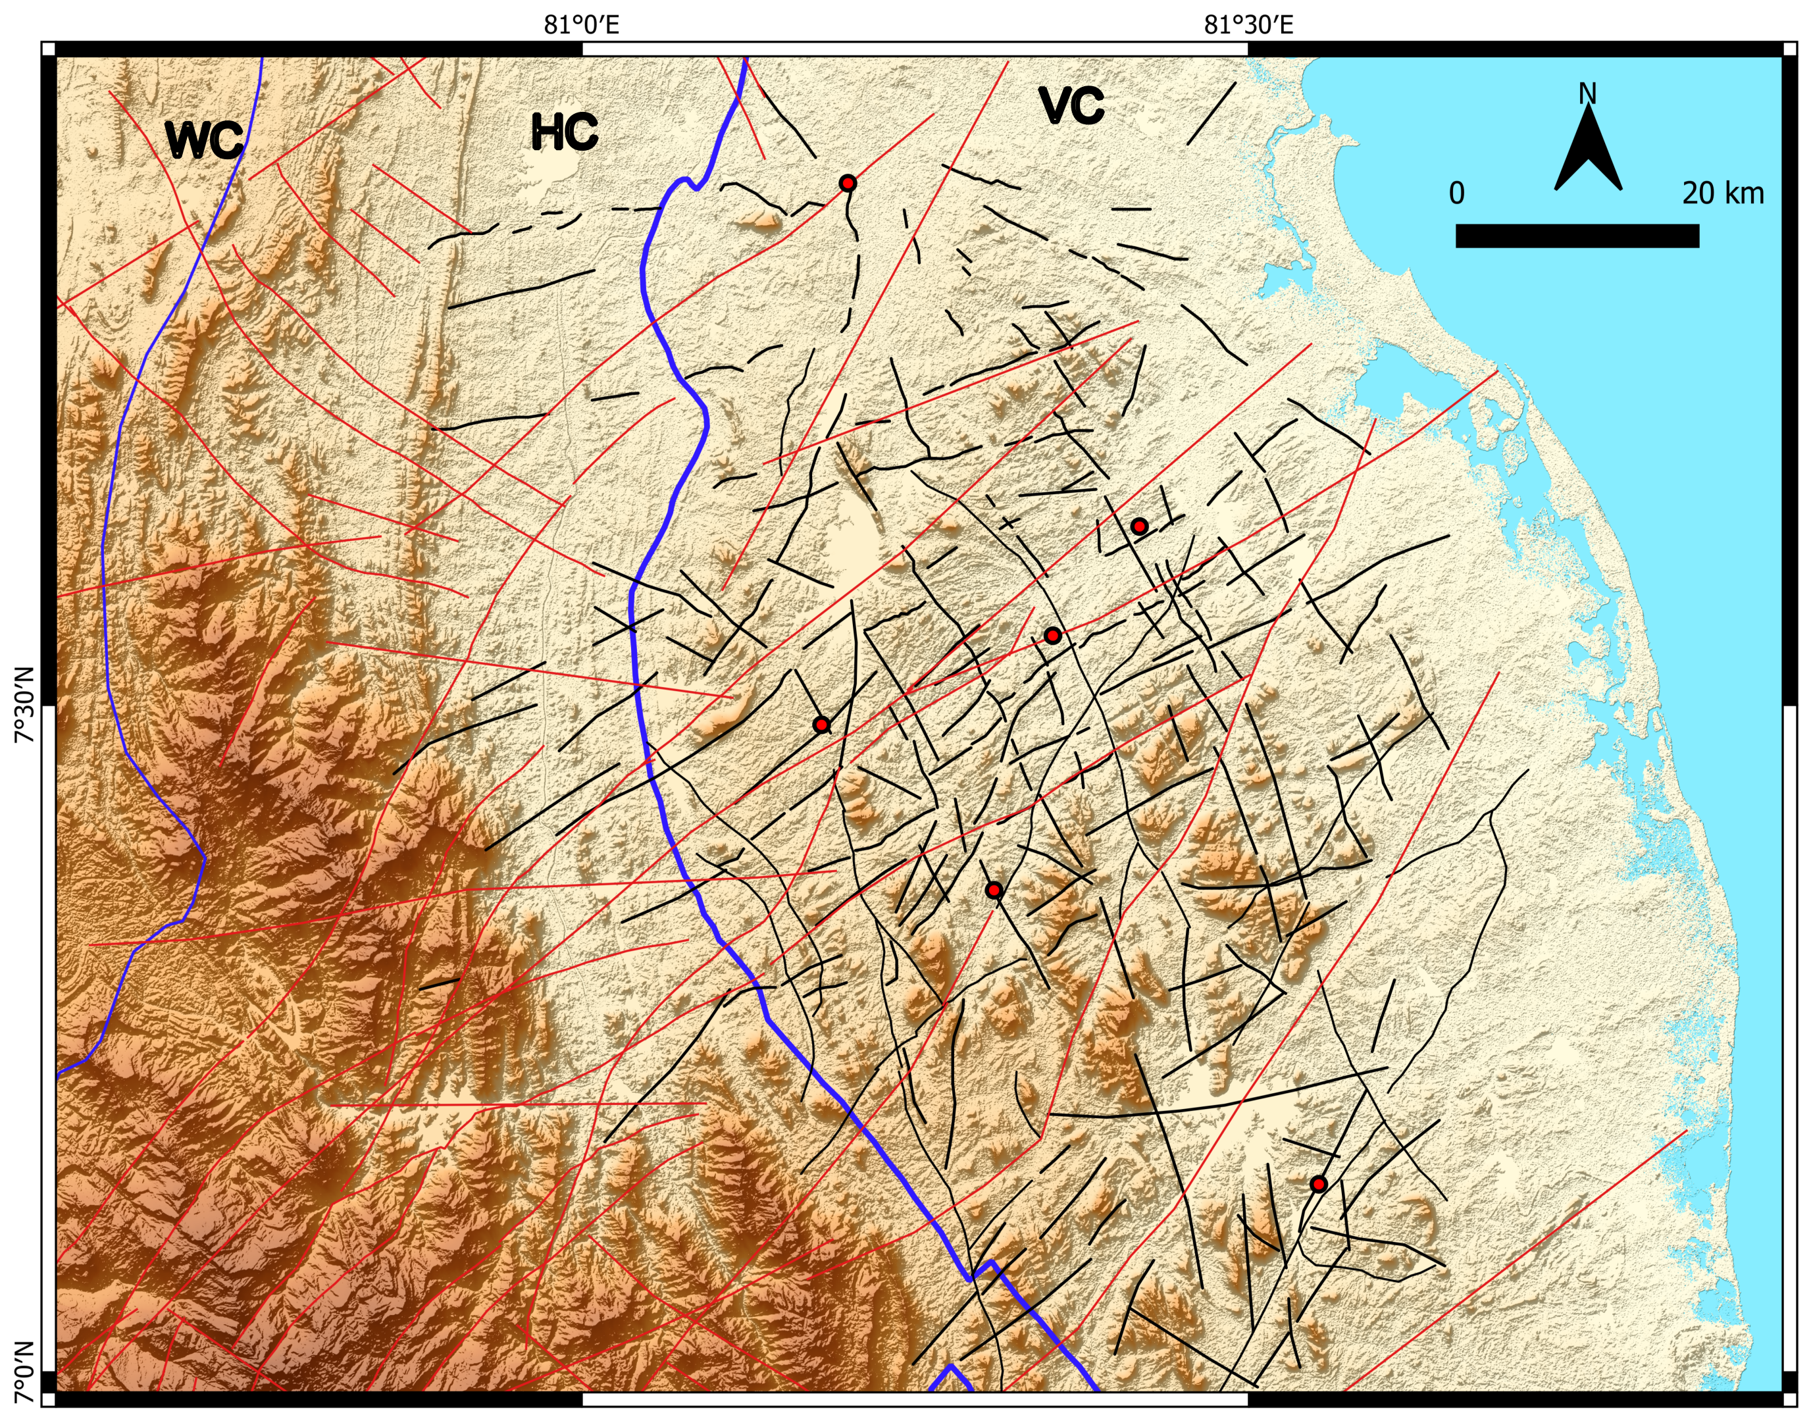
Localizations of hot springs at intersection zones of faults
Zoom the crosscutting paths
Increased permeability in damaged zones
Hot water ascends faster/more easily
Less heat loss

Slide 7
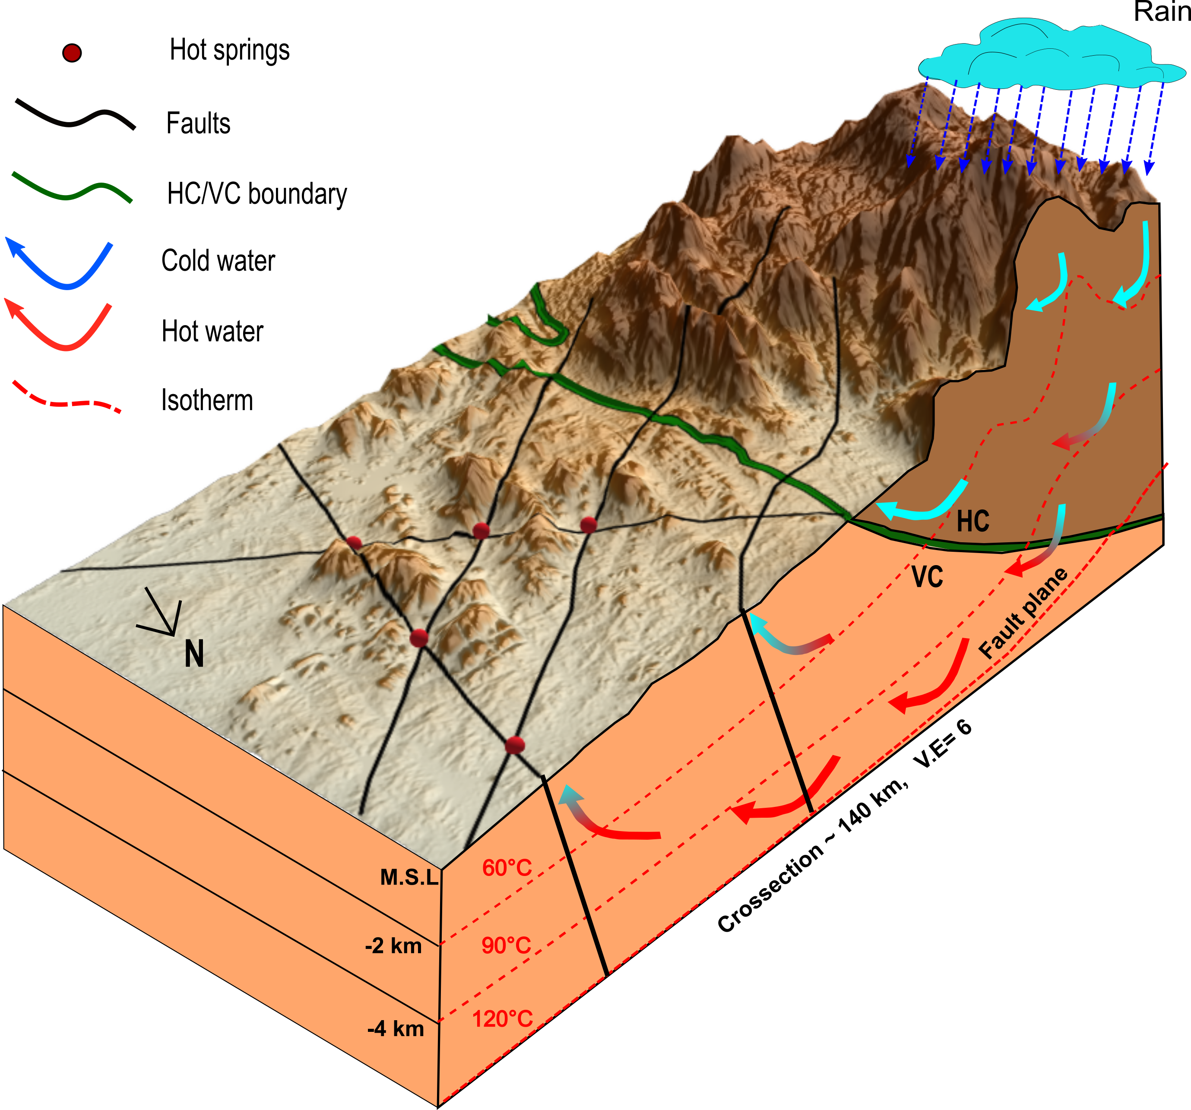
Conceptual model - Conclusions
The fault zones have much higher permeability than the suture (frontal fault)
=> water transported across suture
no hot springs along suture
Fluid flow across greater distance (~100 km), 5-10x the distance of other systems
Potential of finding hot water along the fault zones, crosscuts the mountain front. In many cases such faults could be hidden in the sedimentary cover in the foreland.

Slide 8

THANK YOU!
dilshan.bandara@rub.de
EGU-2022– 23.05.2022

