Slide 1



Assessing drought vulnerability of maize production in the Po Valley
B. Monteleone¹, I. Borzì², B. Bonaccorso², M. Martina¹
¹IUSS - University School for Advanced Studies of Pavia, Pavia, Italy
²Department of Engineering, University of Messina, Italy
Corresponding author: beatrice.monteleone@iusspavia.it

Slide 2
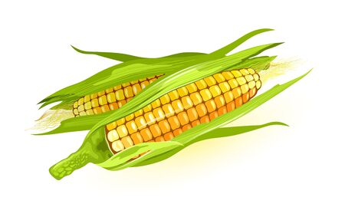
Aim of the study
Develop maize drought vulnerability curves in the context of the Po River basin (Northern Italy).
Identify the maize growth stages most sensitive to drought
Assess the influence of soil texture on maize sensitivity to drought

Slide 3
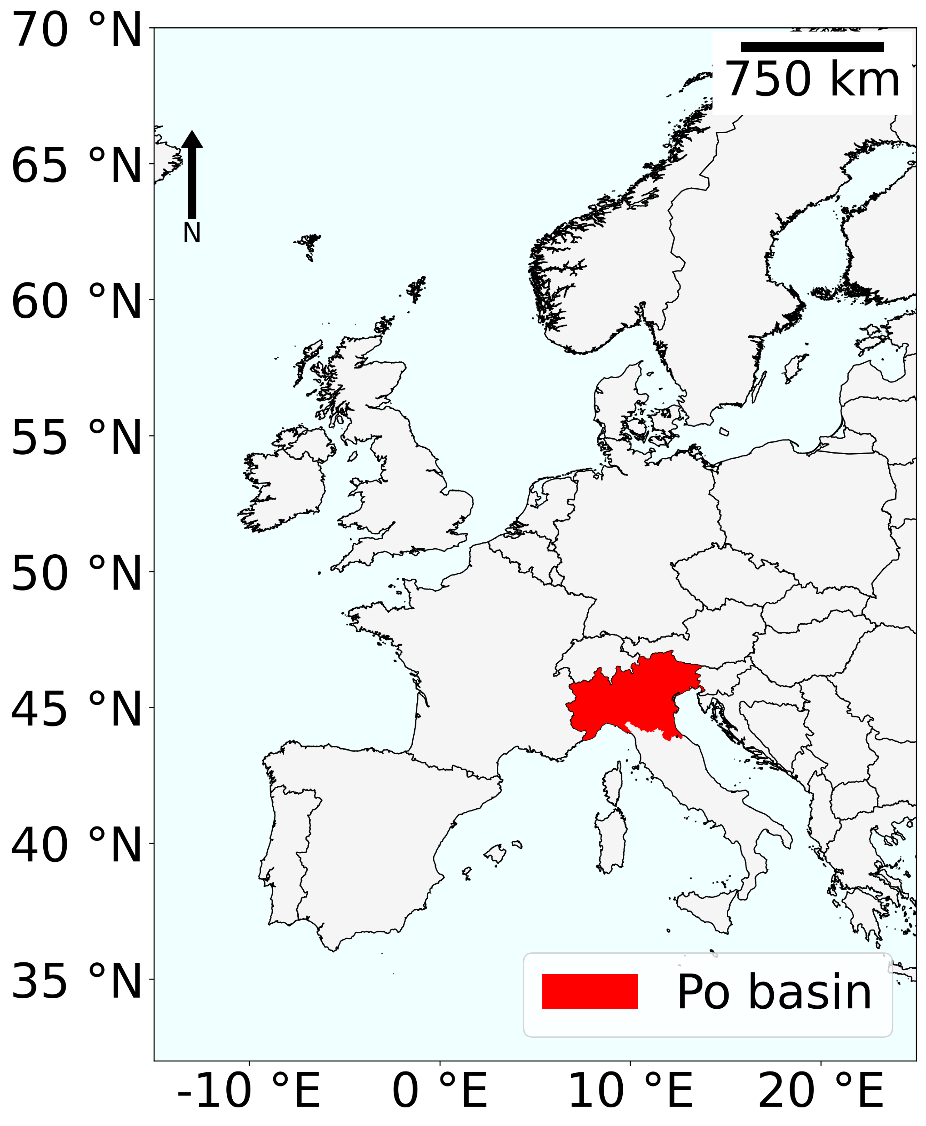
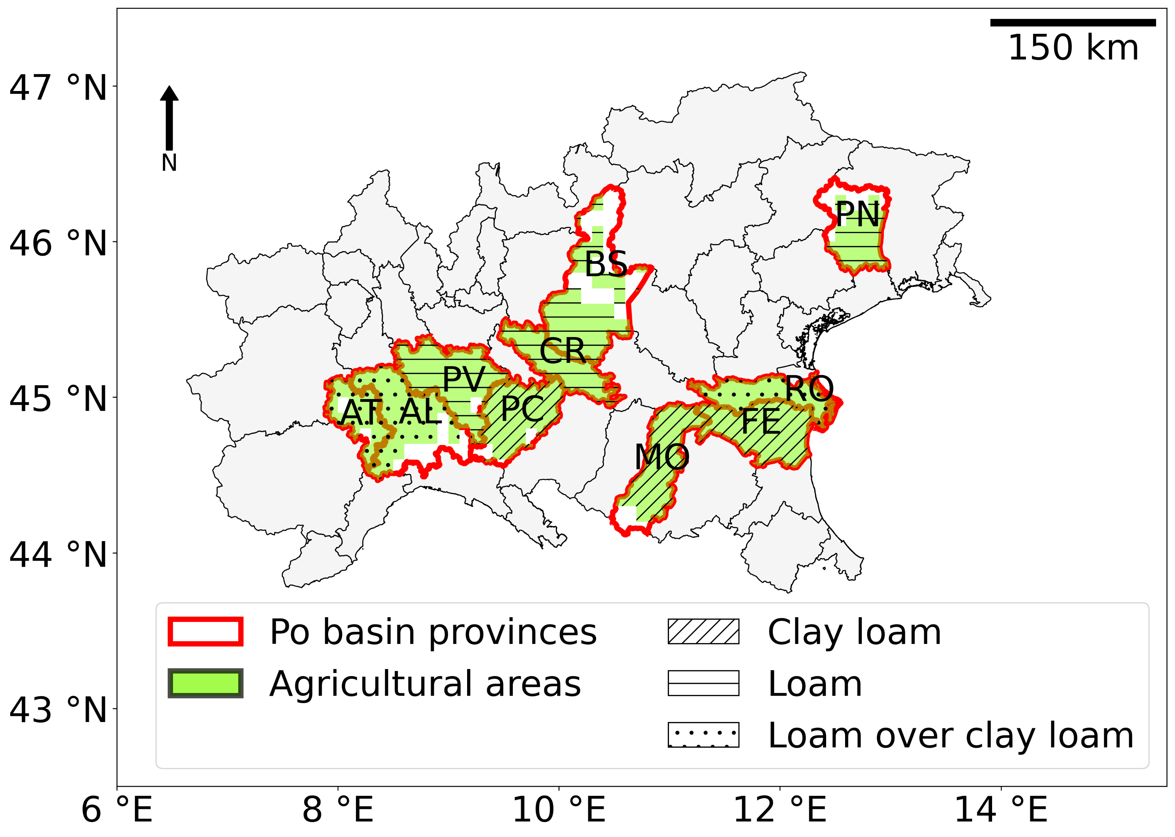
Case study area
10 Italian provinces (maize growing areas)
Three soil textures (Clay Loam, Loam, Loam over Clay Loam)
Crop management practices
Sowing window | April
Sowing density (plants/m2) | 8
Row spasing (mm) | 500
Sowing depth (mm) | 50
Input of N fertilizers (kg/m2) | 0.024

Slide 4


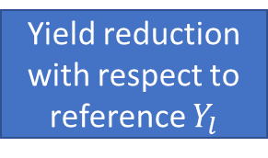
Methodology
Input data
Weather parameters
Soil texture
Crop management practices
Yield modelling
Crop Model
Simulated reference yield
Simulated reduced yield
Simulated water deficit
Vulnerability curves
Yield reduction with respect to reference $Y_{l}$
Crop water deficit ${Def}_{w}$

Slide 5
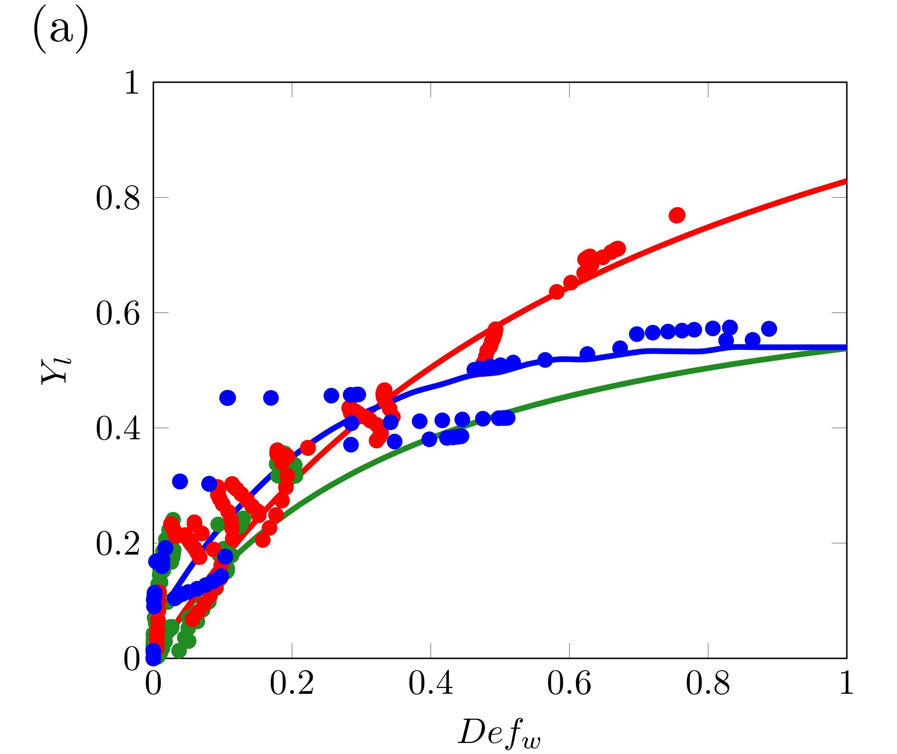
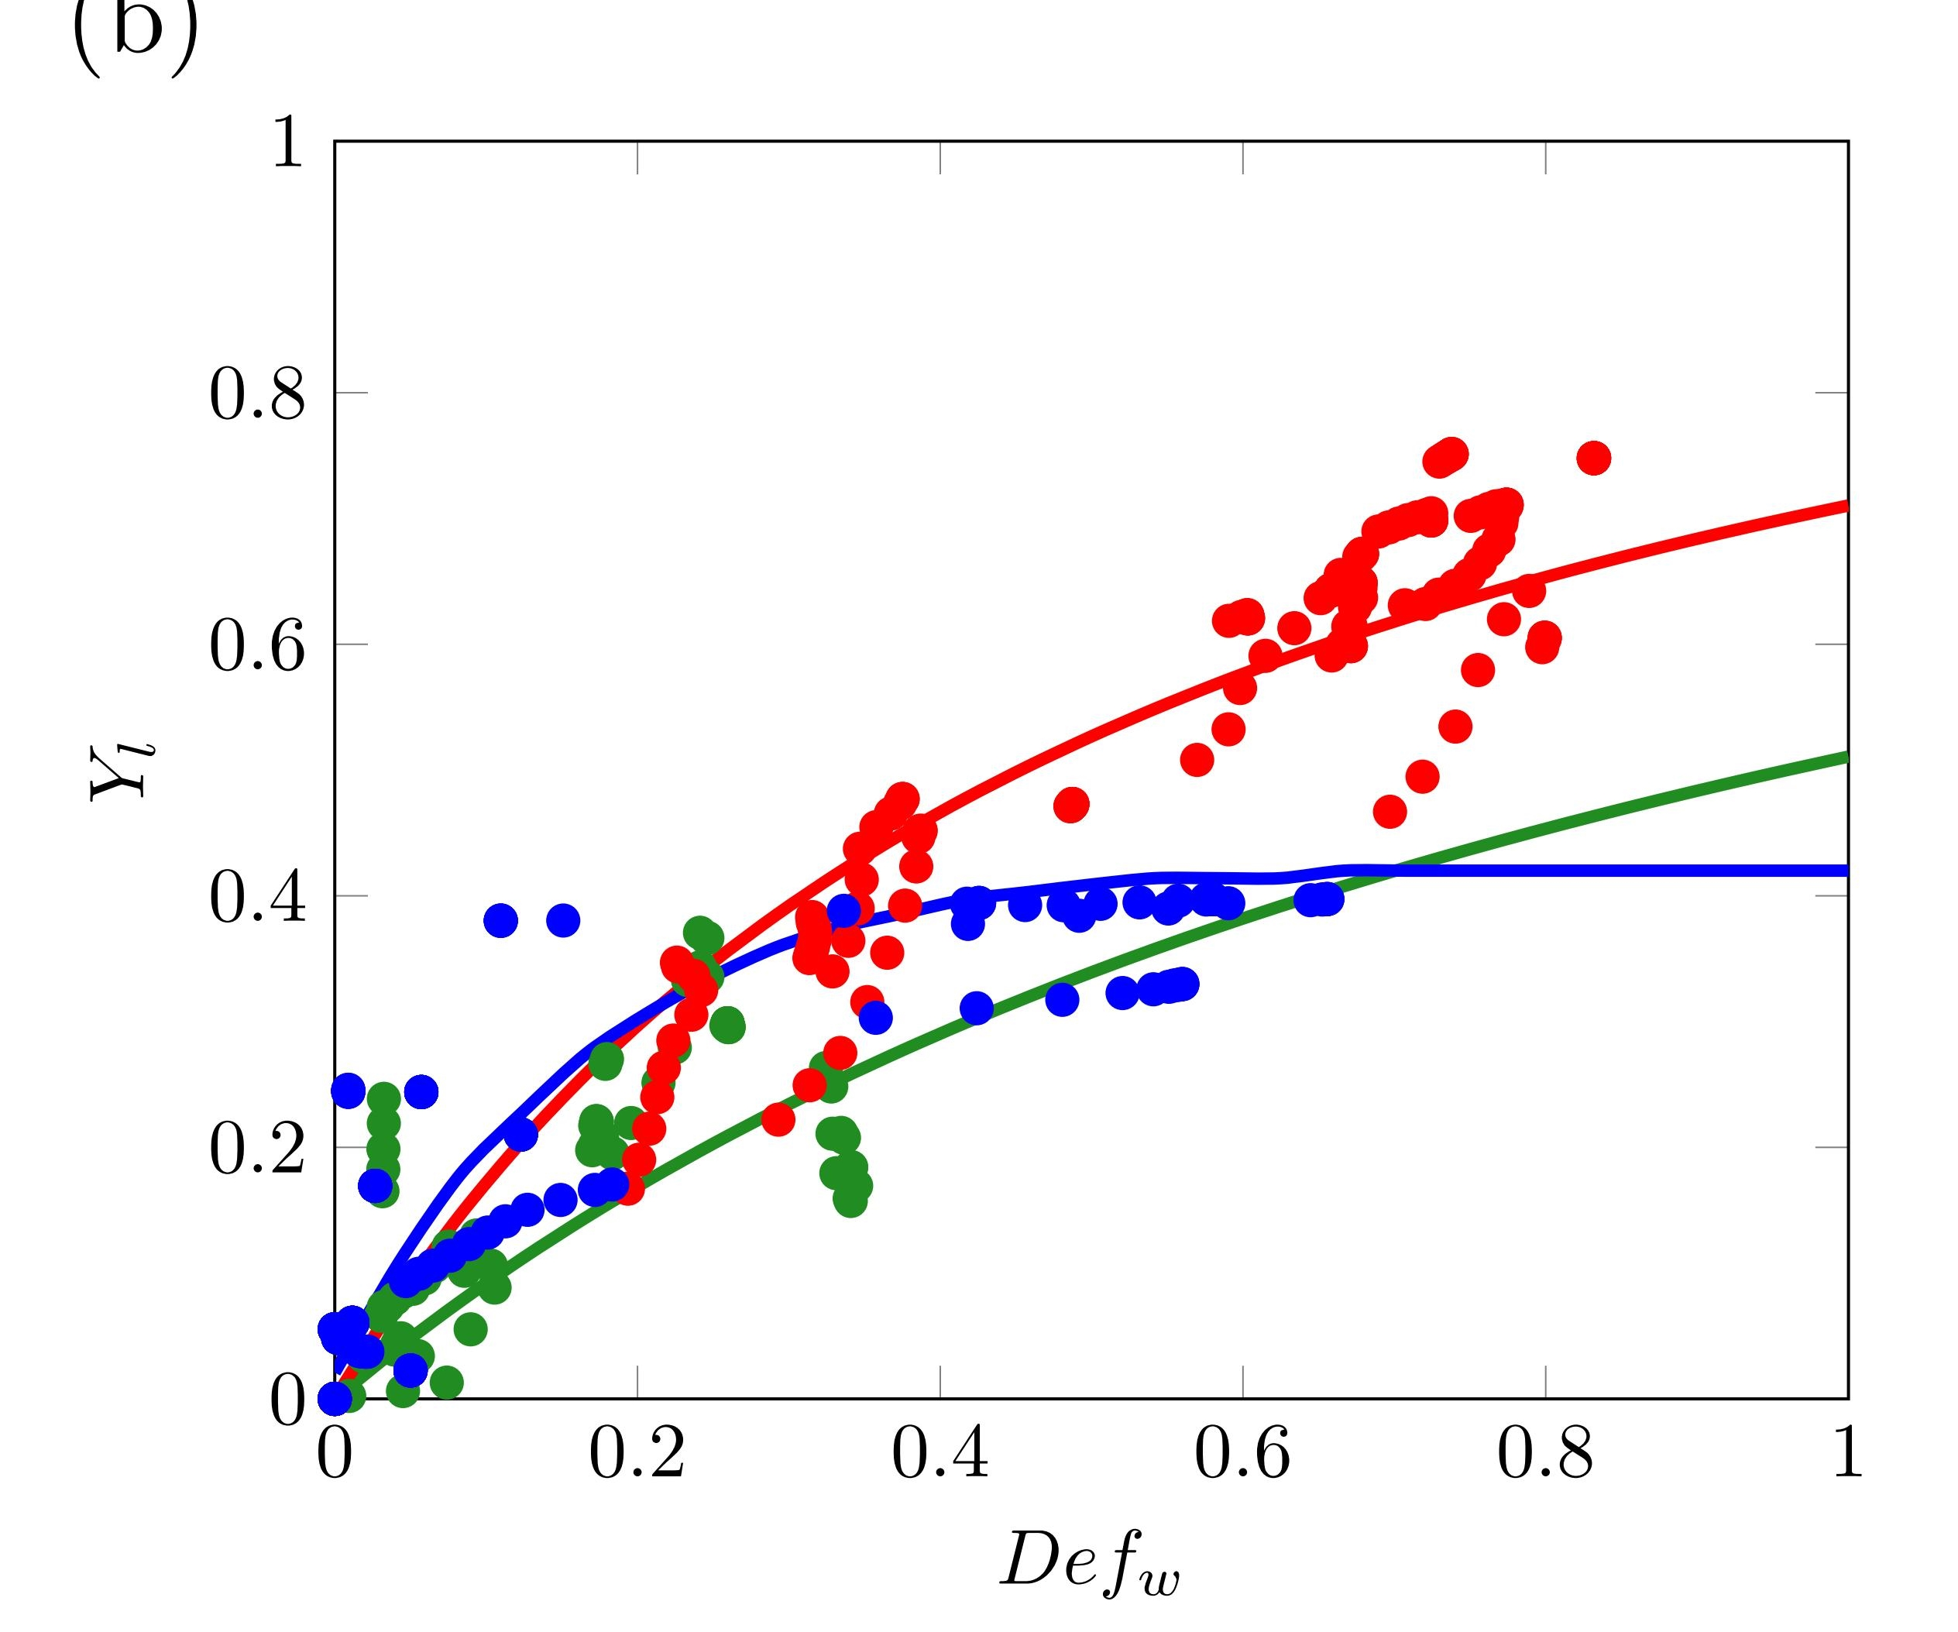
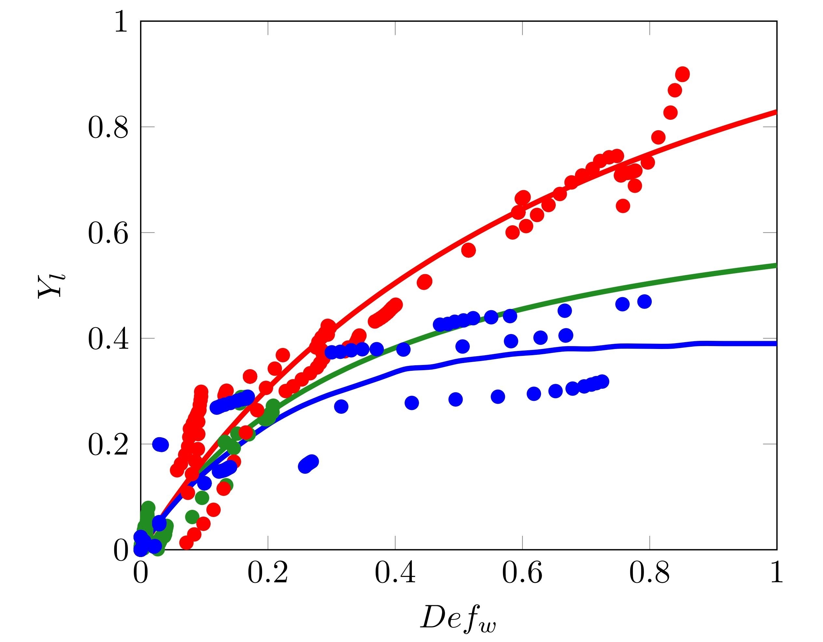
Results
Rovigo (RO): Loam over clay loam
Ferrara (FE): Clay Loam
Pavia (PV): Loam
 | Vegetative |  | Flowering |  | Yield formation

Slide 6
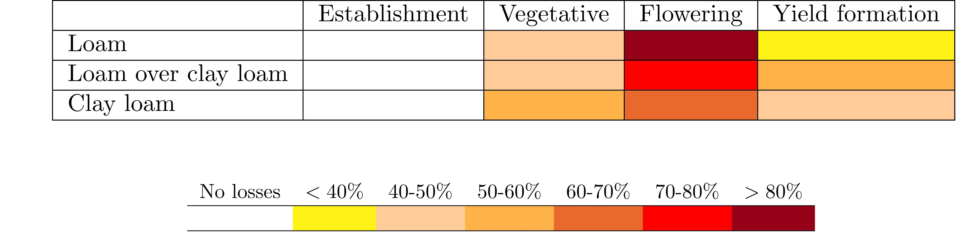
Conclusions and next steps
Flowering is the most sensitive growth stage
Soil texture influences maize response to water stress
Exploitation of the results to implement sustainable water use strategies

Slide 7
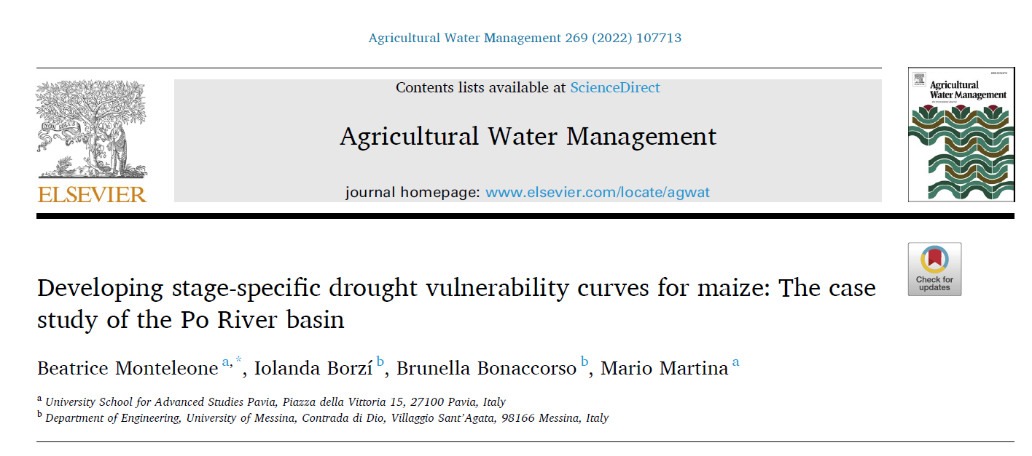
Thank you
beatrice.monteleone@iusspavia.it

